Slide 1
Can scientific information address vaccine hesitancy?
Experimental evidence from the flu vaccine Daniel W. Sacks Brigham Walker

Slide 2
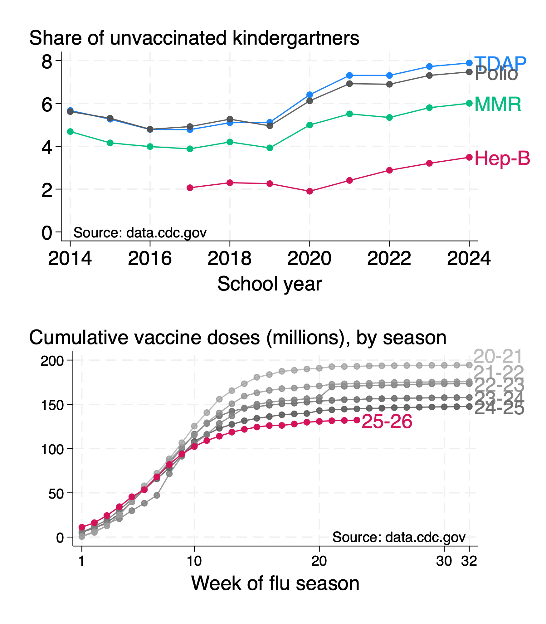
Vaccination rates are falling
From NYT:

Slide 3
Responding to falling vaccination rates
View 1: Right to refuse treatment outweights health consequences
Fears about adverse events outweigh perceived benefits
View 2: Health consequences are large, positive, and rooted in science
Perceptions are not correct
Hypothesis: Communicating science of vaccines can persuade people to vaccinate
Information provision potentially welfare improving by correcting internality
I am hoping to pursue this hypothesis in a series of experiments
End goal: effective, scaleable information provision treatments
Today: First step of the causal chain

Slide 4
From communication to vaccination
Information → Understanding → Beliefs → Actions
Strength of causal links are not clear, even for moving beliefs
Vaccine hesitant people less likely to trust government or doctor
May heavily weigh own or peer experience, or other information source
This paper: online experiment, flu vaccine, short-run side effect info provision
Study population: people not necessarily intending to take flu vaccine
Powered for beliefs, not actions (prespecified)
Actual vaccination effects (hopefully) to come

Slide 5
Why the flu vaccine? Why side effects?
Why flu vaccine?
Substantial health costs: 28,000 deaths, 35-40 million cases, 35-45% vaccination rate
Many people, regular decision: feasible to study
Why side effect information provision?
Side effect perceptions matter for choices
Vaccine hesitant hold biased beliefs relative to clinical trials
Effectiveness and flu risk also natural targets, but beliefs here less biased

Slide 6
Three research questions on scientific information provision and vaccine hesitancy
Can side effect information from scientific studies shift beliefs about personal risk?
Do responses vary with source and study population?
Does information shift vaccine intention and take-up?

Slide 7
Preliminary study results
Side effect information from scientific studies shifts beliefs about personal risk
by 3 percentage points on a base of 15 (vs. 0-1 in clinical trials)
Belief responses don’t clearly move with source
Industry and academic arms similar have similar treatment effects
Inconsistent results for intervention emphasizing study population
Information shifts vaccine intentions, noisy effect on actual vaccination
Results are highly heterogeneous (not preregistered)
Belief responses bigger for people with worse priors, no previous flu vacc
Political views strongly predict belief responses and intention responses

Slide 8
What’s new here?
Contributions to literature on vaccine hesitancy + beliefs
Correlational evidence:
Mistrust in institutions, pessimistic beliefs (side effects and others).
Experiments find:
Nudges + encouragement help but onlyto a limited extent
Identity of messenger can matter (racial concordance, political concordance)
Messages correcting false beliefs mostly unhelpful. No work on short-run side effects.
Contributions:
Message content matters: side effect infomation relevant.
Mistrust in institutions matters because it impedes learning

Slide 9
Experiment Design

Slide 10
Experiment overivew
Screening wave Recruit 8,000 via prolific, screen for hesitancy, late November
Don’t intend to vaccinate against flu; may or may not vaccinate against flu
Also measure vaccine info sources and experience with flu and COVID vaccines
Main wave 3,500 vaccine hesitant participants, 1-7 days later
Randomize information provision, measure priors, posteriors, vaccine intentions
Ask about trustworthiness and relevance of information, politics, demographics
Follow-up wave 3,000 participants, 2-4 weeks later
Obfuscate intentions then measure whether vaccinated this season
Also measure recall of wave 2 (not discussed today)

Slide 11

Info provision: Control arm

Slide 12
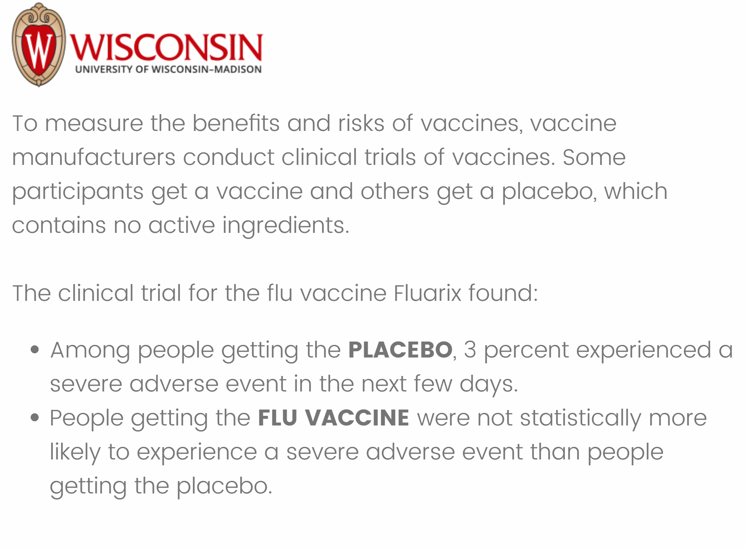
Info provision: Industry info arm

Slide 13
Info provision: Academic info arm

Slide 14
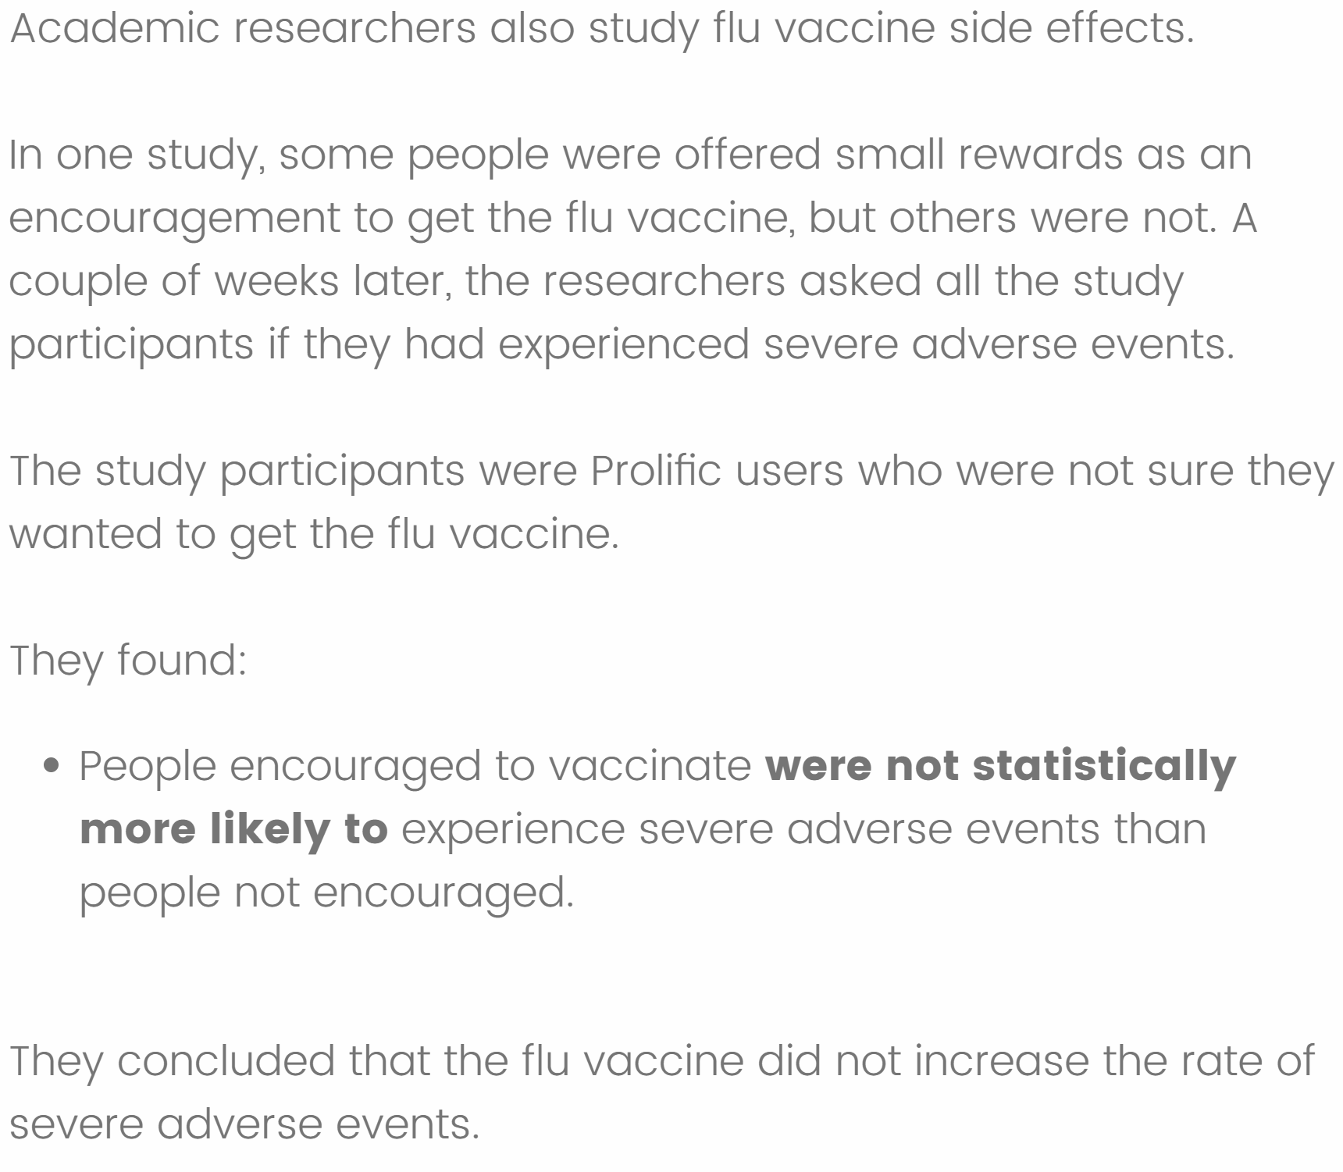
Info provision: Personal info arm

Slide 15
Information provision can affect two dimensions of beliefs
Beliefs about what happened in the trial.
“SE (trial)”
Beliefs about what would happen to you
Personal risk,${\tilde{Δ}}_{self,i}$ or sometimes “Delta”
We examine each separately

Slide 16
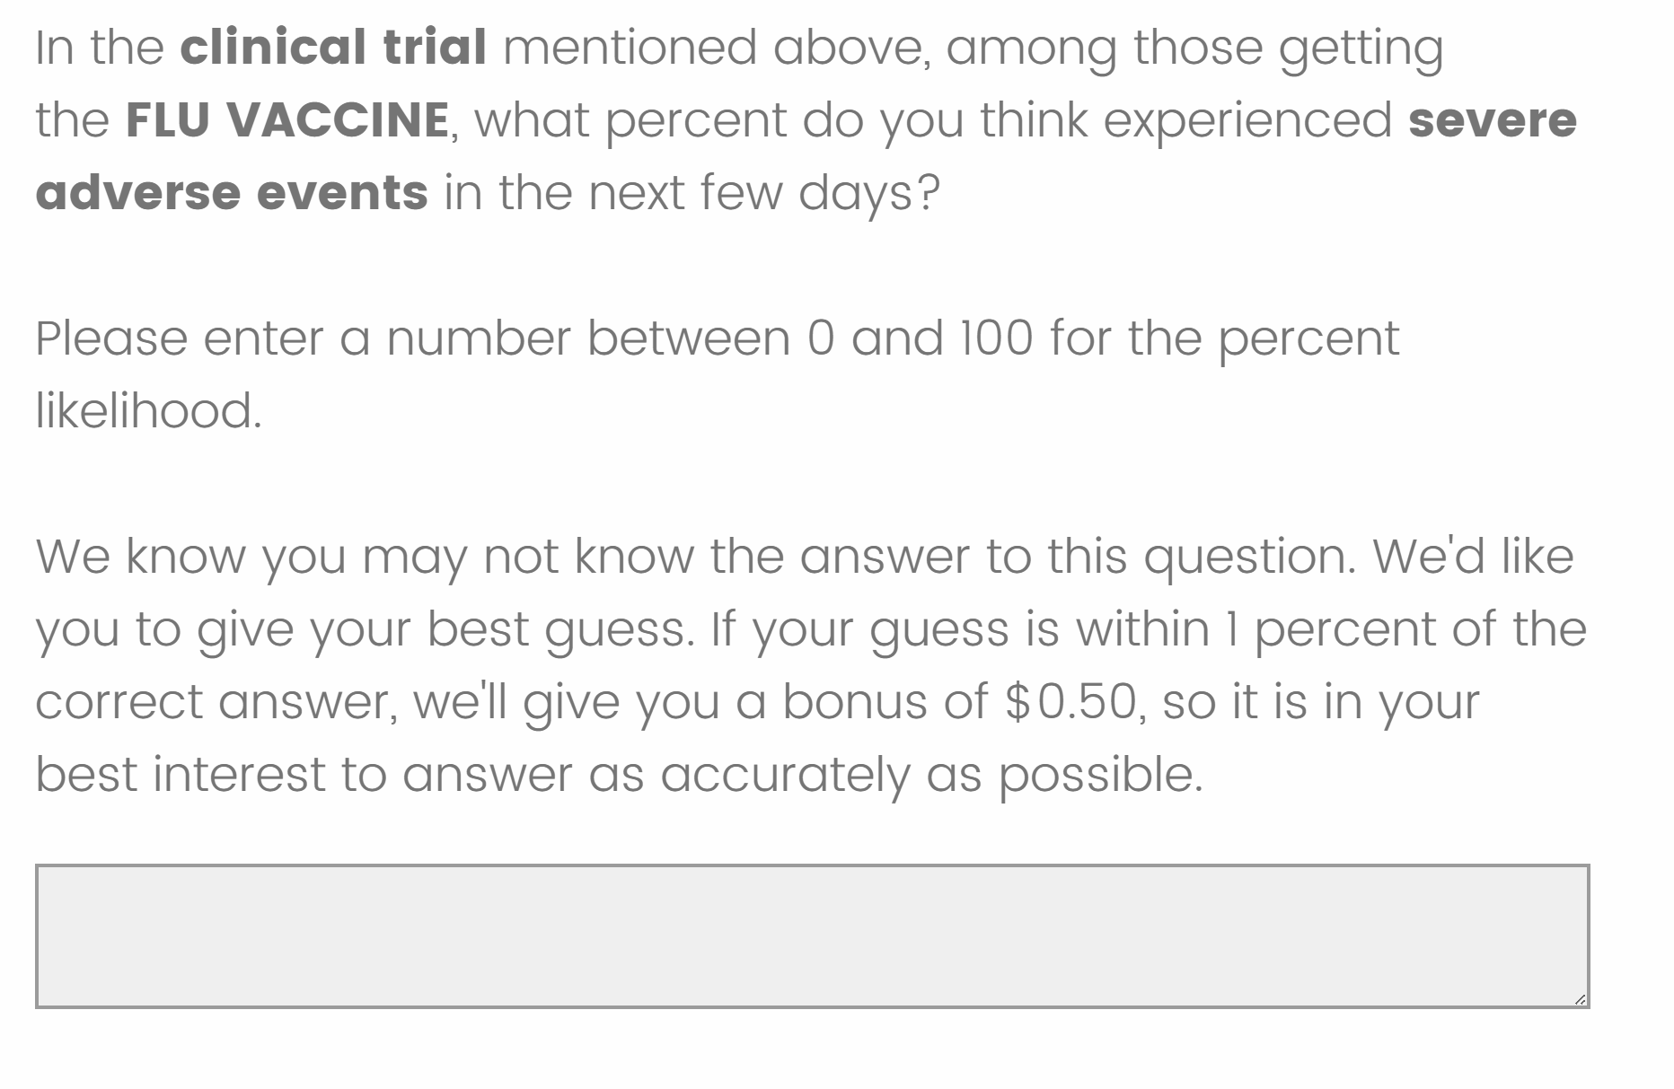
Incentivized elicitation of beliefs about SE (trial)

Slide 17
Eliciting side effect beliefs
Conceptualization
“Side effect” is causal effect of vaccine on short-run, severe adverse event rate
Short-run: lasting a few days
“Severe”: grade 3, disruptive to your day - real cost, not just noticeable
Two requirements for us
Person specific: participant’s expected effect, not population or trial average effect
Causal contrast, not level of symptom: ${\tilde{Δ}}_{self,i}={\tilde{y}}_{i}\left(1\right)−{\tilde{y}}_{i}\left(0\right)$

Slide 18
Eliciting side effect beliefs
Operationalizaiton
We get causal contrast by eliciting both potential outcomes. To elicit ${\tilde{y}}_{i}\left(0\right)$:
For this question, please imagine, regardless of your actual vaccination status, that you DO NOT get the flu vaccine tomorrow or in the following few days.
Thinking about yourself, how likely do you think you would be to experience a severe adverse event, such as headache, muscle ache, tiredness, joint pain, fever, chills, or general discomfort, in the following few days? (As a reminder, severe means bad enough to disrupty your daily activity)
Elicit ${\tilde{y}}_{i}\left(1\right)$ analogously. Subjective side effect rate ${\tilde{Δ}}_{self,i}={\tilde{y}}_{i}\left(1\right)−{\tilde{y}}_{i}\left(0\right)$.
Before information provision, elicit priors for ${\tilde{y}}_{i}\left(0\right)$ and ${\tilde{y}}_{i}\left(1\right)$ using likert scale

Slide 19
Specification
All prespecified
$$y=b_{0}+b_{1}⋅Industry+b_{2}⋅Academic+b_{3}⋅Personal+Controls$$

Slide 20
Outcomes
Side effect experienced in trial
${\tilde{Δ}}_{self}$ Side effect belief (primary)
Intend to vaccinate
Clicked on a link
Indicated vaccination in follow-up survey
Controls (power-improving)
Prior beliefs
Base vacc intent + experiences
Demographics
Trust in government
Chronic condition indicators

Slide 21
Appendix →

Slide 22
Results

Slide 23
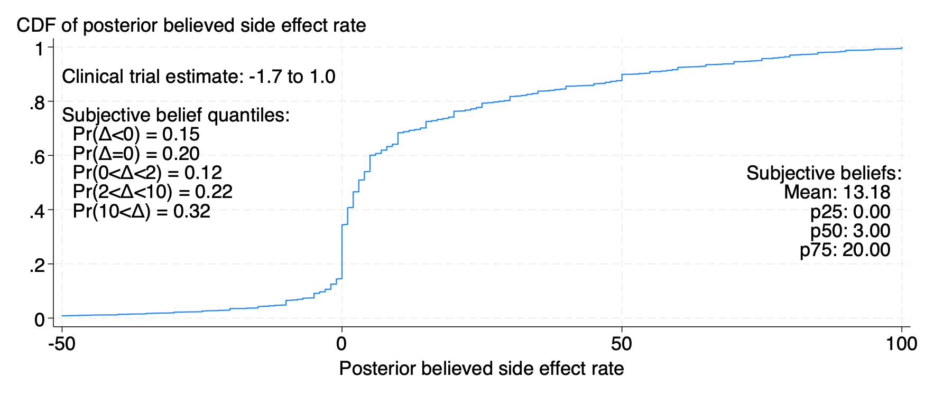
Side effect beliefs $Δ_{self}$ biased with high face validity

Slide 24
Appendix →

Slide 25
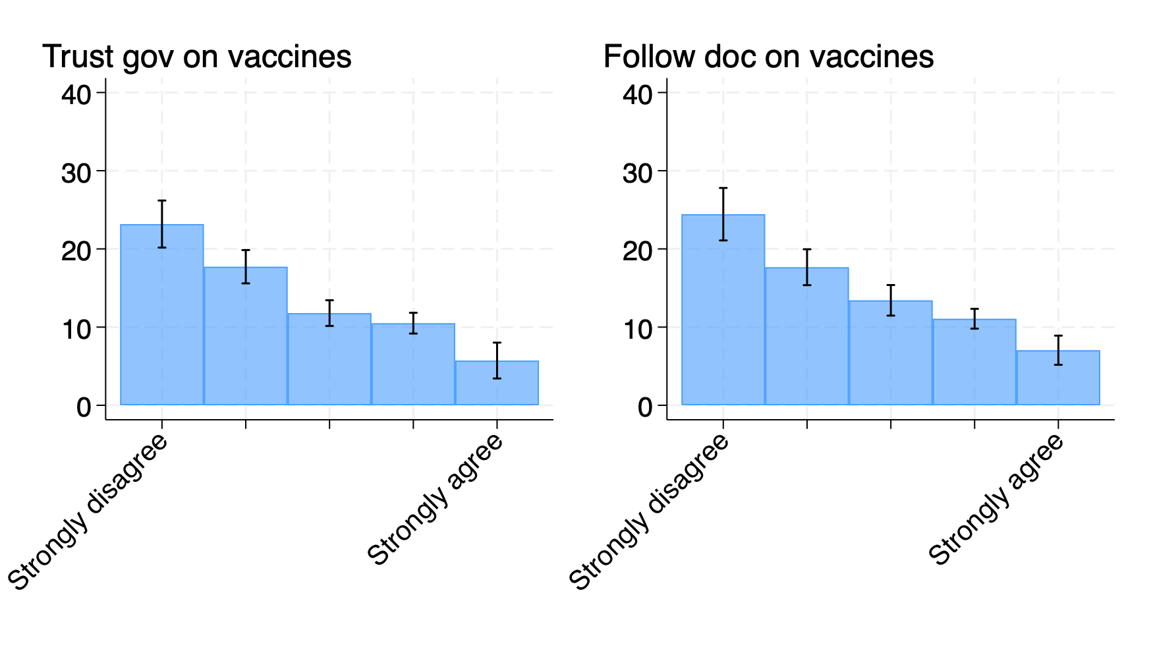
Side effect beliefs $Δ_{self}$ biased with high face validity

Slide 26
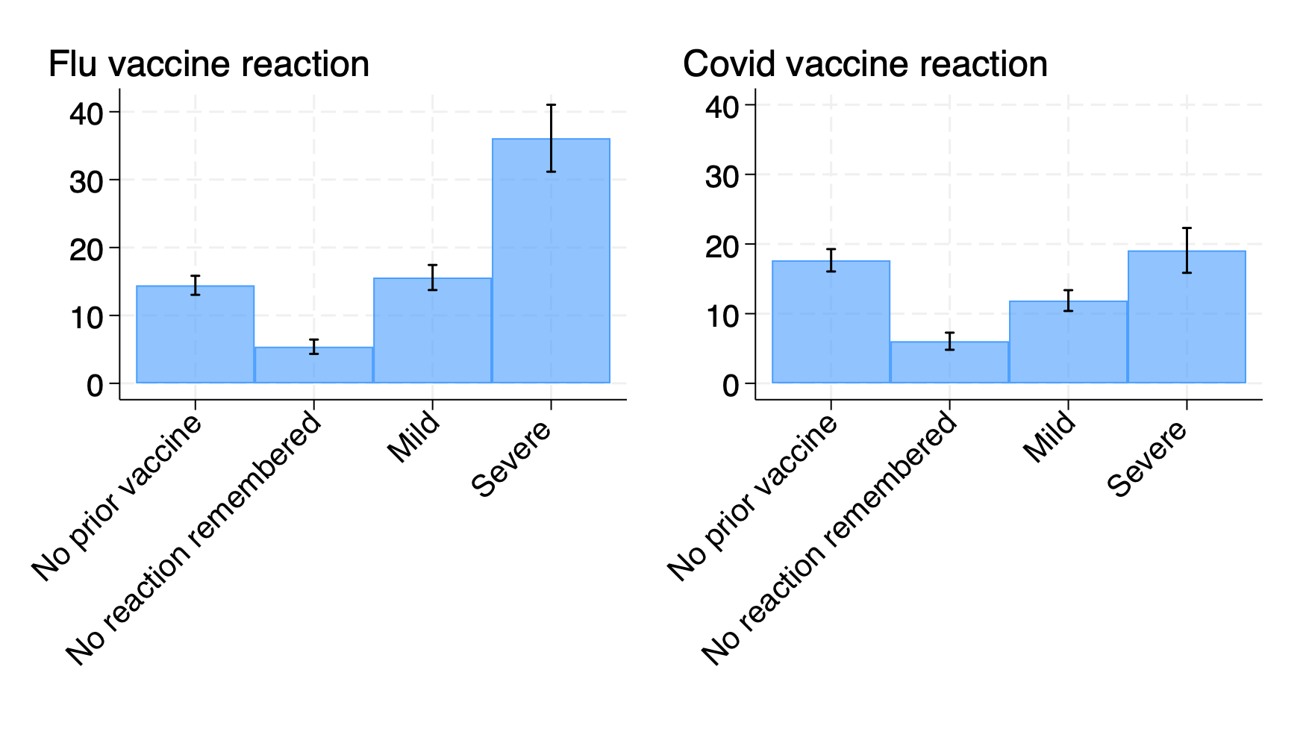
Side effect beliefs $Δ_{self}$ biased with high face validity

Slide 27
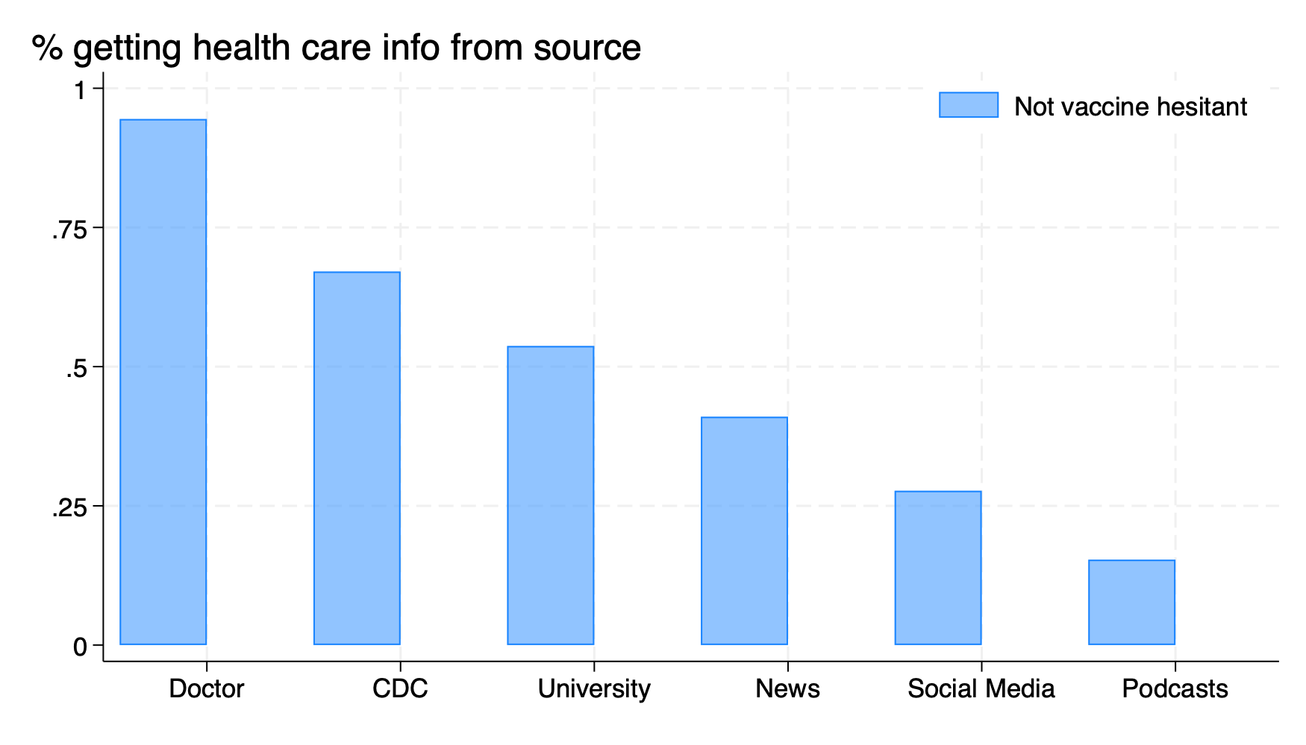
Vaccine hesitant’s beliefs might be hard to move

Slide 28
{.center}

Slide 29
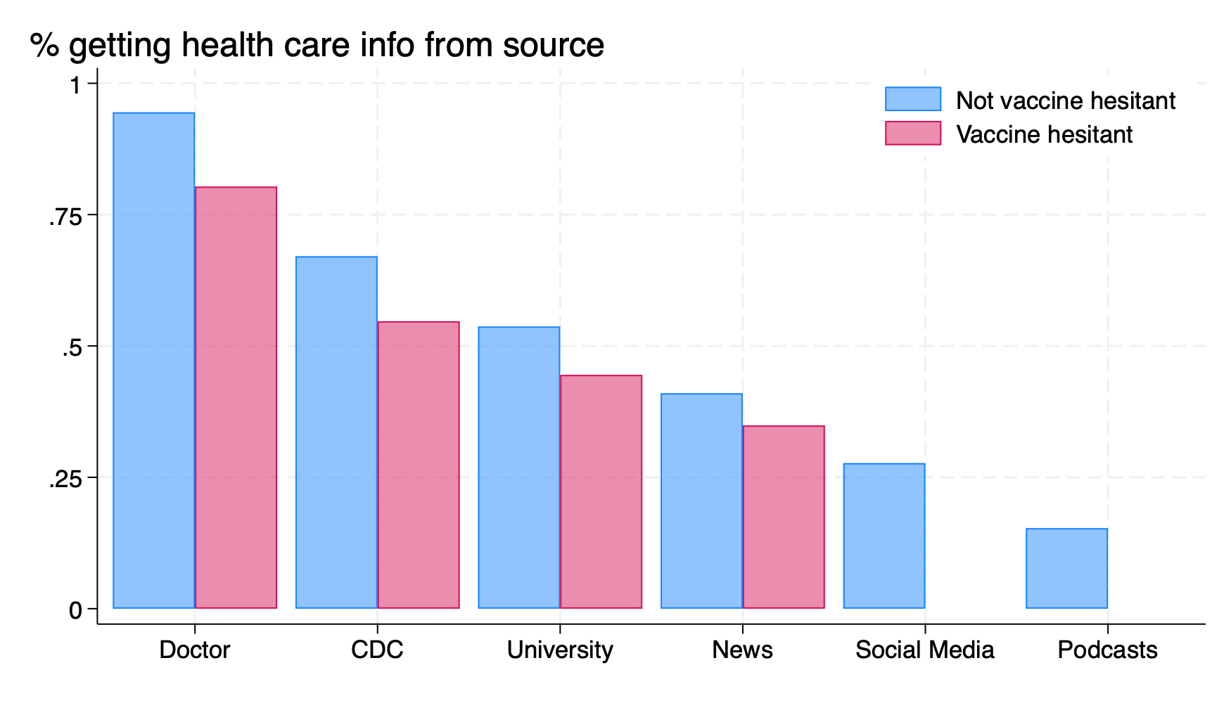
Vaccine hesitant’s beliefs might be hard to move

Slide 30
{.center}

Slide 31
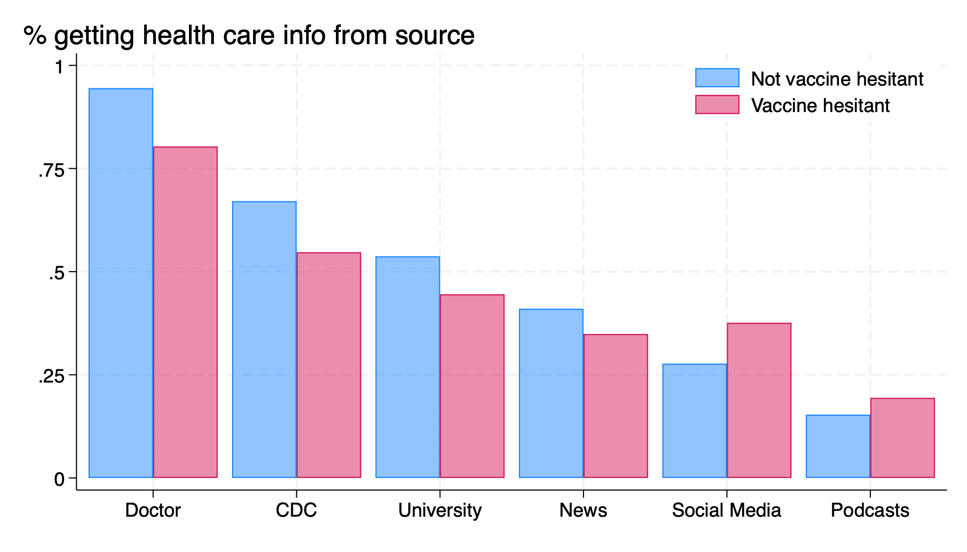
Vaccine hesitant’s beliefs might be hard to move

Slide 32
{.center}

Slide 33
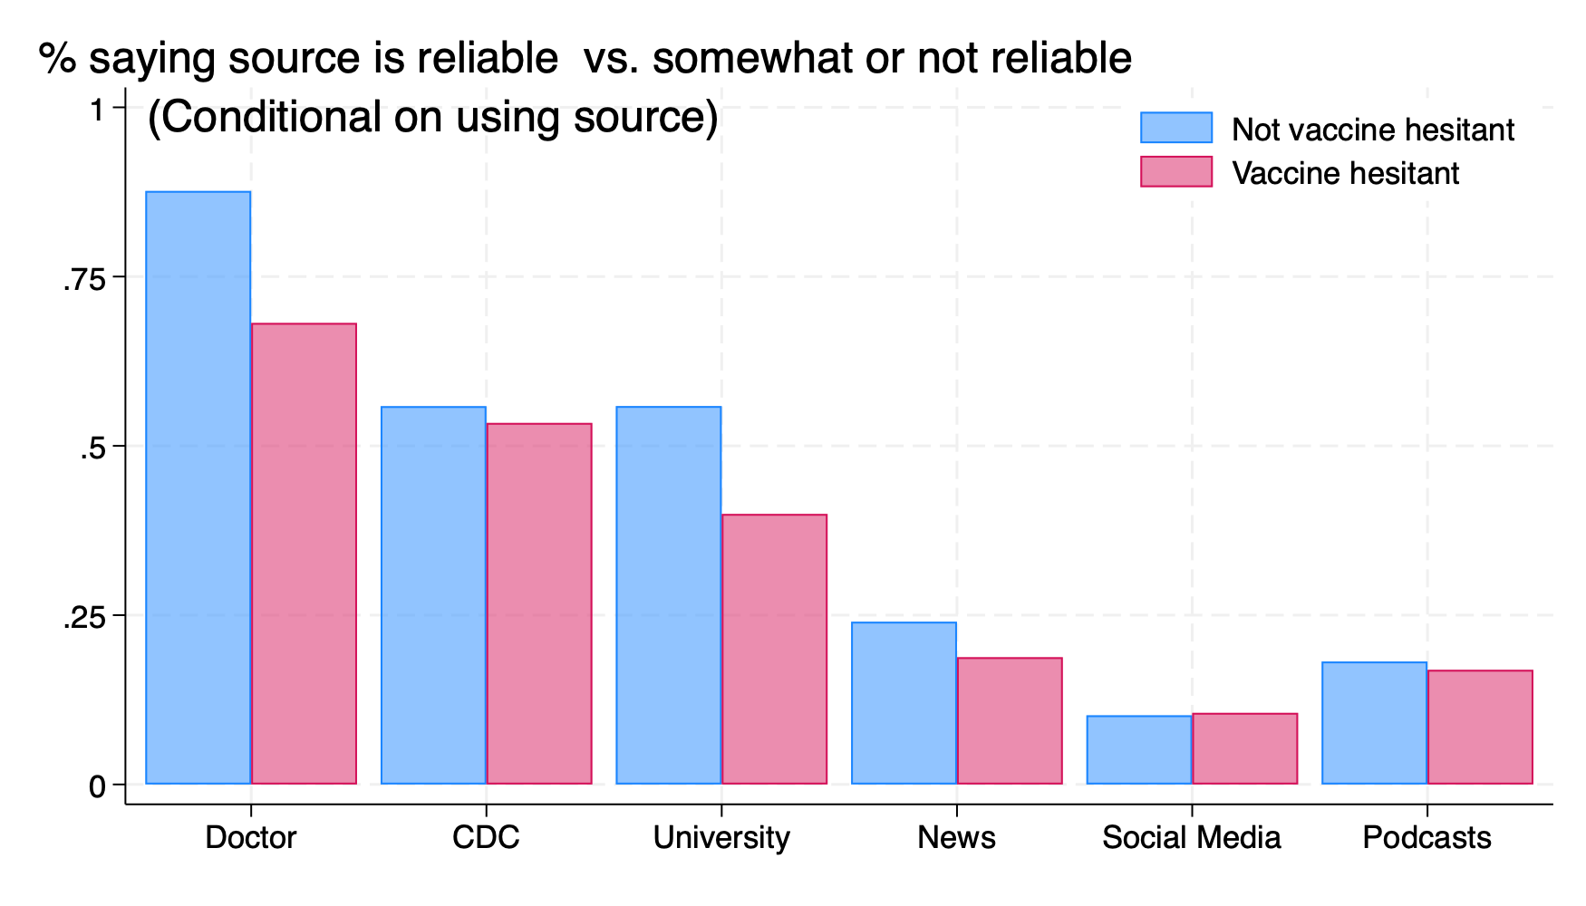
Vaccine hesitant’s beliefs might be hard to move

Slide 34
{.center}

Slide 35
Industry and academic study info moves beliefs
Notes: Robust standard errors in parentheses. Controls not shown. Appendix →

Slide 36
Heterogeneous effects consistent with belief updating rather than experimenter demand
Caution: not preregistered
Effects are larger for people with …
Diffuse priors: no prior vaccine experience rather than no reaction
Worse priors: Prior belief indicates side effect likely
Trust in institutions: says university info reliable
Effects also larger for people who say they found industry info trustworthy and reliable
Details →

Slide 37
Effect of information on intentions and actions
Notes: Robust standard errors in parentheses. Controls not shown. Appendix →

Slide 38
Effect of information on intentions and actions
Notes: Robust standard errors in parentheses. Controls not shown. Appendix →

Slide 39
Summarizing: Results are promising but puzzling
Promising: Some information does shift side effect beliefs and intentions
Insignificant take-up response reflects limited power, uncertainty (not precise null)
Puzzling: Inconsistent pattern of belief and intention responses
Industry arm reduces side effect beliefs but does not increase intentions
Personal arm does not change side effect beliefs but does increase intentions

Slide 40
Partial resolution: Political views
 | SE (trial) | Delta | Vacc Intent | SE (trial) | Delta | Vacc Intent
Industry | -8.422 | -1.502 | -0.023 | -7.684 | -7.044 | 0.044
 | (1.167) | (1.352) | (0.013) | (1.250) | (1.586) | (0.023)
Academic | -3.717 | -1.382 | 0.006 | -5.286 | -6.068 | 0.072
 | (1.205) | (1.349) | (0.014) | (1.243) | (1.546) | (0.024)
Personal | -4.200 | 0.912 | 0.012 | -5.737 | -0.975 | 0.047
 | (1.215) | (1.349) | (0.015) | (1.243) | (1.585) | (0.023)
Control mean | 21.130 | 16.315 | 0.062 | 18.683 | 13.953 | 0.080
N | 2,145 | 2,145 | 2,145 | 1,389 | 1,389 | 1,381
Politics: | Cons/mod | Cons/mod | Cons/mod | Liberal | Liberal | Liberal
Caution: not pre-specified

Slide 41
Notes: Robust standard errors in parentheses. Controls not shown. Appendix →

Slide 42
Politics matter because they correlate with determinants of belief updating
Caution: not pre-specified
View of trial
Did you find it trustworthy? (0-10 scale)
Did ou find relevant? (0-10 scale)
Views of university-provided information
Do you obtain health care info from university research or researchers?
Do you consider that information reliable?
Appendix →

Slide 43
Expressive responding and experimenter demand are unlikely to explain these results
People expressing their vaccine preferences, or saying what they think we want to hear
Very difficult to explain pattern of treatment effects thusly
Participants don’t know which treatment arm they’re in
Control-vs-industry: same signal of experiment intent, different ${\tilde{Δ}}_{self}$
More evidence: reported $Δ_{self}$ inconsistent with expressive answering Appendix →
Correlated with believed trial SE rate, own flu + covid vaccine experiencs
Correlations similar by political view

Slide 44
Conclusions

Slide 45
Conclusions and future work
An extremely uncreative, unslick presentation of scientific information made vaccine hesitant people update their beliefs in a pro-vaccine direction
When belief updating happens, scientific information shifts intentions
Political views key moderator of belief updating, via perceived study informativeness
Effect on vaccinations statistically imprecise; noisy null
Getting detectable effect on vaccinations likely requires bigger belief updating
Better presentation and communication of trials?
Bigger information intervention (effectiveness + side effects)?
Trusted, relevant source?
Possibly other dimensions of information are more important?

Slide 46
Thank You
Comments welcome: dan.sacks@wisc.edu

Slide 47
Appendix

Slide 48
Appendix
← Specification ← Beliefs ← Treatment Effects ← HTEs ← HTE by Politics ← Expressive answering

Slide 49
More on validity
Experiment balance
Experiment balance (demographics)
Belief correlates
CDF of beliefs by treatment arm
Trust in trial by polviews
Trust in university by polviews
Correlates of $Δ$ by polviews
More HTEs
HTE: Prior beliefs
HTE: Prior experience
HTE: Trust
HTE: Relevance
HTE: University info reliable

Slide 50
Experiment balance
← Appendix

Slide 51
Experiment balance (demographics)
← Appendix

Slide 52
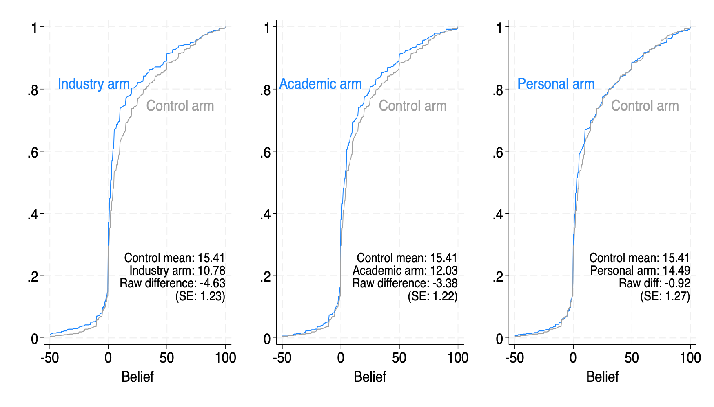
CDF of beliefs by treatment arm

Slide 53
← Appendix

Slide 54
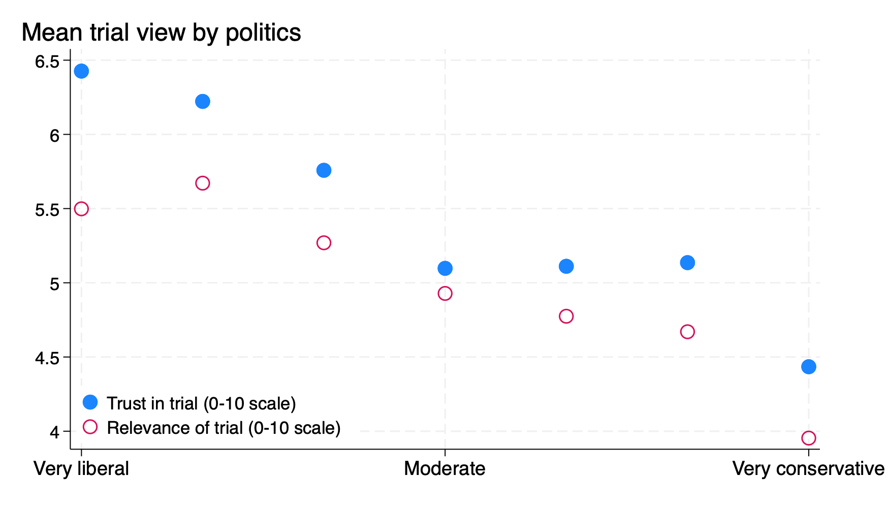
Political views and trust/relevance of trial info

Slide 55
← Appendix

Slide 56
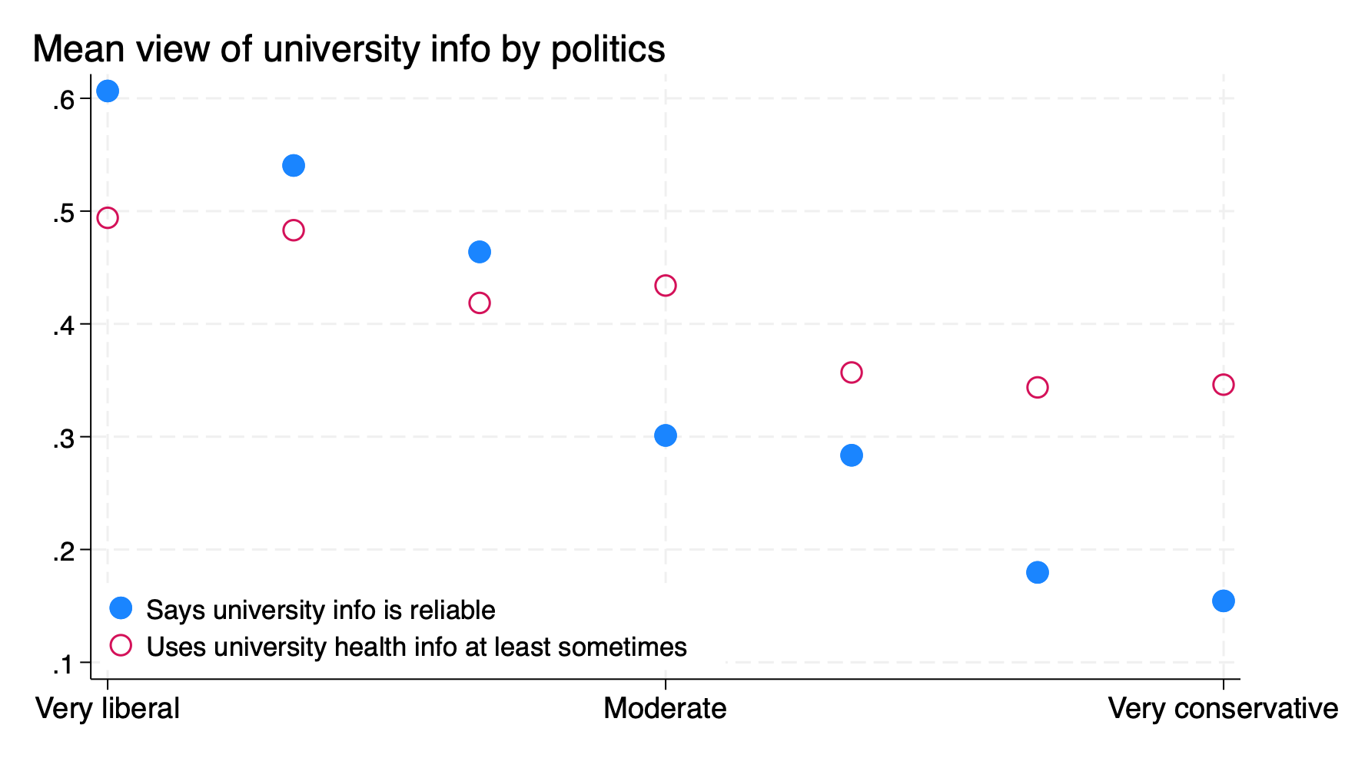
Political views and trust/relevance of university info

Slide 57
← Appendix

Slide 58
HTE: Prior beliefs
 | SE (trial) | Delta | Vacc Intent | SE (trial) | Delta | Vacc Intent
Industry | -4.096 | -0.838 | -0.015 | -10.941 | -5.314 | 0.015
 | (0.999) | (0.964) | (0.020) | (1.324) | (1.694) | (0.014)
Academic | -1.306 | -0.116 | 0.027 | -6.731 | -5.332 | 0.032
 | (1.020) | (0.901) | (0.022) | (1.368) | (1.700) | (0.015)
Personal | -2.091 | -0.147 | 0.025 | -7.015 | 0.628 | 0.022
 | (1.034) | (0.940) | (0.022) | (1.364) | (1.705) | (0.015)
Control mean | 12.824 | 2.318 | 0.099 | 26.187 | 26.060 | 0.045
N | 1,631 | 1,631 | 1,626 | 1,903 | 1,903 | 1,900
Prior | Low | Low | Low | High | High | High

Slide 59
← Appendix

Slide 60
HTE: Prior experience
 | Delta | Delta | Delta | Delta
Industry | -3.619 | -1.852 | -3.708 | 2.875
 | (1.725) | (1.251) | (2.452) | (8.150)
Academic | -3.291 | 0.068 | -5.955 | -3.549
 | (1.656) | (1.492) | (2.416) | (6.617)
Personal | 0.687 | 0.726 | -0.385 | -5.964
 | (1.741) | (1.296) | (2.519) | (6.485)
Control mean | 17.346 | 6.789 | 18.101 | 38.386
N | 1,431 | 1,085 | 802 | 207
Prior reaction | No vacc | No rxn | Mild | Severe

Slide 61
← Appendix

Slide 62
HTE: Trust trial info
 | SE (trial) | Delta | Vacc Intent | SE (trial) | Delta | Vacc Intent
Industry | -7.620 | -1.572 | -0.014 | -8.138 | -4.856 | 0.020
 | (1.352) | (1.576) | (0.012) | (1.086) | (1.324) | (0.021)
Academic | -4.586 | -0.849 | 0.016 | -3.903 | -4.541 | 0.042
 | (1.400) | (1.586) | (0.014) | (1.111) | (1.298) | (0.021)
Personal | -3.748 | 2.089 | 0.005 | -5.413 | -1.142 | 0.046
 | (1.396) | (1.573) | (0.014) | (1.096) | (1.333) | (0.021)
Control mean | 21.921 | 17.573 | 0.040 | 18.786 | 13.650 | 0.093
N | 1,788 | 1,788 | 1,786 | 1,746 | 1,746 | 1,740
Trust | Low | Low | Low | High | High | High

Slide 63
← Appendix

Slide 64
HTE: Found trial relevant
 | SE (trial) | Delta | Vacc Intent | SE (trial) | Delta | Vacc Intent
Industry | -8.171 | -3.002 | -0.020 | -8.122 | -4.364 | 0.022
 | (1.262) | (1.490) | (0.013) | (1.155) | (1.418) | (0.021)
Academic | -5.059 | -2.984 | 0.012 | -3.292 | -3.445 | 0.047
 | (1.261) | (1.455) | (0.014) | (1.244) | (1.381) | (0.022)
Personal | -4.804 | -0.285 | 0.013 | -5.169 | -0.028 | 0.030
 | (1.265) | (1.436) | (0.014) | (1.214) | (1.462) | (0.022)
Control mean | 21.977 | 19.054 | 0.047 | 18.363 | 11.674 | 0.092
N | 1,877 | 1,877 | 1,875 | 1,657 | 1,657 | 1,651
Relevance | Low | Low | Low | High | High | High

Slide 65
← Appendix

Slide 66
HTE: University info reliable
 | SE (trial) | Delta | Vacc Intent | SE (trial) | Delta | Vacc Intent
Industry | -7.309 | -1.058 | -0.008 | -9.320 | -8.189 | 0.012
 | (1.139) | (1.300) | (0.013) | (1.195) | (1.695) | (0.024)
Academic | -3.419 | -2.446 | 0.012 | -5.835 | -4.380 | 0.061
 | (1.167) | (1.315) | (0.014) | (1.298) | (1.565) | (0.025)
Personal | -4.118 | 0.724 | 0.005 | -5.831 | -1.007 | 0.059
 | (1.180) | (1.322) | (0.013) | (1.256) | (1.617) | (0.026)
Control mean | 21.677 | 16.107 | 0.053 | 17.506 | 14.149 | 0.099
N | 2,279 | 2,279 | 2,273 | 1,255 | 1,255 | 1,253
Uni reliable | No | No | No | Yes | Yes | Yes

Slide 67
← Appendix

Slide 68
Correlates of $Δ$ by political views
Notes: Robust standard errors in parentheses. “Conservative” includes moderate. ← Appendix

Slide 69
Side effect beliefs $Δ_{self}$ have high face validity because they correlate with trust and experience

Slide 70
← Appendix

Slide 71
Side effect beliefs $Δ_{self}$ have high face validity because they correlate with trust and experience

Slide 72
← Appendix

Slide 73
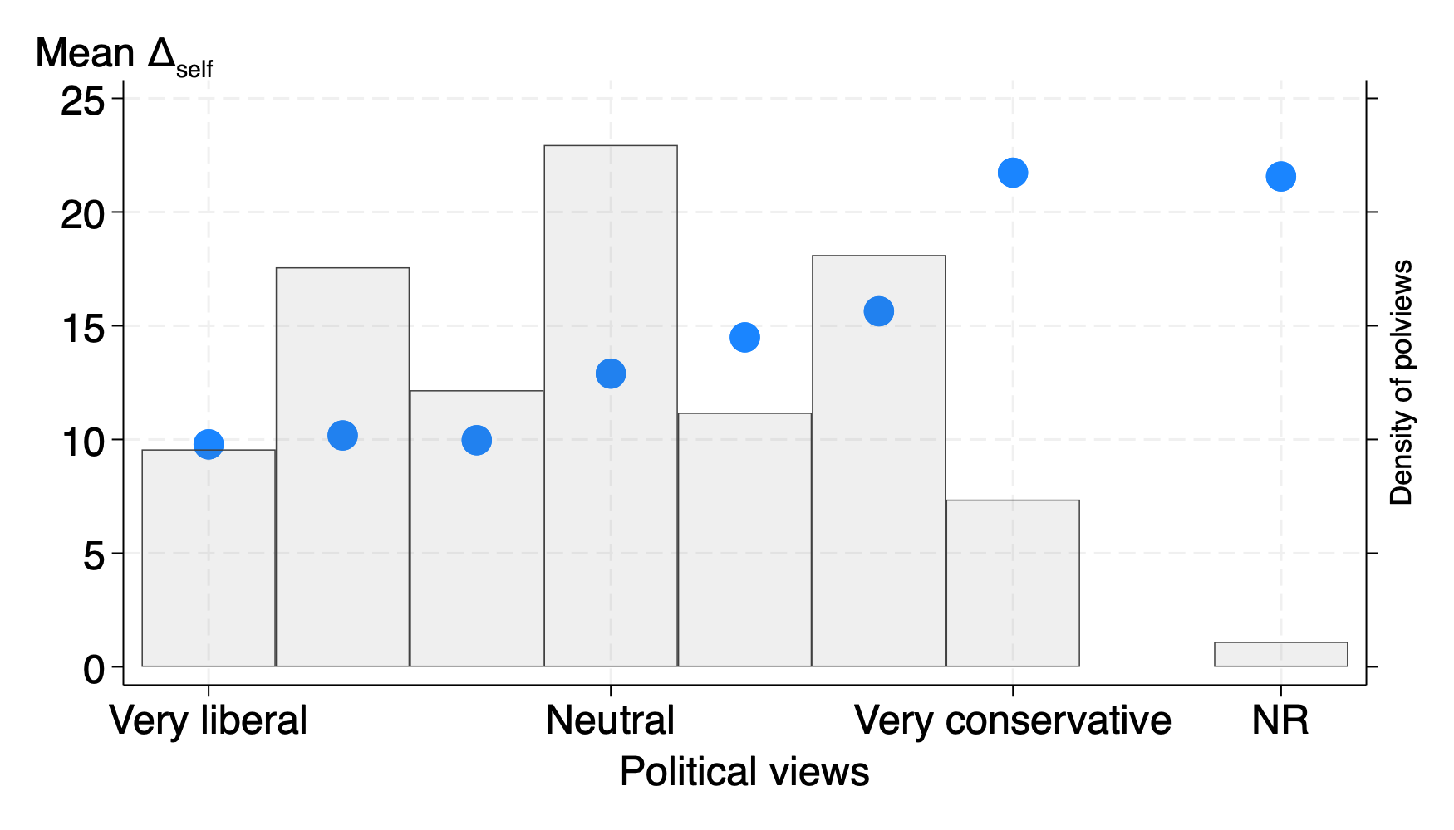
Side effect beliefs $Δ_{self}$ and political views

Slide 74
← Appendix

