Slide 1
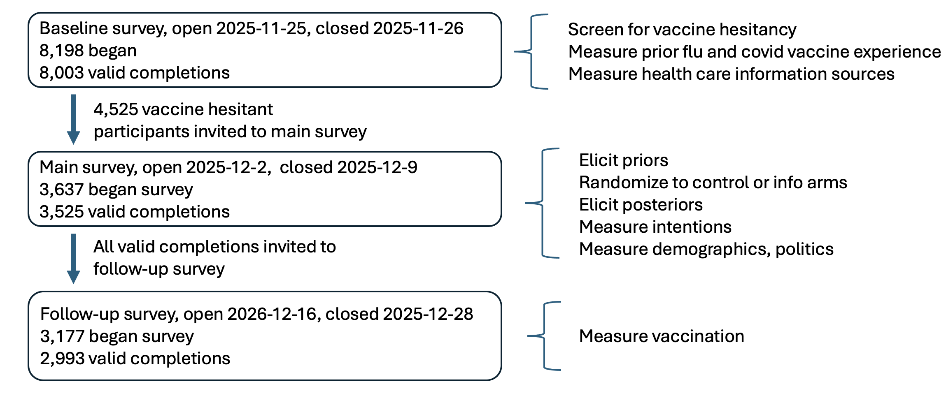

Slide 2
Baseline survey, open 2025-11-25, closed 2025-11-26
8,198 began
8,003 valid completions
Screen for vaccine hesitancy
Measure prior flu and covid vaccine experience
Measure health care information sources
4,525 vaccine hesitant participants invited to main survey
Main survey, open 2025-12-2, closed 2025-12-9
3,637 began survey
3,525 valid completions
Elicit priors
Randomize to control or info arms
Elicit posteriors
Measure intentions
Measure demographics, politics
All valid completions invited to follow-up survey
Follow-up survey, open 2026-12-16, closed 2025-12-28
3,177 began survey
2,993 valid completions
Measure vaccination

