Slide 1
Presentation
On
HTTP and Fiddler
By
Danish Ahmadullah (#493774)

Slide 2
HTTP(Hyper Text Transfer Protocol)
The Hypertext Transfer Protocol (HTTP) is an application-level protocol that is used to deliver data (HTML files, image files, query results, etc.) on the World Wide Web.
HTTP is media independent.
HTTP is stateless.
Note:- HTTP/1.0 uses a new connection for each request/response exchange, whereas HTTP/1.1 connection may be used for one or more request/response exchanges.

Slide 3
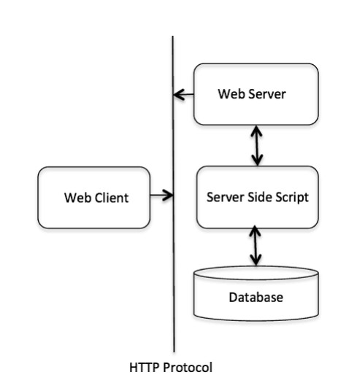
Architecture of HTTP

Slide 4
HTTP Request
An HTTP client sends an HTTP request to a server in the form of a request message which includes the following format:
A Request-line.
Zero or more header (General|Request|Entity) fields.
An empty line indicating the end of the header fields.
Optionally a message-body.

Slide 5
Request Line in HTTP Request
Request-Line = Method, Request-URI, HTTP-Version.
Request Method
The request method indicates the method to be performed on the resource identified by the given Request-URI.
GET
POST
PUT
DELETE
CONNECT
TRACE

Slide 6
REQUEST-URL
It is used when an HTTP request is being made to a proxy. The proxy is requested to forward the request or service from a valid cache, and return the response.
For example: GET http://www.w3.org/pub/WWW/TheProject.html HTTP/1.1

Slide 7
Request Header Fields
The request-header fields allow the client to pass additional information about the request, and about the client itself, to the server. These fields act as request modifiers. Here is a list of some important Request-header fields that can be used based on the requirement:
Accept-Charset: US-ASCII, ISO-8859-1, ISO-8859-7.
Accept-Encoding: gzip, compress , deflate.
Accept-Language: en, en-US, en-cockney, i-cherokee, x-pig-latin.
Authorization: credentials.

Slide 8
HTTP RESPONSE
A Status-line.
Zero or more header (General|Response|Entity) fields.
An empty line indicating the end of the header fields.
Optionally a message-body.

Slide 9
Message Status-Line
Status-Line = HTTP-Version | Status-Code
1xx: Informational
It means the request was received and the process is continuing.
2xx: Success
It means the action was successfully received, understood, and accepted.
3xx: Redirection
It means further action must be taken in order to complete the request.
4xx: Client Error
It means the request contains incorrect syntax or cannot be fulfilled.
5xx: Server Error
It means the server failed to fulfill an apparently valid request.

Slide 10
FIDDLER
Fiddler is a Web Debugging Proxy.
Logs all HTTP(S) traffic between your computer and the Internet.
Allows you to inspect traffic, set breakpoints, and “fiddle” with incoming or outgoing data.

Slide 11
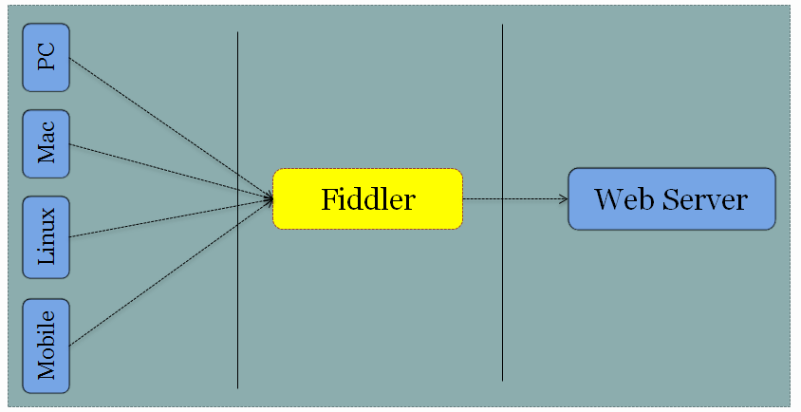
How does it work?

Slide 12
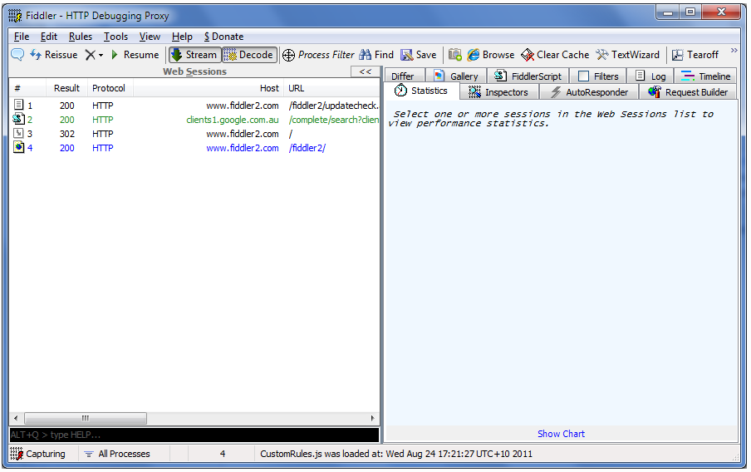
Let’s get started with Fiddler

Slide 13
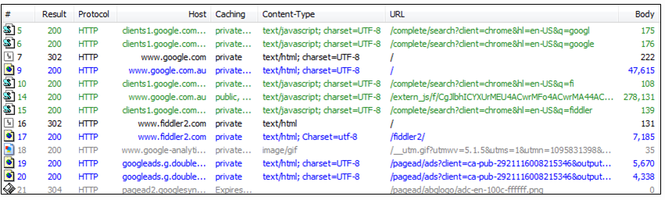
Web Sessions

Slide 14
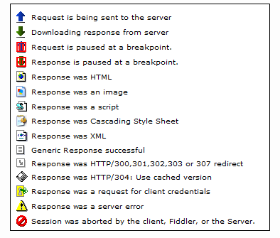

Slide 15
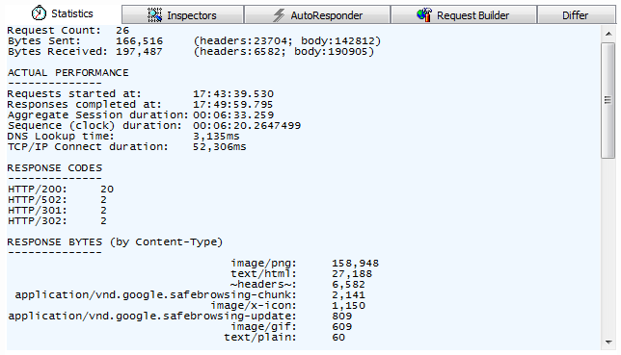
Statistics
The first tab on the right pane is Statistics which shows you some info about the selected session. It is most useful when used on several sessions:

Slide 16
Is not that awesome?! So it is telling me that I have selected 26 requests, where total bytes sent and received are 166K and 197K (with more info about the header and body size), it provides a summary on received status codes and MIME(Multipurpose Internet Mail Extensions) types. And then there is the nice chart on the bottom.

Slide 17
Inspectors
Inspectors allow you to visualize requests and responses in meaningful ways. There are heaps of out of the box inspectors and you can write your own if you need to.
When you double click on a session fiddler takes you to the Inspectors tab for that session. It also detects what the most relevant request and response inspectors are and chooses that for you. For example if you double click on a JSON session, Fiddler takes you to the JSON tab.

Slide 18
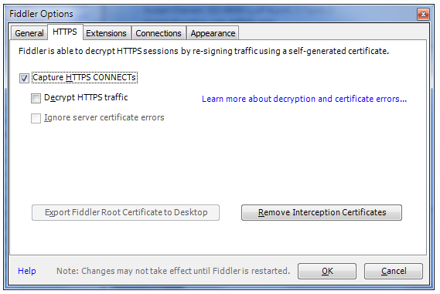
HTTPS Traffic Decryption

Slide 19
QuickExec (Alt+Q)
?sometext: As you type some text, Fiddler will highlight sessions where the URL contains some text. Hit Enter to set focus to the selected matches.; e.g. ?google
>size: Select sessions where response size is greater than size bytes.; e.g. >4000
<size: Select sessions where response size is less than size bytes. e.g <200
=status: Select sessions where response status = status; e.g.=304
=method: Select sessions where request method = method.; e.g. =post.

Slide 20
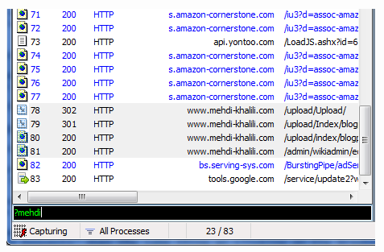

Slide 21
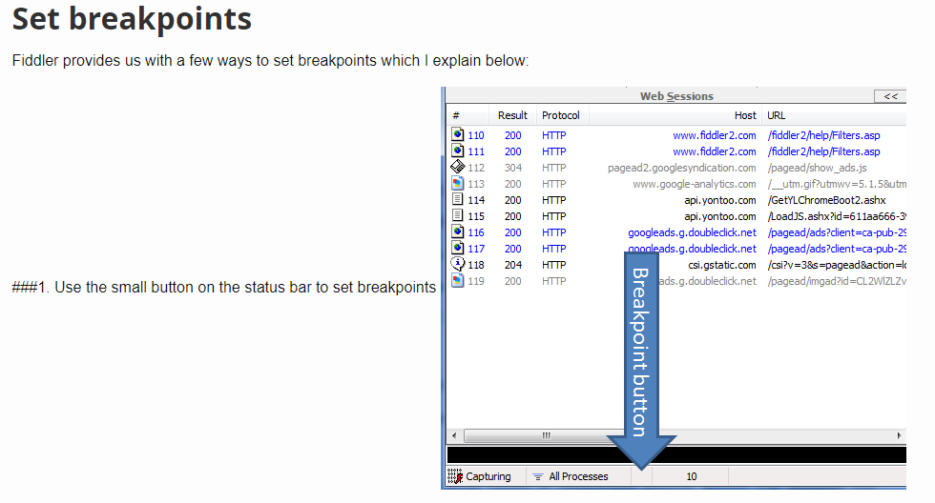

Slide 22
Breakpoint commands run on QuickExec
bpu url: that sets breakpoint for the requests on the provided url; e.g. bpu google
bpm method: that sets breakpoint on a method which is very handy; e.g. bpm post which breaks only on POST requests.
bps status: that sets breakpoint on a response with the provided status; e.g. bps 304
bpafter url: that sets breakpoint for the responses from the provided url.

Slide 23
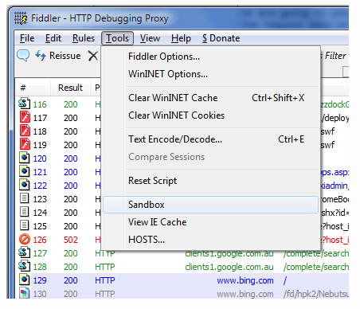
Let’s change the traffic on the fly
When the breakpoint is set the next time you make a request or receive a response that fulfils the breakpoint’s requirements the breakpoint is hit and you get the opportunity to change the traffic.
Request breakpoint on Fiddler’s sandbox

Slide 24
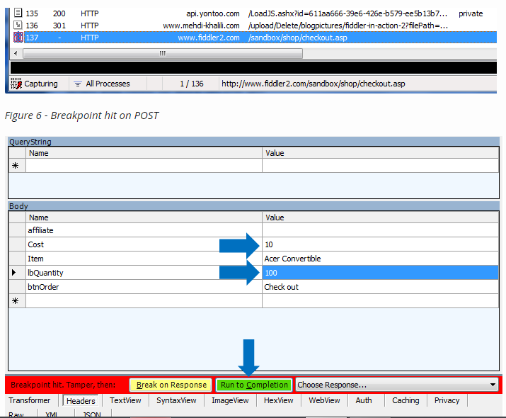

Slide 25
Now double check the website again. Congratulations - you just added 100s of the same item to your cart for the price of one :o)
Response breakpoint on Bing homepage
You could use the knowledge you learnt above to also change a response. For this example I am going to use Bing’s homepage:
bpafter www.bing.com

Slide 26
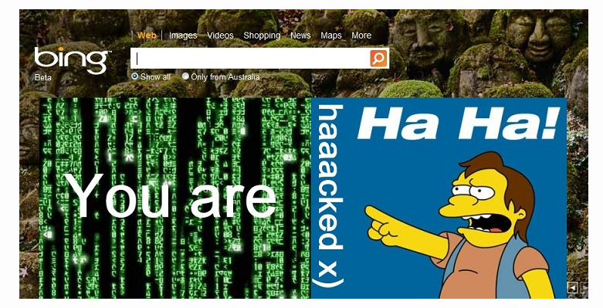

Slide 27
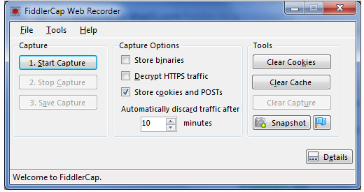
FidlerCap
FiddlerCap is an amazing tool in terms of its ease of use for end users. It allows end user with no technical knowledge to capture some useful information from the production for you to have a look at on your computer and troubleshoot the issue as if you were running the actual tool on the user’s computer. So in a way it bridges the gap between developers and production environment.

Slide 28
I hope you found this PPT useful. This in no way is an exhaustive reference to Fiddler; instead I tried to give you enough information for you to be able to more effectively use Fiddler.
If you want to dig deeper then Fiddler website and Fiddler Blog will be the place to look at.
Hope this helps.

Slide 29
Thank You ☺

