Slide 1
Review of the methodology on the education ranking for the best States

Slide 2
Content 1. Recap on the methodology used 2. Problem Statement 3. Analysis on ACT and SAT trends 4. Summary and recommendation

Slide 3
Recap on the methodology used
States’ education system ranking methodology based on student success:
High School Graduation Rate
High School Dropout Rate
ACT Scores
SAT Scores
College-Going Rates
Reading Test Scores
Math Test Scores
Unclear accuracy in determining college readiness
No connection in predicting college success
Declining ACT participation
areas of concern
Sources:
https://edition.cnn.com/2020/04/14/us/coronavirus-colleges-sat-act-test-trnd/index.html
https://news.uchicago.edu/story/test-scores-dont-stack-gpas-predicting-college-success

Slide 4
Problem Statement
Should United States' (US) standardised college readiness tests' (i.e. American College Testing, ACT and SAT) results be included as the measures for the ranking of the best States for education
Yes or No

Slide 5
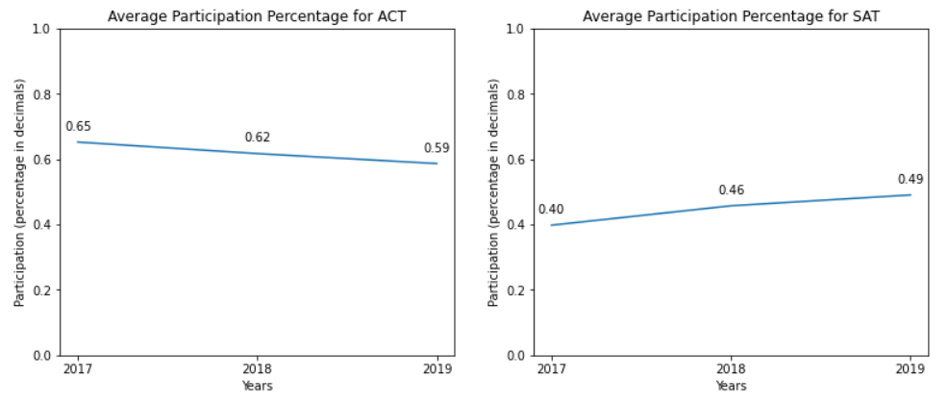
ACT and SAT average participation from 2017 to 2019
Though increase in the average SAT participation over the years, the percentage is still less than 50%
Declining average ACT participation

Slide 6
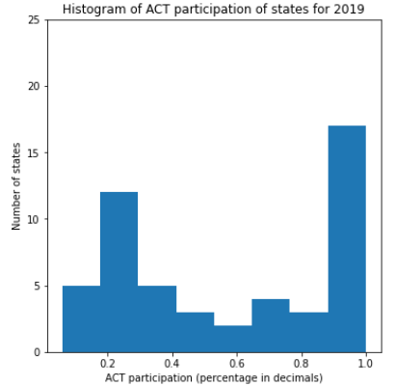
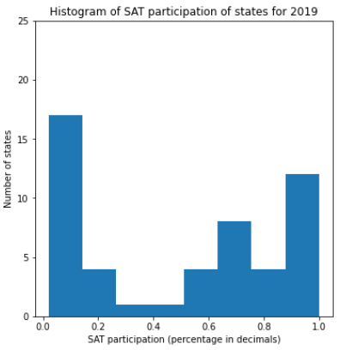
States’ participation in ACT and SAT for 2019
About half of the number of states have very low percentage in ACT/SAT.

Slide 7
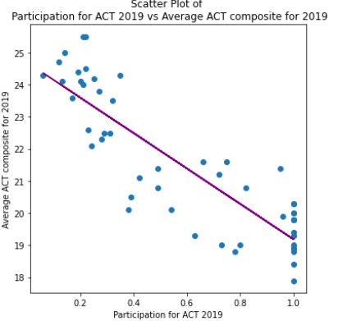
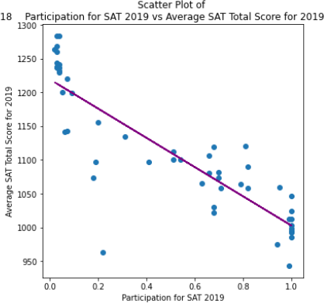
Comparing participation and scores
The lower the participation,
the higher the average test score
The lower the participation,
the higher the average test score
For 2019, comparing the respective ACT and SAT scores of Delaware, Michigan and Rhode Island with the help from the SAT-ACT conversion table. It is found that the trend is true.
For 2019, comparing the respective ACT and SAT scores of Kentucky, Nebraska and Wisconsin with the help from the SAT-ACT conversion table. It is found that the trend is true.

Slide 8
Summary and recommendation
Key Observations:
Around 50% of states with low participation percentage for ACT and SAT
Test results skewed towards higher score for lower participation
Results are not representative of the state’s performance
Recommendation:
Standardised test results (ACT & SAT) should not be included as the measures for the ranking of the best States for education.

Slide 9
Thank you!
Have a great day ahead :)

