Slide 1
Galaxy Project
Web-based bioinformatics framework

Slide 2
What is Galaxy?
Web based bioinformatics framework
Tutorials and documentation readily available at usegalaxy.org
A good great place to get started
https://usegalaxy.org/u/aun1/p/galaxy101

Slide 3
Why use galaxy?
Science should be:
Repeatable
“Can I do that again?”
Reproducible
“Can I achieve similar results?”
Reliable
“Will it work next week?”

Slide 4
It handles these requirements nicely
Repeatable
Galaxy allows us to re-run data analyses as many times as we would like.
We may also share our data and workflows with other users who can repeat our analyses.
Reproducible
Abstract the process from the input, so you can re-use your working analytical workflow on new data sets.
This is a common computational model used in computer science and mathematics, and a powerful tool for us biologists as well! ☺

Slide 5
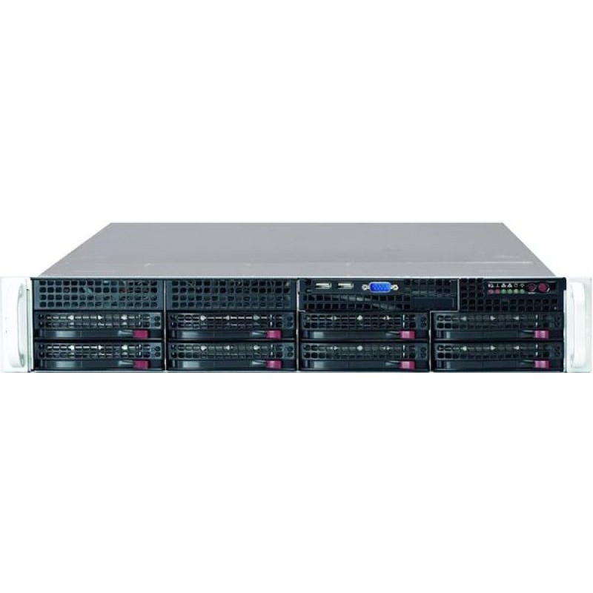
(continued)
Reliable
Behold the power of a fully operational, Turing complete, Von Neumann machine!
Chromosome is backed up, and runs in a data center
Future plans include database exports for increased data protection

Slide 6
Galaxy is the chromosome server
Sort of…
Data sets uploaded to Galaxy get stored in a database on chromosome
Bioinformatics software called by Galaxy is installed locally on chromosome

Slide 7
Stop showing me slides!
And show me Galaxy in action already!
Let’s walkthrough the functionality and examine some sample analyses.
http://chromosome.med.harvard.edu:8080

Slide 8
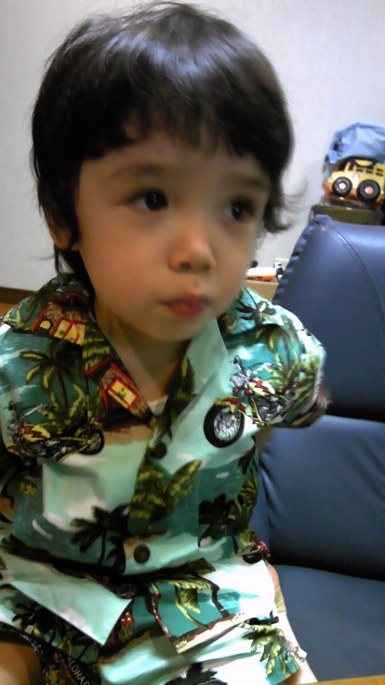

Questions? Comments?
My two associates here will be happy to answer any questions. (As long as you email before nap time!)

Slide 9
完
daniel.john.shea@gmail.com

