Slide 1
Galaxy Introduction and tutorial
Harvard Medical School Moazed Lab

Slide 2
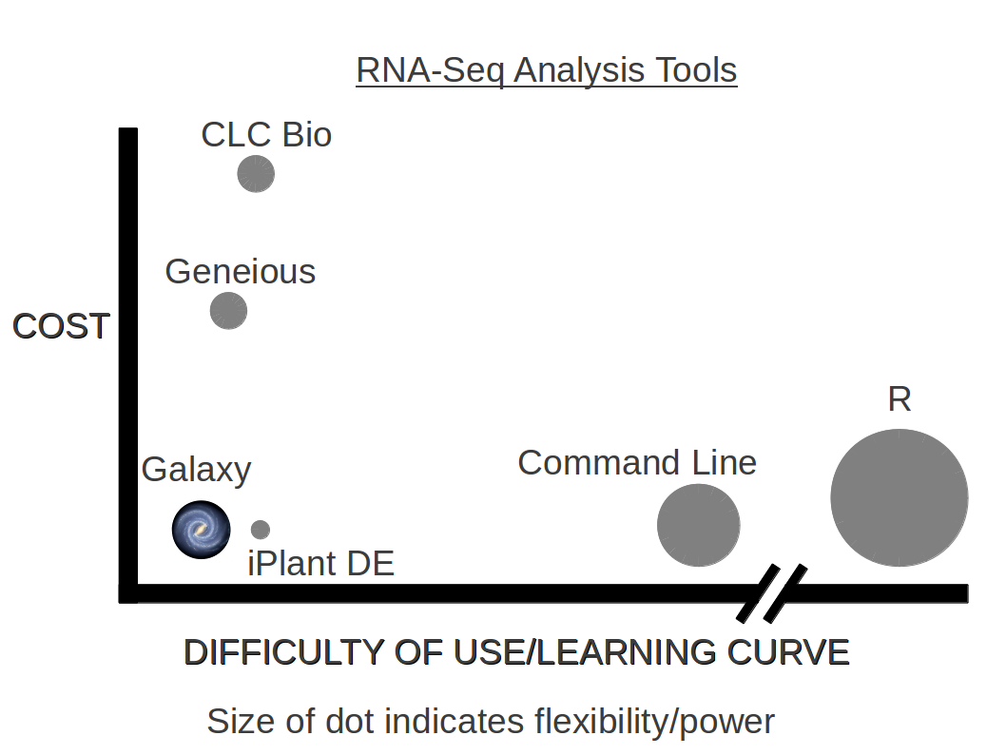
Introduction
Galaxy is a free, easy to use resource for bioinformatics analysis.
It is not as flexible as other systems, but is a good starting point for the average biologist with a minimal learning curve compared to other methodologies.
Notes:
Beginning course details and/or books/materials needed for a class/project.

Slide 3
The Galaxy interface
Point your web browser to
http://chromosome:8080
There are three main panes in the interface.
The left pane is the list of software tools you can use.
The middle pane is used to launch software and view contents of files.
The right pane is a history of your commands and results.
Notes:
Introductory notes.

Slide 4
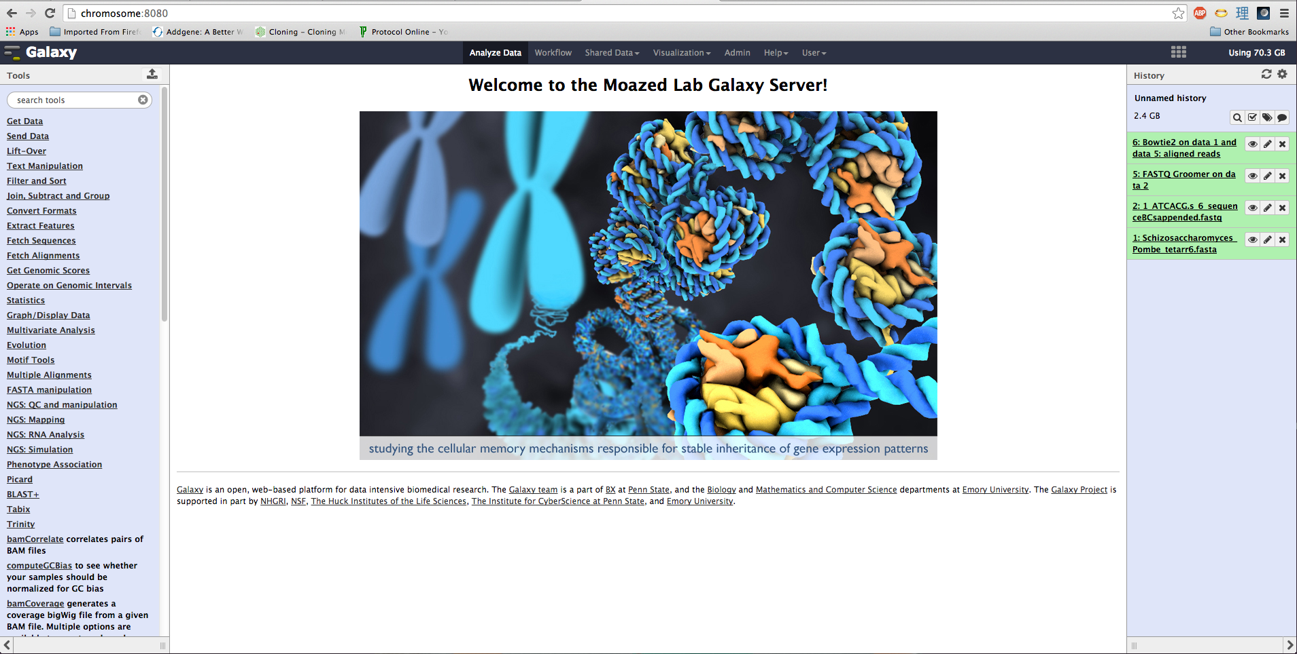
Example of the interface
Notes:
Objectives for instruction and expected results and/or skills developed from learning.

Slide 5
Getting data into Galaxy
Files can be uploaded into Galaxy by selecting Get Data in the left pane and then choosing Upload File
Large, re-useable data sets can be uploaded to the shared Data Library. Speak with Cary or Dan to have files stored in the shared Data Library.
Files in the Data Library can be imported into your Work History by selecting Shared Data and then Data Libraries. You will then be able to select files you wish to import into your work history.
Notes:
Relative vocabulary list.

Slide 6
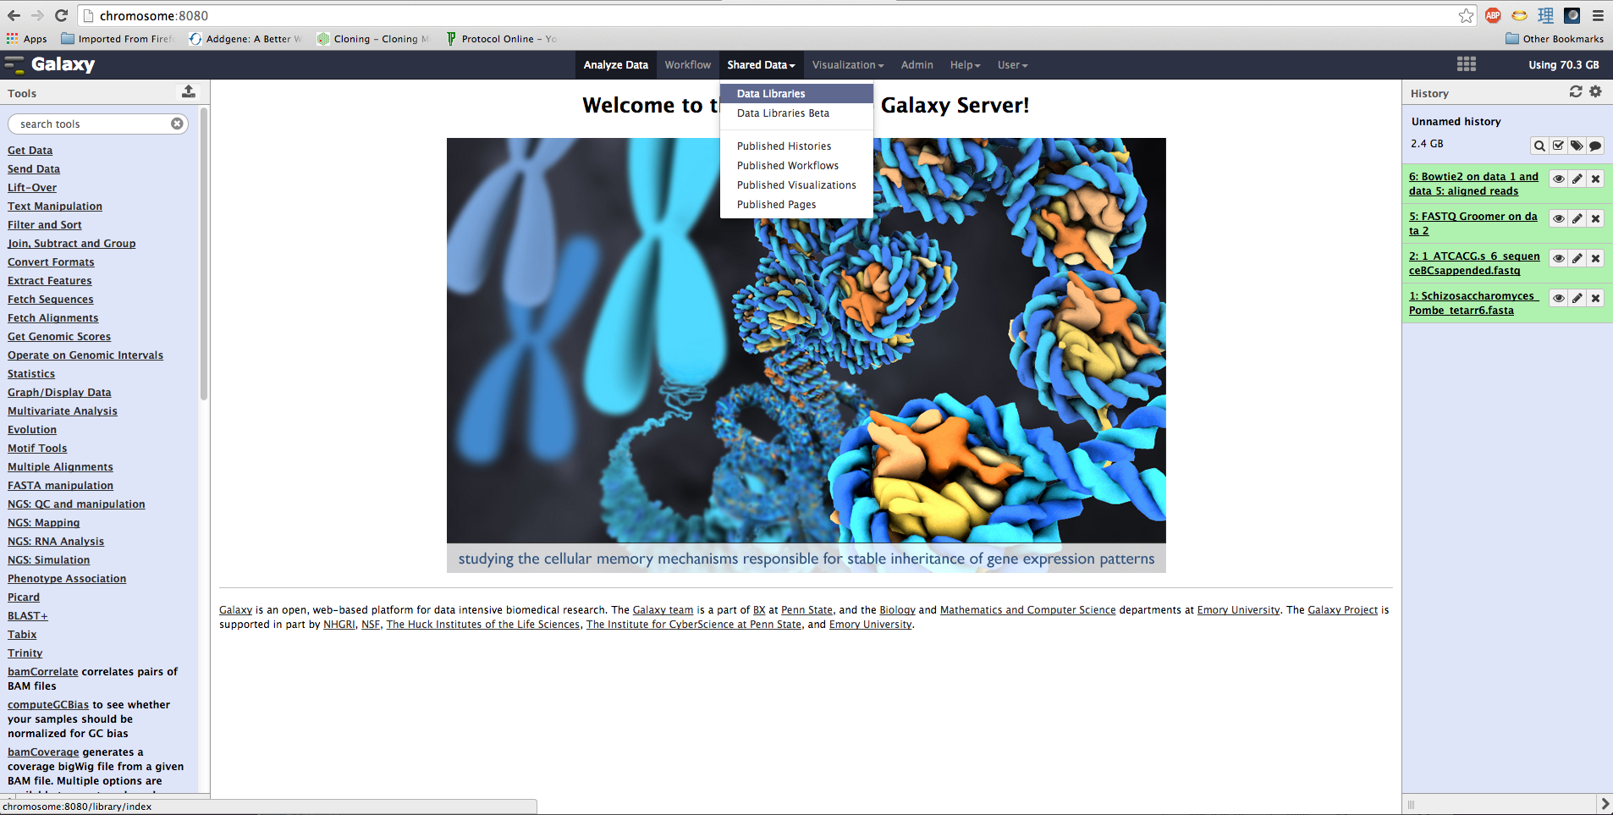
Data Libraries
Notes:
A list of procedures and steps, or a lecture slide with media.

Slide 7
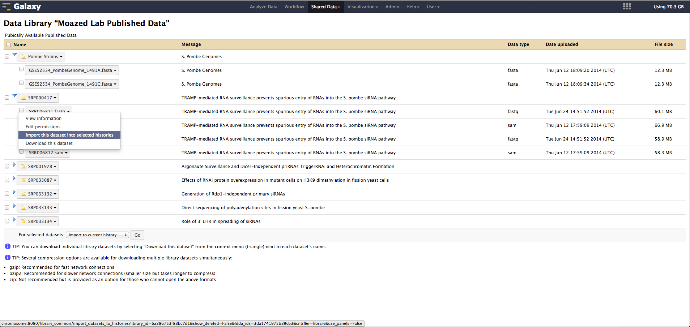
Data Libraries
Notes:
A list of procedures and steps, or a lecture slide with media.

Slide 8
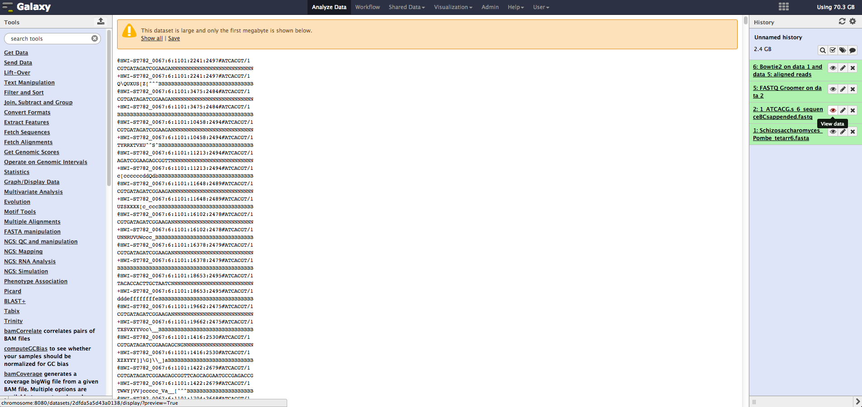
The eye icon may be used to examine the contents of data
Notes:
Example graph/chart.

Slide 9
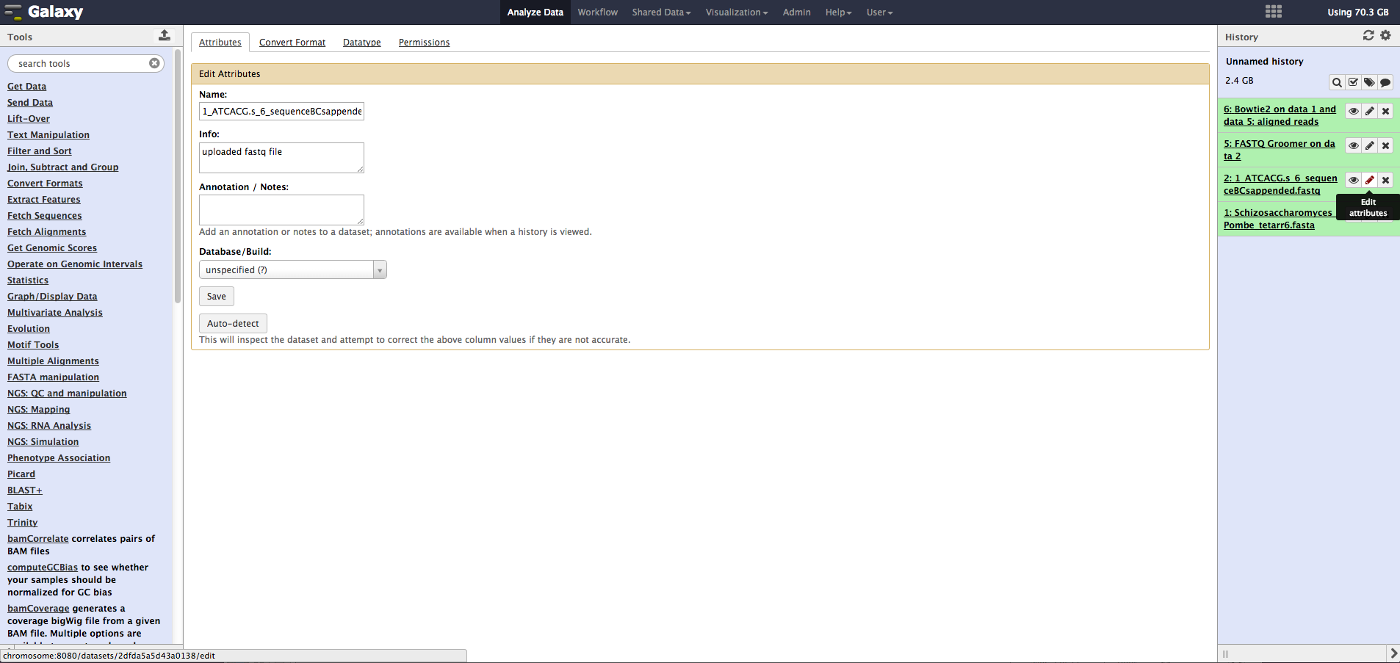
The pencil icon can be used to edit attributes associated with the data
Notes:
Example graph/chart.

Slide 10
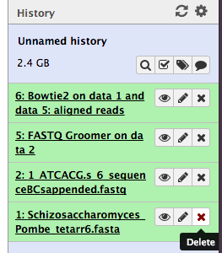
The “X” icon will delete data from your work history
Notes:
Conclusion to course, lecture, et al.

Slide 11
Quick walkthrough of data analysis
The next few slides will walk you through performing a DNA-seq mapping in Galaxy.
From there, you can export your analysis to visualize the data in IGV.
Let’s get started!

Slide 12
Galaxy bowtie tutorial
This short tutorial will illustrate how to run bowtie within Galaxy for mapping DNA-Seq reads against a reference genome and how to construct a workflow from the finished analysis.

Slide 13
Importing the data from the Data Library
The data required has been supplied in a Data Library entitled “Galaxy Tutorial Data Sets”
Once you have logged in you can select “Shared Data” → “Data Libraries” from the top menu in the middle pane of the interface.

Slide 14
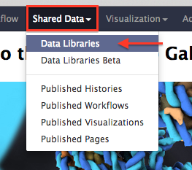
Navigating to a Data Library

Slide 15
Data Libraries
Here you will be presented with a list of the available data libraries.
Select the “Galaxy Tutorial Data Sets” library

Slide 16
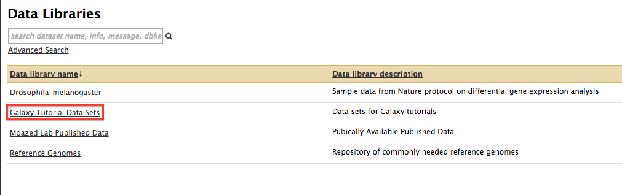
Available Data Libraries

Slide 17
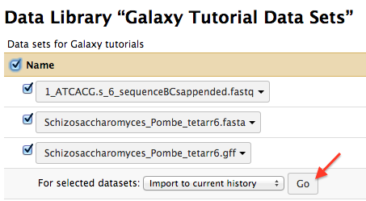
Importing the data to your history

Slide 18
Grooming FASTQ data
Sequence data has quality scores associated with reads contained in the FASTQ file.
We will need to use the data groomer to convert the scores into values that Galaxy can utilize to further process our data.
If you type “groomer” into the search tools textbox in the left pane, you can narrow down the tools available to find the appropriate tool needed.

Slide 19
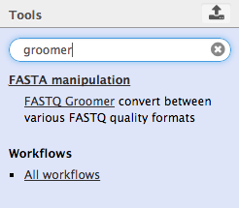
The FASTQ Groomer

Slide 20
Using the groomer
Selecting the groomer will bring up a dialog in the center pane. Galaxy will try to fill in as many values as it can based on the contents of your history.
The next screenshot illustrates this behavior.

Slide 21
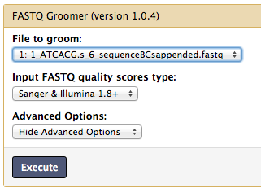
FASTQ Groomer Dialog

Slide 22
Running the groomer
The groomer has pre-populated the fields we require to begin, so we can select the execute button.
The history will be populated with a new entry detailing the status of our run.
Gray with a little stop watch means the job has been queued for execution
Yellow means the job is currently running
Green indicates successful completion
Red indicates there was a problem with the execution of the task

Slide 23

Newly added and running FASTQ Groomer task

Slide 24
Running Bowtie to align reads
While the groomer is executing, we can start to stage the next step of the analysis.
Typing bowtie into the tools search box will allow us to select bowtie2 and begin the edit the bowtie run dialog box

Slide 25
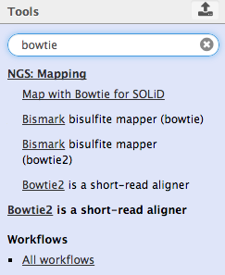
Search results for bowtie

Slide 26
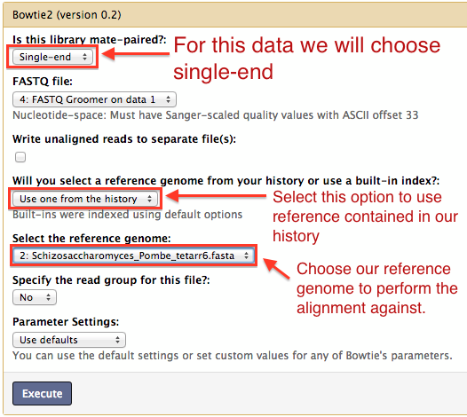
Bowtie2 dialog

Slide 27
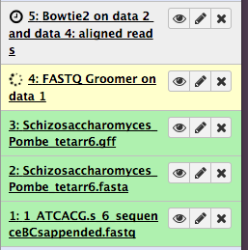
Queuing bowtie to run when groomer completes

Slide 28
Retrieving the data for further analysis
Once the alignment completes, you will have an entry in your history that contains the BAM file and the BAI (BAM Index) file.
You can download these for use in IGV or other downstream visualization tools by selecting the floppy disk icon.

Slide 29
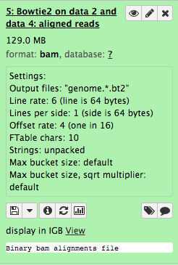
Results

Slide 30
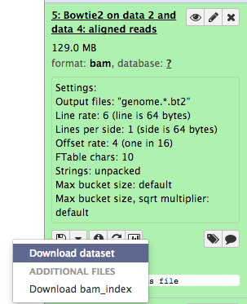
Download dataset and index options

Slide 31
Creating a re-usable workflow
Now that we have performed an alignment, we might like to run the same alignment again on new data sets.
One way to accomplish this, is to create a workflow based on our analysis
Let’s walk through creating a workflow from our current analysis for later use

Slide 32
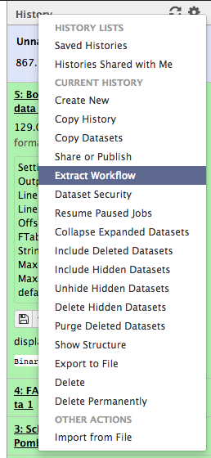
Extracting the workflow
To extract the workflow, click the gear icon in the history pane and select extract workflow

Slide 33
Edit the workflow
The center pane will show the current workflow based upon your history.
Choose a name for your workflow and select the “Create Workflow” button.

Slide 34
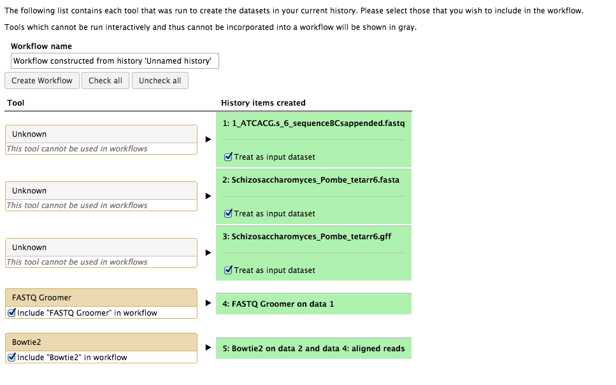

Workflow creation dialog

Slide 35
Visualization tool for workflow
Now that we’ve created a workflow, we can edit it in the visual editing tool if we need to tweak it or make changes.
You can select edit from the dialog that appears when you first save the workflow
Or you can navigate to the workflow by selecting “Workflow” from the top menu bar. Select the workflow you want and choose Edit from the drop down menu that is presented.

Slide 36
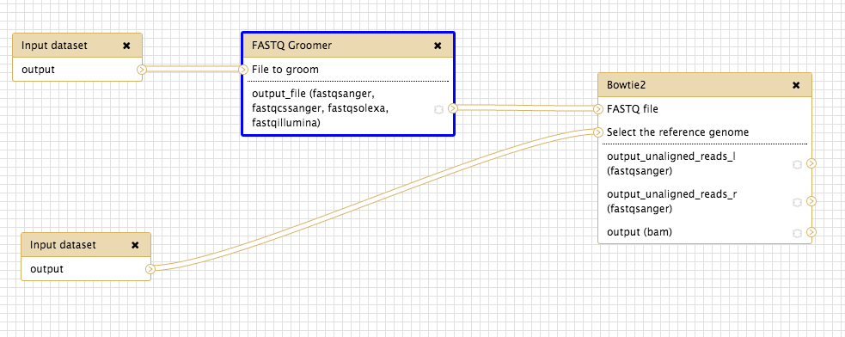
Visual workflow editor

Slide 37
More on the workflow editor
Tools, inputs and intermediate outputs to be passed as inputs to the next tool in a pipeline are all displayed as boxes
Boxes have nodes associated with them labeled as inputs on the left side, and outputs on the right.
We can now run this workflow multiple times.
Let’s create a new history and try running the workflow on the tutorial inputs again to illustrate how this can be useful.

Slide 38
Running a workflow
To get back to our history, choose “Analyze Data” from the top menu.
Select the gear on the right pane History menu, and choose “Create New”
Import the fastq and reference genome file again from the Data Library

Slide 39
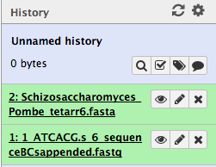
Your new history with data imported

Slide 40
Run the workflow
Now select workflow from the top menu.
Choose the workflow you created earlier and select “Run” from the dropdown menu presented.
You will now have a dialog in the center pane based on your current working history as it relates to the workflow. Galaxy tries to figure out what files should be inputs into the workflow.
Clicking on the individual steps will show the parameters associated with the step, based on the definitions of the workflow.

Slide 41
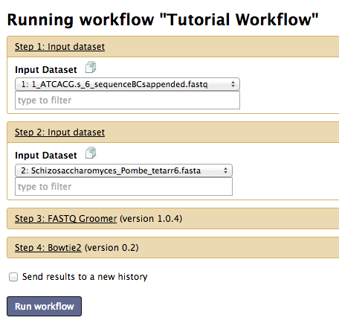
Running workflow dialog

Slide 42
More on workflow execution
If the inputs look correct and the options are as you would like them to be, you can click the “Run workflow” button.
The workflow will begin execution.
Go have a nice cup of coffee while the computer does all the work! ☺
When you return, your results will be in the current workflow history

Slide 43
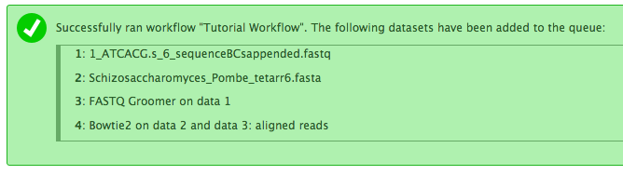
Successful workflow run message

Slide 44
More tutorials and resources
I am but a humble document, covering the very basics of Galaxy.
For more information and tutorials on how to run more complex analyses, please check out the following references:
https://usegalaxy.org/u/aun1/p/galaxy101
https://usegalaxy.org/page/list_published

Slide 45
Resources, where to get help
There are also webcasts and videos detailing how to interact with Galaxy. Look for them here on vimeo:
http://vimeo.com/channels/usegalaxy
If you need assistance, the biostar galaxy forums is the place to go. The Galaxy development team runs these forums.
https://biostar.usegalaxy.org/

Slide 46


