Slide 1
Cricket Match and Score Prediction for One day Internationals
Final Project Review Presentation
By
G Sreenivaasan
CED14I008
Under the Guidance of
Dr.B.SivaSelvan

Slide 2
Motivation for the Project
India is a cricket crazy nation, where people are often found predicting the outcomes of a match whether its IPL, World Cup or bilateral series. But these predictions are based mostly on intuition and emotions.
Betting industry has grown manifold, with cricket being a major part of it. Betting sites have become common platform for bookies and punters. Predicting the outcomes of sporting events based on a computer driven process will benefit both.

Slide 3
Some Interesting Facts.
Cricket has over one billion fans globally, with the Indian sub-continent alone constituting more than 90 percent of them .
The illegal betting market in India is worth $150 billion (Rs 9.9 lakh crore) a year. That includes $200 million bet on every one-day international played by the Indian cricket team.
FICCI has been advocating legalising betting in sports in India on the ground that the government can earn Rs 12,000 crore to Rs 19,000 crore from it every year.

Slide 4
Major Goals of the Project
To predict the results of the cricket match by taking factors like teams playing,venue ,team composition, the batting and bowling averages of the each player in the team,Overall Batting and Bowling Strength of the Team.
Prediction of Cricket Score by taking factors like number of wickets fallen, Number of balls left,On how much scores are the current batsman batting,How much the team had scored in last 5
overs,How much the team had lost wickets in last 5 overs.

Slide 5
Literature Survey
According to [1]
Winning an ODI cricket match depends on various factors related to scoring as well as physical strength of the two teams.factors include home game advantage, day / night effect, winning the toss and batting first.
A software tool called CricAI was developed. This tool outputs the probability of victory in an ODI cricket match using input factors such as home game advantage available at the beginning of the match.
According to [2]
In this paper a model has been proposed that has two methods, first predicts the score of first innings not only on the basis of current run rate but also considers number of wickets fallen, venue of the match and batting team.
The second method predicts the outcome of the match in the second innings considering the same attributes as of the former method along with the target given to the batting team.
Pitch conditions, weather condition, boundary size, the average team scores, opponent bowler’s performance and ground average score are the essential Factors considered.

Slide 6
References for Literature review
[1] A.. Kaluarachchiand and S. Aparna, “Cricai: A classification based tool to predict the outcome in odi cricket,”Fifth International Conference on Information and Automation for Sustainability, 2010.
[2] . Brooker and S. Hogan, “Winning and score predicting (wasp),”International Conference on Recent Innovations in Science, Engineering Technology, 2017

Slide 7
Dataset
Cricinfo is a very popular site for getting cricket related information. It contains statistics of all the matches year wise. To create data sets ,data was crawled from cricinfo website.First crawled URLs of all the matches which were played in the time-span of 1990-2019.
Dataset has the Following Columns: Team-1,Team-2,Stadium Name,Date,Toss-winner (1,2),First-Batting (1,2),Match-winner (1,2),Players from Team -1,Players from Team-2.Here (1,2) in toss-winner ,First-Batting,Match-winner denotes ’1’ for Team-1 and ’2’ for Team-2.
Beautiful Soup is a Python library for extracting data out of HTML and XML files very easily.Beautiful Soup was used to extract required data from each of ODI match’s URL.

Slide 8
Feature Generation
To find the overall strength of the team we use ICC ODI batting and Bowling Rankings. From the match date we get the list of Top 100 batsmen,bowler on the match and we then replace the player name with Bowling and Batting Rank
If the Player name is not present in the rankings then we give a default ranking 101.The intuition behind this rule is that if a player is not present in top 100 batting or bowling ranking table then he is not likely to affect the result of a match,also often it is the case that good batsman is not a good bowler and vice versa
For extracting player ranking we used ICC Men’s ODI Cricket Ranking [18] as source.Beautiful Soup was used to extract required data from each of ICC Rankings.

Slide 9
ICC Rankings
ICC Rankings are the point-based ranking system used by International Cricket Council to rate the Cricket Players and Teams.Players are rated with points between 0-1000.Players with more than 900 points are supreme achievements in Cricket.And 750 plus is what requires to a player to usually rank in the top 10.
ICC updates the Rankings after every Test match and after every ODI Series.
If a player retires from a format, he will be immediately removed from the ICC Rankings. Still, the same player will continue to be in the other formats, if he plays in the format.

Slide 10
ICC Batsmen Rankings-Calculation
Factors considered for Ranking:
Runs scored.
Ratings of the opposing bowling attack, the higher the combined ratings of the attack, the more value is given to the batsman’s innings.
The level of run-scoring in the match, and the team’s innings total, an innings of 100 runs in a match where the team scored >300 is worth less than 100 runs in a match where the team scored <200.
Out or not out (a not out innings receives a bonus).
The result. Batsmen who score highly in victories receive a bonus. That bonus will be higher for highly rated opposition teams.

Slide 11
Final Dataset and Features
To find the Overall Batting Strength,Bowling strength :Each ranking is subtracted from 101.And all the subtracted values are added up to the overall batting and bowling strength.
Intuition behind subtracting each rank from 101 is to nullify the contribution of each player having rank greater than 100.Assuming that any player not present in say top 100 bowler list is actually a batsman and does not bowl and vice versa.
Dataset has the Following Columns: Team-1,Team-2,Stadium Name,Toss-winner ,First-Batting ,Match-winner,Overall Batting Ranking,Bowling Ranking.

Slide 12
Model Building
Predicting the Outcome of the Match is a classification problem with 2 classes. 1)win 2)lose.
Supervised learning is used with won column being the label.
Following are the Machine Learning Techniques which was used:
Decision Tree
K-Neighbour Classifier
Logistic Regression Classifier
Naive Bayes Classification
75 Percentage of the data is used for training and the 25 Percentage of the data is used for testing. The splitting of the data is been done in order to find out the accuracy of the algorithm.

Slide 13
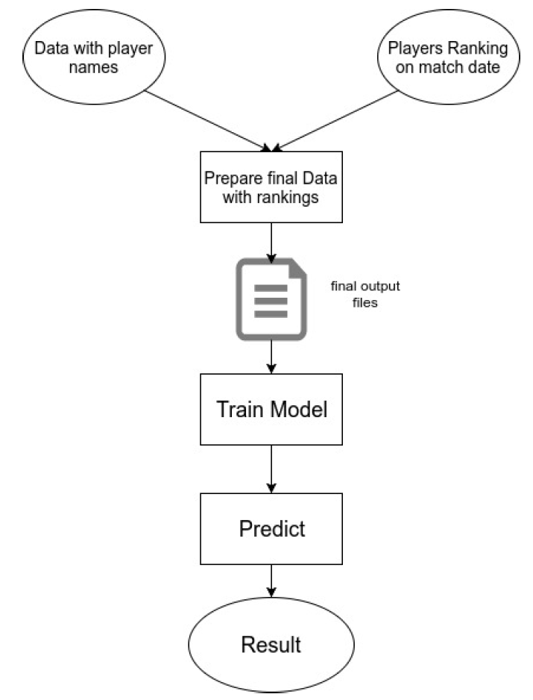
WorkFlow for Match Prediction

Slide 14
Accuracy of Match Prediction Model
[1] V. P. Madan Gopal Jhawar, “Predicting the outcome of odi cricket matches: A team composition based approach,”ECML-PKDD, 2016.
[2] Geddam Jaishankar Harshit,Rajkumar S”Cricket Predictions Using Various Machine Learning Algorithms”IJRASET,2015
Techniques | Accuracy of my model | Accuracy of [1] | Accuracy of [2]
Decision Tree | 0.64 | 0.62 | 0.59
KNN Classifier | 0.62 | 0.59
Logistic Regression Classifier | 0.73 | 0.68 | 0.63
Bayes Classification | 0.69 | - | 0.61

Slide 15
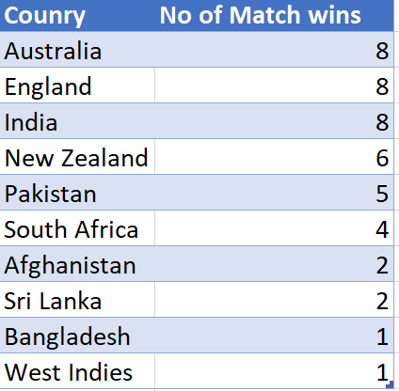
Match Prediction for World Cup 2019

Slide 16
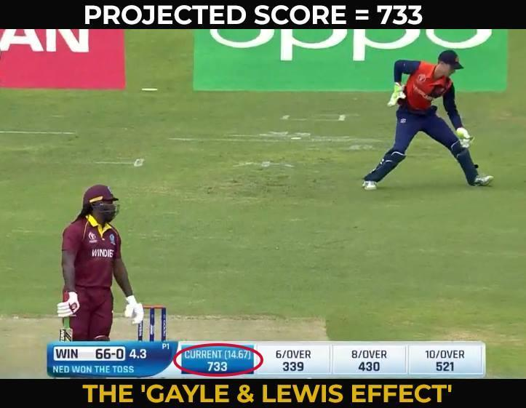
Score Prediction
Currently Run rate is defined as the amount of runs scored per the number of overs bowled. However, run rate is considered as the only criteria for calculating the final score.But there are other factors too which may affect the final score like wickets,runs,batsmen,overs,etc.

Slide 17
Dataset
Cricsheet [20] was used to get ball by ball details of matches.It had the data in YAML format which was then converted to CSV format
Data consisted of the Following details:
Mid: Each match is given a unique number
Date
Stadium Name
bat-team: Batting team name
bowl-team: Bowling team name
batsman: Batsman name who faced that ball
bowler: Bowler who bowled that ball
runs: Total runs scored by team at that instance
wickets: Total wickets fallen at that instance
overs: Total overs bowled at that instance
runs-last-5: Total runs scored in last 5 overs
wickets-last-5: Total wickets that fell in last 5 overs
striker: max(runs scored by striker, runs scored by non-striker)
non-striker: min(runs scored by striker, runs scored by non-striker)
total: Total runs scored by batting team after first innings

Slide 18
Feature Selection and Model Building
Features Used:
runs:Total runs scored by team at that instance
wickets:Total wickets fallen at that instance
overs:Total overs bowled at that instance
striker:max(runs scored by striker, runs scored by non-striker)
non-striker:min(runs scored by striker, runs scored by non-striker)
Since the O/p will be a number(score) Following Algorithms will be used to Predict the Score:
1)Simple Linear Regression 2)Random Forest Regression

Slide 19
Accuracy of Score Prediction Model
S. Kumar and S. Roy, “Score prediction and player classification model in the game of cricket using machine learning,”INTERNATIONAL JOURNAL OF SCIENTIFIC ENGINEERING RESEARCH,2018
Techniques | Accuracy of my model | Accuracy of [1]
Linear Regression | 0.65 | 0.62
Random Forest Regression | 0.79 | -

Slide 20
Future Work
To build a Recommendation model which will assist the team management,Captain,Coach for the Selection of the team considering factors like Venue,opponent, Player Statistics ,Tournament.
To build a User Interface Tool which will Display all the results of the Prediction of any cricket ODI match given the I/p’s as team,Opponent,Toss,Venue,Playing 11.
Extend the features like Weather condition, Nature of the pitch and improve the Accuracy of the existing Models.

Slide 21
THANK
YOU

Slide 22
How did my Internship work help me for project?
Internship was done at PayPal,Chennai,part of Post Transaction Disputes team
Our team main focus improving the customer experience in the dispute phase,Automation of Disputes ,Loss Savings.
As a part of Disputes Automation a data scraping script was made to find out the cases where the merchandise was return back to seller and these cases PayPal would not protect the seller.

