Slide 1


Trends Marketplace | Daniel Smetana | smeta018@umn.edu

Slide 2
Introduction
Python Data visualization library
Efficient resource for creating stunning graphics
Extremely customizable
Built-in functionality to work with pandas data
Tools to quickly add interactive components to graphics
Javascript connectivity
Html output
Easily embedded into web pages and apps

Slide 3
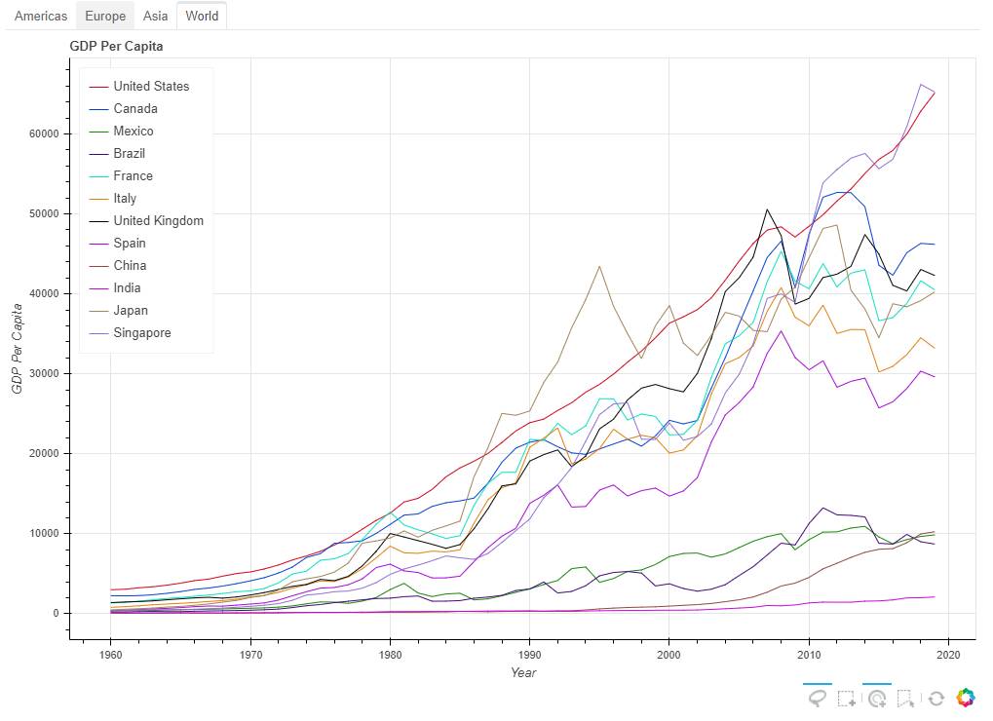
GDP Per Capita Example
link

Slide 4
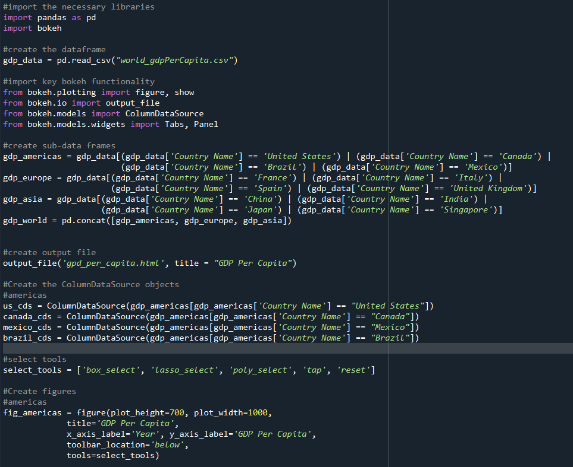
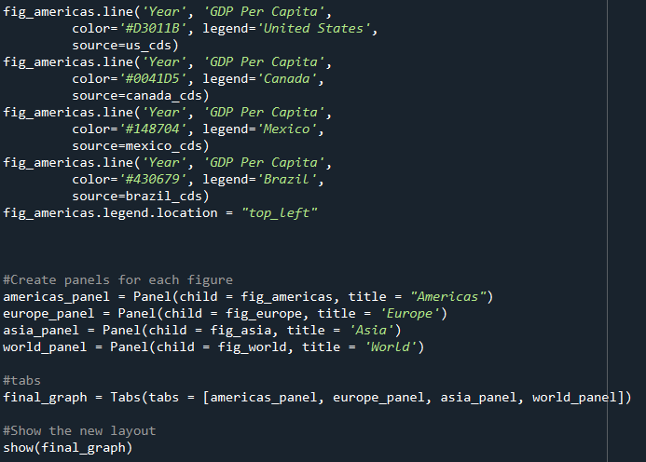

Slide 5
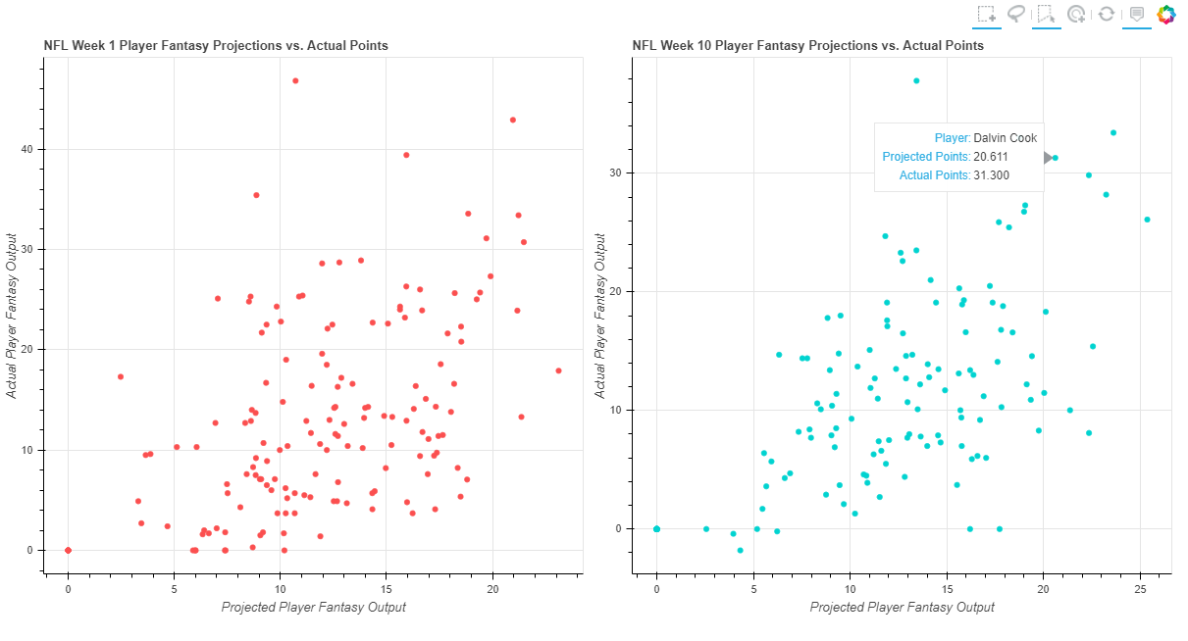
Fantasy Football Projections Example
link

Slide 6
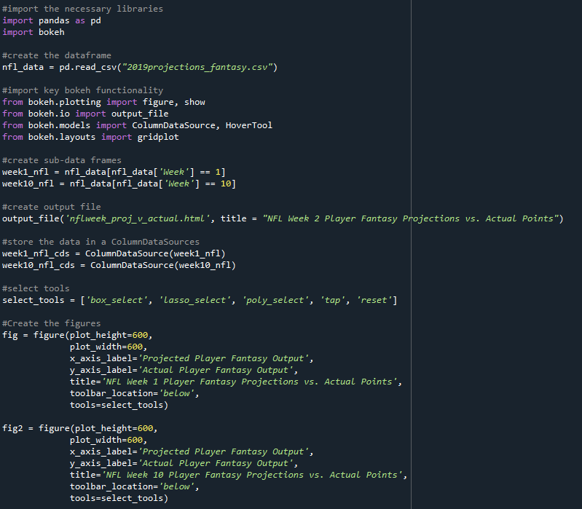
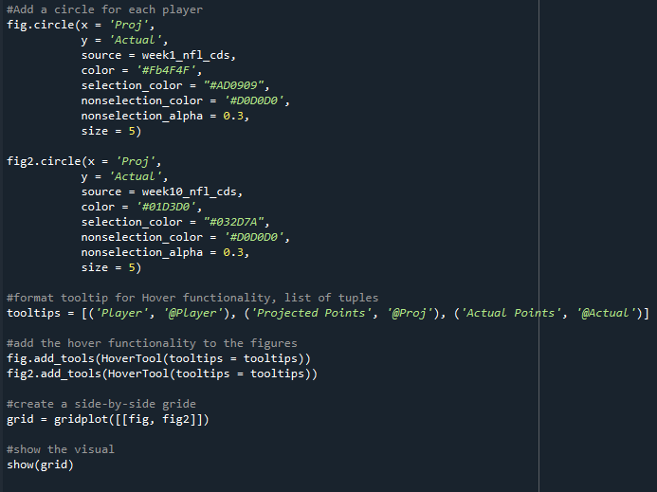

Slide 7
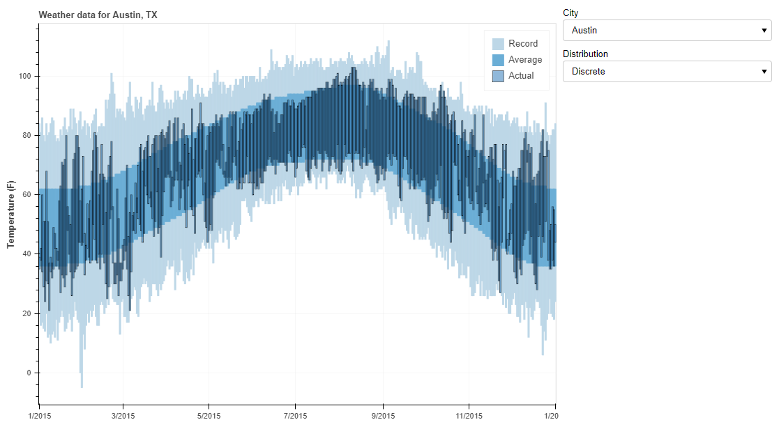
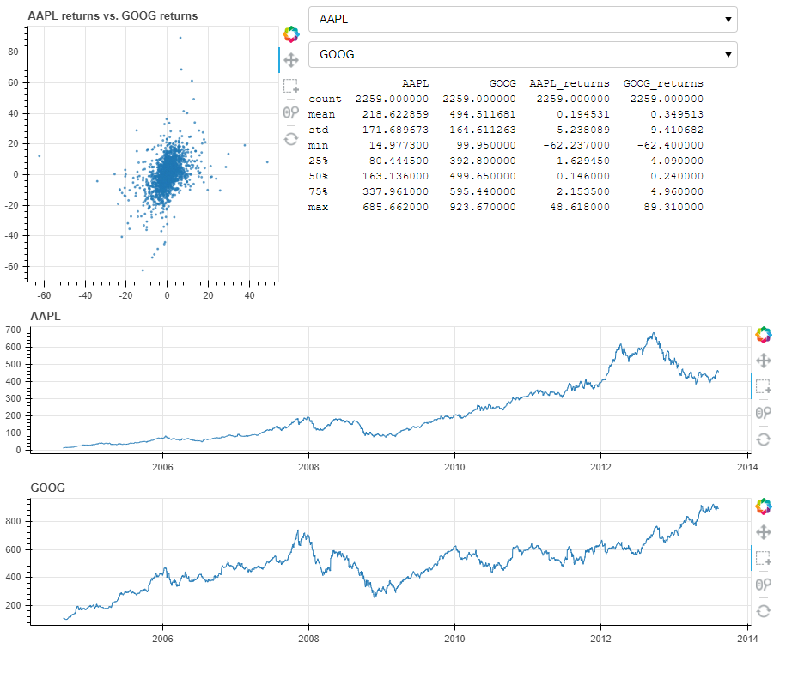
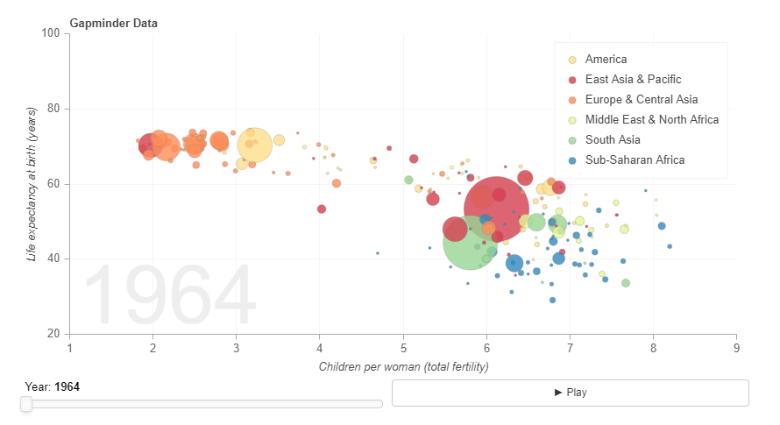

Slide 8
Appendix
Bokeh Documentation – https://docs.bokeh.org/en/latest/docs/user_guide/quickstart.html
Bokeh Gallery of Visuals – https://docs.bokeh.org/en/latest/docs/gallery.html#gallery
“Real Python”, Interactive Data Visualization in Python with Bokeh – https://realpython.com/python-data-visualization-bokeh/
NFL Data - https://www.fantasyfootballdatapros.com/csv_files
GDP Data - https://data.worldbank.org/indicator/NY.GDP.PCAP.CD

