Slide 1
Species Present
37230 Species Presences
34 Species
  13 Aedes
  10 Culex
  8 Anopheles
  3 Other
Resolve taxonomic oddities (s.s. and s.l.)

Slide 4
Grid Size
Move forward with 2km, 5km and 10km grids
Determine spatial autocorrelation
  Compare point correlation to gridded correlation
  Dealing with large memory issues at the moment
Data “padded” simplistically. If not recorded then assumed to be absent.

Slide 5
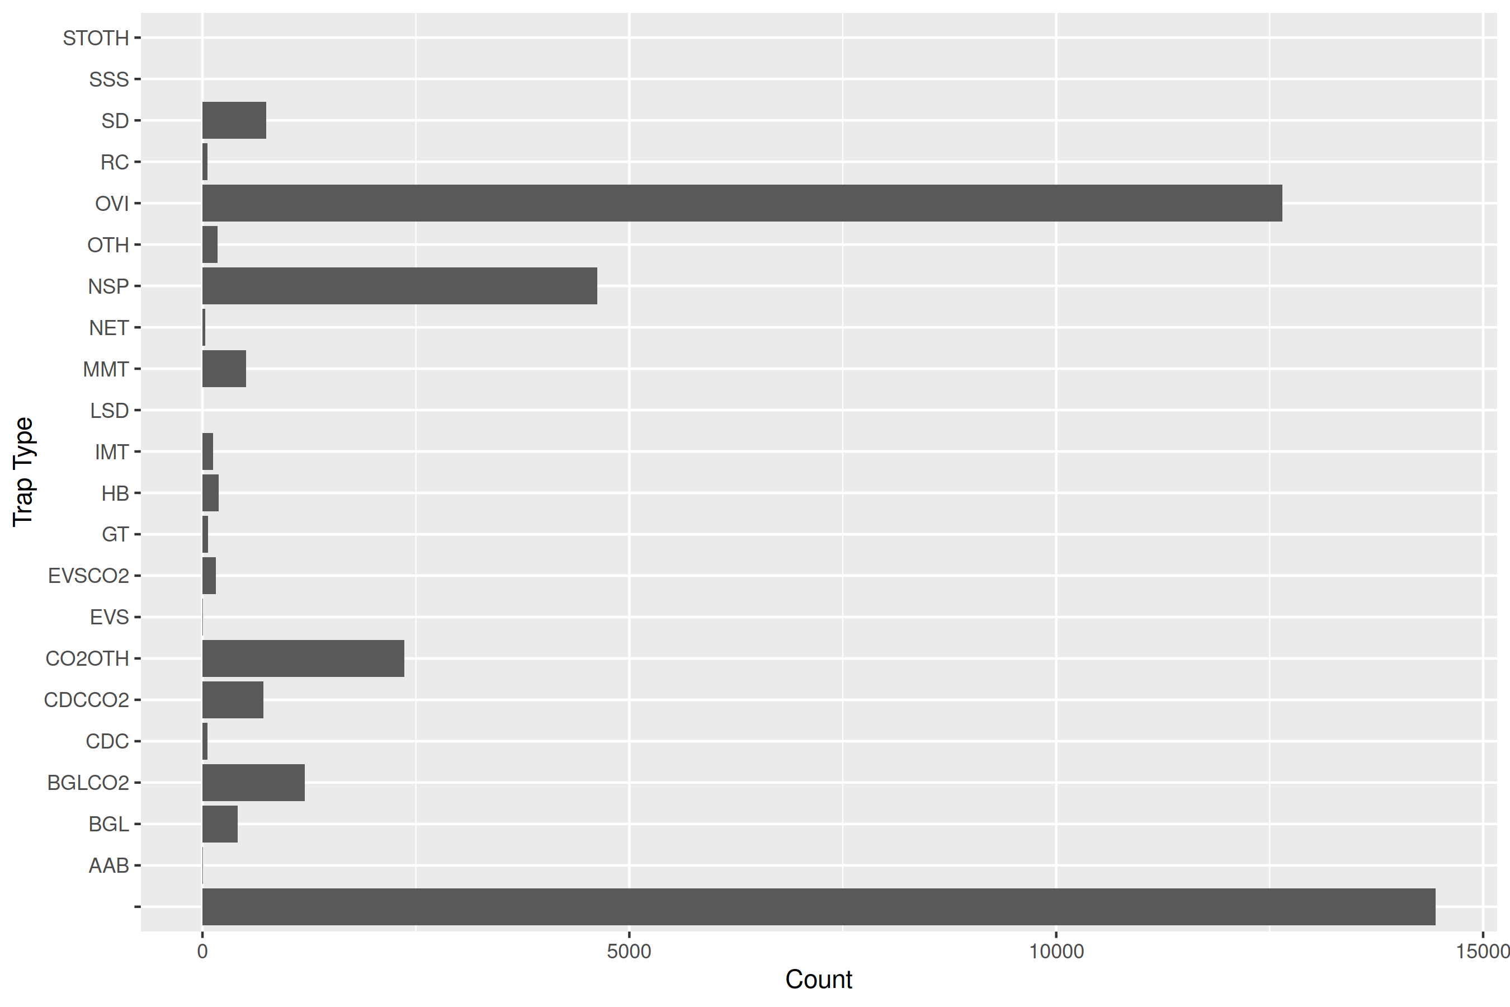

Slide 6
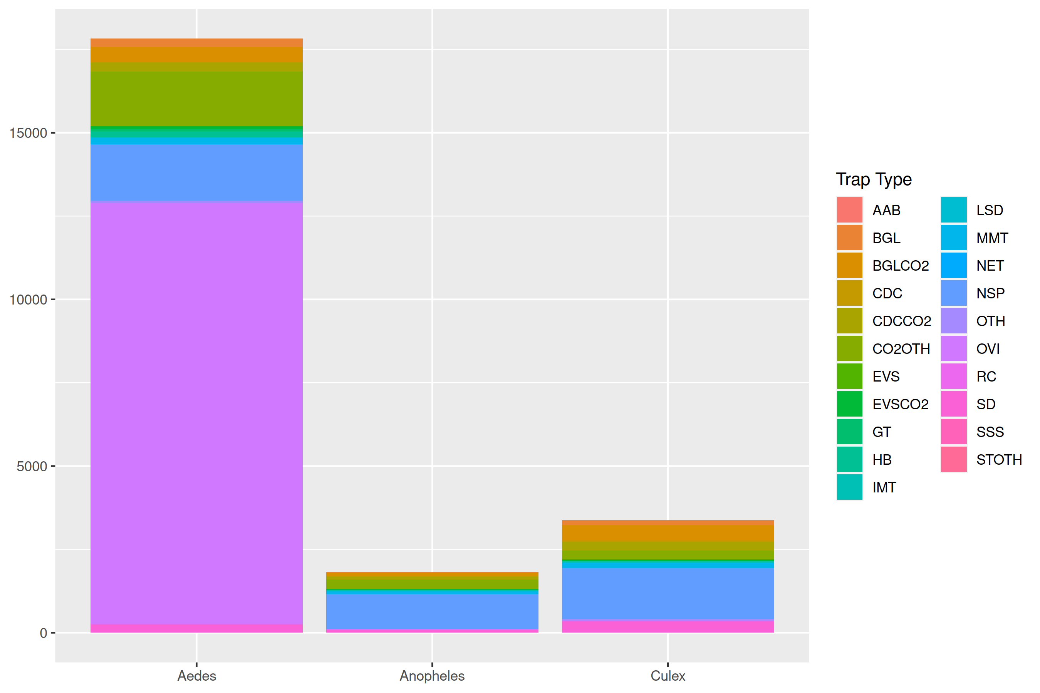

Slide 7
