Slide 1
Wumpus World DeepQ Learning
3547 - Intelligent Agent and Reinforcement Learning
University of Toronto - SCS
Fall 2020
By:
Daniel Stanhope
Daniel Loyd
Karan Teckwani

Slide 2
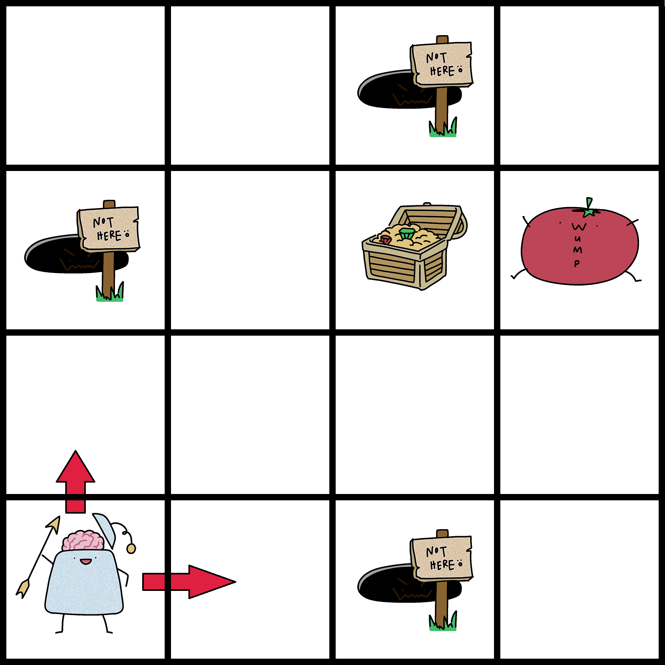
Objective
Agent goal is to find and grab the Gold and climb out of grid with Gold, while attempting to avoid being eaten by the Wumpus or falling into a Pit.
Using Deep Q-Learning
Learn how to move in the environment and
Explore the rooms randomly but safely
Exploration Problem: Find a sequence of actions that
leads to positive reward.
Learning Problem: Remember the sequence of
actions to take, and generalize to related but slightly
different situations.
Deep Learning with Neural Network

Slide 3



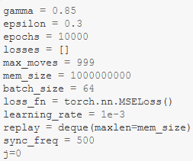
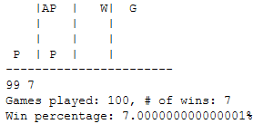
Overview: High Level Code Implementation
Setup Game with Orientation, Environment, Agent, DeepQ Agent and Actions
Model with linear layers and Adam as our optimizer.
Multiple Deep Q-Learning models trained with the various architecture and variety of parameters/hyper parameters.
Model is tested and verified multiple times with different metrics.
Winning rate with average score/Game and
Unwinnable (safe escape) games with average score/Game.
Model Training
Model Architecture
Model Hyper Parameters
Model Testing

Slide 4
Overview: Results and Analysis (1)
Different combination of the parameters and classes are applied and run
Adam, learning rate: 1e⁻³, batch size: 64, gamma: 0.85, epsilon: 0.3, memory size: 1e⁹, Sync frequency: 500 moves.
# | Model | Hyper Parameters | Test Win Rate | Avg Score / Game | Quit Rate (safe escape) | Avg Score / Game
1 | Input, 128, Output | epochs: 500, maxMoves = 250 | 2% | -957 | 84% | -112
2 |  | epochs: 500 | 2% | -1008 | 68% | -195
3 | Input, 512, 128, Output | epochs: 10K, maxMoves = 999 | 7% | -931 | 71% | -125
4 |  | epochs: 10K | 9% | -890 | 72% | -114
5 |  | epochs: 10K | 7% | -953 | 89% | -52
6 | Input, 512, 128, 128, Output | epochs: 10K, maxMoves = 250, memSize: 2K, batch: 128 | 0% | -1020 | 65% | -220
7 |  | epochs: 10K, maxMoves = 500, memSize: 1e⁹, batch: 64 | 8% | -930 | 51% | -350

Slide 5
Overview: Results and Analysis (2)
Different combination of the parameters and classes are applied and run
Adam, learning rate: 1e⁻³, batch size: 64, gamma: 0.85, epsilon: 0.3, memory size: 1e⁹, Sync frequency: 500 moves.
# | Model | Hyper Parameters | Test Win Rate | Avg Score / Game | Quit Rate (safe escape) | Avg Score / Game
8 | Input, 512, 128, 128, 128, Output | epochs: 10K, maxMoves = 999 | 5% | -955 | 78% | -112
9 |  | epochs: 10K, maxMoves = 250 | 8% | -900 | 75% | -166
10 | Input, 128, 256, 512, 512, 256, 128, Output | epochs: 500, maxMoves = 250 | 6% | -923 | 60% | -242
11 | Input, 512, 512, 256, 128, 64, 32, Output | epochs: 20K, maxMoves = 500, batch: 64 | 3% | -1019 | 95% | -21

Slide 6
Overview: Best Run
Model | Hyper Parameters | Test Win Rate | Avg Score / Game | Quit Rate (safe escape) | Avg Score / Game
Input, 512, 128, Output | epochs: 20K maxMoves = 999 Adam, Learning Rate: 1e⁻³, Batch: 64, Gamma: 0.85 Epsilon: 0.3 Memory Size: 1e⁹, Sync Frequency: 500 | 9% | -890 | 72% | -114

Slide 7
Summary
Reinforcement learning addresses how we can learn to survive in our environment
We used Q-Learning which simply learns from experience, No model of the world is needed.
We assumed stochastic dynamics, reward function which was the most challenging part.
Neural Network with Adam Optimization is used for implementing Deep Learning model from our Q-Learning Agent.
Different Models are implemented based on different parameters and functions and the results were analyzed for:
Win rate and Average scores/Game
Quit rate and Average scores/Game

Slide 8
Thank You
Questions ?

