Slide 1
CYWG (CyberInfrastructure Working Group)
October 2014
iDigBio Data Ingestion
Dan Stoner
Advanced Computing and Information Systems Laboratory (ACIS)
University of Florida
dstoner@acis.ufl.edu @thatlinuxbox

Slide 2

Over 300 Data Providers...

Slide 3


Slide 4
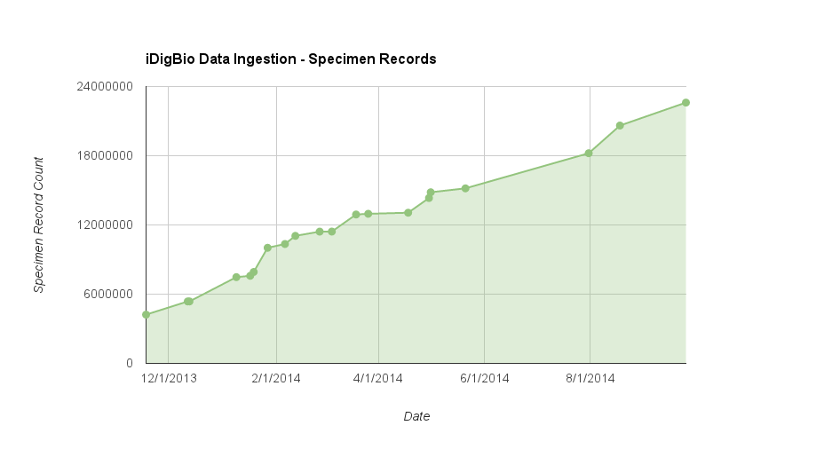

Slide 5
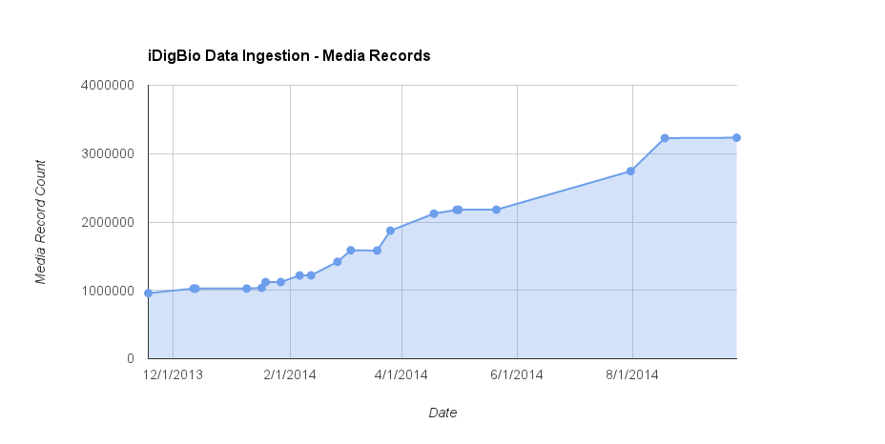

Slide 6
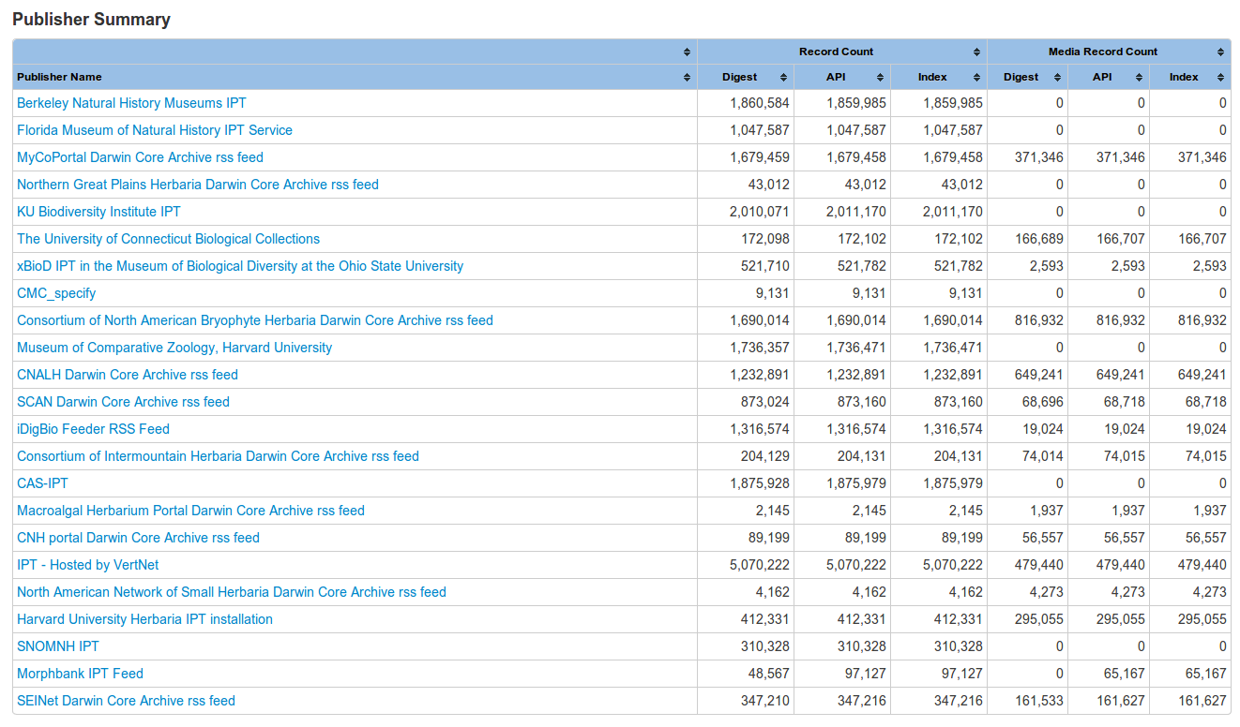
Ingestion Reporting

Slide 7
Three types of data publishing technologies currently being consumed:
GBIF Integrated Publishing Toolkit (IPT)
http://www.gbif.org/ipt
Symbiota – web-based collection management software
http://symbiota.org/
iDigBio Feeder – for providers who do not run infrastructure

Slide 8
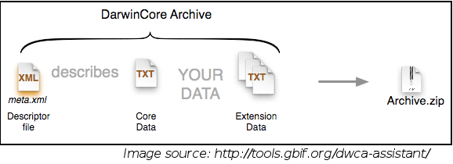
Darwin Core Archive / DwC-A
http://rs.tdwg.org/dwc/terms/guides/text/
A Darwin Core Archive is a zip file that includes both metadata about the dataset, the data itself, and any optional extension data.

Slide 9
Dataset formats
IPT – DwC-A
Symbiota portals – DwC-A
iDigBio Feeder – DwC-A, CSV, …

Slide 10
