Slide 1
CYWG (CyberInfrastructure Working Group)
October 2014
iDigBio Data Ingestion
Dan Stoner
Advanced Computing and Information Systems Laboratory (ACIS)
University of Florida
dstoner@acis.ufl.edu @thatlinuxbox

Slide 2

Over 300 Data Providers...

Slide 3


Slide 4
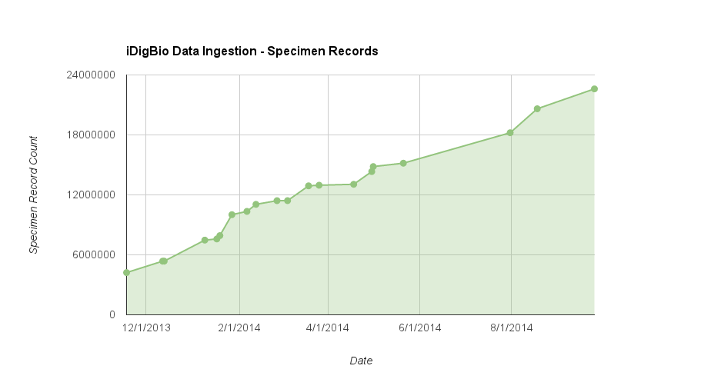

Slide 5
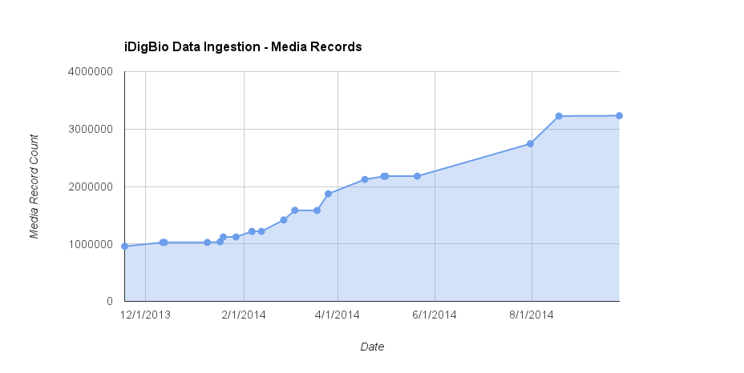

Slide 6
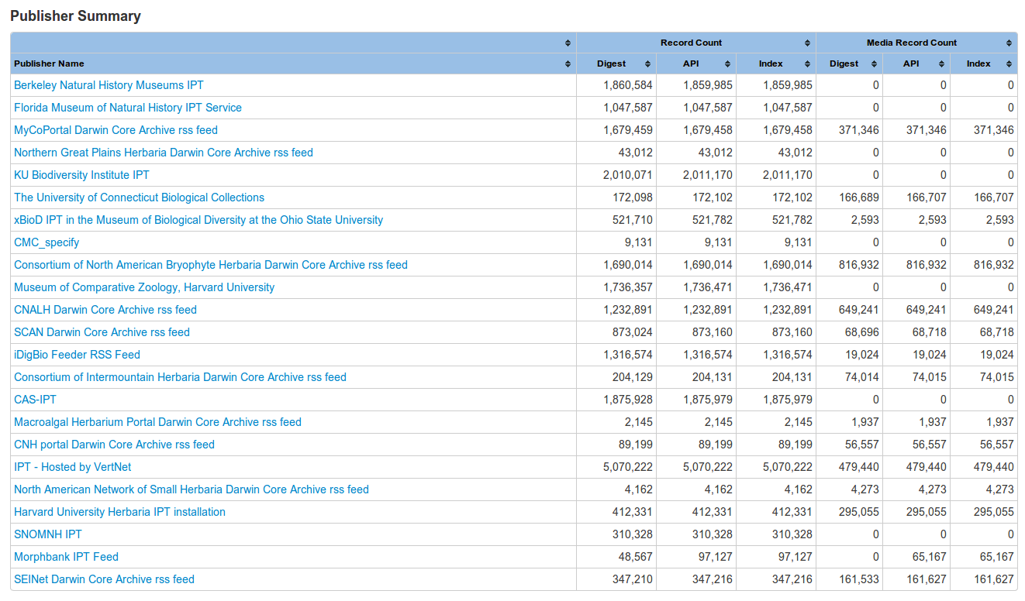
Ingestion Reporting

Slide 7
Three types of data publishing technologies
IPT – GBIF Integrated Publishing Toolkit
Symbiota – web-based collection management software
iDigBio Feeder

Slide 8
Dataset formats
IPT – DwC-A
Symbiota portals – DwC-A
IdigBio Feeder – DwC-A, CSV, ...

Slide 10
