Slide 1
This file deprecated. Slides moved to Google Drive:
https://docs.google.com/presentation/d/1xJkn3_FDuwIJRn9XQ64yGmywJ0bgB8Z5lSM0EbBDrP8/edit?usp=sharing

Slide 2
CYWG (CyberInfrastructure Working Group)
October 2014
iDigBio Data Ingestion
Dan Stoner
Advanced Computing and Information Systems Laboratory (ACIS)
University of Florida
dstoner@acis.ufl.edu @thatlinuxbox

Slide 3

Over 300 Data Providers...

Slide 4


Slide 5
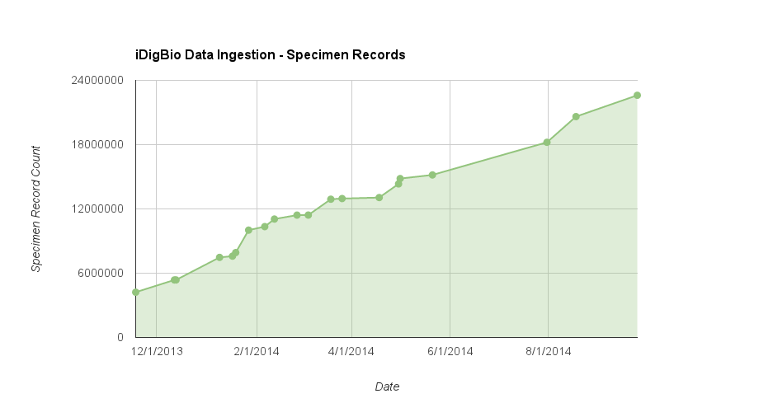

Slide 6
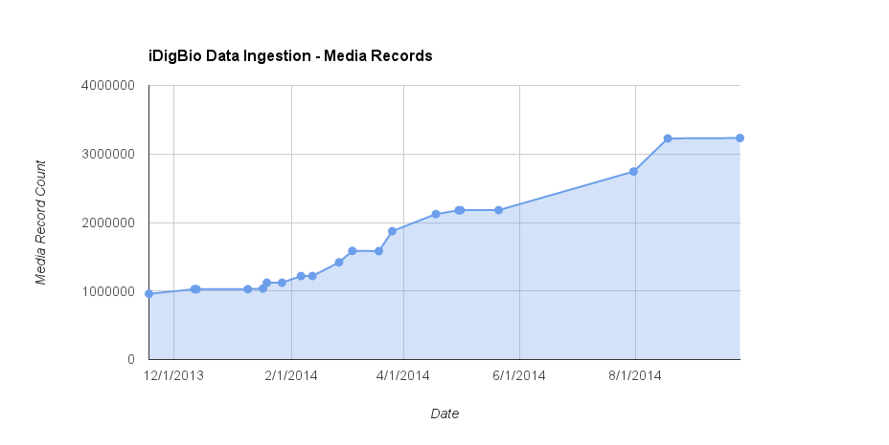

Slide 7
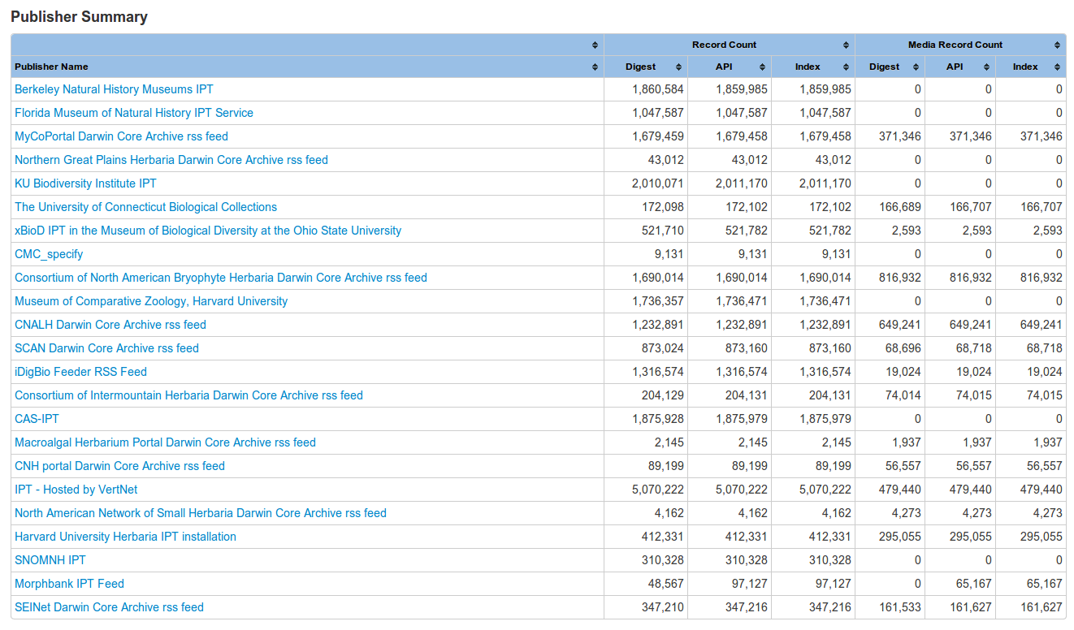
Ingestion Reporting
https://www.idigbio.org/portal/publishers

Slide 8
Three types of data publishing technologies currently being consumed:
GBIF Integrated Publishing Toolkit (IPT)
http://www.gbif.org/ipt
Symbiota – web-based collection management software
http://symbiota.org/
iDigBio Feeder – for providers who do not run infrastructure and send data to iDigBio via email or other means.

Slide 9
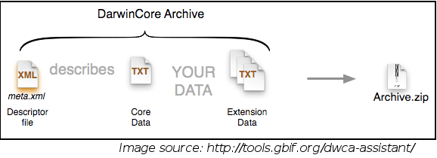
Darwin Core Archive / DwC-A
http://rs.tdwg.org/dwc/terms/guides/text/
A Darwin Core Archive is a zip file that includes both metadata
about the dataset, the data itself, and any optional extension data.

Slide 10
Dataset formats
IPT – DwC-A
Symbiota portals – DwC-A
iDigBio Feeder – DwC-A, CSV, …

Slide 11
Specimen Data – Darwin Core
http://www.tdwg.org/standards/450/
Recommended Minimum: Record ID, Scientific Name, Occurence ID,
Event Date, Collector Name, Locality Data

Slide 12
Media Data – Audubon Core
http://www.tdwg.org/standards/638/

Slide 13
Details not covered in the Standards
Controlled Vocabularies
ISO Country Codes
State/Province names
Data Formats
ISO 8601 Dates
WGS84 Decimal Lat/Long
Identifier Formats (UUID, URN, ARK, DOI, URI, URL, LSID, ...)
Apple Core guidelines for herbaria
http://code.google.com/p/applecore/wiki/Introduction
Copyright and Licensing

Slide 14
