Slide 1
Paternally inherited cis-regulatory structural variants are associated with Autism
Danny Antaki, Sebat Lab
UCSD Genetics Training Program 11th Annual Retreat
Match 22, 2018

Slide 2
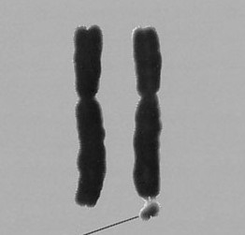
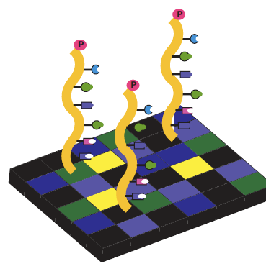

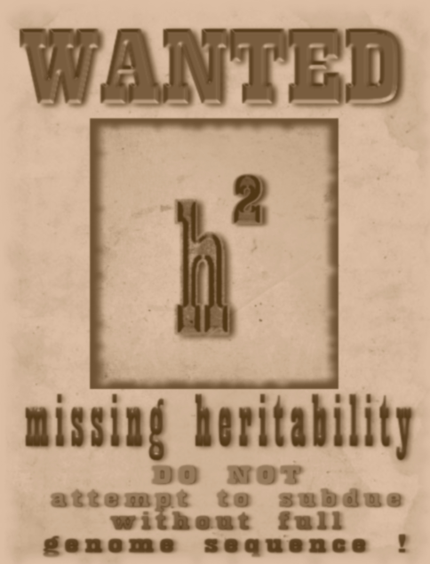
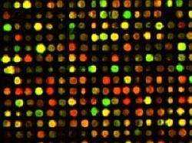
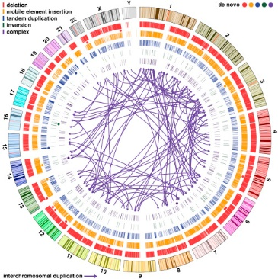
15-25% of cases have a casual variant
~60-100 genes associated with ASD
Exome studies found loss of function and missense SNPs+INDELs (1-50bp)
First genetic associations were
microscopic structural changes
(>10Mb)
Autism is a heterogeneous neurodevelopmental disorder
Impaired social interaction and restricted behavior
Genetic liability is significant
MZ twin concordance 30-99% (0.6-0.8 heritability)
What have previous studies missed?
Cis-Regulatory Elements
1960’S
1970’S
1980’S
1990’S
2000’S
2010’S
Wikipedia Commons
Microarrarys found sub-microscopic structural changes
(100kb-10Mb)
Whole genome sequencing resolved complex de novo structural changes (50bp-10Mb)
Notes:
How presentation will benefit audience: Adult learners are more interested in a subject if they know how or why it is important to them.
Presenter’s level of expertise in the subject: Briefly state your credentials in this area, or explain why participants should listen to you.

Slide 3
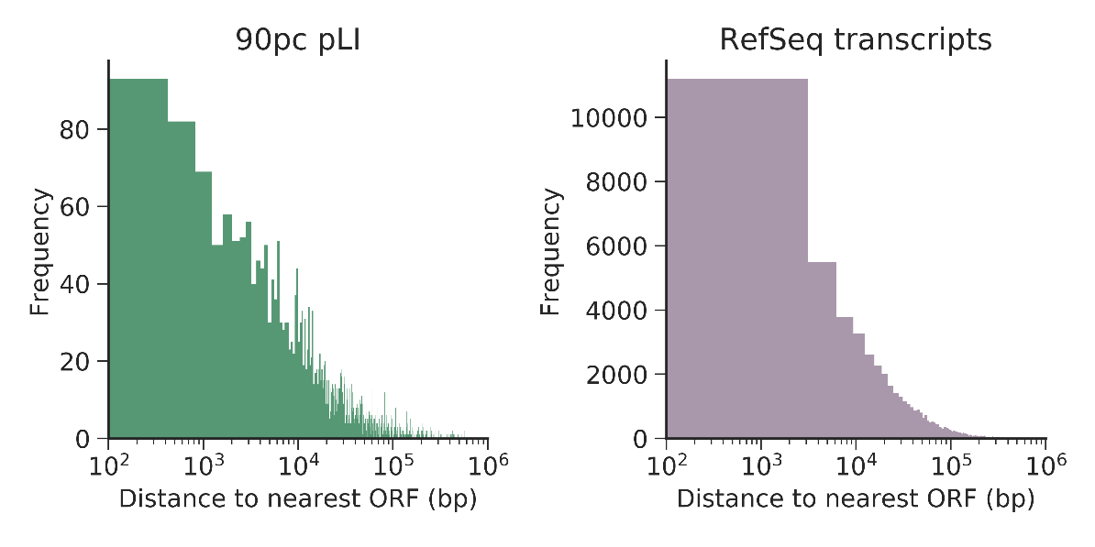
Accounting for Missing Heritability
Exome sequencing neglects cis-regulatory elements
Promoters
UTRs
Transcription Start Sites
*
TSS
*
*
*
Promoter
5’UTR
exon
3’UTR
Microarrays cannot resolve smaller structural variants (50bp-10kb)
37% of non-overlapping open reading frames are within 10kb of each other
pLI: probability that a given gene is intolerant to loss of function mutations (ExAC).
Notes:
Lesson descriptions should be brief.

Slide 4
Rationale for Cis-Regulatory Structural Variants (CRE-SV)
Whole genome sequencing can detect sequence variants in cis-regulatory regions
Classes of Sequence Mutations
SNP: 1bp
INDEL: 2bp-49bp
SV: >50bp
Reference
GATCGATC
GAGCGATC
GAT--CGATC
GAGAG-GATC
Mutation
Functional impact
Potentially more damaging
False Discovery Rate
SV <10kb
Enriched for false positives
SVs are more likely to elicit a functional change but detection carries the cost of a high FDR
Notes:
Example objectives
At the end of this lesson, you will be able to:
Save files to the team Web server.
Move files to different locations on the team Web server.
Share files on the team Web server.

Slide 5
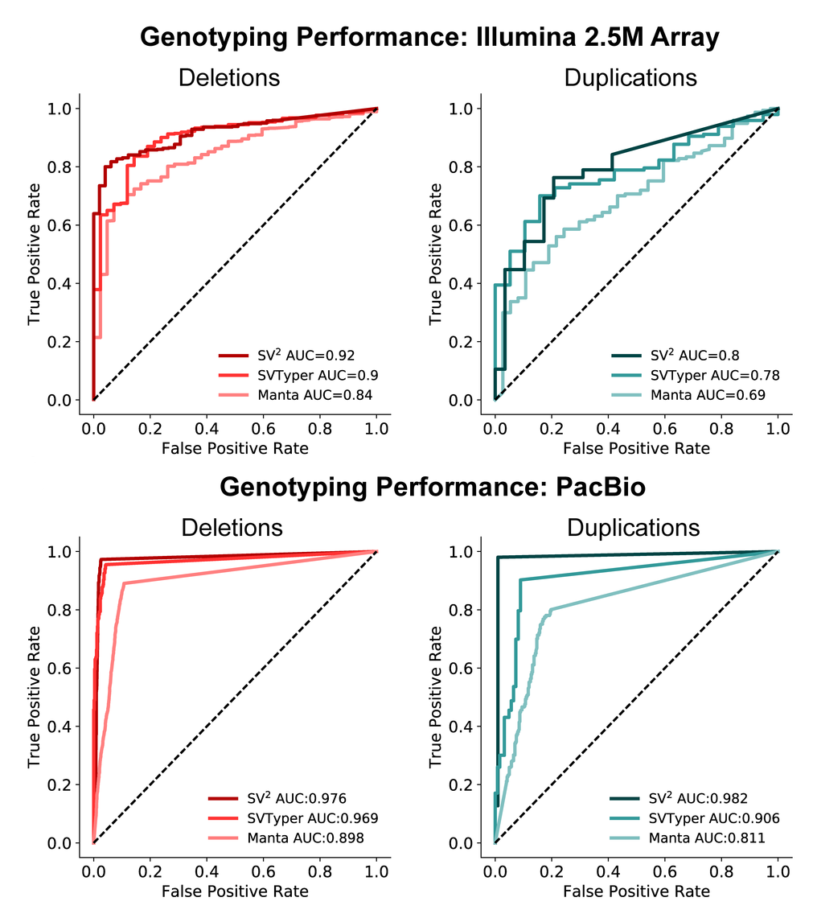
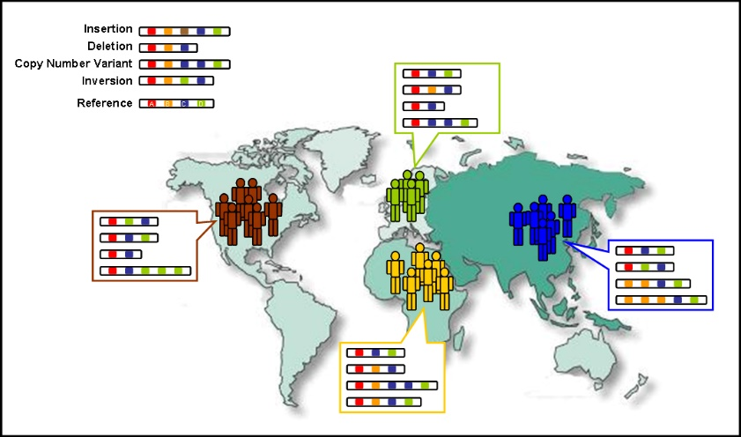
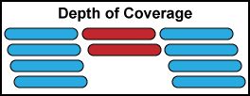
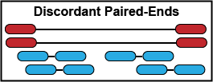
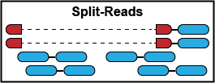
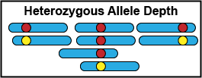

Detecting genotyping errors with machine learning
Machine learning outperforms probabilistic methods
Orthogonal validation of genotypes
Microarrays (N=57)
PacBio Long Reads (N=9)
SV² (Support-Vector Structural-Variant genotyper) is freely available
https://github.com/dantaki/SV2
Training set: 1000 Genomes
SVs from phase 3 release
High coverage WGS (n=27), Low coverage WGS (n=2,494)
Genotypes SVs with features indicative of a structural change
Antaki D. et al. Bioinformatics 2017
Notes:
Example objectives
At the end of this lesson, you will be able to:
Save files to the team Web server.
Move files to different locations on the team Web server.
Share files on the team Web server.

Slide 6
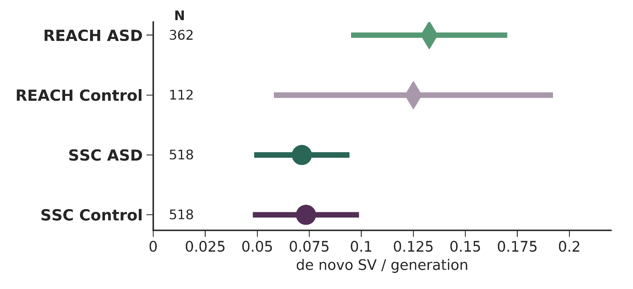
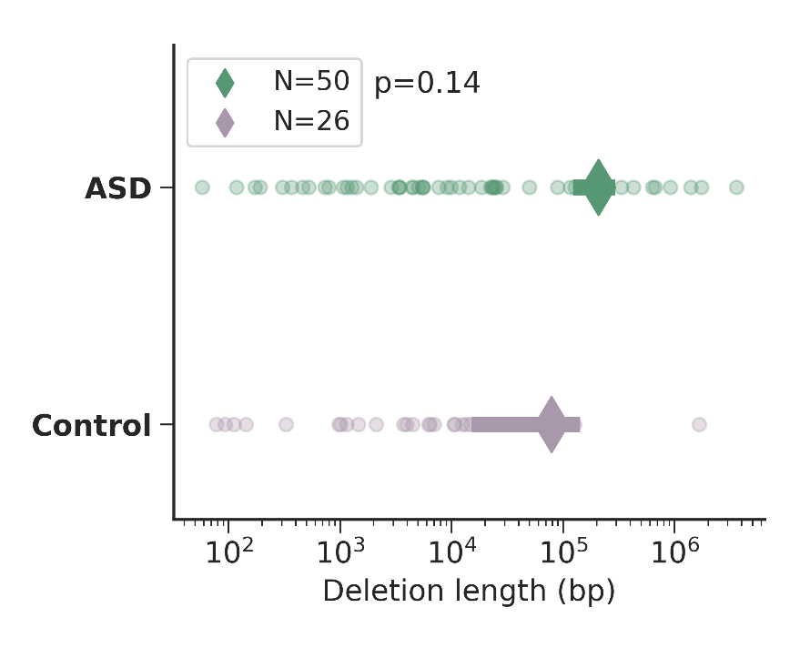
Searching for CRE-SVs in 3,169 whole genomes
2 Cohorts
REACH: local sources ASD patients (Rady Children’s Hospital, 311 families)
Simons Simplex Consortium (518 families)
Screened negative for de novo LoF or large SV
829 familes
880 ASD offspring
630 Control siblings
No de novo CRE-SV detected
Notes:
Example objectives
At the end of this lesson, you will be able to:
Save files to the team Web server.
Move files to different locations on the team Web server.
Share files on the team Web server.

Slide 7
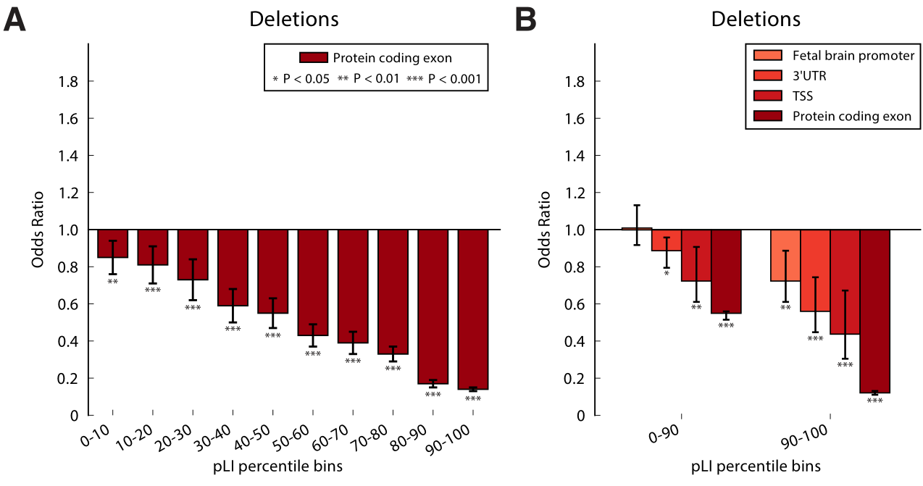
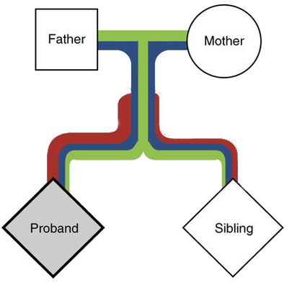
Ascertaining Rare Inherited CRE-SV risk
Intolerant functional elements are rarely deleted
Genes with strong negative selection (pLI >0.9)
Limit to deletions, easier to interpret
Fetal brain promoter annotations taken from RoadmapEpigenomics chromHMM annotations
Are CRE-SVs transmitted to cases more often than controls?
Transmission Disequilibrium Test (TDT)
Benefits: controls for ancestry and LD
Caveats: genotyping errors confound results
Additive model
The affected child (proband) inherits more damaging rare mutations (red), than the control sibling.
Adapted from Krumm et al. Nat Gen 2015
Notes:
Example objectives
At the end of this lesson, you will be able to:
Save files to the team Web server.
Move files to different locations on the team Web server.
Share files on the team Web server.

Slide 8
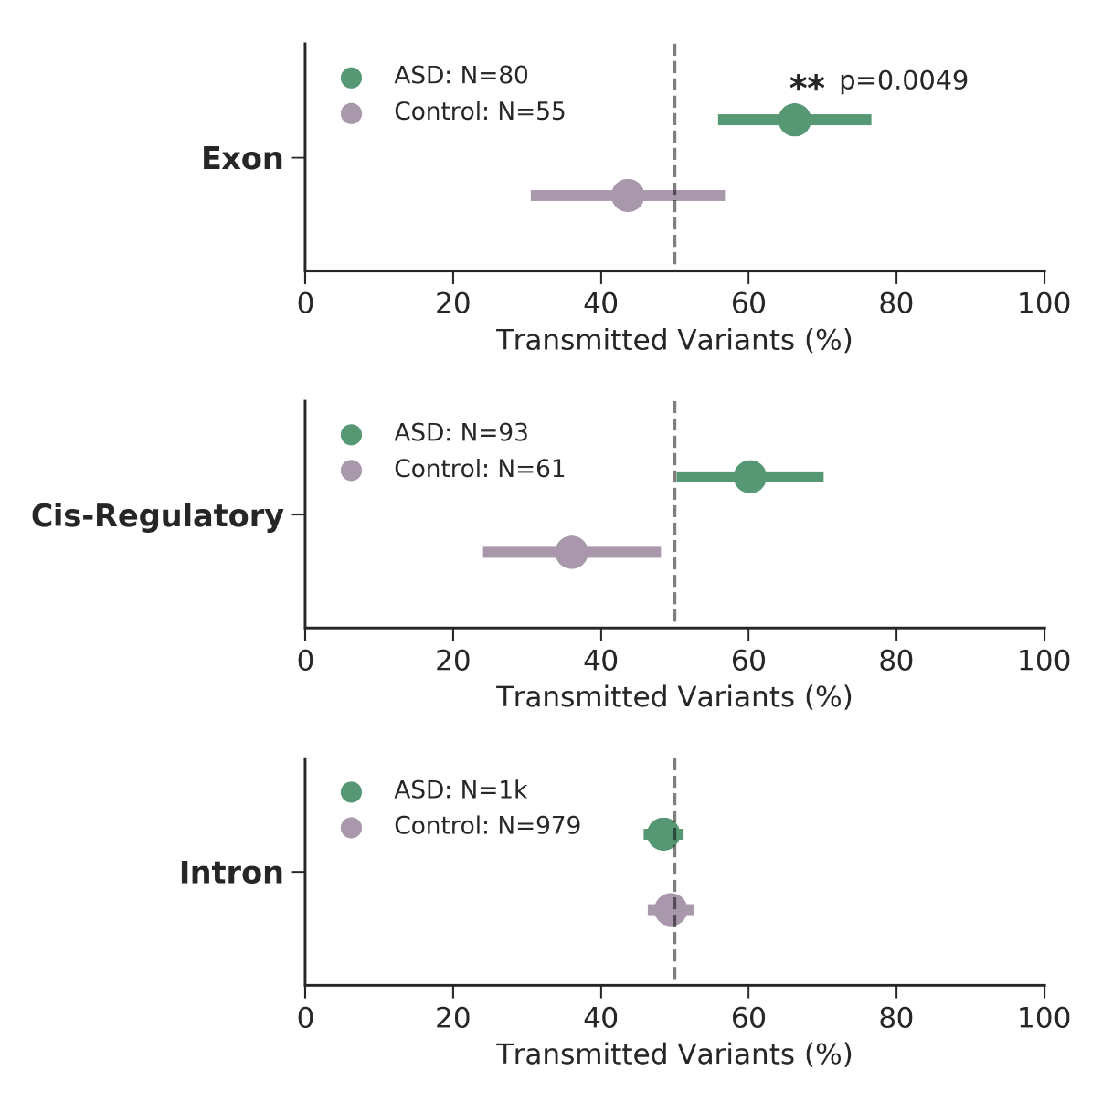

Inheritance of private variants within functionally constrained genes
pLI>0.9908
SVs within introns did not
exhibit transmission bias
Error bars are 95% CI (binomial proportion)
N = number of independent assortment events (transmitted + non-transmitted)
SVs overlapping exons were over-transmitted to cases
Concordant with exome studies
CRE-SVs were slightly over-transmitted to cases
Notes:
Example objectives
At the end of this lesson, you will be able to:
Save files to the team Web server.
Move files to different locations on the team Web server.
Share files on the team Web server.

Slide 9
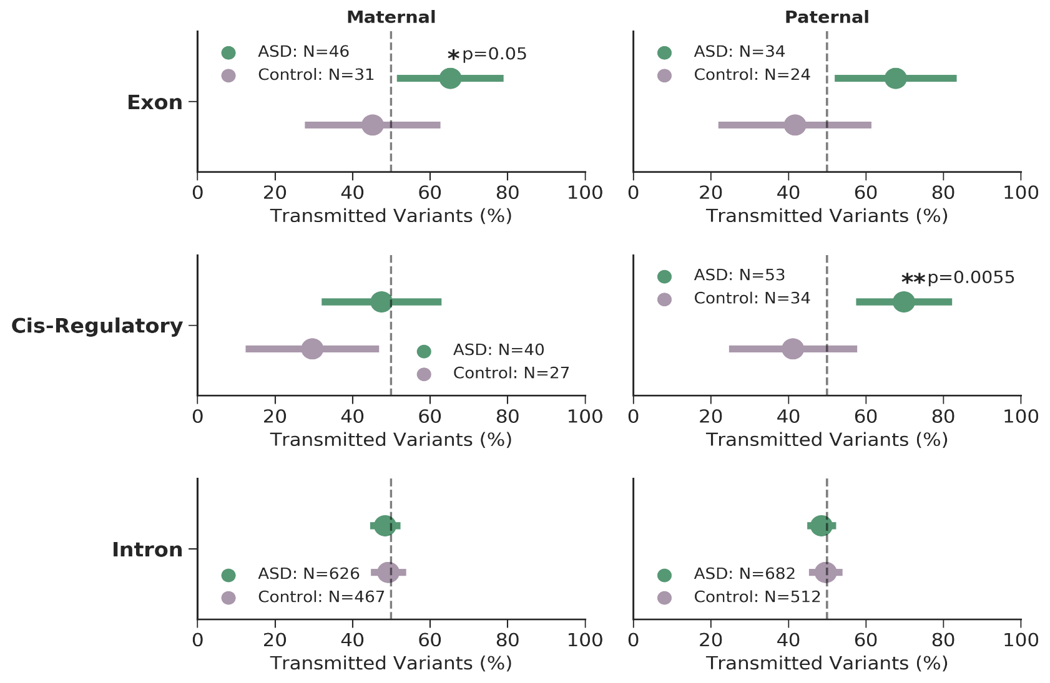
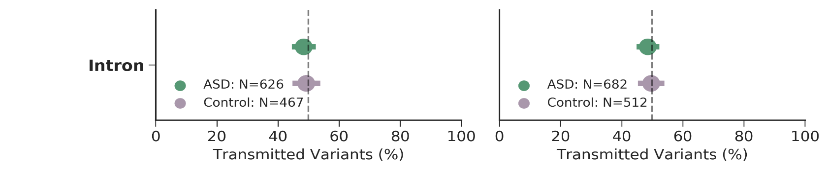

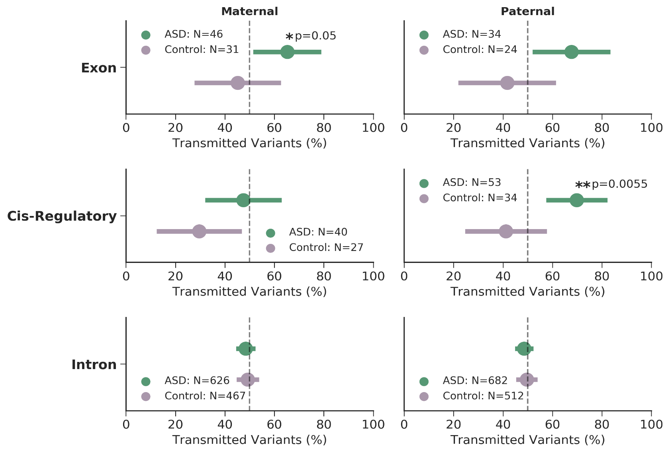
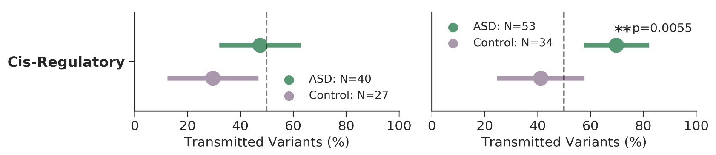
CRE-SVs exhibit a parent of origin effect
pLI>0.9908
No parent of origin effect with private SVs within introns
Mothers over-transmit exonic SVs to cases
Females have higher tolerance for LoF mutations
Fathers over-transmit CRE-SVs to cases
Under-transmission to controls
Notes:
Example objectives
At the end of this lesson, you will be able to:
Save files to the team Web server.
Move files to different locations on the team Web server.
Share files on the team Web server.

Slide 10
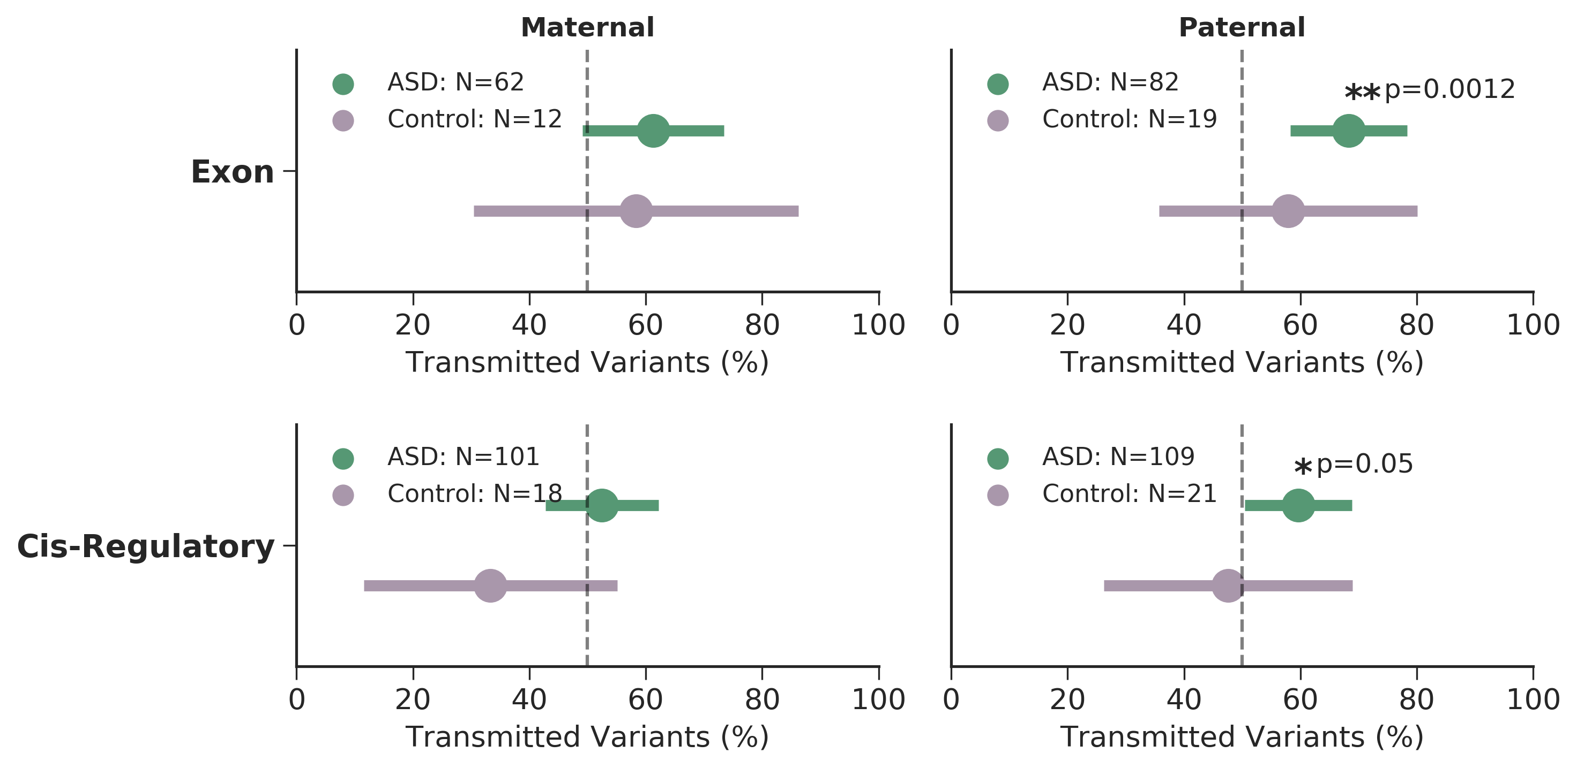
Replicating the parent of origin effect
pLI>0.9908
Collaboration with Stephen Scherer (Toronto)
MSSNG cohort: 3,769 whole genomes
SSC phase 2: 2,336 whole genomes
Exonic SVs are over-transmitted to cases
Fewer assortment events in controls
Modest paternal over-transmission of CRE-SVs to cases
Notes:
Example objectives
At the end of this lesson, you will be able to:
Save files to the team Web server.
Move files to different locations on the team Web server.
Share files on the team Web server.

Slide 11
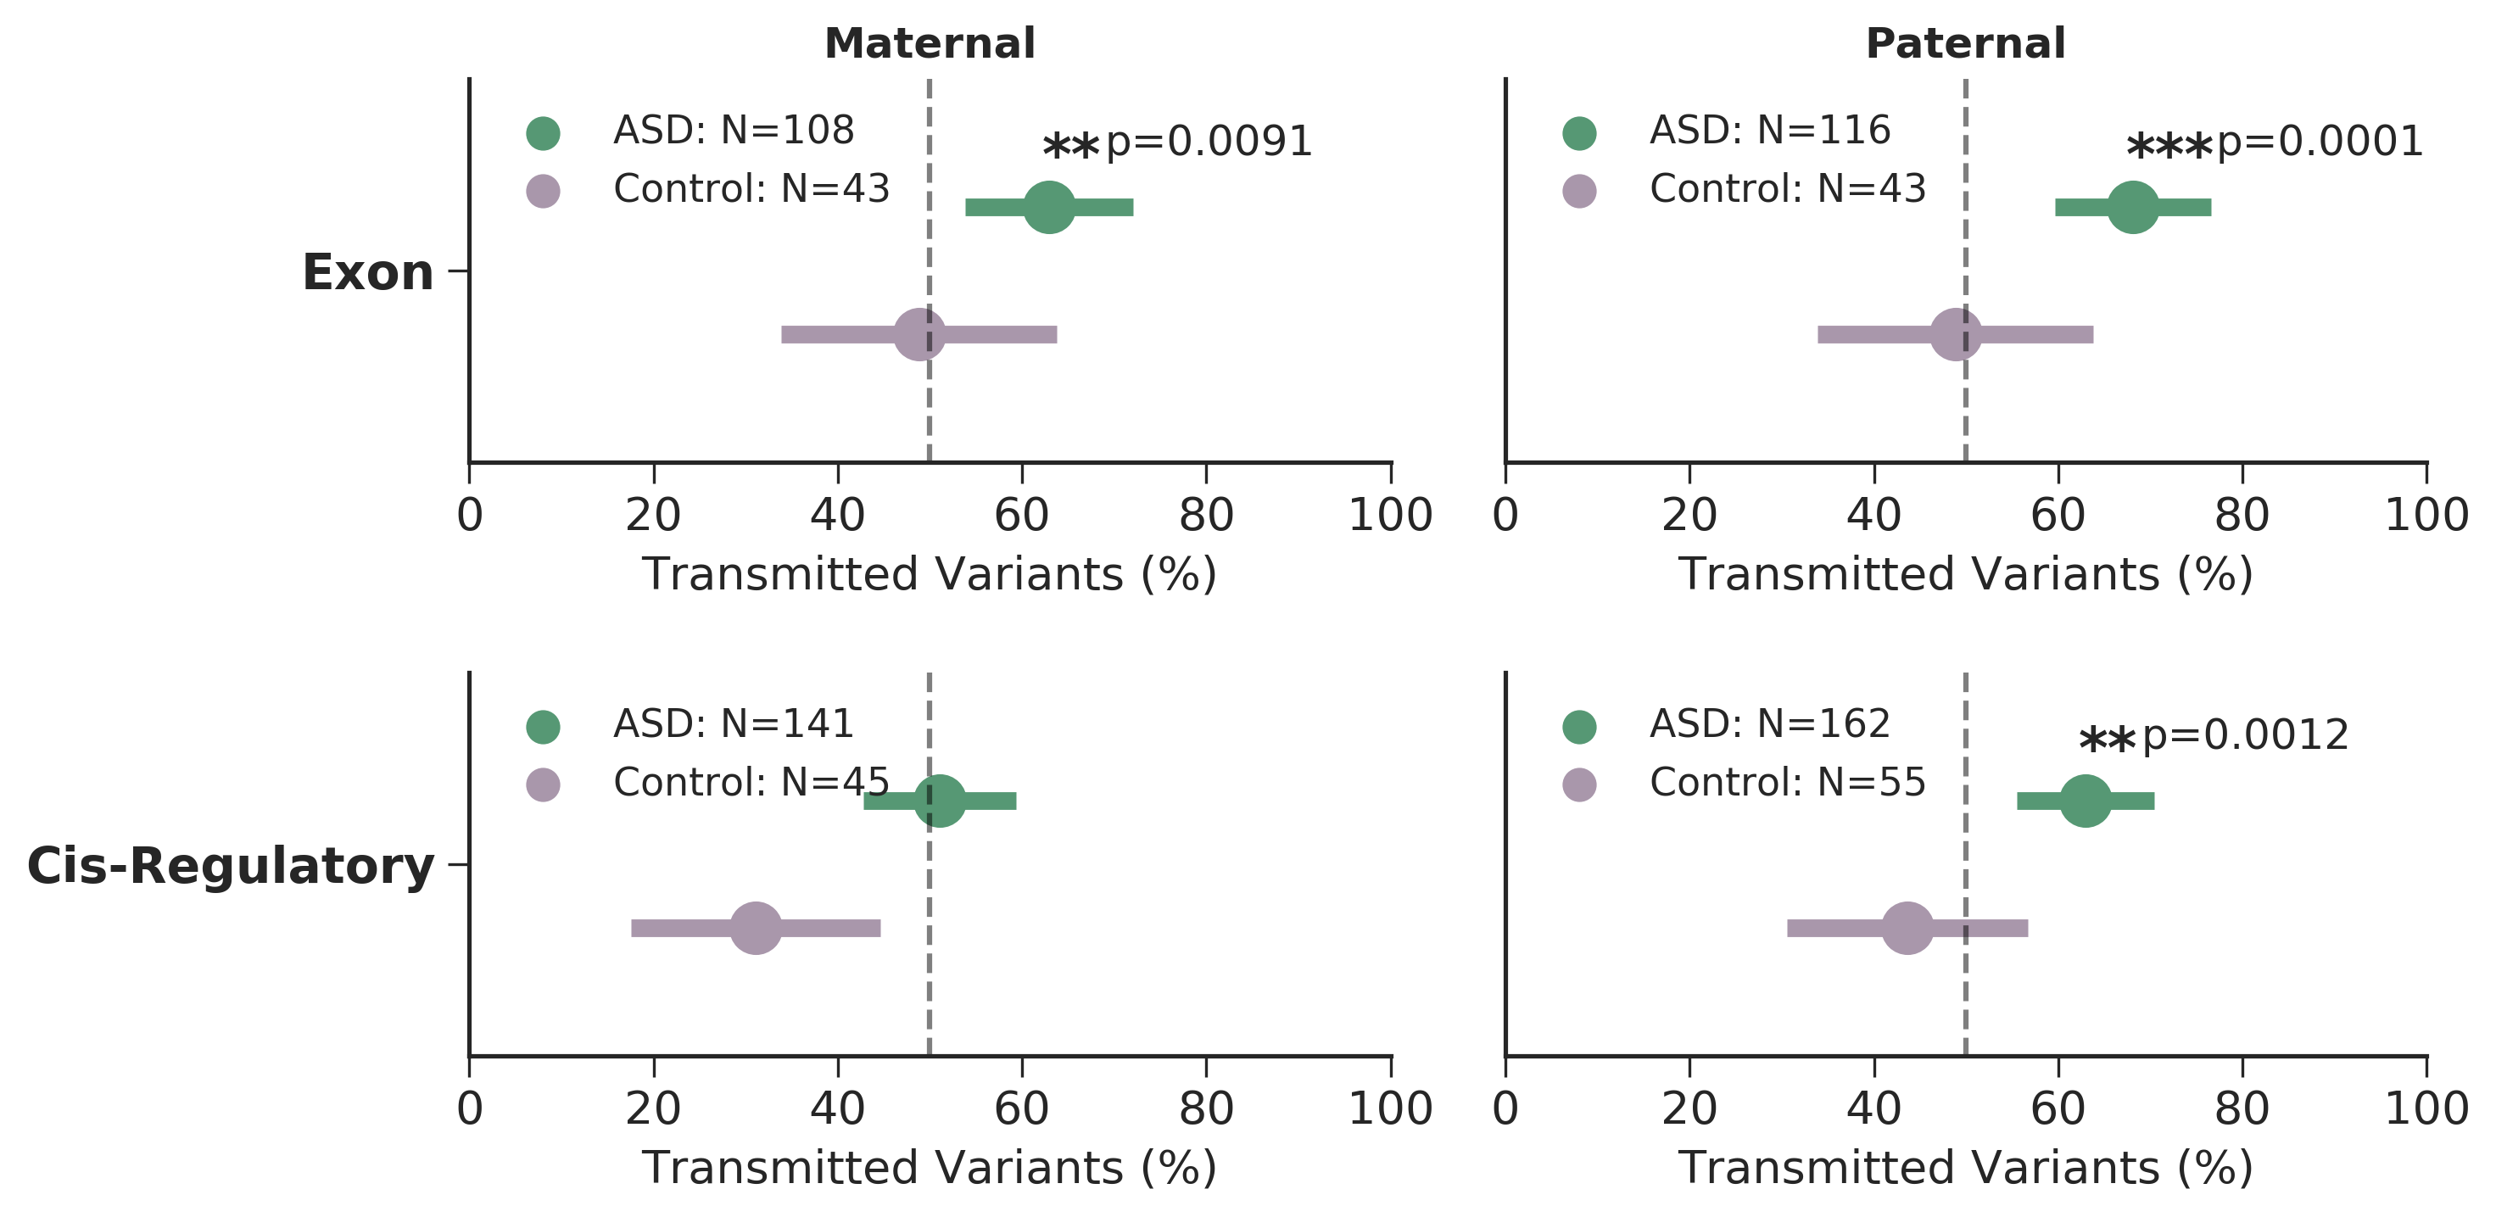
Combining the results
9,274 whole genomes
2,600 families
2,859 cases
1,214 controls
Exonic SVs are over-transmitted to cases
pLI>0.9908
Rare CRE-SVs exhibit a paternal origin effect
Notes:
Example objectives
At the end of this lesson, you will be able to:
Save files to the team Web server.
Move files to different locations on the team Web server.
Share files on the team Web server.

Slide 12
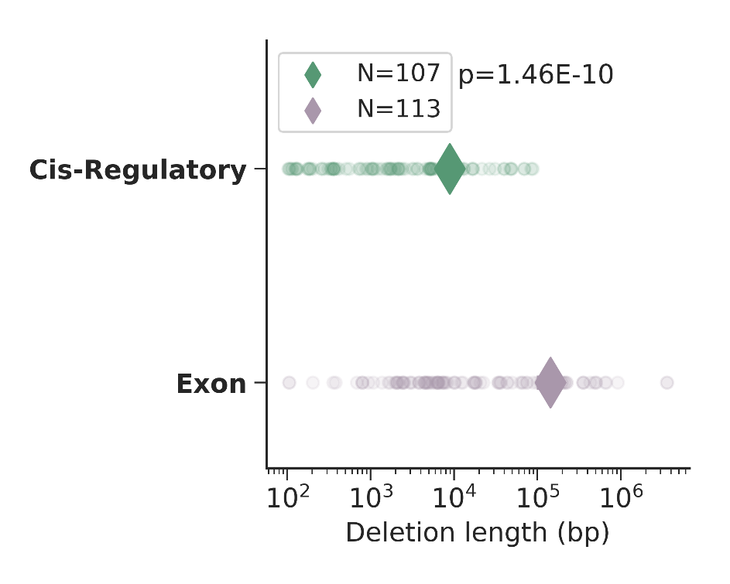
Recurrent CRE-SVs
Gene | Cytoband | Annotation | Syndrome / ASD finding
CNTN4 | 3p26.3-p26.2 | Axon-assoc. cell adhesion molecule | 3p deletion/ASD CNV
RAF1 | 3p25.2 | Proto-oncogene, serine/threonine Kinase | Noonan/ASD CNV
MEST | 7q32.2 | hydrolase activity, paternally expressed | Silver-Russell /7q ASD susceptibility locus
LEO1 | 15q21.2 | Comp. of PAF1 complex, assoc. w/ RNA pol II | ./2 de novo LoF in ASD exome studies
CRE-SVs are significantly smaller than exonic SVs
Notes:
Example objectives
At the end of this lesson, you will be able to:
Save files to the team Web server.
Move files to different locations on the team Web server.
Share files on the team Web server.

Slide 13


Conclusions and future directions
CRE-SVs exhibit a significant paternal origin effect
~0.8% of cases have a paternally inherited CRE-SV
Rare inherited variants thought to contribute ~3-4% to ASD
Bilineal two-hit model
Inherited maternal LoF of large effect
Inherited paternal CRE-SV of moderate effect
Possible epigenetic mechanism?
Brandler, W.M., Antaki, D., Gujral, M., et al. Paternally inherited cis-regulatory structural variants are associated with autism. Science In Press.

Slide 14
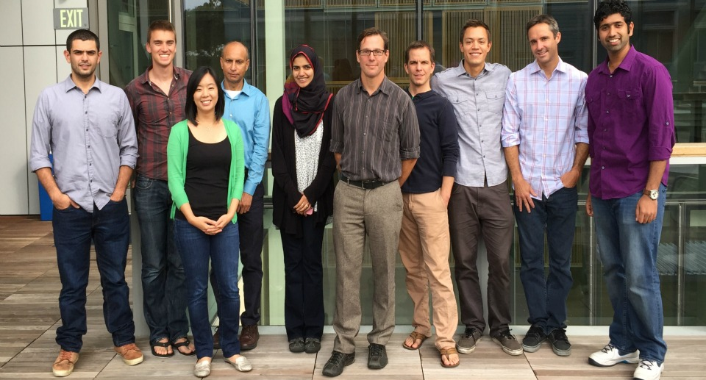

Acknowledgements
Sebat Lab
William Brandler
Madhu Gujral
Prateek Tandon
Oanh Hong
Morgan Kleiber
Tim Chapman
Michelle Maile
Omar Shanta
Adam Koch
Aojie Lian
Stephen Scherer (MSSNG)
Rady Children’s Hospital
REACH project
Human Longevity Institute
Simons Simplex Project
1000 Genomes Project
San Diego Supercomputer Center
Thesis Committee
Jonathan Sebat: chair
Joseph Gleeson
Alysson Muotri
Abraham Palmer
Nicholas Schork
Funding:
NIH predoctoral training grant T32 GM008666 (UCSD Genetics Training Program)
Amazon Web Services Research Grant
Sebat Lab funding:
NIH: MH076431, MH113715
Beyster Family Foundation

Slide 15
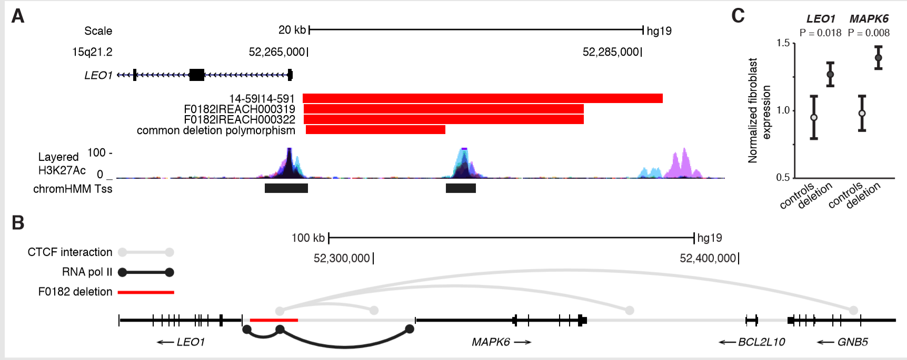
Carriers of the LEO1 CRE-SV had higher expression of LEO1 and MAPK6 in derived fibroblasts
Deletion polymorphism (1.1% AF) does not disrupt any annotated functional elements
ChIA-PET for CTCF and RNA pol II suggest this region is a focal point for long range chromatin interactions
(G.Li et al. Cell 2012) (Z. Tang et al. Cell 2015)

