Slide 1

AJAX
Lab 8
10/16

Slide 2
Project 3
is due this coming Wednesday, 10/22, 8pm on Blackboard
when I grade them, I'll read the readme.txt, and then open statemachinetest.html and see if it works, read through your statemachine.js, then try your 5 statemachine-testN.html files. Include any files I'll need to do that.
(which means project 4 is coming out next Thursday)
Office hours are tomorrow 10/17, 1:30-3pm at Gates café, same as it ever was

Slide 3
mid-course survey
http://bit.ly/ssuiwebmid
(up to) 3 things that are going well
(up to) 3 things that could be improved

Slide 4
AJAX
Asynchronous JavaScript & XML
Loads data from external services without refreshing page
Defined “Web 2.0”
Procedurally:
Make an asynchronous call to an external API
This call will return a value after some delay
Show a loading message (good UI practice)
Update the web page in response to the return value of the asynchronous call

Slide 5
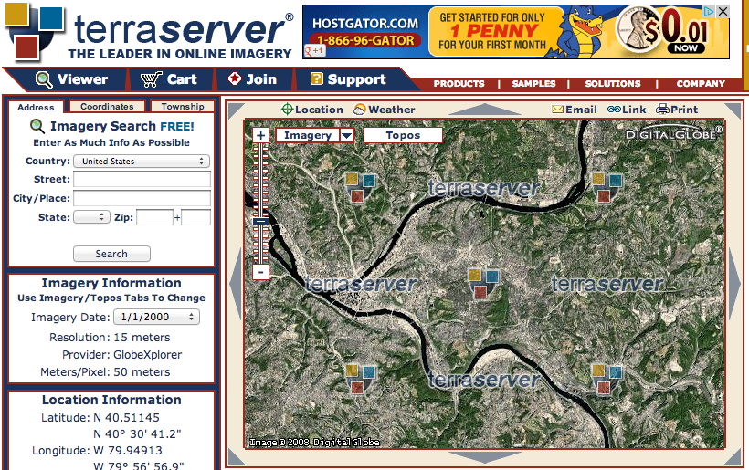
it’s the difference between…

Slide 6
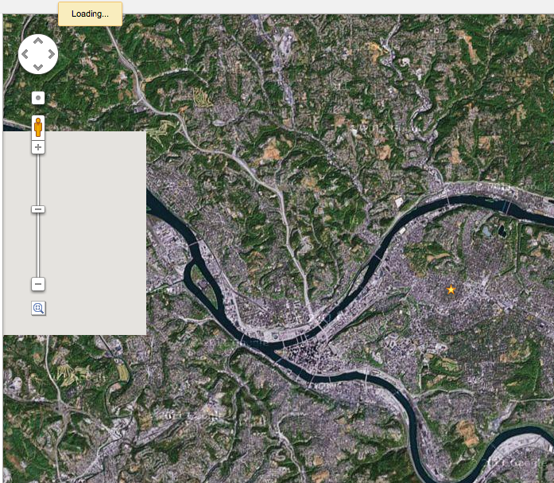

Slide 7
Notes:
other examples of ajax?
what are some of the difficulties in it?

Slide 8
Today:
“Should I wear a jacket today?”
Going to use Yahoo! Weather API
http://developer.yahoo.com/weather/
One of many available weather APIs
http://weather.yahooapis.com/forecastrss?w=2473224
If you didn't last time then do it real quick now:
Install Node.js: http://nodejs.org/

Slide 9
AJAX
Asynchronous JavaScript & XML
Loads data from external services without refreshing page
Defined “Web 2.0”
Procedurally:
Make an asynchronous call to an external API
This call will return a value after some delay
Show a loading message (good UI practice)
Update the web page in response to the return value of the asynchronous call

Slide 10
AJAX
Done with XMLHttpRequest
API for sending requests to a web server within JavaScript
Many libraries simplify the development of AJAX
…we won’t use any of them in this lecture
…but you may for your final projects

Slide 11
XMLHttpRequest
.readyState
1: open method has been successfully called
2: send method has been successfully called, response headers have been received
3: response has begun to load
4: response has finished loading

Slide 12
XMLHttpRequest
.status
Status code in the response from the server
200: OK
403: Forbidden
404: Not found

Slide 13
XMLHttpRequest
.onreadystatechange = function()…
Called when .readyState changes
.open(method, url)
Specify a method (GET, POST, etc.) and a URL to fetch
.send()
Sends the request (optional data argument)

Slide 14
XMLHttpRequest
.readyState
1: open method has been successfully called
2: send method has been successfully called, response headers have been received
3: response has begun to load
4: response has finished loading
.status
Status code in the response from the server
200: OK
403: Forbidden
404: Not found
.onreadystatechange = function()…
Called when .readyState changes
.open(method, url)
Specify a method (GET, POST, etc.) and a URL to fetch
.send()
Sends the request (optional data argument)
Notes:
Much more customizable but you don’t usually need more properties than this…

Slide 15
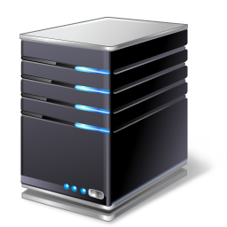

send response w/ 200 status
send
request
Got
response
send 40x status
click to
send XHR
loading…
or
Error
Time

Slide 16
var xmlhttp = new XMLHttpRequest();
xmlhttp.onreadystatechange = function() {
if (xmlhttp.readyState === 4 && xmlhttp.status === 200) {
console.log(xmlhttp);
}
};
xmlhttp.open("GET", "http://from.so/web_lab/pgh_weather.php");
xmlhttp.send();
Notes:
run this in an incognito window so my https extensions don't mess with it

Slide 17
var xmlhttp = new XMLHttpRequest();
xmlhttp.onreadystatechange = function() {
if (xmlhttp.readyState === 4 && xmlhttp.status === 200) {
console.log(xmlhttp);
}
};
xmlhttp.open("GET", ”http://from.so/web_lab/pgh_weather.php");
xmlhttp.send();

Slide 18
var xmlhttp = new XMLHttpRequest();
xmlhttp.onreadystatechange = function() {
if (xmlhttp.readyState === 4 && xmlhttp.status === 200) {
console.log(xmlhttp);
}
};
xmlhttp.open("GET", ”http://from.so/web_lab/pgh_weather.php");
xmlhttp.send();

Slide 19
var xmlhttp = new XMLHttpRequest();
xmlhttp.onreadystatechange = function() {
if (xmlhttp.readyState === 4 && xmlhttp.status === 200) {
console.log(xmlhttp);
}
};
xmlhttp.open("GET", ”http://from.so/web_lab/pgh_weather.php");
xmlhttp.send();

Slide 20
var xmlhttp = new XMLHttpRequest();
xmlhttp.onreadystatechange = function() {
if (xmlhttp.readyState === 4 && xmlhttp.status === 200) {
console.log(xmlhttp);
}
};
xmlhttp.open("GET", ”http://from.so/web_lab/pgh_weather.php");
xmlhttp.send();

Slide 21
var xmlhttp = new XMLHttpRequest();
xmlhttp.onreadystatechange = function() {
if (xmlhttp.readyState === 4 && xmlhttp.status === 200) {
console.log(xmlhttp);
}
};
xmlhttp.open("GET", ”http://from.so/web_lab/pgh_weather.php");
xmlhttp.send();

Slide 22
Should I wear a jacket today?
Yahoo! Weather API
http://from.so/web_lab/pgh_weather.php
More information about the API:
http://developer.yahoo.com/weather/
Step 1: Fetch weather information from Yahoo!
Starter code on next slide
Notes:
we're using stephen's code b/c it takes care of some needs incl. authentication

Slide 23
Step 1: Fetch weather data
var xmlhttp = new XMLHttpRequest();
xmlhttp.onreadystatechange = function() {
if (xmlhttp.readyState === 4 && xmlhttp.status === 200) {
console.log(xmlhttp);
}
};
xmlhttp.open("GET", ”http://from.so/web_lab/pgh_weather.php");
xmlhttp.send();

Slide 24
Dealing with response data
Two most common formats: XML & JSON
XML: Treated like HTML, root: xmlhttp.responseXML
xmlhttp.responseXML.getElementById
xmlhttp.responseXML.getElementsByTagName
JSON: JavaScript objects are directly given
JSON.parse(xmlhttp.responseText)

Slide 25
Dealing with response data
Two most common formats: XML & JSON
XML: Treated like HTML, root: xmlhttp.responseXML
xmlhttp.responseXML.getElementById
xmlhttp.responseXML.getElementsByTagName
JSON: JavaScript objects are directly given
JSON.parse(xmlhttp.responseText)
Yahoo! Weather API uses XML

Slide 26
Step 2: Update your UI with weather data
var xmlhttp = new XMLHttpRequest();
xmlhttp.onreadystatechange = function() {
if (xmlhttp.readyState === 4 && xmlhttp.status === 200) {
var condition= xmlhttp.responseXML.getElementsByTagName("condition");
// your code here...
}
};
xmlhttp.open("GET", "http://from.so/web_lab/pgh_weather.php");
xmlhttp.send();

Slide 27
Step 2: Update your UI with weather data
var xmlhttp = new XMLHttpRequest();
xmlhttp.onreadystatechange = function() {
if (xmlhttp.readyState === 4 && xmlhttp.status === 200) {
var condition= xmlhttp.responseXML.getElementsByTagName("condition");
console.log(condition[0].attributes['temp']);
}
};
xmlhttp.open("GET", "http://from.so/web_lab/pgh_weather.php");
xmlhttp.send();

Slide 28
Let's make a page that calls an API
If you'd like you can take jacket.html from the course website and make it work, or make your own thing using:
ihackernews: http://api.ihackernews.com/page returns posts that are on Hacker News now.
Instagram: https://api.instagram.com/v1/media/popular?client_id=b73c…(client ID required) to see popular photos
usaspending.gov: http://www.usaspending.gov/fpds/fpds.php?state=PA&detail=b for all government contracts in Pennsylvania
or whatever API you like

