Slide 1
Some cool web libraries and tools
Lab 11
11/7

Slide 2
Here are some libraries/tools
Client-side web app frameworks: Angular, Backbone, Ember, Meteor
Server-side frameworks: Rails, Express, Django, Flask
Utilities: jQuery, Underscore, Require
Templates: Jade, Handlebars, Mustache
Visualization: d3, Raphael, Processing
Compilers: CoffeeScript, TypeScript
Other: Bower, Leaflet
Notes:
all JS-based

Slide 3
Web App Framework
Useful if you're building a web app!
You might not be: might be an interactive experiment on a Canvas or a game or a static web page or something.
Does a lot of things
You kind of have to decide this one up front
They're all fine, just pick one.
But do pick one, developing web apps frameworkless is awful.

Slide 4
Web App Framework
Solve two main problems:
Routing: how to map a URL to the code that handles it
Templates: creating HTML dynamically using info from the database
Of course there are a lot more problems too especially when you want to do newfangled fancy things
Notes:
http://www.jeffknupp.com/blog/2014/03/03/what-is-a-web-framework/

Slide 5
Server-side or client-side?
Server-side: Rails, Express, Django, Flask
Client-side: Angular, Ember, Meteor, Backbone
Not really an "xor" – you'll probably need both, but your choice will be which one does more work. Do you render templates, and do you handle routing, on the server or the client?
Notes:
well, either way works…

Slide 6
Which one should I pick?
Try them all (good luck!)
Weigh all the pros and cons (… also good luck.)
Go with what's popular (not guaranteed to be awesome, but at least you probably will get a lot of stack overflow posts when you get stuck. and maybe some other people you know will work with it.)
Notes:
Whorfian effects

Slide 7
Let's start with client side frameworks
Notes:
Whorfian effects

Slide 8
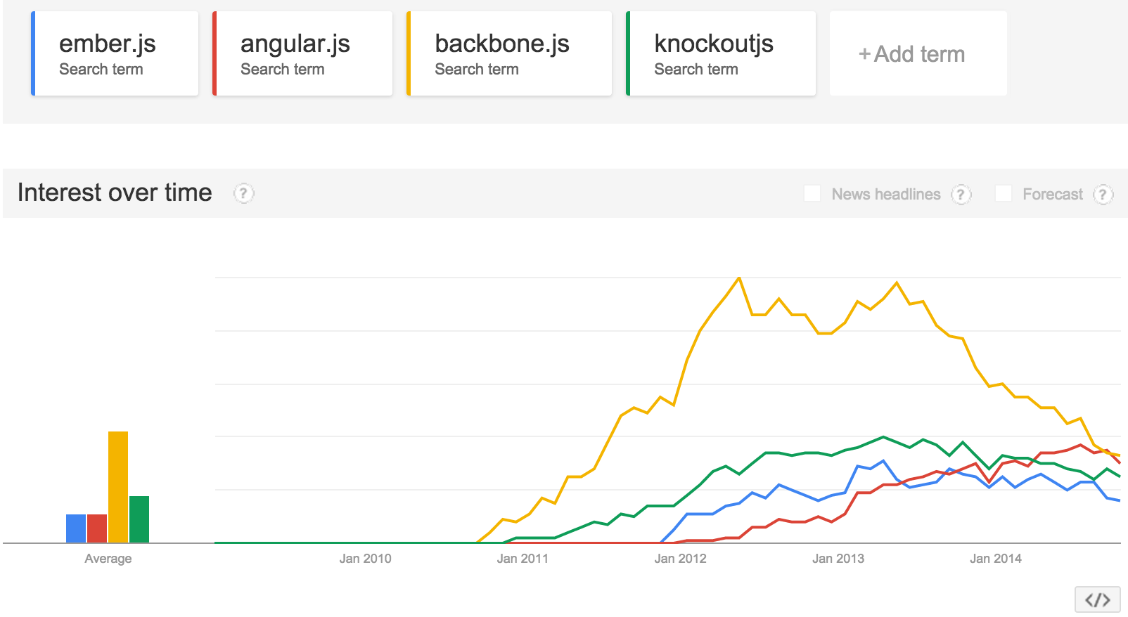
What's popular? (Nov 2014)

Slide 9
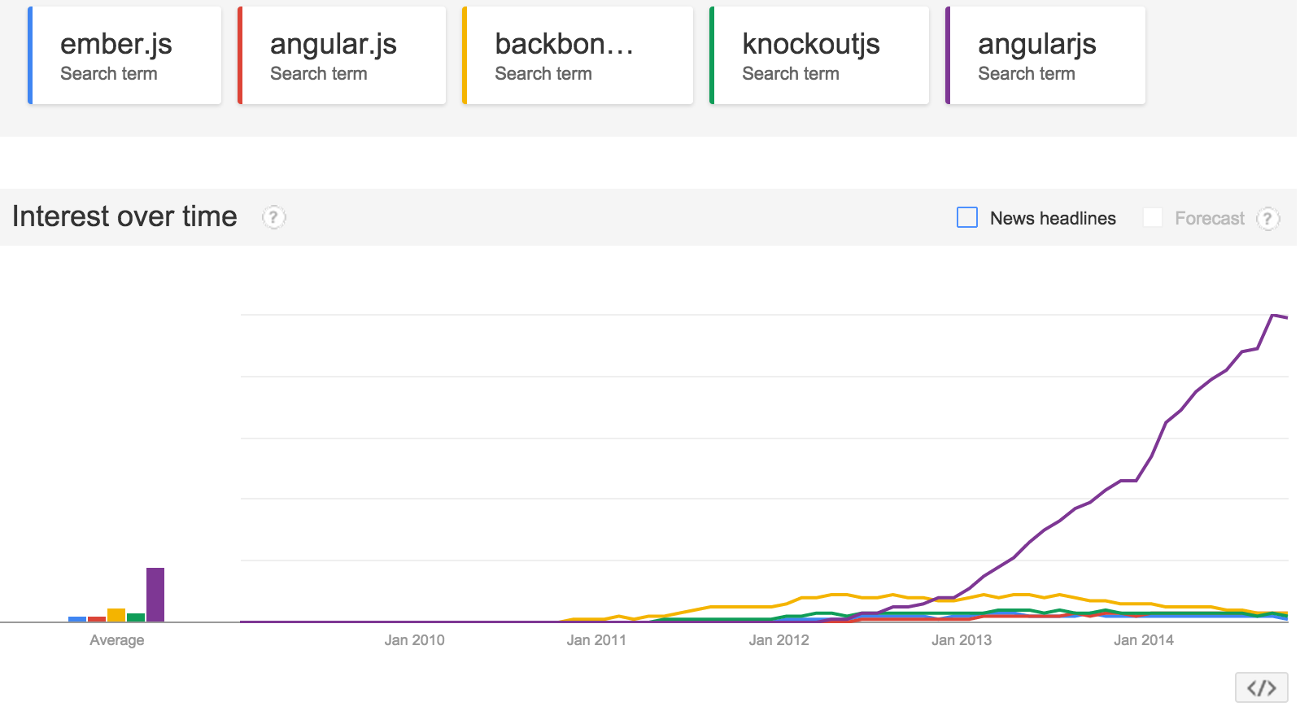
What's popular? (Nov 2014)
Notes:
kind of hard to tell. maybe angular is smashing everyone, maybe they're all about even. http://www.google.com/trends/explore?hl=en-US#q=ember.js%2C%20angular.js%2C%20backbone.js%2C%20knockoutjs%2C%20angularjs&date=1%2F2009%2072m&cmpt=q

Slide 10
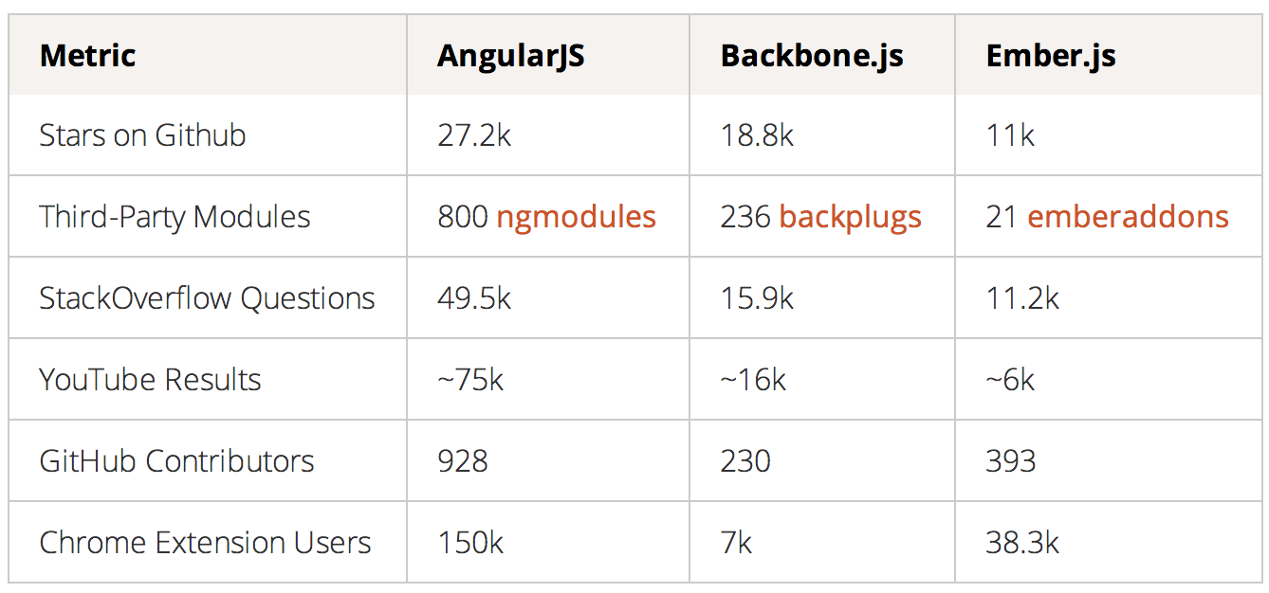
What's popular? (Nov 2014)
Notes:
http://www.airpair.com/js/javascript-framework-comparison
of course maybe this means people are more confused about angular! hmm.

Slide 11
No, but seriously, pros and cons
http://www.100percentjs.com/backbone-or-angular-or-ember-here-is-my-choice-and-why/
http://www.airpair.com/js/javascript-framework-comparison
http://readwrite.com/2014/02/06/angular-backbone-ember-best-javascript-framework-for-you
http://www.quora.com/Client-side-MVC/Is-Angular-js-or-Ember-js-the-better-choice-for-JavaScript-frameworks

Slide 12
Vague hand waving
Ember sounds pretty good, but I haven't used it. Angular can make for some very clean code but you run into scaling issues eventually if your code gets too big. Use Meteor if you are doing a lot of multi-user real-time things. Backbone is super lightweight; kind of too lightweight for my taste.

Slide 13
Angular
… which is the only one I've worked with extensively
philosophy: "how we would create HTML/JS if we invented it today"
What does it do for you?
directives
two-way data binding
templates
dependency injection
Used by Google (for some things), kind of new so it doesn't have as wide adoption by big names yet.

Slide 14
Directives: reusable HTML elements
<tabs>
<pane title="Localization">
Date: {{ '2012-04-01' | date:'fullDate' }} <br>
Currency: {{ 123456 | currency }} <br>
Number: {{ 98765.4321 | number }} <br>
</pane>
<pane title="Pluralization">
<div ng-controller="BeerCounter">
<div ng-repeat="beerCount in beers">
<ng-pluralize count="beerCount" when="beerForms"></ng-pluralize>
</div>
</div>
</pane>
</tabs>
Notes:
what are "tabs" and "pane"?
see angularjs.org for more example

Slide 15
Two way data binding
Model
View
Controller
Notes:
how does info get from the model into the view?

Slide 16
Two way data binding
<input type="text" ng-model="yourName">
<h1>Hello {{yourName}}!</h1>
Notes:
from https://angularjs.org/

Slide 17
Templates
<span>
1+2={{1+2}}
</span>
<div ng-model="person">
hello {{person.name}}
</span>
Notes:
things in double braces expand
(why is this good?

Slide 18
Dependency injection
Makes testing easier/possible
I'll talk more about it next week
Angular also gives you a host of other goodies, but that's the main thing.

Slide 19
Ember
Same data binding for templates, but less logic
Components instead of directives
Great comparison: http://www.quora.com/Client-side-MVC/Is-Angular-js-or-Ember-js-the-better-choice-for-JavaScript-frameworks
Used by Zendesk, Square, Groupon

Slide 20
Backbone
Philosophy: "an attempt to discover the minimal set of data-structuring and UI primitives that are generally useful when building web apps with Javascript."
Data binding to views
Event handling on any JS object
Models that manage validation, access control, computed properties… and sync to a data store on the server
Used by rdio, foursquare, basecamp, airbnb, …
Notes:
backbonejs.org

Slide 21
Meteor
designed for real-time, multi-user communication
same basics: templates, data binding, event handling
more of data persistence handled on client side (via mongo collections) – so it's kind of bound to Node and MongoDB

Slide 22
Another tool to help choose: TodoMVC
http://todomvc.com
same app implemented in a ton of different frameworks.

Slide 23
Server-side web frameworks

Slide 24
In Javascript
Just Node
This is pretty simple, but kind of annoying to do anything complicated
it can work if you're doing all your logic client side and your server is pretty dumb, just sending over all your JS.
Express
Lets you do more complicated routing
Can render templates as well

Slide 25
In Python
Django
is older and full featured
Flask
is more minimalist and modern

Slide 26
In Ruby
Use Rails; you're probably not even asking this question because Rails is kind of the #1 reason to use Ruby

Slide 27
In Java
Gosh, I have no idea. Five years ago I'd say try Spring or JSP or GWT but honestly they're all kind of verbose because Java is. Still, you may work on one of them because Java is popular at Big Companies, because it's been around forever and therefore it's "faster" or "more stable"
Scala and Groovy/Grails are kind of popular – JVM languages, not java itself.
Play seems to be a new popular thing but I have no experience

Slide 28
Dan's totally objectively correct views
I like Flask + whatever client-side stuff I need for simple things, and MEAN (mongo, express, angular, node) for bigger things
I'd like to try Ember or Meteor if I were doing a new project now, but I may also continue all Angular all day
I dislike Django, Rails, and Backbone
But this is not Expert Sage Advice; these are the ramblings of a part-time hacker, at best.

Slide 29
Utilities

Slide 30
jQuery
(see slides from last week)

Slide 31
Underscore
"A mess of useful functional programming helpers"
A lot of stuff I wish I had when I didn't have it.
Collections: each, map, find, contains, sortBy, …
Arrays: first, last, union, uniq, …
Objects: keys, values, isArray, …
Functions: bind, partial, memoize, …
Other: random, escape (for html), …

Slide 32
Require
JS file and module loader.
There's no #include/import built in to JS.
allows you to define modules and require them:

Slide 33
Require
define(
//The name of this module
"types/Manager",
//The array of dependencies
["types/Employee"],
//Function to execute when all dependencies have loaded.
function (Employee) {
function Manager () {
this.reports = [];
}
Manager.prototype = new Employee();
return Manager;
}
);

Slide 34
Require
require(["some/script.js"], function() {
//This function is called after some/script.js has loaded.
});
Notes:
or just this

Slide 35
Templates

Slide 36
What are templates good for?
inserting dynamic data (from the server, or from other JS logic) into your html
you don't want to do this:
$.each(messages.reverse(), function(index, message) {
$('#messageList').append(
'<li><span class="list-title">' +
message.userName + '</span>' +
'<abbr class="list-timestamp" title="' +
message.datePosted + '"></abbr>' +
'<p class="list-text">' + message.messageText + '</p></li>');
}
});
Notes:
so instead you compile a template

Slide 37
Mustache
"logic-less" – no loops or ifs.
well, that's kind of true, but they also have "sections" that do something for each thing in your data
the benefit is that it's hard to accidentally put logic in your templates (which is bad because then it's hard to test and hard to tell what your code is doing)

Slide 38
Handlebars
Like Mustache, and compatible, but with a little more logic
Paths to reference arbitrary content in data:
{{user.name}} instead of just {{name}}
Helpers to render data in custom ways:
Handlebars.registerHelper('fullName', function(person) {
return person.firstName + " " + person.lastName;
});

Slide 39
Jade
Clean syntax, looks pythonish
Allows inline JS (so… logic)

Slide 40
Jade
doctype html
html(lang="en")
head
title= pageTitle
script(type='text/javascript').
if (foo) {
bar(1 + 5)
}
body
h1 Jade - node template engine
#container.col
if youAreUsingJade
p You are amazing
else
p Get on it!
p.
Jade is a terse and simple
templating language with a
strong focus on performance
and powerful features.

Slide 41
Choosing a template language
is a lot less important than choosing a web framework
a lot of time the choice will be made for you
angular uses its own built-in templates, ember uses handlebars, express uses jade in its docs

Slide 42
Visualization

Slide 43
But wait, didn't we already learn canvas?
Yeah, but the drawing library we built up is probably too low level to help you make progress quickly.

Slide 44
d3
vector graphics based on data
very popular, very slick
can make very complex and interactive data visualizations
see gallery on http://d3js.org/

Slide 45
d3
Selectors kind of like jquery
Enter and Exit to affect how new data points that are added to the selection should be, and what to do when points leave the selection
Examples: http://bost.ocks.org/mike/circles/

Slide 46
Raphael
Vector graphics (SVG) on the web
More straightforward than d3; more drawing, less data-representation.
demos: http://raphaeljs.com/

Slide 47
Interlude: vector or raster?
what's a case where vector graphics would be better?
what's a case where raster graphics would be better?

Slide 48
Processing
Simple; java-ish language. "setup()" and "loop()" functions provided for you, as well as primitives for line(), rect(), etc. Useful for low-level things. Kind of like what we could have made if we developed P2 into a full-fledged useful library.
neat examples: http://beesandbombs.tumblr.com/

Slide 49
Compilers

Slide 50
I thought Javascript was interpreted…
it is
but you can compile down to Javascript, to make reading/writing code easier.

Slide 51
Coffeescript
Prettier language (looks like python) that has extra features and compiles down to javascript.
# Assignment:
number = 42
opposite = true
# Conditions:
number = -42 if opposite
# Functions:
square = (x) -> x * x
# Array comprehensions
cubes = (math.cube num for num in list)

Slide 52
Typescript
Actual classes and types in Javascript
class Greeter {
constructor(public greeting: string) { }
greet() {
return "<h1>" + this.greeting + "</h1>";
}
};
var greeter = new Greeter("Hello, world!");
var str = greeter.greet();
document.body.innerHTML = str;

Slide 53
Other

Slide 54
Bower
Managing your frontend dependencies
Like npm but client-side
so if you have libraries A and B that both require C, you don't load C twice
also you don't load different versions of C
not really a library, more of a package manager

Slide 55
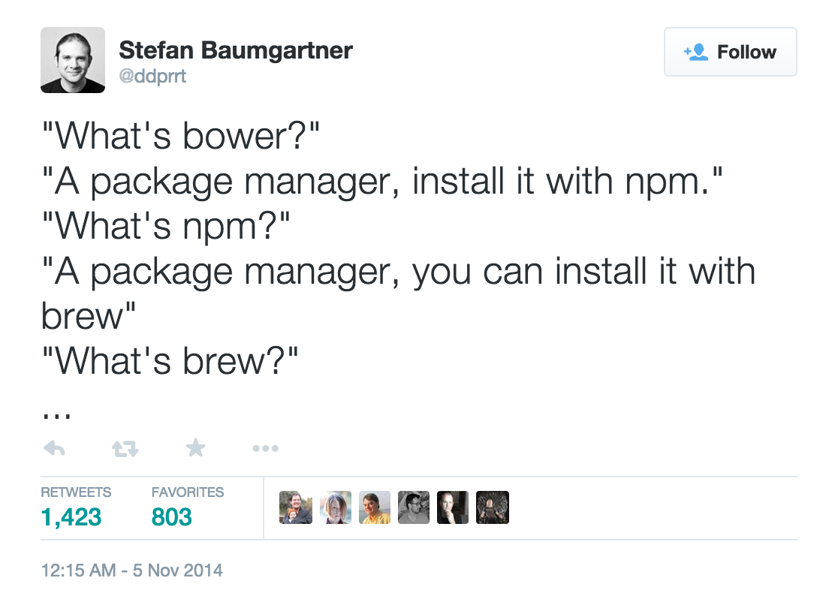
Bower

Slide 56
Leaflet
Makin' sweet maps
http://leafletjs.com/

Slide 57
Other things that were mentioned last year that might be worth talking more about
Data Storage
SQL (MySQL, SQLite, MongoDB, sql.js)
Hosting
Heroku, Google App Engine, Amazon AWS
Game engines – know any?
React.js

Slide 58
What other tools have you used and liked (for anything)?

Slide 59
How are your projects going?
Specifically, is there anything that you're trying to do that you don't know how to do?
(ask it now and then someone else might know a library that does that.)

