Slide 1
Writing Testable Web Apps
Lab 11
11/13

Slide 2
Testing
Unit testing
Dependency injection
Integration testing
UI testing?
Other concerns?
Notes:
this is the easy one

Slide 3
Unit testing
var factorial = function(n) {
if (n == 0) return 1;
else return n * factorial (n-1);
};
assert(1 === factorial(1));
assert(120 === factorial(5));
...
Notes:
this is the easy one

Slide 4
Unit testing
... is good! (why?)
what makes something a "unit" test?
assert?
"this thing is too complicated to be tested" – what made factorial() easy to test?
Notes:
unit = quick, stateless. where does assert come from?

Slide 5
Unit testing: mocha
$ npm install -g mocha
$ mkdir test
$ $EDITOR test/test.js
var assert = require("assert")
describe('Array', function(){
describe('#indexOf()', function(){
it('should return -1 when value is not present', function(){
assert.equal(-1, [1,2,3].indexOf(5));
assert.equal(-1, [1,2,3].indexOf(0));
})
})
})
mochajs.org, or npm install mocha

Slide 6
Unit testing: expect.js
https://github.com/LearnBoost/expect.js
expect(1+2).to.be(3)
expect(5).to.be.greaterThan(4);
expect([1,2,3]).to.have.length(3);
expect(fn).to.throwError();
Notes:
peers include should.js, chai

Slide 7
Dependency injection (DI)
var saveHighScoreUrl = "hs/save";
var game = function(...) {
...
save = function() {
$.post(saveHighScoreUrl, {'highScore':score}, function(data) {
// do something with response...
});
}
}
global state boooooo

Slide 8
Dependency injection (DI)
var game = function(...) {
...
save = function(saveHighScoreUrl) {
$.post(saveHighScoreUrl, {'highScore':score}, function(data) {
// do something with response...
});
}
}
Notes:
this works, or

Slide 9
Dependency injection (DI)
var game = function(saveHighScoreUrl) {
...
save = function() {
$.post(saveHighScoreUrl, {'highScore':score}, function(data) {
// do something with response...
});
}
}
Notes:
this works too

Slide 10
Dependency injection (DI)
//some initialization somewhere:
var injector = {
'saveHighScoreUrl': 'hs/save',
...
}
...
var thisgame = game(injector.saveHighScoreUrl);
global state boooooo
Notes:
what's the problem with this

Slide 11
Dependency Injection: solution
hand it off to a framework to manage
in angular:
var myMod = angular.module('myModule', []);
myMod.value('saveHighScoreUrl', 'hs/save');
Notes:
the brackets are for dependencies

Slide 12
Dependency Injection
other types of providers in angular: service, factory, provider
you can generate a complex object instead of just a simple value
benefits: mostly organizational (but this is big!)
you don't have to think about managing the Injector object
modules allow you to run the same program multiple ways
also allows mocking

Slide 13
Dependency Injection: modules, running two different ways
var prodMod = angular.module('productionUrls', []);
prodMod.value('saveHighScoreUrl', 'hs/save');
var testMod = angular.module('testingUrls', []);
testMod.value('saveHighScoreUrl', 'test/hs/save');
Notes:
the brackets are for dependencies

Slide 14
Dependency Injection: mocking
http://sinonjs.org/, jasmine.github.io, others (jsmockito, etc)
see demo on sinonjs.org, testing that a function is called
instead of setting up state, calling a function, then checking the end state, you check that the right things were called.

Slide 15
Dependency Injection: mocking
useful, for example, if you want to make sure that something on your server was called, without actually setting up a client and a server.

Slide 16
How does angular know what to inject where?
someModule.controller('MyController', ['$scope', 'greeter',
function($scope, greeter) {
// ...
}]);
Notes:
by name, mostly reflection magic. and you have to give the names of all the args in an array like so so they don't get minified.

Slide 17
unit testing: in conclusion
unit test everything you possibly can
use DI to make more things unit tested
nice side effect: code is more modular
but there will still be some things you can't unit test. for those:

Slide 18
Integration testing
depending on who you ask, this is sometimes "everything but unit testing"
make sure the parts of your program all work together
make sure a user can click "sign up" then enter their info and create an account or whatever
users can do all sorts of stuff, and you have to deal with it all; often can't just use unit testing

Slide 19
Integration testing
describe('User', function(){
describe('#save()', function(){
it('should save without error', function(done){
var user = new User('Luna');
user.save(function(err){
if (err) throw err;
done();
});
})
})
})
Notes:
how to test asynchronous things? here we're testing save(), which calls server. call done() when you're done

Slide 20
Integration testing with selenium-webdriver
var By = require('selenium-webdriver').By,
until = require('selenium-webdriver').until,
firefox = require('selenium-webdriver/firefox');
var driver = new firefox.Driver();
driver.get('http://www.google.com/ncr');
driver.findElement(By.name('q')).sendKeys('webdriver');
driver.findElement(By.name('btnG')).click();
driver.wait(until.titleIs('webdriver - Google Search'), 1000);
driver.quit();
Notes:
selenium is the big thing in this space

Slide 21
Integration testing with selenium-webdriver
chai.use(chaiWebdriver(driver));
driver.get('http://chaijs.com/');
expect('nav h1').dom.to.contain.text('Chai');
expect('#node .button').dom.to.have.style('float', 'left');
Notes:
chai + webdriver works too
----- Meeting Notes (11/13/14 11:20) -----
load testing
performance testing

Slide 22
UI testing
But integration testing does everything, right?

Slide 23
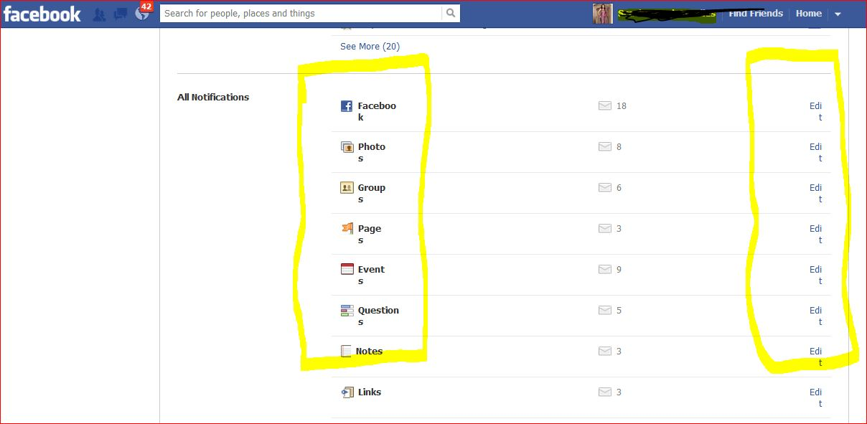
UI testing
Notes:
http://kaizentesting.files.wordpress.com/2012/08/facebookui1.jpg

Slide 24
Cross browser rendering tools
selenium, again
dalek.js (can do screenshots) (developer preview)
or, do manual tests! make big lists of test cases. this is certainly a part of testing at most companies.

Slide 25
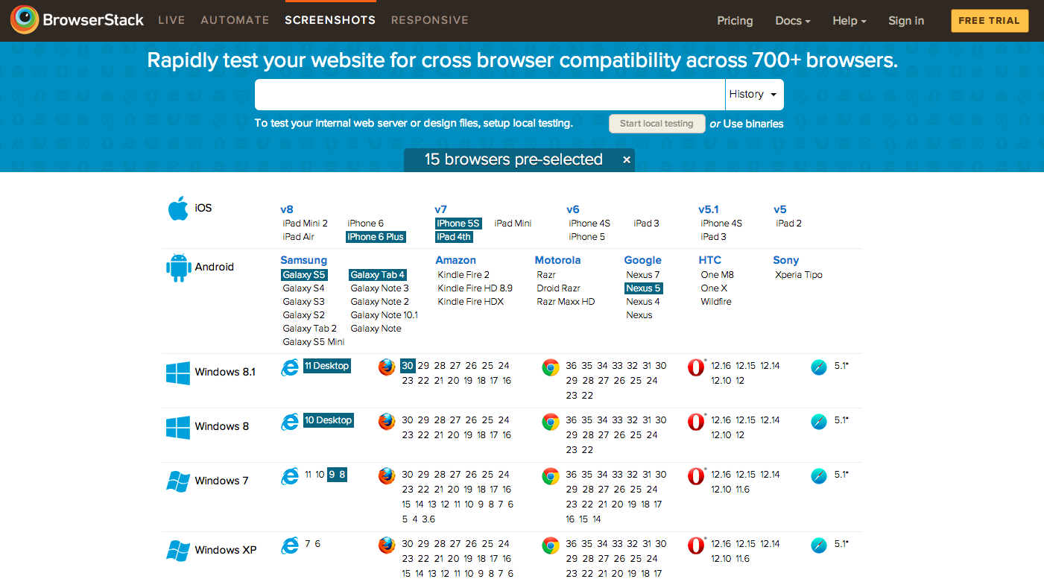
UI testing with BrowserStack
Notes:
which I have not used either, but it looks pretty easy to just check out your site in screenshots across a bunch of different OS/browsers.

Slide 26
Test-driven development
what does it mean?
biases toward unit tests
sometimes tests you write are not really meaningful

Slide 27
Documentation and testing
explaining how code works for different audiences
make sure they keep in sync, don't write excessive documentation

