Slide 1
A Grand Review
Lab 13
11/20

Slide 2
Your Projects Are Due Soon
11/25

Slide 3
SSUI Concepts + Javascript
You've learned some concepts in SSUI
You've learned lots about how to do stuff in HTML/JS/CSS
Let's connect them: how does (concept x) come up in web development? Do you have to think about it? How does it work?
more info: http://taligarsiel.com/Projects/howbrowserswork1.htm

Slide 4
SSUI Concepts + Javascript
UI Layers
Output
Input

Slide 5
Interactive System Layers
Interactive Application
Toolkit
Window System
Basic Drawing & Input
OS
I/O Hardware

Slide 6
Layers of UI in web programming
What's the windowing system?
(basically, you don't have to worry about it; everything is within browser tabs, handled by the OS)
Browser?
What's the toolkit?
HTML?
CSS?
Javascript?
HTML Canvas?
Let’s answer this by exploring where different things happen
Notes:
tabs is kind of the only way to do things – your OS windowing system also handles the browser windows

Slide 7
Interactor Hierarchy == DOM
Who decides how to draw DOM elements?
Some of this is handled in CSS
Some of this is in the definition of HTML
Can these be easily modified?
Do they have state?
Can attach state in javascript
Do they have common properties (position, size, visibility?)
Can be set in javascript; css
May be ‘inherited’ (CSS)
Childen: element.appendChild()
Notes:
E.g., a button draws something that looks like a button and appears as enable vs. disabled, depressed vs. not, with the proper text label, etc. based on information encapsulated inside the button itself

Slide 8
Normal Job of Hierarchy
Parent elements set children up for drawing (0,0; clipping)
In web programming?
Notes:
well, stuff goes where it goes. you don't really have to think about it.

Slide 9
Normal Job of Hierarchy
Parent elements set children up for drawing (0,0; clipping)
In web programming?
Efficiently handle damage/redraw
1) Each element reports whether it is damaged (may depend on interaction, window size changes, etc)
2) Aggregated up hierarchy. Only include elements that overlap the bounding box of the damaged region
3) Batch redraw
In web programming?
Notes:
can you mess with this?

Slide 10
Normal Job of Hierarchy
Parent elements set children up for drawing (0,0; clipping)
In web programming?
Efficiently handle damage/redraw
In web programming?
Layout management
Done dynamically just before redraw
Top down + bottom up combined
Specified through the hierarchy (e.g. springs and struts)
In web programming?
Notes:
http://taligarsiel.com/Projects/howbrowserswork1.htm#Dirty_bit_system

Slide 11
Layout: more details
Parent renderer determines its own width.
Parent goes over children and:
Place the child renderer (sets its x and y).
Calls child layout if needed(they are dirty or we are in a global layout or some other reason) - this calculates the child's height.
Parent uses children accumulative heights and the heights of the margins and paddings to set it own height - this will be used by the parent renderer's parent.
Sets its dirty bit to false.
Notes:
note width and height handled differently

Slide 12
Spans & Divs vs Rows & Cols
You know rows and columns e.g. in Swing? Can you do those in Javascript?
What's the difference between laying out a page of rows and columns, and laying out a page of spans and divs?
Notes:
spans and divs align themselves, row and column layouts layout the things inside them

Slide 13
How else can you do layout?
Boxes & Glue – web equivalent?
well, this is just a little more general than springs and struts – glue has a "stretchiness" and min and max values; you can really do all the same things here
Constraints – web equivalent?
http://cjs.from.so/
Absolute layout?

Slide 14
Input
State machines
done manually unless you're using an existing widget
where do existing widgets come from?
browser, or library like jQueryUI
Can you ‘add’ a state machine to any element?

Slide 15
Input
Event modeling
event handlers get an event

Slide 16
Input
Event modeling
event handlers get an event
Event dispatch
picking: position vs focus
mouse things are generally position, keyboard things are focus
Any way to manipulate picking?
capture/bubbling
can you manipulate when your events get handled?

Slide 17
Human Properties
Affordances – examples?
Feedback – examples?
Fitts's law – don't make stuff too small
Perception ranges
20ms: screen refresh, 100ms: "instant", 1-2s: "conversational", 10-15s: "lost train of thought"
Errors: enable undo/experimentation
Notes:
drop down boxes
feedback: spinners
fitts law – urls, other web things, also clicking tabs at the top of the screen
perception: what do we do if we can't control these things

Slide 18
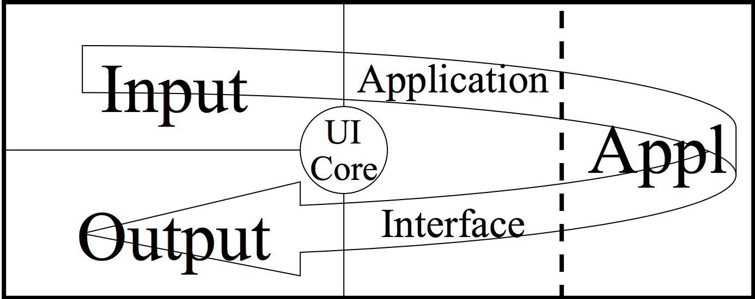
Application Architecture

Slide 19
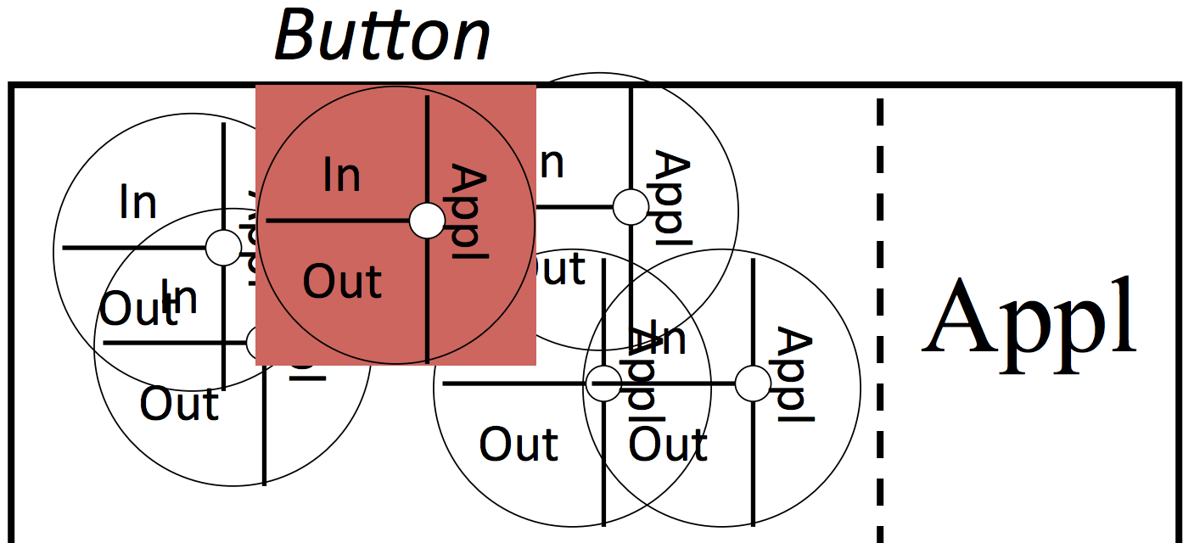
Application Architecture
Notes:
how to tame this complexity

Slide 20
Application Architecture
Composition/inheritance/aggregation
examples of each?
types of interactors that are available on the web vs desktop app
we have more simpler interactors on the web – why?
indirection of specifying a button on web vs. e.g. Swing
lack of inheritance -> difficulty adding some behavior to a button
Notes:
composition: html, put stuff together in a container
inheritance: hard to deal with, only prototypes.. whorfian effects of it not being there?
aggregation:

Slide 21
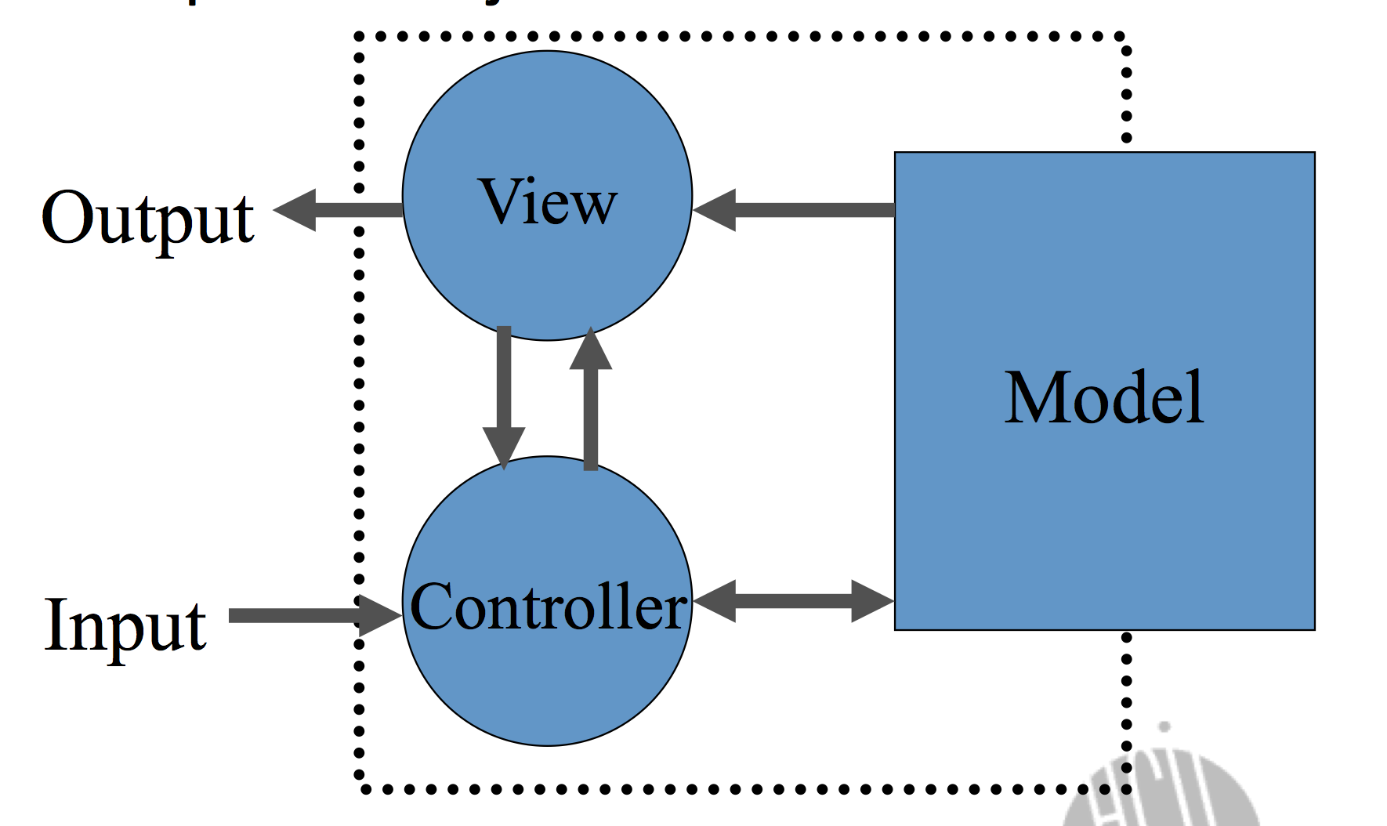
Application Architecture

Slide 22
Application Architecture
MVC: HTML model, CSS view, JS controller
What's unique about this for the web?

Slide 23
Application Architecture
MVC: HTML model, CSS view, JS controller
What's unique about this for the web?
some of these output-to-input round trips take an arbitrarily long amount of time (→ asynchronous everything, AJAX)
the server, as a component, takes all kinds of input (→ routing!)
people are viewing this on all kinds of devices

