Slide 1
A Grand Review
Lab 13
11/20

Slide 2
Your Projects Are Due Soon
11/25

Slide 3
SSUI Concepts + Javascript
You've learned some concepts in SSUI
You've learned lots about how to do stuff in HTML/JS/CSS
Let's connect them: how does (concept x) come up in web development? Do you have to think about it? How does it work?

Slide 4
SSUI Concepts + Javascript
UI Layers
Output
Input

Slide 5
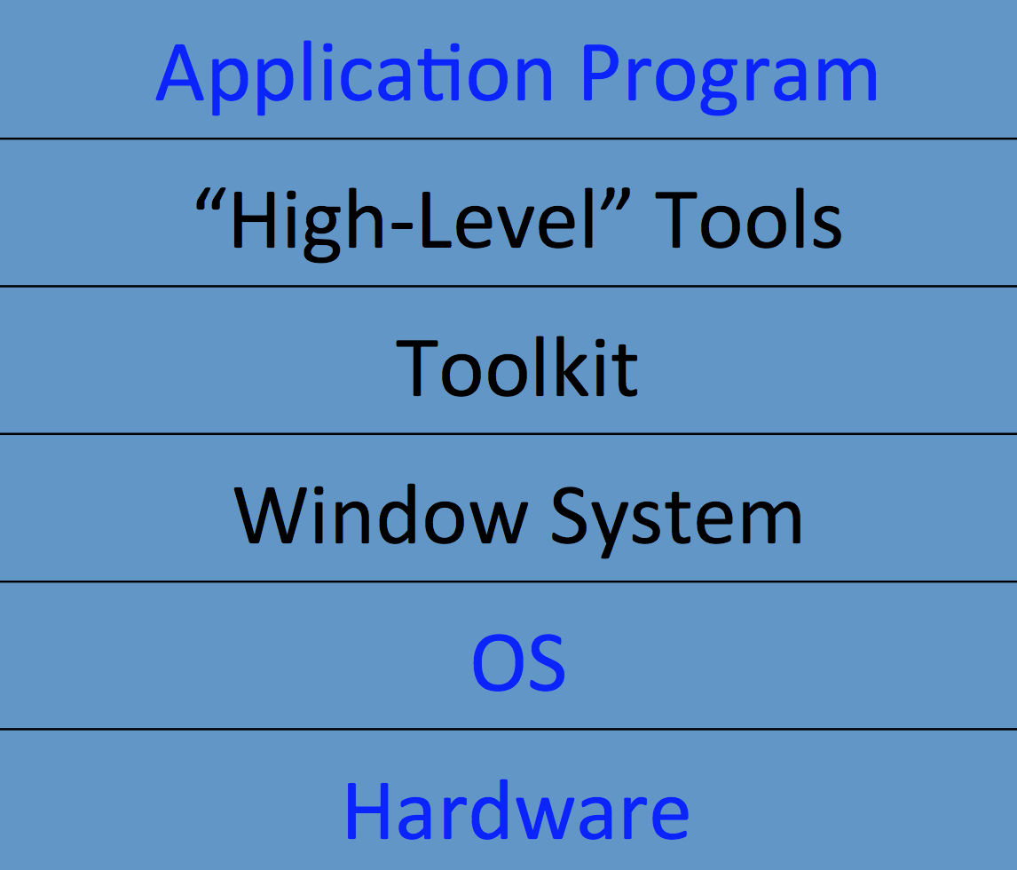

Slide 6
Layers of UI in web programming
What's the windowing system?
(basically, you don't have to worry about it; everything is within one browser window)
What's the toolkit?
HTML and other widgets: buttons, checkboxes, text areas, etc

Slide 7
Interactor tree
What's the interactor tree?
the DOM
How do we, well, interact with it?
DOM manipulations, in javascript
document.getElementById(foo).doSomething()
element.appendChild()
jQuery's $('#foo').append("<hr>")

Slide 8
Output
Hierarchical drawing
Each interactor draws itself
set clipping region
save and restore context
concepts useful w/ canvas, otherwise browser does them for you
Damage/redraw
handled by browser, not much to worry about

Slide 9
Output: Layout
fixed (position: absolute/relative/fixed) – simple, but has problems
dynamic (position: static) – more difficult
springs and struts? boxes and glue? general constraints?
Notes:
relative is "relative to where it should be", absolute is absolute in the page, fixed is absolute in the window
we mostly have springs and struts in css. this is still complicated.

Slide 10
Input
State machines
done manually unless you're using an existing widget
where do existing widgets come from?
browser, or library like jQueryUI
Event modeling
event handlers get an event
Event dispatch
capture/bubbling
picking: position vs focus
mouse things are generally position, keyboard things are focus

Slide 11
Human Properties
Affordances – examples?
Feedback – examples?
Fitts's law – don't make stuff too small
Perception ranges
20ms: screen refresh, 100ms: "instant", 1-2s: "conversational", 10-15s: "lost train of thought"
Errors: enable undo/experimentation
Notes:
drop down boxes
feedback: spinners

Slide 12
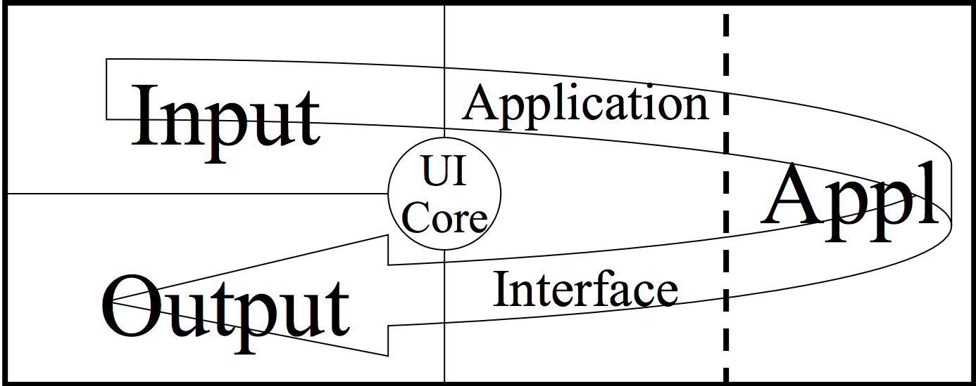
Application Architecture

Slide 13
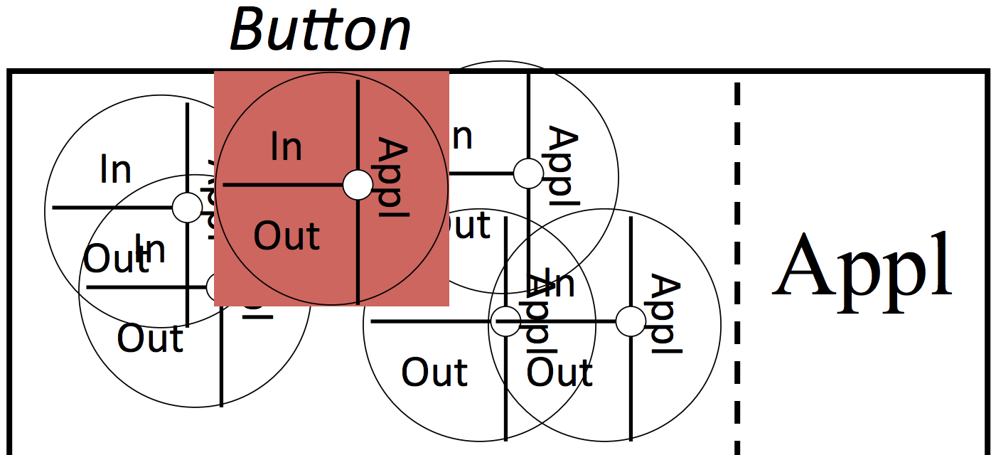
Application Architecture

Slide 14
Model-View-Controller
Loosely: HTML-CSS-JS

