Slide 1

State machines and AJAX
Lab 7
10/6

Slide 2
Last time…
Events & callbacks
target.addEventListener(<event>, <callback>);
target.removeEventListener(<event>, <callback>);
setTimeout(<callback>, <delay>);
Event bubbling
Capture versus bubbling

Slide 3
Today
P2 doodles
FSMs & P3 (optional)
Positional and focus based dispatch
AJAX
Accessing data from remote servers
Making your own servers (if there's time)

Slide 4
but first administrative stuff
Got to cancel office hours tomorrow, I'm at a conference
Monday 5:30-7:00pm good?

Slide 5
P2 Doodles
Notes:
christok/doodle.html – cannon
itingl/doodle.html – drawing app
jamesmar/doodle.html – towers
mzhang/doodle.html – neat clock

Slide 6
Finite State Machines
a quick review

Slide 7
What is a Finite State Machine?
Very simple component or ‘machine’ that responds to input of some kind.
When discussed in CS theory, input is usually a character or number.
In HCI, input is usually a mouse down event, a key press event, etc.
Input can be anything that the machine takes in.

Slide 8
What is a Finite State Machine?
What a state machine has:
Its current state
A start state
Rules that define what state it should go to given a state and input (called ‘transitions’)
What the state machine does:
When it gets input, it moves to another state.

Slide 9
What are some examples of Finite State Machines?

Slide 10
FSM Notation
Means: when you are in state A and you see a mouse down, go to state B
Mouse_Dn
A
B

Slide 11
Example: Binary # with Odd or Even Number of Zeros:
1
0
even
odd
0
1

Slide 12
Why do we Care?
For interactions like a draggable icon (or something more complex), it is good to think of the icon as a state machine.
Often people implicitly use state into their code without knowing it.
Then, when their code gets more complex they often wish they’d used a state machine.

Slide 13
State Machines for HCI
Adding one extra thing: the action to execute when a transition is taken.

Slide 14
FSM Notation for HCI
Means: when you are in state A and you see a mouse down, do the action (call draw_line),
and go to state B
Mouse_Dn/ Draw Line
A
B

Slide 15
FSM for a button
Release / D
Enter / C
Leave / B
Press-inside / A
Release / E
A: highlight button
B: unhighlight button
C: highlight button
D: <do nothing>
E: unhighlight; do button action

Slide 16
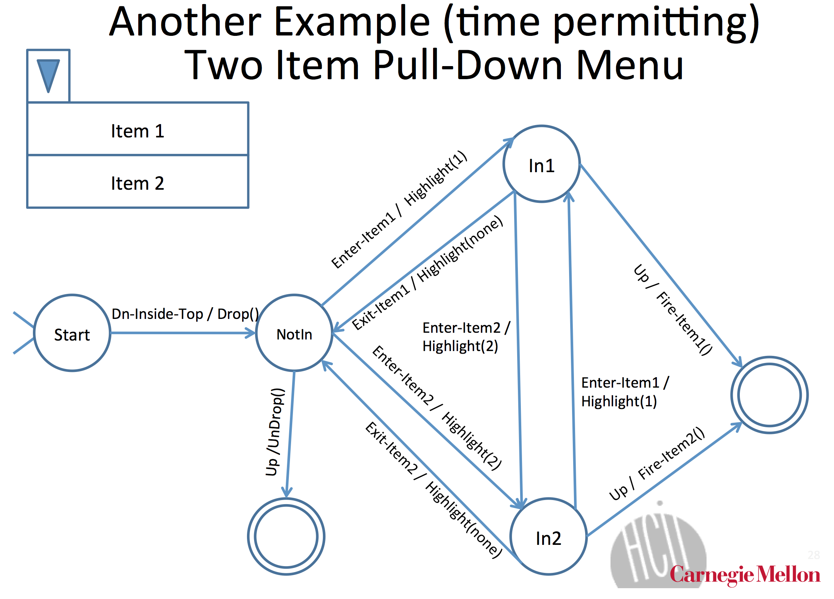

Slide 17
FSM for…?
Notes:
pick an example of some interaction on a website, say. go through what it does. (optional, if they want)

Slide 18
How do browsers dispatch events?
focus vs. positional – some events use focus and some use position. (which?)
dragging needs focus-based dispatch. but mouse events are positional. how would you add focus-based dispatch?
Notes:
show example of my project 3 solution
keyboard events are focus based
mouse events are mostly location based
(don't want to go into too much detail b/c that's the project)

Slide 19
Project 3
Write a StateMachine object that takes in a description of a state machine and acts according to the description.
Then write some tests.
How's it going?

Slide 20
AJAX
Asynchronous JavaScript & XML
Loads data from external services without refreshing page
Defined “Web 2.0”
Procedurally:
Make an asynchronous call to an external API
This call will return a value after some delay
Show a loading message (good UI practice)
Update the web page in response to the return value of the asynchronous call

Slide 21
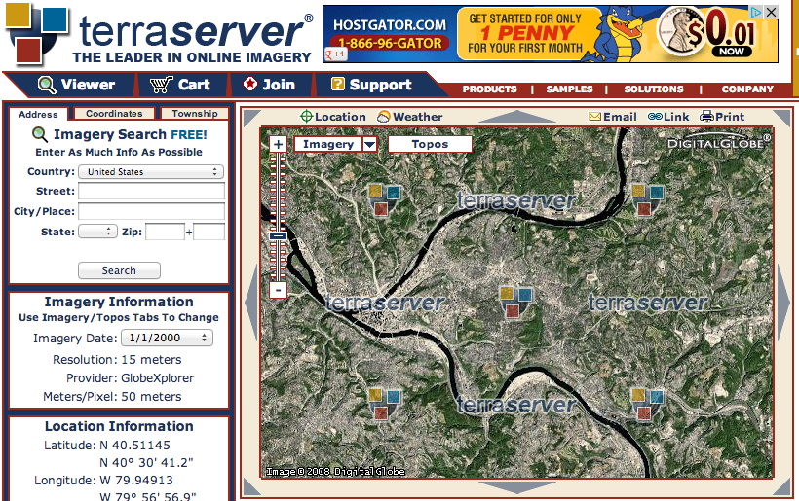
it’s the difference between…

Slide 22
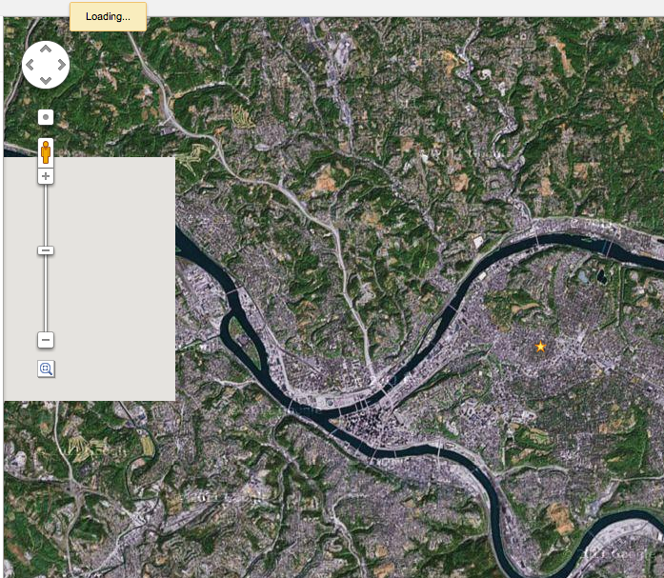

Slide 23
Notes:
other examples of ajax?
what are some of the difficulties in it?

Slide 24
Next time…
“Should I wear a jacket today?”
Going to use Yahoo! Weather API
http://developer.yahoo.com/weather/
One of many available weather APIs
http://weather.yahooapis.com/forecastrss?w=2473224
For next class:
Install Node.js: http://nodejs.org/

Slide 25
AJAX
Lab 8 – or maybe earlier if we get to it in lab 7
10/16

Slide 26
AJAX
Asynchronous JavaScript & XML
Loads data from external services without refreshing page
Defined “Web 2.0”
Procedurally:
Make an asynchronous call to an external API
This call will return a value after some delay
Show a loading message (good UI practice)
Update the web page in response to the return value of the asynchronous call

Slide 27
AJAX
Done with XMLHttpRequest
API for sending requests to a web server within JavaScript
Many libraries simplify the development of AJAX
…we won’t use any of them in this lecture
…but you may for your final projects

Slide 28
XMLHttpRequest
.readyState
1: open method has been successfully called
2: send method has been successfully called, response headers have been recieved
3: response has begun to load
4: response has finished loading

Slide 29
XMLHttpRequest
.status
Status code in the response from the server
200: OK
403: Forbidden
404: Not found

Slide 30
XMLHttpRequest
.onreadystatechange = function()…
Called when .readyState changes
.open(method, url)
Specify a method (GET, POST, etc.) and a URL to fetch
.send()
Sends the request (optional data argument)

Slide 31
XMLHttpRequest
.readyState
1: open method has been successfully called
2: send method has been successfully called, response headers have been recieved
3: response has begun to load
4: response has finished loading
.status
Status code in the response from the server
200: OK
403: Forbidden
404: Not found
.onreadystatechange = function()…
Called when .readyState changes
.open(method, url)
Specify a method (GET, POST, etc.) and a URL to fetch
.send()
Sends the request (optional data argument)
Notes:
Much more customizable but you don’t usually need more properties than this…

Slide 32
var xmlhttp = new XMLHttpRequest();
xmlhttp.onreadystatechange = function() {
if (xmlhttp.readyState === 4 && xmlhttp.status === 200) {
console.log(xmlhttp);
}
};
xmlhttp.open("GET", "http://from.so/web_lab/pgh_weather.php");
xmlhttp.send();

Slide 33
var xmlhttp = new XMLHttpRequest();
xmlhttp.onreadystatechange = function() {
if (xmlhttp.readyState === 4 && xmlhttp.status === 200) {
console.log(xmlhttp);
}
};
xmlhttp.open("GET", ”http://from.so/web_lab/pgh_weather.php");
xmlhttp.send();

Slide 34
var xmlhttp = new XMLHttpRequest();
xmlhttp.onreadystatechange = function() {
if (xmlhttp.readyState === 4 && xmlhttp.status === 200) {
console.log(xmlhttp);
}
};
xmlhttp.open("GET", ”http://from.so/web_lab/pgh_weather.php");
xmlhttp.send();

Slide 35
var xmlhttp = new XMLHttpRequest();
xmlhttp.onreadystatechange = function() {
if (xmlhttp.readyState === 4 && xmlhttp.status === 200) {
console.log(xmlhttp);
}
};
xmlhttp.open("GET", ”http://from.so/web_lab/pgh_weather.php");
xmlhttp.send();

Slide 36
var xmlhttp = new XMLHttpRequest();
xmlhttp.onreadystatechange = function() {
if (xmlhttp.readyState === 4 && xmlhttp.status === 200) {
console.log(xmlhttp);
}
};
xmlhttp.open("GET", ”http://from.so/web_lab/pgh_weather.php");
xmlhttp.send();

Slide 37
var xmlhttp = new XMLHttpRequest();
xmlhttp.onreadystatechange = function() {
if (xmlhttp.readyState === 4 && xmlhttp.status === 200) {
console.log(xmlhttp);
}
};
xmlhttp.open("GET", ”http://from.so/web_lab/pgh_weather.php");
xmlhttp.send();

Slide 38
Should I wear a jacket today?
Yahoo! Weather API
http://from.so/web_lab/pgh_weather.php
More information about the API:
http://developer.yahoo.com/weather/
Step 1: Fetch weather information from Yahoo!
Starter code on next slide
Notes:
show your code as an example

Slide 39
Step 1: Fetch weather data
var xmlhttp = new XMLHttpRequest();
xmlhttp.onreadystatechange = function() {
if (xmlhttp.readyState === 4 && xmlhttp.status === 200) {
console.log(xmlhttp);
}
};
xmlhttp.open("GET", ”http://from.so/web_lab/pgh_weather.php");
xmlhttp.send();

Slide 40
Dealing with response data
Two most common formats: XML & JSON
XML: Treated like HTML, root: xmlhttp.responseXML
xmlhttp.responseXML.getElementById
xmlhttp.responseXML.getElementsByTagName
JSON: JavaScript objects are directly given
JSON.parse(xmlhttp.responseText)

Slide 41
Dealing with response data
Two most common formats: XML & JSON
XML: Treated like HTML, root: xmlhttp.responseXML
xmlhttp.responseXML.getElementById
xmlhttp.responseXML.getElementsByTagName
JSON: JavaScript objects are directly given
JSON.parse(xmlhttp.responseText)
Yahoo! Weather API uses XML

Slide 42
Step 2: Update your UI with weather data
var xmlhttp = new XMLHttpRequest();
xmlhttp.onreadystatechange = function() {
if (xmlhttp.readyState === 4 && xmlhttp.status === 200) {
var condition= xmlhttp.responseXML.getElementsByTagName("condition");
// your code here...
}
};
xmlhttp.open("GET", "http://from.so/web_lab/pgh_weather.php");
xmlhttp.send();

Slide 43
Step 2: Update your UI with weather data
var xmlhttp = new XMLHttpRequest();
xmlhttp.onreadystatechange = function() {
if (xmlhttp.readyState === 4 && xmlhttp.status === 200) {
var condition= xmlhttp.responseXML.getElementsByTagName("condition");
console.log(condition[0].attributes['temp']);
}
};
xmlhttp.open("GET", "http://from.so/web_lab/pgh_weather.php");
xmlhttp.send();

Slide 44
Web Servers

Slide 45
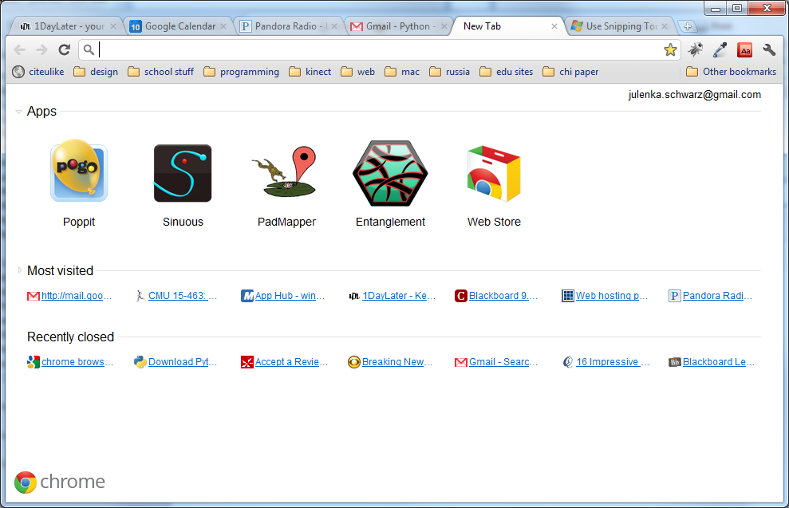
So Far…
Notes:
All of this logic runs on your computer.
If you change computers, all of your information is lost.
Can’t access large amounts of information this way.
You couldn’t build Gmail using what we’ve learned so far.

Slide 46
So Far…
We’ve learned about how to make cool interactive stuff happen on your web page.
All of this logic runs on your computer.
If you change computers, all of your information is lost.
Notes:
All of this logic runs on your computer.
If you change computers, all of your information is lost.
Can’t access large amounts of information this way.
You couldn’t build Gmail using what we’ve learned so far.

Slide 47
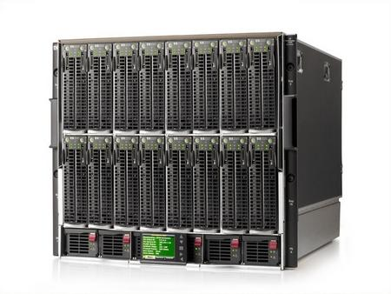
The missing peice
http://1userverrack.net/wp-content/uploads/2011/05/web-server1.jpg
Notes:
In order to store your data when your computer closes, or be able to access your same email across computers, you need to store it somewhere else, like in this giant behemoth.
When you get webpages, you are usually not loading them from your computer as we are in class. You’re loading them from a web server, a computer that’s sitting somewhere else (could be in your room or somewhere in Kentucky. Probably not in your room). Usually you load pages from computers that are called servers.
These servers can do more than just give you a simple HTML page. You can also run programs on servers, and more importantly, store huge amounts of data.

Slide 48

The Beauty of Servers
Notes:
Servers can query that data and give it to you wherever you are.

Slide 49
Server-Side Programming
Writing code that runs on the server.
Logic that gets data for you
Stores data
Combines data intelligently and generates a page to present to you.
You may hear people talk about "front end" and "back end". These terms are a little overloaded – some people mean "front end" is client and "back end" is server; some people talk about both "front end" and "back end" servers. The terms "Client" and "Server" are more clear.

Slide 50
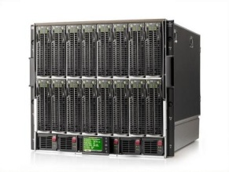

How Server-Side Code Executes (Simple Model)
http://mysite.com/blog/getPost?day=xyz
Web browser makes request to server
Server thinks
def doGet():
doSomething()
getData()
Server gives you a page

Slide 51
what is “server-side?”
most javascript is client-side
executed in the user’s browser
javascript may now be server-side
executed in the web page server
executed anywhere!

Slide 52
node.js
took Chrome javascript engine
made it an application
added libraries and utilities
result: javascript everywhere
http://node.js.org

Slide 53
why server-side js?
Notes:
Ask students: why would you want server-side js?

Slide 54
why server-side js?
re-use client-side code on the server
well known language
event-listener paradigm works well
node.js is actually faster sometimes
...or maybe you just like javascript
Notes:
Ask students: why would you want server-side js?

Slide 55
node web server
var http = require('http');
http.createServer(function (req, res) {
res.writeHead(200, {'Content-Type': 'text/plain'});
res.end('Hello World');
}).listen(80);
console.log('Server running at http://127.0.0.1/');
http://nodejs.org/

Slide 56
node web server
var http = require('http');
http.createServer(function (req, res) {
res.writeHead(200, {'Content-Type': 'text/plain'});
res.end('Hello World');
}).listen(80);
console.log('Server running at
http://nodejs.org/

Slide 57
node web server
var http = require('http');
http.createServer(function (req, res) {
res.writeHead(200, {'Content-Type': 'text/plain'});
res.end('Hello World');
}).listen(80);
console.log('Server running at
http://nodejs.org/

Slide 58
node web server
var http = require('http');
http.createServer(function (req, res) {
res.writeHead(200, {'Content-Type': 'text/plain'});
res.end('Hello World');
}).listen(80);
console.log('Server running at
http://nodejs.org/

Slide 59
node web server
var http = require('http');
http.createServer(function (req, res) {
res.writeHead(200, {'Content-Type': 'text/plain'});
res.end('Hello World');
}).listen(80);
console.log('Server running at
http://nodejs.org/

Slide 60
node web server
var http = require('http');
http.createServer(function (req, res) {
res.writeHead(200, {'Content-Type': 'text/plain'});
res.end('Hello World');
}).listen(80);
console.log('Server running at;
http://nodejs.org/

Slide 61
node web server
var http = require('http');
http.createServer(function (req, res) {
res.writeHead(200, {'Content-Type': 'text/plain'});
res.end('Hello World');
}).listen(80);
console.log('Server running at http://127.0.0.1/');
http://nodejs.org/

Slide 62
node web server
var http = require('http');
http.createServer(function (req, res) {
res.writeHead(200, {'Content-Type': 'text/plain'});
res.end('Hello World');
}).listen(80);
console.log('Server running at http://127.0.0.1/');
http://nodejs.org/

Slide 63
node: socket.io
create sockets for quick client-server communication
allows for very “live” web pages
socket.emit(event, data);
socket.on(event, function);
http://socket.io/

Slide 64
node: socket.io
create sockets for quick client-server communication
allows for very “live” web pages
install via "npm install socket.io"
http://socket.io/

Slide 65
socket.io for node
server-side
client-side
var io = require('socket.io').listen(80);
io.sockets.on('connection', function (socket) {
socket.emit('news', 'Stocks are up!');
socket.on('response', function (data) {
console.log(data);
});
});
<script src="/socket.io/socket.io.js"></script>
<script>
var socket = io.connect('http://localhost');
socket.on('news', function (data) {
socket.emit('response', { user: 'steve' });
});
</script>
http://socket.io/

Slide 66
socket.io for node
server-side
client-side
var io = require('socket.io').listen(80);
io.sockets.on('connection', function (socket) {
socket.emit('news', 'Stocks are up!');
socket.on('response', function (data) {
console.log(data);
});
});
<script src="/socket.io/socket.io.js"></script>
<script>
var socket = io.connect('http://localhost');
socket.on('news', function (data) {
socket.emit('response', { user: 'steve' });
});
</script>
http://socket.io/

Slide 67
socket.io for node
server-side
client-side
var io = require('socket.io').listen(80);
io.sockets.on('connection', function (socket) {
socket.emit('news', 'Stocks are up!');
socket.on('response', function (data) {
console.log(data);
});
});
<script src="/socket.io/socket.io.js"></script>
<script>
var socket = io.connect('http://localhost');
socket.on('news', function (data) {
socket.emit('response', { user: 'steve' });
});
</script>
http://socket.io/

Slide 68
socket.io for node
server-side
client-side
var io = require('socket.io').listen(80);
io.sockets.on('connection', function (socket) {
socket.emit('news', 'Stocks are up!');
socket.on('response', function (data) {
console.log(data);
});
});
<script src="/socket.io/socket.io.js"></script>
<script>
var socket = io.connect('http://localhost');
socket.on('news', function (data) {
socket.emit('response', { user: 'steve' });
});
</script>
http://socket.io/

Slide 69
socket.io for node
server-side
client-side
var io = require('socket.io').listen(80);
io.sockets.on('connection', function (socket) {
socket.emit('news', 'Stocks are up!');
socket.on('response', function (data) {
console.log(data);
});
});
<script src="/socket.io/socket.io.js"></script>
<script>
var socket = io.connect('http://localhost');
socket.on('news', function (data) {
socket.emit('response', { user: 'steve' });
});
</script>
http://socket.io/

Slide 70
socket.io for node
server-side
client-side
var io = require('socket.io').listen(80);
io.sockets.on('connection', function (socket) {
socket.emit('news', 'Stocks are up!');
socket.on('response', function (data) {
console.log(data);
});
});
<script src="/socket.io/socket.io.js"></script>
<script>
var socket = io.connect('http://localhost');
socket.on('news', function (data) {
socket.emit('response', { user: 'steve' });
});
</script>
http://socket.io/

Slide 71
socket.io for node
server-side
client-side
var io = require('socket.io').listen(80);
io.sockets.on('connection', function (socket) {
socket.emit('news', 'Stocks are up!');
socket.on('response', function (data) {
console.log(data);
});
});
<script src="/socket.io/socket.io.js"></script>
<script>
var socket = io.connect('http://localhost');
socket.on('news', function (data) {
socket.emit('response', { user: 'steve' });
});
</script>
http://socket.io/

Slide 72
socket.io for node
server-side
client-side
var io = require('socket.io').listen(80);
io.sockets.on('connection', function (socket) {
socket.emit('news', 'Stocks are up!');
socket.on('response', function (data) {
console.log(data);
});
});
<script src="/socket.io/socket.io.js"></script>
<script>
var socket = io.connect('http://localhost');
socket.on('news', function (data) {
socket.emit('response', { user: 'steve' });
});
</script>
http://socket.io/

Slide 73
socket.io for node
server-side
client-side
var io = require('socket.io').listen(80);
io.sockets.on('connection', function (socket) {
socket.emit('news', 'Stocks are up!');
socket.on('response', function (data) {
console.log(data);
});
});
<script src="/socket.io/socket.io.js"></script>
<script>
var socket = io.connect('http://localhost');
socket.on('news', function (data) {
socket.emit('response', { user: 'steve' });
});
</script>
http://socket.io/

Slide 74
socket.io for node
server-side
client-side
var io = require('socket.io').listen(80);
io.sockets.on('connection', function (socket) {
socket.emit('news', 'Stocks are up!');
socket.on('response', function (data) {
console.log(data);
});
});
<script src="/socket.io/socket.io.js"></script>
<script>
var socket = io.connect('http://localhost');
socket.on('news', function (data) {
socket.emit('response', { user: 'steve' });
});
</script>
http://socket.io/

Slide 75
In-class project
Write a chat application using Socket.IO
Teams of 2 (randomly divided)

