Slide 1

AJAX and servers
Lab 8
10/16

Slide 2
AJAX
Asynchronous JavaScript & XML
Loads data from external services without refreshing page
Defined “Web 2.0”
Procedurally:
Make an asynchronous call to an external API
This call will return a value after some delay
Show a loading message (good UI practice)
Update the web page in response to the return value of the asynchronous call

Slide 3
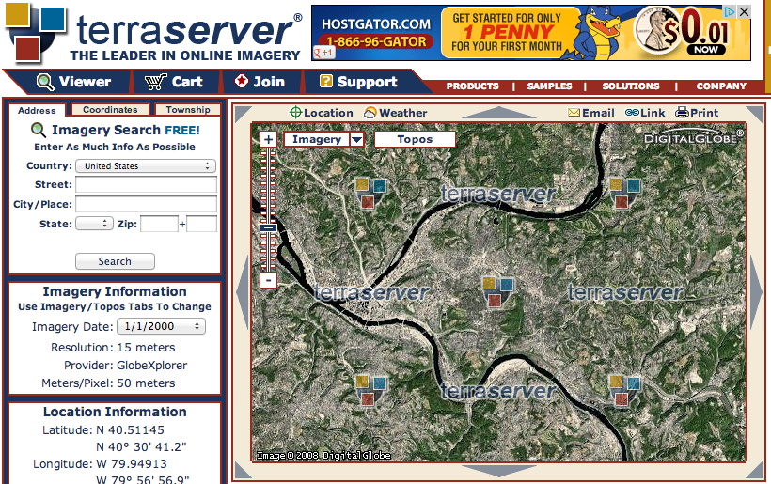
it’s the difference between…

Slide 4
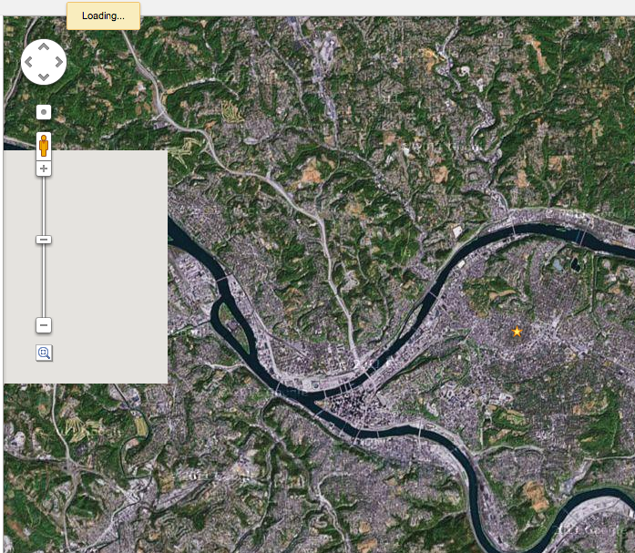

Slide 5
Notes:
other examples of ajax?
what are some of the difficulties in it?

Slide 6
Next time…
“Should I wear a jacket today?”
Going to use Yahoo! Weather API
http://developer.yahoo.com/weather/
One of many available weather APIs
http://weather.yahooapis.com/forecastrss?w=2473224
For next class:
Install Node.js: http://nodejs.org/

Slide 7
AJAX
Asynchronous JavaScript & XML
Loads data from external services without refreshing page
Defined “Web 2.0”
Procedurally:
Make an asynchronous call to an external API
This call will return a value after some delay
Show a loading message (good UI practice)
Update the web page in response to the return value of the asynchronous call

Slide 8
AJAX
Done with XMLHttpRequest
API for sending requests to a web server within JavaScript
Many libraries simplify the development of AJAX
…we won’t use any of them in this lecture
…but you may for your final projects

Slide 9
XMLHttpRequest
.readyState
1: open method has been successfully called
2: send method has been successfully called, response headers have been recieved
3: response has begun to load
4: response has finished loading

Slide 10
XMLHttpRequest
.status
Status code in the response from the server
200: OK
403: Forbidden
404: Not found

Slide 11
XMLHttpRequest
.onreadystatechange = function()…
Called when .readyState changes
.open(method, url)
Specify a method (GET, POST, etc.) and a URL to fetch
.send()
Sends the request (optional data argument)

Slide 12
XMLHttpRequest
.readyState
1: open method has been successfully called
2: send method has been successfully called, response headers have been recieved
3: response has begun to load
4: response has finished loading
.status
Status code in the response from the server
200: OK
403: Forbidden
404: Not found
.onreadystatechange = function()…
Called when .readyState changes
.open(method, url)
Specify a method (GET, POST, etc.) and a URL to fetch
.send()
Sends the request (optional data argument)
Notes:
Much more customizable but you don’t usually need more properties than this…

Slide 13
var xmlhttp = new XMLHttpRequest();
xmlhttp.onreadystatechange = function() {
if (xmlhttp.readyState === 4 && xmlhttp.status === 200) {
console.log(xmlhttp);
}
};
xmlhttp.open("GET", "http://from.so/web_lab/pgh_weather.php");
xmlhttp.send();
Notes:
run this in an incognito window so my https extensions don't mess with it

Slide 14
var xmlhttp = new XMLHttpRequest();
xmlhttp.onreadystatechange = function() {
if (xmlhttp.readyState === 4 && xmlhttp.status === 200) {
console.log(xmlhttp);
}
};
xmlhttp.open("GET", ”http://from.so/web_lab/pgh_weather.php");
xmlhttp.send();

Slide 15
var xmlhttp = new XMLHttpRequest();
xmlhttp.onreadystatechange = function() {
if (xmlhttp.readyState === 4 && xmlhttp.status === 200) {
console.log(xmlhttp);
}
};
xmlhttp.open("GET", ”http://from.so/web_lab/pgh_weather.php");
xmlhttp.send();

Slide 16
var xmlhttp = new XMLHttpRequest();
xmlhttp.onreadystatechange = function() {
if (xmlhttp.readyState === 4 && xmlhttp.status === 200) {
console.log(xmlhttp);
}
};
xmlhttp.open("GET", ”http://from.so/web_lab/pgh_weather.php");
xmlhttp.send();

Slide 17
var xmlhttp = new XMLHttpRequest();
xmlhttp.onreadystatechange = function() {
if (xmlhttp.readyState === 4 && xmlhttp.status === 200) {
console.log(xmlhttp);
}
};
xmlhttp.open("GET", ”http://from.so/web_lab/pgh_weather.php");
xmlhttp.send();

Slide 18
var xmlhttp = new XMLHttpRequest();
xmlhttp.onreadystatechange = function() {
if (xmlhttp.readyState === 4 && xmlhttp.status === 200) {
console.log(xmlhttp);
}
};
xmlhttp.open("GET", ”http://from.so/web_lab/pgh_weather.php");
xmlhttp.send();

Slide 19
Should I wear a jacket today?
Yahoo! Weather API
http://from.so/web_lab/pgh_weather.php
More information about the API:
http://developer.yahoo.com/weather/
Step 1: Fetch weather information from Yahoo!
Starter code on next slide
Notes:
we're using stephen's code b/c it takes care of some needs incl. authentication

Slide 20
Step 1: Fetch weather data
var xmlhttp = new XMLHttpRequest();
xmlhttp.onreadystatechange = function() {
if (xmlhttp.readyState === 4 && xmlhttp.status === 200) {
console.log(xmlhttp);
}
};
xmlhttp.open("GET", ”http://from.so/web_lab/pgh_weather.php");
xmlhttp.send();

Slide 21
Dealing with response data
Two most common formats: XML & JSON
XML: Treated like HTML, root: xmlhttp.responseXML
xmlhttp.responseXML.getElementById
xmlhttp.responseXML.getElementsByTagName
JSON: JavaScript objects are directly given
JSON.parse(xmlhttp.responseText)

Slide 22
Dealing with response data
Two most common formats: XML & JSON
XML: Treated like HTML, root: xmlhttp.responseXML
xmlhttp.responseXML.getElementById
xmlhttp.responseXML.getElementsByTagName
JSON: JavaScript objects are directly given
JSON.parse(xmlhttp.responseText)
Yahoo! Weather API uses XML

Slide 23
Step 2: Update your UI with weather data
var xmlhttp = new XMLHttpRequest();
xmlhttp.onreadystatechange = function() {
if (xmlhttp.readyState === 4 && xmlhttp.status === 200) {
var condition= xmlhttp.responseXML.getElementsByTagName("condition");
// your code here...
}
};
xmlhttp.open("GET", "http://from.so/web_lab/pgh_weather.php");
xmlhttp.send();

Slide 24
Step 2: Update your UI with weather data
var xmlhttp = new XMLHttpRequest();
xmlhttp.onreadystatechange = function() {
if (xmlhttp.readyState === 4 && xmlhttp.status === 200) {
var condition= xmlhttp.responseXML.getElementsByTagName("condition");
console.log(condition[0].attributes['temp']);
}
};
xmlhttp.open("GET", "http://from.so/web_lab/pgh_weather.php");
xmlhttp.send();

Slide 25
Web Servers

Slide 26
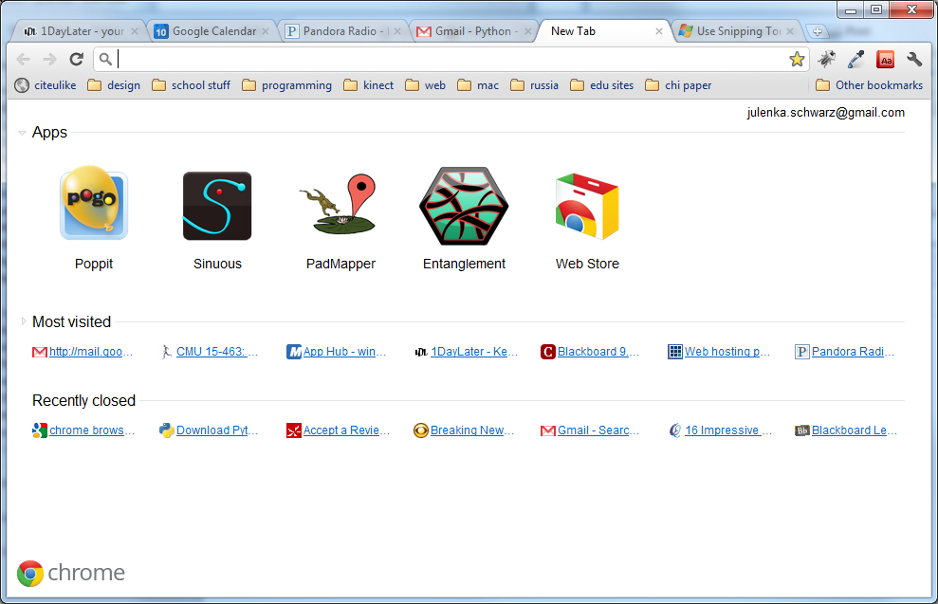
So Far…
Notes:
All of this logic runs on your computer.
If you change computers, all of your information is lost.
Can’t access large amounts of information this way.
You couldn’t build Gmail using what we’ve learned so far.

Slide 27
So Far…
We’ve learned about how to make cool interactive stuff happen on your web page.
All of this logic runs on your computer.
If you change computers, all of your information is lost.
Notes:
All of this logic runs on your computer.
If you change computers, all of your information is lost.
Can’t access large amounts of information this way.
You couldn’t build Gmail using what we’ve learned so far.

Slide 28
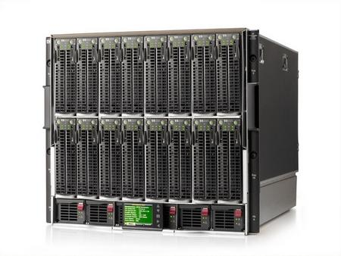
The missing piece
http://1userverrack.net/wp-content/uploads/2011/05/web-server1.jpg
Notes:
In order to store your data when your computer closes, or be able to access your same email across computers, you need to store it somewhere else, like in this giant behemoth.
When you get webpages, you are usually not loading them from your computer as we are in class. You’re loading them from a web server, a computer that’s sitting somewhere else (could be in your room or somewhere in Kentucky. Probably not in your room). Usually you load pages from computers that are called servers.
These servers can do more than just give you a simple HTML page. You can also run programs on servers, and more importantly, store huge amounts of data.

Slide 29

The Beauty of Servers
Notes:
Servers can query that data and give it to you wherever you are.

Slide 30
Server-Side Programming
Writing code that runs on the server.
Logic that gets data for you
Stores data
Combines data intelligently and generates a page to present to you.
You may hear people talk about "front end" and "back end". These terms are a little overloaded – some people mean "front end" is client and "back end" is server; some people talk about both "front end" and "back end" servers. The terms "Client" (your laptop and a browser) and "Server" (usually a big data center somewhere) are more clear.

Slide 31
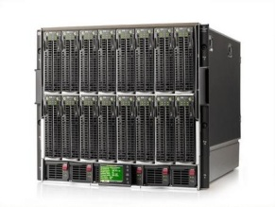

How Server-Side Code Executes (Simple Model)
http://mysite.com/blog/getPost?day=xyz
Web browser makes request to server
Server thinks
def doGet():
doSomething()
getData()
Server gives you a page

Slide 32
what is “server-side?”
most javascript is client-side
executed in the user’s browser
javascript may now be server-side
executed in the web page server
executed anywhere!

Slide 33
node.js
took Chrome javascript engine
made it an application
added libraries and utilities
result: javascript everywhere
http://node.js.org

Slide 34
why server-side js?
Notes:
Ask students: why would you want server-side js?

Slide 35
why server-side js?
re-use client-side code on the server
well known language
event-listener paradigm works well
node.js is actually faster sometimes
...or maybe you just like javascript
Notes:
Ask students: why would you want server-side js?

Slide 36
node web server
var http = require('http');
http.createServer(function (req, res) {
res.writeHead(200, {'Content-Type': 'text/plain'});
res.end('Hello World');
}).listen(80);
console.log('Server running at http://127.0.0.1/');
http://nodejs.org/

Slide 37
node web server
var http = require('http');
http.createServer(function (req, res) {
res.writeHead(200, {'Content-Type': 'text/plain'});
res.end('Hello World');
}).listen(80);
console.log('Server running at
http://nodejs.org/

Slide 38
node web server
var http = require('http');
http.createServer(function (req, res) {
res.writeHead(200, {'Content-Type': 'text/plain'});
res.end('Hello World');
}).listen(80);
console.log('Server running at
http://nodejs.org/

Slide 39
node web server
var http = require('http');
http.createServer(function (req, res) {
res.writeHead(200, {'Content-Type': 'text/plain'});
res.end('Hello World');
}).listen(80);
console.log('Server running at
http://nodejs.org/

Slide 40
node web server
var http = require('http');
http.createServer(function (req, res) {
res.writeHead(200, {'Content-Type': 'text/plain'});
res.end('Hello World');
}).listen(80);
console.log('Server running at
http://nodejs.org/

Slide 41
node web server
var http = require('http');
http.createServer(function (req, res) {
res.writeHead(200, {'Content-Type': 'text/plain'});
res.end('Hello World');
}).listen(80);
console.log('Server running at;
http://nodejs.org/

Slide 42
node web server
var http = require('http');
http.createServer(function (req, res) {
res.writeHead(200, {'Content-Type': 'text/plain'});
res.end('Hello World');
}).listen(80);
console.log('Server running at http://127.0.0.1/');
http://nodejs.org/

Slide 43
node web server
var http = require('http');
http.createServer(function (req, res) {
res.writeHead(200, {'Content-Type': 'text/plain'});
res.end('Hello World');
}).listen(80);
console.log('Server running at http://127.0.0.1/');
http://nodejs.org/

Slide 44
node: socket.io
create sockets for quick client-server communication
allows for very “live” web pages
socket.emit(event, data);
socket.on(event, function);
http://socket.io/

Slide 45
node: socket.io
create sockets for quick client-server communication
allows for very “live” web pages
install via "npm install socket.io"
http://socket.io/

Slide 46
socket.io for node
server-side
client-side
var io = require('socket.io').listen(80);
io.sockets.on('connection', function (socket) {
socket.emit('news', 'Stocks are up!');
socket.on('response', function (data) {
console.log(data);
});
});
<script src="/socket.io/socket.io.js"></script>
<script>
var socket = io.connect('http://localhost');
socket.on('news', function (data) {
socket.emit('response', { user: 'steve' });
});
</script>
http://socket.io/

Slide 47
socket.io for node
server-side
client-side
var io = require('socket.io').listen(80);
io.sockets.on('connection', function (socket) {
socket.emit('news', 'Stocks are up!');
socket.on('response', function (data) {
console.log(data);
});
});
<script src="/socket.io/socket.io.js"></script>
<script>
var socket = io.connect('http://localhost');
socket.on('news', function (data) {
socket.emit('response', { user: 'steve' });
});
</script>
http://socket.io/

Slide 48
socket.io for node
server-side
client-side
var io = require('socket.io').listen(80);
io.sockets.on('connection', function (socket) {
socket.emit('news', 'Stocks are up!');
socket.on('response', function (data) {
console.log(data);
});
});
<script src="/socket.io/socket.io.js"></script>
<script>
var socket = io.connect('http://localhost');
socket.on('news', function (data) {
socket.emit('response', { user: 'steve' });
});
</script>
http://socket.io/

Slide 49
socket.io for node
server-side
client-side
var io = require('socket.io').listen(80);
io.sockets.on('connection', function (socket) {
socket.emit('news', 'Stocks are up!');
socket.on('response', function (data) {
console.log(data);
});
});
<script src="/socket.io/socket.io.js"></script>
<script>
var socket = io.connect('http://localhost');
socket.on('news', function (data) {
socket.emit('response', { user: 'steve' });
});
</script>
http://socket.io/

Slide 50
socket.io for node
server-side
client-side
var io = require('socket.io').listen(80);
io.sockets.on('connection', function (socket) {
socket.emit('news', 'Stocks are up!');
socket.on('response', function (data) {
console.log(data);
});
});
<script src="/socket.io/socket.io.js"></script>
<script>
var socket = io.connect('http://localhost');
socket.on('news', function (data) {
socket.emit('response', { user: 'steve' });
});
</script>
http://socket.io/

Slide 51
socket.io for node
server-side
client-side
var io = require('socket.io').listen(80);
io.sockets.on('connection', function (socket) {
socket.emit('news', 'Stocks are up!');
socket.on('response', function (data) {
console.log(data);
});
});
<script src="/socket.io/socket.io.js"></script>
<script>
var socket = io.connect('http://localhost');
socket.on('news', function (data) {
socket.emit('response', { user: 'steve' });
});
</script>
http://socket.io/

Slide 52
socket.io for node
server-side
client-side
var io = require('socket.io').listen(80);
io.sockets.on('connection', function (socket) {
socket.emit('news', 'Stocks are up!');
socket.on('response', function (data) {
console.log(data);
});
});
<script src="/socket.io/socket.io.js"></script>
<script>
var socket = io.connect('http://localhost');
socket.on('news', function (data) {
socket.emit('response', { user: 'steve' });
});
</script>
http://socket.io/

Slide 53
socket.io for node
server-side
client-side
var io = require('socket.io').listen(80);
io.sockets.on('connection', function (socket) {
socket.emit('news', 'Stocks are up!');
socket.on('response', function (data) {
console.log(data);
});
});
<script src="/socket.io/socket.io.js"></script>
<script>
var socket = io.connect('http://localhost');
socket.on('news', function (data) {
socket.emit('response', { user: 'steve' });
});
</script>
http://socket.io/

Slide 54
socket.io for node
server-side
client-side
var io = require('socket.io').listen(80);
io.sockets.on('connection', function (socket) {
socket.emit('news', 'Stocks are up!');
socket.on('response', function (data) {
console.log(data);
});
});
<script src="/socket.io/socket.io.js"></script>
<script>
var socket = io.connect('http://localhost');
socket.on('news', function (data) {
socket.emit('response', { user: 'steve' });
});
</script>
http://socket.io/

Slide 55
socket.io for node
server-side
client-side
var io = require('socket.io').listen(80);
io.sockets.on('connection', function (socket) {
socket.emit('news', 'Stocks are up!');
socket.on('response', function (data) {
console.log(data);
});
});
<script src="/socket.io/socket.io.js"></script>
<script>
var socket = io.connect('http://localhost');
socket.on('news', function (data) {
socket.emit('response', { user: 'steve' });
});
</script>
http://socket.io/

Slide 56
In-class project
Write a chat application using Socket.IO
Teams of 2 (randomly divided)

