Slide 1
Server-Side Development
Lab 9
10/24

Slide 2
Project 3
Due next Thursday (Oct. 31st)
Office hours @ 1pm Friday

Slide 3
Project 0, 1, 2
All graded, see Blackboard
My comments are in the rubric, be sure to read them
Some of you submitted empty projects or files with errors. Contact me to turn in the correct files.
Contact me if you have questions about your project grades (email or office hours)

Slide 4
Midterm grades
Based on Project 0, 1, 2 (40%)
Grades are curved
Some of you don’t have midterm grades because I have trouble grading your projects.
Contact me asap.
Contact Scott if you have questions about how number grades are turned into letter grades

Slide 5
Project 4
Last project
Project of your own choosing
Must use JavaScript but can design for any platform (desktop, mobile...)
May overlap with a personal project or other class projects (with approval)
Proposals due Nov 3rd (Sunday) at 5pm
Project checkpoint November 14th
Presentations Dec 5th (regular class time) and Dec. 6th (8:30-11:30)
Start thinking of project ideas now
Notes:
Ask Scott about the requirement – first one why can it not overlap with other classes’ project

Slide 6
Project 4 Proposals
Turn in a set of 1-3 topics by 11/3, 5pm
Through Blackboard
Each description should be two paragraphs:
A paragraph describing the project
A paragraph describing (on a high level) how you plan on implementing it
I will provide feedback and expect a finalized topic by 11/8

Slide 7
Project 4 Expectations
Individual projects (except in very specific circumstances, email me).
You should build an artifact that has a large interactive component.
Front end (i.e. interactive) code should have a significant amount of JavaScript.
Doesn’t have to have a backend.
The artifact should have one or more of these: aesthetic value (i.e. interactive animation), entertainment value (i.e. a game), practical value.

Slide 8
Project 4 Expectations
You should make substantial and interesting use of JavaScript code (if you just make numerous calls to different JavaScript libraries without any JavaScript logic you will get 0 points here).
Again, the focus here is on building nice interfaces, so focus on first making a compelling interface (if you write a web app with a bad/boring interface you will not get full points).
Your project should work, no mockups.
If your demo doesn’t work then that’s bad. Test your code!

Slide 9
Project 4 Example Ideas
Take something you built from a previous project (i.e. a game for the drawing library or an interactive component from your state machines project) and build something really amazing from it.
Build a game.
Build a 3D model using WebGL (i.e. http://madebyevan.com/webgl-water/. Only attempt if you’re good at graphics and have a lot of free time!)
Build a useful application, like a photo gallery, a memo, …
Make your personal website much more compelling/interactive (if you already had a website, save an old version of it so I can compare).

Slide 10
Project 4 Constraints
You can use whatever JavaScript libraries you want, as long as you document it in your README for your submission.
You should also mention libraries you used in your final presentation.
REMINDER: piecing together libraries for this project will not give you full points under the ‘makes significant use of JavaScript’ criteria

Slide 11
Project 4 Submission
Submit all of the code needed for your project to Blackboard
Include a README describing what you did, why it is interesting, how your work makes significant use of JavaScript, any problems you encountered or known bugs, and all of the libraries you used (with urls to references).

Slide 12
Project 4 Final Presentations
Will be held Dec 5th & 6th
Each person will give a 6 minute demo of their project.
No powerpoint necessary, just show us what you built.
Talk about what was challenging about this project.
Show us at least one interesting feature of your project.

Slide 13
Project 4 Evaluation
100 points:
70 points: Peer evaluation
Based on technical implementation and presentation
20 points: Substantial and interesting use of JavaScript code.
Base scores: Easy: 0-7 Moderate: 8-14 Hard: 15-20
I will provide my estimation of the difficulty of your project ideas as part of the proposal feedback.
10 points: peer grading participation

Slide 14
Last time…
AJAX

Slide 15
Today
Server-side code
Node.JS
Build an application using Node.JS (this week and next week)
Real-time chat application

Slide 16
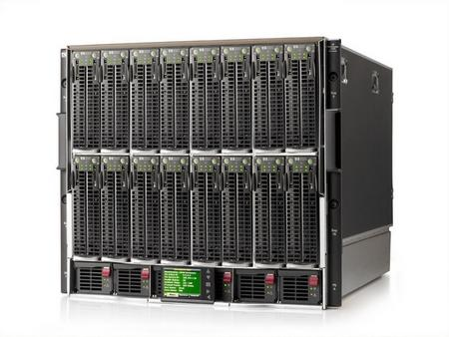
what is “server-side?”
most javascript is client-side
executed in the user’s browser
javascript may now be server-side
executed in the web server (where the web pages are host)
Notes:
Executed anywhere??
In order to store your data when your computer closes, or be able to access your same email across computers, you need to store it somewhere else, like in this giant behemoth.
When you get webpages, you are usually not loading them from your computer as we are in class. You’re loading them from a web server, a computer that’s sitting somewhere else (could be in your room or somewhere in Kentucky. Probably not in your room). Usually you load pages from computers that are called servers.
These servers can do more than just give you a simple HTML page. You can also run programs on servers, and more importantly, store huge amounts of data.

Slide 17
Server-Side Programming
Writing code that runs on the server.
Logic that gets data for you
Stores data
Combines data intelligently and generates a page to present to you.
Also called “Back end Programming”
Stuff you were doing before: “Front end Programming”

Slide 18
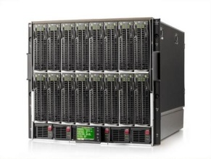
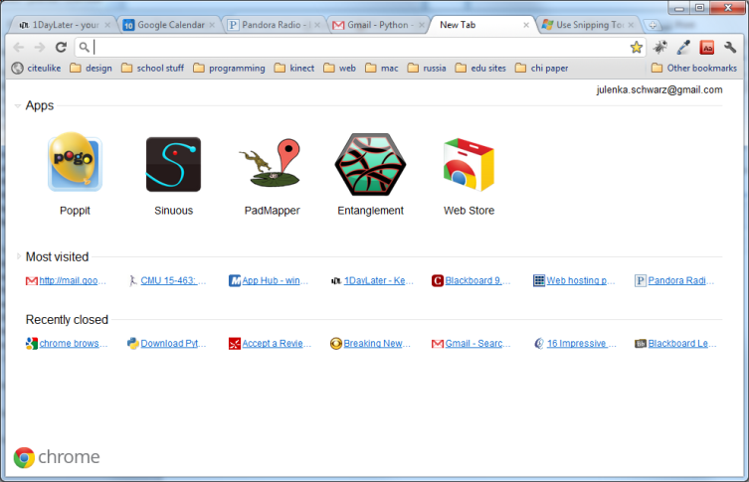
How Server-Side Code Executes (Simple Model)
http://mysite.com/blog/getPost?day=xyz
Web browser makes request to server
Server thinks
def doGet():
doSomething()
getData()
Server gives you a page

Slide 19
Same Origin Policy and CORS
For security reasons, browser-side scripts are not allowed to access DOMs on other sites. The same restriction applies to XMLHttpRequest when sending data requests.
example.com/page.html can access example.com/file.php, but cannot access someothersite.com/file.php
Most browser now implements cross-origin resource sharing (CORS)
The server can sends an “Access-Control-Allow-Origin” header in its response. If the origin is allowed, the request can be sent successfully. Otherwise, the browser returns an error.

Slide 20
node.js
took Chrome javascript engine
made it an application
added libraries and utilities
result: javascript everywhere
http://node.js.org

Slide 21
why sever-side js?
well known language
event-listener paradigm works well
node.js is actually faster sometimes
...or maybe you just like javascript
Notes:
Ask students: why would you want server-side js?

Slide 22
Install node.js and socket.io
Download Node.js http://nodejs.org/download/
After installing Node.js, open the command line app and enter npm install socket.io
npm is the node package manager
Socket.io is a library that allows real-time browser-server communication

Slide 23
Hello World
Now we write JavaScript code that runs on the server (your laptop)! Run the code using node filename.js
console.log(‘hello world’)!
// run the script, should see ‘hello world’ in the command line

Slide 24
node web server
In this class, we use Node.js to create a HTTP server
Node has many other features. See http://nodejs.org/api/
Let’s create a file named server.js
Step 1: requre(“http”) to use the library
Step 2: create server and give a event handler for the “request” event, which fires every time when there’s a request coming in.

Slide 25
node web server
var http = require('http');
http.createServer(function (req, res) {
res.writeHead(200, {'Content-Type': 'text/plain'});
res.write('Hello World');
res.end();
}).listen(8888);
console.log('Server running at http://localhost:8888/');

Slide 26
node web server
var http = require('http');
http.createServer(function (req, res) {
res.writeHead(200, {'Content-Type': 'text/plain'});
res.write('Hello World');
res.end();
}).listen(8888);
console.log('Server running at http://localhost:8888/');

Slide 27
node web server
var http = require('http');
http.createServer(function (req, res) {
res.writeHead(200, {'Content-Type': 'text/plain'});
res.write('Hello World');
res.end();
}).listen(8888);
console.log('Server running at http://localhost:8888/');

Slide 28
node web server
var http = require('http');
http.createServer(function (req, res) {
res.writeHead(200, {'Content-Type': 'text/plain'});
res.write('Hello World');
res.end();
}).listen(8888);
console.log('Server running at http://localhost:8888/');

Slide 29
node web server
var http = require('http');
http.createServer(function (req, res) {
res.writeHead(200, {'Content-Type': 'text/plain'});
res.write('Hello World');
res.end();
}).listen(8888);
console.log('Server running at http://localhost:8888/');

Slide 30
node web server
var http = require('http');
http.createServer(function (req, res) {
res.writeHead(200, {'Content-Type': 'text/plain'});
res.write('Hello World');
res.end();
}).listen(8888);
console.log('Server running at http://localhost:8888/');

Slide 31
node web server
var http = require('http');
http.createServer(function (req, res) {
res.writeHead(200, {'Content-Type': 'text/plain'});
res.write('Hello World');
res.end();
}).listen(8888);
console.log('Server running at http://localhost:8888/');

Slide 32
node web server
var http = require('http');
http.createServer(function (req, res) {
res.writeHead(200, {'Content-Type': 'text/plain'});
res.write('Hello World');
res.end();
}).listen(8888);
console.log('Server running at http://localhost:8888/');
Notes:
ask everyone to get this running

Slide 33
node: socket.io
create sockets for quick client-server communication
allows for very “live” web pages
socket.emit(event, data);
socket.on(event, function);
http://socket.io/

Slide 34
socket.io for node
server-side
client-side
var io = require('socket.io').listen(server);
io.sockets.on('connection', function (socket) {
socket.emit('news', 'Stocks are up!');
socket.on('response', function (data) {
console.log(data);
});
});
<script src="/socket.io/socket.io.js"></script>
<script>
var socket = io.connect('http://localhost');
socket.on('news', function (data) {
socket.emit('response', { user: 'steve' });
});
</script>

Slide 35
client-side
var io = require('socket.io').listen(server);
io.sockets.on('connection', function (socket) {
socket.emit('news', 'Stocks are up!');
socket.on('response', function (data) {
console.log(data);
});
});
<script src="/socket.io/socket.io.js"></script>
<script>
var socket = io.connect('http://localhost');
socket.on('news', function (data) {
socket.emit('response', { user: 'steve' });
});
</script>

Slide 36
client-side
var io = require('socket.io').listen(server);
io.sockets.on('connection', function (socket) {
socket.emit('news', 'Stocks are up!');
socket.on('response', function (data) {
console.log(data);
});
});
<script src="/socket.io/socket.io.js"></script>
<script>
var socket = io.connect('http://localhost');
socket.on('news', function (data) {
socket.emit('response', { user: 'steve' });
});
</script>

Slide 37
server-side
var io = require('socket.io').listen(server);
io.sockets.on('connection', function (socket) {
socket.emit('news', 'Stocks are up!');
socket.on('response', function (data) {
console.log(data);
});
});
<script src="/socket.io/socket.io.js"></script>
<script>
var socket = io.connect('http://localhost');
socket.on('news', function (data) {
socket.emit('response', { user: 'steve' });
});
</script>

Slide 38
server-side
var io = require('socket.io').listen(server);
io.sockets.on('connection', function (socket) {
socket.emit('news', 'Stocks are up!');
socket.on('response', function (data) {
console.log(data);
});
});
<script src="/socket.io/socket.io.js"></script>
<script>
var socket = io.connect('http://localhost');
socket.on('news', function (data) {
socket.emit('response', { user: 'steve' });
});
</script>

Slide 39
client-side
var io = require('socket.io').listen(server);
io.sockets.on('connection', function (socket) {
socket.emit('news', 'Stocks are up!');
socket.on('response', function (data) {
console.log(data);
});
});
<script src="/socket.io/socket.io.js"></script>
<script>
var socket = io.connect('http://localhost');
socket.on('news', function (data) {
socket.emit('response', { user: 'steve' });
});
</script>

Slide 40
server-side
client-side
var io = require('socket.io').listen(server);
io.sockets.on('connection', function (socket) {
socket.emit('news', 'Stocks are up!');
socket.on('response', function (data) {
console.log(data);
});
});
<script src="/socket.io/socket.io.js"></script>
<script>
var socket = io.connect('http://localhost');
socket.on('news', function (data) {
socket.emit('response', { user: 'steve' });
});
</script>

Slide 41
client-side
var io = require('socket.io').listen(server);
io.sockets.on('connection', function (socket) {
socket.emit('news', 'Stocks are up!');
socket.on('response', function (data) {
console.log(data);
});
});
<script src="/socket.io/socket.io.js"></script>
<script>
var socket = io.connect('http://localhost');
socket.on('news', function (data) {
socket.emit('response', { user: 'steve' });
});
</script>

Slide 42
server-side
client-side
var io = require('socket.io').listen(server);
io.sockets.on('connection', function (socket) {
socket.emit('news', 'Stocks are up!');
socket.on('response', function (data) {
console.log(data);
});
});
<script src="/socket.io/socket.io.js"></script>
<script>
var socket = io.connect('http://localhost');
socket.on('news', function (data) {
socket.emit('response', { user: 'steve' });
});
</script>

Slide 43
server-side
client-side
var io = require('socket.io').listen(server);
io.sockets.on('connection', function (socket) {
socket.emit('news', 'Stocks are up!');
socket.on('response', function (data) {
console.log(data);
});
});
<script src="/socket.io/socket.io.js"></script>
<script>
var socket = io.connect('http://localhost');
socket.on('news', function (data) {
socket.emit('response', { user: 'steve' });
});
</script>

Slide 44
socket.emit(event, data);
socket.on(event, function);
io.sockets.emit(event, data);

Slide 45
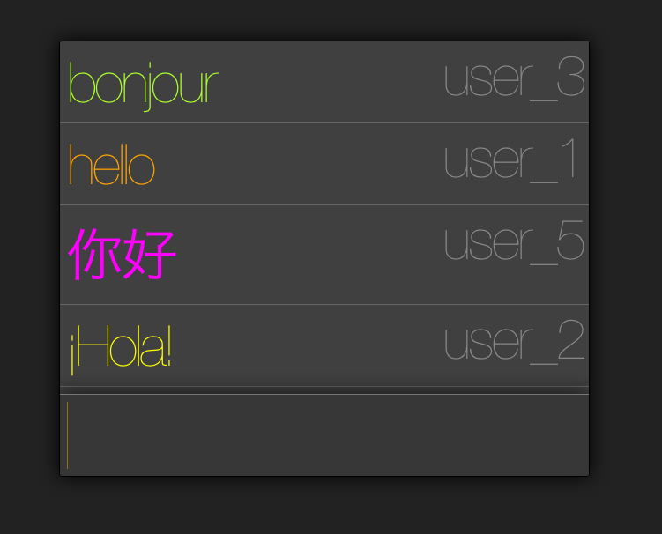

Slide 46
Let’s implement a chat app!

Slide 47
Install socket.IO. In your project folder, run:
npm install socket.io
Create a file chat_server.js:
var app = require('http').createServer(handler)
, io = require('socket.io').listen(app)
, fs = require('fs')
app.listen(8000);
function handler (req, res) {
fs.readFile(__dirname + '/index.html',
function (err, data) {
if (err) {
res.writeHead(500);
return res.end('Error loading index.html');
}
res.writeHead(200);
res.end(data);
});
}

Slide 48
Next time…
Get barebones_chat work on your laptop
CSS and styling
Will use CSS to add style to chat application

