Slide 1
Server-Side Development
Lab 9
10/25

Slide 2
Project 3
Due next Thursday!
Office hours @ 2pm Friday

Slide 3
Project 4
Last project
Project of your own choosing
May overlap with a personal project but may not overlap with any projects for other classes
Must use topics discussed in class but may run on any platform
client-side, server-side, iOS, dashboard widgets, Chrome extensions, etc.
3-5 project proposals due November 1st
Decide on a project November 8th
Project checkpoint November 15th
Presentations November 29th & December 6th

Slide 4
Project 4 Proposals
Turn in a set of 3-5 topics by 11/1
Each description should be two paragraphs:
A paragraph describing the project
A paragraph describing (on a high level) how you plan on implementing it
I will provide feedback and expect a finalized topic by 11/8

Slide 5
Project 4 Expectations
Individual projects (except in very specific circumstances, email me).
You should build an artifact that has a large interactive component.
Front end (i.e. interactive) code should have a significant amount of JavaScript.
Doesn’t have to have a backend.
The artifact should have one or more of these: aesthetic value (i.e. interactive animation), entertainment value (i.e. a game), practical value.

Slide 6
Project 4 Expectations
You should make substantial and interesting use of JavaScript code (if you just make numerous calls to different JavaScript libraries without any JavaScript logic you will get 0 points here).
Again, the focus here is on building nice interfaces, so focus on first making a compelling interface (if you write a web app with a bad/boring interface you will not get full points).
Your project should work, no mockups.
If your demo doesn’t work then that’s bad. Test your code!

Slide 7
Project 4 Example Ideas
Take something you built from a previous project (i.e. a game for the drawing library or an interactive component from your state machines project) and build something really amazing from it.
Build a cryptogram solver
Like http://www.blisstonia.com/software/WebDecrypto/ but make it look better.

Slide 8
Project 4 Example Ideas
Build a game (using either the drawing library or something of your own).
Build a 3D model that you can view (i.e. http://madebyevan.com/webgl-water/. Only attempt if you’re good at graphics and have a lot of free time!)
Roll your own image gallery viewer.
Make your personal website much more compelling/interactive (if you already had a website, save an old version of it so I can compare).

Slide 9
Project 4 Constraints
You can use whatever JavaScript libraries you want, as long as you document it in your README for your submission.
You should also mention libraries you used in your final presentation.
REMINDER: piecing together libraries for this project will not give you full points under the ‘makes significant use of JavaScript’ criteria

Slide 10
Project 4 Submission
E-mail all of the code needed for your project
Include a README describing what you did, why it is interesting, how your work makes significant use of JavaScript, any problems you encountered or known bugs, and all of the libraries you used (with urls to references).

Slide 11
Project 4 Final Presentations
Will be held November 29th & December 6th
Each person will give a 5-10 minute demo of their project.
No powerpoint necessary, just show us what you built.
Talk about what was challenging about this project.
Show us at least one interesting feature of your project.

Slide 12
Project 4 Evaluation
100 points:
10 points: turn in is correct (all code is included, README is present).
10 points: formatting and comments.
30 points: Substantial and interesting use of JavaScript code (if you just make numerous calls to different JavaScript libraries without any JavaScript logic you will get 10 points here).
30 points: Aesthetic, entertainment, or practical value of what you made.
20 points: Presentation (class will fill out score cards)

Slide 13
Last time…
AJAX
Server-side code
Node.JS

Slide 14
Today
Node.JS review
Build an application using Node.JS
Real-time chat application
Work in teams of two (randomly selected)

Slide 15
what is “server-side?”
most javascript is client-side
executed in the user’s browser
javascript may now be server-side
executed in the web page server
executed anywhere!

Slide 16
node.js
took Chrome javascript engine
made it an application
added libraries and utilities
result: javascript everywhere
http://node.js.org

Slide 17
node web server
var http = require('http');
http.createServer(function (req, res) {
res.writeHead(200, {'Content-Type': 'text/plain'});
res.end('Hello World');
}).listen(80);
console.log('Server running at http://127.0.0.1/');

Slide 18
node web server
var http = require('http');
http.createServer(function (req, res) {
res.writeHead(200, {'Content-Type': 'text/plain'});
res.end('Hello World');
}).listen(80);
console.log('Server running at http://127.0.0.1/');

Slide 19
node web server
var http = require('http');
http.createServer(function (req, res) {
res.writeHead(200, {'Content-Type': 'text/plain'});
res.end('Hello World');
}).listen(80);
console.log('Server running at http://127.0.0.1/');

Slide 20
node web server
var http = require('http');
http.createServer(function (req, res) {
res.writeHead(200, {'Content-Type': 'text/plain'});
res.end('Hello World');
}).listen(80);
console.log('Server running at http://127.0.0.1/');

Slide 21
node web server
var http = require('http');
http.createServer(function (req, res) {
res.writeHead(200, {'Content-Type': 'text/plain'});
res.end('Hello World');
}).listen(80);
console.log('Server running at http://127.0.0.1/');

Slide 22
node web server
var http = require('http');
http.createServer(function (req, res) {
res.writeHead(200, {'Content-Type': 'text/plain'});
res.end('Hello World');
}).listen(80);
console.log('Server running at http://127.0.0.1/');

Slide 23
node web server
var http = require('http');
http.createServer(function (req, res) {
res.writeHead(200, {'Content-Type': 'text/plain'});
res.end('Hello World');
}).listen(80);
console.log('Server running at http://127.0.0.1/');
Notes:
ask everyone to get this running

Slide 24
node: socket.io
create sockets for quick client-server communication
allows for very “live” web pages
socket.emit(event, data);
socket.on(event, function);
http://socket.io/

Slide 25
socket.io for node
server-side
client-side
var io = require('socket.io').listen(80);
io.sockets.on('connection', function (socket) {
socket.emit('news', 'Stocks are up!');
socket.on('response', function (data) {
console.log(data);
});
});
<script src="/socket.io/socket.io.js"></script>
<script>
var socket = io.connect('http://localhost');
socket.on('news', function (data) {
socket.emit('response', { user: 'steve' });
});
</script>

Slide 26
client-side
var io = require('socket.io').listen(80);
io.sockets.on('connection', function (socket) {
socket.emit('news', 'Stocks are up!');
socket.on('response', function (data) {
console.log(data);
});
});
<script src="/socket.io/socket.io.js"></script>
<script>
var socket = io.connect('http://localhost');
socket.on('news', function (data) {
socket.emit('response', { user: 'steve' });
});
</script>

Slide 27
client-side
var io = require('socket.io').listen(80);
io.sockets.on('connection', function (socket) {
socket.emit('news', 'Stocks are up!');
socket.on('response', function (data) {
console.log(data);
});
});
<script src="/socket.io/socket.io.js"></script>
<script>
var socket = io.connect('http://localhost');
socket.on('news', function (data) {
socket.emit('response', { user: 'steve' });
});
</script>

Slide 28
server-side
var io = require('socket.io').listen(80);
io.sockets.on('connection', function (socket) {
socket.emit('news', 'Stocks are up!');
socket.on('response', function (data) {
console.log(data);
});
});
<script src="/socket.io/socket.io.js"></script>
<script>
var socket = io.connect('http://localhost');
socket.on('news', function (data) {
socket.emit('response', { user: 'steve' });
});
</script>

Slide 29
server-side
var io = require('socket.io').listen(80);
io.sockets.on('connection', function (socket) {
socket.emit('news', 'Stocks are up!');
socket.on('response', function (data) {
console.log(data);
});
});
<script src="/socket.io/socket.io.js"></script>
<script>
var socket = io.connect('http://localhost');
socket.on('news', function (data) {
socket.emit('response', { user: 'steve' });
});
</script>

Slide 30
client-side
var io = require('socket.io').listen(80);
io.sockets.on('connection', function (socket) {
socket.emit('news', 'Stocks are up!');
socket.on('response', function (data) {
console.log(data);
});
});
<script src="/socket.io/socket.io.js"></script>
<script>
var socket = io.connect('http://localhost');
socket.on('news', function (data) {
socket.emit('response', { user: 'steve' });
});
</script>

Slide 31
server-side
client-side
var io = require('socket.io').listen(80);
io.sockets.on('connection', function (socket) {
socket.emit('news', 'Stocks are up!');
socket.on('response', function (data) {
console.log(data);
});
});
<script src="/socket.io/socket.io.js"></script>
<script>
var socket = io.connect('http://localhost');
socket.on('news', function (data) {
socket.emit('response', { user: 'steve' });
});
</script>

Slide 32
client-side
var io = require('socket.io').listen(80);
io.sockets.on('connection', function (socket) {
socket.emit('news', 'Stocks are up!');
socket.on('response', function (data) {
console.log(data);
});
});
<script src="/socket.io/socket.io.js"></script>
<script>
var socket = io.connect('http://localhost');
socket.on('news', function (data) {
socket.emit('response', { user: 'steve' });
});
</script>

Slide 33
server-side
client-side
var io = require('socket.io').listen(80);
io.sockets.on('connection', function (socket) {
socket.emit('news', 'Stocks are up!');
socket.on('response', function (data) {
console.log(data);
});
});
<script src="/socket.io/socket.io.js"></script>
<script>
var socket = io.connect('http://localhost');
socket.on('news', function (data) {
socket.emit('response', { user: 'steve' });
});
</script>

Slide 34
server-side
client-side
var io = require('socket.io').listen(80);
io.sockets.on('connection', function (socket) {
socket.emit('news', 'Stocks are up!');
socket.on('response', function (data) {
console.log(data);
});
});
<script src="/socket.io/socket.io.js"></script>
<script>
var socket = io.connect('http://localhost');
socket.on('news', function (data) {
socket.emit('response', { user: 'steve' });
});
</script>

Slide 35
socket.emit(event, data);
socket.on(event, function);
io.sockets.emit(event, data);

Slide 36
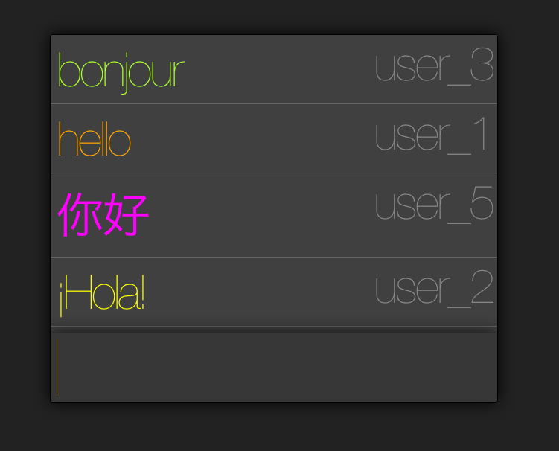

Slide 37
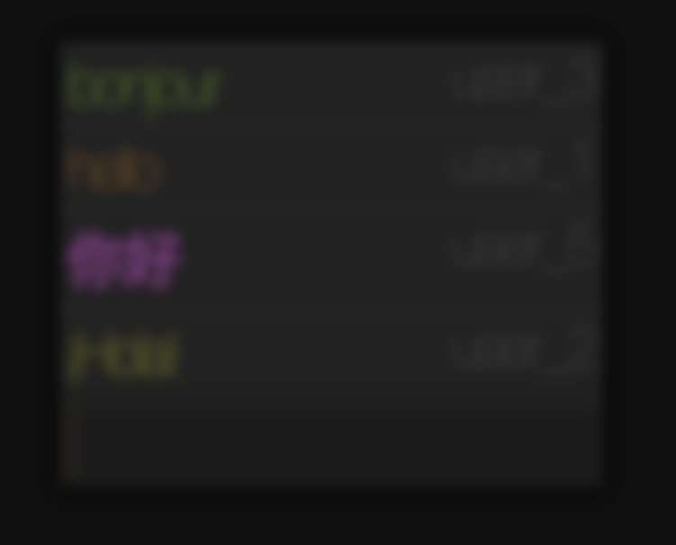
http://from.so/web_lab/chat.html

Slide 38
Let’s implement a chat app!

Slide 39
Install socket.IO. In your project folder, run:
npm install socket.io
Create a file chat_server.js:
var app = require('http').createServer(handler)
, io = require('socket.io').listen(app)
, fs = require('fs')
app.listen(8000);
function handler (req, res) {
fs.readFile(__dirname + '/index.html',
function (err, data) {
if (err) {
res.writeHead(500);
return res.end('Error loading index.html');
}
res.writeHead(200);
res.end(data);
});
}

Slide 40
Next time…
CSS and styling
Will use CSS to add style to chat application

