Slide 1
web lab
lab 1
8/28

Slide 2
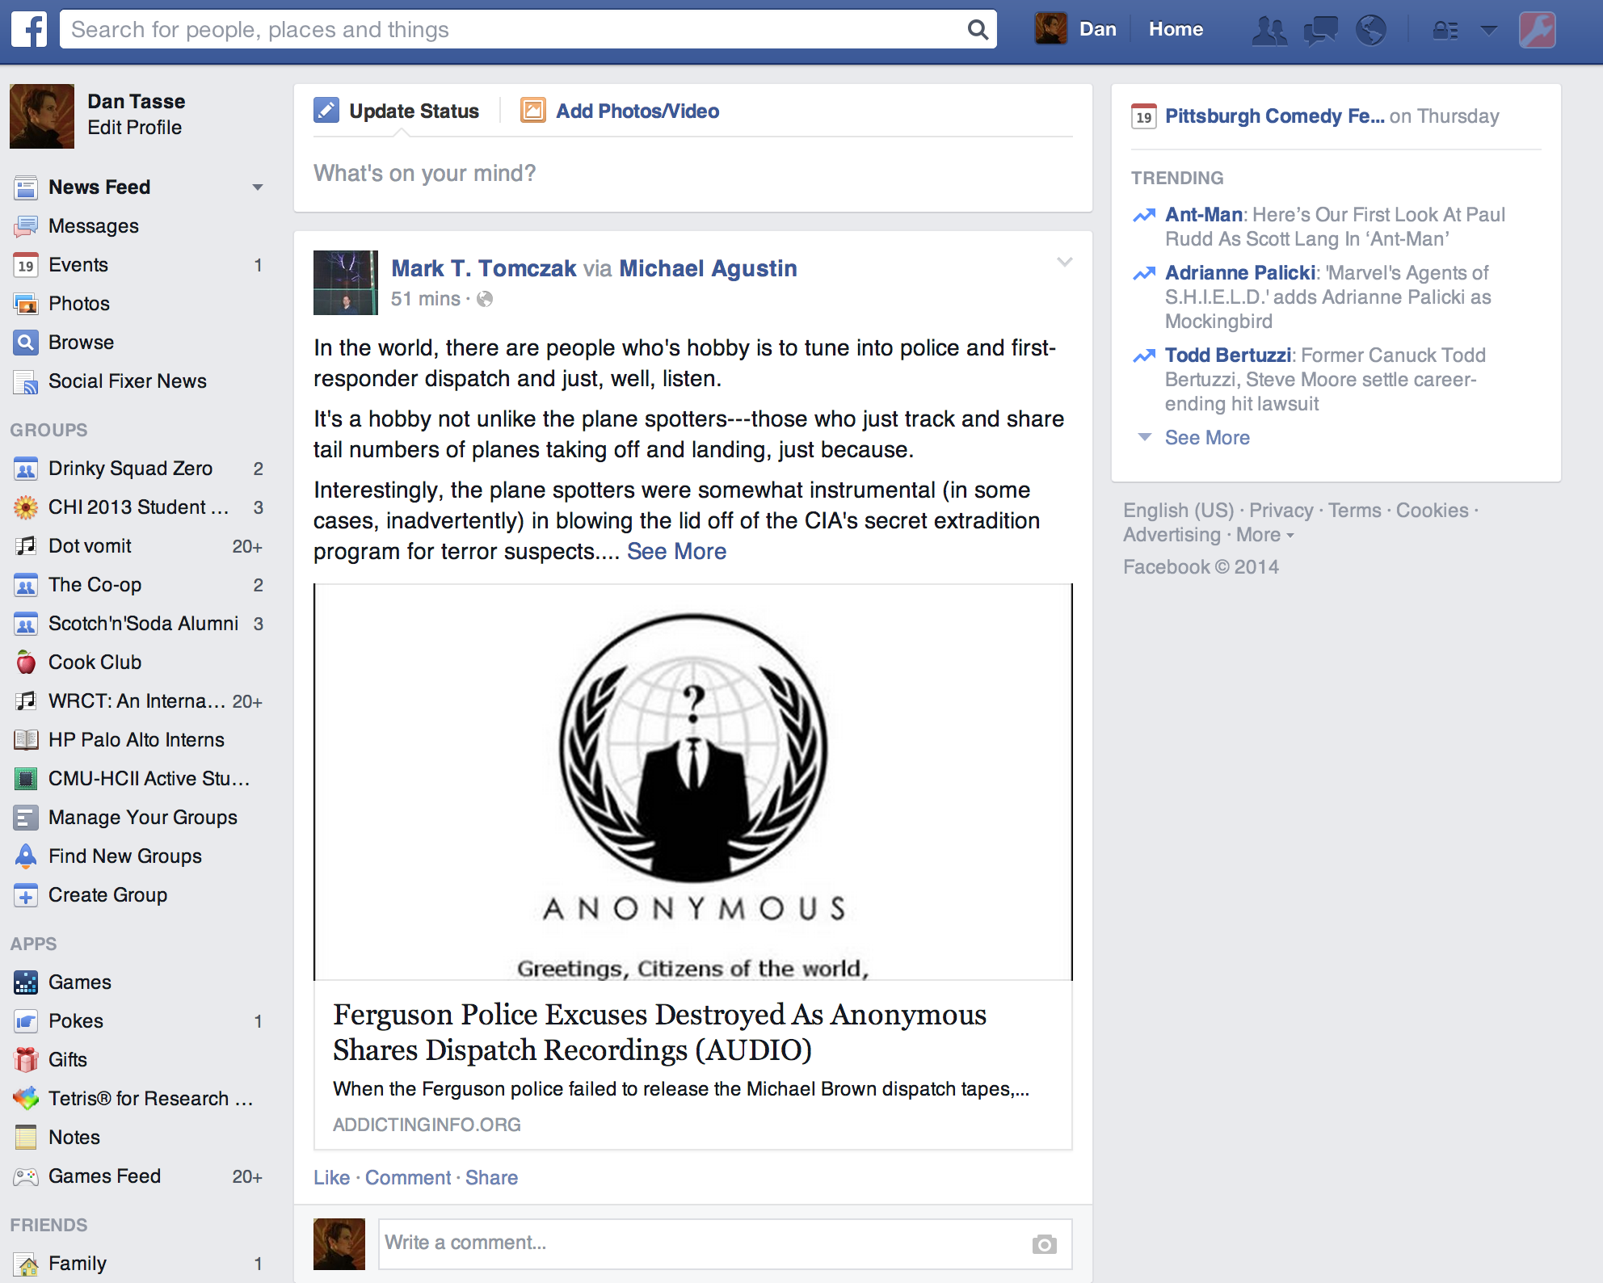
Notes:
ok, imagine you were making this website. what is difficult about it? (there are a million things.) (open up in another tab)

Slide 3
Web Lab
Supplement to PUI/SSUI
Practice building real UIs for the web
It’s assumed that you know how to program something (equivalent to an undergraduate CS degree)
You’ll learn:
Programming and debugging JavaScript
How to write dynamic web interfaces with JavaScript
A set of useful libraries and tools
HTML5 and CSS, some server side programming
Suggest topics that you are interested in learning
Notes:
Supplement to SSUI: Give you practice building infrastructures behind user interfaces on the web.
How will we do this?
Teach you how to use JavaScript and debug in JavaScript.
Use Javascript to build interactive web interfaces – input and output. //Use JavaScript to build interfaces, and infrastructure for interfaces.
Give you a set of tools such as libraries that you’ll be able to take with you later (selection, animation, visualization, interaction)
…and some HTML and CSS, which are the other two languages behind most web sites…but these are relatively easy to learn so we won’t spend as much time on them. And some techniques that let you create interface that can interact with the backend server such as storing files.
Want to make it more relevant to what you are doing – suggests topics that you are interested.
Look at handhout – the schedule part

Slide 4
Web Lab
Thursday 10:30 - 11:50am, SCR 172
80 minutes class, lecture & practice
Bring your laptops to class
1+4 main projects
Project 0 will be assigned today and due 9/12
http://dantasse.github.io/ssuiweb2014
https://piazza.com/cmu/fall2014/05633d/
Notes:
<ask if anyone did not get e-mail or is not signed up for the class>

Slide 5
Me
Dan Tasse
PhD student in HCII
dantasse@cmu.edu
Office hours
Tuesday 1:00-2:30pm (Tazza D’oro café in Gates 3rd floor)
Thursday 12:00-12:30pm (room TBD, around the class room)
By appointment
Notes:
If you need to reach me, e-mail is usually best. If you have questions, then office hours are the best time for that.
also, try Piazza
how do these office hours work for you?

Slide 6
You
Pre-class survey/pre-test
(accessible for the next 12 hours at shoutkey.com/hip)
Notes:
pre-test
python, ruby, java, c++, c#, obj-c
heads down, have you … made a website?
worked on a project with >500ish lines of javascript?
worked on a project with ~10k lines of javascript?
used angular, ember, backbone?
talk to me if you don’t have that background or are worried about it

Slide 7
You (plural)
Notes:
pair up. take out your laptops, tell each other your home page. look up each other’s home page. tell each other something you like about it. content or style – “you like basketball, I do too” or “I like this font” or whatever.

Slide 8
Coordinator
Prof. Jen Mankoff (jmankoff@cs.cmu.edu)
Office Hours
Monday/Wednesday 12:00-12:30 – NSH 3612E (inside DevLab)
Thursday 9:30-10:30AM – SCR (right before this class)
Notes:
though check out my office hours first

Slide 9
Syllabus overview

Slide 10
Let’s dive in.*
*Much of this material is based off of Douglas Crockford’s lectures, you can see a version at: http://www.youtube.com/watch?v=hQVTIJBZook

Slide 11
HTML
(structure)

Slide 12
HTML
(structure)
CSS
(look)

Slide 13
HTML
(structure)
CSS
(look)
JavaScript
(Interactivity)

Slide 14
HTML
(structure)
CSS
(look)
JavaScript
(Interactivity)

Slide 15
What is JavaScript?
Most widely used client-side web programming language
Specifies interactivity in Web sites
Also used server-side with node.js
Starting to be used in other domains (ex: Windows 8 apps)
Largely misunderstood
Kind of terrible

Slide 16
JavaScript has nothing to do with Java
No compilation.
Loosely typed. (things don’t “have a type” so much)
Functions (methods) are variables.
No inheritance.
Notes:
check in about vocabulary
no inheritance
- some sense of comparing to existing things
Has the same syntax as java only because the guys that were writing it wanted that.
Loosely typed: <-> strict typing
Language does not look for type errors
variable can be an int and then a string
good and bad

Slide 17
JavaScript Pitfalls
Several specific design flaws
Semicolon insertion
Implicit global variables (always check your variable names!)
http://oreilly.com/javascript/excerpts/javascript-good-parts/bad-parts.html
JavaScript + HTML behave differently in different browsers
Not actually JavaScript’s fault (browser’s fault)
We use Google Chrome for everything to avoid headaches.
Notes:
Semicolons: if you miss a semicolon, this is okay in javascript. How it works:
If your code has a syntax error, Javascript goes backwards replacing the first newline it finds with a semicolon, then tries again.
Variable names: (Implicit globals)
if you accidentally misname a variable, Javascript assumes that this is okay: it creates a global variable for you with that name and sets its value to undefined.
We will grade everything in chrome

Slide 18
JavaScript + HTML
JavaScript mostly used in web pages which are written in HTML
<!DOCTYPE html>
<html>
<head>
<script type="text/javascript">
var message = "hello world!";
document.write(message);
</script>
</head>
<body>
</body>
</html>

Slide 19
JavaScript + HTML
JavaScript mostly used in web pages which are written in HTML
<!DOCTYPE html>
<html>
<head>
<script type="text/javascript">
var message = "hello world!";
document.write(message);
</script>
</head>
<body>
</body>
</html>

Slide 20
JavaScript + HTML
Another way of adding JavaScript (we will use this way)
<!DOCTYPE html>
<html>
<head>
<script src=“hello_world.js“ type="text/javascript"></script>
</head>
<body>
</body>
</html>
Don’t forget the </script> tag!

Slide 21
JavaScript + HTML
JavaScript mostly used in HTML web pages
<!DOCTYPE html>
<html>
<head
<script src=“hello_world.js“ type="text/javascript"></script>
</head>
<body>
</body>
</html>

Slide 22
JavaScript + HTML
JavaScript mostly used in HTML web pages
<!DOCTYPE html>
<html>
<head
<script src=“hello_world.js“ type="text/javascript"></script>
</head>
<body>
</body>
</html>
Tell the HTML page to load the javascript file “hello_world.js”
“hello_world.js” can be either relative (“../../hello_world.js”) or absolute (“http://mysite.com/hello_world.js”)
Notes:
Google hosted libraries

Slide 23
JavaScript + HTML
JavaScript mostly used in HTML web pages
<!DOCTYPE html>
<html>
<head
<script src=“hello_world.js“ type="text/javascript"></script>
</head>
<body>
</body>
</html>
Script usually goes in head but can actually go anywhere in head and body
Location consideration: dependency, performance, maintainability
Notes:
I mostly put script in head for better organization.
Some people put the files in bottom because of performance.
Don’t use stuff before it’s defined
Some libraries requires you to put them in head – read documents.

Slide 24
Writing code

Slide 25
JavaScript: Editor
Mac Users:
TextWrangler (free)
TextMate ($)
Sublime Text (OSX, Windows, Linux)
PC Users
Notepad++ (free)
Other Recommendations?
Also there are IDEs like Eclipse (Web Tools Platform or Aptana) (free) or Visual Studio (Windows, express is free)
Dreamweaver ($)
Notes:
IDE is not as good, and maybe not recommended

Slide 26
JavaScript: Editor
You can also use vim or emacs if you want to be more hardcore
I have gotten ok with vim and am not sure if it’s worth it
You do earn a little cred, if that’s important to you

Slide 27
Flashcards
When you learn a new “word”, make a card.
e.g. “how do I split a string on a single space?”
google google

Slide 28
Flashcards
how do you split a variable s, which is ‘aaa bb ccc’, into [‘aaa’, ‘bb’, ‘ccc’]?
other side: s.split(‘ ‘)
use Anki or just paper, whatever you like

Slide 29
Testing and Debugging your code
Using Chrome Development Tools Console
Open your .html file in Chrome
Right click -> Inspect Element or Menu -> Tools -> Developer Tools
Use console.log(value) and view in the console panel
http://code.google.com/chrome/devtools/docs/shortcuts.html
Notes:
View->Tools->Developer Tools
Windows: hit F12
Mac: ⌥⌘I (Command - Option - I) keys to open Developer Tools

Slide 30
or use jsfiddle
http://jsfiddle.net/
contains html, js, css all in one – good if you want to ask someone a question, on a forum or something, just link them to a jsfiddle that reproduces your problem
or http://plnkr.co/

Slide 31
okay let’s write hello world
alert(‘hello world’)
or console.log(‘hello world’)
Notes:
open up your browser, join in

Slide 32
Variables
var message = "hello world!";
Possible types:
Number
String
Boolean (true or false)
Object
Function
Undefined
typeof variable_name
undefined vs. null
Warning: Implicit global variables
Notes:
make sure to add warnings in a certain way – gotchas per topic
Variables don’t have types
Undefined means a variable has been declare but has not yet assigned a value. For example,
Var test;
Alert (test); //shows undefined
Alert (typeof test) // shows undefined
Null is an assigned value. It can be assigned to a variable as a representation of no value
Var test = null;
Alert(test); // shows null
Alert (typeof test) // shows object!
Undefined is a type itself, while null is an object (…)
Implicit globals: if you accidentally misname a variable, Javascript assumes that this is okay: it creates a global variable for you with that name and sets its value to undefined.

Slide 33
Numbers
Numbers are stored as 64-bit floating point
only! there are no integers! wah!
Floating point arithmetic is not always accurate
0.1 + 0.2 != 0.3
http://stackoverflow.com/questions/588004/is-javascripts-floating-point-math-broken
Infinity and –Infinity
parseInt(string, base)
NaN
Math. functions (floor, random, sin, etc.)
Notes:
Demonstrate 0.1 + 0.2
parseInt(“12threefour”)
parseInt(“12”)
parseInt(“055”)
parseInt(“0x55”)
NaN is JavaScript reserved word indicating that the result of a numeric operation was not a number.
Base- radix, the number system
The javascript math object has many functions

Slide 34
Strings
‘ myString’ or “myString”, doesn’t matter
.length
String * number is number, string + number is string
String object has some useful properties and methods
Ex. .split() (homework)
More:
http://www.quirksmode.org/js/strings.html

Slide 35
Output
Mostly you’re changing a web page, but to start you can use:
Chrome console:
javascript: console.log(myMessage);
alert(myMessage);
document.write(myMessage);
Changes the html of the page.

Slide 36
If
if (condition) {
// action if true
} else {
// action if false
}
== vs ===
== uses type coercion (checks only value), === checks both type and value.
1 == “1” -> true; 1 === “1” -> false
0 == false -> true; 0 === false -> false
Basically always use ===
Notes:
== is weird
1 == “1” , 1 === “1”
0 == false, 0 === false

Slide 37
Objects
To create an object:
var object = {};
var object = new Object();
You assign properties to these objects via:
object.property1 = value1
object.function1 = function1;
Notes:
Hash tables -> lookup tables or dictionaries
From names to programming entities

Slide 38
Arrays
var arr = []; // <- generally good
var arr2 = new Array();
Access elements using []
They’re objects too so you can add other things to them, but don’t.
push();
length
join(str)
http://www.w3schools.com/jsref/jsref_obj_array.asp
Notes:
how do you add something to an array…

Slide 39
https://www.destroyallsoftware.com/talks/wat

Slide 40
Functions!
In JavaScript, functions are like objects
Assigned to variables
Can be passed around to methods
Can have properties
Can return functions
Functions always return something.
If nothing is specified, return undefined.
Notes:
“just a special type of object that can do all the things that regular objects can do”
http://helephant.com/2008/08/19/functions-are-first-class-objects-in-javascript/

Slide 41
Two Ways to Declare functions
Like in Java:
function myFunction(params) { }
Declare as objects:
var myFunction = function(params) { };
Call using myFunction(params)
Notes:
<slightly different but very similar…think of them as equivalent>

Slide 42
Let’s Write Functions
Notes:
Random number function
Function that takes no parameters
Passing a function in as a parameter, including error checking (execute it twice)
Returning a function
Demo how to add a header
(try to make this available after class)

Slide 43
Project 0
Practice writing some javascript
http://dantasse.github.io/ssuiweb2014/p0/project0.html

Slide 44
Project 0
Grading:
Does it work?
Is it legible?
Notes:
be more verbose than you think

Slide 45
Links to learn more
http://yuiblog.com/crockford/
http://stackoverflow.com/questions/11246/best-resources-to-learn-javascript
http://www.youtube.com/watch?v=hQVTIJBZook
http://www.w3schools.com/js/default.asp
https://www.destroyallsoftware.com/talks/wat (not entirely serious)

Slide 46
Next Time: Objects
Objects are just containers
No predefined classes like in Java.
Can dynamically change objects at any time.
var myObj = {};
Var myObj2 = new Object();
myObj{“property1”} = “foo”;
myObj{“function1”} = function(){};
myObj.property1;
myObj.function1();
Notes:
no inheritance
get them to write a few lines of code before the end of lab
check out jsfiddle
get them to do something every 20-30 minutes

