Slide 1
Client-Side JavaScript: window and the DOM
web lab
9/5

Slide 2
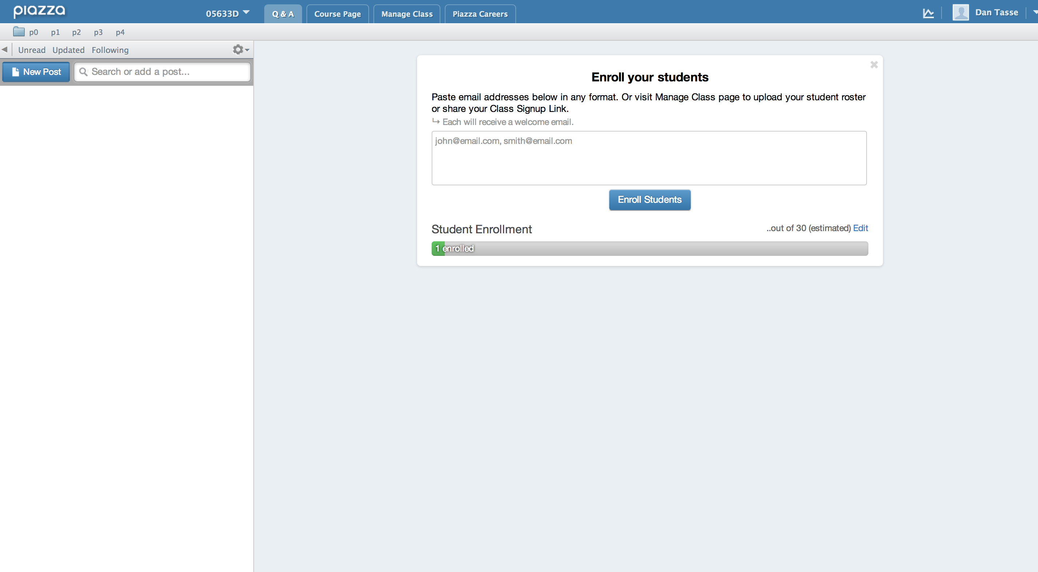
Notes:
what’s hard about this?

Slide 3
https://www.destroyallsoftware.com/talks/wat
Notes:
a fun video now that we’ve learned something about javascript

Slide 4
Last Week
How to add JavaScript to a web page
JavaScript basics
variables
types
functions
arrays
objects
Using the Chrome console
console.log

Slide 5
Admin: Project 0 questions? Sign up for Piazza: www.shoutkey.com/breath Send me your andrew ID so I can sign you up for Blackboard
Notes:
Take a look at Project 0 again

Slide 6
Today
A little bit more about JavaScript objects
Introduction to HTML
Introduction to the DOM

Slide 7
Objects in javascript

Slide 8
Objects are Collections
Objects are collections of name/value pairs:
Name=>value, Name=>value, Name=>value
In this lab, let’s practice Google’s naming convention: functionNamesLikeThis variableNamesLikeThis ConstructorNamesLikeThis CONSTANT_VALUES_LIKE_THIS, foo.namespaceNamesLikeThis.bar, and filenameslikethis.js”
Values can be of any type
string, numbers, functions, even other Objects.
Notes:
Names are just strings,
style is more important in js: no syntax highlighting, hard to tell whats a constructor, you can misspell stuff

Slide 9
Creating Objects
Using a function (constructor function)
var obj = new Object();
Using object literals
var obj = {};
Note that there are no “classes” in JavaScript.
Everything is an object.
Notes:
Functions may be used to somewhat simulate classes, but in general javascript is class-less.

Slide 10
Creating Objects: Object Literals
A pair of curly braces surrounding zero or more name/value pairs.
Just like you can create arrays using
var arr = [1,2,3,4,5];
You can create an object using: var myColor= { red: 255,
green: 0,
blue: 0,
makeWhite: function() { … } };

Slide 11
‘this’
Recall our myColor object:
var myColor= { red: 255,
green: 0,
blue: 0,
makeWhite: function() { … }
}
How do we write makeWhite?
Notes:
let them try it

Slide 12
‘this’
How do we write makeWhite?
For our myColor object, we want to write a function that makes myColor white.
Our function somehow needs to point to the variables that are in the object itself.
Use the ‘this’ keyword to point to the object itself.
makeWhite = function(){
this.red = 255;
this.green = 255;
this.blue = 255;
}
Notes:
we’ll talk more about “this” later.

Slide 13
Creating Objects: Functions
Define a normal function and then create an new object by using the new keyword.
var obj = new Object(); var a = new Array();
Functions that are used to create objects are sometimes called “constructors”.
Calling new Constructor(…):
Makes a new empty object
Executes the code specified in the constructor function, where ‘this’ keyword refers to the new empty object
Returns the resulting object

Slide 14
Writing a constructor
Same as a function, but use ‘this’ to set properties of your object.
As convention, capitalize first letter of constructors.
function Color(r, g, b){
this.red = r;
this.green = g;
this.blue = b;
this.makeWhite = function() {
this.red = 255;
this.green = 255;
this.blue = 255;
}
}
var c = new Color(155, 255, 255);
Notes:
Mention that "this" is an implicit parameter invoked as a method call on the object
Demo this and var

Slide 15
Reminders
Project 0 is due at next Thursday (Sep 11, 10:30am)
Project 1 will go out today, due in two weeks (Sep 17, 8pm)
Dan’s office hours: Friday 1:30-3:00PM at Gates Café, 12:00-12:30PM on Thursday right after this class
Notes:
Because people are switching classes and starting late, late penalties for project 0 will be minimal

Slide 16
HTML

Slide 17
What is HTML?
Hypertext Markup Language
Describes the content of a web page.

Slide 18
HTML basics
HTML broken up into ‘elements’ or ‘nodes’
<tag> </tag>
Element is defined by <> tags.
<element prop1=“value1” prop2=“value2”> element contents </element>
Contents of an element can be text and/or more elements.
Root of an HTML document is the <html> element.

Slide 19
Simple HTML page
<!DOCTYPE html>
<html>
<head>
<title></title>
<script src="p0.js"></script>
</head>
<body></body>
</html>

Slide 20
Simple HTML page
specifies this is HTML
<!DOCTYPE html>
<html>
<head>
<title></title>
<script src="p0.js"></script>
</head>
<body></body>
</html>

Slide 21
Simple HTML page
<!DOCTYPE html>
<html>
<head>
<title></title>
<script src="p0.js"></script>
</head>
<body></body>
</html>
The actual webpage

Slide 22
Simple HTML page
<!DOCTYPE html>
<html>
<head>
<title></title>
<script src="p0.js"></script>
</head>
<body></body>
</html>
The ‘head’ (contains title and loads javascript)

Slide 23
Simple HTML page
<!DOCTYPE html>
<html>
<head>
<title></title>
<script src="p0.js"></script>
</head>
<body></body>
</html>
The ‘body’ (contains the meat of a web page)

Slide 24
A few HTML Elements
<div></div>
div tag: describes a rectangular block on your page.
We will use this for project 1.
<h1></h1>
Header tag (already experimented with these): Describes a heading or important text.
<p></p>
Paragraph: a paragraph of text.
Notes:
Demo with a few html elements

Slide 25
A few HTML Elements
<img src=“…”></img>
Describes an image at a specified location.
Src describes where the image file is located.
<a href=“…”></a>
Describes a link.
Href specifies destination.

Slide 26
Best Way to Understand HTML
Open Chrome, IE or Firefox (if you have firebug installed).
Right click anywhere on the page
Click ‘inspect element’.
Mouse over parts of the page to understand what visually corresponds to what HTML
Notes:
stop and have them do it – pick a page in advance? dantasse.github.io/ssuiweb2014

Slide 27
Styles
Style describes how your elements should look.
Every HTML element has a style property
<div style=“color: green; background-color: black; width: 100px; height: 100px;”></div>
Can set the style property of every HTML element you have to specify how page should look.
Children of an element have same style as parent.
E.g.: How to make all text on a page red?
Good reference: http://www.w3schools.com/cssref/
Notes:
Children inherit the style from parents

Slide 28
Aside: CSS
Applying style attribute to every HTML element can be tedious, unmaintainable
You can use CSS (Cascading Style Sheets) to apply style rules to multiple items.
Simple Syntax:
selector [, selector2,…] {
property: value;
property: value;
}
Notes:
Make larger

Slide 29
CSS Selectors
element type
div {…}
class
<div class=“designer”></div>
.designer {…}
Id
<div id=“myDiv1”></div>
#mydiv1 {…}
Notes:
Class attribute doesn't have anything to do with classes

Slide 30
CSS Selections
#rect
rect
.rect
[color=red]
color red
rect.rounded
rect#rounded
<any id=“rect”>
<rect>
<any class=“rect”>
<any color=“red”>
<color><red></color>
<rect class=“rounded”>
<rect id=“rounded”>
Notes:
how do you select something – if there are competing selectors, specificity rules, and this can be a mire of complexity: http://css-tricks.com/specifics-on-css-specificity/
http://cssspecificity.com/

Slide 31
Adding CSS to your page
Put your style rules within <style></style> tags.
<html>
<head>
<style>
rules go here.
</style>
</head>
…

Slide 32
Adding CSS, the better way
Include a .css file (in practice, everyone does this, and you should too)
<html>
<head>
<link rel=“stylesheet” type=“text/css” href=“mystyle.css” />
</head>
…

Slide 33
window and The DOM

Slide 34
window
Main entry-point to all client-side javascript code.
“Client-side”: running locally on your browser/machine
Represents the web browser window.
All global variables are properties of window.

Slide 35
window
Important properties/functions:
location: current URL
onload: function that executes once all content is done loading.
document: represents the HTML in the document
setTimeout(ms, function): executes a function after ms milliseconds.
setInterval(ms, function): executes a function every ms milliseconds.

Slide 36
What is the DOM?
Document Object Model
It’s how programs can access/modify HTML, XHTML, XML documents.
The HTML DOM views HTML documents as tree structures.
Each node is an HTML element.
Nodes can have attributes

Slide 37
Structure of an HTML Page as JavaScript Sees it
HTML
<html>
<head>
<title>
Hello World!
</title>
</head>
<body>
<h1> Hello </h1>
<div>some text</div></body>
</html>
What JavaScript Sees
document
head
title
body
h1
“hello”
div
“some text”
“hello world!”

Slide 38
document
the element that represents your HTML document.
document.body: the root of the body
document.getElementById(id);
Gets the first element that has that id
document.createElement(“elementType”);
Creates an HTML element of the type specified
document.createTextNode(“this text”);
Creates text with content text.
Notes:
this is javascript again – make sure they know which is which

Slide 39
Element Object
Element is returned when you do document.getElementById, or get an Element using any other method (by name, type).
An element is a node in the DOM tree

Slide 40
Element Properties
childNodes
gives all immediate children of element.
nodeName
gives you the name of the node
Many other fields that let you do object traversal (firstChild, nextSibling, etc.).

Slide 41
More Element Properties
style
Sets style string as in <div style=“…”>
E.g. myElement.style.width = “100px”;
className
Sets class string as in <div class=“…”>
id
Sets id string as in <div id=“…”>
Notes:
class doesn't mean Class in Java sense – make sure the distinction between js and html is clear

Slide 42
More Element Properties
onclick = function(event) {…};
Function that gets called when the element is clicked.
Event contains information about the mouse event
To get a pointer to the item clicked, use event.target
Can also use setAttribute
When in doubt, use setAttribute.

Slide 43
Element Functions
appendChild(element) appends a child to your node
setAttribute(string, value)
Sets a specific attribute of the html element
myElement.style= “height: 100px” => myElement.setAttribute(“style”, “height: 100px”);
Sometimes setting object properties doesn’t work. Use setAttribute if you can’t set element properties.

Slide 44
Tip
Remember, HTML elements are just objects
This means that you can add your own properties to your div, h1, p elements
You can even add methods/properties to all elements.
Via prototypal inheritance, we will cover this next lecture.
Notes:
go slowly, make sure not to lose people

Slide 45
Project 1

Slide 46
Demo: Making Tic-Tac-Toe
Notes:
maybe just have them come with me on “build up the squares” – some JS modifying the DOM

