Slide 1
Server-Side Development
Lab 9
10/23

Slide 2
Office hours tomorrow
1:30-2:30pm (not 3) tomorrow

Slide 3
Project 4
Last project
Project of your own choosing
May overlap with a personal project but may not overlap with any projects for other classes
Details on website: http://dantasse.github.io/ssuiweb2014/p4/project4.html
1-3 project proposals due October 30
Decide on a project November 6
Project checkpoint November 13
Due Nov 25 (before Thanksgiving break)
Presentations Dec 4
Notes:
go through the project in detail on the website

Slide 4
Last time…
AJAX
Server-side code
Node.JS

Slide 5
Today
Node.JS review
Build an application using Node.JS
Real-time chat application
Work in teams of two (randomly selected)

Slide 6
what is “server-side?”
most javascript is client-side
executed in the user’s browser
javascript may now be server-side
executed in the web page server
executed anywhere!

Slide 7
node.js
took Chrome javascript engine
made it an application
added libraries and utilities
result: javascript everywhere
http://node.js.org

Slide 8
node web server
var http = require('http');
http.createServer(function (req, res) {
res.writeHead(200, {'Content-Type': 'text/plain'});
res.end('Hello World');
}).listen(80);
console.log('Server running at http://127.0.0.1/');

Slide 9
node web server
var http = require('http');
http.createServer(function (req, res) {
res.writeHead(200, {'Content-Type': 'text/plain'});
res.end('Hello World');
}).listen(80);
console.log('Server running at http://127.0.0.1/');

Slide 10
node web server
var http = require('http');
http.createServer(function (req, res) {
res.writeHead(200, {'Content-Type': 'text/plain'});
res.end('Hello World');
}).listen(80);
console.log('Server running at http://127.0.0.1/');

Slide 11
node web server
var http = require('http');
http.createServer(function (req, res) {
res.writeHead(200, {'Content-Type': 'text/plain'});
res.end('Hello World');
}).listen(80);
console.log('Server running at http://127.0.0.1/');

Slide 12
node web server
var http = require('http');
http.createServer(function (req, res) {
res.writeHead(200, {'Content-Type': 'text/plain'});
res.end('Hello World');
}).listen(80);
console.log('Server running at http://127.0.0.1/');

Slide 13
node web server
var http = require('http');
http.createServer(function (req, res) {
res.writeHead(200, {'Content-Type': 'text/plain'});
res.end('Hello World');
}).listen(80);
console.log('Server running at http://127.0.0.1/');

Slide 14
node web server
var http = require('http');
http.createServer(function (req, res) {
res.writeHead(200, {'Content-Type': 'text/plain'});
res.end('Hello World');
}).listen(80);
console.log('Server running at http://127.0.0.1/');
Notes:
ask everyone to get this running

Slide 15
node: socket.io
create sockets for quick client-server communication
allows for very “live” web pages
socket.emit(event, data);
socket.on(event, function);
http://socket.io/

Slide 16
socket.io for node
server-side
client-side
var io = require('socket.io').listen(80);
io.sockets.on('connection', function (socket) {
socket.emit('news', 'Stocks are up!');
socket.on('response', function (data) {
console.log(data);
});
});
<script src="/socket.io/socket.io.js"></script>
<script>
var socket = io.connect('http://localhost');
socket.on('news', function (data) {
socket.emit('response', { user: 'steve' });
});
</script>

Slide 17
client-side
var io = require('socket.io').listen(80);
io.sockets.on('connection', function (socket) {
socket.emit('news', 'Stocks are up!');
socket.on('response', function (data) {
console.log(data);
});
});
<script src="/socket.io/socket.io.js"></script>
<script>
var socket = io.connect('http://localhost');
socket.on('news', function (data) {
socket.emit('response', { user: 'steve' });
});
</script>

Slide 18
client-side
var io = require('socket.io').listen(80);
io.sockets.on('connection', function (socket) {
socket.emit('news', 'Stocks are up!');
socket.on('response', function (data) {
console.log(data);
});
});
<script src="/socket.io/socket.io.js"></script>
<script>
var socket = io.connect('http://localhost');
socket.on('news', function (data) {
socket.emit('response', { user: 'steve' });
});
</script>

Slide 19
server-side
var io = require('socket.io').listen(80);
io.sockets.on('connection', function (socket) {
socket.emit('news', 'Stocks are up!');
socket.on('response', function (data) {
console.log(data);
});
});
<script src="/socket.io/socket.io.js"></script>
<script>
var socket = io.connect('http://localhost');
socket.on('news', function (data) {
socket.emit('response', { user: 'steve' });
});
</script>

Slide 20
server-side
var io = require('socket.io').listen(80);
io.sockets.on('connection', function (socket) {
socket.emit('news', 'Stocks are up!');
socket.on('response', function (data) {
console.log(data);
});
});
<script src="/socket.io/socket.io.js"></script>
<script>
var socket = io.connect('http://localhost');
socket.on('news', function (data) {
socket.emit('response', { user: 'steve' });
});
</script>

Slide 21
client-side
var io = require('socket.io').listen(80);
io.sockets.on('connection', function (socket) {
socket.emit('news', 'Stocks are up!');
socket.on('response', function (data) {
console.log(data);
});
});
<script src="/socket.io/socket.io.js"></script>
<script>
var socket = io.connect('http://localhost');
socket.on('news', function (data) {
socket.emit('response', { user: 'steve' });
});
</script>

Slide 22
server-side
client-side
var io = require('socket.io').listen(80);
io.sockets.on('connection', function (socket) {
socket.emit('news', 'Stocks are up!');
socket.on('response', function (data) {
console.log(data);
});
});
<script src="/socket.io/socket.io.js"></script>
<script>
var socket = io.connect('http://localhost');
socket.on('news', function (data) {
socket.emit('response', { user: 'steve' });
});
</script>

Slide 23
client-side
var io = require('socket.io').listen(80);
io.sockets.on('connection', function (socket) {
socket.emit('news', 'Stocks are up!');
socket.on('response', function (data) {
console.log(data);
});
});
<script src="/socket.io/socket.io.js"></script>
<script>
var socket = io.connect('http://localhost');
socket.on('news', function (data) {
socket.emit('response', { user: 'steve' });
});
</script>

Slide 24
server-side
client-side
var io = require('socket.io').listen(80);
io.sockets.on('connection', function (socket) {
socket.emit('news', 'Stocks are up!');
socket.on('response', function (data) {
console.log(data);
});
});
<script src="/socket.io/socket.io.js"></script>
<script>
var socket = io.connect('http://localhost');
socket.on('news', function (data) {
socket.emit('response', { user: 'steve' });
});
</script>

Slide 25
server-side
client-side
var io = require('socket.io').listen(80);
io.sockets.on('connection', function (socket) {
socket.emit('news', 'Stocks are up!');
socket.on('response', function (data) {
console.log(data);
});
});
<script src="/socket.io/socket.io.js"></script>
<script>
var socket = io.connect('http://localhost');
socket.on('news', function (data) {
socket.emit('response', { user: 'steve' });
});
</script>

Slide 26
socket.emit(event, data);
socket.on(event, function);
io.sockets.emit(event, data);

Slide 27
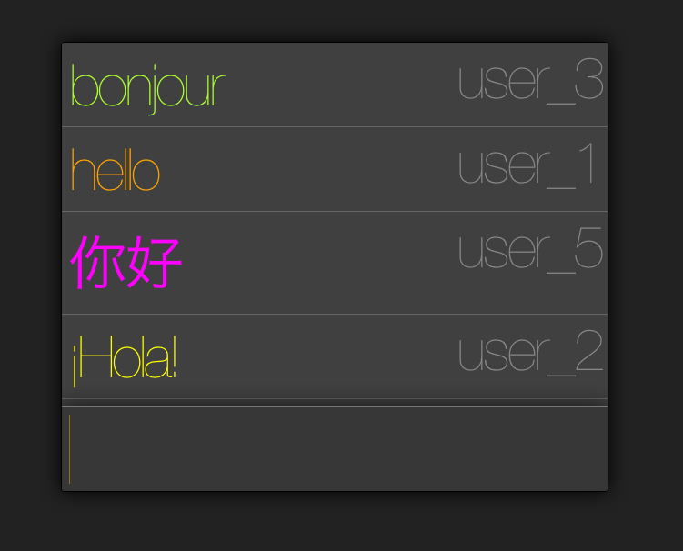

Slide 28
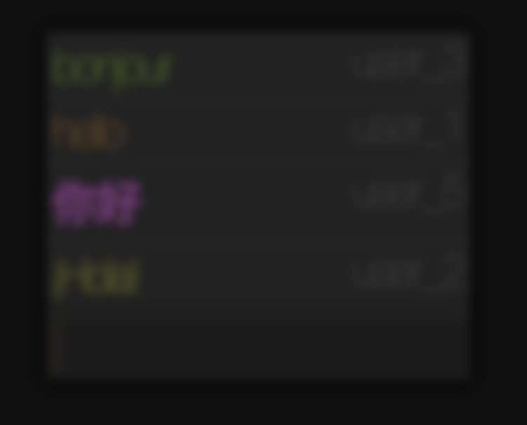
http://from.so/web_lab/chat.html

Slide 29
Let’s implement a chat app!

Slide 30
Install socket.IO. In your project folder, run:
npm install socket.io
Create a file chat_server.js:
var app = require('http').createServer(handler)
, io = require('socket.io').listen(app)
, fs = require('fs')
app.listen(8000);
function handler (req, res) {
fs.readFile(__dirname + '/index.html',
function (err, data) {
if (err) {
res.writeHead(500);
return res.end('Error loading index.html');
}
res.writeHead(200);
res.end(data);
});
}

Slide 31
Next time…
CSS and styling
Will use CSS to add style to chat application

Slide 32
Web Servers

Slide 33
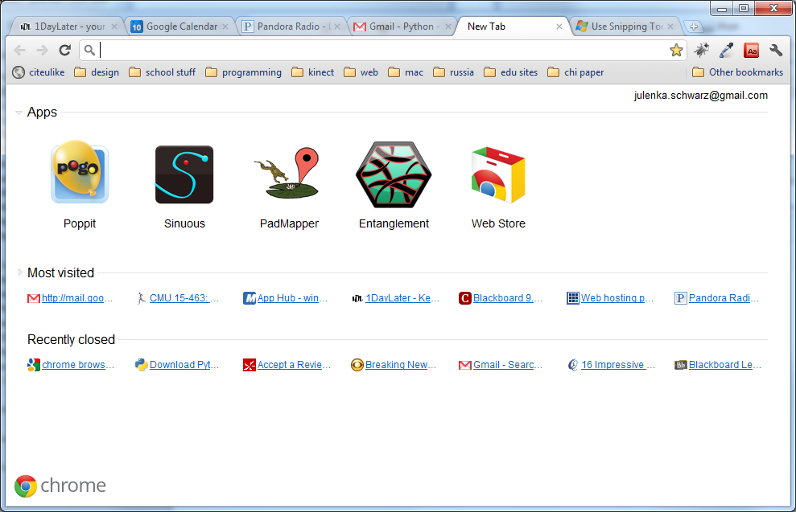
So Far…
Notes:
All of this logic runs on your computer.
If you change computers, all of your information is lost.
Can’t access large amounts of information this way.
You couldn’t build Gmail using what we’ve learned so far.

Slide 34
So Far…
We’ve learned about how to make cool interactive stuff happen on your web page.
All of this logic runs on your computer.
If you change computers, all of your information is lost.
Notes:
All of this logic runs on your computer.
If you change computers, all of your information is lost.
Can’t access large amounts of information this way.
You couldn’t build Gmail using what we’ve learned so far.

Slide 35

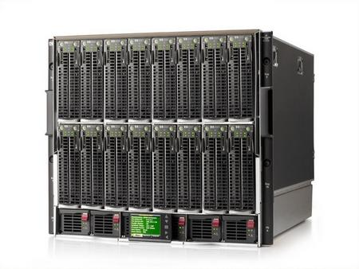
The Beauty of Servers
Notes:
Servers can query that data and give it to you wherever you are.

Slide 36
The missing piece
http://1userverrack.net/wp-content/uploads/2011/05/web-server1.jpg
Notes:
In order to store your data when your computer closes, or be able to access your same email across computers, you need to store it somewhere else, like in this giant behemoth.
When you get webpages, you are usually not loading them from your computer as we are in class. You’re loading them from a web server, a computer that’s sitting somewhere else (could be in your room or somewhere in Kentucky. Probably not in your room). Usually you load pages from computers that are called servers.
These servers can do more than just give you a simple HTML page. You can also run programs on servers, and more importantly, store huge amounts of data.

Slide 37
Server-Side Programming
Writing code that runs on the server.
Logic that gets data for you
Stores data
Combines data intelligently and generates a page to present to you.
You may hear people talk about "front end" and "back end". These terms are a little overloaded – some people mean "front end" is client and "back end" is server; some people talk about both "front end" and "back end" servers. The terms "Client" (your laptop and a browser) and "Server" (usually a big data center somewhere) are more clear.

Slide 38
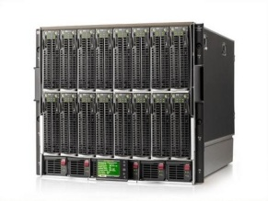

How Server-Side Code Executes (Simple Model)
http://mysite.com/blog/getPost?day=xyz
Web browser makes request to server
Server thinks
def doGet():
doSomething()
getData()
Server gives you a page

Slide 39
node.js
took Chrome javascript engine
made it an application
added libraries and utilities
result: javascript everywhere
http://node.js.org

Slide 40
what is “server-side?”
most javascript is client-side
executed in the user’s browser
javascript may now be server-side
executed in the web page server
executed anywhere!

Slide 41
why server-side js?
Notes:
Ask students: why would you want server-side js?

Slide 42
why server-side js?
re-use client-side code on the server
well known language
event-listener paradigm works well
node.js is actually faster sometimes
...or maybe you just like javascript
Notes:
Ask students: why would you want server-side js?

Slide 43
node web server
var http = require('http');
http.createServer(function (req, res) {
res.writeHead(200, {'Content-Type': 'text/plain'});
res.end('Hello World');
}).listen(80);
console.log('Server running at http://127.0.0.1/');
http://nodejs.org/

Slide 44
node web server
var http = require('http');
http.createServer(function (req, res) {
res.writeHead(200, {'Content-Type': 'text/plain'});
res.end('Hello World');
}).listen(80);
console.log('Server running at
http://nodejs.org/

Slide 45
node web server
var http = require('http');
http.createServer(function (req, res) {
res.writeHead(200, {'Content-Type': 'text/plain'});
res.end('Hello World');
}).listen(80);
console.log('Server running at
http://nodejs.org/

Slide 46
node web server
var http = require('http');
http.createServer(function (req, res) {
res.writeHead(200, {'Content-Type': 'text/plain'});
res.end('Hello World');
}).listen(80);
console.log('Server running at
http://nodejs.org/

Slide 47
node web server
var http = require('http');
http.createServer(function (req, res) {
res.writeHead(200, {'Content-Type': 'text/plain'});
res.end('Hello World');
}).listen(80);
console.log('Server running at
http://nodejs.org/

Slide 48
node web server
var http = require('http');
http.createServer(function (req, res) {
res.writeHead(200, {'Content-Type': 'text/plain'});
res.end('Hello World');
}).listen(80);
console.log('Server running at;
http://nodejs.org/

Slide 49
node web server
var http = require('http');
http.createServer(function (req, res) {
res.writeHead(200, {'Content-Type': 'text/plain'});
res.end('Hello World');
}).listen(80);
console.log('Server running at http://127.0.0.1/');
http://nodejs.org/

Slide 50
node web server
var http = require('http');
http.createServer(function (req, res) {
res.writeHead(200, {'Content-Type': 'text/plain'});
res.end('Hello World');
}).listen(80);
console.log('Server running at http://127.0.0.1/');
http://nodejs.org/

Slide 51
node: socket.io
create sockets for quick client-server communication
allows for very “live” web pages
socket.emit(event, data);
socket.on(event, function);
http://socket.io/

Slide 52
node: socket.io
create sockets for quick client-server communication
allows for very “live” web pages
install via "npm install socket.io"
http://socket.io/

Slide 53
socket.io for node
server-side
client-side
var io = require('socket.io').listen(80);
io.sockets.on('connection', function (socket) {
socket.emit('news', 'Stocks are up!');
socket.on('response', function (data) {
console.log(data);
});
});
<script src="/socket.io/socket.io.js"></script>
<script>
var socket = io.connect('http://localhost');
socket.on('news', function (data) {
socket.emit('response', { user: 'steve' });
});
</script>
http://socket.io/

Slide 54
socket.io for node
server-side
client-side
var io = require('socket.io').listen(80);
io.sockets.on('connection', function (socket) {
socket.emit('news', 'Stocks are up!');
socket.on('response', function (data) {
console.log(data);
});
});
<script src="/socket.io/socket.io.js"></script>
<script>
var socket = io.connect('http://localhost');
socket.on('news', function (data) {
socket.emit('response', { user: 'steve' });
});
</script>
http://socket.io/

Slide 55
socket.io for node
server-side
client-side
var io = require('socket.io').listen(80);
io.sockets.on('connection', function (socket) {
socket.emit('news', 'Stocks are up!');
socket.on('response', function (data) {
console.log(data);
});
});
<script src="/socket.io/socket.io.js"></script>
<script>
var socket = io.connect('http://localhost');
socket.on('news', function (data) {
socket.emit('response', { user: 'steve' });
});
</script>
http://socket.io/

Slide 56
socket.io for node
server-side
client-side
var io = require('socket.io').listen(80);
io.sockets.on('connection', function (socket) {
socket.emit('news', 'Stocks are up!');
socket.on('response', function (data) {
console.log(data);
});
});
<script src="/socket.io/socket.io.js"></script>
<script>
var socket = io.connect('http://localhost');
socket.on('news', function (data) {
socket.emit('response', { user: 'steve' });
});
</script>
http://socket.io/

Slide 57
socket.io for node
server-side
client-side
var io = require('socket.io').listen(80);
io.sockets.on('connection', function (socket) {
socket.emit('news', 'Stocks are up!');
socket.on('response', function (data) {
console.log(data);
});
});
<script src="/socket.io/socket.io.js"></script>
<script>
var socket = io.connect('http://localhost');
socket.on('news', function (data) {
socket.emit('response', { user: 'steve' });
});
</script>
http://socket.io/

Slide 58
socket.io for node
server-side
client-side
var io = require('socket.io').listen(80);
io.sockets.on('connection', function (socket) {
socket.emit('news', 'Stocks are up!');
socket.on('response', function (data) {
console.log(data);
});
});
<script src="/socket.io/socket.io.js"></script>
<script>
var socket = io.connect('http://localhost');
socket.on('news', function (data) {
socket.emit('response', { user: 'steve' });
});
</script>
http://socket.io/

Slide 59
socket.io for node
server-side
client-side
var io = require('socket.io').listen(80);
io.sockets.on('connection', function (socket) {
socket.emit('news', 'Stocks are up!');
socket.on('response', function (data) {
console.log(data);
});
});
<script src="/socket.io/socket.io.js"></script>
<script>
var socket = io.connect('http://localhost');
socket.on('news', function (data) {
socket.emit('response', { user: 'steve' });
});
</script>
http://socket.io/

Slide 60
socket.io for node
server-side
client-side
var io = require('socket.io').listen(80);
io.sockets.on('connection', function (socket) {
socket.emit('news', 'Stocks are up!');
socket.on('response', function (data) {
console.log(data);
});
});
<script src="/socket.io/socket.io.js"></script>
<script>
var socket = io.connect('http://localhost');
socket.on('news', function (data) {
socket.emit('response', { user: 'steve' });
});
</script>
http://socket.io/

Slide 61
socket.io for node
server-side
client-side
var io = require('socket.io').listen(80);
io.sockets.on('connection', function (socket) {
socket.emit('news', 'Stocks are up!');
socket.on('response', function (data) {
console.log(data);
});
});
<script src="/socket.io/socket.io.js"></script>
<script>
var socket = io.connect('http://localhost');
socket.on('news', function (data) {
socket.emit('response', { user: 'steve' });
});
</script>
http://socket.io/

Slide 62
socket.io for node
server-side
client-side
var io = require('socket.io').listen(80);
io.sockets.on('connection', function (socket) {
socket.emit('news', 'Stocks are up!');
socket.on('response', function (data) {
console.log(data);
});
});
<script src="/socket.io/socket.io.js"></script>
<script>
var socket = io.connect('http://localhost');
socket.on('news', function (data) {
socket.emit('response', { user: 'steve' });
});
</script>
http://socket.io/

Slide 63
In-class project
Write a chat application using Socket.IO
Teams of 2 (randomly divided)

