Slide 1

State machines and AJAX
Lab 7
10/6

Slide 2
Last time…
Events & callbacks
target.addEventListener(<event>, <callback>);
target.removeEventListener(<event>, <callback>);
setTimeout(<callback>, <delay>);
Event bubbling
Capture versus bubbling

Slide 3
Today
P2 doodles
FSMs & P3 (optional)
Positional and focus based dispatch
AJAX
Accessing data from remote servers
Making your own servers (if there's time)

Slide 4
P2 Doodles
TODO: pick out some good ones

Slide 5
Finite State Machines
a quick review

Slide 6
What is a Finite State Machine?
Very simple component or ‘machine’ that responds to input of some kind.
When discussed in CS theory, input is usually a character or number.
In HCI, input is usually a mouse down event, a key press event, etc.
Input can be anything that the machine takes in.

Slide 7
What is a Finite State Machine?
What a state machine has:
Its current state
A start state
Rules that define what state it should go to given a state and input (called ‘transitions’)
What the state machine does:
When it gets input, it moves to another state.

Slide 8
What are some examples of Finite State Machines?

Slide 9
FSM Notation
Means: when you are in state A and you see a mouse down, go to state B
Mouse_Dn
A
B

Slide 10
Example: Binary # with Odd or Even Number of Zeros:
1
0
even
odd
0
1

Slide 11
Why do we Care?
For interactions like a draggable icon (or something more complex), it is good to think of the icon as a state machine.
Often people implicitly use state into their code without knowing it.
Then, when their code gets more complex they often wish they’d used a state machine.

Slide 12
State Machines for HCI
Adding one extra thing: the action to execute when a transition is taken.

Slide 13
FSM Notation for HCI
Means: when you are in state A and you see a mouse down, do the action (call draw_line),
and go to state B
Mouse_Dn/ Draw Line
A
B

Slide 14
FSM for a button
Release / D
Enter / C
Leave / B
Press-inside / A
Release / E
A: highlight button
B: unhighlight button
C: highlight button
D: <do nothing>
E: unhighlight; do button action

Slide 15
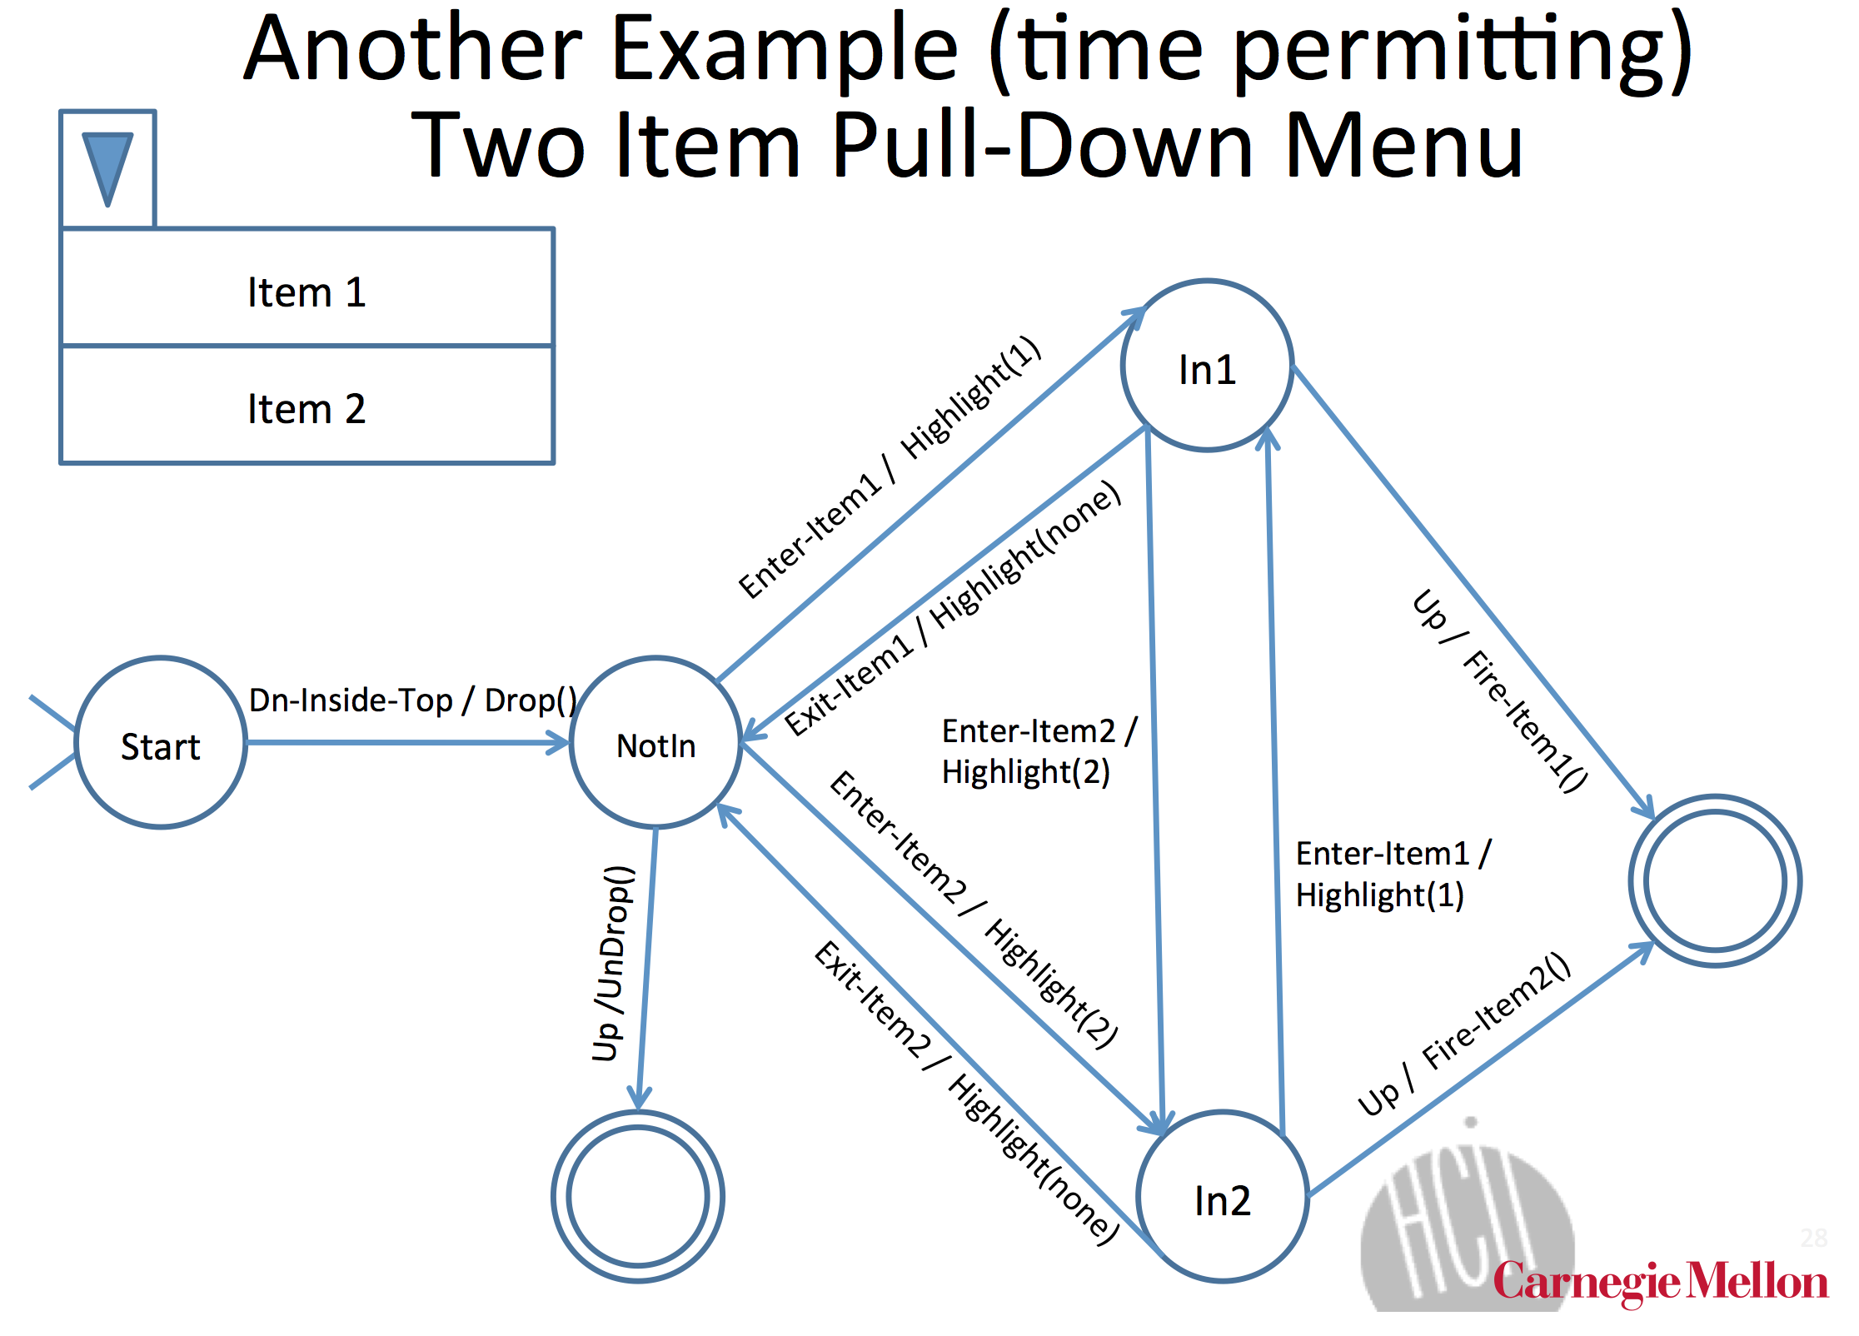

Slide 16
FSM for…?
Notes:
pick an example of some interaction on a website, say. go through what it does. (optional, if they want)

Slide 17
How do browsers dispatch events?
focus vs. positional – some events use focus and some use position. (which?)
dragging needs focus-based dispatch. but mouse events are positional. how would you add focus-based dispatch?
Notes:
show example of my project 3 solution
keyboard events are focus based
mouse events are mostly location based
(don't want to go into too much detail b/c that's the project)

Slide 18
Project 3
Write a StateMachine object that takes in a description of a state machine and acts according to the description.
Then write some tests.
How's it going?

Slide 19
AJAX
Asynchronous JavaScript & XML
Loads data from external services without refreshing page
Defined “Web 2.0”
Procedurally:
Make an asynchronous call to an external API
This call will return a value after some delay
Show a loading message (good UI practice)
Update the web page in response to the return value of the asynchronous call

Slide 20
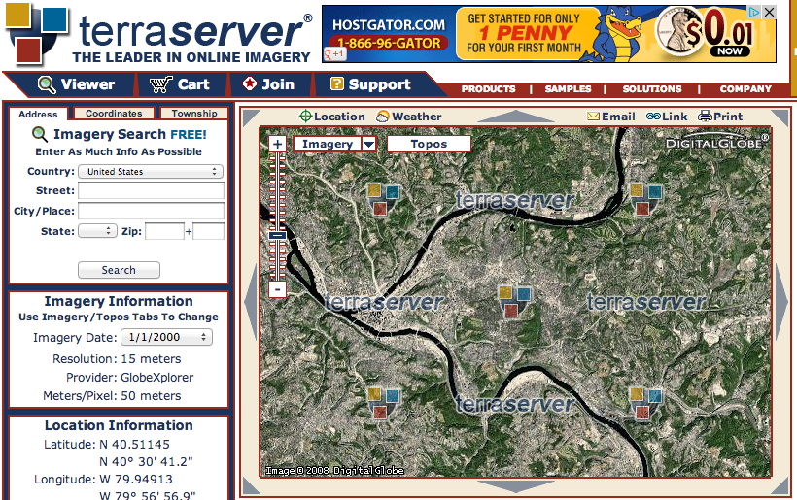
it’s the difference between…

Slide 21
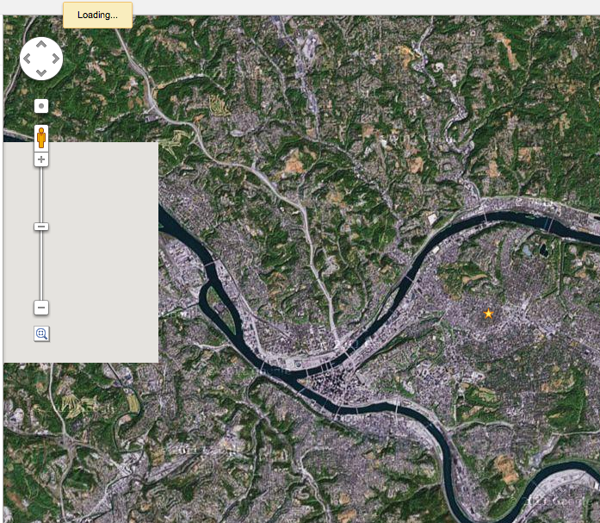

Slide 22
Notes:
other examples of ajax?
what are some of the difficulties in it?

Slide 23
Next time…
“Should I wear a jacket today?”
Going to use Yahoo! Weather API
http://developer.yahoo.com/weather/
One of many available weather APIs
http://weather.yahooapis.com/forecastrss?w=2473224
For next class:
Install Node.js: http://nodejs.org/

Slide 24
AJAX
Lab 8 – or maybe earlier if we get to it in lab 7
10/16

Slide 25
Project 4
Last project
Project of your own choosing
May overlap with a personal project but may not overlap with any projects for other classes
Must use topics discussed in class but may run on any platform
client-side, server-side, iOS, dashboard widgets, Chrome extensions, etc.
Proposals due November 1st
Project checkpoint November 15th
Presentations November 29th & December 6th
Start thinking of project ideas now

Slide 26
Today
AJAX
Server-side code
Node.JS
Begin a multi-day in-class project
Part of participation grade rather than project grade
Intention: only work in-class, groups of 3

Slide 27
AJAX
Asynchronous JavaScript & XML
Loads data from external services without refreshing page
Defined “Web 2.0”
Procedurally:
Make an asynchronous call to an external API
This call will return a value after some delay
Show a loading message (good UI practice)
Update the web page in response to the return value of the asynchronous call

Slide 28
AJAX
Done with XMLHttpRequest
API for sending requests to a web server within JavaScript
Many libraries simplify the development of AJAX
…we won’t use any of them
…but you may for your final projects

Slide 29
XMLHttpRequest
.readyState
1: open method has been successfully called
2: send method has been successfully called, response headers have been recieved
3: response has begun to load
4: response has finished loading

Slide 30
XMLHttpRequest
.readyState
1: open method has been successfully called
2: send method has been successfully called, response headers have been recieved
3: response has begun to load
4: response has finished loading
.status
Status code in the response from the server
200: OK
403: Forbidden
404: Not found

Slide 31
XMLHttpRequest
.readyState
1: open method has been successfully called
2: send method has been successfully called, response headers have been recieved
3: response has begun to load
4: response has finished loading
.status
Status code in the response from the server
200: OK
403: Forbidden
404: Not found
.onreadystatechange = function()…
Called when .readyState changes

Slide 32
XMLHttpRequest
.readyState
1: open method has been successfully called
2: send method has been successfully called, response headers have been recieved
3: response has begun to load
4: response has finished loading
.status
Status code in the response from the server
200: OK
403: Forbidden
404: Not found
.onreadystatechange = function()…
Called when .readyState changes
.open(method, url)
Specify a method (GET, POST, etc.) and a URL to fetch

Slide 33
XMLHttpRequest
.readyState
1: open method has been successfully called
2: send method has been successfully called, response headers have been recieved
3: response has begun to load
4: response has finished loading
.status
Status code in the response from the server
200: OK
403: Forbidden
404: Not found
.onreadystatechange = function()…
Called when .readyState changes
.open(method, url)
Specify a method (GET, POST, etc.) and a URL to fetch
.send()
Sends the request (optional data argument)
Notes:
Much more customizable but you don’t usually need more properties than this…

Slide 34
var xmlhttp = new XMLHttpRequest();
xmlhttp.onreadystatechange = function() {
if (xmlhttp.readyState === 4 && xmlhttp.status === 200) {
console.log(xmlhttp);
}
};
xmlhttp.open("GET", ”http://from.so/web_lab/pgh_weather.php");
xmlhttp.send();

Slide 35
var xmlhttp = new XMLHttpRequest();
xmlhttp.onreadystatechange = function() {
if (xmlhttp.readyState === 4 && xmlhttp.status === 200) {
console.log(xmlhttp);
}
};
xmlhttp.open("GET", ”http://from.so/web_lab/pgh_weather.php");
xmlhttp.send();

Slide 36
var xmlhttp = new XMLHttpRequest();
xmlhttp.onreadystatechange = function() {
if (xmlhttp.readyState === 4 && xmlhttp.status === 200) {
console.log(xmlhttp);
}
};
xmlhttp.open("GET", ”http://from.so/web_lab/pgh_weather.php");
xmlhttp.send();

Slide 37
var xmlhttp = new XMLHttpRequest();
xmlhttp.onreadystatechange = function() {
if (xmlhttp.readyState === 4 && xmlhttp.status === 200) {
console.log(xmlhttp);
}
};
xmlhttp.open("GET", ”http://from.so/web_lab/pgh_weather.php");
xmlhttp.send();

Slide 38
var xmlhttp = new XMLHttpRequest();
xmlhttp.onreadystatechange = function() {
if (xmlhttp.readyState === 4 && xmlhttp.status === 200) {
console.log(xmlhttp);
}
};
xmlhttp.open("GET", ”http://from.so/web_lab/pgh_weather.php");
xmlhttp.send();

Slide 39
var xmlhttp = new XMLHttpRequest();
xmlhttp.onreadystatechange = function() {
if (xmlhttp.readyState === 4 && xmlhttp.status === 200) {
console.log(xmlhttp);
}
};
xmlhttp.open("GET", ”http://from.so/web_lab/pgh_weather.php");
xmlhttp.send();

Slide 40
Should I wear a jacket today?
Yahoo! Weather API
http://from.so/web_lab/pgh_weather.php
More information about the API:
http://developer.yahoo.com/weather/
Step 1: Fetch weather information from Yahoo!
Starter code on next slide
Notes:
show your code as an example

Slide 41
Step 1: Fetch weather data
var xmlhttp = new XMLHttpRequest();
xmlhttp.onreadystatechange = function() {
if (xmlhttp.readyState === 4 && xmlhttp.status === 200) {
console.log(xmlhttp);
}
};
xmlhttp.open("GET", ”http://from.so/web_lab/pgh_weather.php");
xmlhttp.send();

Slide 42
Dealing with response data
Two most common formats: XML & JSON
XML: Treated like HTML, root: xmlhttp.responseXML
xmlhttp.responseXML.getElementById
xmlhttp.responseXML.getElementsByTagName
JSON: JavaScript objects are directly given
JSON.parse(xmlhttp.responseText)

Slide 43
Dealing with response data
Two most common formats: XML & JSON
XML: Treated like HTML, root: xmlhttp.responseXML
xmlhttp.responseXML.getElementById
xmlhttp.responseXML.getElementsByTagName
JSON: JavaScript objects are directly given
JSON.parse(xmlhttp.responseText)
Yahoo! Weather API uses XML

Slide 44
Step 2: Update your UI with weather data
var xmlhttp = new XMLHttpRequest();
xmlhttp.onreadystatechange = function() {
if (xmlhttp.readyState === 4 && xmlhttp.status === 200) {
var condition=
xmlhttp.responseXML.getElementsByTagName("condition”);
// your code here...
}
};
xmlhttp.open("GET", ”http://from.so/web_lab/pgh_weather.php");
xmlhttp.send();

Slide 45
Web Back ends

Slide 46
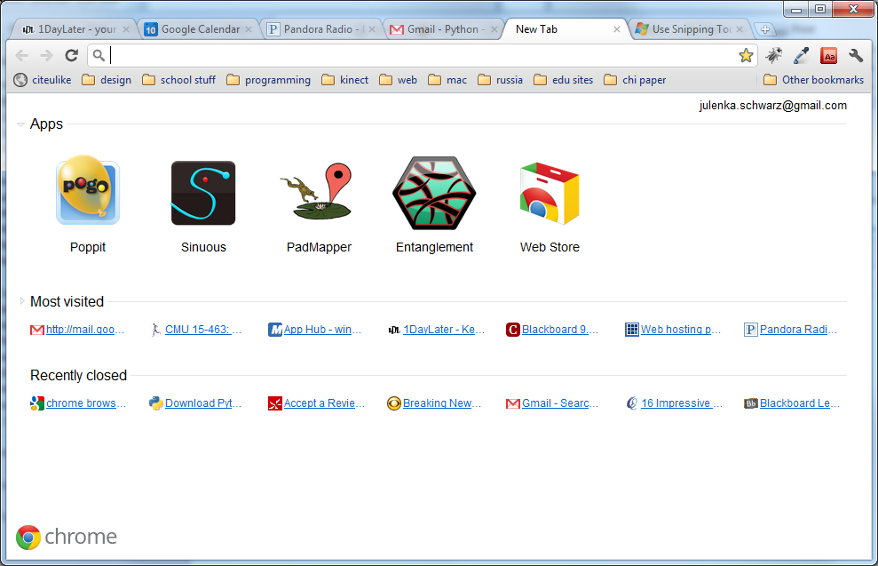
So Far…
Notes:
All of this logic runs on your computer.
If you change computers, all of your information is lost.
Can’t access large amounts of information this way.
You couldn’t build Gmail using what we’ve learned so far.

Slide 47
So Far…
We’ve learned about how to make cool interactive stuff happen on your web page.
All of this logic runs on your computer.
If you change computers, all of your information is lost.
Notes:
All of this logic runs on your computer.
If you change computers, all of your information is lost.
Can’t access large amounts of information this way.
You couldn’t build Gmail using what we’ve learned so far.

Slide 48
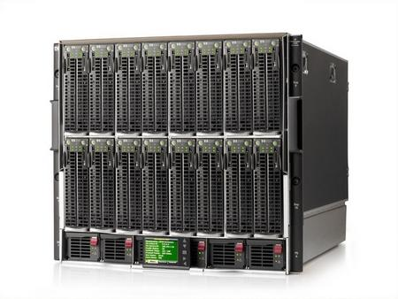
The missing piece
http://1userverrack.net/wp-content/uploads/2011/05/web-server1.jpg
Notes:
In order to store your data when your computer closes, or be able to access your same email across computers, you need to store it somewhere else, like in this giant behemoth.
When you get webpages, you are usually not loading them from your computer as we are in class. You’re loading them from a web server, a computer that’s sitting somewhere else (could be in your room or somewhere in Kentucky. Probably not in your room). Usually you load pages from computers that are called servers.
These servers can do more than just give you a simple HTML page. You can also run programs on servers, and more importantly, store huge amounts of data.

Slide 49

The Beauty of Servers
Notes:
Servers can query that data and give it to you wherever you are.

Slide 50
Server-Side Programming
Writing code that runs on the server.
Logic that gets data for you
Stores data
Combines data intelligently and generates a page to present to you.
Also called “Back end Programming”
Stuff you were doing before: “Front end Programming”

Slide 51
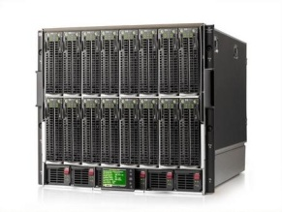

How Server-Side Code Executes (Simple Model)
http://mysite.com/blog/getPost?day=xyz
Web browser makes request to server
Server thinks
def doGet():
doSomething()
getData()
Server gives you a page

Slide 52
Web Back ends

Slide 53
So Far…
Notes:
All of this logic runs on your computer.
If you change computers, all of your information is lost.
Can’t access large amounts of information this way.
You couldn’t build Gmail using what we’ve learned so far.

Slide 54
So Far…
We’ve learned about how to make cool interactive stuff happen on your web page.
All of this logic runs on your computer.
If you change computers, all of your information is lost.
Notes:
All of this logic runs on your computer.
If you change computers, all of your information is lost.
Can’t access large amounts of information this way.
You couldn’t build Gmail using what we’ve learned so far.

Slide 55
The missing peice
http://1userverrack.net/wp-content/uploads/2011/05/web-server1.jpg
Notes:
In order to store your data when your computer closes, or be able to access your same email across computers, you need to store it somewhere else, like in this giant behemoth.
When you get webpages, you are usually not loading them from your computer as we are in class. You’re loading them from a web server, a computer that’s sitting somewhere else (could be in your room or somewhere in Kentucky. Probably not in your room). Usually you load pages from computers that are called servers.
These servers can do more than just give you a simple HTML page. You can also run programs on servers, and more importantly, store huge amounts of data.

Slide 56
The Beauty of Servers
Notes:
Servers can query that data and give it to you wherever you are.

Slide 57
Server-Side Programming
Writing code that runs on the server.
Logic that gets data for you
Stores data
Combines data intelligently and generates a page to present to you.
You may hear people talk about "front end" and "back end". These terms are a little overloaded – some people mean "front end" is client and "back end" is server; some people talk about both "front end" and "back end" servers. The terms "Client" and "Server" are more clear.

Slide 58
How Server-Side Code Executes (Simple Model)
http://mysite.com/blog/getPost?day=xyz
Web browser makes request to server
Server thinks
def doGet():
doSomething()
getData()
Server gives you a page

Slide 59
what is “server-side?”
most javascript is client-side
executed in the user’s browser
javascript may now be server-side
executed in the web page server
executed anywhere!

Slide 60
node.js
took Chrome javascript engine
made it an application
added libraries and utilities
result: javascript everywhere
http://node.js.org

Slide 61
why server-side js?
Notes:
Ask students: why would you want server-side js?

Slide 62
why server-side js?
re-use client-side code on the server
well known language
event-listener paradigm works well
node.js is actually faster sometimes
...or maybe you just like javascript
Notes:
Ask students: why would you want server-side js?

Slide 63
node web server
var http = require('http');
http.createServer(function (req, res) {
res.writeHead(200, {'Content-Type': 'text/plain'});
res.end('Hello World');
}).listen(80);
console.log('Server running at http://127.0.0.1/');
http://nodejs.org/

Slide 64
node web server
var http = require('http');
http.createServer(function (req, res) {
res.writeHead(200, {'Content-Type': 'text/plain'});
res.end('Hello World');
}).listen(80);
console.log('Server running at
http://nodejs.org/

Slide 65
node web server
var http = require('http');
http.createServer(function (req, res) {
res.writeHead(200, {'Content-Type': 'text/plain'});
res.end('Hello World');
}).listen(80);
console.log('Server running at
http://nodejs.org/

Slide 66
node web server
var http = require('http');
http.createServer(function (req, res) {
res.writeHead(200, {'Content-Type': 'text/plain'});
res.end('Hello World');
}).listen(80);
console.log('Server running at
http://nodejs.org/

Slide 67
node web server
var http = require('http');
http.createServer(function (req, res) {
res.writeHead(200, {'Content-Type': 'text/plain'});
res.end('Hello World');
}).listen(80);
console.log('Server running at
http://nodejs.org/

Slide 68
node web server
var http = require('http');
http.createServer(function (req, res) {
res.writeHead(200, {'Content-Type': 'text/plain'});
res.end('Hello World');
}).listen(80);
console.log('Server running at;
http://nodejs.org/

Slide 69
node web server
var http = require('http');
http.createServer(function (req, res) {
res.writeHead(200, {'Content-Type': 'text/plain'});
res.end('Hello World');
}).listen(80);
console.log('Server running at http://127.0.0.1/');
http://nodejs.org/

Slide 70
node web server
var http = require('http');
http.createServer(function (req, res) {
res.writeHead(200, {'Content-Type': 'text/plain'});
res.end('Hello World');
}).listen(80);
console.log('Server running at http://127.0.0.1/');
http://nodejs.org/

Slide 71
node: socket.io
create sockets for quick client-server communication
allows for very “live” web pages
socket.emit(event, data);
socket.on(event, function);
http://socket.io/

Slide 72
socket.io for node
server-side
client-side
var io = require('socket.io').listen(80);
io.sockets.on('connection', function (socket) {
socket.emit('news', 'Stocks are up!');
socket.on('response', function (data) {
console.log(data);
});
});
<script src="/socket.io/socket.io.js"></script>
<script>
var socket = io.connect('http://localhost');
socket.on('news', function (data) {
socket.emit('response', { user: 'steve' });
});
</script>
http://socket.io/

Slide 73
socket.io for node
server-side
client-side
var io = require('socket.io').listen(80);
io.sockets.on('connection', function (socket) {
socket.emit('news', 'Stocks are up!');
socket.on('response', function (data) {
console.log(data);
});
});
<script src="/socket.io/socket.io.js"></script>
<script>
var socket = io.connect('http://localhost');
socket.on('news', function (data) {
socket.emit('response', { user: 'steve' });
});
</script>
http://socket.io/

Slide 74
socket.io for node
server-side
client-side
var io = require('socket.io').listen(80);
io.sockets.on('connection', function (socket) {
socket.emit('news', 'Stocks are up!');
socket.on('response', function (data) {
console.log(data);
});
});
<script src="/socket.io/socket.io.js"></script>
<script>
var socket = io.connect('http://localhost');
socket.on('news', function (data) {
socket.emit('response', { user: 'steve' });
});
</script>
http://socket.io/

Slide 75
socket.io for node
server-side
client-side
var io = require('socket.io').listen(80);
io.sockets.on('connection', function (socket) {
socket.emit('news', 'Stocks are up!');
socket.on('response', function (data) {
console.log(data);
});
});
<script src="/socket.io/socket.io.js"></script>
<script>
var socket = io.connect('http://localhost');
socket.on('news', function (data) {
socket.emit('response', { user: 'steve' });
});
</script>
http://socket.io/

Slide 76
socket.io for node
server-side
client-side
var io = require('socket.io').listen(80);
io.sockets.on('connection', function (socket) {
socket.emit('news', 'Stocks are up!');
socket.on('response', function (data) {
console.log(data);
});
});
<script src="/socket.io/socket.io.js"></script>
<script>
var socket = io.connect('http://localhost');
socket.on('news', function (data) {
socket.emit('response', { user: 'steve' });
});
</script>
http://socket.io/

Slide 77
socket.io for node
server-side
client-side
var io = require('socket.io').listen(80);
io.sockets.on('connection', function (socket) {
socket.emit('news', 'Stocks are up!');
socket.on('response', function (data) {
console.log(data);
});
});
<script src="/socket.io/socket.io.js"></script>
<script>
var socket = io.connect('http://localhost');
socket.on('news', function (data) {
socket.emit('response', { user: 'steve' });
});
</script>
http://socket.io/

Slide 78
socket.io for node
server-side
client-side
var io = require('socket.io').listen(80);
io.sockets.on('connection', function (socket) {
socket.emit('news', 'Stocks are up!');
socket.on('response', function (data) {
console.log(data);
});
});
<script src="/socket.io/socket.io.js"></script>
<script>
var socket = io.connect('http://localhost');
socket.on('news', function (data) {
socket.emit('response', { user: 'steve' });
});
</script>
http://socket.io/

Slide 79
socket.io for node
server-side
client-side
var io = require('socket.io').listen(80);
io.sockets.on('connection', function (socket) {
socket.emit('news', 'Stocks are up!');
socket.on('response', function (data) {
console.log(data);
});
});
<script src="/socket.io/socket.io.js"></script>
<script>
var socket = io.connect('http://localhost');
socket.on('news', function (data) {
socket.emit('response', { user: 'steve' });
});
</script>
http://socket.io/

Slide 80
socket.io for node
server-side
client-side
var io = require('socket.io').listen(80);
io.sockets.on('connection', function (socket) {
socket.emit('news', 'Stocks are up!');
socket.on('response', function (data) {
console.log(data);
});
});
<script src="/socket.io/socket.io.js"></script>
<script>
var socket = io.connect('http://localhost');
socket.on('news', function (data) {
socket.emit('response', { user: 'steve' });
});
</script>
http://socket.io/

Slide 81
socket.io for node
server-side
client-side
var io = require('socket.io').listen(80);
io.sockets.on('connection', function (socket) {
socket.emit('news', 'Stocks are up!');
socket.on('response', function (data) {
console.log(data);
});
});
<script src="/socket.io/socket.io.js"></script>
<script>
var socket = io.connect('http://localhost');
socket.on('news', function (data) {
socket.emit('response', { user: 'steve' });
});
</script>
http://socket.io/

Slide 82
In-class project
Write an application using Socket.IO
Teams of 2 (randomly divided)

