Slide 1
Server-Side Development
Lab 9
10/23

Slide 2
Office hours tomorrow
1:30-2:30pm (not 3) tomorrow

Slide 3
Class feedback
assignments and class difficulty: mix of "too easy" and "too hard" and "just right"
maybe could have more shorter assignments (too late now, but thanks for the feedback for next year)
canvas + inheritance lab was a little convoluted and frustrating
lectures could have more hands on work
following SSUI: a little split; could be closer, but maybe not
future topics: jquery (yes), sweet CSS tricks (probably), more modern frameworks (yes!), coffeescript (maybe)

Slide 4
Class feedback
why are you writing code on the whiteboard when you've got your computer plugged in? good point.
"it's in craig st :(" and "walking to craig st is good exercise"
"do we have a final project?" glad you asked…

Slide 5
Project 4
Last project
Project of your own choosing
May overlap with a personal project or a project for other classes
Details on website: http://dantasse.github.io/ssuiweb2014/p4/project4.html
1-3 project proposals due October 30
Decide on a project November 6
Project checkpoint November 13
Due Nov 25 (before Thanksgiving break)
Presentations Dec 4
Notes:
go through the project in detail on the website

Slide 6
Last time…
AJAX
Server-side code
Node.JS

Slide 7
So Far…
We’ve learned about how to make cool interactive stuff happen on your web page.
All of this logic runs on your computer.
If you change computers, all of your information is lost.

Slide 8
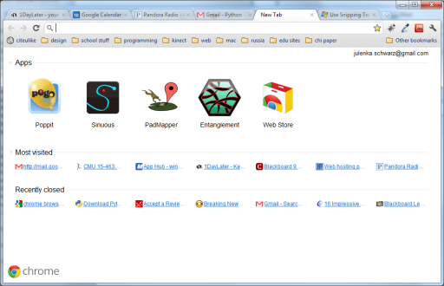
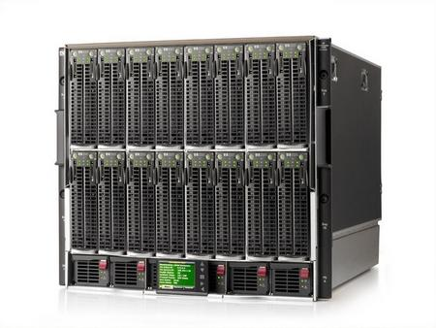
The Beauty of Servers
Notes:
Servers can query that data and give it to you wherever you are.

Slide 9
The missing piece
http://1userverrack.net/wp-content/uploads/2011/05/web-server1.jpg
Notes:
In order to store your data when your computer closes, or be able to access your same email across computers, you need to store it somewhere else, like in this giant behemoth.
When you get webpages, you are usually not loading them from your computer as we are in class. You’re loading them from a web server, a computer that’s sitting somewhere else (could be in your room or somewhere in Kentucky. Probably not in your room). Usually you load pages from computers that are called servers.
These servers can do more than just give you a simple HTML page. You can also run programs on servers, and more importantly, store huge amounts of data.

Slide 10
Server-Side Programming
Writing code that runs on the server.
Logic that gets data for you
Stores data
Combines data intelligently and generates a page to present to you.
You may hear people talk about "front end" and "back end". These terms are a little overloaded – some people mean "front end" is client and "back end" is server; some people talk about both "front end" and "back end" servers. The terms "Client" (your laptop and a browser) and "Server" (usually a big data center somewhere) are more clear.

Slide 11
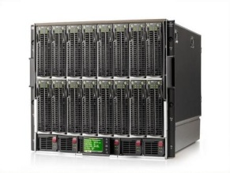

How Server-Side Code Executes (Simple Model)
http://mysite.com/blog/getPost?day=xyz
Web browser makes request to server
Server thinks
def doGet():
doSomething()
getData()
Server gives you a page

Slide 12
node.js
took Chrome javascript engine
made it an application
added libraries and utilities
result: javascript everywhere
http://node.js.org

Slide 13
what is “server-side?”
most javascript is client-side
executed in the user’s browser
javascript may now be server-side
executed in the web page server
executed anywhere!

Slide 14
node.js
took Chrome javascript engine
made it an application
added libraries and utilities
result: javascript everywhere
http://node.js.org

Slide 15
node web server
var http = require('http');
http.createServer(function (req, res) {
res.writeHead(200, {'Content-Type': 'text/plain'});
res.end('Hello World');
}).listen(80);
console.log('Server running at http://127.0.0.1/');

Slide 16
node web server
var http = require('http');
http.createServer(function (req, res) {
res.writeHead(200, {'Content-Type': 'text/plain'});
res.end('Hello World');
}).listen(80);
console.log('Server running at http://127.0.0.1/');

Slide 17
node web server
var http = require('http');
http.createServer(function (req, res) {
res.writeHead(200, {'Content-Type': 'text/plain'});
res.end('Hello World');
}).listen(80);
console.log('Server running at http://127.0.0.1/');

Slide 18
node web server
var http = require('http');
http.createServer(function (req, res) {
res.writeHead(200, {'Content-Type': 'text/plain'});
res.end('Hello World');
}).listen(80);
console.log('Server running at http://127.0.0.1/');

Slide 19
node web server
var http = require('http');
http.createServer(function (req, res) {
res.writeHead(200, {'Content-Type': 'text/plain'});
res.end('Hello World');
}).listen(80);
console.log('Server running at http://127.0.0.1/');

Slide 20
node web server
var http = require('http');
http.createServer(function (req, res) {
res.writeHead(200, {'Content-Type': 'text/plain'});
res.end('Hello World');
}).listen(80);
console.log('Server running at http://127.0.0.1/');

Slide 21
node web server
var http = require('http');
http.createServer(function (req, res) {
res.writeHead(200, {'Content-Type': 'text/plain'});
res.end('Hello World');
}).listen(80);
console.log('Server running at http://127.0.0.1/');
Notes:
ask everyone to get this running

Slide 22
a couple exercises
write an HTTP server that returns the current date
write an HTTP server that, when you visit /api/hello?name=foo, responds with "hello foo"
use "var url = require('url')" then "url.parse(request.url, true)"
write an HTTP server that you can save something to.
you can perhaps pass in the data in the query string, like a server that, if you visit /save?hello, will write "hello" into a text file
embed that within a page so you can type your name, click a button, and a message is generated server-side to greet you, then sent to the client and displayed. (think AJAX like we learned last time.)

Slide 23
other node resources
http://howtonode.org/hello-node
http://nodeschool.io/#learnyounode
npm install –g learnyounode (exercises 10-13)

Slide 24
Bonus: socket.io
if we have time, or if you're downloading these slides after class and you're interested

Slide 25
node: socket.io
create sockets for quick client-server communication
allows for very “live” web pages
socket.emit(event, data);
socket.on(event, function);
http://socket.io/

Slide 26
socket.io for node
server-side
client-side
var io = require('socket.io').listen(80);
io.sockets.on('connection', function (socket) {
socket.emit('news', 'Stocks are up!');
socket.on('response', function (data) {
console.log(data);
});
});
<script src="/socket.io/socket.io.js"></script>
<script>
var socket = io.connect('http://localhost');
socket.on('news', function (data) {
socket.emit('response', { user: 'steve' });
});
</script>

Slide 27
client-side
var io = require('socket.io').listen(80);
io.sockets.on('connection', function (socket) {
socket.emit('news', 'Stocks are up!');
socket.on('response', function (data) {
console.log(data);
});
});
<script src="/socket.io/socket.io.js"></script>
<script>
var socket = io.connect('http://localhost');
socket.on('news', function (data) {
socket.emit('response', { user: 'steve' });
});
</script>

Slide 28
client-side
var io = require('socket.io').listen(80);
io.sockets.on('connection', function (socket) {
socket.emit('news', 'Stocks are up!');
socket.on('response', function (data) {
console.log(data);
});
});
<script src="/socket.io/socket.io.js"></script>
<script>
var socket = io.connect('http://localhost');
socket.on('news', function (data) {
socket.emit('response', { user: 'steve' });
});
</script>

Slide 29
server-side
var io = require('socket.io').listen(80);
io.sockets.on('connection', function (socket) {
socket.emit('news', 'Stocks are up!');
socket.on('response', function (data) {
console.log(data);
});
});
<script src="/socket.io/socket.io.js"></script>
<script>
var socket = io.connect('http://localhost');
socket.on('news', function (data) {
socket.emit('response', { user: 'steve' });
});
</script>

Slide 30
server-side
var io = require('socket.io').listen(80);
io.sockets.on('connection', function (socket) {
socket.emit('news', 'Stocks are up!');
socket.on('response', function (data) {
console.log(data);
});
});
<script src="/socket.io/socket.io.js"></script>
<script>
var socket = io.connect('http://localhost');
socket.on('news', function (data) {
socket.emit('response', { user: 'steve' });
});
</script>

Slide 31
client-side
var io = require('socket.io').listen(80);
io.sockets.on('connection', function (socket) {
socket.emit('news', 'Stocks are up!');
socket.on('response', function (data) {
console.log(data);
});
});
<script src="/socket.io/socket.io.js"></script>
<script>
var socket = io.connect('http://localhost');
socket.on('news', function (data) {
socket.emit('response', { user: 'steve' });
});
</script>

Slide 32
server-side
client-side
var io = require('socket.io').listen(80);
io.sockets.on('connection', function (socket) {
socket.emit('news', 'Stocks are up!');
socket.on('response', function (data) {
console.log(data);
});
});
<script src="/socket.io/socket.io.js"></script>
<script>
var socket = io.connect('http://localhost');
socket.on('news', function (data) {
socket.emit('response', { user: 'steve' });
});
</script>

Slide 33
client-side
var io = require('socket.io').listen(80);
io.sockets.on('connection', function (socket) {
socket.emit('news', 'Stocks are up!');
socket.on('response', function (data) {
console.log(data);
});
});
<script src="/socket.io/socket.io.js"></script>
<script>
var socket = io.connect('http://localhost');
socket.on('news', function (data) {
socket.emit('response', { user: 'steve' });
});
</script>

Slide 34
server-side
client-side
var io = require('socket.io').listen(80);
io.sockets.on('connection', function (socket) {
socket.emit('news', 'Stocks are up!');
socket.on('response', function (data) {
console.log(data);
});
});
<script src="/socket.io/socket.io.js"></script>
<script>
var socket = io.connect('http://localhost');
socket.on('news', function (data) {
socket.emit('response', { user: 'steve' });
});
</script>

Slide 35
server-side
client-side
var io = require('socket.io').listen(80);
io.sockets.on('connection', function (socket) {
socket.emit('news', 'Stocks are up!');
socket.on('response', function (data) {
console.log(data);
});
});
<script src="/socket.io/socket.io.js"></script>
<script>
var socket = io.connect('http://localhost');
socket.on('news', function (data) {
socket.emit('response', { user: 'steve' });
});
</script>

Slide 36
socket.emit(event, data);
socket.on(event, function);
io.sockets.emit(event, data);

Slide 37
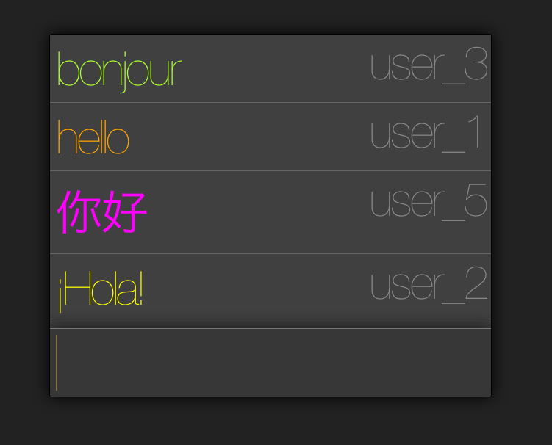

Slide 38
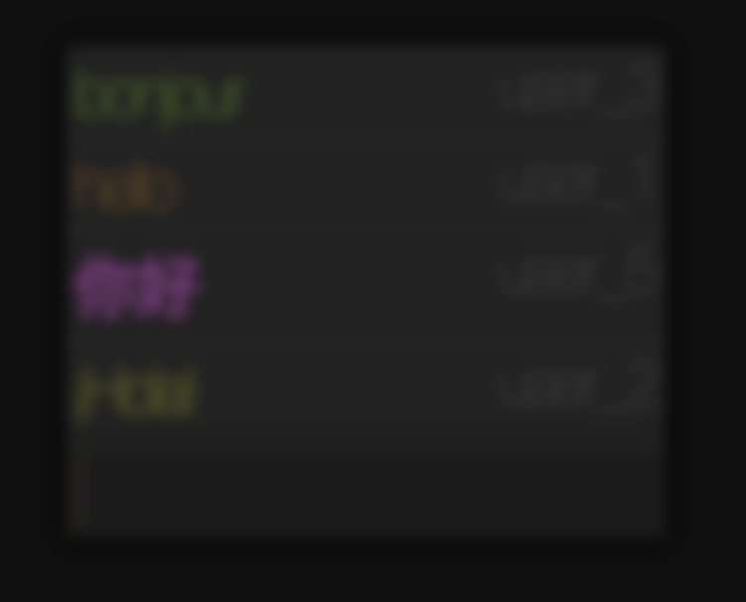
http://from.so/web_lab/chat.html

Slide 39
Let’s implement a chat app!

Slide 40
In-class project
Write a chat application using Socket.IO
Teams of 2 (randomly divided)

Slide 41
Install socket.IO. In your project folder, run:
npm install socket.io
Create a file chat_server.js:
var app = require('http').createServer(handler)
, io = require('socket.io').listen(app)
, fs = require('fs')
app.listen(8000);
function handler (req, res) {
fs.readFile(__dirname + '/index.html',
function (err, data) {
if (err) {
res.writeHead(500);
return res.end('Error loading index.html');
}
res.writeHead(200);
res.end(data);
});
}

