Slide 1
Adult Income Classification Using Machine Learning
Buhari Nasir Ahmad
Topics on Machine Learning and its Applications
Adult Census
Income Dataset
Data Science Project Presentation
1
Notes:
Good morning everyone.
Today I will present my project on Adult Income Classification using Machine Learning.
The objective of this project is to build predictive models capable of determining whether an individual's annual income exceeds fifty thousand dollars based on demographic and socioeconomic attributes.
Throughout this project, I implemented a complete machine learning pipeline including data exploration, preprocessing, model training, hyperparameter tuning, evaluation, and model interpretation.

Slide 2
Income Classification Using Machine Learning
1. Problem Definition & Dataset Selection
6. Hyperparameter Tuning
2. Exploratory Data Analysis
7. Final Model Evaluation & Interpretability
3. Data Preprocessing & Feature Engineering
8. Conclusion & Ethical Considerations
4. Class Imbalance Handling (SMOTE)
5. Model Selection & Training
2

Slide 3
1. Problem Definition & Dataset
3

Slide 4
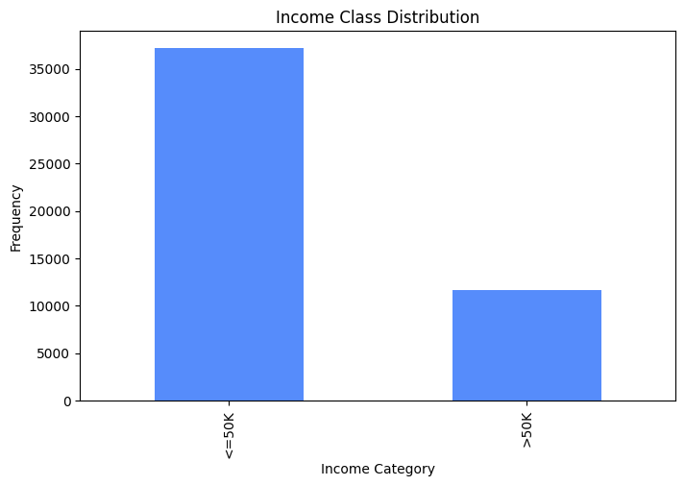
Income Classification Using Machine Learning
Problem Definition
Problem Statement
Problem Statement
This is a binary classification problem. The objective is to predict whether a person's income exceeds $50,000 per year using demographic and socioeconomic information?
Why is this important?
Income prediction supports:
- socioeconomic analysis
- Useful for policy planning
- Useful for labor market studies
- Demonstrates real-world tabular classification
4
Notes:
This project addresses a binary classification problem.
The target variable is income and has two possible classes:
Less than or equal to fifty thousand dollars.
Greater than fifty thousand dollars.
Predicting income is useful for socioeconomic analysis, labor market studies, and policy planning.
From a machine learning perspective, it is a practical real-world classification problem involving both numerical and categorical data.

Slide 5
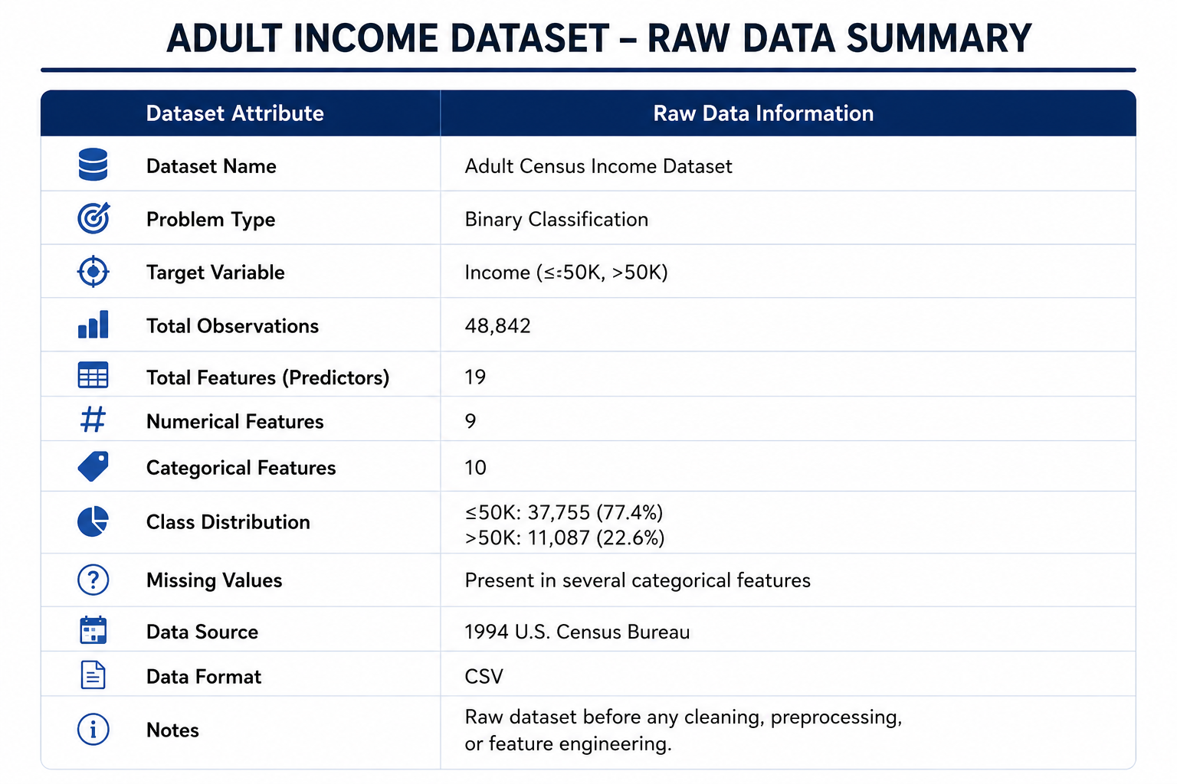
Income Classification Using Machine Learning
Dataset Overview
Problem Statement
Adult Census Income Dataset
Features include:
Age
Education
Occupation
Marital Status
Workclass
Hours per Week
Capital Gain
Capital Loss
Dataset Summary
Number of observations : 48,790
Number of features: : 19
Numerical features: 9
Categorical features: 10
4
Notes:
The dataset used is the Adult Income dataset from the UCI Machine Learning Repository.
It contains census-based demographic and employment information.
Examples of features include age, education level, marital status, occupation, hours worked per week, capital gain, and capital loss.
The dataset contains approximately forty-eight thousand records and is widely used as a benchmark dataset for machine learning classification tasks.
Before building models, I performed a detailed quality assessment of the dataset.
I checked for:
Missing values
Duplicate records
Incorrect data types
Class imbalance
Understanding data quality is important because machine learning models are highly dependent on the quality of the input data.
Any issues identified at this stage can negatively affect model performance.

Slide 6
2. Exploratory Data Analysis
5
Notes:
Exploratory Data Analysis was performed to better understand the relationships between features and income.
One important observation is that the dataset is imbalanced.
Most individuals belong to the income category below fifty thousand dollars.
I also observed that higher income levels tend to be associated with higher education levels, specific occupations, and larger capital gains.
These insights indicate that the dataset contains meaningful predictive patterns.

Slide 7
Income Classification Using Machine Learning
Exploratory Data Analysis
Income Class Distribution Key Findings
76% of samples belong to the <=50K class
24% of samples belong to the >50K class
Majority class is approximately 3× larger
Dataset is moderately imbalanced
Accuracy alone may be misleading
Should be evaluated using Precision, Recall, F1-Score, MCC, and ROC-AUC
Explored SMOTE and class weighting
6
Notes:
This chart shows the distribution of the target variable.
We can clearly see that the dataset is imbalanced.
The majority of observations belong to the lower income category.
This imbalance is important because a model could achieve high accuracy simply by predicting the majority class.
Therefore, additional evaluation metrics beyond accuracy are necessary.

Slide 8
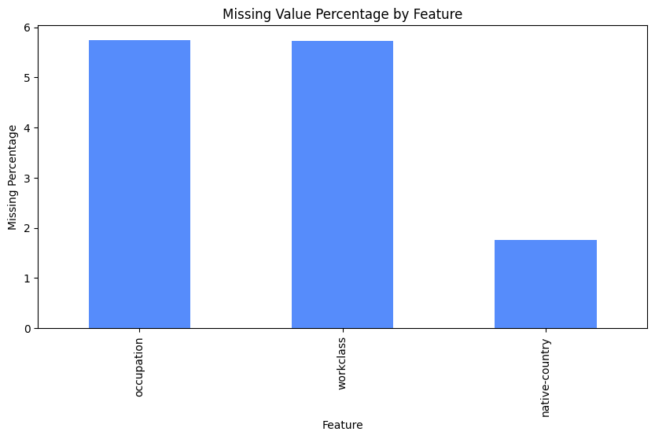
Income Classification Using Machine Learning
Exploratory Data Analysis
Missing Values Key Findings
Missing values were represented as "?" rather than standard null values.
Missing data was concentrated in only three categorical features: occupation, workclass and native-country
occupation contained approximately 5.7% missing values.
workclass contained approximately 5.6% missing values.
native-country contained approximately 1.8% missing values.
All remaining features contained no missing values
6
Notes:
As part of the exploratory data analysis, I examined data quality by identifying missing values.
In the Adult Income dataset, missing values were not stored as standard null values but as question mark symbols. These were first converted into proper missing values to enable accurate analysis.
The missing-value analysis revealed that only three categorical features contained missing observations: occupation, workclass, and native-country.
Occupation and workclass each contained approximately 5.7% missing values, while native-country contained approximately 1.8%.
Since the proportion of missing data was relatively small and these variables contain important socioeconomic information, I decided not to remove the affected observations. Instead, missing values were handled later using most-frequent imputation within the preprocessing pipeline.
This approach preserved the dataset size while ensuring that the models could be trained on complete data.

Slide 9
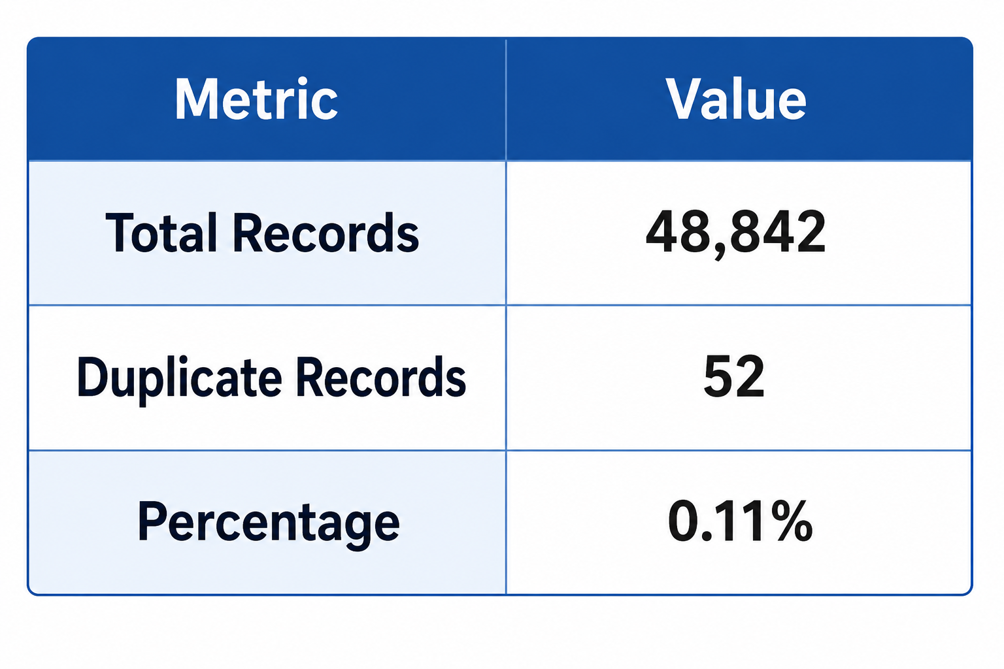
Income Classification Using Machine Learning
Exploratory Data Analysis
Duplicate Records Key Findings
52 duplicate records were identified.
Duplicates represented approximately 0.11% of the dataset.
Although the proportion was small, duplicates can introduce redundancy.
Duplicate records may bias model learning and evaluation.
All duplicates will be removed during data cleaning.
6
Notes:
I also checked the dataset for duplicate observations because duplicate records can negatively affect machine learning models.
The analysis identified 52 duplicate rows, representing approximately 0.11% of the dataset.
While this percentage is very small, duplicate observations can still introduce redundant information and potentially bias the learning process.
To ensure data quality and prevent repeated observations from influencing model training, all duplicate records were removed during the data-cleaning stage.
This helped improve the reliability and validity of the subsequent machine learning analysis.

Slide 10
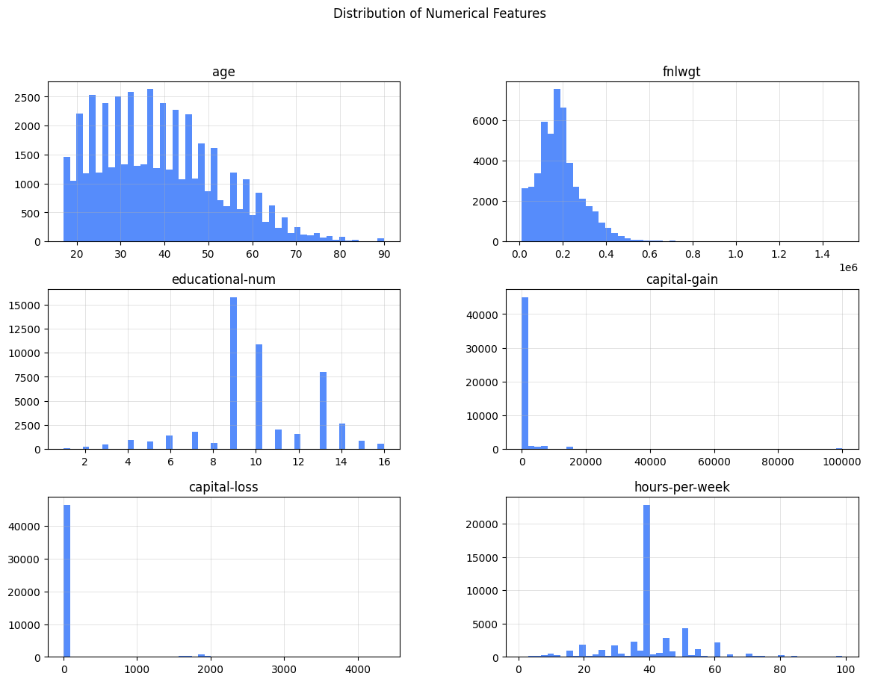
Income Classification Using Machine Learning
Exploratory Data Analysis
Numerical Features Key Findings
Age is concentrated between 25–50 years.
Most individuals work approximately 40 hours per week.
capital-gain and capital-loss are highly right-skewed.
Most observations have zero capital gain and loss.
fnlwgt exhibits a highly skewed distribution.
Skewed variables may require transformation before modeling.
6
Notes:
This figure shows the distributions of the numerical variables in the dataset.
The age distribution is concentrated between approximately 25 and 50 years, indicating that most observations represent working-age adults.
Hours worked per week is heavily concentrated around 40 hours, which is consistent with full-time employment.
The most important observation is that both capital-gain and capital-loss are extremely right-skewed. Most individuals have values equal to zero, while a small number of observations contain very large values.
The fnlwgt variable is also highly skewed. Since fnlwgt represents a census sampling weight rather than a direct socioeconomic characteristic, it was removed from the final modeling process to improve interpretability.
These findings motivated the feature-engineering steps applied later in the project.

Slide 11
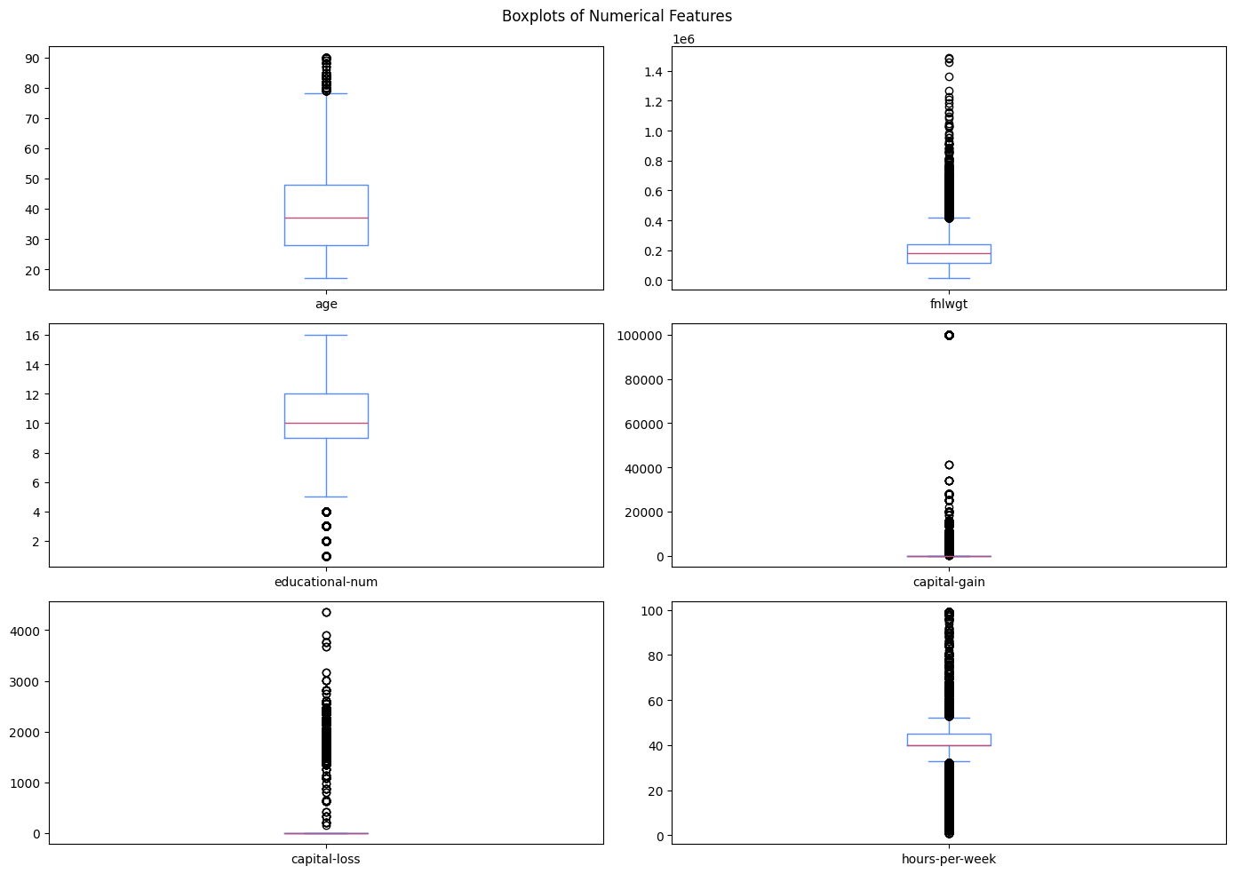
Income Classification Using Machine Learning
Exploratory Data Analysis
Outliers and extreme values
Outliers are present in several numerical variables.
Capital-gain contains extreme high-value observations.
Capital-loss contains extreme high-value observations.
Hours-per-week includes unusually low and high working hours.
Outliers reflect real socioeconomic variation rather than data-entry errors.
Log transformations will be applied to highly skewed financial variables.
6
Notes:
The boxplots provide a clearer view of potential outliers within the numerical features.
We can observe a large number of extreme observations in capital-gain and capital-loss. However, these values are expected because some individuals genuinely report unusually high investment gains or losses.
Hours-per-week also contains observations at both extremes, ranging from very low working hours to nearly 100 hours per week.
Rather than removing these observations, I retained them because they represent valid real-world cases. Instead, I applied logarithmic transformations to capital-gain and capital-loss to reduce skewness and improve model learning.
This approach preserves potentially important information while reducing the influence of extreme values on the machine learning algorithms.

Slide 12
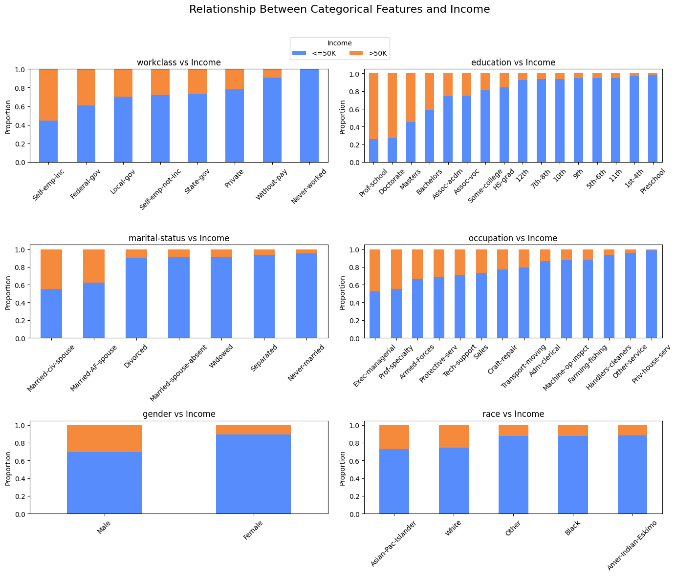
Income Classification Using Machine Learning
Exploratory Data Analysis
Categorical Features Key Findings
Higher education levels are strongly associated with higher income.
Married individuals have a substantially higher proportion of >50K earners.
Executive and professional occupations show the highest income levels.
6
Notes:
To better understand how categorical variables relate to income, I analyzed the proportion of individuals earning more than and less than $50,000 across several demographic and socioeconomic characteristics.
Starting with education, we can observe a clear trend: individuals with higher educational attainment, such as Master's and Doctorate degrees, have a much larger proportion of high-income observations. This suggests that education is a strong predictor of income level.
Looking at marital status, married individuals, particularly those classified as married-civil-spouse, show a significantly higher proportion of individuals earning more than $50,000 compared with other groups.
Occupational differences are also evident. Executive-managerial and professional-specialty occupations contain a larger share of high-income earners, while service-related occupations contain fewer high-income observations.

Slide 13
Income Classification Using Machine Learning
Exploratory Data Analysis
Categorical Features Key Findings
Males have a higher proportion of >50K income observations than females.
Self-employed and private-sector workers tend to have higher income proportions.
Income distribution varies across demographic groups, indicating potential fairness considerations.
6
Notes:
Gender analysis shows that males have a higher proportion of high-income observations than females. This reflects patterns present in the dataset and highlights the importance of later fairness analysis.
Finally, income proportions vary across racial groups, although these differences should be interpreted carefully because some groups have relatively small sample sizes.
Overall, these findings indicate that education, marital status, occupation, and demographic characteristics are likely to be important predictors for machine learning models.

Slide 14
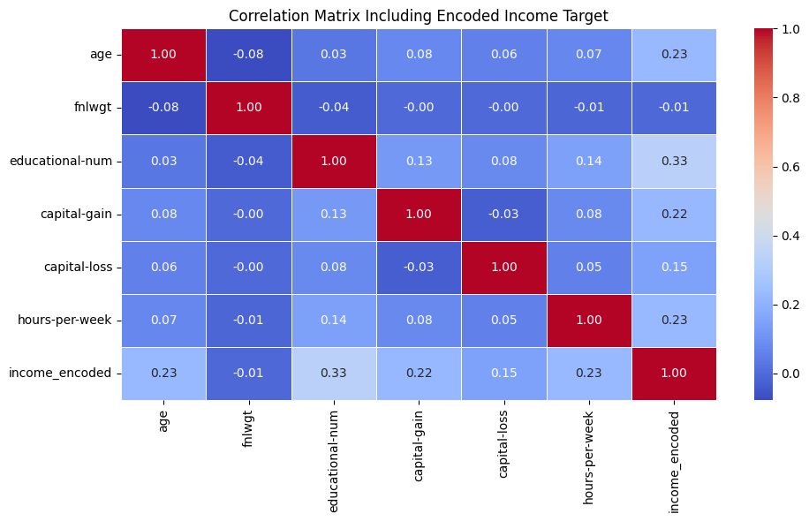
Income Classification Using Machine Learning
Exploratory Data Analysis
Correlation Analysis Key Findings
Most numerical features show weak-to-moderate correlations with income.
Educational level (educational-num) has the strongest correlation with income (r = 0.33)
Age and hours-per-week show moderate positive correlations (r = 0.23).
Capital-gain is positively associated with income (r = 0.22).
6
Notes:
To better understand the relationships between numerical variables and the target variable, I computed a correlation matrix using Pearson correlation coefficients.
The strongest relationship with income was observed for educational-num, with a correlation of 0.33, indicating that higher educational attainment is generally associated with higher income levels.
Age, hours worked per week, and capital gain also showed positive relationships with income, suggesting that older individuals, those working more hours, and those reporting investment gains are more likely to belong to the high-income class.
In contrast, fnlwgt exhibited almost no relationship with income, with a correlation of −0.01. Since fnlwgt is a census sampling weight rather than a meaningful socioeconomic characteristic, this finding further supported its removal from the final modeling process.
The heatmap also shows that correlations among the numerical features themselves are relatively low, indicating that severe multicollinearity is not a major concern for this dataset.
Overall, the analysis suggests that income is influenced by multiple factors rather than a single dominant numerical predictor, highlighting the value of machine learning models that can capture complex interactions between variables.

Slide 15
Income Classification Using Machine Learning
Exploratory Data Analysis
Correlation Analysis Key Findings
Capital-loss shows a weaker positive relationship (r = 0.15).
fnlwgt has virtually no correlation with income (r = -0.01).
No evidence of severe multicollinearity among the retained numerical features.
6
Notes:
During exploratory data analysis, I observed that both capital-gain and capital-loss were highly right-skewed. Most individuals had values equal to zero, while a small number of observations had very large values.
Such skewed distributions can make it difficult for machine learning models to learn meaningful patterns because extreme values dominate the feature range.
To address this issue, I applied a logarithmic transformation using log1p, creating the features capital-gain-log and capital-loss-log. This reduced skewness, improved the distribution of the variables, and ultimately produced some of the most important predictors in the final models.

Slide 16
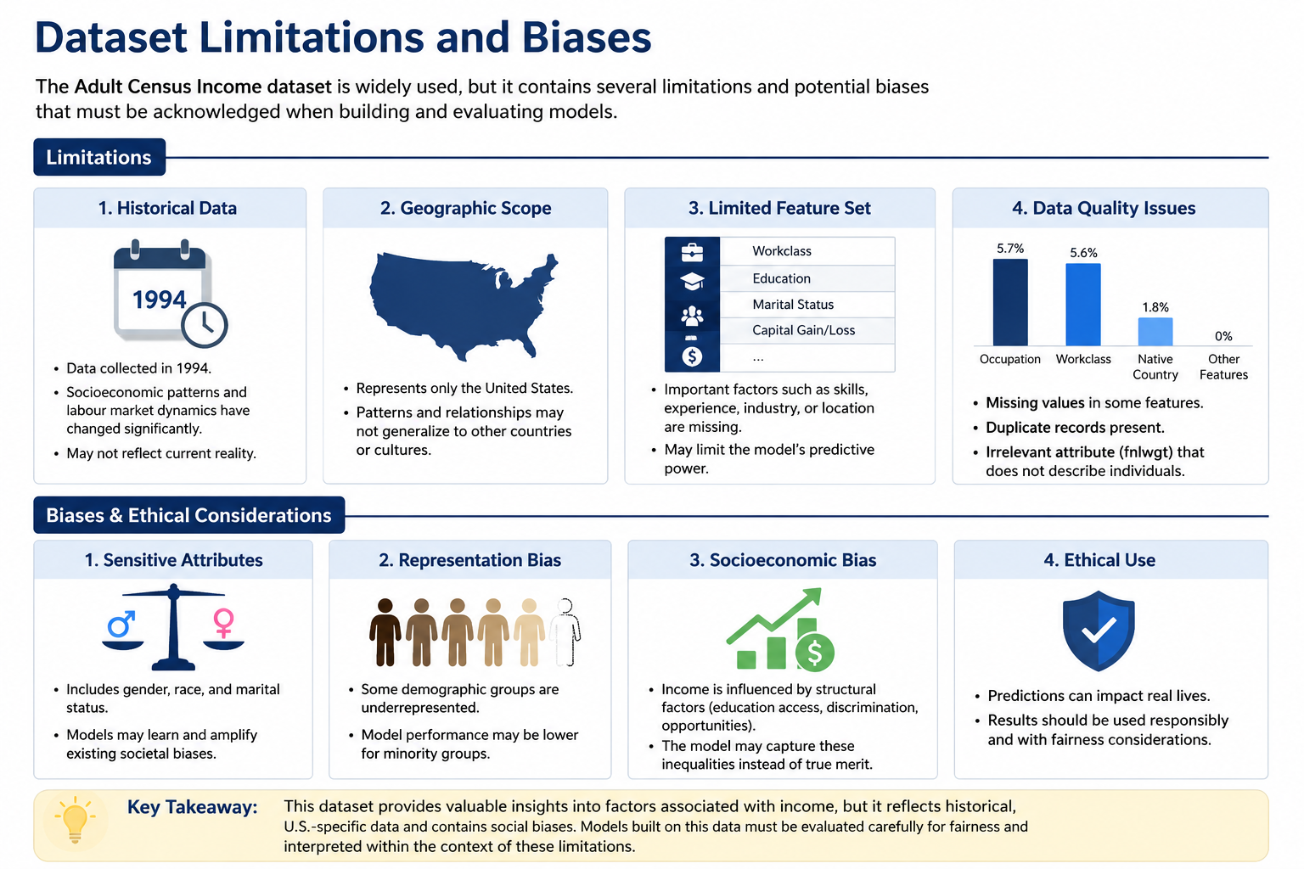
Income Classification Using Machine Learning
6
Notes:
During exploratory data analysis, I observed that both capital-gain and capital-loss were highly right-skewed. Most individuals had values equal to zero, while a small number of observations had very large values.
Such skewed distributions can make it difficult for machine learning models to learn meaningful patterns because extreme values dominate the feature range.
To address this issue, I applied a logarithmic transformation using log1p, creating the features capital-gain-log and capital-loss-log. This reduced skewness, improved the distribution of the variables, and ultimately produced some of the most important predictors in the final models.

Slide 17
3. Data Preprocessing & Feature Engineering
7

Slide 18
Income Classification Using Machine Learning
Data Preprocessing & Feature Engineering
Missing Value Handling
Missing values represented by "?" were converted to NaN
Numerical features imputed using Median
Categorical features imputed using Most Frequent Value
Applied within a preprocessing pipeline to prevent data leakage
Duplicate Record Removal
Identified and removed duplicate observations
52 duplicate records removed
Reduced redundancy and potential bias in model training
Final dataset contained only unique records
6
Notes:
During exploratory data analysis, I observed that both capital-gain and capital-loss were highly right-skewed. Most individuals had values equal to zero, while a small number of observations had very large values.
Such skewed distributions can make it difficult for machine learning models to learn meaningful patterns because extreme values dominate the feature range.
To address this issue, I applied a logarithmic transformation using log1p, creating the features capital-gain-log and capital-loss-log. This reduced skewness, improved the distribution of the variables, and ultimately produced some of the most important predictors in the final models.

Slide 19
Income Classification Using Machine Learning
Data Preprocessing & Feature Engineering
Feature Engineering Overview
Improved raw features before modeling
Reduced category sparsity
Created meaningful financial indicators
Reduced skewness in capital variables
Dropped low-interpretability feature: fnlwgt
6
Notes:
In this section, I transformed some raw variables into more meaningful features. The goal was to reduce complexity, improve model learning, and make the feature space more interpretable.

Slide 20
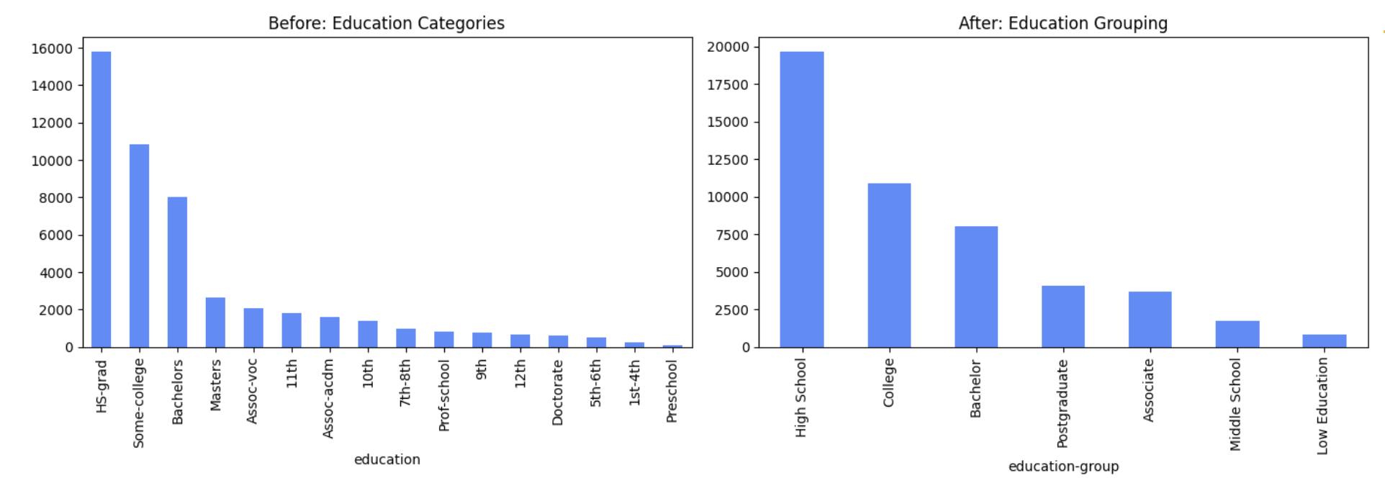
Income Classification Using Machine Learning
Data Preprocessing & Feature Engineering
Education Grouping
Original education had many detailed categories
Grouped into broader education levels
Examples: High School, Bachelor, Postgraduate
Reduced sparsity while preserving meaning
6
Notes:
I grouped detailed education categories into broader levels. This reduced sparsity and made the feature easier to interpret while still preserving the relationship between education and income.

Slide 21
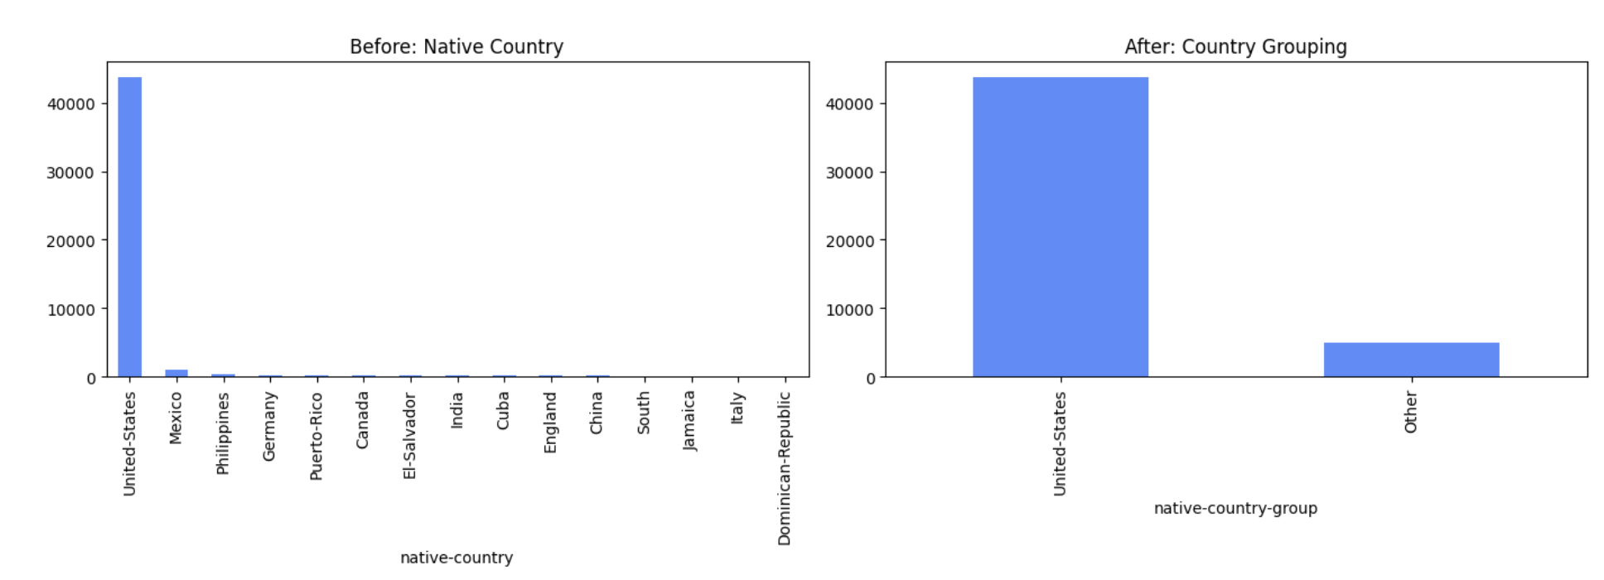
Income Classification Using Machine Learning
Data Preprocessing & Feature Engineering
Native Country Grouping
Original native-country had many country categories
Most observations were from the United States
Created native-country-group
Categories: United States / Other
6
Notes:
Since most observations came from the United States, I grouped native country into United States and Other. This reduced high cardinality and helped avoid sparse one-hot encoded features.

Slide 22
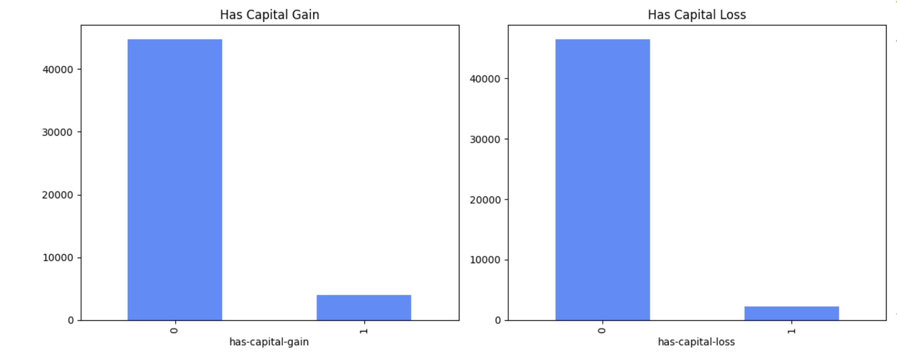
Income Classification Using Machine Learning
Data Preprocessing & Feature Engineering
Capital Gain and Capital Loss Indicators
Created binary indicators:
has-capital-gain
has-capital-loss
Captures whether investment-related income/loss exists
Separates “presence” from “amount”
6
Notes:
Most people had zero capital gain or loss. I created binary indicators to capture whether a person had any capital gain or loss at all. This gives the model a simple signal about investment activity.

Slide 23
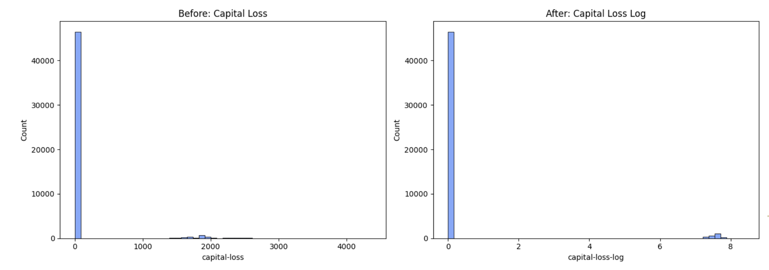
Income Classification Using Machine Learning
Data Preprocessing & Feature Engineering
Log Transformation of Skewed Variables
capital-gain and capital-loss were highly right-skewed
Most values were zero
Few observations had very large values
Applied log1p transformation Created:
capital-gain-log
capital-loss-log
6
Notes:
Capital gain and capital loss were extremely skewed. Instead of removing extreme values, I kept them because they are valid observations and applied log transformation to compress large values while preserving information.

Slide 24
4. Class Imbalance Handling (SMOTE)
9

Slide 25
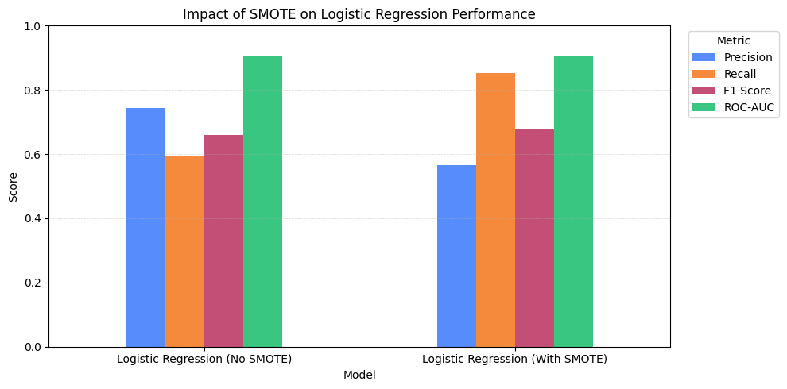
Income Classification Using Machine Learning
Class Imbalance Handling
Class Imbalance Findings:
SMOTE was evaluated to improve minority-class detection.
SMOTE significantly increased Recall (≈ 0.60 → 0.85).
F1-score improved slightly (≈ 0.66 → 0.68).
Precision and overall Accuracy decreased due to more false positives.
ROC-AUC remained largely unchanged.
Final models were trained on the original stratified dataset.
The original dataset provided the best balance between performance and generalization.
≤50K 50%
>50 24%
>50K 50%
10
Notes:
SMOTE improved minority-class detection, but the original dataset achieved stronger overall generalization and was selected for the final modeling pipeline.

Slide 26
5. Model Selection
11

Slide 27
Income Classification Using Machine Learning
Model Selection & Training
Random Forest
Gradient Boosting
▪ Ensemble of multiple decision trees
▪ Sequential ensemble learning approach
▪ Reduces overfitting through bagging
▪ Each tree corrects errors from previous trees
▪ Robust to noise and feature interactions
▪ Strong performance on tabular datasets
▪ Provides feature importance estimates
▪ Captures complex non-linear patterns
Tuned: n_estimators, max_depth, min_samples_split
Tuned: n_estimators, learning_rate, max_depth
All models tuned via Grid Search (5-fold cross-validation, F1-score as optimization metric)
12
Notes:
I first evaluated Logistic Regression and Decision Tree because they are highly interpretable models. Logistic Regression provides feature coefficients that show how variables influence income predictions, while Decision Trees provide explicit decision rules that can be visualized and explained. These models serve as strong baselines and help us understand the trade-off between interpretability and predictive performance.

Slide 28
Income Classification Using Machine Learning
Model Selection & Training
Logistic Regression
Decision Tree
▪ Interpretable linear model
▪ Explicit rule-based structure
▪ Coefficients show feature influence
▪ Easily visualizable & interpretable
▪ Strong baseline for binary classification
▪ Captures non-linear boundaries
▪ Efficient training on large datasets
▪ Prone to overfitting — tuning critical
Tuned: C, solver
Tuned: max_depth, min_samples
All models tuned via Grid Search (5-fold cross-validation, F1-score as optimization metric)
12
Notes:
I then evaluated Random Forest and Gradient Boosting, which are ensemble learning methods designed to improve predictive performance. Random Forest combines multiple decision trees to reduce overfitting and improve robustness, while Gradient Boosting sequentially corrects prediction errors to build a stronger model. These models allow us to compare the performance gains achieved by more complex ensemble approaches against simpler interpretable models.

Slide 29
Model Training & Hyperparameter Tuning
13

Slide 30
Income Classification Using Machine Learning
Model Training & Hyperparameter Tuning
Model Training Strategy
Stratified Train/Test Split (80% / 20%)
Same preprocessing pipeline applied to all models
5-Fold Cross-Validation
Hyperparameter tuning using GridSearchCV
Evaluation performed on unseen test data
6
Notes:
After preprocessing and feature engineering, I trained four machine learning models. To ensure a fair comparison, all models used the same training and testing sets as well as the same preprocessing pipeline. Hyperparameters were optimized using GridSearchCV with 5-fold cross-validation before evaluating performance on the unseen test set.

Slide 31
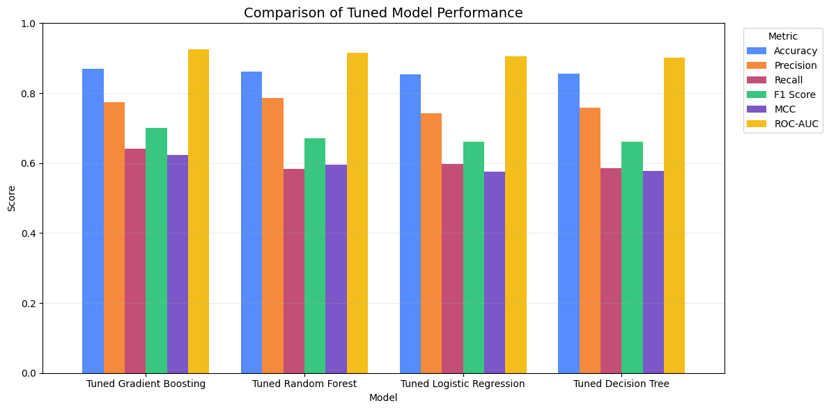
Income Classification Using Machine Learning
Tuned Model Performance Comparison
Key Performance Insights
Gradient Boosting achieved the best overall performance, with 86.9% Accuracy, 64.2% Recall, 0.701 F1-Score, 0.623 MCC, and 0.925 ROC-AUC.
Random Forest achieved the highest Precision (78.6%), indicating the lowest false-positive rate among all models.
All models achieved ROC-AUC values above 0.90, ranging from 0.902 to 0.925, demonstrating strong class-separation capability.
6
Notes:
This chart compares the performance of all tuned models. Ensemble learning methods clearly outperformed the individual models. Gradient Boosting consistently achieved the strongest results across nearly all evaluation metrics, while Random Forest achieved the highest Precision. Logistic Regression and Decision Tree provided lower performance but offered greater interpretability.

Slide 32
Income Classification Using Machine Learning
Tuned Model Performance Comparison
Key Performance Insights
Hyperparameter tuning improved all models, with Decision Tree ROC-AUC increasing from 0.772 to 0.902 and F1-Score increasing from 0.609 to 0.660.
Ensemble methods outperformed individual models, with Gradient Boosting (F1 = 0.701) and Random Forest (F1 = 0.670) achieving the strongest predictive performance.
Gradient Boosting was selected as the final model because it achieved the highest Accuracy (86.9%), Recall (64.2%), F1-Score (0.701), MCC (0.623), and ROC-AUC (0.925).
6
Notes:
This chart compares the performance of all tuned models. Ensemble learning methods clearly outperformed the individual models. Gradient Boosting consistently achieved the strongest results across nearly all evaluation metrics, while Random Forest achieved the highest Precision. Logistic Regression and Decision Tree provided lower performance but offered greater interpretability.

Slide 33
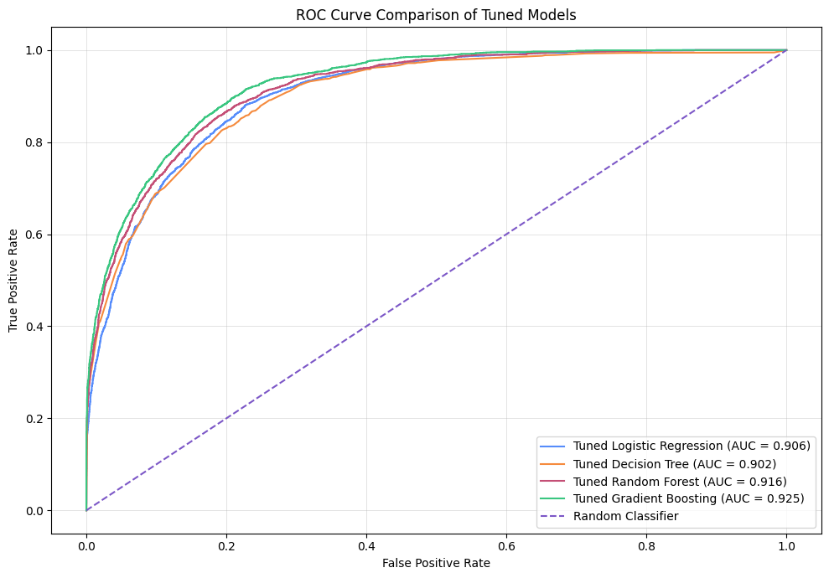
Income Classification Using Machine Learning
ROC Curve Comparison: Model Discrimination Performance
Key Findings
Gradient Boosting achieved the highest ROC-AUC (0.925).
Random Forest achieved the second-best ROC-AUC (0.916).
All models achieved ROC-AUC values above 0.90, indicating strong predictive capability.
Ensemble methods demonstrated superior class-separation performance.
Gradient Boosting showed the strongest ability to distinguish between high-income and low-income individuals across different classification thresholds.
6
Notes:
This slide compares the ROC curves of all evaluated models.
The ROC curve illustrates the trade-off between the True Positive Rate, or Recall, and the False Positive Rate across different classification thresholds.
The Area Under the Curve, or ROC-AUC, summarizes the model's ability to distinguish between the two income classes regardless of the chosen threshold.
Gradient Boosting achieved the highest ROC-AUC value of approximately 0.925, indicating the strongest class-separation capability among all evaluated models.
Random Forest achieved the second-highest ROC-AUC and also demonstrated strong discrimination performance.
Interestingly, all models achieved ROC-AUC values above 0.90, suggesting that the dataset contains meaningful predictive patterns that can be learned effectively.
The superior ROC-AUC achieved by Gradient Boosting further supports its selection as the final model for this project.

Slide 34
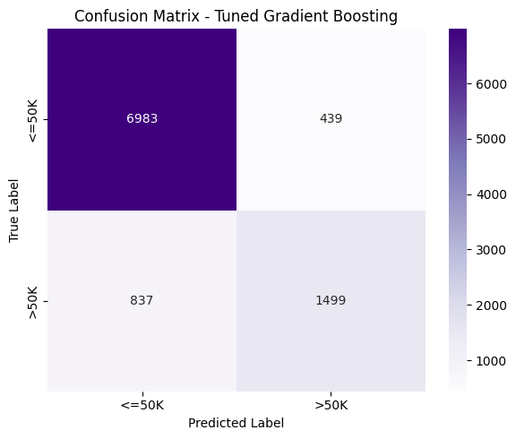
Income Classification Using Machine Learning
Confusion Matrix (Best Model)
Key Findings
Strong overall classification performance across both income classes.
High-income individuals were identified effectively, achieving 64.2% Recall.
Predictions for the high-income class were reliable, achieving 77.3% Precision.
More false negatives than false positives indicate a slightly conservative prediction strategy.
Achieved the best balance between Precision and Recall (F1-Score = 0.701).
Confirms why Gradient Boosting was selected as the final model.
6
Notes:
The model achieved a strong balance between correctly identifying high-income individuals and avoiding incorrect positive predictions.

Slide 35
Model Interpretability & Responsible AI Evaluation
16

Slide 36
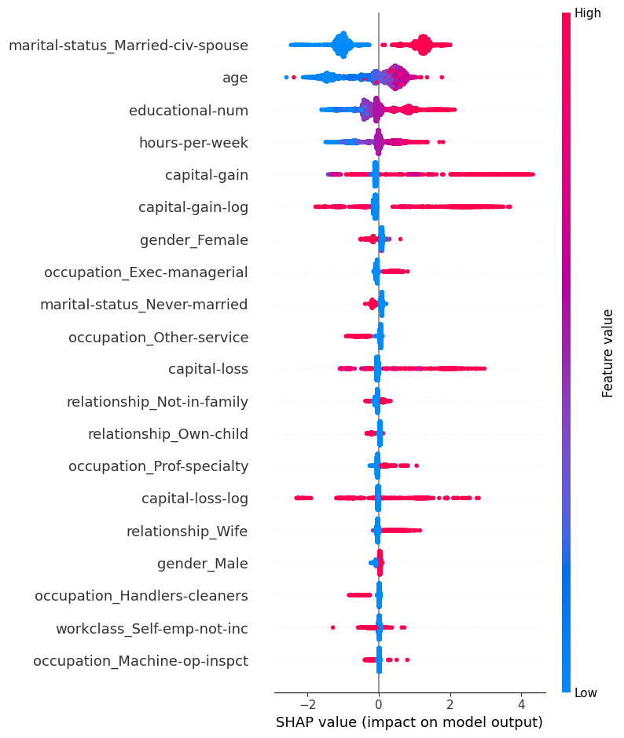
Income Classification Using Machine Learning
Model Interpretability (SHAP Analysis)
Key Findings
Marital Status (Married-civ-spouse) was the most influential predictor of income.
Age showed a strong positive relationship with high-income predictions.
Educational Number significantly influenced income classification.
Capital Gain was one of the strongest financial predictors of high income.
Hours per Week contributed meaningfully to income prediction.
Both feature importance and feature impact can be observed simultaneously.
6
Notes:
To better understand the behavior of the final Gradient Boosting model, I used SHAP, which stands for SHapley Additive exPlanations.
SHAP is a model-agnostic interpretability technique that explains how each feature contributes to predictions. Unlike traditional feature importance methods, SHAP not only shows which features are important but also whether they increase or decrease the likelihood of predicting the high-income class.
The results show that marital status, age, education level, capital gain, and hours worked per week were among the most influential factors affecting income predictions.
For example, being married, having higher educational attainment, higher capital gains, and working more hours generally increased the probability of belonging to the high-income class.
The SHAP analysis provides transparency into the model's decision-making process and confirms that the model learned meaningful socioeconomic patterns rather than relying on arbitrary relationships.

Slide 37
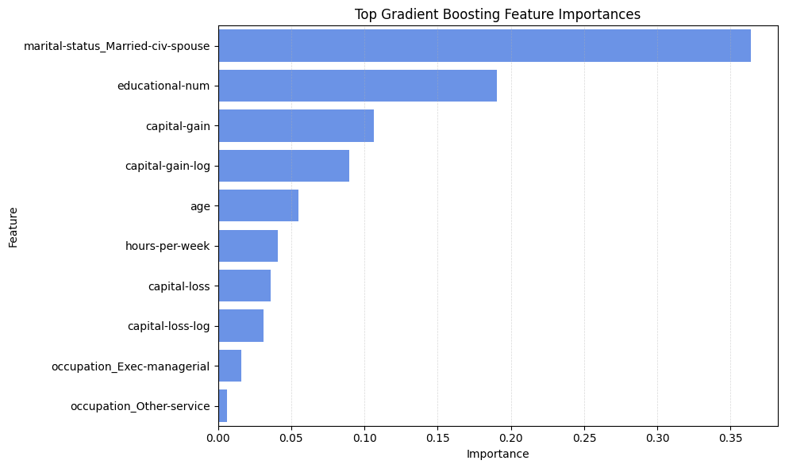
Income Classification Using Machine Learning
Feature Importance
Key Findings
Marital Status was the most influential predictor of income level.
Education Level strongly influenced the probability of earning more than $50K.
Capital Gain emerged as one of the strongest financial predictors.
Age contributed significantly to income prediction, reflecting experience and career progression.
Hours per Week was positively associated with higher income levels.
6
Notes:
This slide presents the feature importance analysis from the final Gradient Boosting model.
Feature importance helps us understand which variables contributed most to the model's predictions.
The results show that marital status was the most influential feature, followed by education level, capital gain, age, and hours worked per week.
These findings are consistent with real-world socioeconomic patterns. Individuals with higher education, greater investment income, more work experience, and longer working hours are generally more likely to belong to the high-income category.
It is also interesting to observe that both demographic and financial variables contributed significantly to the model's predictions, indicating that income is influenced by multiple interacting factors rather than a single characteristic.
The fact that the most important features are intuitive and economically meaningful increases confidence in the validity of the model and its predictions.

Slide 38
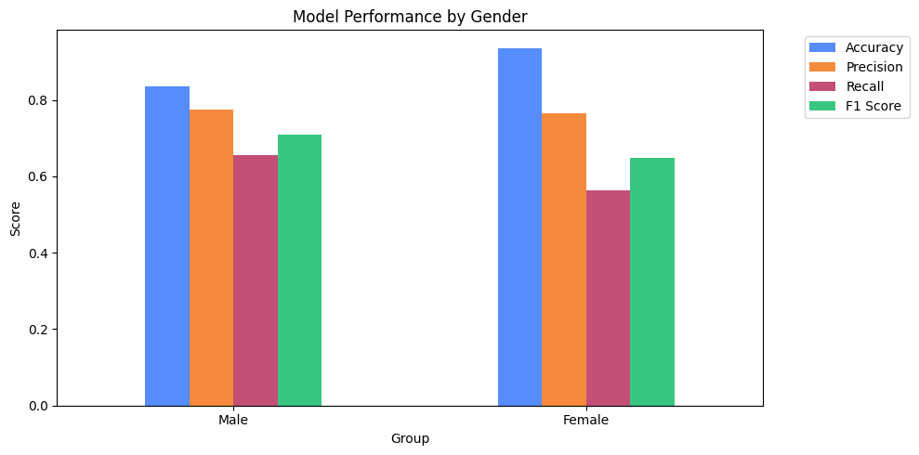
Income Classification Using Machine Learning
Responsible AI Evaluation: Gender Fairness
Key Findings
Model performance varied across gender groups.
Female observations achieved higher overall Accuracy (93.6%) than males (84.0%).
Male observations achieved higher Recall (67.1%) and F1-Score (72.1%).
The model was more effective at identifying high-income males than high-income females.
Precision remained relatively similar across both groups.
Results suggest potential performance disparities between demographic groups.
6
Notes:
To evaluate the fairness of the final model, I analyzed performance separately for male and female individuals.
The results show that overall performance differed across groups. While the model achieved higher Accuracy for females, it achieved substantially higher Recall and F1-score for males.
This indicates that the model was more effective at identifying high-income males than high-income females.
Although these differences do not necessarily imply intentional discrimination, they demonstrate that predictive performance is not distributed equally across all demographic groups.
This highlights the importance of fairness-aware evaluation when machine learning models are applied to socially sensitive problems.

Slide 39
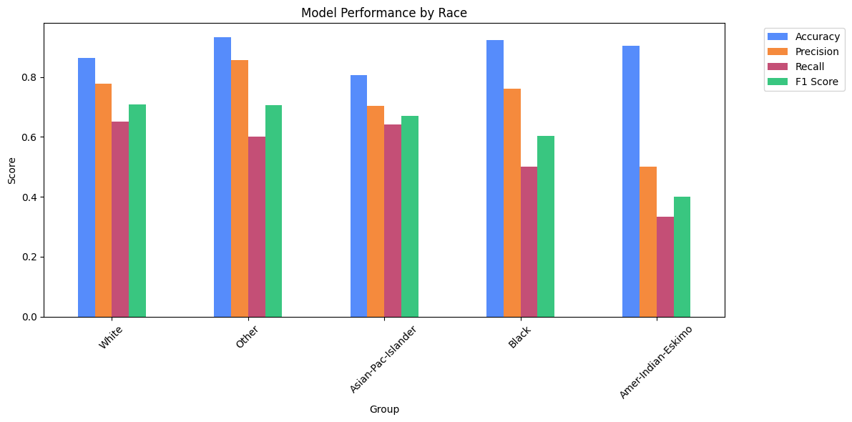
Income Classification Using Machine Learning
Responsible AI Evaluation: Race Fairness
Key Findings
Performance varied across racial groups.
The White group achieved the highest F1-Score (0.716).
The Asian-Pac-Islander group also achieved strong performance (F1 = 0.702).
The Amer-Indian-Eskimo group achieved the lowest Recall (44.4%) and F1-Score (0.533).
Smaller demographic groups produced less stable performance estimates.
Uneven representation may contribute to performance differences across groups.
6
Notes:
I also evaluated model performance across racial groups.
The results show noticeable differences in Recall and F1-score among demographic groups. The White and Asian-Pac-Islander groups achieved the strongest overall performance, while the Amer-Indian-Eskimo group achieved the lowest Recall and F1-score.
One important factor is sample size. Some groups contain far fewer observations than others, which can make performance estimates less stable and increase variability.
These findings do not prove that the model is discriminatory. However, they demonstrate how machine learning systems can inherit patterns and imbalances present in historical data.
This reinforces the importance of evaluating fairness alongside traditional performance metrics such as Accuracy and F1-score.

Slide 40
Limitations and Future Improvements
16

Slide 41
Income Classification Using Machine Learning
Limitations and Future Improvements
Key Limitations
Dataset age: The Adult Income dataset is based on the 1994 U.S. Census and may not fully reflect current socioeconomic conditions.
Correlation ≠ Causation: The models identify predictive relationships but cannot determine causal factors influencing income.
Small demographic subgroups: Some racial groups contain relatively few observations, leading to less reliable fairness estimates.
Limited hyperparameter search space: More extensive optimization techniques could potentially improve model performance further.
Fairness evaluation scope: The analysis focused on demographic group performance and did not include advanced fairness metrics such as demographic parity or equal opportunity.
6
Notes:
Although the project achieved strong predictive performance, several limitations should be acknowledged.
First, the Adult Income dataset is based on the 1994 U.S. Census, meaning some relationships may not accurately represent today's labor market and socioeconomic conditions.
Second, machine learning models identify patterns and correlations within the data, but they cannot establish causal relationships. Therefore, important features should not be interpreted as direct causes of income differences.
Another limitation concerns fairness analysis. Some demographic groups contain relatively few observations, making performance estimates less stable and potentially less reliable.
In addition, hyperparameter tuning was performed using GridSearchCV over a selected search space. While this improved performance significantly, broader optimization strategies could potentially identify even better model configurations.
Finally, fairness evaluation could be expanded by incorporating additional fairness metrics and mitigation techniques.
These limitations highlight opportunities for future work and reflect common challenges encountered in real-world machine learning projects.

Slide 42
Income Classification Using Machine Learning
Limitations and Future Improvements
Potential Future Improvements
Evaluate on more recent socioeconomic datasets.
Explore additional feature engineering techniques.
Apply advanced hyperparameter optimization methods.
Investigate fairness-aware machine learning approaches.
Compare with additional algorithms such as XGBoost or LightGBM.
Expand interpretability analysis using local SHAP explanations.
6
Notes:
Although the project achieved strong predictive performance, several limitations should be acknowledged.
First, the Adult Income dataset is based on the 1994 U.S. Census, meaning some relationships may not accurately represent today's labor market and socioeconomic conditions.
Second, machine learning models identify patterns and correlations within the data, but they cannot establish causal relationships. Therefore, important features should not be interpreted as direct causes of income differences.
Another limitation concerns fairness analysis. Some demographic groups contain relatively few observations, making performance estimates less stable and potentially less reliable.
In addition, hyperparameter tuning was performed using GridSearchCV over a selected search space. While this improved performance significantly, broader optimization strategies could potentially identify even better model configurations.
Finally, fairness evaluation could be expanded by incorporating additional fairness metrics and mitigation techniques.
These limitations highlight opportunities for future work and reflect common challenges encountered in real-world machine learning projects.

Slide 43
Income Classification Using Machine Learning
Conclusion
Main Findings
Developed a complete end-to-end machine learning pipeline for income classification
Performed comprehensive data cleaning, preprocessing, and feature engineering
Evaluated and compared four machine learning algorithms
Hyperparameter tuning improved model performance across all models
Gradient Boosting achieved the strongest overall predictive performance
SHAP analysis improved model interpretability and transparency
Fairness evaluation revealed performance disparities across demographic groups
Feature engineering contributed significantly to model effectiveness
6
Notes:
In conclusion, this project successfully developed a complete machine learning pipeline for predicting whether an individual's income exceeds fifty thousand dollars per year.
The project covered all major stages of the data science workflow, including exploratory data analysis, preprocessing, feature engineering, class imbalance analysis, model training, hyperparameter optimization, evaluation, interpretability analysis, and fairness assessment.
Among the evaluated models, Gradient Boosting achieved the best overall performance, with an Accuracy of 86.9%, an F1-score of 70.1%, and a ROC-AUC of 92.5%.
The interpretability analysis showed that marital status, education, capital gain, age, and hours worked per week were the most influential predictors of income. Additionally, the fairness evaluation demonstrated that strong overall performance does not necessarily imply equal performance across demographic groups.
Overall, the project demonstrates how machine learning can effectively model complex socioeconomic patterns while highlighting the importance of interpretability, fairness, and responsible AI practices in real-world applications.

Slide 44
Thank You
Income Classification Using Machine Learning
Adult Census Dataset
Buhari Nasir Ahmad · Data Science Project
Questions & Discussion

