Slide 1
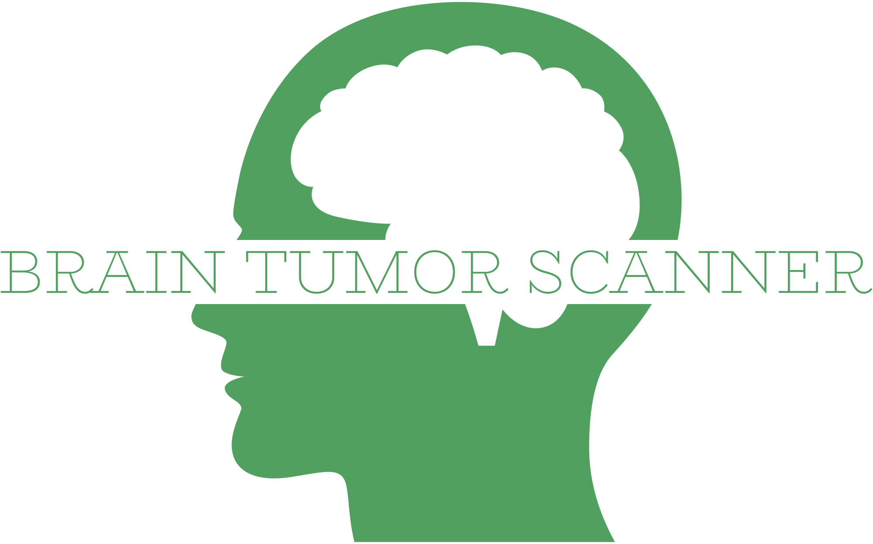
A deep learning application for healthcare support
By Juan Jimenez
Data source: https://www.kaggle.com/datasets/masoudnickparvar/brain-tumor-mri-dataset

Slide 2
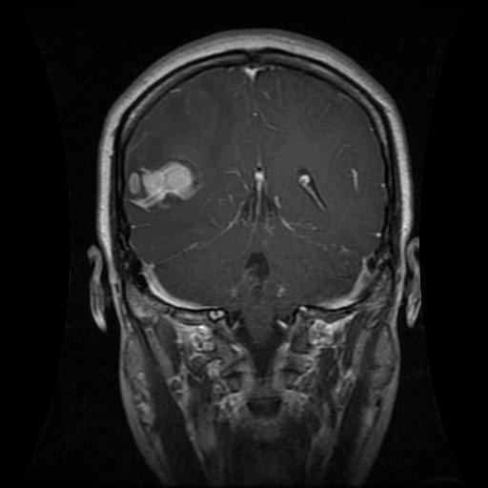
3 types of tumors: Glioma
Common type of tumor originating in the brain.
About 30 percent of all brain tumors (and 80% of all malignant ones). They originate in the glial cells that surround and support neurons in the brain.
5 year survival rate on glioblastoma:
20-44 years: 22%
55-64 years: 6%
It depends on the subtype of tumor and age, overall they have the least favorable prognosis.

Slide 3
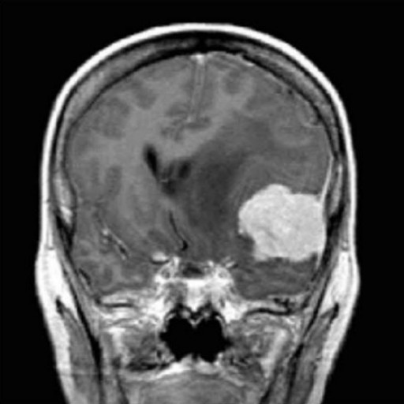
3 types of tumors: Meningioma
The most common type of primary brain tumor, approximately 30 percent of all brain tumors.
Overall, meningiomas have the best prognosis.
5-year survival rate for atypical and anaplastic meningioma is 63.8%

Slide 4
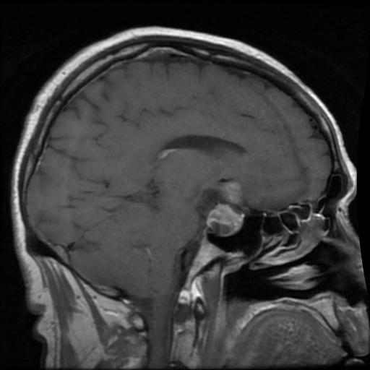
3 types of tumors: Pituitary
The pituitary is a small gland at the base of the skull, just below the brain and above the nasal cavities. The optic nerves pass just above it.
Considered the “master control gland” - it generates the hormones that control other endocrine glands in the body.
Very limited space, so any abnormal growth can press on the optic nerves – causing blindness.
Also, can affect the normal release of hormones, increasing or decreasing it. Some examples:
Growth hormone
Thyroid-stimulating hormone
Luteinizing hormone (LH) and follicle-stimulating hormone (FSH) – sexual hormones.
The 5-year survival rate for people with a pituitary tumor is excellent — 97%.

Slide 5
Brain scanner model
Our model takes a database with images belonging to 4 classes: the 3 types of tumors and a control class (no tumor).
Pictures are enhanced and sent to the model for training

