Slide 1
Team Presentation
ISEE 2018

Slide 2
Team & Roles
Jahnavi – Coordination with the Product Owner
Moritz – Scrum Master
Quang – Flexible
Dean – Flexible
Notes:
Quang, Dean -> will get their roles, as soon as new roles are required

Slide 3
Motivation
Knowledge about Software Engineering
Team work and soft skills
Developing a mobile application
Notes:
Short overview of our motivation, more on our blog
processes, project management
Very important!

Slide 4
Team Work - Skills
Benefit of diversity
Exchange knowledge
Notes:
Different backgrounds (Electrical Engineering, Industrial Engineering, Automation),
experiences (Scrum, Java, worked for some years) and cultures, that will surely lead to controverse discussions, which will (hopefully) result in success in our project
we will support each other, when somebody has minor knowledge about a specific topic

Slide 5
Communication
Slack
Maintain Scrum Board on ZenHub
Weekly meetings
Team calendar
Notes:
Like a chatroom, which can integrate many 3rd party apps -> in my opinion very helpful to organize and document our work
We will motivate & encourage each other to maintain the scrum board and copmment the user stories with his/ her opinion
Booked a room in library plus we see each other pretty often during the week, so short communication paths

Slide 6
Flexibility
At least two team members will have knowledge about a specific topic
Applying agile methods (Scrum)
Notes:
Two team members work on a topic together if possible and useful -> if one cannot contribute for any reason, we can still continue
Some team members have experience in SCRUM, weekly meetings and short communication paths help to adapt fast to any change. Being agile can also include that we will work on topics to which we have not been used so far or even all 4 of us have to work on one taks, if neccessary. FOCUS on delivering sth after every sprint

Slide 7
Slack
Chatroom
Integrates many apps
Easier for follow-up documentation

Slide 8
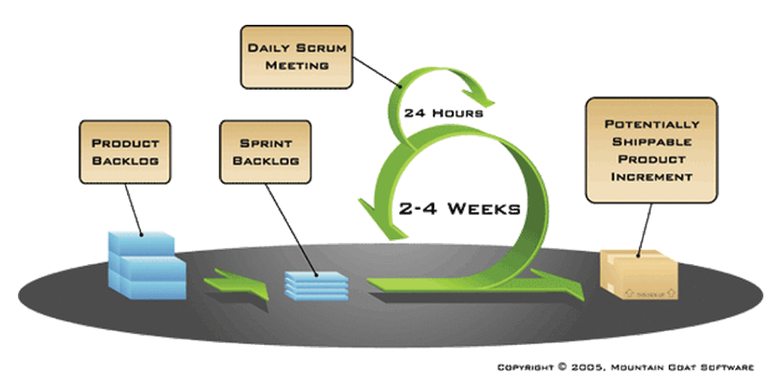
Scrum

Slide 9
Slide Title
Product A
Product B
Feature 1
Feature 2
Feature 3
Feature 1
Feature 2
Feature 3

Slide 10
Thank you for your attention!
Questions?

