Slide 1

REQUIREMENTS ANALYSIS
ACTIVITY MONITORING

Slide 2
Contents
Requirements Elicitation
Requirements Formulation
User stories
Use case : Logging a new activity
Requirements Validation
References

Slide 3

Requirements Elicitation
Meeting with the Customer
Team meeting
Figure 1
Figure 1

Slide 4

Requirements Formulation
Requirement list
Usable on Android mobile phones
Handful predefined categories
User specifies name of activities and categories
Assign colours to categories
Set goals, check if met
Figure 2

Slide 5
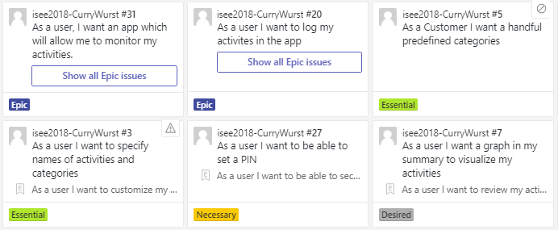
User stories

Slide 6
User stories
As a user I want to customize my app - EPIC
As a user I want to specify names of activities and categories
As a user I want to modify activities and categories
As a user I want to be able to apply different themes to the app
As a user I want to assign colors to categories

Slide 7
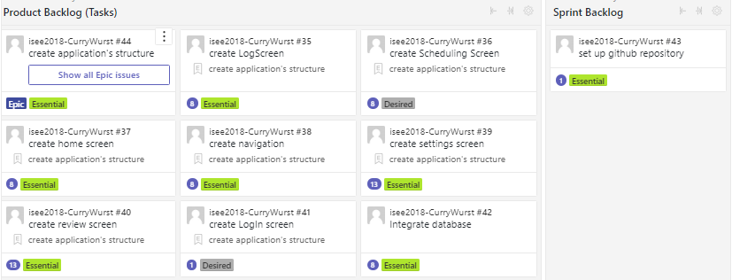
Estimation of time

Slide 8
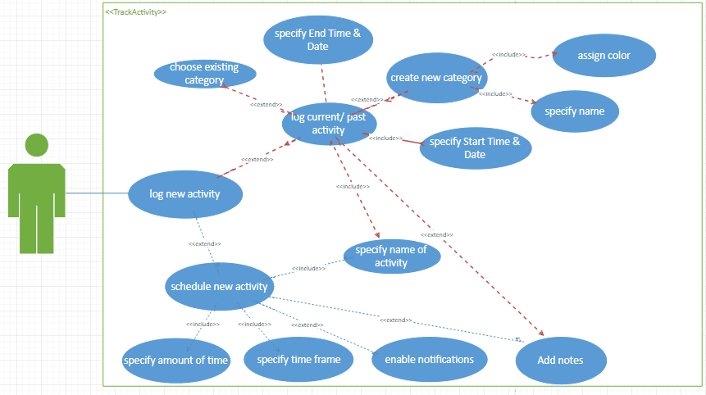
Use case : Logging a new activity

Slide 9
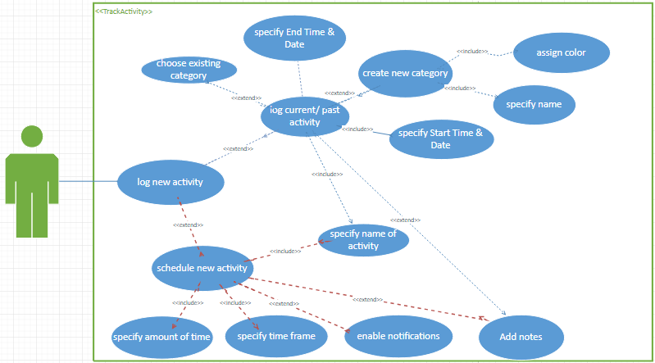
Use case : Logging a new activity

Slide 10
Requirements validation
Checked for completeness, correctness and unambiguity
Wrong assumptions:
Predefined categories and activities
Activities are monitored using Live tracking. Start and end time should be entered while logging a new activity.

Slide 11
REFerences
https://fr.123rf.com [Figure 1]
https://pixabay.com/en/notepad-memo-pencil-writing-note-117597 [Figure 2]
http://www.pptbackgrounds.org [Page 9]

Slide 12


