Slide 1

Scaling up the mbhs / dhis2 tracker and trainer applications
LibreHealth

Slide 2
MBHS/DHIS2 TRACKER AND TRAINER
DHIS 2 - global public good transforming health information management around the world , developed by HISP(health information system program)
DHIS2 has a modular, layered architecture with a strong and open application programming interface (API).
It stores information from various sources , stored in dhis2 database and can be used to analyze the situation
Also has an offline feature , that is sending SMS .
Can be used in less internet areas also

Slide 3
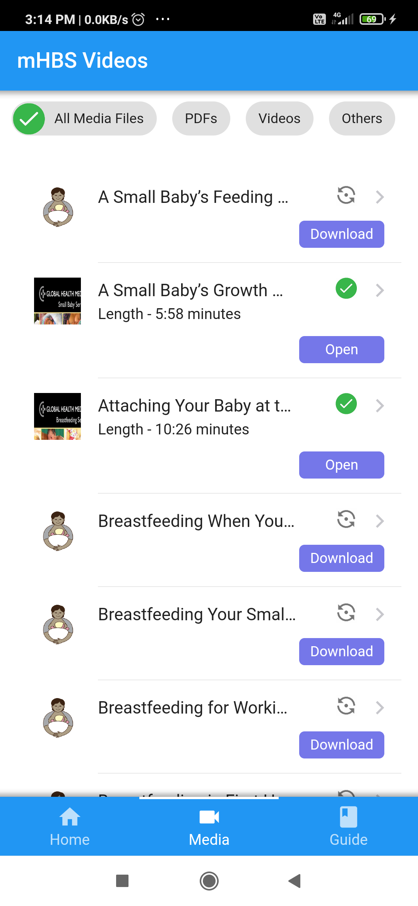
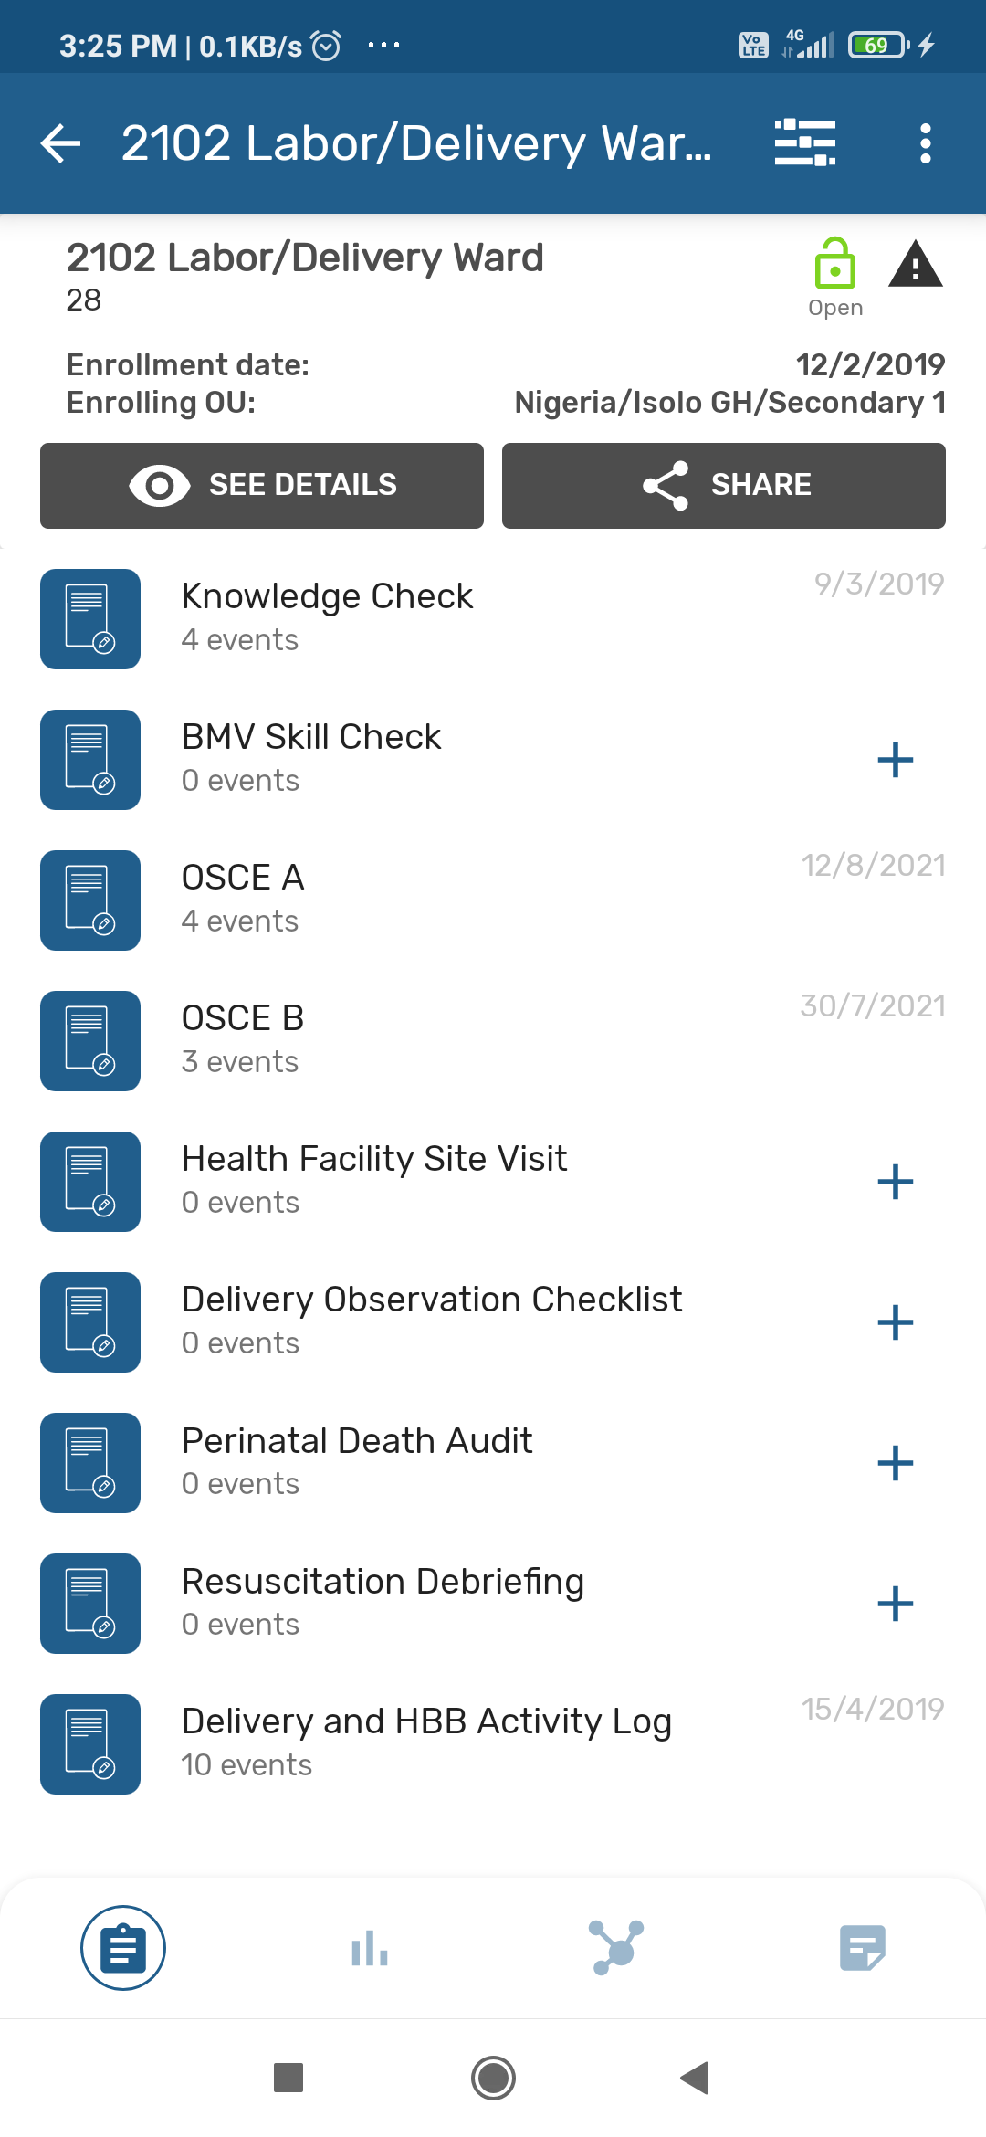
TRAINER AND TRACKER APPS
TRAINER APP
TRACKER APP

Slide 4
LibreHealth (https://librehealth.io)
LibreHealth is an umbrella organization(collaborative community) where multiple health information technology projects collaborate.
The mission of LibreHealth is to help provide high quality medical care to all people, regardless of race, socioeconomic status, or geographic location, by providing medical practices and clinics across the globe access to free of charge medical software.

Slide 5
LibreHealth organization’s trending works are :
LIBREHEALTH EHR APLLICATION
is a clinically focused electronic health record(EHR) system , which is easy to use and also customizable for use in a variety of health care settings
LIBREHEALTH RADIOLOGY
is an open source radiology information system , it manages the clinical workflow of radiology department , using DECOM (International standard to transmit, store, retrieve, print, process, and display medical imaging information)
LIBREHEALTH TOOLKIT
is A software that serves as an foundational API and also is a data model for foundational applications (is a powerful REST API)
**THE MAJOR TECHNOLOGIES USED ARE ANDROID,JAVA,JAVASCRIPT,PYTHON AND PHP**

Slide 6
DEVELOPING AN ANDROID APPLCATION FOR NEW BORN CLINICAL DECISION SUPPORT
before we dive into the project , lets understand what ECEB is?
ECEB(essential care for every baby) is an educational an training program , developed by American academy of pediatrics , provides knowledge, skills, and competencies to nurses and doctors in low/middle-income settings so that they can provide life-saving care to newborns from birth through 24 hours postnatal(period after childbirth).
The aim of this project is to develop an android mobile application , the ECEB digital action plan , that is purposel4y built to provide clinical decision-support for nurses and doctors delivering essential newborn care interventions(actions) during first day of life

Slide 7
FEATURES OF ECEB ANDROID APPLICATION
1. Time-stamping(recording time and date) births to generate an essential newborn care clock for babies.
2. ability to track multiple babies at a time
3. automated classification of babies health status , based on results from observations and assessments
4. automated advice on management of babies , based on their classification
5. reminders/alerts to provide recommended essential newborn care interventions
6. if particular interventions are not delivered on time , then capture information regarding why this essential newborn care was late or missed

Slide 8
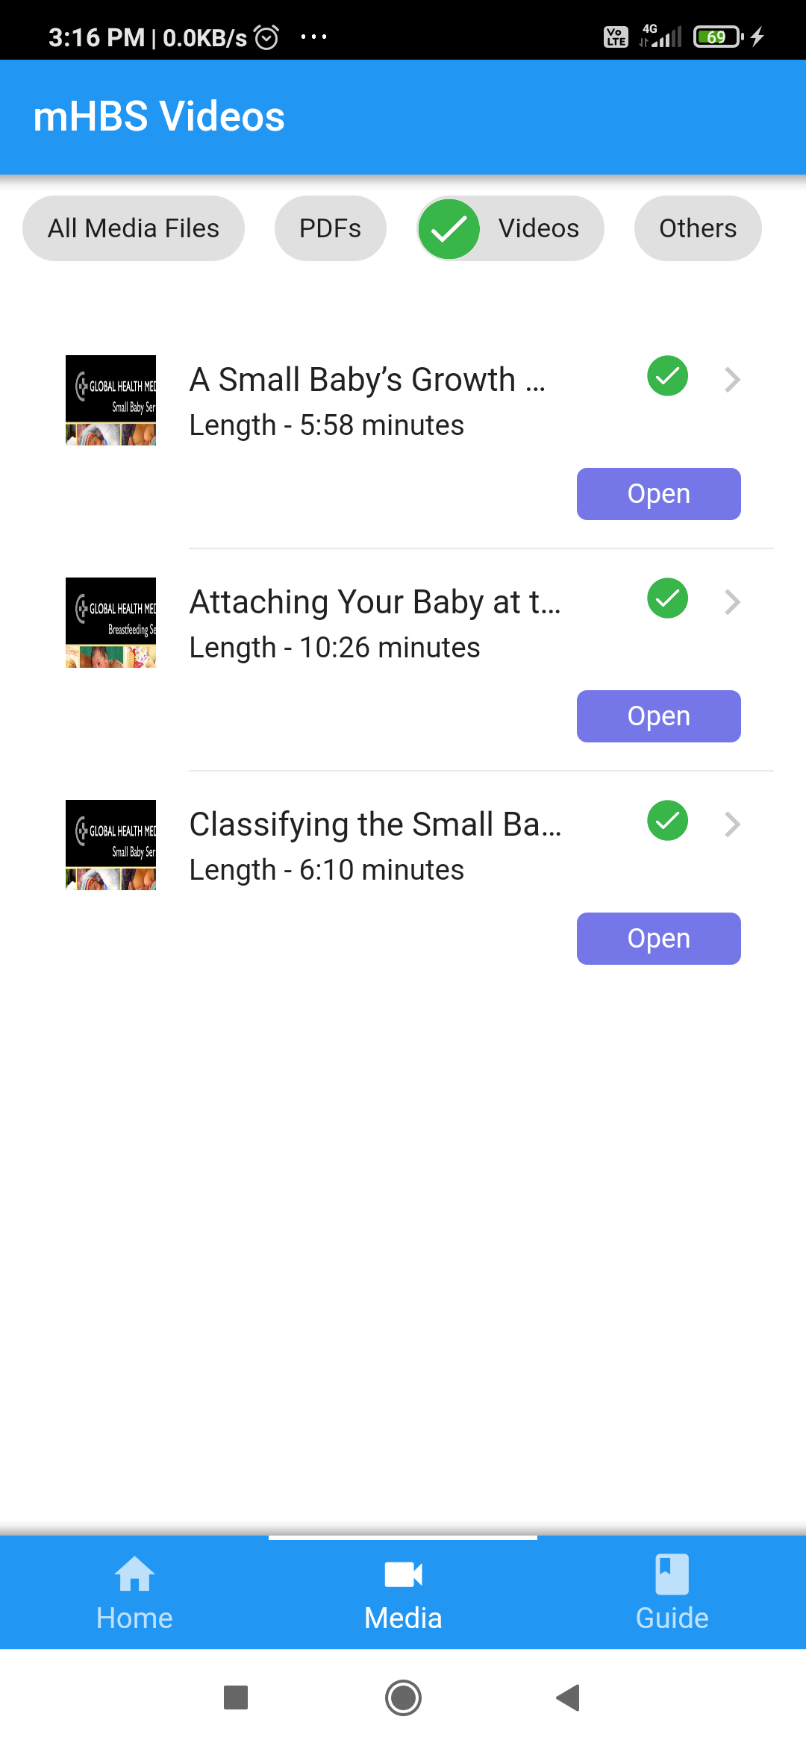
TRAINER APP
TECH : cordova(html,css,javascript) , xml , framework7(free and open source HTML mobile framework to develop hybrid mobile apps or web apps with iOS or Android)
training for neonatal resuscitation through videos, guide and other kind of training material
FEATURES :
offline support and sync facility (using SQL)
uploading resources and accessing
app usage tracking system (SQL)

Slide 9
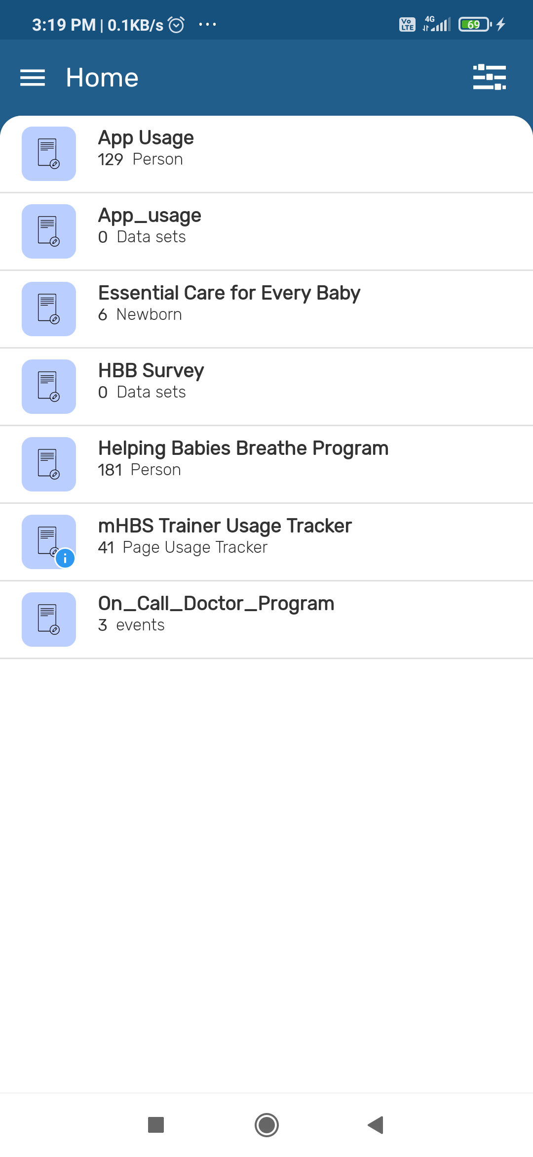
TESTER APP
TECH : Kotlin , Java , Python , Shell(interactive command and scripting language) , HTML ,Gradle(to build software's)
training for neonatal resuscitation through videos, guide and other kind of training material
FEATURES :
MHBS Tracker app is used to collect data from the dhis2 mobile application
It tracks the health status of the baby in the early days of his birth.
App usage tracker, offline support

Slide 10
THANK YOU!

