Slide 1
Technical Analysis on Financial Data
Ng Kang Wei WQD170068
Kavish Punchoo WQD170097
Alireza Ghanbarzadeh WQD170061
Khashayar Namsehchi WQD170034

Slide 2
The dataset
20 financial institutions stock listed on New York Stock Exchange (NYSE)
Time series data, from 2012 to 2017
Each stock is a CSV files, so there are 20 CSV files
Total there are 18 columns 25180 rows
Company details is in another CSV file

Slide 3
Purpose
To gain insight into the future performance of the stock based its past performance
To discover patterns on the price fluctuation of the stock
Try to predict the price based on historical data

Slide 4
Data Science Process
Load the data
Cleanse the data
Merge the data
Exploratory data analysis to discover the correlation between the features
Linear regression to predict the stock price
ARIMA analysis

Slide 5
Data Cleansing
Make sure all the columns are in the right format
The date columns are in string format after importing
Change some columns to factors
Handle the missing values
Number incorrectly formatted as string because of comma

Slide 6
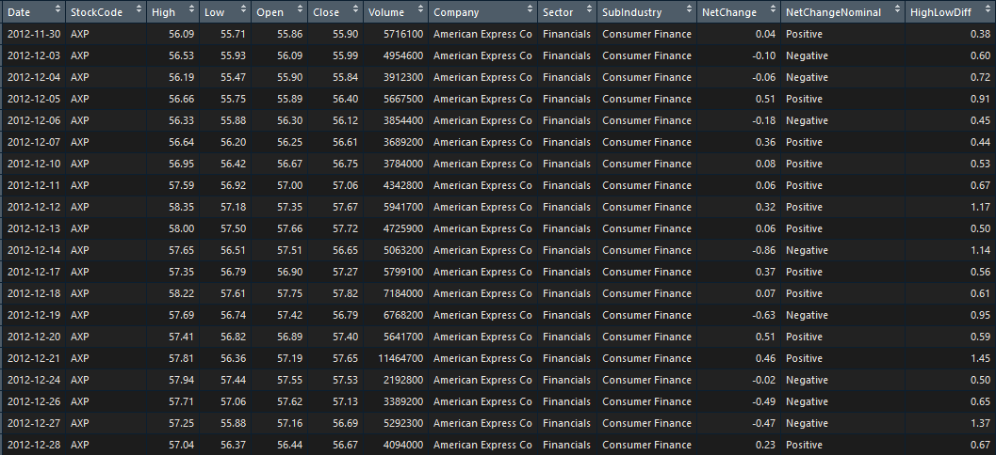
Structure of the dataset after cleaning

Slide 7
Exploratory Data Analysis
Checking the correlation between the features
Exploratory graphs to check the patterns on the data
Open price has a high correlation with High, Close and Low
Can use Open price to predict the High price of the day

Slide 8
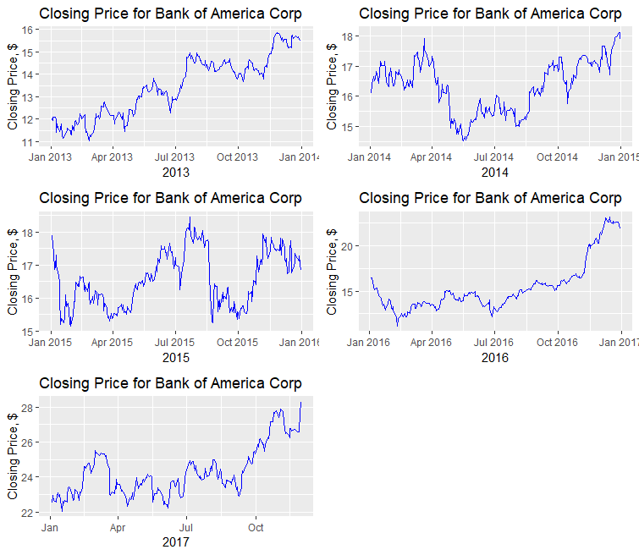
Comparison of the year on year closing price

Slide 9
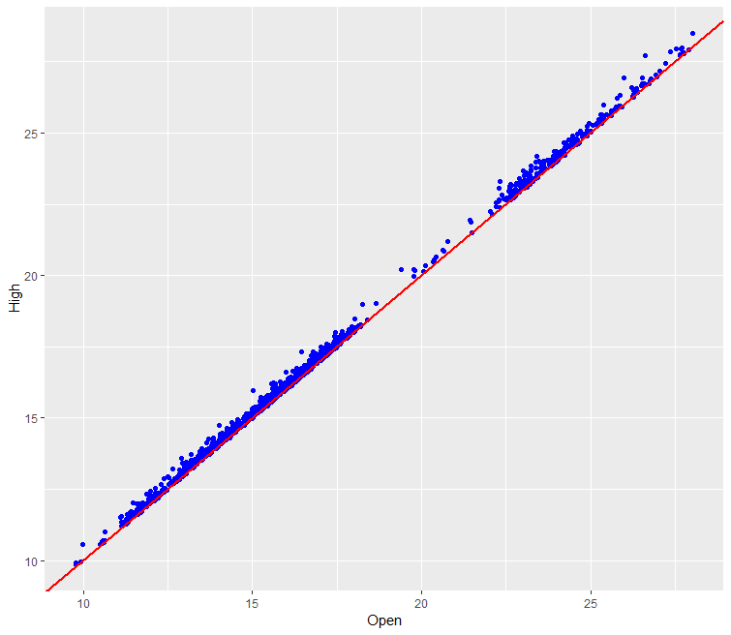
The Correlation between Open and High

Slide 10
Linear Regression
The high correlation between Open and High is utilized for prediction
The root mean squared error of the trained regression model, 0.13 and 0.38
The training data is the stock price from 2013 to 2016
The testing data is the stock price in 2017
The error rate is low, the prediction is quite accurate

Slide 11
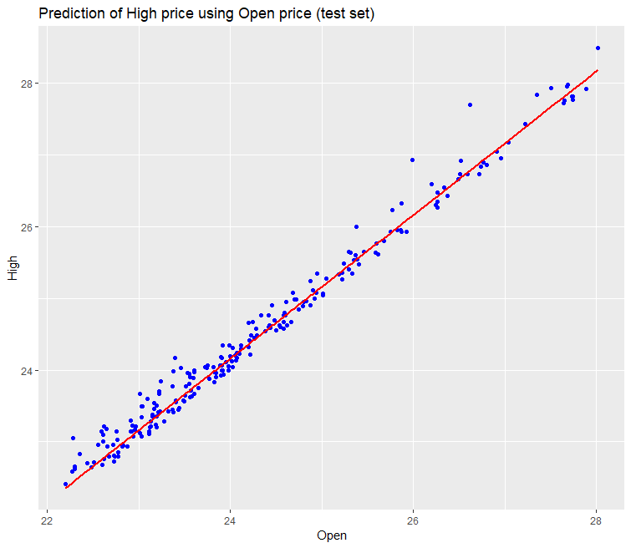
Prediction Result

Slide 12
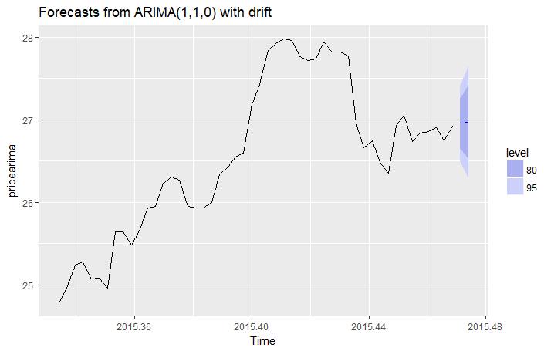
Forecasting with ARIMA
The patterns present in the dataset revealed to be suitable for the implementation of the ARIMA model
The ‘High’ price of the ‘BAC’ stock is forecasted using the ARIMA model
The prediction is quite accurate with an error rate of 4.01%

