Slide 1
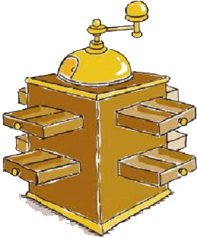
Java New I/O
JavaPolis 2003
  Ron Hitchens
  ron@ronsoft.com
  http://www.ronsoft.com
  Java NIO Book Website
  http://javanio.info
  JavaPolis 2003 - Antwerp, Belgium
  Dec 3, 2003
© 2003, Ronsoft Technologies

Slide 2
Purpose of This Presentation
To introduce you to Java New I/O (NIO) and to illustrate some of the new capabilities it provides.

Slide 3
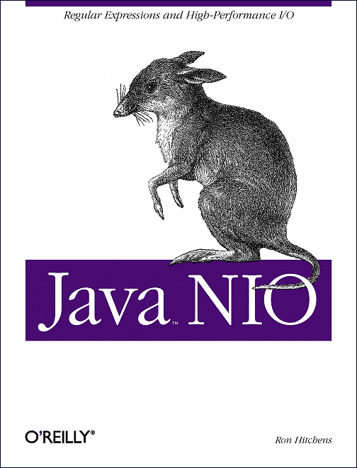
Speaker Bio
25+ Years Computer Experience
  Started with mainframes
  Unix internals - academic and commercial
  Low-level, device drivers, kernel internals
  Early Mac and Amiga user, not PCs
  Been on the Internet for ~20 years
6+ Years Java Experience
  Primarily server-side
  Web/commercial applications
Full-time Independent Consultant
Part-time Author
Silicon Valley Dot Com Survivor

Slide 4
It’s a Pig-Footed Bandicoot
See http://javanio.info for details

Slide 5
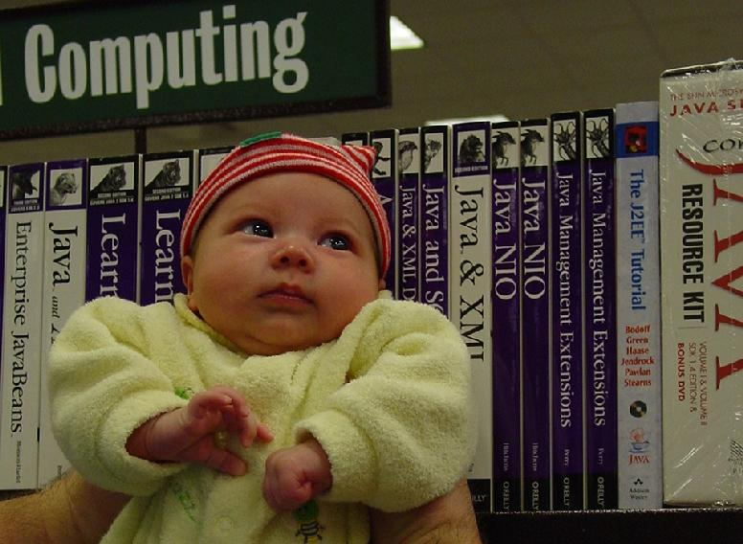
Check Your Local Bookstore

Slide 6
Topics Covered In This Talk
The need for NIO
  Limitations of traditional Java I/O
  What was missing
  What’s new
The makeup of NIO
  Buffers
  Channels
  Selectors
Making use of NIO
  Multiplexing
  Gotchas
  Protoplex
The future of NIO
  JSR 203

Slide 7
Topics Not Covered
Regular Expressions (Chapter 5)
  JSR 51 is a laundry list of features Java was missing – Regex was an important item on that list
  Implemented by the same Expert Group
Character Sets (Chapter 6)
  Same thing for pluggable character sets
NIO and JNI (Appendix A)
  Allows pure Java code access to native memory via direct ByteBuffer objects
Quantum Physics
  Not qualified
Michael Jackson
  Not interested
American Foreign Policy
  Not involved

Slide 8
Why Do We Need NIO?
Efficiency – The Need For Speed
  Byte/char-oriented pipelines are flexible but relatively inefficient
  The OS provides high-performance I/O services - the JVM gets in the way
Scalability – Livin' Large
  Big applications have big appetites, they consume large amounts of data
  Traditional method of handling large numbers of I/O streams does not scale
  Multiplexing can only be done effectively with OS support
Reliability – Less Code Written = Fewer Bugs
  These I/O needs are generic and should be provided by the Java platform
  Application programmers should write application code, not infrastructure
No Longer CPU Bound
  Moving data has become the bottleneck, not bytecode execution speed
JSR 51 (http://www.jcp.org/en/jsr/detail?id=51)
  Requested I/O features widely available on most OSs but missing from Java

Slide 9
Should I Stop Using java.io?
Nope
java.nio is not a replacement for java.io
  NIO addresses different needs
  java.nio does not re-implement java.io
java.io is not going away
NIO is not the right tool for every job

Slide 10
Hello
public class HelloWorld
{
public static void main (String [] argv)
{
System.out.println ("Hello World");
}
}

Slide 11
Hello NIO
import java.nio.ByteBuffer;
import java.nio.channels.WritableByteChannel;
import java.nio.channels.Channels;
public class HelloWorldNio
{
public static void main (String [] argv)
throws Exception
{
String hello = "Hello World" + System.getProperty ("line.separator");
ByteBuffer bb = ByteBuffer.wrap (hello.getBytes ("UTF-8"));
WritableByteChannel wbc = Channels.newChannel (System.out);
wbc.write (bb);
wbc.close();
}
}

Slide 12
What Does NIO Do For Me?
New Abstractions
  Buffers
  Channels
  Selectors
New I/O Capabilities
  Non-Blocking Sockets
  Readiness Selection
  File Locking
  Memory Mapped Files
New Non-I/O Features
  Regular Expressions
  Pluggable Charset Transcoders

Slide 13
Use NIO When You Need To:
Move large amounts of data efficiently
  NIO is primarily block oriented – java.io uses streams
  Direct buffers to do raw, overlapped I/O – bypassing the JVM
Multiplex large numbers of open sockets
  NIO sockets can operate in non-blocking mode
  One thread can manage huge numbers of socket channels
  Better resource utilization
Use OS-level file locking or memory mapping
  Locking: Integration with legacy/non-Java applications
  Mapped Files: Non-traditional I/O model - leverages virtual memory
Do custom character set Transcoding
  Control translation of chars to/from byte streams

Slide 14
What Makes Up NIO?
Buffers
  Data container objects
Channels
  Transfer data between buffers and I/O services
Selectors
  Provide status information about channels
Regular Expressions
  Perform pattern matching against character sequences
Character Set Coding
  Perform encoding/decoding of character sequences to/from byte streams

Slide 15
NIO Buffers
Fixed size containers of primitive data types
  ByteBuffer, CharBuffer, FloatBuffer, etc.
Byte buffers are special
  Used with channels to perform I/O
  Can provide alternate views of contained data
Direct and Non-direct ByteBuffers
  Direct ByteBuffers address native memory
  OS-level I/O accesses direct buffer content directly
Buffers can be views of other buffers or wrap arrays
Byte order (endian-ness)
  Settable for ByteBuffers
  Immutable for non-ByteBuffer objects
  Affects byte swabbing in views of ByteBuffers

Slide 16
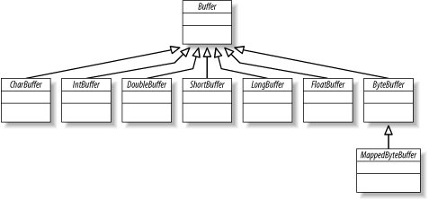
Buffer Classes

Slide 17


Buffer Objects (Empty/Fill)

Slide 18

Buffer Objects (Flip)

Slide 19
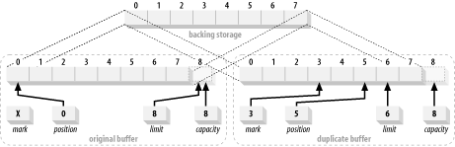
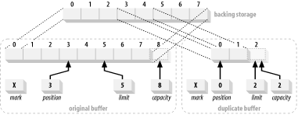
Buffer Views (Dupe/Slice)

Slide 20
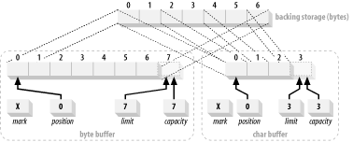
Buffer Views (Char View)

Slide 21
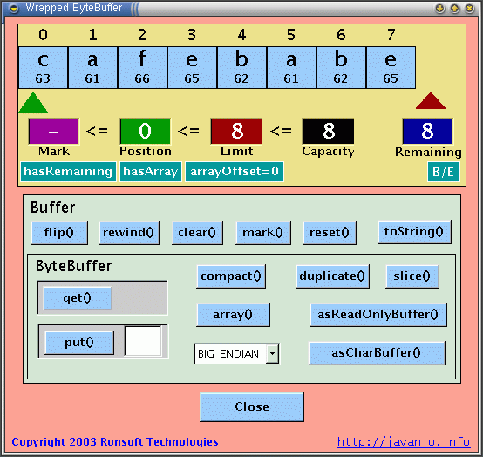
I'm Confused...Show Me

Slide 22
NIO Channels
New I/O metaphor
  Conduit to an I/O service (“nexus”)
  Channels are not streams
Channels do bulk data transfers to and from buffers
  channel.write (buffer) ~= buffer.get (byteArray)
  channel.read (buffer) ~= buffer.put (byteArray)
  Data is logically transferred in blocks, not byte/char at a time
More capable APIs
  Scatter/gather
  Channel-to-channel transfers
Three primary channel implementations
  FileChannel: File locks, memory mapping, cross-connect transfers
  Sockets: Non-blocking, selectable, async connections, socket peers
  Pipe: loopback channel pair, selectable, generic channels
Selectable Channel Implementations are pluggable (SPI)
  Specialized implementations are possible

Slide 23
Channel Copy – Simple #1*
public void channelCopy (ReadableByteChannel src, WritableByteChannel dest)
throws IOException
{
ByteBuffer buffer = ByteBuffer.allocate (16 * 1024);
while (src.read (buffer) != -1) {
// prepare the buffer to be drained
buffer.flip();
// make sure the buffer was fully drained.
while (buffer.hasRemaining()) {
dest.write (buffer);
}
// make the buffer empty, ready for filling
buffer.clear();
}
}
* No buffer copies, but potentially more system calls.

Slide 24
Channel Copy – Simple #2*
public void channelCopy (ReadableByteChannel src, WritableByteChannel dest)
throws IOException
{
ByteBuffer buffer = ByteBuffer.allocate (16 * 1024);
while (src.read (buffer) != -1) {
// prepare the buffer to be drained
buffer.flip();
// write to the channel, may block
dest.write (buffer);
// if partial transfer, shift remaining elements down
// if buffer was empty, same as doing clear
buffer.compact();
}
buffer.flip(); // EOF leaves buffer in fill state
while (buffer.hasRemaining()) {
dest.write (buffer);
}
}
* Minimal system calls, but may do buffer copies. Post loop cleanup needed.

Slide 25
Channel Copy – Transfer*
public void channelCopy (FileChannel src, WritableByteChannel dest)
throws IOException
{
src.transferTo (0, src.size(), dest);
}
public void channelCopy (ReadableByteChannel src, FileChannel dest)
throws IOException
{
dest.transferFrom (src, 0, Long.MAX_VALUE);
}
* Very easy, but one end must always be a FileChannel. Transfer may occur entirely in kernel space.

Slide 26
Memory Mapped Buffers
RandomAccessFile raf = new RandomAccessFile (fileName, "rw");
FileChannel fc = raf.getChannel();
MappedByteBuffer buffer = fc.map (FileChannel.MapMode.READ_WRITE, 0, fc.size());
byte b = buffer.get(); // reads from file
...
buffer.put (someOtherByte); // writes to file
The content of buffer is the content of fileName
Any change to one affects the other

Slide 27
Non-Blocking Sockets – Simple Really
ByteBuffer buffer = ByteBuffer.allocate (1024);
SocketChannel socketChannel = SocketChannel.open();
socketChannel.configureBlocking (false);
...
while (true) {
...
if (socketChannel.read (buffer) != 0) {
processInput (buffer);
}
...
}

Slide 28
Non-Blocking Server Socket
ServerSocketChannel ssc = ServerSocketChannel.open();
ssc.socket().bind (new InetSocketAddress (port));
ssc.configureBlocking (false);
while (true) {
SocketChannel newConnection = ssc.accept();
if (newConnection == null) {
doSomethingToKeepBusy();
} else {
doSomethingWithSocket (newConnection);
}
}

Slide 29
NIO Selectors
Multiplexing Channels – Readiness Selection
Channels are registered with Selectors
  A SelectionKey object encapsulates one selector/channel relationship
  Each Selector maintains a set of channels registered with it (Registered Set)
  A subset of ready channels is selected from the Selector's Registered Set of channels (Selector.select())
  Selected Set returned by select() contains keys with non-empty Ready Sets
Each SelectionKey has Interest & Ready Sets
  Possible members of Interest Set: accept, read, write, connect
  Interest Set (bit mask) is specified at registration, can be changed at any time
  Ready Set is a subset of the Interest Set as-of the last select() call
Readiness Selection means less work
  Ignore idle channels
  Sockets are decoupled from threads
  Less synchronization required
  Far simpler code - less debugging, more reliable

Slide 30
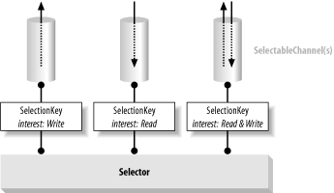
Selectors, Keys and Channels

Slide 31
Multiplexing: The Selection Process
Create a Selector and register channels with it
  The register() method is on SelectableChannel, not Selector
Invoke select() on the Selector object
Fetch the Selected Set of keys from the Selector
  Selected set: Registered keys with non-empty Ready Sets
  keys = selector.selectedKeys()
Iterate over the Selected Set
  Check each key's Ready Set (set of operations ready to go as-of last select())
  Remove the key from the Selected Set (iterator.remove())
    Bits in the Ready Sets are never reset while the key is in the Selected Set
    The Selector never removes keys from the Selected Set – you must do so
  Service the channel (key.channel()) as appropriate (read, write, etc)

Slide 32
Registering With a Selector
ServerSocketChannel serverChannel = ServerSocketChannel.open();
Selector selector = Selector.open();
serverChannel.socket().bind (new InetSocketAddress (port));
serverChannel.configureBlocking (false);
serverChannel.register (selector, SelectionKey.OP_ACCEPT);

Slide 33
Running a Selection Loop
while (true) {
selector.select();
Iterator it = selector.selectedKeys().iterator();
while (it.hasNext()) {
SelectionKey key = (SelectionKey) it.next();
it.remove();
if (key.isAcceptable()) {
ServerSocketChannel server =
(ServerSocketChannel) key.channel();
SocketChannel channel = server.accept();
channel.configureBlocking (false);
channel.register (selector, SelectionKey.OP_READ);
}
if (key.isReadable()) readDataFromSocket (key);
}
}

Slide 34
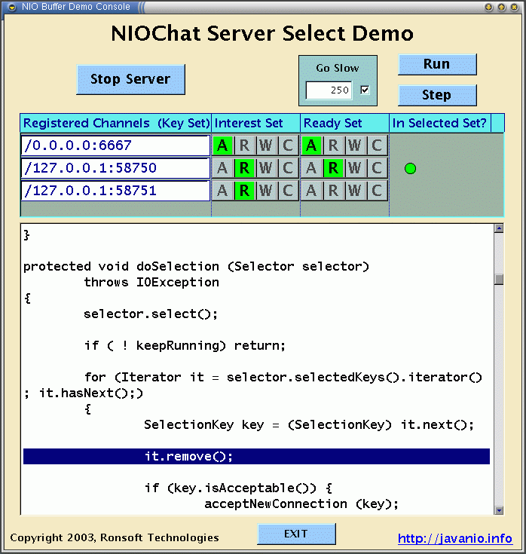
How Does That Work...Exactly?

Slide 35
Scalability With Selectors
One Thread to Rule Them All
  More threads != More Efficient
  More threads means more context switching overhead
  Actual concurrency is limited by the number of CPUs available
The OS and/or JVM do the hard work for you
  Only the kernel can efficiently do Readiness Selection
  No need to write and debug tricky socket management code
No more thread-per-socket nonsense
  Simpler, easier to maintain code
  Less concurrency hassles – locking overhead, thread races
  Single point of dispatch
Not necessarily single-threaded
  Single selection thread can dispatch to multiple worker threads
  You can have multiple selection dispatchers managing distinct sets of sockets

Slide 36
Gotcha: Things To Watch Out For
Multithreaded access to Selectors
  select() holds a lock while it’s sleeping
  Causes calls to methods on SelectionKey to block
  More stringent locking in JDK 1.4.2
  Example 4-2 (SelectSocketsThreadPool) in my book no longer works
Empty channels are always ready to write
  Registering interest in write may cause busy spinning
  Turn off write interest when you have nothing to write
Don’t memory map beyond the end of a file
  On some OSs, this may expand the size of the file
  OK to lock beyond the end of a file
In general, NIO is more efficient for reading and writing large chunks of data
  No buffering is done, each call incurs system call overhead

Slide 37
Protoplex: NIO Made Easy
Protocol-Independent Channel Multiplexer
Open Source
  Available soon on SourceForge
  Watch http://javanio.info for availability (or contact me)
Handles all details of channel management
  Queues outbound data
  Manages Interest Sets appropriately
  Manages both inbound and outbound connections
Multi-thread friendly
  Multiple acceptor threads per server socket can be configured
  Configurable worker thread pool
  Uses Doug Lea’s concurrency package
Application implements the Protocol interface
  A simple chat server was implemented in 200 lines of code

Slide 38
Regular Expressions and Charsets
No time
Buy the book
Let’s move on

Slide 39
What Did They Leave Out?
Formatted I/O (ala printf/scanf)
  Will leverage Regular Expressions
Enhanced Filesystem Interface
  More consistent across OS platforms
  Better access to file/directory attributes
  Pluggable to support new filesystem types
True Asynchronous I/O
  Under consideration
  Very hard to do across all OS platforms
  May never happen

Slide 40
What’s Next for NIO?
JSR 203 - More NIO
  Originally planned as part of JDK 1.5 (Tiger)
  Deferred because of other priorities - 1.6?
Enhanced filesystem interface
  Bulk access to file attributes
  Escape to filesystem-specific APIs
  SPI for pluggable filesystem API implementations
True Asynchronous I/O
  Async data transfer for both socket and file I/O
Extend the SocketChannel APIs
  Bind and configure sockets directly (not through Socket peer)
  Support for multi-cast
Formatted I/O?
  Demonstrated at JavaOne 2003
  Not mentioned in JSR 203

Slide 41
Final Thoughts
NIO is not for all I/O uses
  It’s not even for most
Some things can only be done with NIO
  Use it when you need it (when you need it, you’ll know)
  Don’t change code that’s working fine without it
NIO is still maturing
  Implementation is complex
  API is not as elegant as it could be
  Performance still needs improvement
  Expect improvements in future releases
Contact me if you still have questions
  ron@ronsoft.com

Slide 42
Questions
?
?
?
?
?
?
?

Slide 43

Bye Bye - Tot Ziens - Au Revoir - Auf Wiedersehen
  Buy my Daddy's book. I think I see one right over there.
  Ron (and Miranda) Hitchens
  ron@ronsoft.com
  http://www.ronsoft.com http://javanio.info

