Slide 1
Cyclistic Rideshare Analysis
A Google Data Analytics Capstone Project
Analysis and Presentation by Dante Imerito
September 14th 2023

Slide 2
The Goal
Business Task
Increase company revenue by developing a marketing strategy that
will convert Cyclistic’s casual riders into annual members.
Goal of Analysis
Identify differences in the way members and casual riders use
Cyclistic bikes differently.

Slide 3
Data sources
One year of Cyclistic's bicycle user data (July 2022 - June 2023)
Bicycle station location data provided by the City of Chicago Data Portal.
Station location data manually verified and collected through the use of online maps.

Slide 4
Key Findings

Slide 5
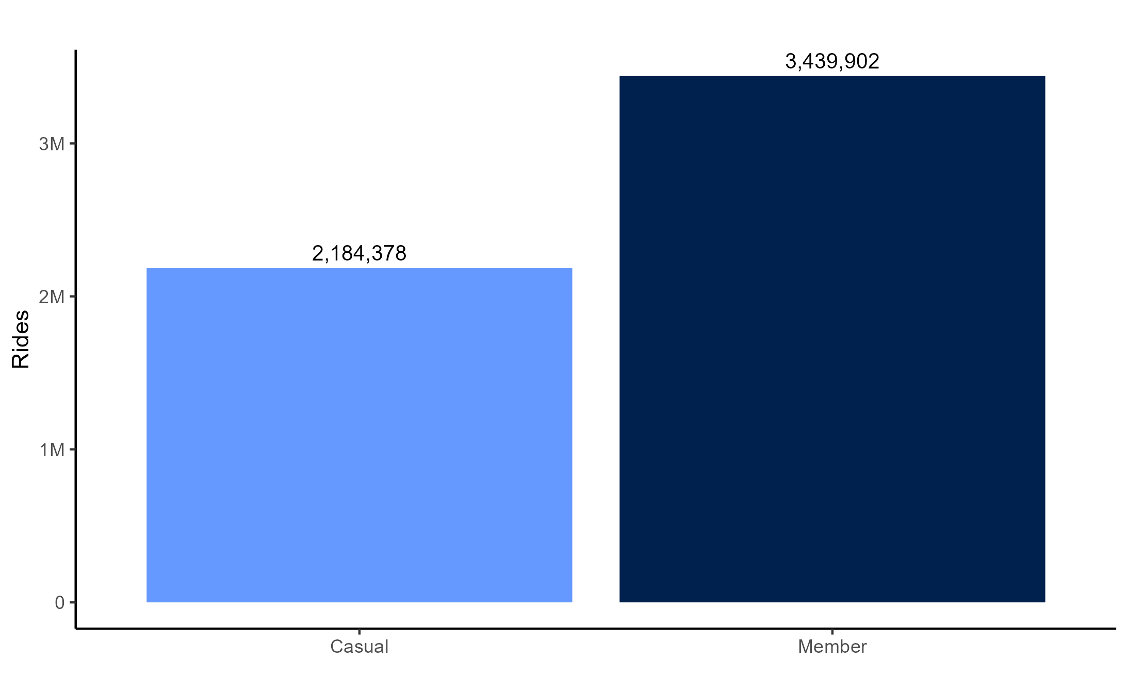
Total Rides

Slide 6
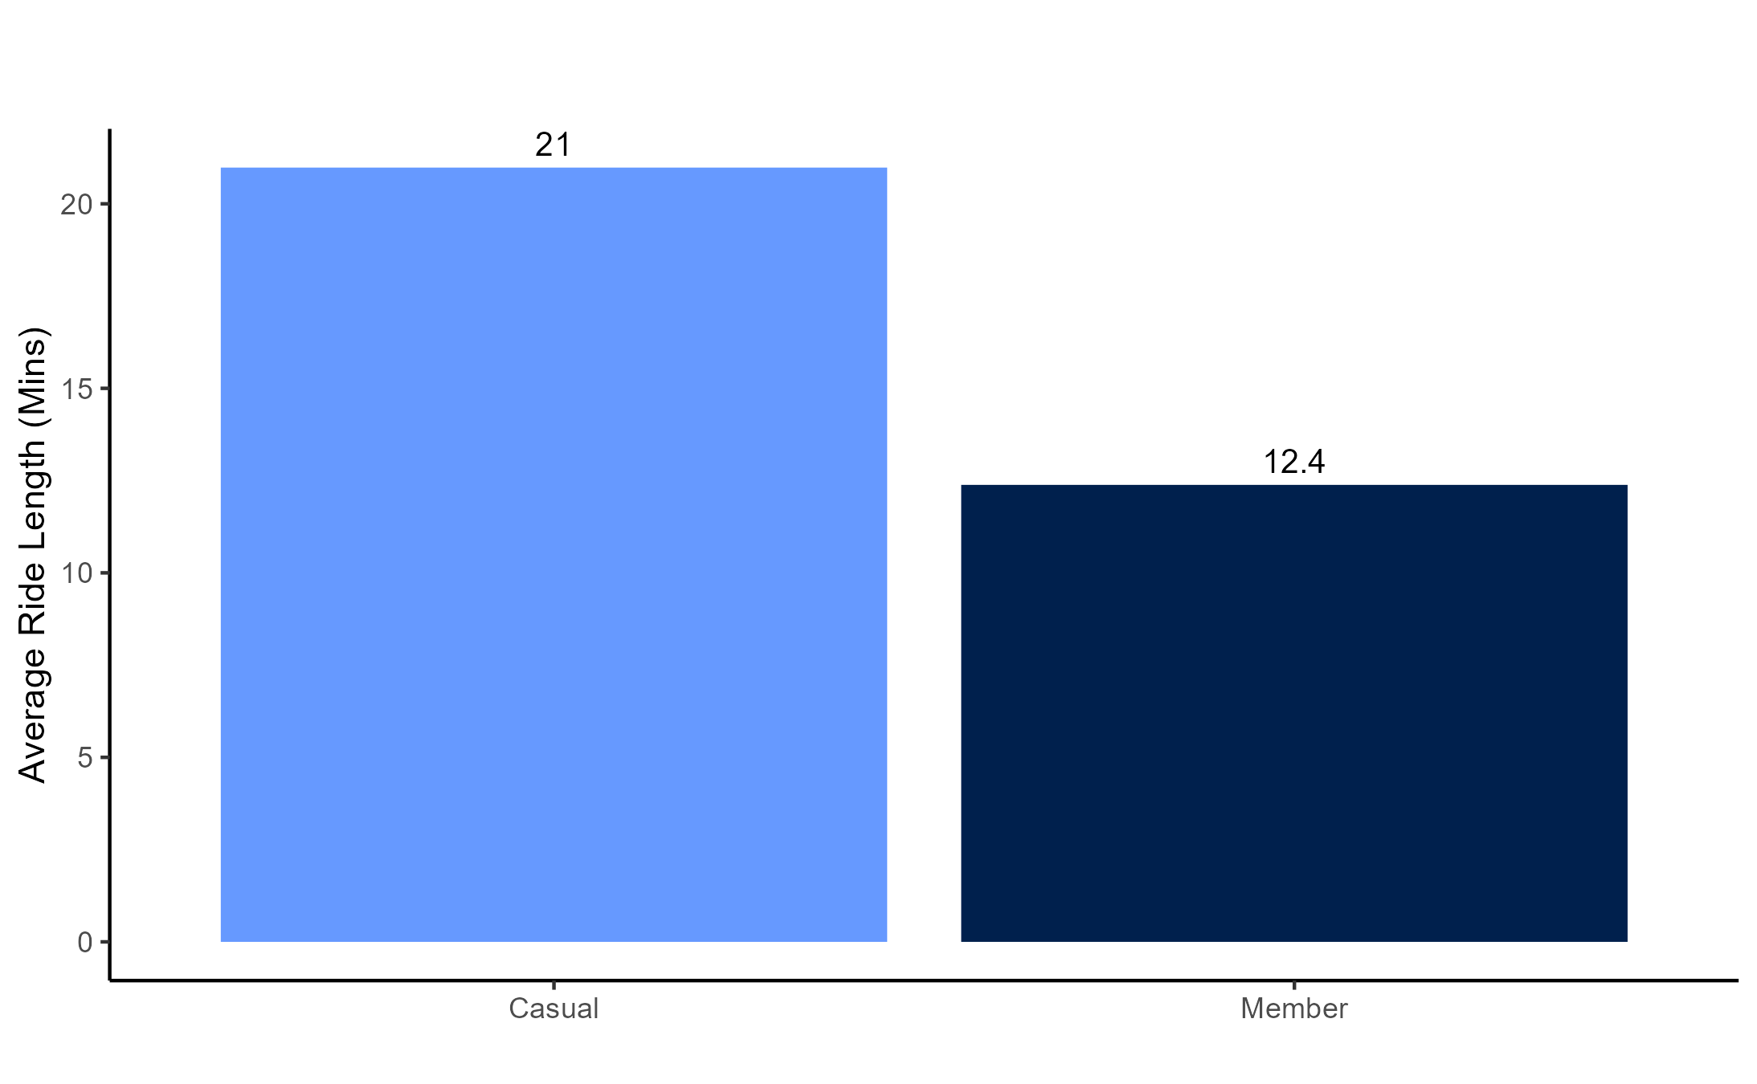
Average Ride length

Slide 7
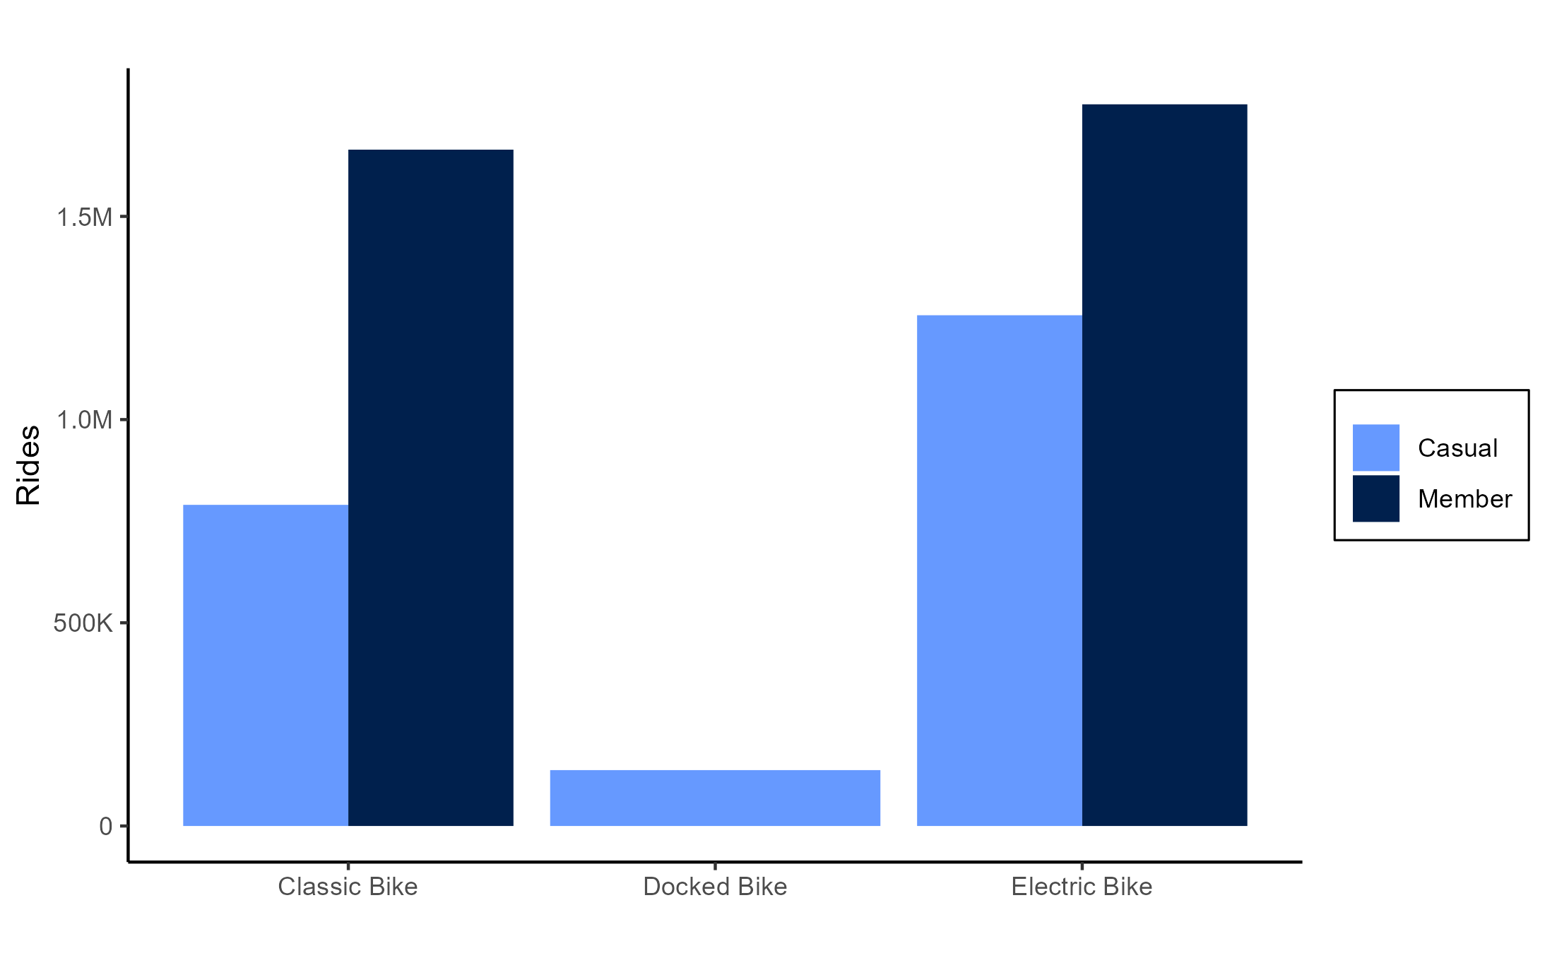
Rides by Bike Type

Slide 8
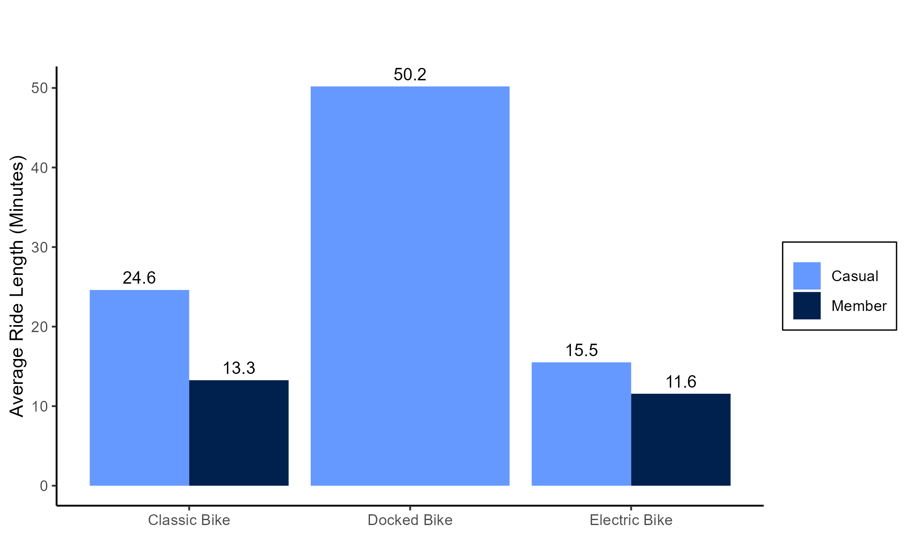
Average ride length By Bike Type

Slide 9
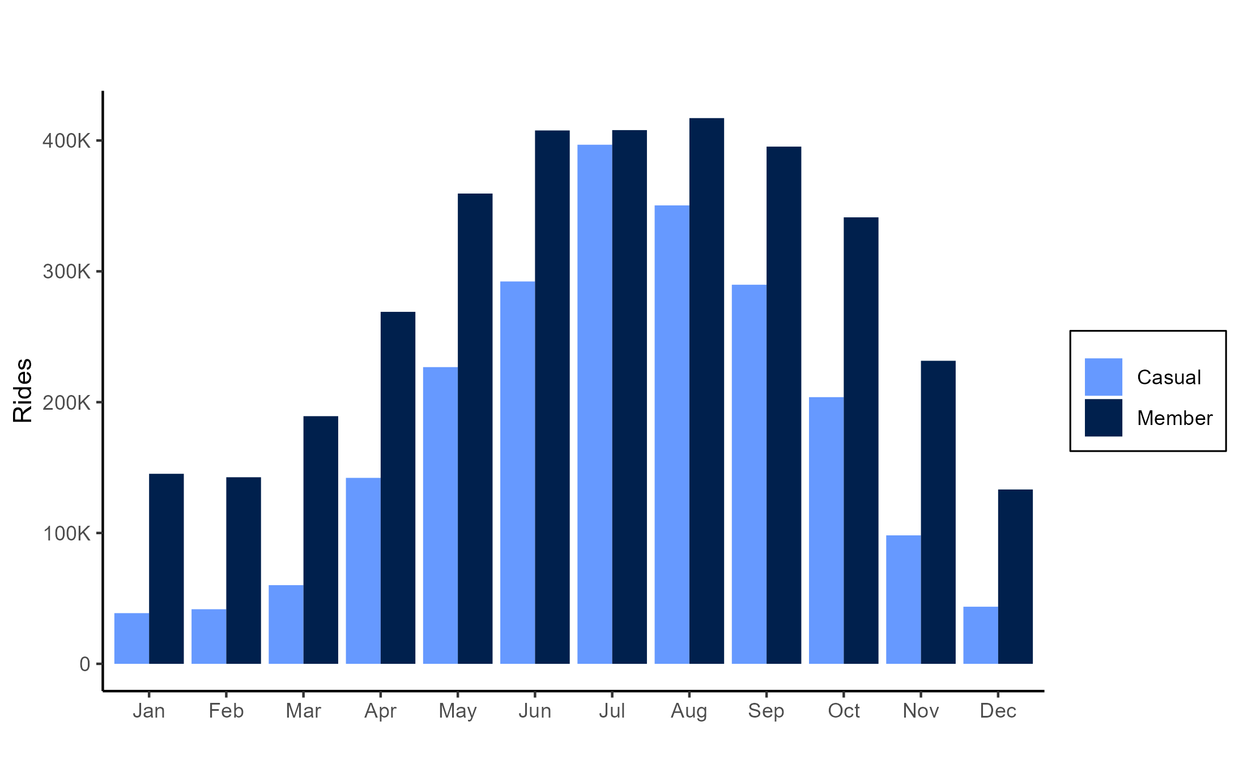
Rides per month

Slide 10
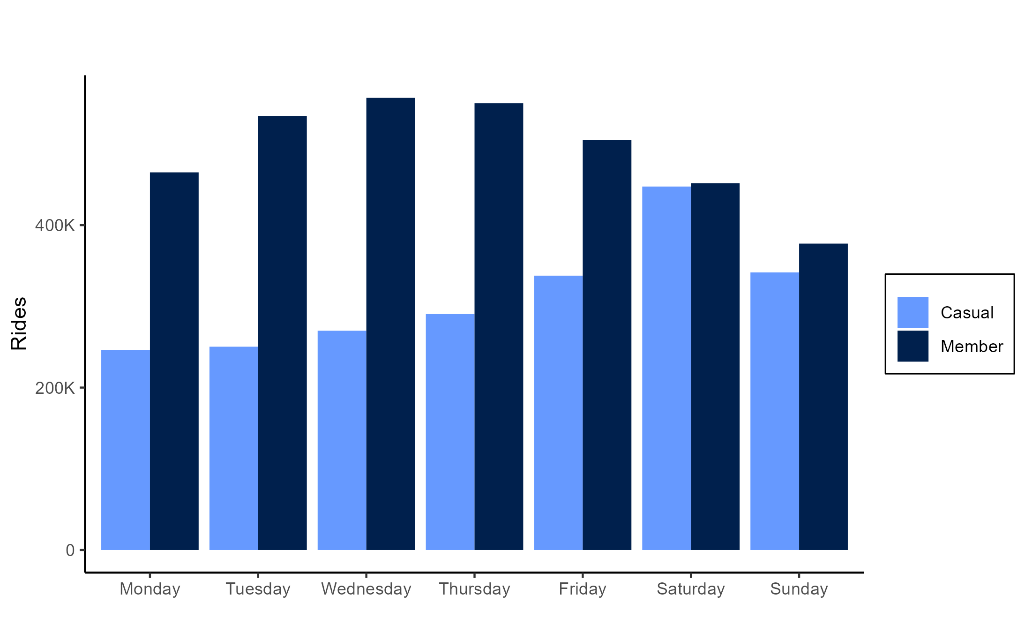
Rides by day of week

Slide 11
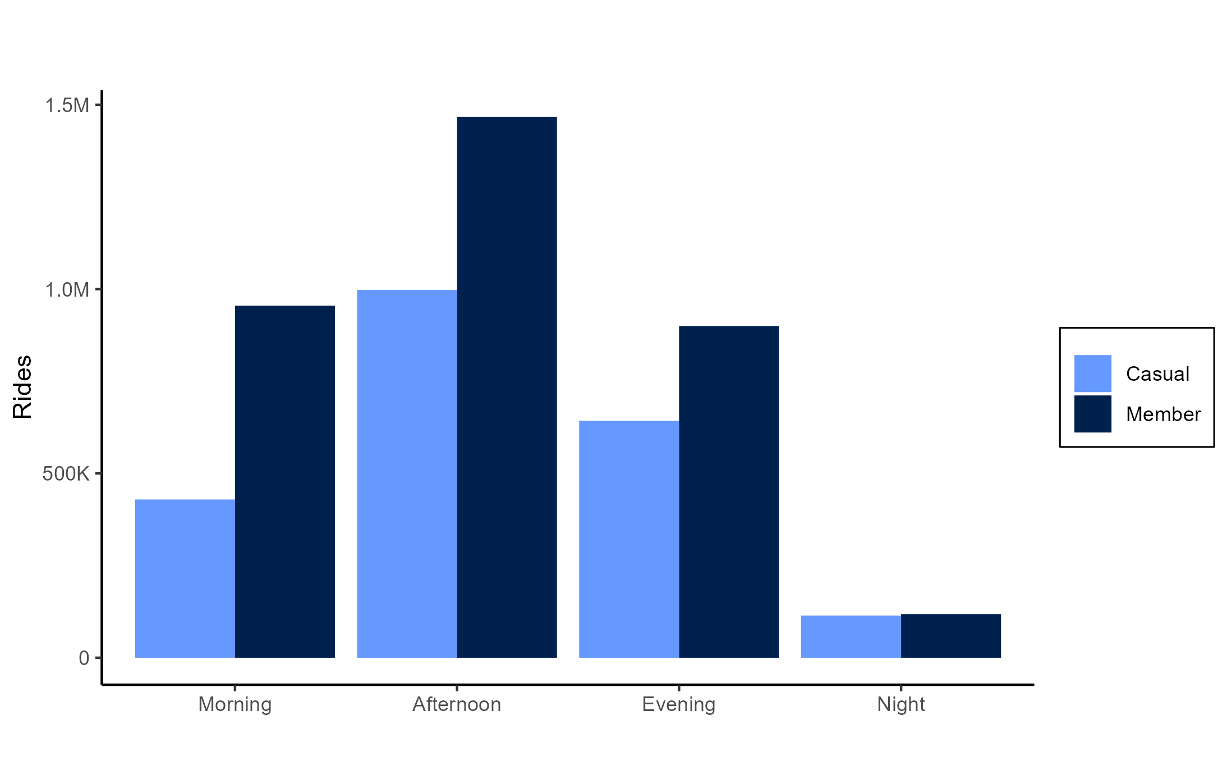
Rides by time of day

Slide 12
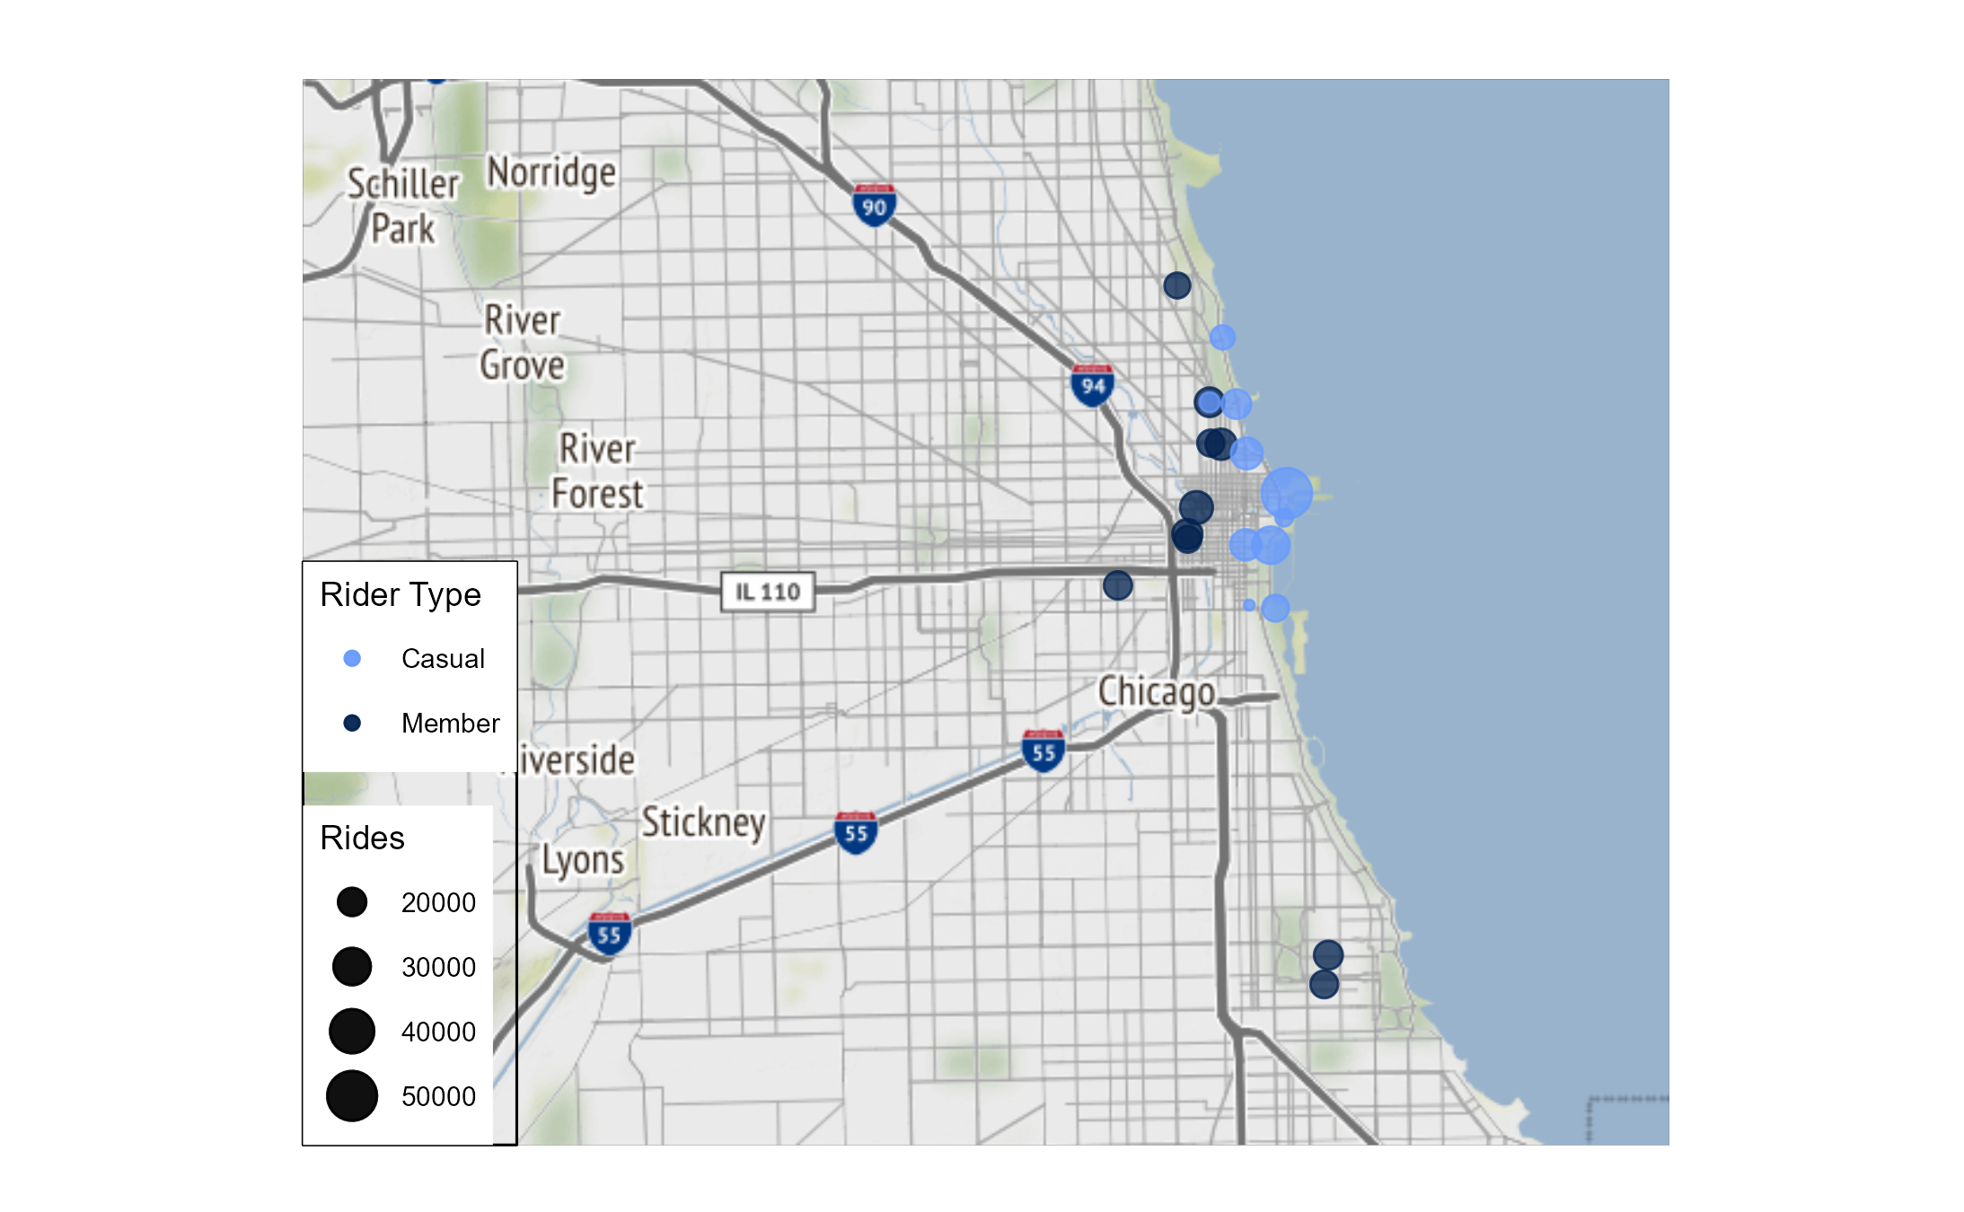
Top 10 stations for members and casuals

Slide 13
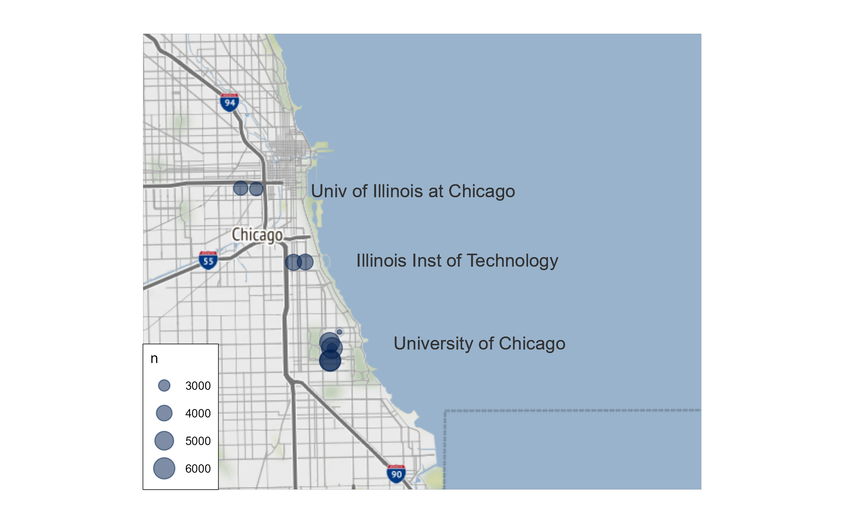
Top 10 Routes for members

Slide 14
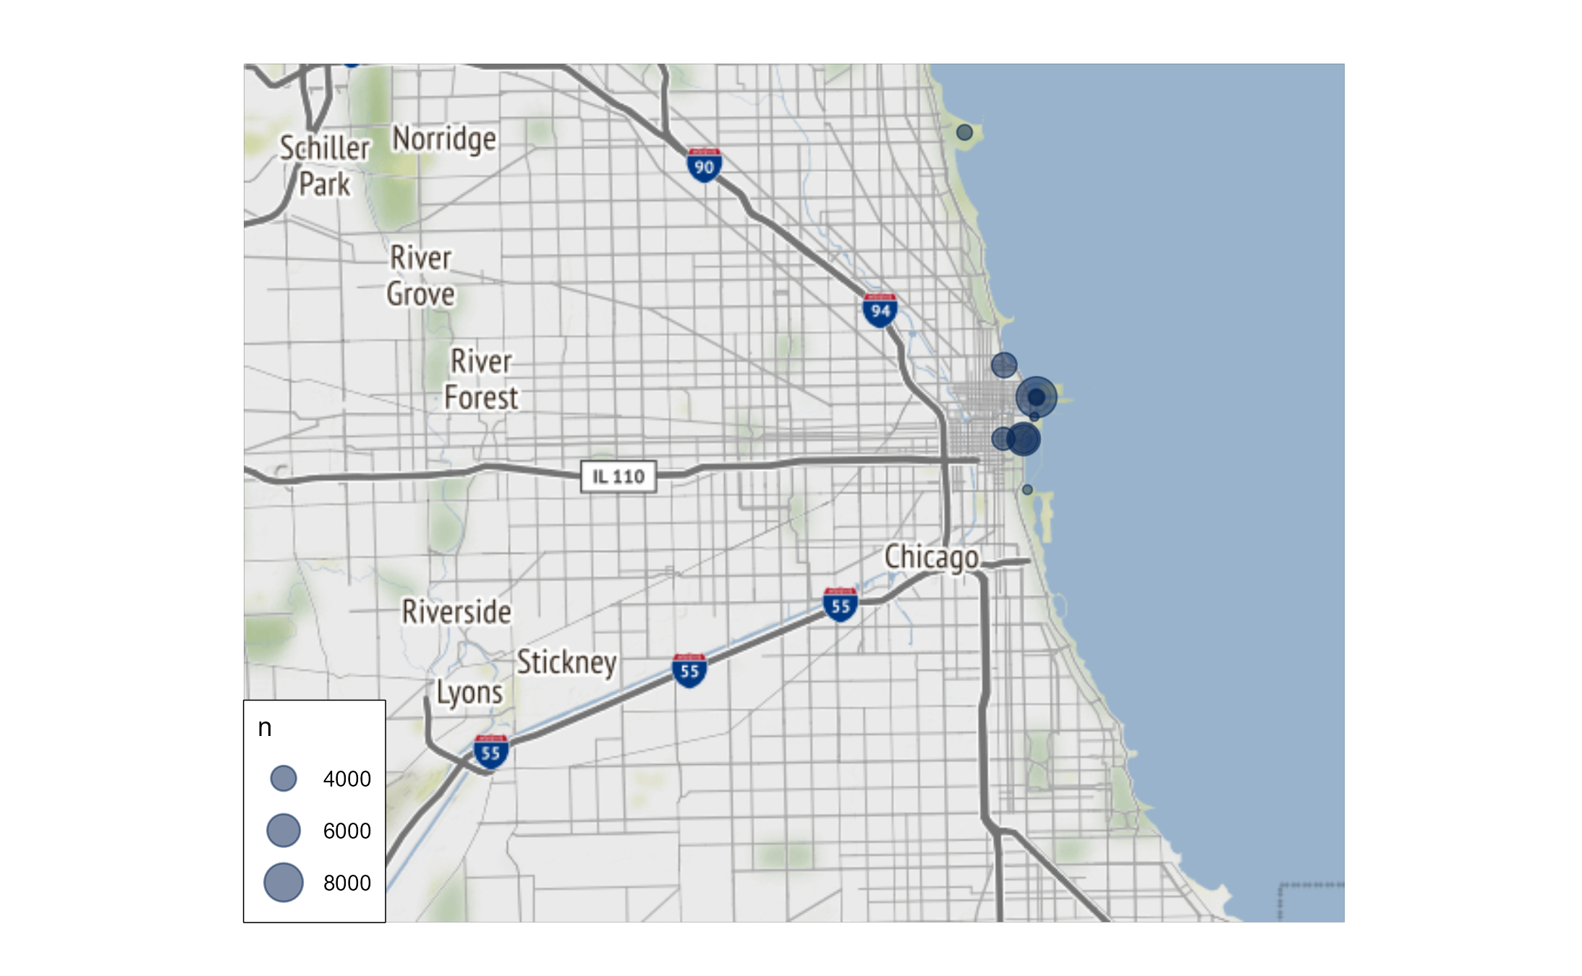
Top 10 Routes for casuals

Slide 15
Conclusion
Casual rides are fewer than member rides and last more than 8 minutes longer per ride on average than member rides.
Casual riders ride more often on the weekends near Chicago's coastal parks while member riders tend to be most active during the workweek several blocks from the shoreline.
The most frequently traveled routes by members occur on and around college campuses while the most frequently traveled routes for casual riders are clustered in and around Chicago's coastal parks.

Slide 16
Recommendations
Encourage casual riders to convert to an annual membership by highlighting the cost savings involved in riding more often. Cyclistic’s network of 1000+ bike stations makes it easy to ride for a variety of tasks such as recreation, school and work - anywhere in the Chicago area.
2) Target advertising toward high densities of casual riders in Chicago’s coastal parks and ramp up advertising during the month of March when the anticipation of increased ridership is high.
3) Gather more data by conducting a survey. Ask Cyclistic riders:
Why have you chosen Cyclistic for your mobility needs?
What tasks do you perform when using Cylistic bikes?
What do you like or dislike about Cyclistic?

Slide 17
Questions?

