Slide 1

Personal
Homelab Dashboard
Dante Razo
SEIS 606 FA26

Slide 2

What?
A single place to view cluster status
Frutiger Aero
  Nostalgic
  Whimsical
  Beautiful
  Elegant
  Sensational

Slide 3
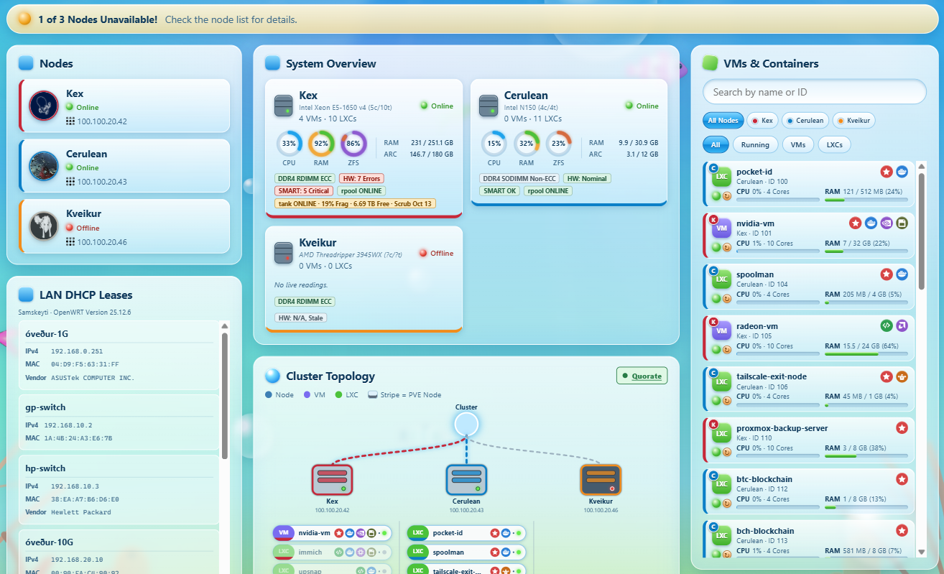
What?
A single place to view cluster status
Frutiger Aero
  Nostalgic
  Whimsical
  Beautiful
  Elegant
  Sensational

Slide 4
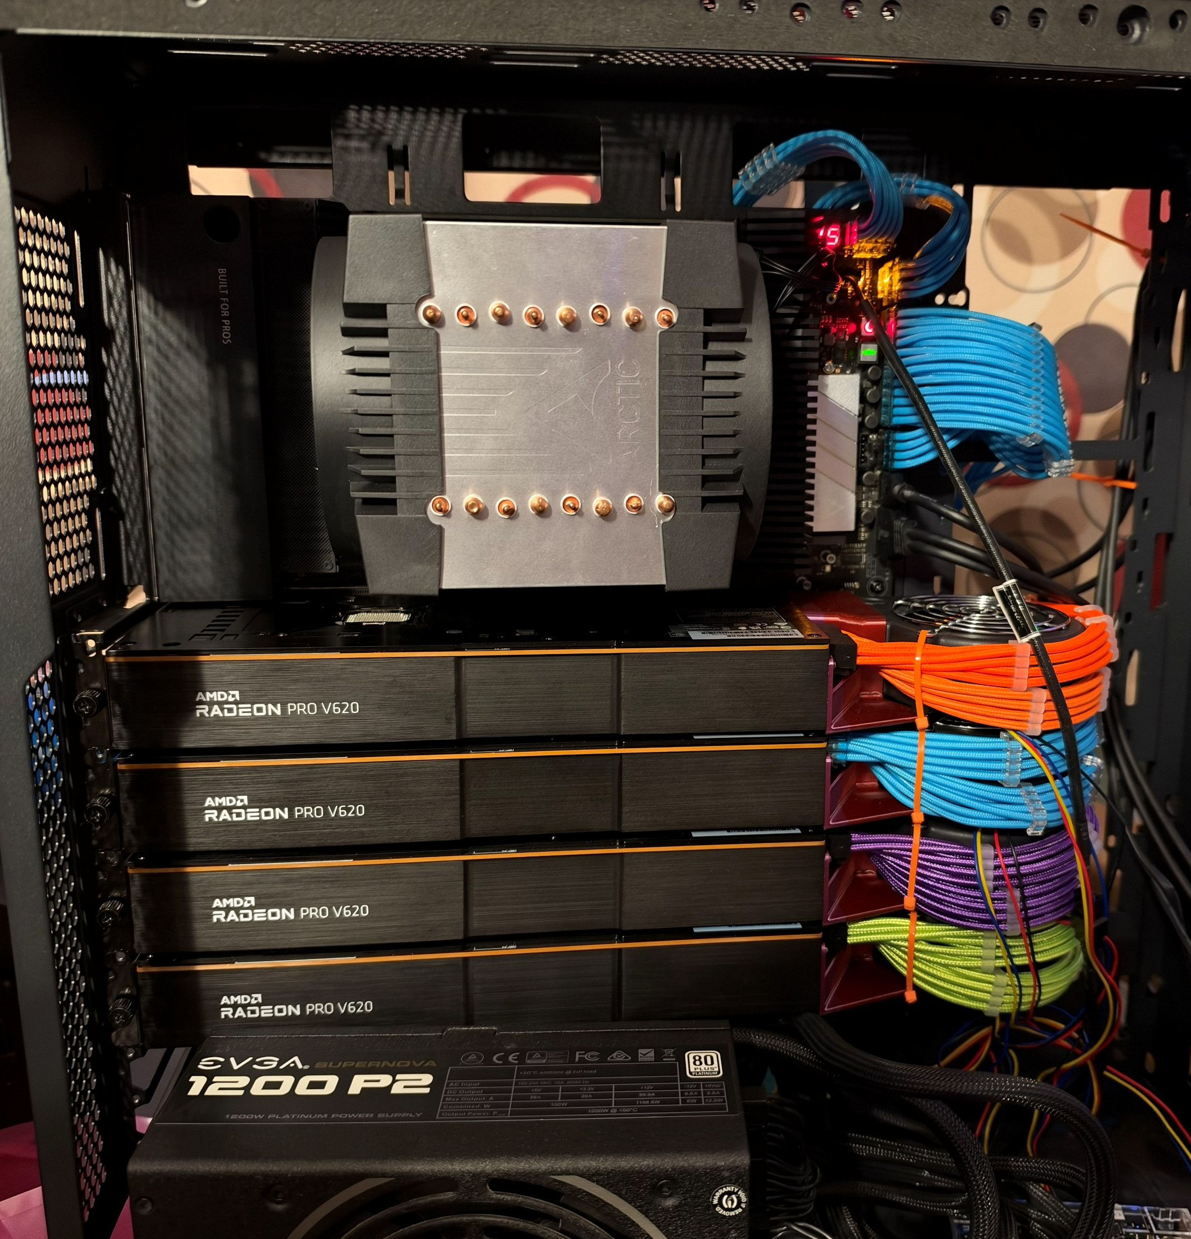
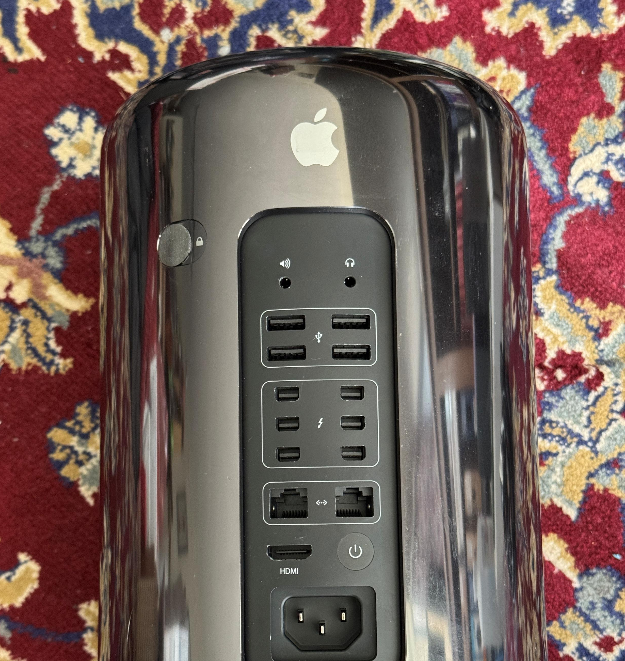
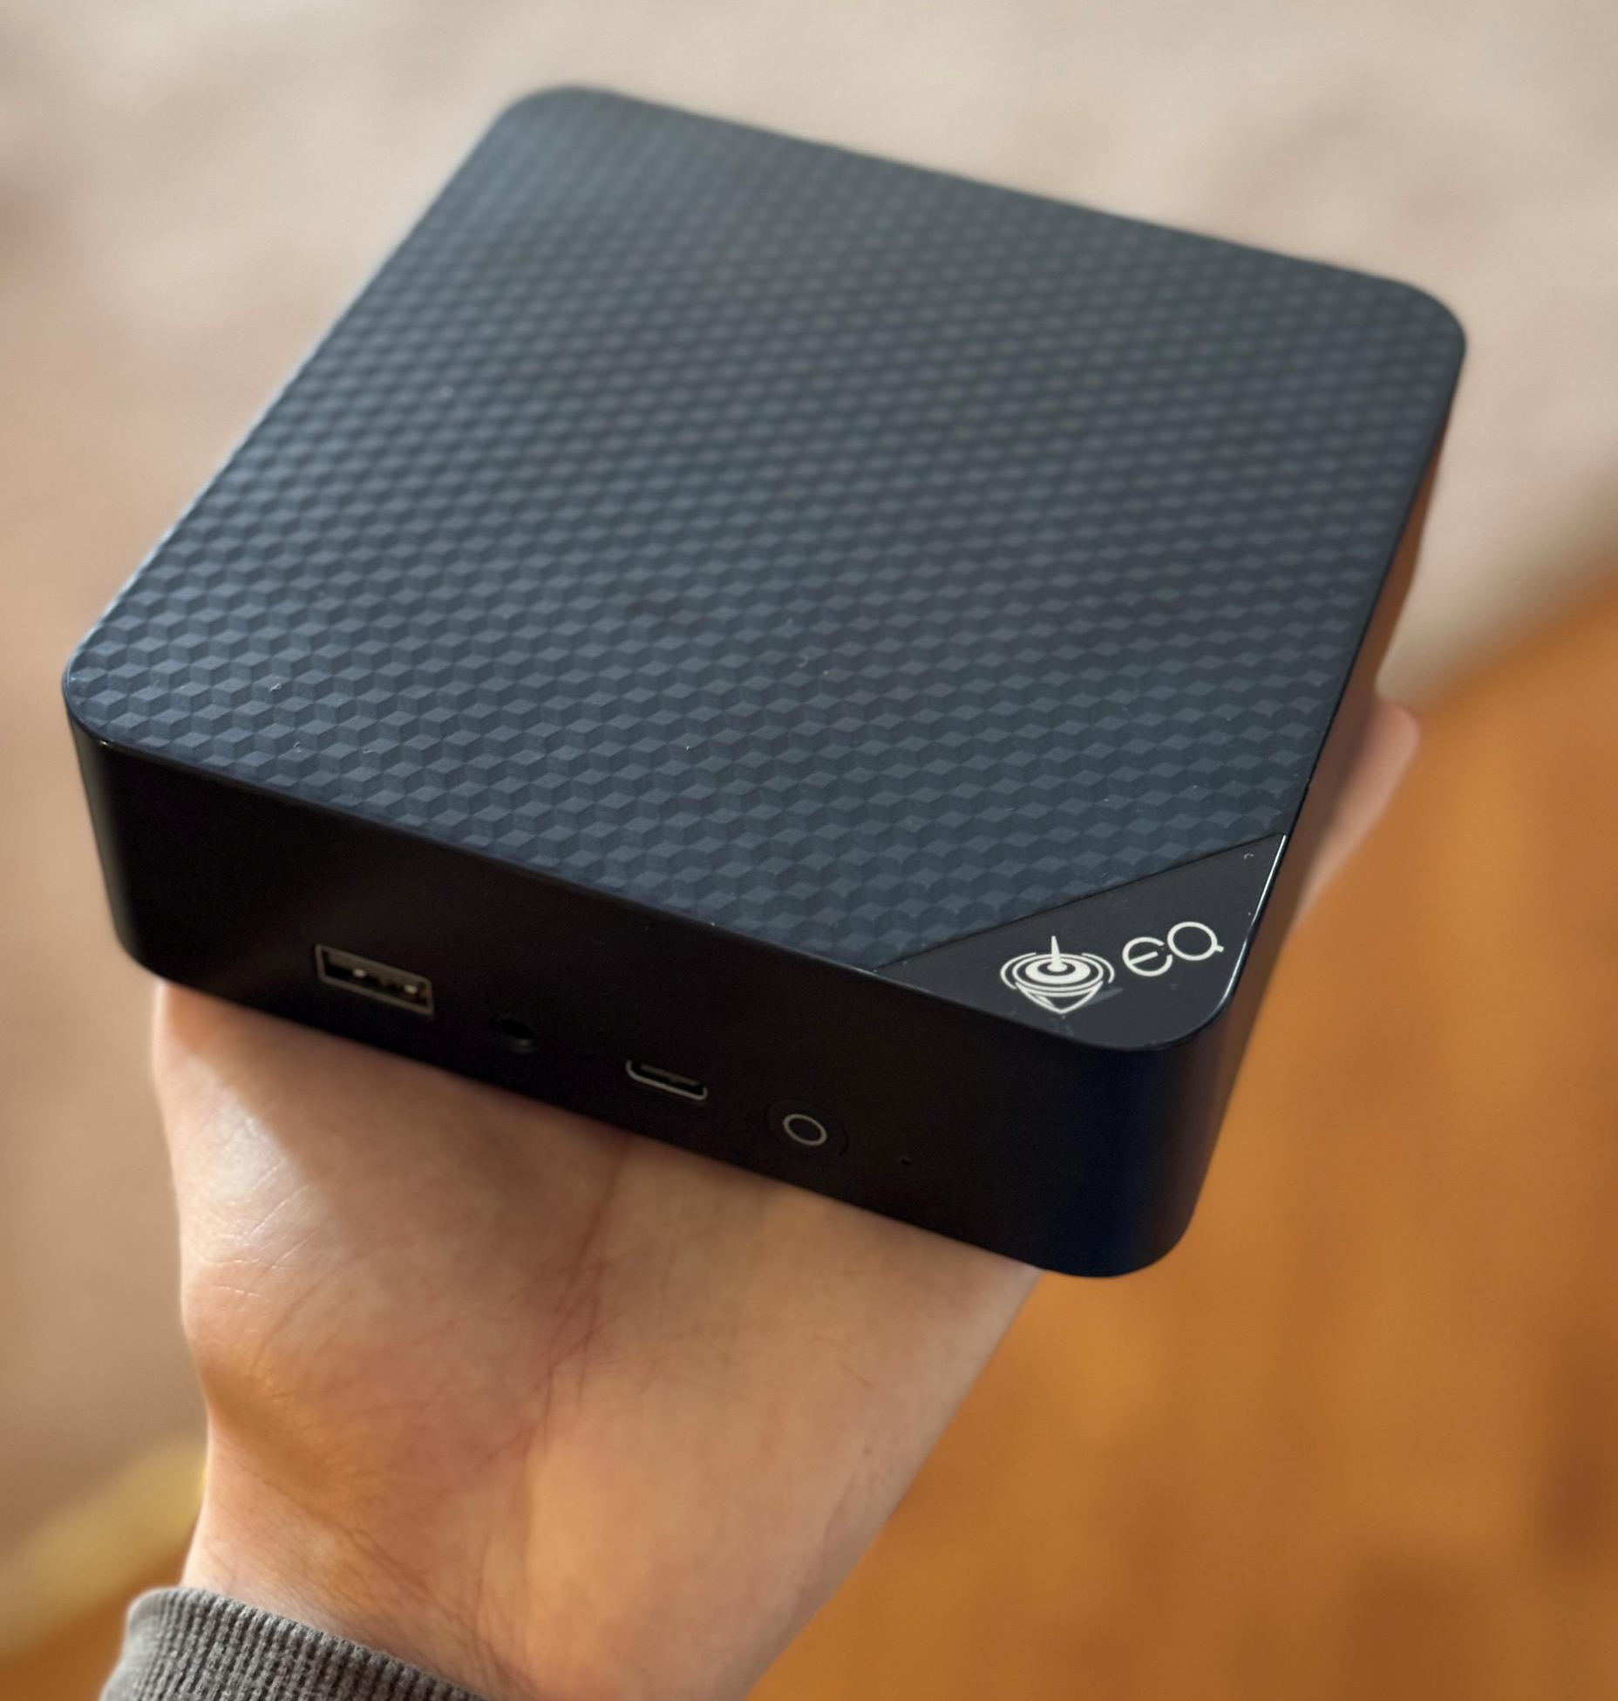
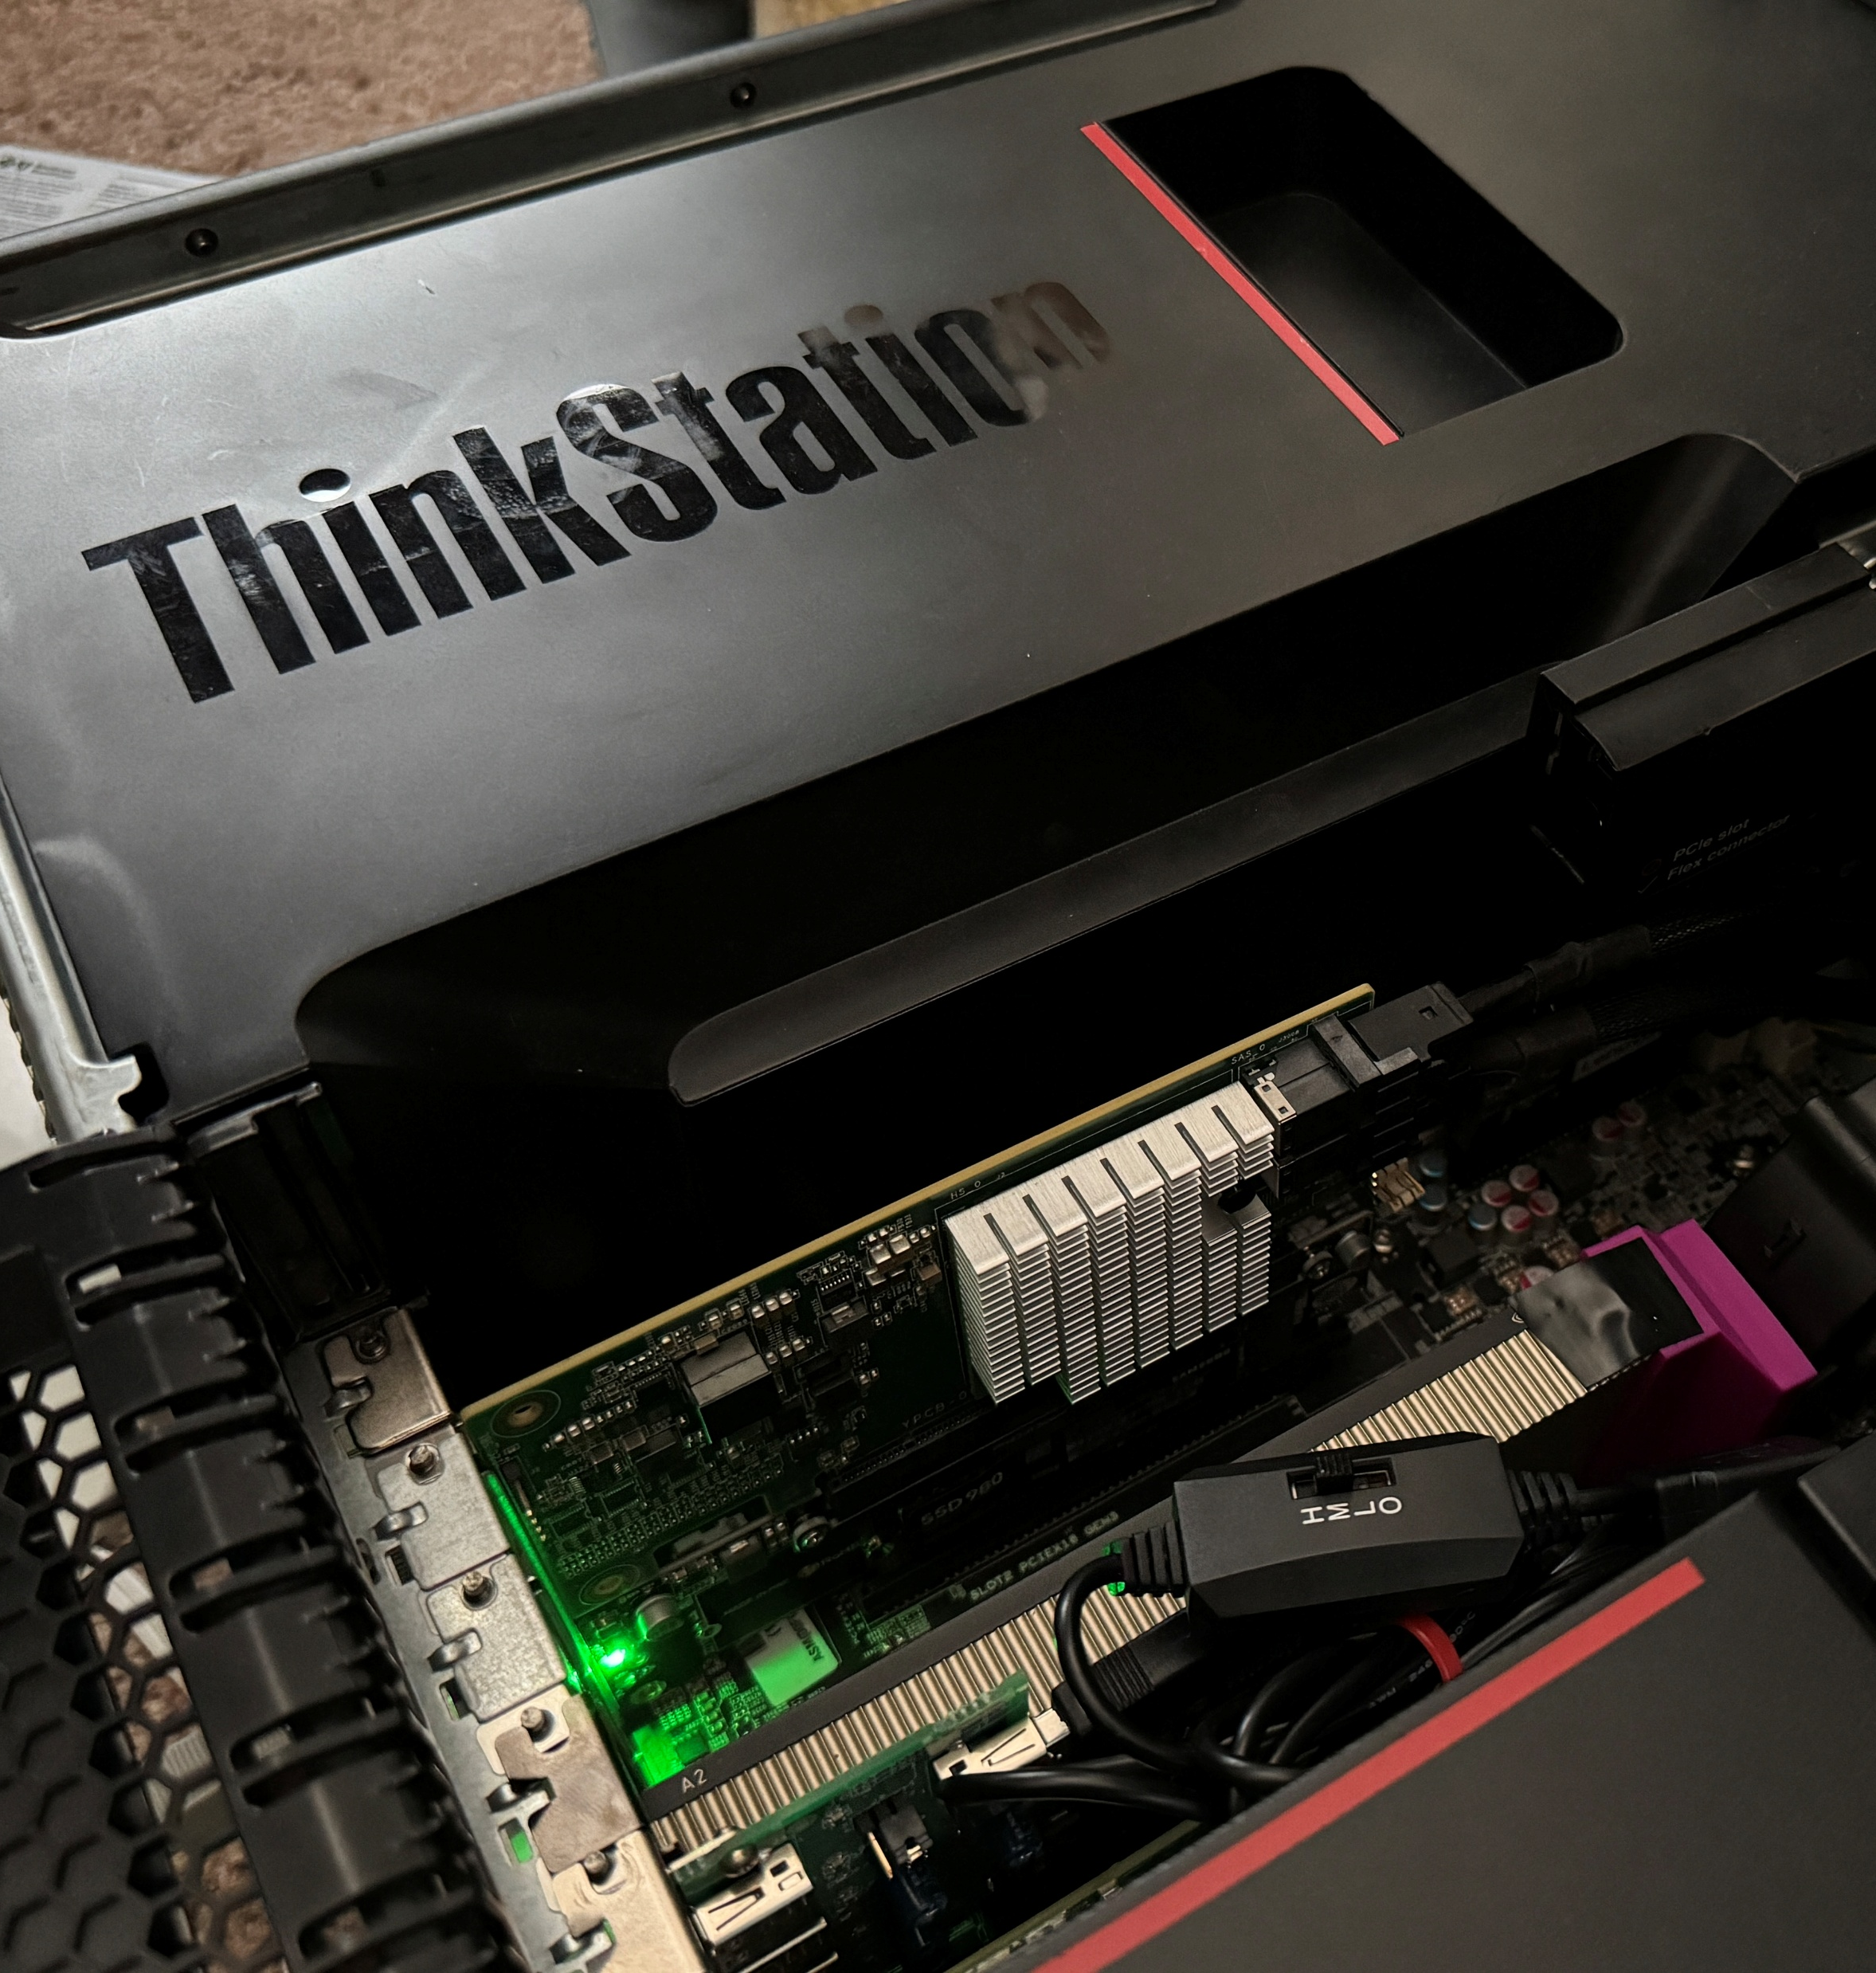
Why?
My cluster is my pride and joy
My cluster is my burden
Too many machines, not enough time
Divine retribution (more hardware, more problems)
I was going to make one anyway

Slide 5
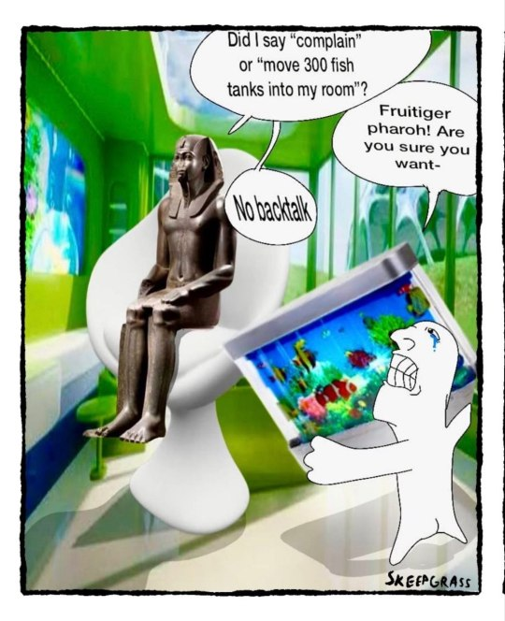
How?
Copilot-as-a-service
  Copilot Student, initially
Copilot-as-a-harness
  An RTX 5090. 32GB and a dream
  Qwen3.8 27B @ Q4_K_M
    The greatest overthinker of our time
    Only briefly
  Gemma4 26B A4B QAT @ Q4
    Independent AI review

Slide 6

Live Demo on Proxmox Cluster

Slide 7
Security by Ignorance Obscurity
LAN access only
I live alone
Hosted on my hardware for my hardware

Slide 8

What’s Next?
Hosted in a dedicated LXC
Reverse proxied by Caddy
Passkeys (OAuth2 / WebAuthn)
  Served by LXC 100 (pocket-id)
  Requires HTTPS, and Caddy by extension
LLM integration
  Active, occasional monitoring
  Nuanced answers vs. deterministic decision trees
    e.g. critical SMART data

Slide 9
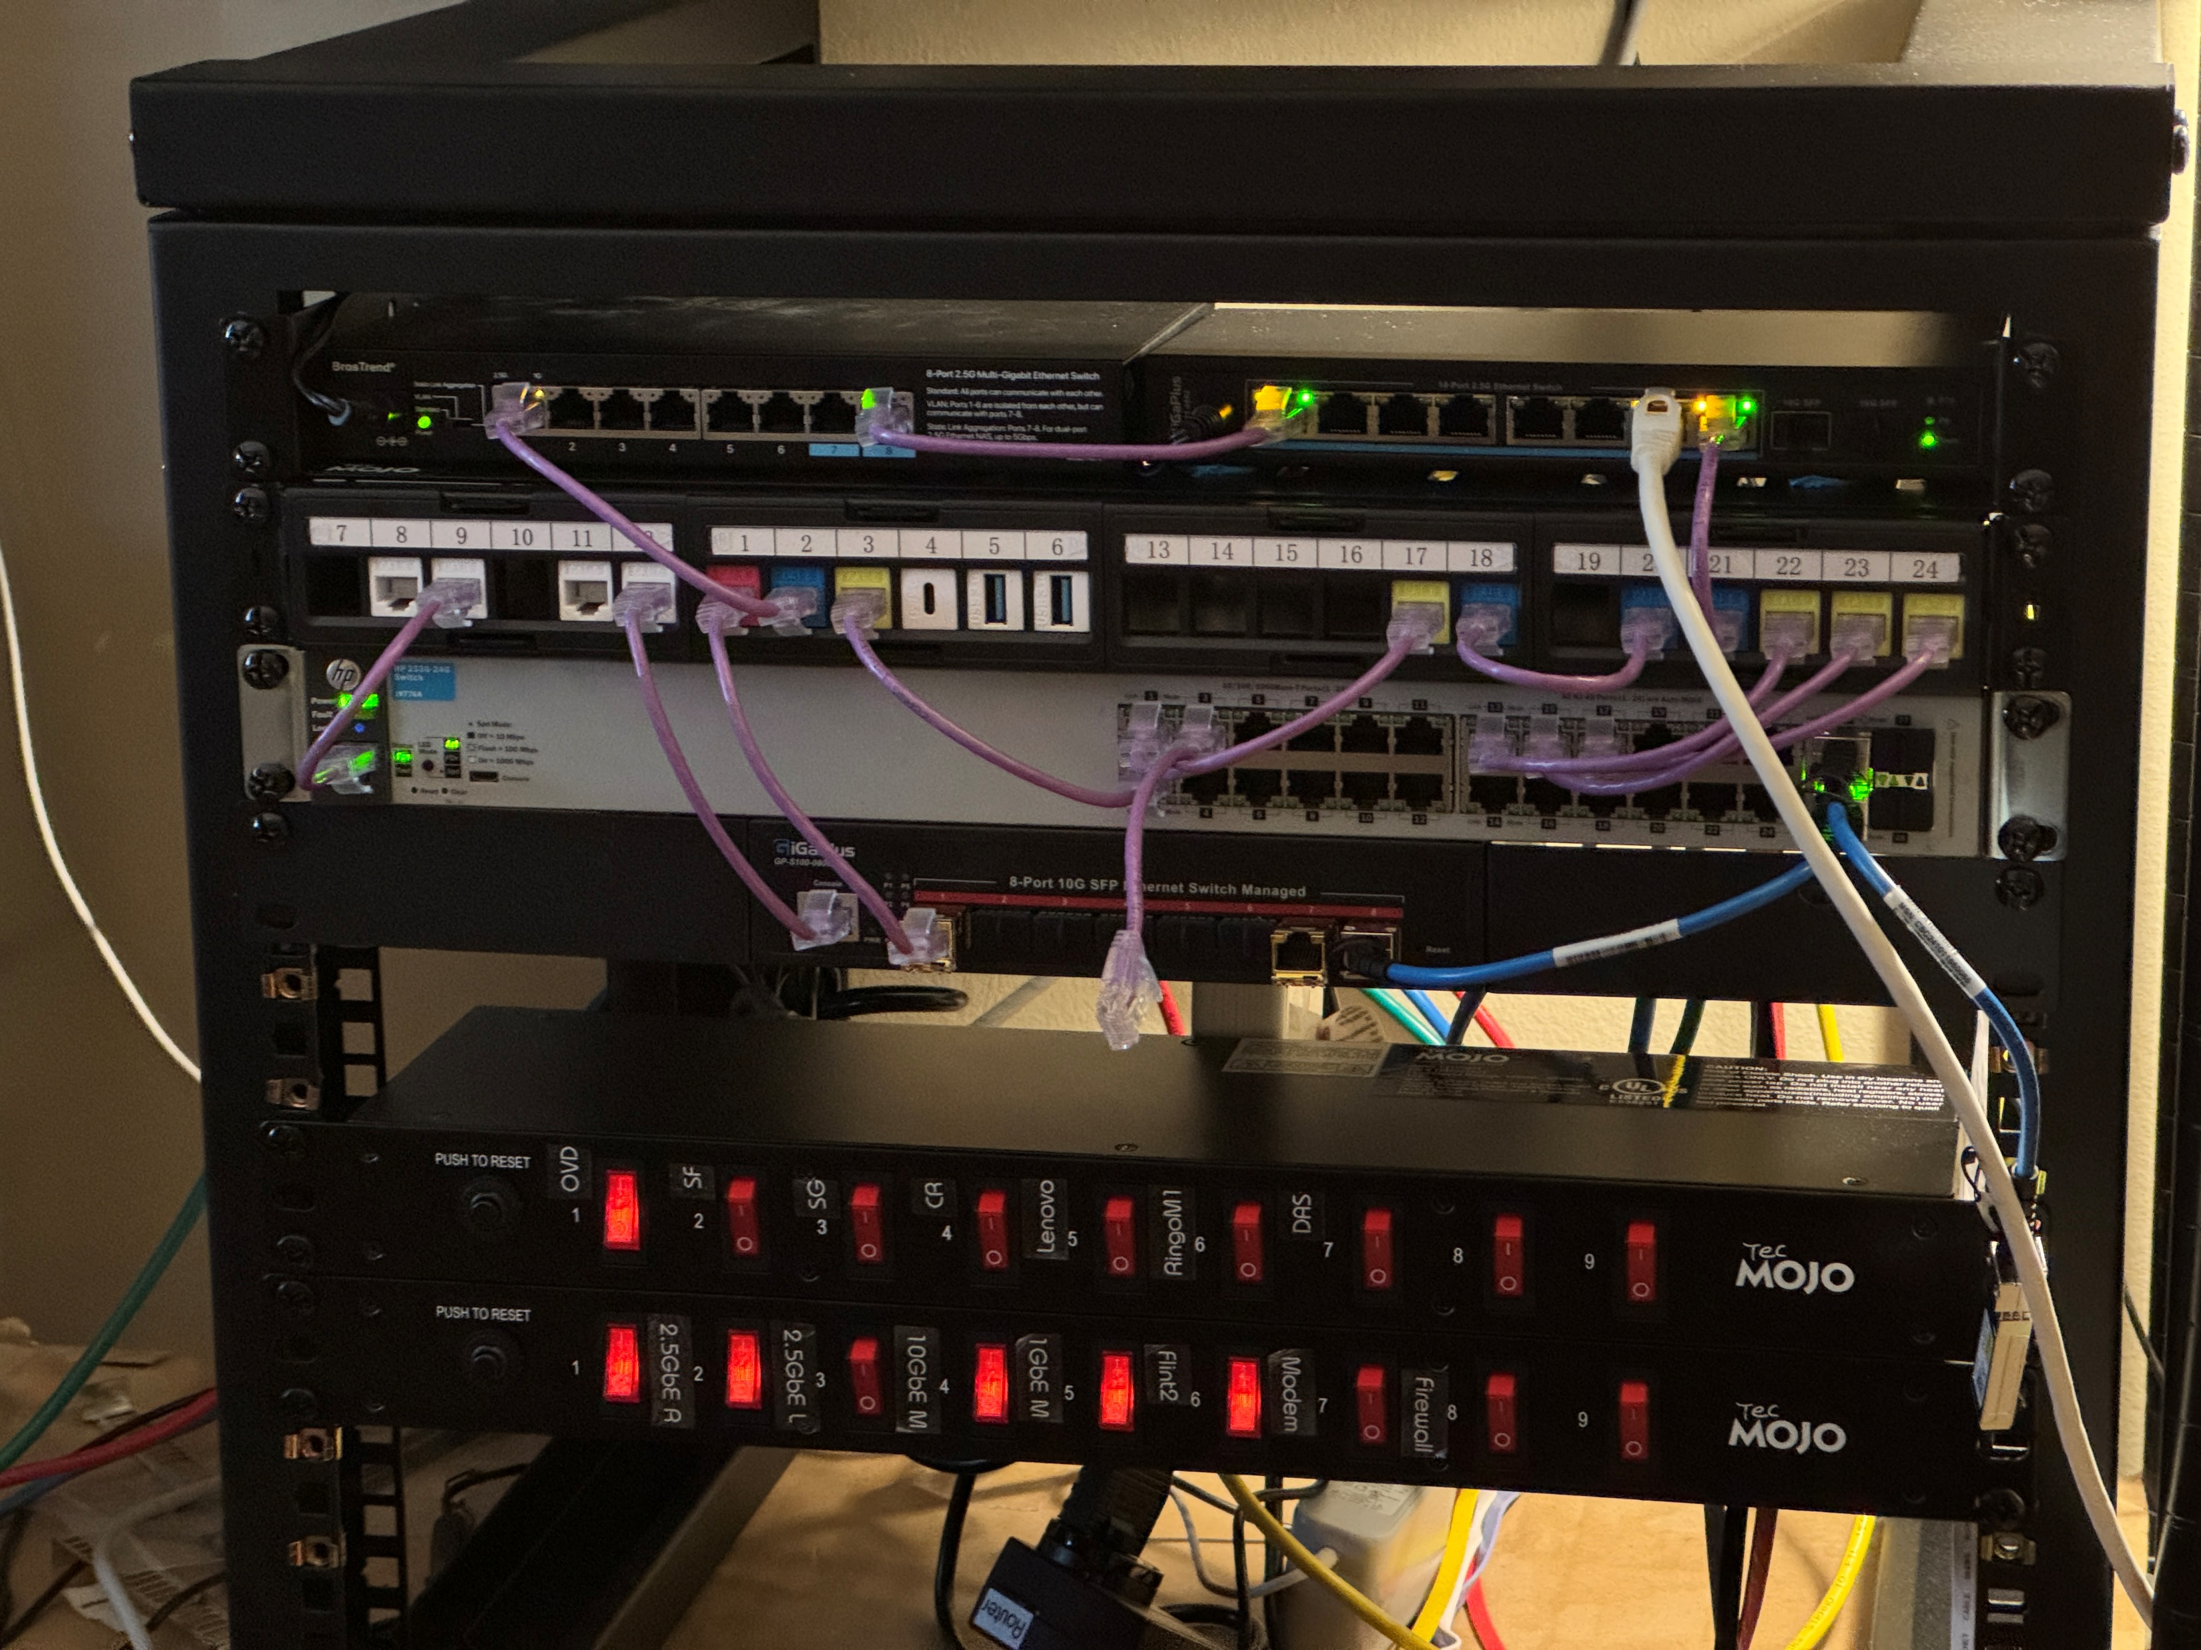
Lessons Learned
Copilot is expensive
Don’t get lost in the sauce
Think of AI as a tool for learning, not a substitute
Tune AI for your use case with memory, instructions, style guides, etc.

