Slide 1
B9AI001 · PROGRAMMING FOR DATA ANALYSIS · CA2
Fragrance Market
Intelligence
A daily-updating decision-support system for the global fragrance market
Daneel Khan
MSc Artificial Intelligence · Dublin Business School
Student ID 20084451

Slide 2
The problem
Fragrance market data is fragmented across incompatible sources.
Fragrantica
Amazon USA / UAE
Nobody
HAS
HAS
HAS
Ratings · notes · accords
Sentiment · seasons
Daily pricing · stock
Reviews · sizes
Tracks longitudinal
change daily across
all sources
LACKS
LACKS
LACKS
No prices
No community sentiment
Until now
Fragrance Market Intelligence · B9AI001 CA2
2

Slide 3
What the system produces
Four concrete outputs. Updated automatically every day.
01
SQLite database
02
Feature store
5 normalised tables with FK relations.
Idempotent daily writes, full history.
Encoded · scaled · derived features.
Ready to consume from any ML model.
03
Analytical CSVs
04
Interactive report
Four analyses: designer-vs-arabic,
arbitrage, value, sentiment.
Self-contained HTML.
Bokeh scatter + hover tooltips.
Fragrance Market Intelligence · B9AI001 CA2
3

Slide 4
Pipeline architecture
Five stages. Each with its own intermediate checkpoint.
1
2
3
4
5
SCRAPE
CLEAN
ENGINEER
LOAD
ANALYZE
Playwright
Fragrantica + Amazon
transforms.py
Live ECB FX rates
Encoders · scalers
Derived features
SQLite
Raw + feature tables
4 analyses
+ Bokeh report
AUTOMATED DAILY + PUBLISHED
GitHub Actions cron 06:00 UTC · Live on GitHub Pages
US runners bypass Irish-IP EUR redirect · Auto-commits to repo + docs/ · Single URL always shows today's report
Fragrance Market Intelligence · B9AI001 CA2
4

Slide 5
Data acquisition & ethics
TOOLING
ETHICS
REAL-WORLD MESS
Playwright + stealth
BeautifulSoup
Fresh context per product
ECB live FX feed
Public pages only
Rate limited
ToS reviewed
No auth bypass
Cloudflare on Fragrantica
Irish IP → EUR redirect
Dupes outrank real products
Bot detection via ranking
THE CREED STORY WHY MATCHING IS THE HARD PART
First matcher picked up a $20 roll-on oil for Creed Silver Mountain Water instead of the $490 real bottle.
Fix required a four-layer filter:
Non-fragrance blacklist
Rejects roll-on · diffuser · inspired by · decant · dupe
Full-token coverage rule + scoring system
Requires every product-name word in title; picks highest score, not first match
Fragrance Market Intelligence · B9AI001 CA2
5

Slide 6
Transforms & feature engineering
From raw strings to ML-ready features two distinct layers.
LAYER 1
LAYER 2
Cleaning · transforms.py
Engineering · feature_engineering.py
14 transform functions
Type coercion · display strings (10.5k → 10500)
fl oz → ml conversion
Live FX rates from ECB daily feed
USD/AED → EUR, cached per-day for provenance
Drop rows with NO price AND NO rating
LabelEncoder gender · brand_origin
OneHotEncoder fragrance_family · price_band
MinMaxScaler rating · price_per_ml · votes
Derived value_score · sentiment_polarisation
Selection variance threshold · |r|>0.95 drop
Fragrance Market Intelligence · B9AI001 CA2
6

Slide 7
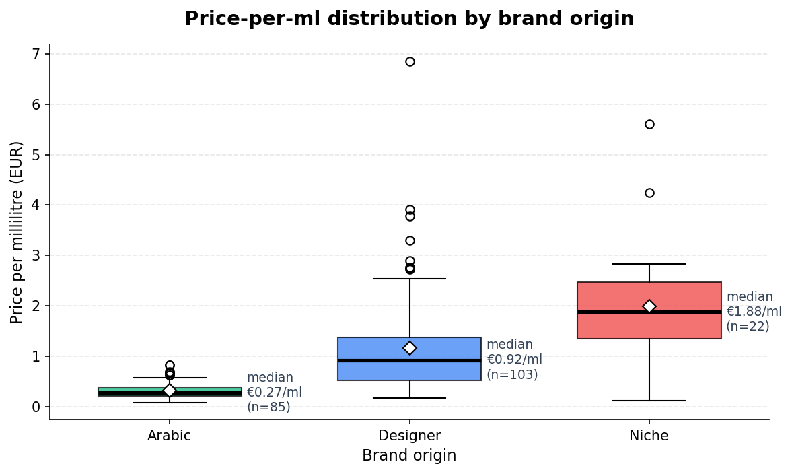
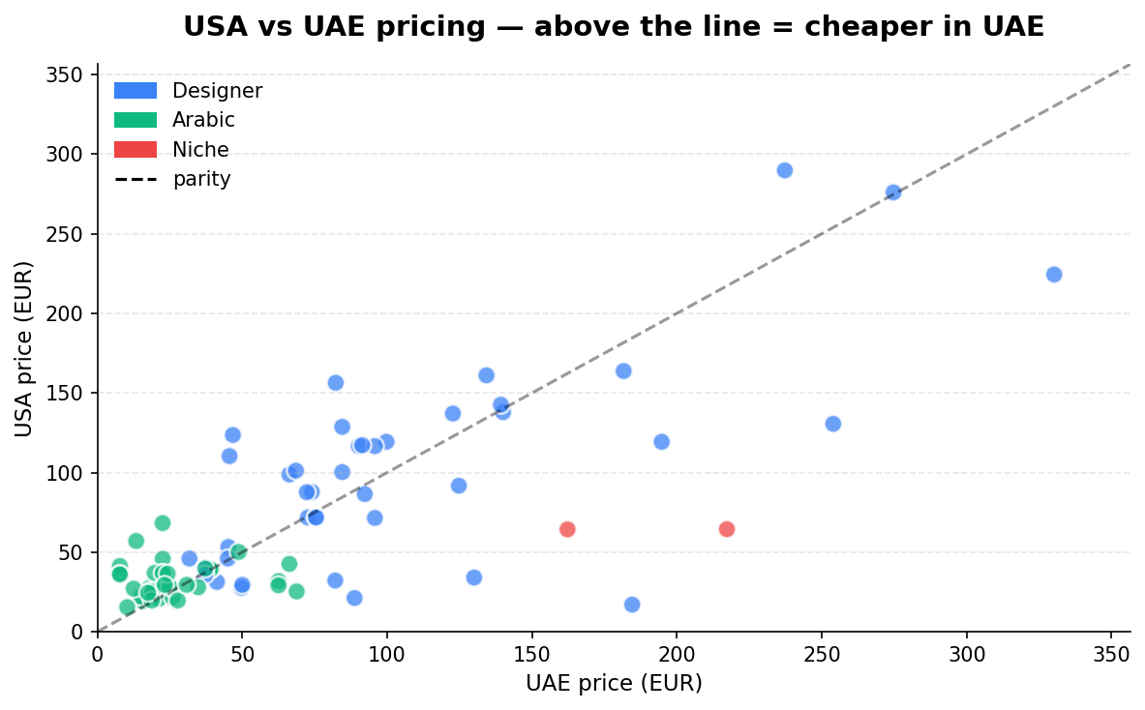
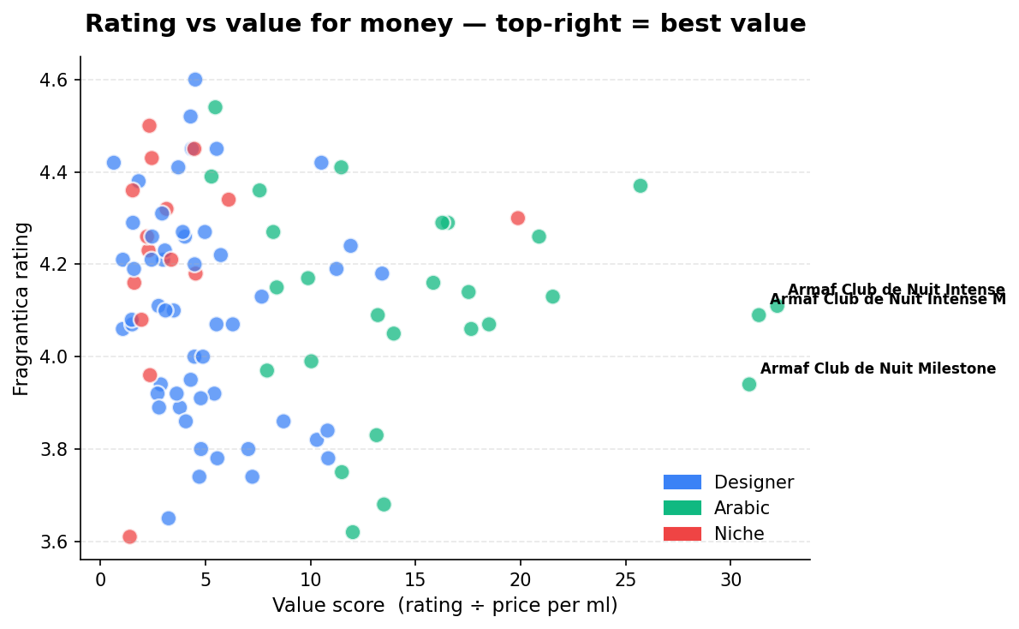
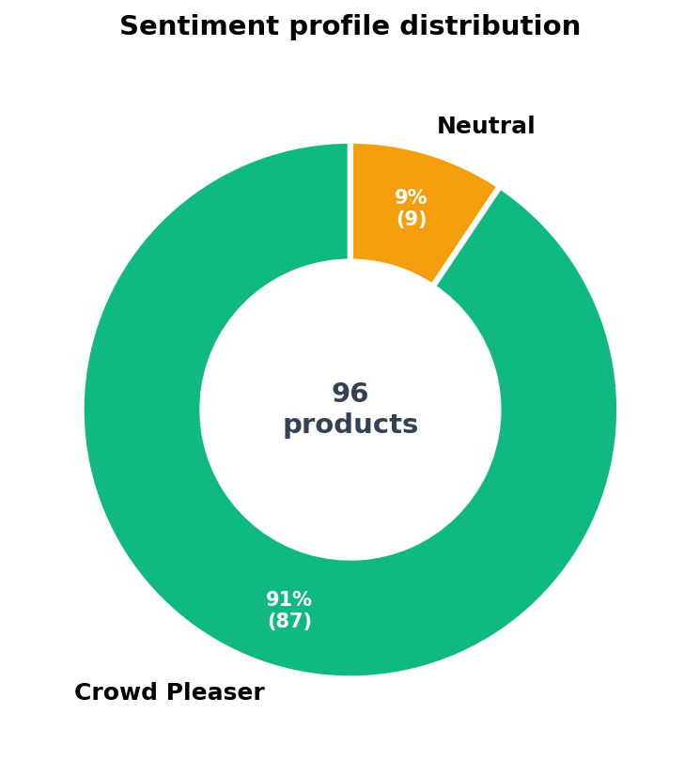
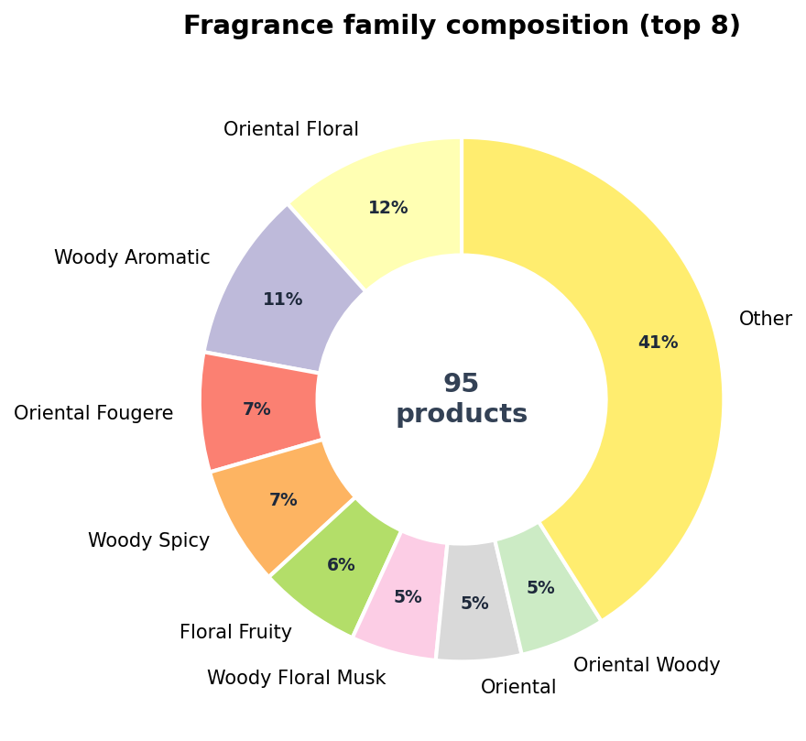
Live insights from today's pipeline
Real charts from cleaned_data/report_2026-04-14.html · 157 rated products · 84 USA+UAE overlap
1
Price distribution
2
USA vs UAE arbitrage
3
Rating vs value
4
Sentiment buckets
5
Family composition
Fragrance Market Intelligence · B9AI001 CA2
7

Slide 8
Real-world use case
The first customer is me.
TODAY'S ARBITRAGE FLAG · EUR-NORMALISED, LIVE FX
€22
€68
+203%
Lattafa Khamrah Qahwa
Amazon UAE
Same product
Amazon USA
Price gap
auto-flagged
01
02
03
04
Brand sourcing
Competitive intel
Value recommender
Research dataset
Opulence by Arkane
supply decisions
Market entrants
& positioning
Note-overlap matching
for consumers
Longitudinal market
time series
Fragrance Market Intelligence · B9AI001 CA2
8

Slide 9
Testing, automation & reliability
54
06:00
LIVE
unit + integration tests
daily UTC cron
on GitHub Pages
1
Idempotent migrations
CREATE IF NOT EXISTS plus ALTER TABLE ADD COLUMN in try/except - safe to re-run.
2
Insert-or-replace writes
Same-day re-runs overwrite rather than duplicate. No manual cleanup ever.
3
Three-tier FX fallback
Live ECB → cached earlier date → hardcoded. Pipeline never hard-fails on network blip.
Fragrance Market Intelligence · B9AI001 CA2
9

