Slide 1
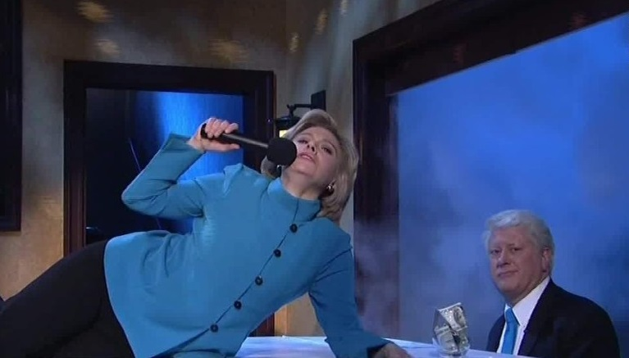
Election Analysis 2016
What happened ?
R 607 Final Project
Fall 2016
12/20/2016
R 607 Final Project Fall 2016

Slide 2


Andrew Carson – Trend Analysis
Daniel Thonn – Predictive Model
12/20/2016
R 607 Final Project Fall 2016

Slide 3



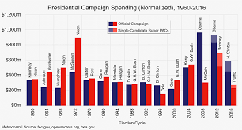
Questions & Issues
What were the main factors ?
Was there historical influence?
How did the outcome occur ?
Was the outcome predictable ?
12/20/2016
R 607 Final Project Fall 2016

Slide 4





The Data
Bias and Type of Data
  Measured vs Speculative
Sources
  US Census
  Bureau of Labor Statistics
  Dept of Homeland Security
  University of California (UCSB)
12/20/2016
R 607 Final Project Fall 2016

Slide 5



Analysis
Trends
Predictions
12/20/2016
R 607 Final Project Fall 2016

