Slide 1
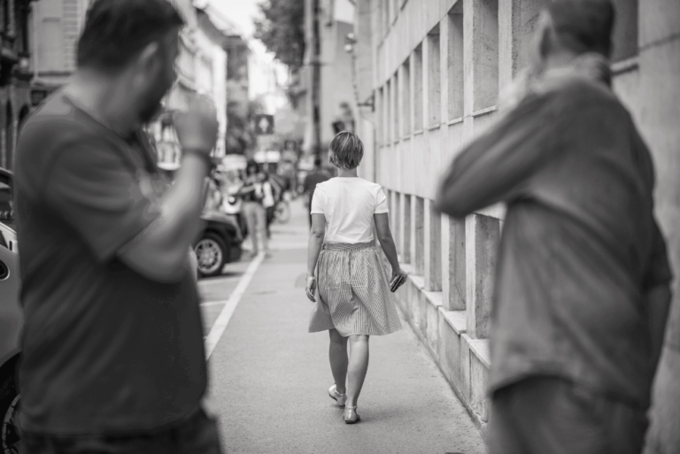

You may change this photograph
Use the same title you
used in the report
THE SAME TITLE YOU USED IN THE TECHNICAL REPORT GOES HERE

Slide 2

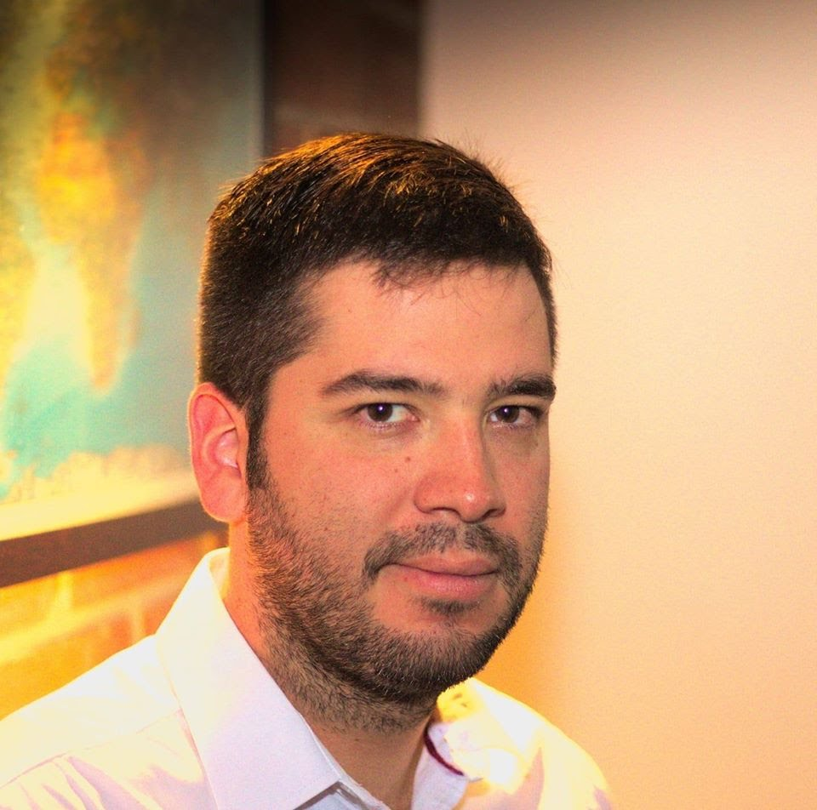
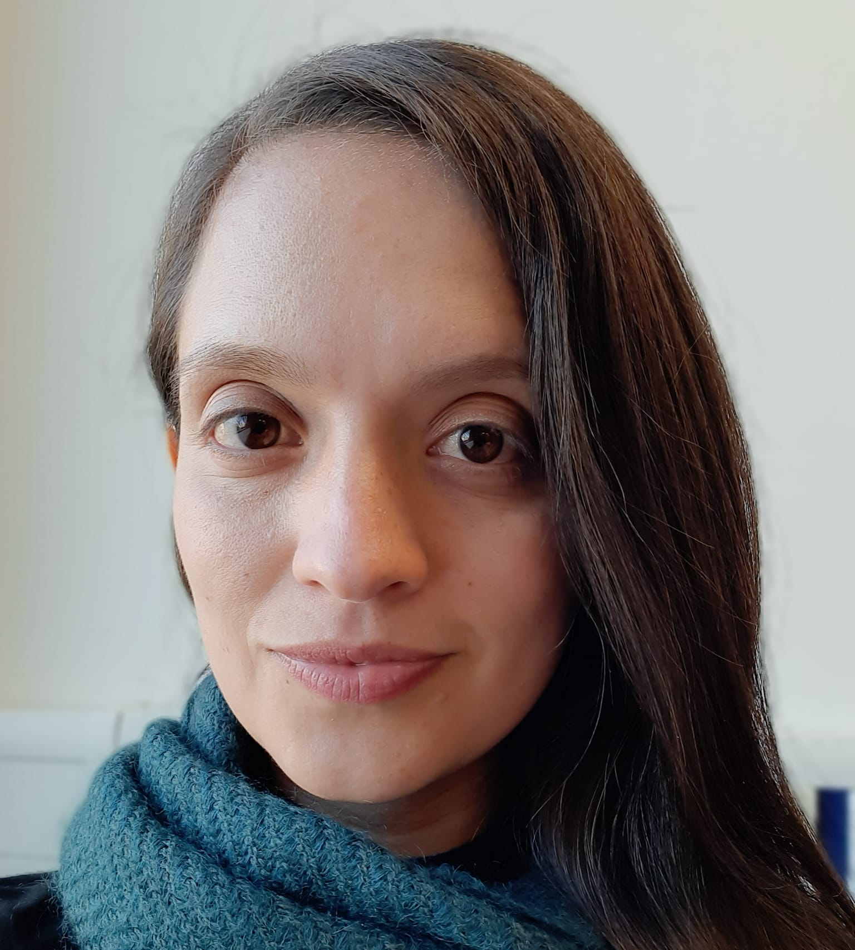

Keep this title
Team Presentation
DO NOT use red color in the slides
Complete this slide
For the first deliverable
Put a smiling picture and your name
If possible, include female student first
First author
what did you do?
Second author
what did you do?
Andrea Serna
Literature review
Mauricio
Toro
Data preparation
Please, include what was your contribution to this work (2-3 words)
http://github.com/yourUserName/proyecto/
Include the URL where your project is located
and remove the circle

Slide 3
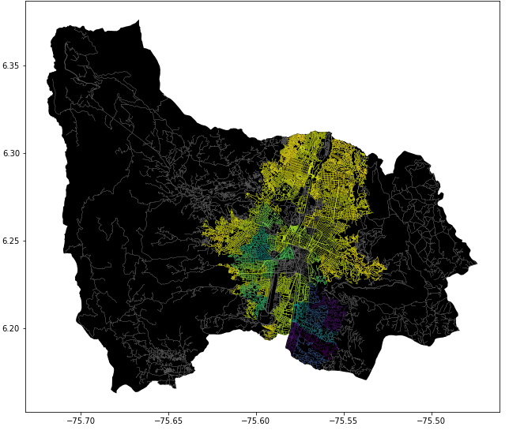
Problem Statement
Keep this title
Complete this slide
For the first deliverable
DO NOT use red color in the slides
Constrained Shortest Path Algorithm
Streets
of Medellín, Origin and Destination
Constrained
Shortest
Paths
Perhaps you do not need to change anything in this slide

Slide 4
Complete this slide
For the second deliverable
First Algorithm
Keep this title
DO NOT use red color in the slides
Please, write the name of your algorithm
r
Streets
of Medellín, Origin and Destination
Shortest path without exceeding a weighted-average risk of harassment r
Add the name of your algorithm

Slide 5
Complete this slide
For the second deliverable
Second Algorithm
Keep this title
DO NOT use red color in the slides
Please, write the name of your algorithm
d
Streets
of Medellín, Origin and Destination
Path with the lowest weighted-average risk of harassment without exceeding a distance d
Add the name of your algorithm

Slide 6
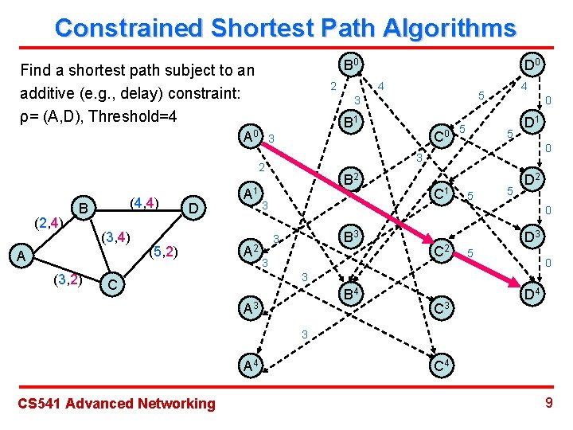
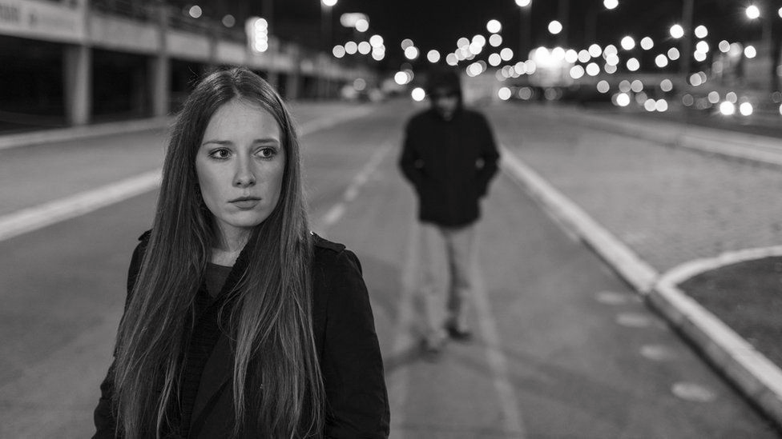
Keep this title
Complete this slide
For the second deliverable
Algorithm Explanation
DO NOT use red color in the slides
Design you own figures in Lucidchart or equivalent: https://www.lucidchart.com/
Use these
Colors for
Your figures
‘Algorithm Name’ for the Constrained Shortest Path (In this semester, one could be DFS, BFS, Dijkstra, A*… please choose).
Include a HD picture related to the problem of street sexual harassment
Explain the figures in your
own words

Slide 7
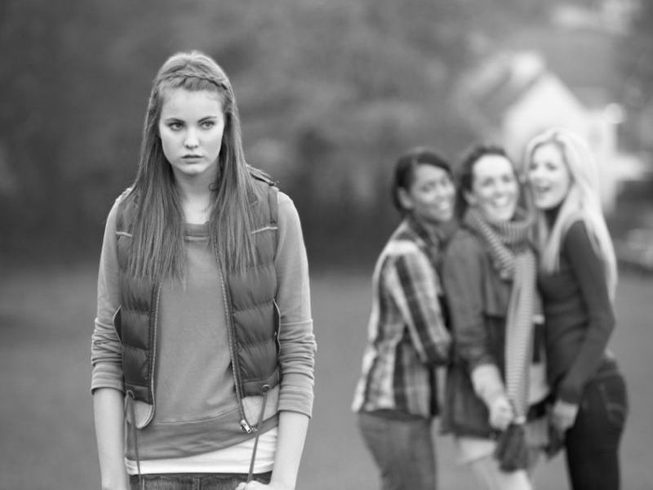
Keep this title
Complete this slide
For the second deliverable
Algorithm Complexity
Create the table in Powerpoint. Do not copy pixelated screenshots from the technical report please!
 | Time Complexity | Memory Complexity
Algorithm name | O(V²*E*2^{V}) | O(V*E*2E)
Algorithm name (if you tried two) | O(V*V) | O(E)
DO NOT use red color in the slides
Time and memory complexity of the algorithm name. V is…E is… (In this semester, one could be DFS, BFS, Dijkstra, A*). Please explain what do V and E mean in this problem. PLEASE DO IT!
Include a HD picture related to the problem of street sexual harassment
Explain the tables in your
own words
Use superindices to represent the exponents. DO NOT use the ^ symbol
Font size should be of at least 22 points

Slide 8
Keep this title
Complete this slide
For the third deliverable
Shortest Path Results
DO NOT use red color in the slides
Create the table in Powerpoint. Do not copy pixelated screenshots from the technical report please!
Origin | Destination | Shortest distance (meters) | Without exceeding a weighted-average risk of harassment
Universidad EAFIT | Universidad de Medellín | ?? | 0.84
Universidad de Antioquia | Universidad Nacional | ??? | 0.83
Universidad Nacional | Universidad Luis Amigó | ?? | 0.85
Shortest distance obtained without exceeding a weighted average risk of harassment r.
Explain the tables in your
own words
Font size should be of at least 22 points

Slide 9
Keep this title
Complete this slide
For the third deliverable
Lowest Risk Results
DO NOT use red color in the slides
Create the table in Powerpoint. Do not copy pixelated screenshots from the technical report please!
Origin | Destination | Weighted-average risk of harassment | Without exceeding a distance (meters)
Universidad EAFIT | Universidad de Medellín | ?? | 5000
Universidad de Antioquia | Universidad Nacional | ??? | 7000
Universidad Nacional | Universidad Luis Amigó | ?? | 6500
Lowest weighted-average risk of harassment obtained without exceeding a distance d.
Explain the tables in your
own words
Font size should be of at least 22 points

Slide 10






Complete this slide
For the third deliverable
Algorithm Execution Times
Keep this title
DO NOT use red color in the slides
Execution Times
2 hours 51 minutes
6 hours 51 minutes
8 hours 51 minutes
Font size should be of at least 22 points
Please, include measurement units, for instance, minutes, hours...

Slide 11

Complete this slide
For the third deliverable
Future Work Directions
Keep this title
DO NOT use red color in the slides
Please, name the courses in which you could continue working on this project
Probability
Optimization 1
Statistics 2
S & M 4
Other risk estimations
Biobjective
optimization
MV risk estimations
Traffic Estimation
Remove this
slide if you
study
Informatics Engineering
Please, name what you could do, in following courses, to improve this project
Font size should be of at least 22 points
You may add, remove or change some future work directions

Slide 12
Complete this slide
For the third deliverable
Future Work Directions
Keep this title
DO NOT use red color in the slides
Please, name the courses in which you could continue working on this project
Databases
Project 1
Software Eng.
Project 2
Add other variables
A Web Application
A Web Application
Include ML or VR
Remove this
slide if you
study
Mathematics Engineering
Please, name what you could do, in following courses, to improve this project
Font size should be of at least 22 points
You may add, remove or change some future work directions

Slide 13
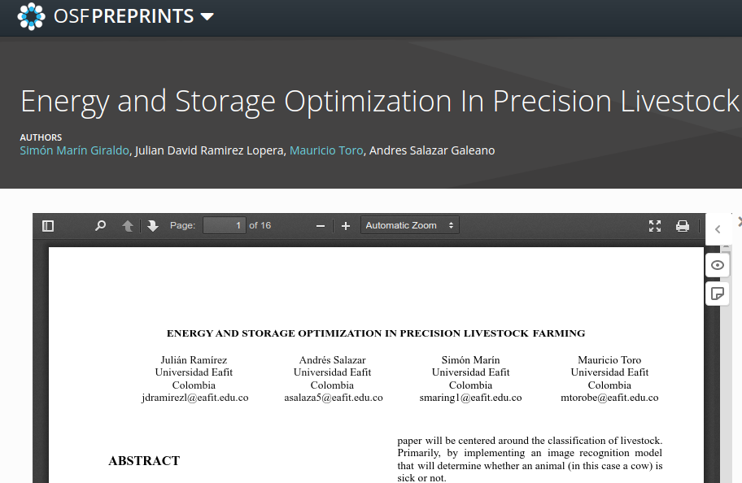
Complete this slide
For the third deliverable
Report Accepted on OSF.IO
Keep this title
DO NOT use red color in the slides
Remove this slide if you report was not submitted to OSF
This is a screenshot example of a previous report
This is a citation example of a previous report
Include the citation of the report in OSF PREPRINTS and link. No, not in OSF projects, but in OSF Preprints.
Julián Ramírez, Andrés Salazar, Simón Marín, Mauricio Toro. Energy and Storage Optimization in Precision Livestock Farming. Technical Report, Universidad EAFIT, 2021. https://doi.org/10.31219/osf.io/du8yt
Include a screenshot of your report published in osf.io and remove circle
Font size should be of at least 22 points
Include teaching assistant and professor among the authors, please

Slide 14
THANK YOU!.
You may change this photograph
Complete this slide
For the third deliverable
DO NOT use red color in the slides
Please do not forget the acknowledgements to your scholarship (if you have one) Otherwise, for who pays your tuition fee
Supported by
The first two authors were supported by Sapiencia grant, financed by Medellín municipality. All the authors would like to thank the "Vicerrectoría de Descubrimiento y Creación", of Universidad EAFIT, for their support on this research.
Font size should be of at least 22 points

