Slide 1

Benchmarking, Statistics & PHPBench
A framework for creating glorious benchmarks
by Daniel Leech
@dantleech @phpbench

Slide 2




About Me
Daniel Leech
PHP Developer
  Symfony CMF and associated projects
    PHPCR-ODM, Jackalope, PHPCR
  Sulu CMF
  PHPBench
Cycle tourer

Slide 3

What is Benchmarking?

Slide 4
SCPT
Testing: Running an operation and obtaining a result.
Performance: We are concerned about the performance of the subject.
Comparative: Ultimately, we are always concerned about the performance of one thing as compared to another thing.
Standardized: The tests should be standardized so that they can be applied meaningfully to all subjects.

Slide 5
Differences to Profiling
 | Benchmarking | Profiling
Measures | External wall time | Internal call times
Observer effect? | Minimal | Major
Scope (typical) | Scenario | Request
Applies to (typical) | Libraries | Applications

Slide 6

Benchmarking Script
http://stackoverflow.com/questions/13483219/what-is-faster-in-array-or-isset
<?php
$a = array();
$start = microtime( true );
for ($i = 0; $i < 10000; ++$i) {
isset($a['key']);
}
$total_time = microtime( true ) - $start;
echo "Total time: ", number_format($total_time, 6), PHP_EOL;
$start = microtime( true );
for ($i = 0; $i < 10000; ++$i) {
in_array('key', $a);
}
$total_time = microtime( true ) - $start;
echo "Total time: ", number_format($total_time, 6), PHP_EOL;
found in the wild

Slide 7
Issues
Boilerplate code.
Relies on single samples.
Results are not persisted.
Not scalable.

Slide 8
Benchmarking Framework Should
Execute code units.
Perform tests multiple times to verify results.
Provide visual feedback.
Perform statistical analysis.
Be able to serialize and store results.

Slide 9
Concepts

Slide 10
Revolutions
Number of times we consecutively execute our benchmark subject.
<?php
$revolutions = 10000;
for ($i =0; $i < $revolutions; $i++) {
// do something
}

Slide 11
Iterations
Each iteration records the time taken to execute the revolutions.
<?php
$iterations = 100;
$revolutions = 10000;
$results = [];
for ($iteration = 0; $iteration < $iterations; $iteration++) {
$startTime = microtime(true);
for ($rev = 0; $rev < $revolultions; $rev++) {
// do something
}
$time = microtime(true) - $startTime;
$times[] = $time;
}
illustrative example

Slide 12







Subjects
The actual code we are benchmarking.
Subjects could be:
  PHP internal functions.
  User functions (think unit tests).
  User services (think functional tests).
  External services.
  Anything you can wrap in a function.

Slide 13
Subjects
<?php
isset($a['b']);
Algorithms
<?php
$pdoConnection->query(“SELECT * FROM foo”);
External services
<?php
$container->get('some.service');
User libraries
<?php
$guzzle->get('https://github.com/phpbench/phpbench');
HTTP

Slide 14
Benchmarking with PHPBench
PHPBench is a command line based benchmarking tool similar to PHPUniut.
$ phpbench
phpbench version 0.10.0-dev
Usage:
command [options] [arguments]
...
Available commands:
help Displays help for a command
list Lists commands
report Generate a report from an XML file
run Run benchmarks

Slide 15
Benchmark Class
<?php
class HashBench
{
public function benchHash()
{
md5('hello world');
}
}
Class name suffixed with “Bench”.
Subject prefixed with “bench”.
Does not know about PHPBench.
HashBench.php
actual working example!

Slide 16
Benchmark Class
<?php
class HashBench
{
/**
* @Revs(10000)
* @Iterations(100)
*/
public function benchHash()
{
md5('hello world');
}
}
Annotations determine how the subject is executed.
Class and/or method level.
Aware of class inheritance.
HashBench.php

Slide 17
Running Benchmarks
$ phpbench run HashBench.php
PhpBench 0.9.0-dev. Running benchmarks.
\HashBench
benchHash I9 P0 μ/r: 1.716μs μSD/r 0.099μs μRSD/r: 5.77%
1 subjects, 10 iterations, 0 revs, 0 rejects
(min mean max) = 1.567 1.716 1.887 (μs)
⅀T: 17.160μs μSD/r 0.099μs μRSD/r: 5.772%
I: Iteration #
P: Parameter set #
/r: Times are divided by number of revolutions.
μ: Mean (average).
μs: Microseconds.
⅀T: Total time.
SD: Standard deviation.
RSD: Relative standard deviation.

Slide 18
Running Benchmarks
$ phpbench run HashBench.php
PhpBench 0.9.0-dev. Running benchmarks.
\HashBench
benchHash I9 P0 μ/r: 1.716μs μSD/r 0.099μs μRSD/r: 5.77%
1 subjects, 10 iterations, 0 revs, 0 rejects
(min mean max) = 1.567 1.716 1.887 (μs)
⅀T: 17.160μs μSD/r 0.099μs μRSD/r: 5.772%
Progress loggers provide realtime feedback.
Specified with --progress
Reports can also be generated.

Slide 19

Stability and Accuracy

Slide 20
Revolutions
How do revolutions affect time?
<?php
$revolutions = 10000;
$start = microtime(true);
for ($i =0; $i < $revolutions; $i++) {
md5('hello world');
}
$elapsed = microtime(true) - $start;

Slide 21
Revolutions
Reported time is total time divided by number of revolutions.
<?php
$time = $iterationTime / $revolutions;
Answers the question:
What is the average execution time of the method?

Slide 22
Micro Revolutionary Effect
Micro (microseconds) benchmarks are heavily affected by the number of revolutions.
Revolutions | Time (µs/r)
1 | 10 | 100%
2 | 6 | 60%
4 | 3.75 | 37.5%
8 | 2.625 | 26.2%
16 | 2.188 | 21.8%
32 | 1.969 | 19.6%
64 | 1.75 | 17.5%
10,000 | 1.72 | 17.2%
Includes microtime and loop calls.
Begins to stabilise at ~32 revolutions.
Regression to ~17% of first value.

Slide 23
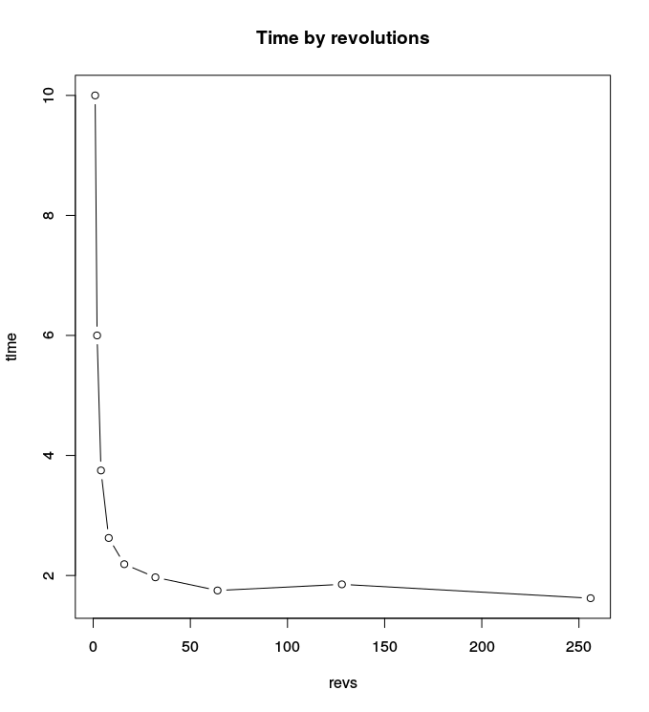

Slide 24
Macro Revolutionary Effect
Macro (milliseconds, seconds) benchmarks less affected.
Revolutions | Time (ms/r)
1 | 512 | 100%
2 | 407 | 79%
4 | 381 | 74%
8 | 375 | 73%
16 | 408 | 79%
32 | 369 | 72%
64 | 367 | 71%
Warmup factor (autoload cache, etc)
Earlier stabilisation.
Regression to 71% of first value.

Slide 25
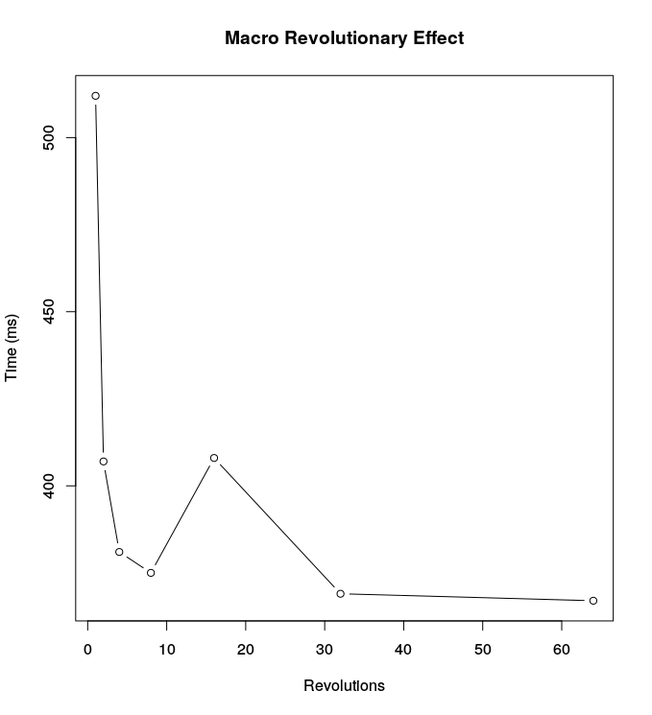

Slide 26
Iterations
Each iteration provides a time measurement.
Iterations produce a range of different time measurements.
<?php
class HashBench
{
/**
* @Revs(10000)
* @Iterations(100)
*/
public function benchHash()
{
md5('hello world');
}
}

Slide 27
Iterations
Iteration | μ Time (μs)
1 | 2.766
2 | 2.773
3 | 2.737
4 | 2.782
5 | 2.776
6 | 2.716
7 | 2.729
.. | ..

Slide 28
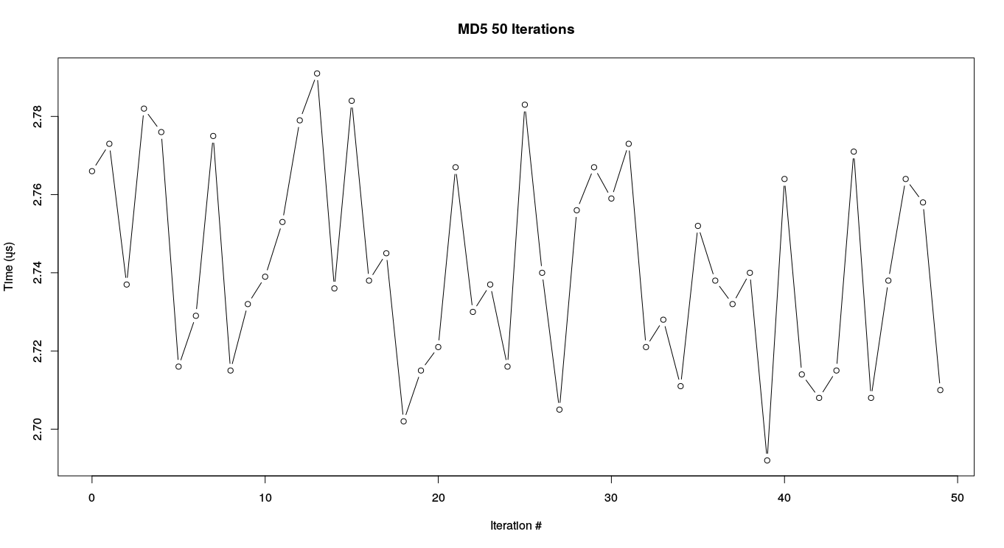

Slide 29
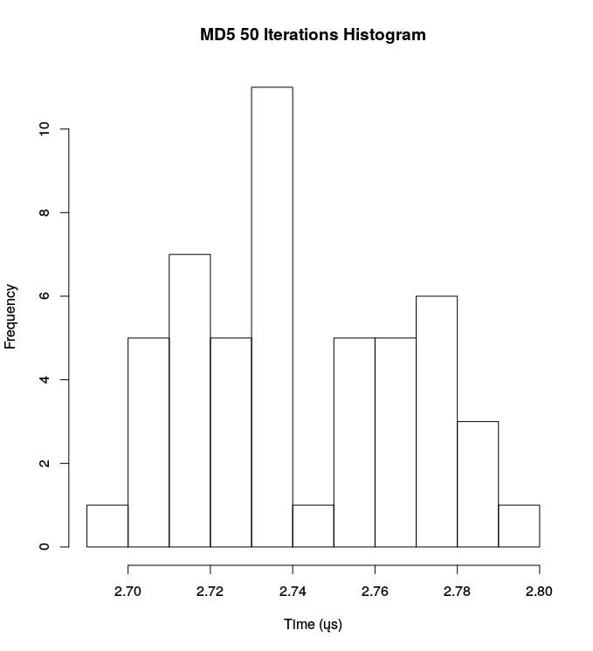
Histogram

Slide 30
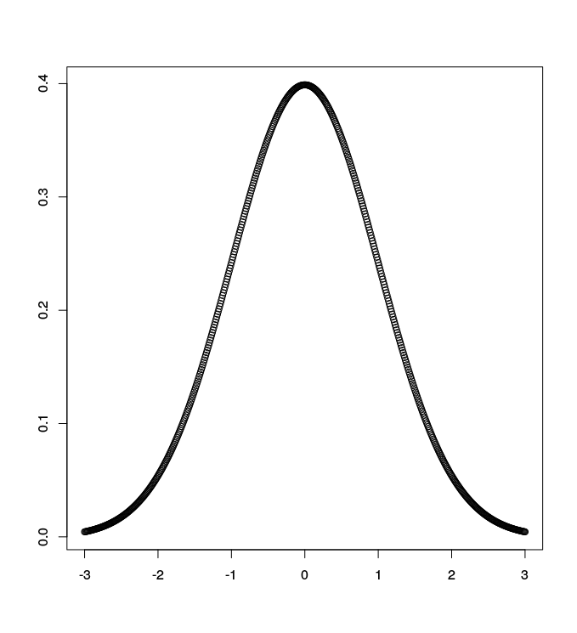
Normal Distribution
Applies to any set of random variables with an Expected Value.
Benchmark times should be normally distributed.
Peak is the most probable time.

Slide 31
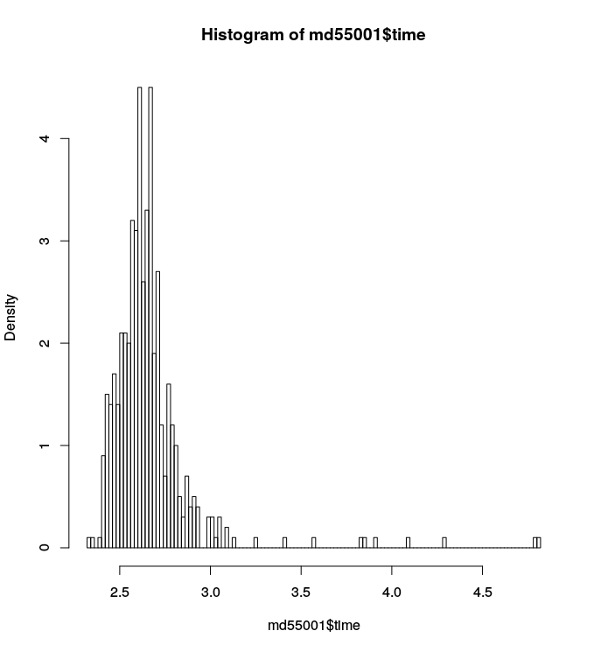

Slide 32
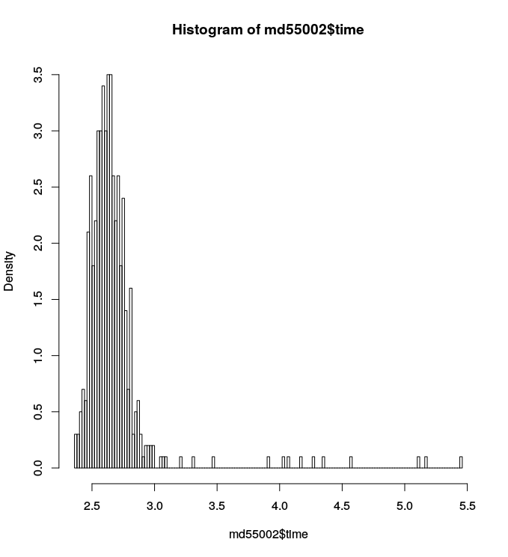

Slide 33
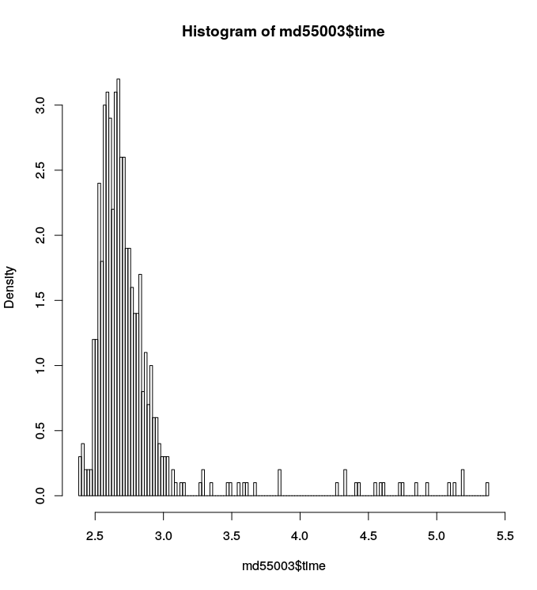

Slide 34
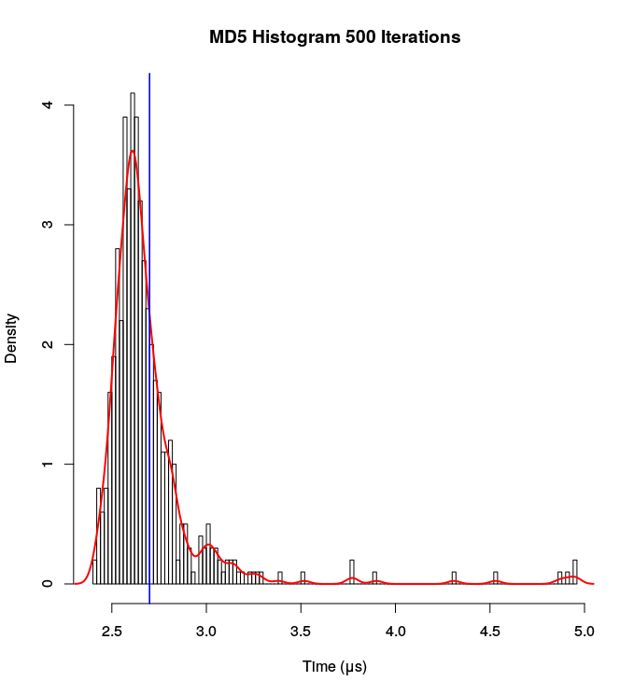
Outliers!

Slide 35

The Mean and the Mode
Mean: Average value of the set:
Mode: Most common value in the set...

Slide 36
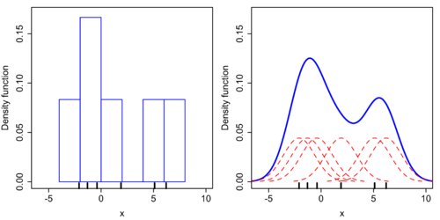
Determining the mode
histogram
kernel density estimate
https://en.wikipedia.org/wiki/Kernel_density_estimate

Slide 37

Measuring Stability

Slide 38
Standard Deviation (SD)
Unit represented as “sigma” σ
Almost the average distance between values in the set.
An SD of zero indicates that all the values are identical.
Relative standard deviation (RSD) is the SD divided by the mean. It is a percentage.
RSD provides a comparable number.

Slide 39
Standard Deviation
RSD = 3%
MEAN = 2.078
MIN = 2.5
MAX = 3.2

Slide 40
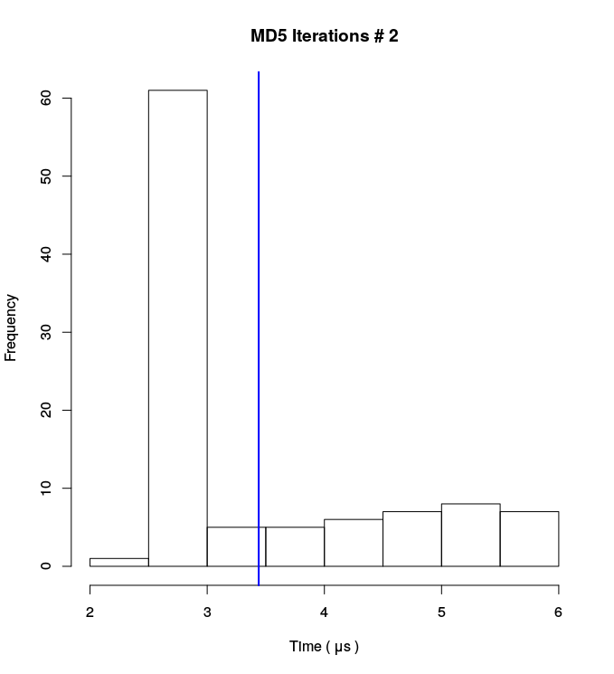
Standard Deviation
RSD = 30%
MEAN = 3.440
MIN = 2
MAX = 6

Slide 41
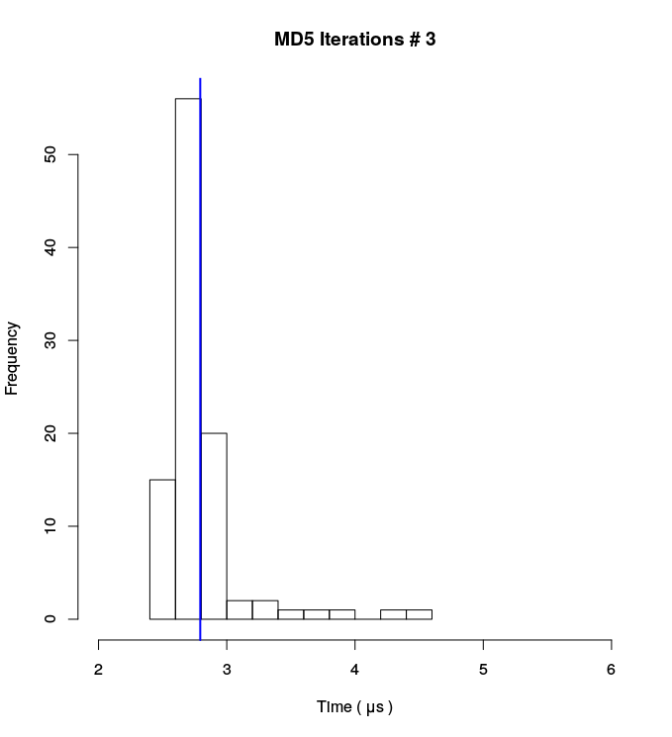
Standard Deviation
RSD = 11%
MEAN = 2.793
MIN = 2.5
MAX = 4.5

Slide 42
Improving Stability

Slide 43
Shutdown Unecessary Stuff
No music processes.
No video processes.
No Grand Theft Aauto.

Slide 44
Retry Threshold
Keep running the iteration set until all times fall into a given margin of error (MOE).
Feature of PHPBench
Retries iterations when they fall outside of the MOE.
phpbench run examples/HashBench.php --retry-threshold=2

Slide 45
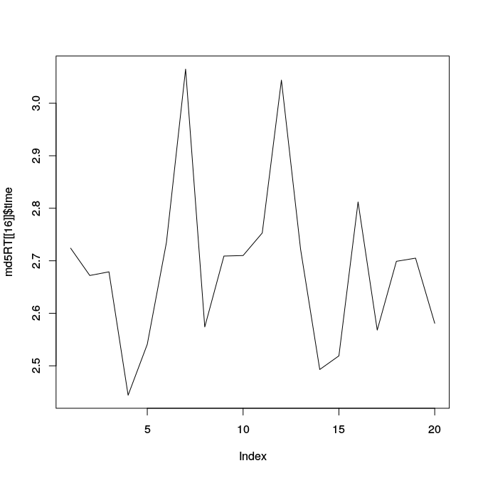
16% retry threshold
RSD: 5.7%

Slide 46
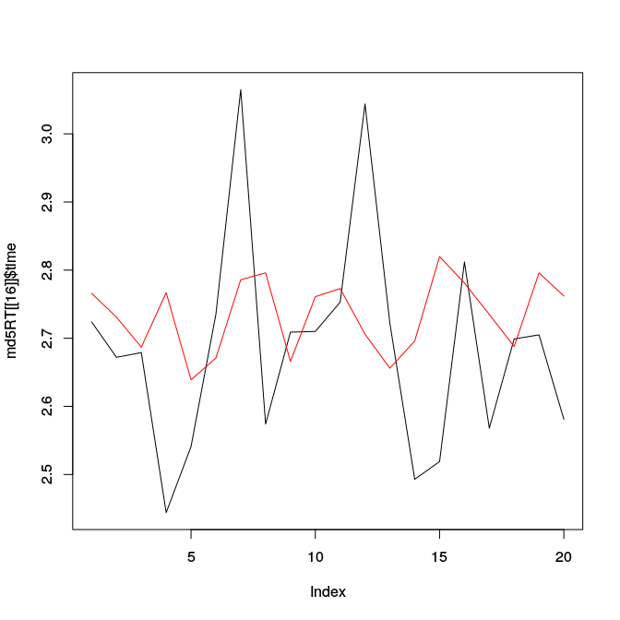
4% retry threshold
RSD: 1.9%

Slide 47
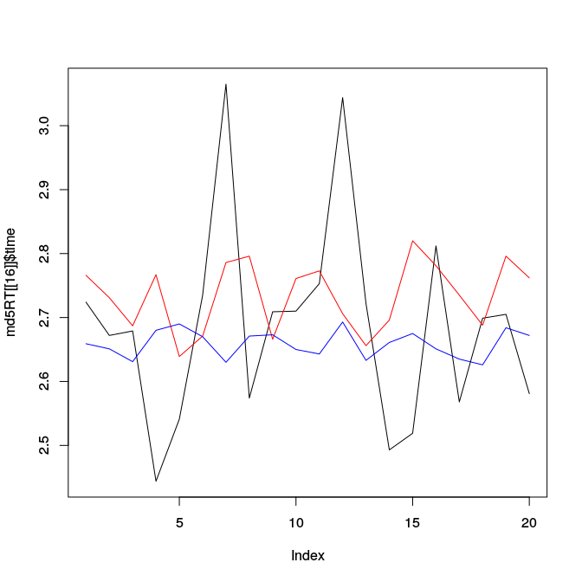
2% retry threshold
RSD: < 1%

Slide 48
Take Away
Use a large number of revolutions for micro benchmarks (at least 1000).
For best results use a large number of Iterations (100-500).
Use less for casual use.
Enforce a 2-5% margin-of-error consensus to reduce standard deviation.

Slide 49
Demonstration!

Slide 50
The End
Github: https://github.com/phpbench/phpbench
Readthedocs: https://phpbench.readthedocs.org/
Twitter: @phpbench @dantleech

Slide 52
Things we should take with us
Wall time: Total (external) time taken.
CPU time: CPU time taken.
Microsecond: 1,000,000th of a second
Mean: Average of a set of numbers.
Standard Deviation (SD): Average deviation from the mean between samples (kind of), often represented as sigma (σ).
Relative SD: As above but expressed as a percentage (dimensionless quantity).

Slide 53

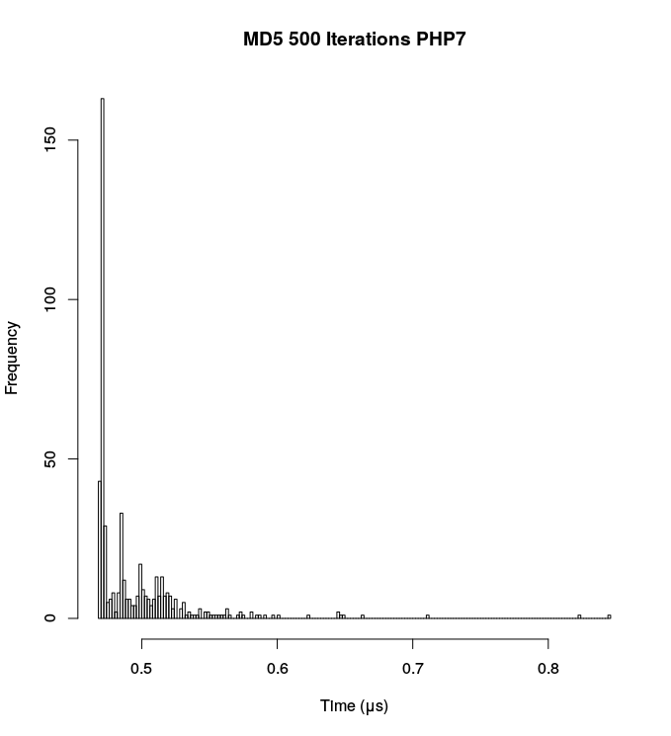

Slide 54
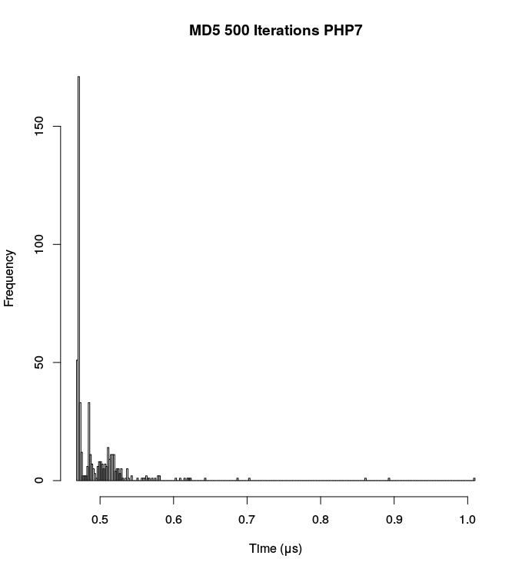

Slide 55
Outliers!

