Slide 1
S.O.L.I.D Principles
Đoàn Minh Quân
Trần Ngọc Đản

Slide 2
Introduction
What is S.O.L.I.D ?
It is a collection of five principles following:
Single responsibility princeple.
Open/closed principle
Liskov substitution principle
Interface segregation principle
Dependency inversion principle

Slide 3
II. [S]OLID - The Single Responsibility Principle
A class should have one single thing to do. And one thing only.
Why is this a good thing? Because the clutter from having a class do too much stuff is long-term damaging to whatever you're trying to design.
Deal with: leave your classes with just a single thing to do.
Notes:
http://www.codeproject.com/Articles/723631/SOLID-Principles-in-Laymans-Terms-Single-Responsib

Slide 4
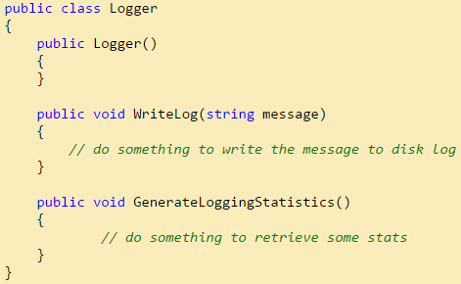
II. [S]OLID - The Single Responsibility Principle
e.g:
Do you have a class that renders an object AND saves it to disk? Not good!
Notes:
http://www.codeproject.com/Articles/723631/SOLID-Principles-in-Laymans-Terms-Single-Responsib

Slide 5
III. S[O]LID - The Open/Closed Principle
“Software components should be open for extension, but closed for modification”
The Open Close Principle states that the design and writing of the code should be done in a way that new functionality should be added with minimum changes in the existing code.
The design should be done in a way to allow the adding of new functionality as new classes, keeping as much as possible existing code unchanged.
Notes:
http://www.oodesign.com/design-principles.html

Slide 6
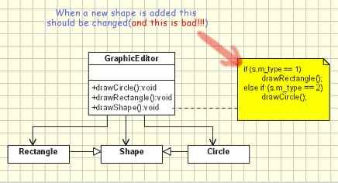
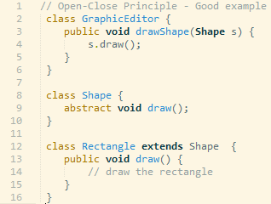
III. S[O]LID - The Open/Closed Principle
Open-Close Principle - Bad example
Notes:
http://www.oodesign.com/design-principles.html

Slide 7
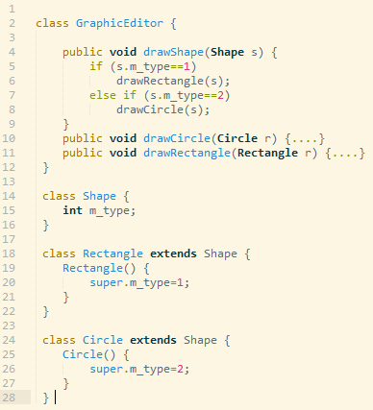
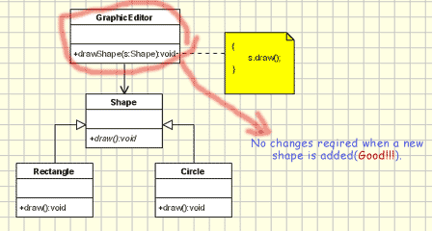
III. S[O]LID - The Open/Closed Principle
Open-Close Principle - Good example
Notes:
http://www.oodesign.com/design-principles.html

Slide 8
IV. SO[L]ID - Liskov Substitution Principle
Objects in a program should be replaceable with instances of their subtypes without altering the correctness of that program.
If S is a subtype of T, then objects of type T may be replaced with objects of type S (i.e., an object of the type T may be substituted with its subtype object of the type S) without altering any of the desirable properties of that program.
Notes:
https://en.wikipedia.org/wiki/Liskov_substitution_principle
http://www.codeproject.com/Articles/567768/Object-Oriented-Design-Principles

Slide 9
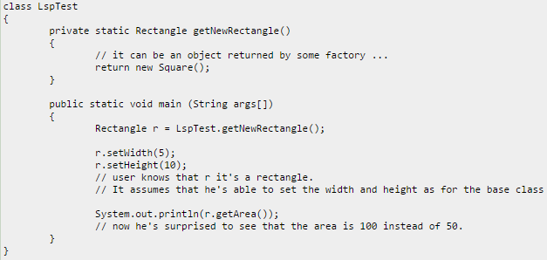
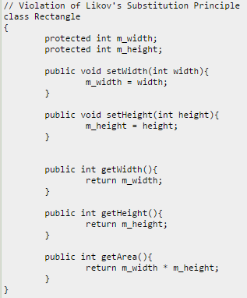
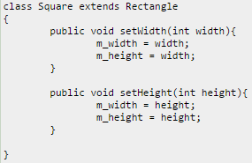
IV. SO[L]ID - Liskov Substitution Principle
Notes:
https://en.wikipedia.org/wiki/Liskov_substitution_principle
http://www.codeproject.com/Articles/567768/Object-Oriented-Design-Principles

Slide 10
V. SOL[I]D - Interface Segregation Principle
"Clients should not be forced to implement unnecessary methods which they will not use"
If we add methods that should not be there the classes implementing the interface will have to implement those methods as well.
As a conclusion Interfaces containing methods that are not specific to it are called polluted or fat interfaces. We should avoid them.
Notes:
http://www.codeproject.com/Articles/723631/SOLID-Principles-in-Laymans-Terms-Single-Responsib

Slide 11
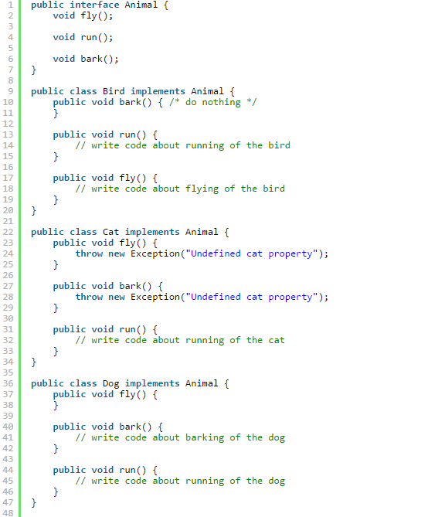
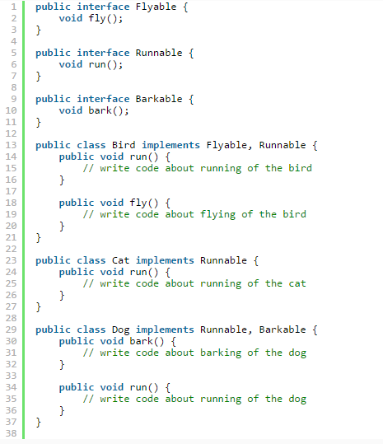
V. SOL[I]D - Interface Segregation Principle
Bad example
Good example
Notes:
http://www.codeproject.com/Articles/723631/SOLID-Principles-in-Laymans-Terms-Single-Responsib

Slide 12
VI. SOLI[D] - Dependency inversion principle
One should “Depend upon Abstractions. Do not depend upon concretions.
A. High-level modules should not depend on low-level modules. Both should depend on abstractions.
B. Abstractions should not depend on details. Details should depend on abstractions.
Notes:
http://www.codeproject.com/Articles/723631/SOLID-Principles-in-Laymans-Terms-Single-Responsib

Slide 13
VI. SOLI[D] - Dependency inversion principle
With the addition of an abstract layer, both high- and lower-level layers avoid the traditional dependencies from top to bottom. Nevertheless, the ″inversion″ concept does not mean that lower-level layers depend on higher-level layers. Both layers should depend on abstractions that draw the behavior needed by higher-level layers.
Notes:
https://en.wikipedia.org/wiki/Dependency_inversion_principle
http://www.codeproject.com/Articles/567768/Object-Oriented-Design-Principles

Slide 14
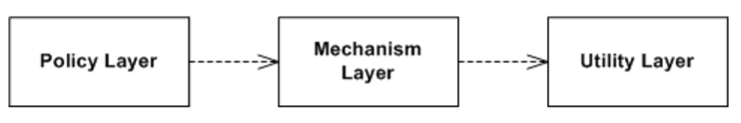
VI. SOLI[D] - Dependency inversion principle
Traditional layers pattern (should not appliment)
Notes:
https://en.wikipedia.org/wiki/Dependency_inversion_principle
http://www.codeproject.com/Articles/567768/Object-Oriented-Design-Principles

Slide 15
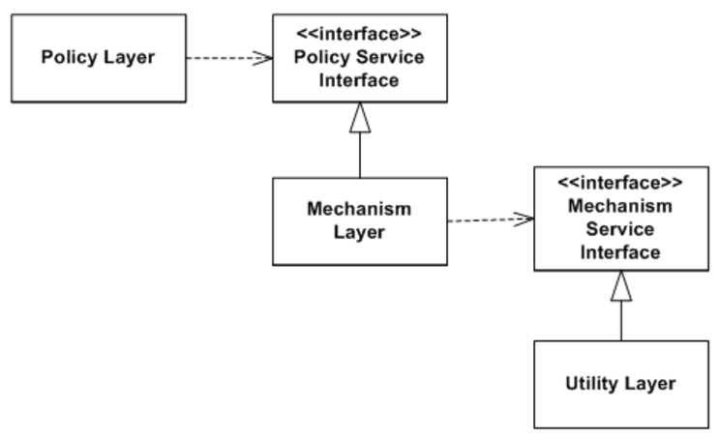
VI. SOLI[D] - Dependency inversion principle
Ownership inversion (should impplement)
Notes:
https://en.wikipedia.org/wiki/Dependency_inversion_principle
http://www.codeproject.com/Articles/567768/Object-Oriented-Design-Principles

