Slide 1
INNOVATION PROPOSAL · BAOR MASTER
An integrated matching system
for the BAOR Master.
Thesis allocation · Early-career matching · Career-services analytics
Business Analytics & Operations Research · TiSEM, Tilburg University · 2026
Built on the Rookies matching engine

Slide 2
01 · THE IDEA
Three problems.
One mathematics.
The BAOR master runs three allocation processes that are, structurally, the same problem: matching thesis students to topics and supervisors, matching graduates to first jobs, and guiding students toward the careers that fit them. Each is a two-sided matching market. Each is run by hand today. Mechanism design solves all three with one engine.
BAOR × ROOKIES · INNOVATION PROPOSAL
2 / 14

Slide 3
02 · TODAY
How the BAOR master allocates today.
Three processes, each run manually, none informed by the others.
Thesis allocation
Job placement
Career guidance
[INSERT CURRENT ALLOCATION METHOD]
…coordinators reconcile by hand. No shared view of fit, fairness, or capacity.
Students apply by guesswork; employers screen by keyword; no one computes fit. The allocation is left to chance, and the program never sees where the cohort lands.
Advising rests on intuition and last year's anecdotes — not on what this cohort's data, and the live labour market, actually show.
BAOR × ROOKIES · INNOVATION PROPOSAL
3 / 14

Slide 4
03 · FOUNDATION
Stable matching is solved mathematics.
The department already teaches it. This proposal puts it to work inside the department.
1962
2012
2025
Gale & Shapley
Roth & Shapley
NRMP
Stable matching.
Nobel Prize — market design as engineering.
37,667 doctors placed in a single match.
The same framework that places medical residents, allocates school seats, and clears kidney-exchange networks applies directly to thesis allocation and early-career hiring. The expertise to deploy it already sits in Econometrics & OR.
BAOR × ROOKIES · INNOVATION PROPOSAL
4 / 14

Slide 5
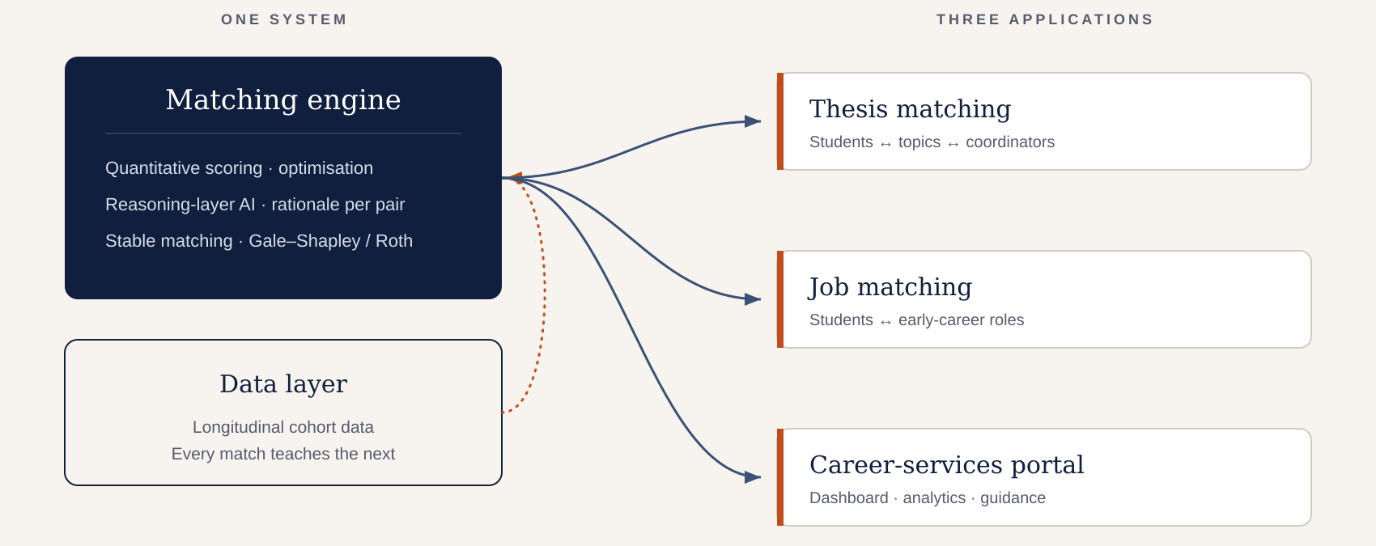
04 · ARCHITECTURE
One engine. One data layer. Three applications.
BAOR × ROOKIES · INNOVATION PROPOSAL
5 / 14

Slide 6
05 · PILLAR ONE · THESIS
Thesis allocation as a matching market.
A three-sided problem: students, topics, and the coordinators who own them.
Each student–topic pair receives a compatibility score from the matching engine, blending methodological fit, prior coursework, and stated interest. The algorithm then returns the assignment that maximizes total compatibility across the cohort, subject to each coordinator's supervision capacity and expertise. Individual fit and the strength of the cohort-wide allocation are produced together, the best overall set of theses the programme can run this year.
Fair & stable
Less manual work
Better-fit theses
Auditable
No back-room reshuffles. Every allocation is defensible.
Coordinators set preferences and capacity once — not weeks of email.
Matches reflect methodological fit, not who emailed first.
Every assignment carries a reason. Transparent by construction.
BAOR × ROOKIES · INNOVATION PROPOSAL
6 / 14

Slide 7
06 · PILLAR TWO · JOBS
Early-career matching for BAOR graduates.
The same engine, pointed at the first job instead of the thesis.
A BAOR student builds one profile: courses, projects, skills, ambitions. The matching engine scores fit against live roles: a quantitative layer over structured features, and a reasoning layer for the qualitative signal that mathematics cannot capture. The student receives a short list of ranked, explained matches: five roles worth applying to, not a hundred to spray.
Quantitative scoring
Reasoning layer
Explainable by design
Skills, courses, and project signal scored against role requirements. Deterministic and fast.
Reads projects and self-descriptions for the qualitative fit, with a rationale for every score.
Per-pair transparency — aligned with the EU AI Act for high-risk recruitment systems.
BAOR × ROOKIES · INNOVATION PROPOSAL
7 / 14

Slide 8
07 · PILLAR THREE · PORTAL
A career-services portal for BAOR.
The Career Officer dashboard turns cohort data into decisions. Four tools.
Match Analyzer
Market Pulse
Pick a student and a target role. See the match score, where the gaps are, and what to raise in the 1-on-1.
What employers are searching for at Tilburg right now: trending skills, sector demand, hot roles. Refreshed weekly.
Career Path Explorer
Engagement & At-risk
Type a role. See the skills employers ask for, the backgrounds of students who placed, and what lifts an application.
Who's slipping, who's progressing, and where the team should focus outreach this month.
BAOR × ROOKIES · INNOVATION PROPOSAL
8 / 14

Slide 9
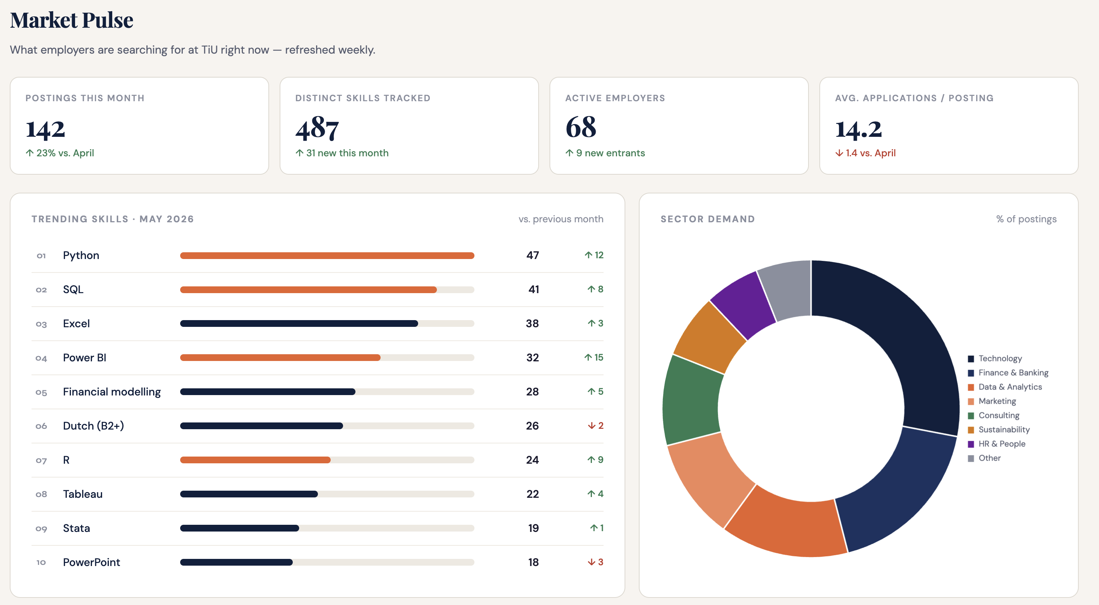
08 · LIVE DEMO
Built, not (only) pitched.
demo version
ROOKIES · PITCH · 2026
9 / 14

Slide 10
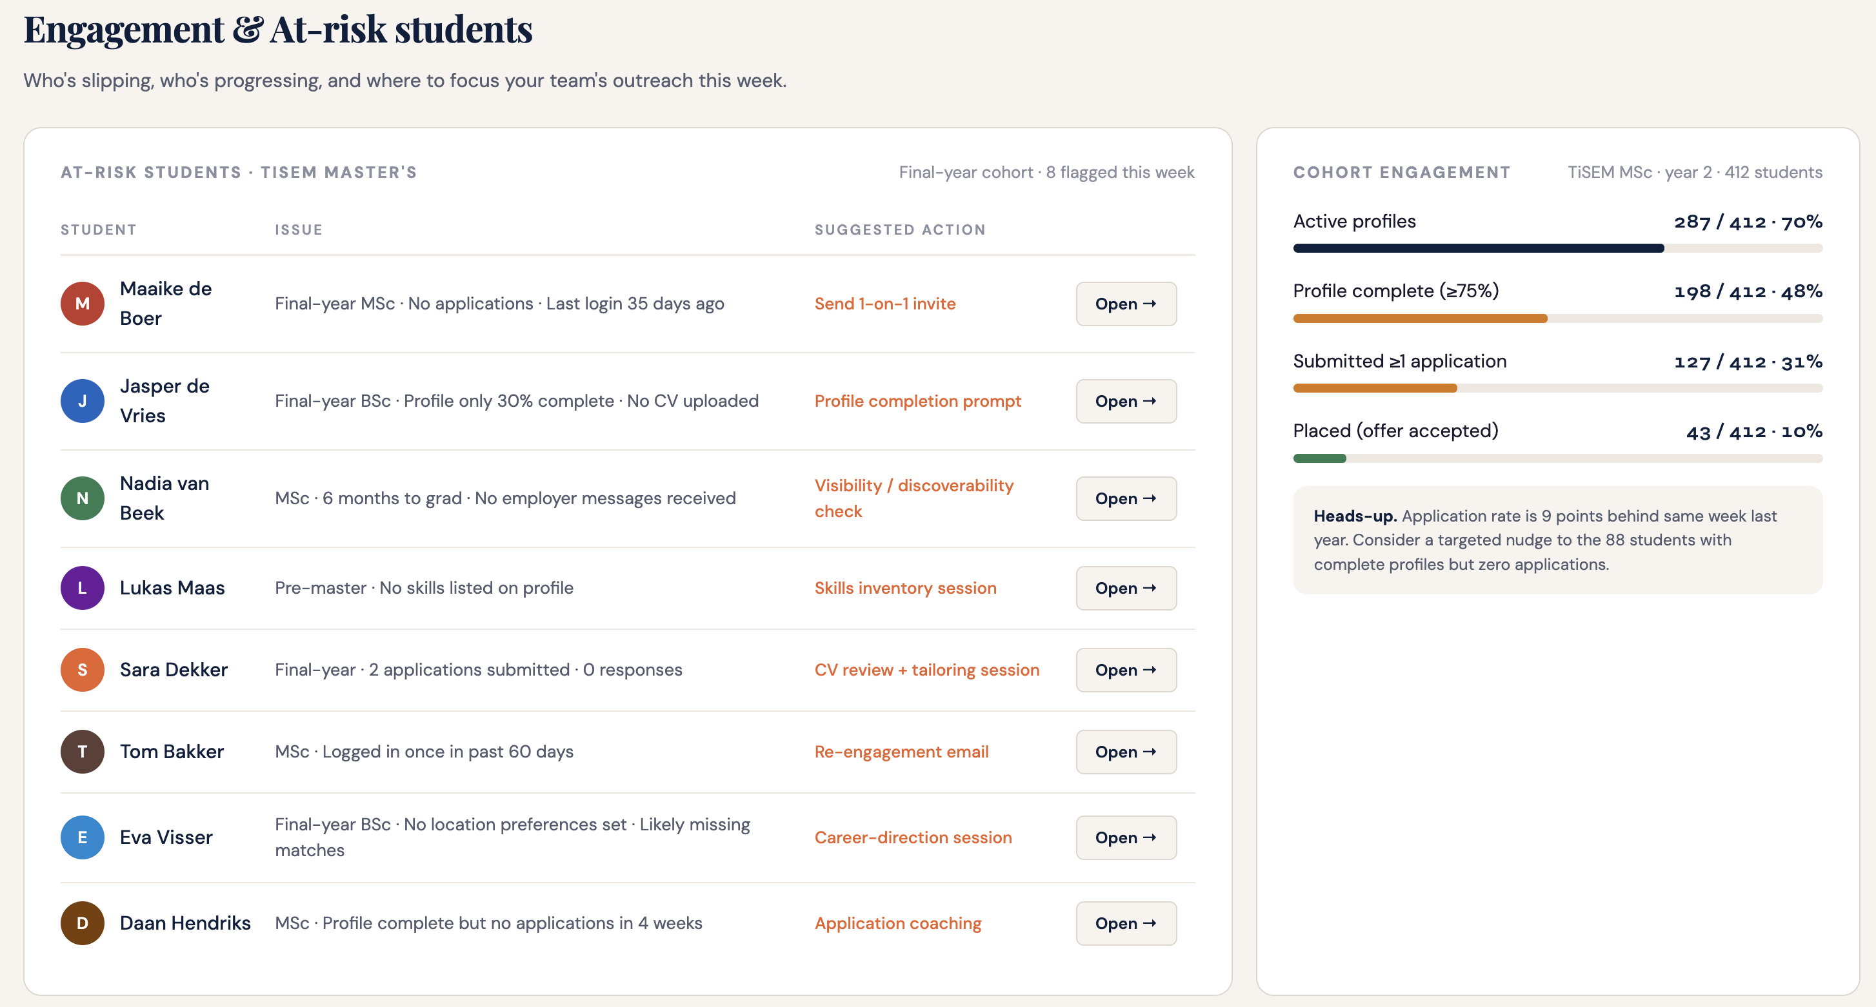
09 · LIVE DEMO
Built, not (only) pitched.
demo version
ROOKIES · PITCH · 2026
10 / 14

Slide 11
10 · PILLAR THREE · STUDENT VIEW
What the BAOR student gets.
One profile, built once, working across the whole student lifecycle.
Ranked, explained thesis options
Topics that fit the student's methods and interests: with the reason for each, not a first-come scramble.
Ranked, explained job matches
A short list of roles worth applying to, each with a rationale. No spray-applying.
A clear view of skills gaps
What the market asks for, what the student has, and the concrete steps that close the distance.
Continuity from thesis to first job
The same profile and the same engine carry the student from topic selection through placement.
BAOR × ROOKIES · INNOVATION PROPOSAL
11 / 14

Slide 12
11 · DATA
Every match teaches the system.
Each allocation and each placement feeds a longitudinal record: which student–topic matches produced strong theses, which placements held, what skills the market demanded and when. That record improves every future match, and it is, in itself, a research asset.
Better matches
Program insight
Research output
Outcome data tunes the engine. The next cohort's allocation is sharper than this one's.
Skills-gap and placement signal feed curriculum and advising decisions with evidence.
A dataset on revealed-preference matching under information asymmetry — publishable, and on the department's own line of work.
BAOR × ROOKIES · INNOVATION PROPOSAL
12/ 14

Slide 13
12 · INNOVATION
Innovation?
A first in NL higher education
The first application of stable-matching mechanism design to an integrated academic-and-career student lifecycle.
Explainable by construction
Every match carries a rationale, aligned with the EU AI Act's transparency rules for high-risk systems.
A research dataset
Generates publishable data on matching under information asymmetry, on the department's existing research line.
Replicable across TiSEM
Built once for BAOR, the architecture extends to every master's programme in the school.
Concrete operational wins
Coordinator hours saved, fairer thesis allocation, and measurable placement outcomes from year one.
BAOR × ROOKIES · INNOVATION PROPOSAL
13 / 14

Slide 14
13 · VISION
The first programme with a
matched student lifecycle.
From the first thesis topic to the first job, every BAOR student allocated by the same mathematics the department teaches. Better outcomes for students, fewer manual hours for coordinators, and a dataset that turns the programme's own operations into research.
BAOR × Rookies · TiSEM, Tilburg University

