Slide 1
Rookies.
The matching architecture for early-career hiring.
Investor pitch · Pre-seed · 2026
Confidential

Slide 2
01 · THESIS
The first job
is a market.
And like any market, it only works when both sides can find each other. Today, they can't. We’re rebuilding the layer between them, from the mathematics up.
ROOKIES · PITCH · 2026
2 / 17

Slide 3
Rookies.
02 · PROBLEM
Four ways the market breaks.
The dysfunction isn't an accident — it's structural.
The visibility tax
One-sided scoring
Today's job platforms are subscription-driven advertising marketplaces. The 424,000 NL SMEs that would fit a student lose to a handful of well-marketed brands every cohort.
Existing platforms optimise for engagement, not for matching. Students filter by keyword; recruiters filter for keywords. Neither side's recommendation is informed by what the other side actually needs.
AI vs AI
Universities standing still
Applicants tailor CVs with AI. Recruiters screen them with AI. The two systems negotiate, neither has ever met the person at the centre. The market has reduced itself to a single prayer.
Career-office tooling was built before LLMs. No longitudinal tracking, no real-time labour-market view, no skills-gap intelligence. The institutions best positioned to fix the system can't see it.
ROOKIES · PITCH · 2026
3 / 17

Slide 4
03 · EVIDENCE
The cost, in numbers.
From the Dutch early-career market, today.
120+
7s
3 in 4
8 in 10
applications per junior role
recruiter time per CV
applicants now use AI to apply
companies screen with AI in 2026
Getting your first job has become a game of chance. It does not have to be.
ROOKIES · PITCH · 2026
4 / 17

Slide 5
Rookies.
04 · WHY NOW
Three forces, converging this cohort.
The conditions that make this problem solvable now did not exist eighteen months ago.
01
AI has industrialised the dysfunction.
Generative AI didn't solve matching; it scaled the failure. The cycle worsens with each new cohort. The cost of waiting is paid by the next graduating class.
02
The EU AI Act now governs high-risk recruitment.
Article 13 mandates per-pair transparency. Existing platforms can't deliver it. We are built to comply from day one, explainable scoring is the product, not a patch.
03
Universities are being asked questions they can't answer.
Boards, faculty, and ministries need real-time outcome data. Career-office software from the pre-LLM era can't produce it. The first vendor that does becomes the default layer.
ROOKIES · PITCH · 2026
5 / 17

Slide 6
05 · SOLUTION
We replace the architecture.
Rookies is a matching architecture, not a job board. We pair quantitative scoring with explainable AI reasoning, embed natively in Dutch universities, and build a longitudinal community of students whose career trajectories compound the system's intelligence over time.
Quantitative scoring
Reasoning-layer AI
Longitudinal community
Math first. Deterministic, auditable, fast.
Rookies AI Agent for the signal math can't capture, with a rationale per pair.
Cohort data that compounds. Each match teaches the system.
ROOKIES · PITCH · 2026
6 / 17

Slide 7
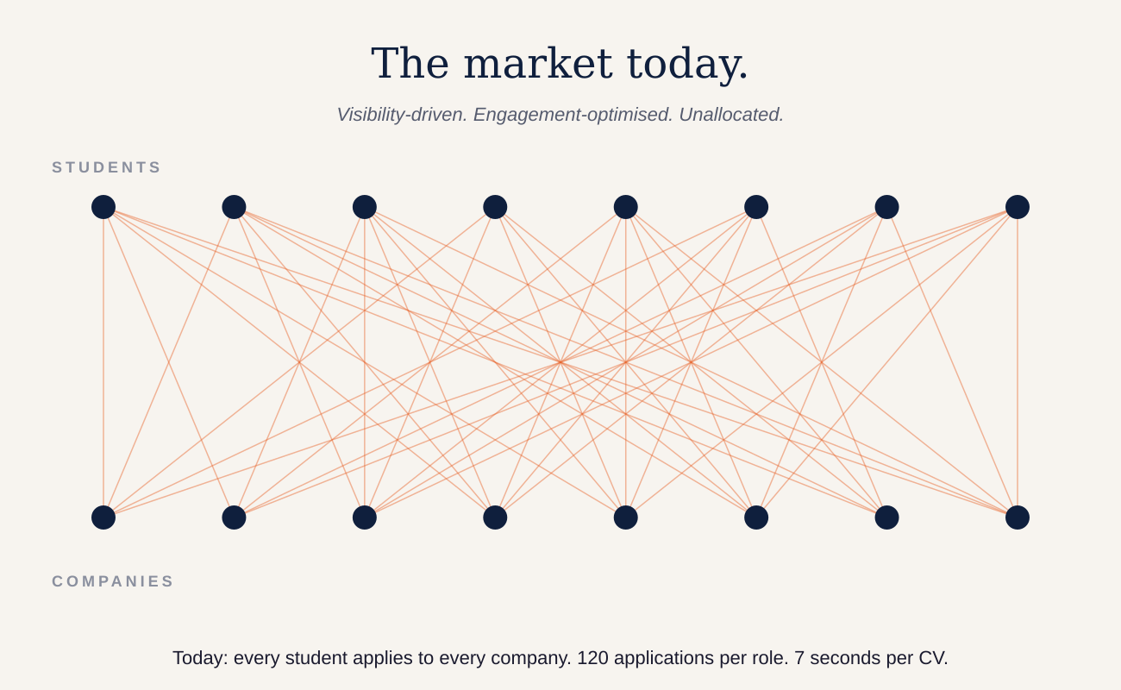
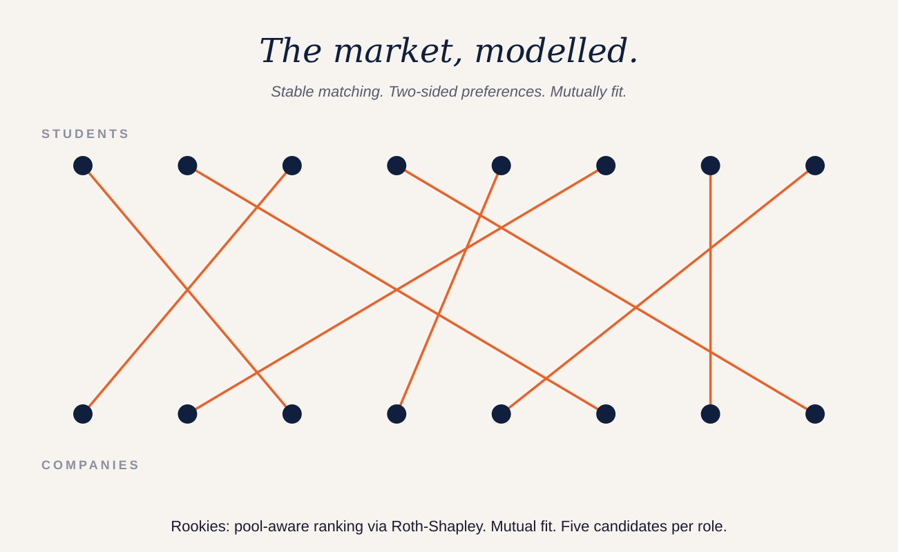
06 · VISUALISED
From spray to allocation.
The same students. The same companies. A different layer beneath them.
We do not rank harder. We change what is being ranked.
ROOKIES · PITCH · 2026
7 / 17

Slide 8
Rookies.
07 · LINEAGE
The mathematics is published.
The deployments are operational.
1962
1994
2012
2025
Gale & Shapley
Nash
Roth & Shapley
NRMP
Stable matching.
Equilibrium in strategic markets.
Nobel Prize — market design as engineering.
37,667 doctors placed in a single match.
Kidney exchange. School choice. Dynamic fleets. Moneyball. The early-career hiring market is the most prominent matching market that has not yet been redesigned.
ROOKIES · PITCH · 2026
8 / 17

Slide 9
08 · THE MODEL
Four layers no existing platform models together.
Each layer answers a different question. The combination is the product.
L1
Hard skills
L2
Soft skills
Linear optimisation over structured features. Deterministic, auditable, fast — the kind of math an EU regulator can read.
Rookies AI Agent reads CVs, projects, and self-descriptions. Math stays primary; AI extends its reach with a rationale per score.
L3
The market
L4
Community
Pool-aware ranking via Roth-Shapley. Fit is not absolute — it depends on who else is in the pool, in real time.
Longitudinal cohorts. Events, content, post-placement feedback. Each match teaches the next. The moat compounds.
ROOKIES · PITCH · 2026
9 / 17

Slide 10
Rookies.
09 · PRODUCT
Four products. One system.
Three sides of the market, finally pulling in the same direction.
Matchmaking architecture
Career-services analytics
Quant + reasoning AI feeding a stable-matching algorithm. EU AI Act compliant by construction.
Cohort outcomes, skills-gap intelligence, board-ready reports — the first such tooling in Dutch higher education.
SME & startup visibility
Recruiter outreach
Free for every Dutch employer. Visibility set by match quality, not by paid placement.
Pre-scored shortlists with explainable rationale. Five candidates ranked, not three hundred CVs to scan.
ROOKIES · PITCH · 2026
10 / 17

Slide 11
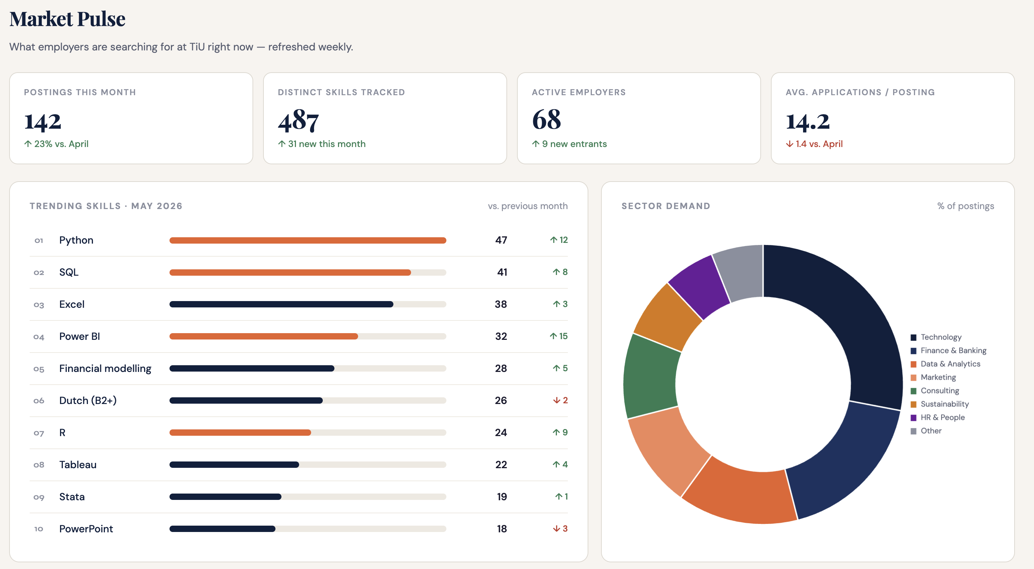
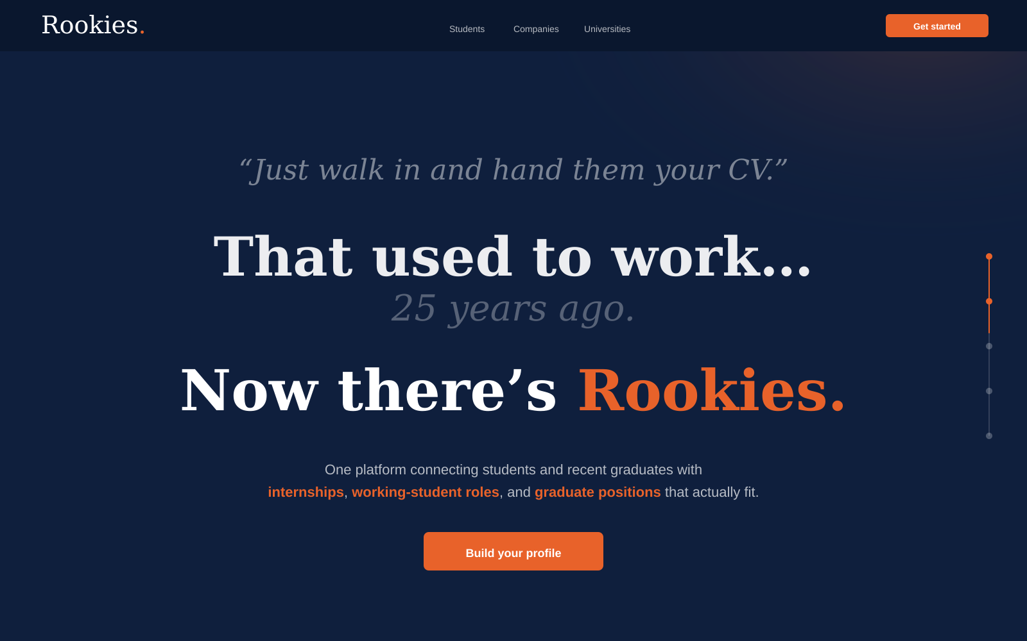
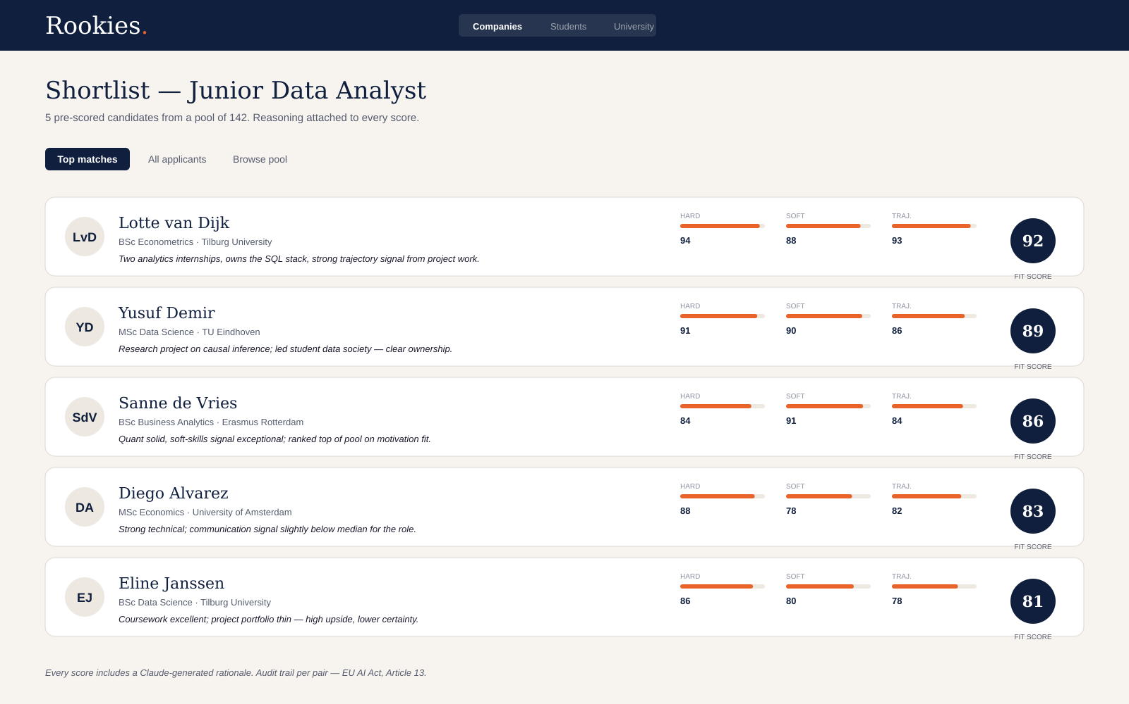
10 · LIVE DEMO
Built, not (only) pitched.
The beta version is live and operating. Two views below.
One of the tools of the Career Officer dashboard. Market Pulse
Recruiter shortlist. Rationale per score. Audit trail per pair.
ROOKIES · PITCH · 2026
11 / 17

Slide 12
11 · MARKET
A focused home market. A continental prize.
NETHERLANDS
EUROPE
€100M
€2–3B
Total addressable, at maturity.
Total addressable, at maturity.
800K students · 50 institutions
183K graduates per year
424K SMEs · the visibility tax to solve
~5M higher-ed graduates per year
27 member states · one EU AI Act regime
Replication, not reinvention
Revenue path (bottom-up, conservative)
2026
€60K ARR
2028
€1.65M ARR
2030
€13M+ ARR
Tilburg pilot
Dutch scale
EU rollout
ROOKIES · PITCH · 2026
12 / 17

Slide 13
Rookies.
12 · BUSINESS MODEL
A flywheel, not a portfolio.
Three revenue streams. One compounding loop.
PRIMARY
DISTRIBUTION
MARGIN
Employer platform
University licenses
Brand partnerships
Freemium → SaaS
€5K–€15K / institution / year
Add-on
Employers pay to host curated events, branded workshops, and sponsored trips with pre-screened Rookies cohorts. The community is the moat; this is how it monetizes.
Free posting and discovery for every Dutch employer. Paid tiers unlock preference tailoring, employer branding, and hiring analytics. The growth engine in Y1–2, the recurring base at scale.
Career-office software, cohort analytics, skills-gap intelligence. Not the revenue line — the moat and the qualification layer. Each university is worth multiples of its license in employer pull-through.
ROOKIES · PITCH · 2026
13 / 17

Slide 14
13 · GO-TO-MARKET
Universities first. Everything follows.
Trusted distribution beats direct outbound at the early-career layer.
01
2026
Founding team embedded at Tilburg. Academic advisor on faculty. Career Officer Console live. The founding cohort of Rookies is seeded.
Tilburg + 2 anchors
02
2027
Replicate. Employer demand pulled by trusted university partners — no cold outbound. Default early-career layer of Dutch research-university system.
Top 14 research universities
03
2028+
Universities of applied sciences. Belgium, Germany, the wider EU. Same playbook, multilingual matching engine.
All 50 institutions, then EU
Win universities first. Students follow. Employers follow. The network compounds.
ROOKIES · PITCH · 2026
14 / 17

Slide 15
Rookies.
14 · COMPETITION
Everyone solves a fragment. We built the system.
Matching Algorithm
Early career focused?
Uni-embedded
Community/ Longitudinal
Career Officer tool
JobTeaser
AI - recruiters only
No
Partial
No
No
Magnet.me
Filters based
Partial
No
Partial
No
LinkedIn / Indeed
Basic AI-LLM
No
No
No
No
Rookies
Econometric model + AI positioning + Market Optimization
✓
✓
✓
✓
JobTeaser last raised in 2019. Magnet.me has been capital-constrained since 2017. LinkedIn and Indeed aren't built for the early-career segment, and none of them optimizes the available market — different economics, different signal.
ROOKIES · PITCH · 2026
15 / 17

Slide 16
15 · TEAM
Three people, one architecture.
“I built this because I lived this market. I watched friends spray-apply to three hundred jobs and end up working in something they didn't choose. The market doesn't have to be a lottery. The mathematics is solved. We just have to ship it.”
— Dan Toma Poenaru, founder
Dan Toma Poenaru
Tudor Octavian Poenaru
Dr. Cristian Dobre
Co-founder & CEO
Co-founder & CTO
Academic Advisor
MSc Business Analytics & OR, BSc IBA — Tilburg University. Designing the algorithm. Product, partnerships, fundraising.
BSc Computer Science & Engineering — TU Eindhoven. Leads the back-end, connectivity and deployment.
Associate Professor, Econometrics & OR, Tilburg. Master Academic Director, Business Analytics & OR (TiSEM). Advisor on the mathematics behind the matching algorithm.
ROOKIES · PITCH · 2026
16 / 17

Slide 17
Rookies.
16 · THE ASK
€250K SAFE
Pre-seed. 18 months runway. Five anchor pilots.
ARCHITECTURE
COMMUNITY
Engineering hires to ship the math, reasoning, and market-clearing layers in production at pilot scale.
Events, content, and longitudinal engagement at the first five universities. The community is the moat.
DISTRIBUTION
RUNWAY
University BD across five anchors. The first 10,000 employers on the platform. 5% paid-conversion benchmark.
Eighteen months to the milestones that unlock a Series A: signed pilots, ARR validation, paper published.
In five years, no graduate in Europe will find their first job through a CV black hole. They will find it as Rookies — in a system designed around the people in it, not around the algorithm sorting them.

