Slide 1
EARLY-CAREER MATCHING INFRASTRUCTURE · NL
ROOKIES
Smart enough to match.
Human enough to belong.
Engineered like a market. Run like a community. Anchored in Dutch universities.
ROOKIES · PITCH DECK · 2026
Confidential

Slide 2
01 · THE PROBLEM
The early-career market
is broken in four ways.
01
The Visibility Tax
02
One-Sided Matching
Subscription-based platforms reward the biggest recruitment budgets. SMEs, startups and challenger employers get buried.
Either companies hire agencies for "the perfect candidate," or students push themselves into the void. Friction, opinion, never modelled data.
03
AI vs AI
04
Universities Standing Still
Students use AI to rephrase CVs and inject keywords. Companies use AI to scan for those same keywords. The result: spray applications, irrelevant CVs, and a market matching on syntax, not on fit.
Wooden tools in an age of disruption. No anchor to what the market wants now. No way to follow students longitudinally.
The cause: fragmentation — three sides solving the same problem, alone.
ROOKIES
02 / 14

Slide 3
01 · TODAY · PREFERENCE-BASED
Preference, not compatibility.
Recommendations follow what students want and what companies want — not who actually fits whom. Everyone aims at the same 5.
STUDENTS
BIG BRANDS · OVERSUBSCRIBED
SMEs · INVISIBLE
BIG 1
BIG 1
A
A
BIG 2
BIG 2
B
B
BIG 3
BIG 3
C
C
BIG 4
BIG 4
D
D
BIG 5
BIG 5
E
E
+ 10,000s more
Big brands drown in 2,000+ applications per slot. Better-fit employers go invisible.
ROOKIES
01 / 03

Slide 4
02 · WITH ROOKIES · COMPATIBILITY-BASED
Compatibility, ranked.
Each student gets a personal list — companies ordered by actual fit, not visibility. Different students get different orderings.
A
B
C
D
E
STUDENT A
STUDENT B
STUDENT C
STUDENT D
STUDENT E
#1
Healthtech 03
#1
Tech Scale-up
#1
Big Brand 02
#1
Family Biz 04
#1
Mid-Mfg 12
#2
Big Brand 02
#2
Mid-Mfg 12
#2
Healthtech 03
#2
Mid-Mfg 12
#2
Tech Scale-up
#3
Tech Scale-up
#3
Big Brand 02
#3
Family Biz 04
#3
Healthtech 03
#3
Family Biz 04
#4
Mid-Mfg 12
#4
Healthtech 03
#4
Tech Scale-up
#4
Tech Scale-up
#4
Big Brand 02
#5
Family Biz 04
#5
Family Biz 04
#5
Mid-Mfg 12
#5
Big Brand 02
#5
Healthtech 03
Same students. Different lists. The right matches, in the right order.
ROOKIES
02 / 03

Slide 5
03 · THE DIFFERENCE
From spray to signal.
The same outcome — one interview — through completely different effort and quality.
TODAY
WITH ROOKIES
100 applications
5 best matches
1 interview.
1 interview.
Spray, pray, get rejected, spray more.
Ranked by fit. Apply with confidence.
20× more efficient. Infinitely less frustrating.
Preference makes chaos. Compatibility makes Rookies.
ROOKIES
03 / 03

Slide 6
02 · THE EVIDENCE
And the numbers say it louder.
6+ mo
120+
3 in 4
7 sec
Average time-to-first-job for graduates in The Netherlands
Applications per junior opening — most irrelevant
Students leave The Netherlands after graduation
Average recruiter attention per CV
“Two AIs negotiating a job. Neither has ever met the person.”
— the early-career market, 2026
ROOKIES
03 / 14

Slide 7
Getting your first job
has become a game of chance.
It doesn't have to be.
ROOKIES
04 / 14

Slide 8
02 · STILL · THE EVIDENCE
Doctors get matched
by a Nobel-Prize algorithm.
Graduates get a 7-second skim.
MEDICAL RESIDENCY · NRMP · 1998–PRESENT
EARLY-CAREER HIRING · 2026
Matching residents to hospitals.
Matching graduates to employers.
37,667 doctors matched in 2025 — the largest match in history. Stable algorithm. Roth · Shapley · 2012 Nobel.
183K NL grads a year. Spray, filter, scroll. 7 seconds per CV. 120+ applications per opening.
Every matching market that mattered has been redesigned. Hiring is the last one left.
ROOKIES

Slide 9
That's how Rookies is born.
One platform for every side of the early-career equation. Internships, working-student roles and first jobs — students, employers and universities — finally share a floor.
THE THREE SIDES
Students
Employers
Universities
ALL THE ROLES
Internships
Working students
First jobs
[ funny tagline goes here — TBD ]
ROOKIES
05 / 14

Slide 10
04 · HOW IT SHIPS
Four products.
One system.
01
Matchmaking Architecture
02
Career-Services Analytics
Three layers modelled econometrically: quantitative scoring for the measurable, Rookie AI Agents for the non-measurable and market optimization. Explainable, defensible, fast.
A live dashboard for career officers and university management. Cohort outcomes, skills-gap intelligence, longitudinal data nobody else surfaces.
03
SME & Startup Visibility
04
Recruiter Outreach
We weight on fit, not budget. Smaller employers compete on signal — challengers get the airtime the subscription model never gave them.
Pre-scored shortlists with explainable rationale. Recruiters spend seconds on the right candidates instead of hundreds on the wrong ones.
Built so all three sides finally pull in the same direction.
ROOKIES
07 / 14

Slide 11
03 · WHAT WE MODEL
Four things
nobody has modelled together.
We don't just measure how a candidate fits a role. We measure how they score in the pool that's actually available — and where the role scores for them. Stable matches, not theoretical fits.
LAYER 01
LAYER 02
LAYER 03
THE MOAT
Hard Skills
Soft Skills
The Market
Community
Technical & non-technical, from experiences, projects, and self-learning.
Ownership, drive, transferability — the signal that doesn't fit a regression.
Pool-aware ranking. The match isn't a score in isolation — it's how you fit the pool that exists right now.
The part everyone else skips. The part that compounds.
Modelled mathematically
Read by Rookie AI Agents
Two-sided stable matching (Roth · Shapley)
Events, engagement, longitudinal follow-up
Linear optimization
Supports the math
Pool-aware fit, not absolute fit
Match, learn, iterate — one cohort at a time
Guided by career officers & research
Quantifying what no one else can
Moneyball logic for first jobs
Not an ad page. A movement.
Less chaos, less friction, no more randomness. Just Rookies.
ROOKIES

Slide 12
WHY NOW · WHY THIS WORKS
It's already been won.
Twice.
Two Nobel Prizes. Three industries. The same machinery — now applied to the first job.
THE THEORY · PROVEN
THE PRACTICE · DEPLOYED
Nash equilibrium
Moneyball
2002 · Oakland A's
1994 Nobel · John Nash
Outperformed teams 5× their budget by finding the labor-market signal everyone else had mispriced.
Strategic decisions in non-cooperative games. The math behind every market where players act on what others choose.
Kidney exchange networks
Roth-designed · ongoing
Stable matching
National multi-party chains save thousands of lives a year — clearing matches no bilateral market could.
2012 Nobel · Roth & Shapley
Fleet matching
Two-sided matching theory. The math behind allocating people to slots — residents to hospitals, students to schools, donors to recipients.
Rental cars · ride-share
A live algorithm assigns every customer to a specific unit — the pool rebalances in real time.
Same problem. Same machinery. New market — first jobs.
ROOKIES

Slide 13
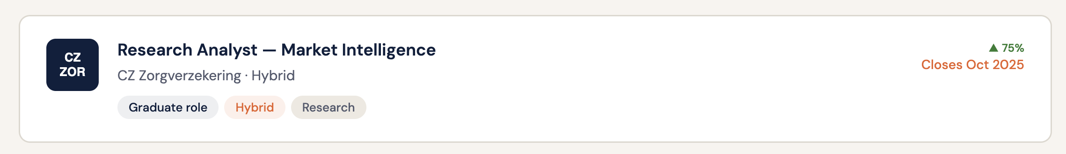
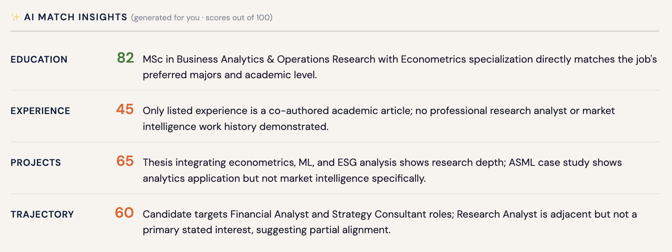
PRODUCT · 01 · MATCHMAKING ARCHITECTURE
Match on fit,
not on keywords.
Two layers, one match. Quantitative scoring for what's measurable, Claude Sonnet 4.6 reasoning for everything else.
LAYER 01
SCREENSHOT PLACEHOLDER
Quantitative Scoring
Linear optimization over structured features — degree fit, skills overlap, experience depth, location, work authorization. Deterministic. Auditable. Fast.
LAYER 02
Reasoning Layer
Claude Sonnet 4.6 over unstructured signal: project depth, trajectory, voice, ambition. Every match comes with a rationale.
Built for the EU AI Act: explainable, defensible, audit-ready.
ROOKIES
PRODUCT 01 / 04

Slide 14
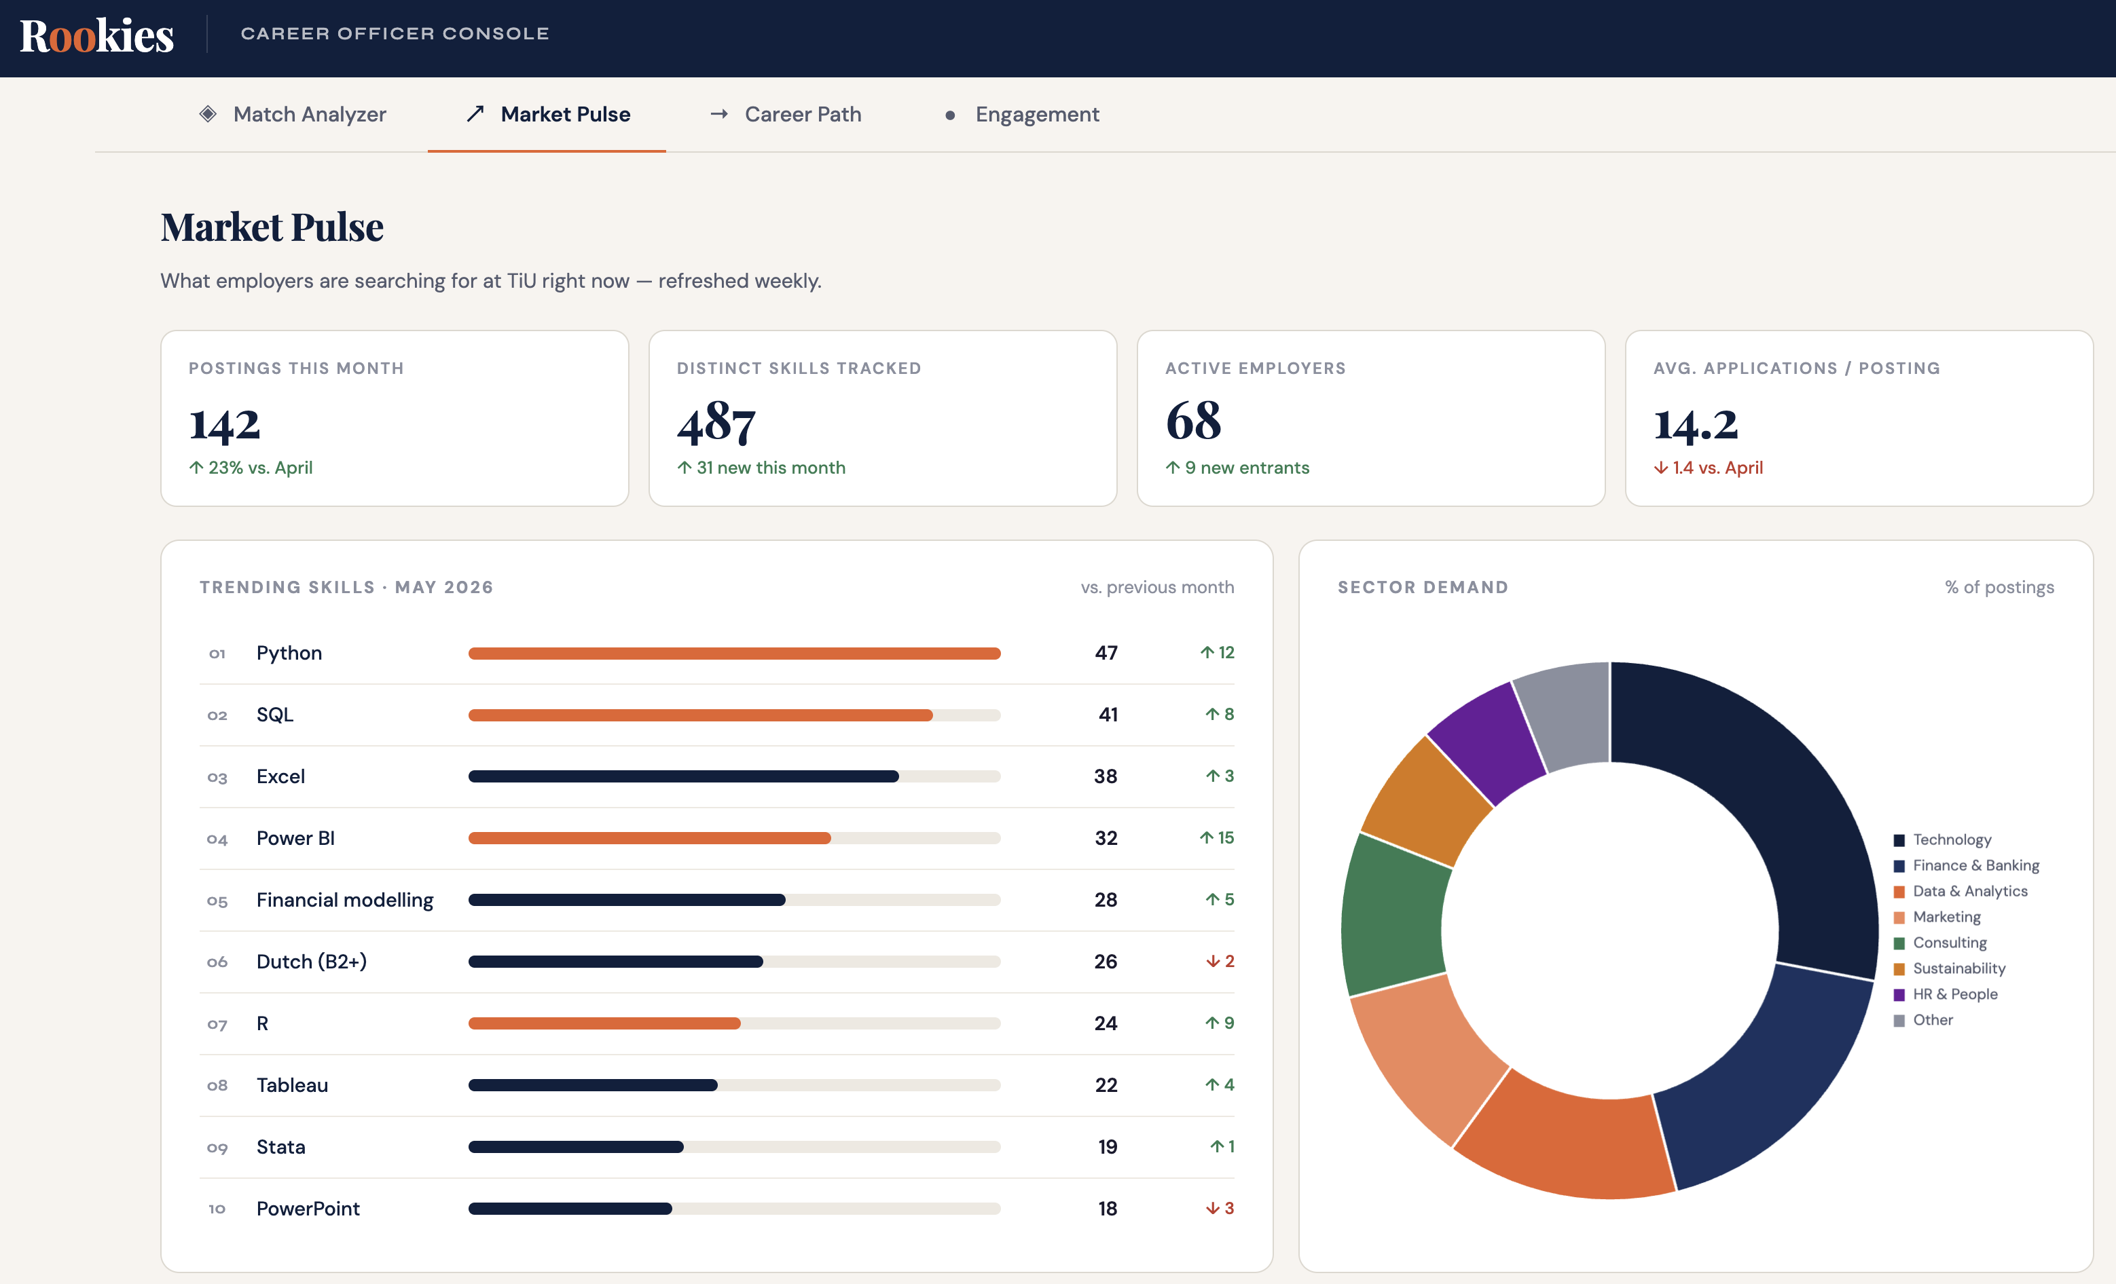
PRODUCT · 02 · CAREER-SERVICES ANALYTICS
Cohort intelligence
career offices have never had.
A live dashboard for career officers and university management — outcomes, skills gaps, longitudinal data nobody else surfaces.
Cohort outcome tracking
Time-to-first-job, role quality, retention, and salary trends per cohort.
SCREENSHOT PLACEHOLDER
Skills-gap intelligence
Real-time view of what employers search for vs. what students have.
Career Officer Console — main dashboard view
Longitudinal follow-up
Multi-year data on alumni outcomes — what paths actually lead to good first jobs.
Curriculum-relevant data
Board-ready reports career offices can take to faculty and accreditation.
Insert image: replace this placeholder with the actual screenshot.
Data career offices can actually take to the board.
ROOKIES
PRODUCT 02 / 04

Slide 15
PRODUCT · 03 · SME & STARTUP VISIBILITY
Where smaller employers
compete on signal.
The matching engine doesn't care about ad spend. SMEs and startups get the airtime the subscription model never gave them.
Free tier for every NL employer
Every NL company can post and discover candidates from day one. No paywall on visibility.
~424K
99%+
Visibility on fit, not budget
NL SMEs (2-249 employees)
Of NL employers are SMEs (excl. self-employed solo)
Match quality determines who sees what — paid placement does not exist.
CBS Statline 2024
CBS Statline 2024
AI shortlists regardless of plan
Free employers get the same matching engine. Paid unlocks tools, not ranking.
[ TBD ]
[ TBD ]
The SME bet, made explicit
% of NL workforce employed by SMEs
% of early-career hiring happening at SMEs
Designed for the long tail Dutch students need to discover — the 99% of NL companies who aren't Booking, Philips, or ASML.
Eurostat / CBS — confirm
Add source
Visibility tax: zero. Match quality: equal for all.
ROOKIES
PRODUCT 03 / 04

Slide 16
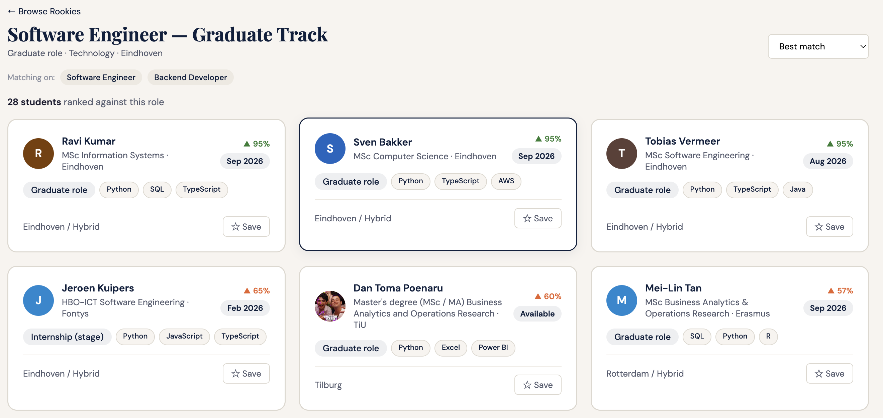
PRODUCT · 04 · RECRUITER OUTREACH
Seconds on the right ones.
Not hundreds on the wrong ones.
Pre-scored shortlists with explainable rationale. Recruiters reclaim their time and their judgment.
Pre-scored shortlists
Every candidate scored before the recruiter clicks.
SCREENSHOT PLACEHOLDER
Explainable rationale
Not a black-box number.
Recruiter shortlist / outreach view
One-click outreach with context
Pre-loaded message templates that reference the actual match logic.
Response tracking & follow-up
Pipeline visibility — who replied, who's interviewing, who needs a nudge.
Insert image: replace this placeholder with the actual screenshot.
From 200 CVs in 7 seconds each — to 5 matches in 5 minutes each.
ROOKIES
PRODUCT 04 / 04

Slide 17
05 · MARKET
A €100M home market.
A €2-3B European prize.
800K+
183K
REVENUE PATH
From NL pilot to EU standard.
Students in Dutch higher ed (CBS / UNL)
Higher-ed graduates per year (UNL + DUO)
2026 · NL pilot · ~€60K ARR
49
~€100M
2027 · NL scale · ~€430K ARR
Dutch universities (13 WO + 36 HBO)
NL TAM at maturity (bottom-up)
2028 · Full NL · ~€1.65M ARR
2030 · EU rollout · €13M+ ARR
ROOKIES
08 / 14

Slide 18
06 · BUSINESS MODEL
Three revenue streams.
One flywheel.
FREEMIUM → SAAS
INSTITUTIONAL SAAS
OPTIONAL ADD-ON
Employer Platform
University Licenses
Talent Services (light)
Free for every NL employer to post and discover. Paid tier unlocks preference tailoring, employer branding, longitudinal hiring analytics, and many more
€5-15K per institution per year. Career office software, cohort analytics, and skills-gap intelligence.
Premium student services — CV review, interview prep. Intentionally lean to protect mission.
Growth engine today · primary ARR tomorrow
Distribution + qualification · not primary revenue
Margin layer · not the core
ROOKIES
09 / 14

Slide 19
07 · GO-TO-MARKET
Win universities first.
Everything follows.
01
02
03
PHASE 01 · 2026
PHASE 02 · 2027
PHASE 03 · 2028+
Tilburg + 2 anchor pilots
Top 14 research universities
Applied sciences + EU
Prove conversion. Embed the Career Officer Console. Seed the founding Rookies community.
Replicate the pilot. Employer demand pulled by trusted university partners.
All 49 Dutch institutions, then Belgium and Germany. Same playbook, multilingual engine.
ROOKIES
10 / 14

Slide 20
08 · COMPETITION
Everyone's solving a fragment.
We built the system.
NL focus
Uni-embedded
Matching algorithm
Explainable AI / EU-AI-Act ready
Community / longitudinal
Career-officer tooling
JobTeaser
Partial
Yes (5/50)
AI — only for recruiters
No
No
Yes — basic engagement statistics
Magnet.me
Yes
No
Filters based
No
Partial
No
LinkedIn
Partial
No
Basic
No
No
No
Indeed
Partial
No
AI — only for recruiters
No
No
No
Rookies
Yes
Native
Econometric model + AI positioning + Market Optimization
Yes
Native
Yes
Rookies is the only platform pairing explainable AI matching with native university embedding and community as a moat.
ROOKIES
11 / 14

Slide 21
09 · TEAM
Founder-led. Technical.
On the ground.
Built by people who lived the problem — students, builders, and operators inside the Dutch university system.
D
CO-FOUNDER & CEO
T
CO-FOUNDER & CTO
C
ADVISOR
Dan Toma Poenaru
Tudor Octavian Poenaru
Cristian Dobre
Associate Professor, Department of Econometrics and Operations Research
Master Academic Director, Business Analytics and Operations Research, TiSEM.
MSc Business Analytics & Operations Research,
BSc International Business Administration
Tilburg University.
BSc Computer Science and Engineering,
Eindhoven University of Technology.
ROOKIES
12 / 14

Slide 22
10 · THE ASK
Fund the next 18 months.
Own the European standard.
WHAT WE'RE RAISING
Pre-seed round: 150-350k
USE OF FUNDS · 18 MONTHS
Architecture
Engineering & Marketing hires · ship the math + reasoning layers
Targeting strategic capital — angels and early-stage funds with NL or AI distribution.
Community
Events, content, longitudinal engagement
Distribution
5 universities · 10K employers on platform · 5% paid
Runway
18 months to Series A milestones
ROOKIES
13 / 14

Slide 23
11 · 2035
In nine years,
no graduate in Europe
finds their first job
through a CV black hole.
They find it as Rookies.
DAN POENARU · ROOKIES · 2026
Thank you.

