Slide 1
Team L – Evacuation Simulator
Hector Grebbell
Tony Lau
Peeranat Fupongsiripan
Dan Tomosoiu
Michael Kilian
Supervisor: Prof. Chris Johnson

Slide 2
What is an Evacuation Simulator?
A system which attempts to accurately predict the egress of a population from a given environment, such as a building or large vehicle.

Slide 3
Why implement one?
Evaluating evacuation procedures or the safety of a buildings design can be diffcult and expensive to do using 'real world' tests.
Sometimes this is impossible.
An accurate simulator allows an expert to consider a wide range of different scenarios and population distributions relatively cheaply.

Slide 4
Previous Work
There has been extensive previous work in this field.
The approaches adopted vary greatly from project to project.
We have taken several concepts from these combined with extensive additional research to form a foundation for our requirements.

Slide 5
Aims
An update of the technologies used in previous projects.
Use of 'navmesh' methods for accurate movement.
Possibility to import multiple other models in the future.
A multi-agent model of human interaction and the representation of individual behaviour.

Slide 6
Overview of Simulation
The features needed by the software can be broken down into a series of steps. We will discuss how these are realised:
Create and import a 3D model of an environment.
Populate the environment.
Run the simulation. The simulation ends when every member of the population has exited (safely or otherwise).

Slide 7

Environment: Tall Ship, Glasgow

Slide 8
Environment: Tall Ship, Glasgow
Over 100 years old.
Serves as both a tourist attraction and a function hall below decks.
The ship is permanently docked and can be considered a static structure.

Slide 9
Why choose it?
Events can host up to 200 guests, not including staff.
Has a sufficiently complex structure in which to explore simulation techniques.
No full scale evacuations have ever been held before — only staff have been used.
These drills are infrequent.

Slide 10
Process Model
A linear process of continuous prototyping was used.
Chosen because of the large amount of research underlying the theory of the system.
Allowed us to “scale up” from small to large environments.

Slide 11
Agile Development
Agile development techniques employed to offset risk of continuous prototyping.
Team was divided into two sub-teams to streamline communication.
Core Development Team (Dan, Tony, Michael)
GUI and Modelling Team (Peeranat and Hector)
Modelling the ship occurred in parallel to system development.

Slide 12
Modelling the Ship
A representation of the floorplan for the software to work with.
Since the ship is itself a three-dimensional structure, ideally the model needed to be also.
It was decided to use Blender, a powerful and free 3D graphics suite.

Slide 13


Modelling the Ship
We started with plans provided to us by the Tall Ship staff.

Slide 14


Modelling the Ship
By fitting planes to these we could map out the decks of the ship.

Slide 15


Modelling the Ship
Which provided us with a model we could import into our simulation engine.

Slide 16
jMonkeyEngine
For the simulation development, we chose jMonkey as our 3D graphics engine since it is generally considered the best in class open-source Java 3D environment.
Java was chosen as it provides a good degree of portability, supports multi-threading and we all have at least 1 year of experience in using it.

Slide 17

Using the model
The next step is to convert the 3D model into a structure that can be used for pathfinding.
A grid-like model is simple but inefficient.

Slide 18

NavMesh: Introduction
Navigation Meshes are a more efficient structure on which we can still use standard graph algorithms like Dijkstra or A*, in order to achieve pathfinding.

Slide 19
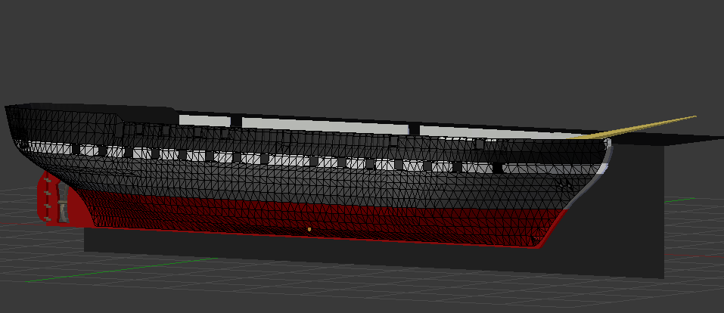
Navmesh: Convert from 3D Model
Several conversion and optimization routines were used to identify the model's walkable surfaces and map them to a Navigation Mesh

Slide 20

Navmesh: Visualisation

Slide 21

Navmesh: Visualisation

Slide 22

Navmesh: Pathfinding with A*

Slide 23
A multi-agent system
Previous projects have focused on the crowd
Each person in the simulation is represented by an individual process
A simple set of behavioral principles determines the outcome of interactions
The benefit of this approach is the introduction of emergent behaviour
Experienced problems in acheiving this in the final system

Slide 24

Population Design

Slide 25

Goals

Slide 26
GUI Implementation
Uses Swing
  Rich set of components
  100% Java
  Portable to most platforms
Applies Model-View-Controller (MVC) paradigm
  Model – data structures representing paths for the population to evacuate
  View – Swing, jMonkeyEngine
  Controller – algorithms used when user triggers some action

Slide 27

GUI Implementation
Main window with status bar (top-right corner), control pad (bottom-right corner)

Slide 28

GUI Implementation
General Settings Dialog

Slide 29

GUI Implementation
Population Settings Dialog – adds a group of evacuee with their specific properties

Slide 30

GUI Implementation
Distribution Settings Dialog

Slide 31


GUI Implementation
Import and Export Settings Dialogs

Slide 32
GUI Evaluation
Heuristic Evaluation using Nielsen's Heuristics
Think Aloud Usability Evaluation using a Within-Subjects Design
NASA Task Load Index (TLX)

Slide 33
Heuristic Evaluation
Carried out by team
Nielsen's 10 Heuristics
  Visibility of system status
  Match between system and the real world
  User control and freedom
  Consistency and standards
  Error prevention
  Recognition rather than recall
  Flexibility and efficiency of use
  Aesthetic and minimalist design
  Help users recognize, diagnose, and recover from errors
  Help and documentation
Feedback used to enhance GUI

Slide 34
Think Aloud
Subjects asked to perform tasks and encouraged to think aloud
Tasks:
  Set the population size to 50. Populate the ship.
  Hide the ship frame from view, then show it again.
  Generate the exit routes for the population.
  Change the camera angle so you have a bird's eye view of the ship.
  Evacuate the ship. While the evacuation is occurring, change the camera view to face the exits of the ship. Please say when you believe the evacuation is over.
  Read out loud the time the simulation took and the number of people evacuated.
Notes:
Tested the main features of the application to see if they are usable
Took notes as they did it and encouraged them to think aloud
2 people supervising per test
Notes collated and analysed to feed back into GUI development and improvemnt

Slide 35
NASA Task Load Index (TLX)
NASA TLX used to measure workload
Developed by Human Performance Group at NASA Ames Research Center
Weighted average of ratings on six subscales:
  Mental Demands, Physical Demands, Temporal Demands, Own Performance, Effort and Frustration
Online system used to gather scores and output as csv

Slide 36
Summary of results from the Evaluation
Visibility of system status not clear at times
Technical language/jargon used which was not user-friendly
Visibility of key information easy to read and comprehend
Help and documentation to guide user would be useful

Slide 37
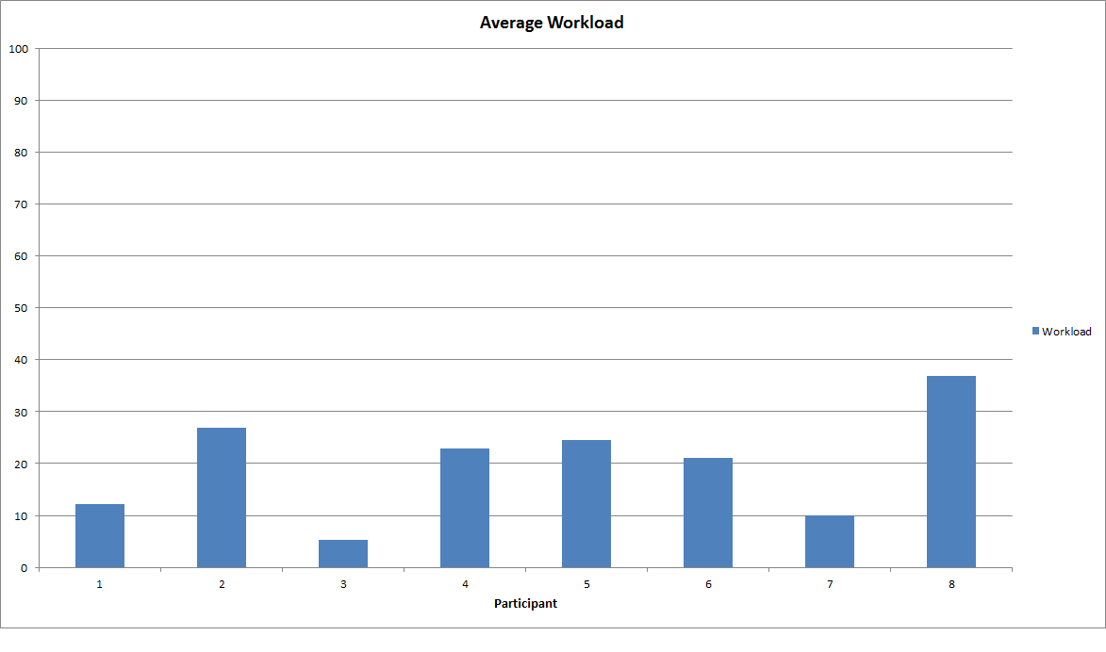
Summary of results from the Evaluation
Low workload to use system

Slide 38
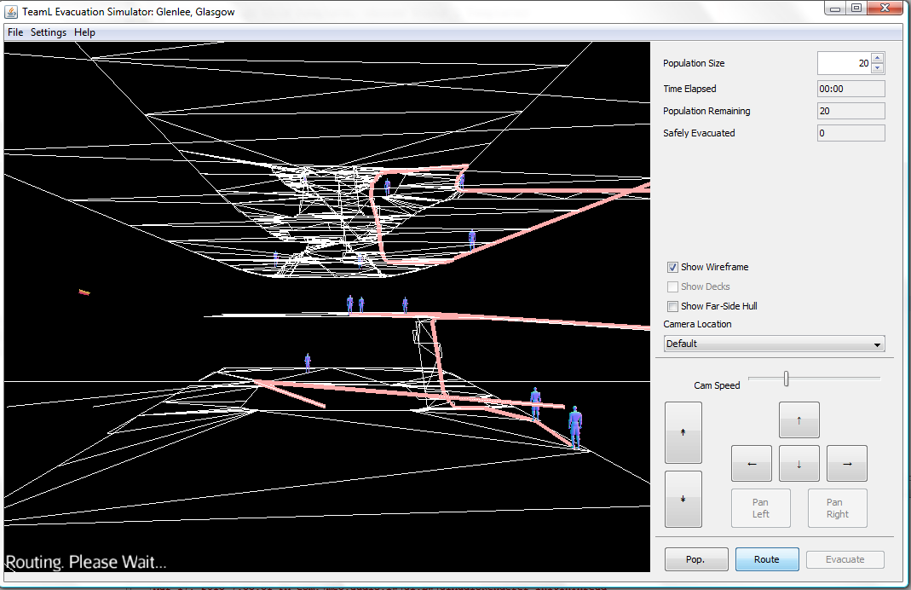
Action on Evaluation Results

Slide 39
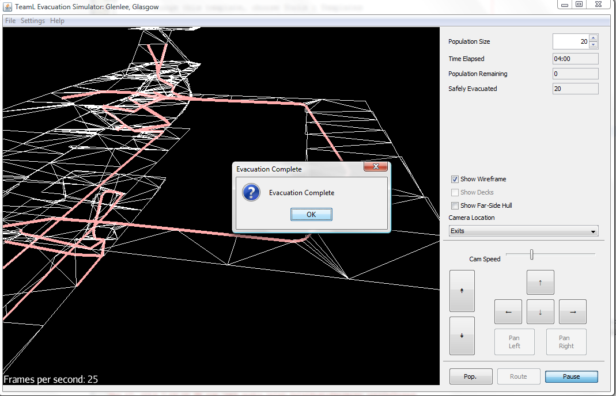
Action on Evaluation Results

Slide 40
Problems Encountered
Ship problematic to model due to curved floors
Further problems importing the model
NavMesh package found to be faulty when used with multiple floors
Complexity of engine used was greater than anticipated due to its poor documentation

Slide 41
What would we have done differently?
Look into technologies in further detail before committing to use them.
Invest more time into training and familiarity with tools
Decrease the scope of the project to something more realistic given the available time-frame
More upfront design to pre-empt possible future problems

Slide 42
Future Work
Integrate the people model into the application to allow further customisation
Use of a thread pool to reduce overhead, and increase performance and GUI responsiveness.
Collision avoidance using ORCA (Optimal Reciprocal Collision Avoidance)

Slide 43
Thank you.
Questions?

