Slide 1
weekly stock prediction
March 2019

Slide 2
Content
Introduction
Exploratory Analysis
Analyses
  Logistic regression
  Linear Discriminant Analysis
  K–Nearest Neighbour
Combined predictors
Conclusion

Slide 3
Introduction
It is very difficult to determine when the stock value hits a top or a bottom.
The Stock Market patterns are non-linear in nature; hence it is difficult to forecast future trends of the market behavior.
With the advent of the digital computer, the stock market prediction has since moved into the machine learning field. The most prominent technique involves the use of artificial neural networks (ANNs), Genetic Algorithms (GA), and Hidden Markov Models (HMM).
This work presents an analysis and development of three machine learning techniques to predict the binary direction (up or down) for a given market asset: Logistic regression model using 4 predictor variables, a linear discriminant and a K Nearest Neighbors analysis.
To further improve the model, the initial data can be normalized and the variables can be combined to find hidden relations.

Slide 4
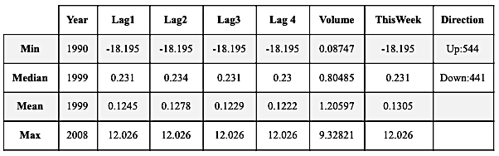
Exploratory analysis
The data consists of 8 variables and 985 weekly returns for 18 years, from the beginning of 1990 to the end of 2008.

Slide 5
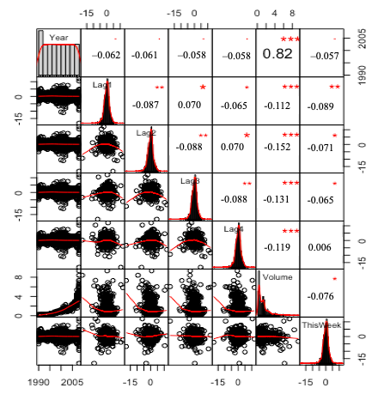
Exploratory analysis
Correlation between ‘Year’ and ‘Volume’ is very high (0.821), indicating that volume increases over time.
To avoid possible collinearity problems, the variable ‘Year’ will not be used as a feature in the classifiers.

Slide 6
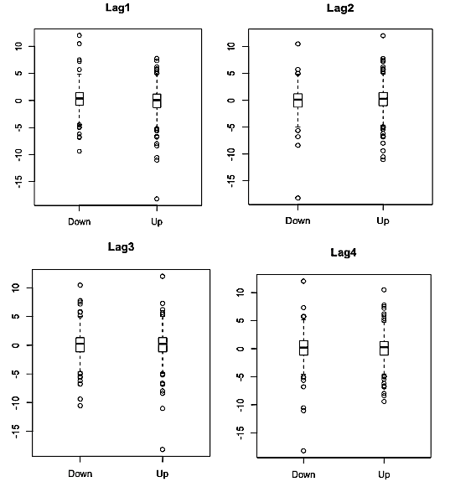
Exploratory analysis
No significant difference in the median values of the features for both classes (Up and Down).
It should be expected that the models are going to have difficulties in predicting our categorical response variable, ‘Direction’ which might result in poor prediction accuracy.

Slide 7
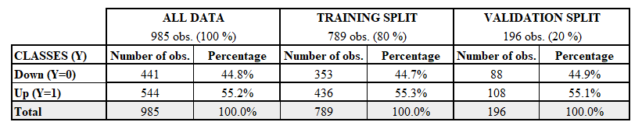
TRAINING AND TEST DATASETS
The splitting was done by randomly selecting 80% of the data for training and 20% for testing.
A validation over the classes distributions was done to ensure an equal representation of the class ‘Up’ in each split.

Slide 8

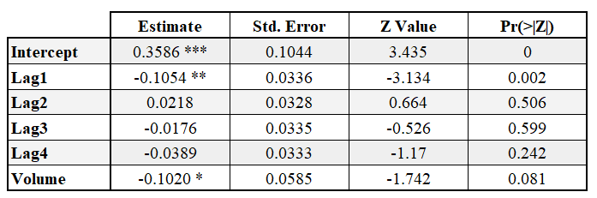
Logistic REgression
The probability of belonging to class ‘Up’ is computed by using the logistic function:
Out of our five predictors, only the parameter for ‘Lag1’ is significant at a 5% level. At a 10% level, the parameter for ‘Volume’ is also significant.

Slide 9
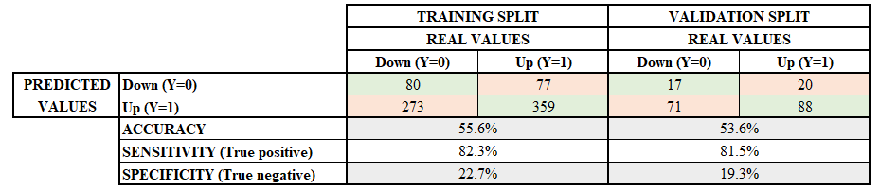
Logistic REgression
This performance is quite poor because by doing a random classification we would expect accuracy of around 50%, so the model is only a minor improvement over randomness.
This is because the model predicts a much higher percentage of Up than the original distribution (81.1% vs. 55.2%).
Accuracy over the training set is 55.6% and it decreases in two points when testing the model over the validation set, 53.6%.
Sensitivity (true positives) is very high 81.5% whereas Specificity (true negatives) is low 19.3%. The distribution of the predicted classes is unbalanced towards ‘Up’ (over 80% of the predictions).
The Average Mean Square Error obtained when using the Leave-one-out cross-validation 0.247 This is a very high square error for a variable that takes values between 0 and 1.

Slide 10

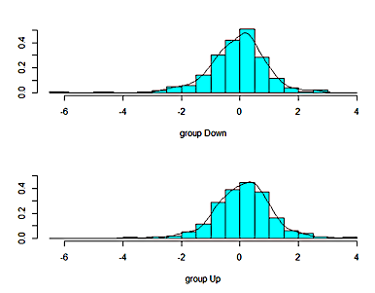
LINEAR DISCRIMINANT ANALYSis
The probability of belonging to class ‘Up’ is computed by using the Bayes Theorem as:
The graphs represent one-dimensional separation of the group Down and Up.
Projection of the data after the implementation of the Linear Discriminant classification.
It shows that even after the projection procedure, the two classes are almost indistinguishable and therefore, not easily separable.

Slide 11
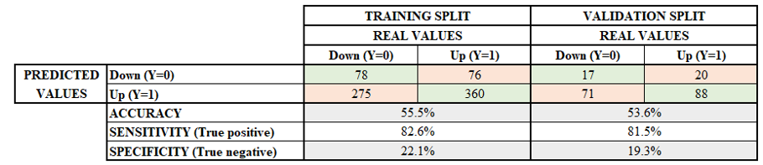
LINEAR DISCRIMINANT ANALYSis
Accuracy over the training set is 55.5% and it decreases in two points when testing the model over the validation set, 53.6%.
Sensitivity (true positives) is very high 81.5% whereas Specificity (true negatives) is low 19.3%. The distribution of the predicted classes is unbalanced towards ‘Up’ (over 80% of the predictions).
The Average Mean Square Error obtained when using the Leave-one-out cross-validation 0.248. This is a very high square error for a variable that takes values between 0 and 1.

Slide 12

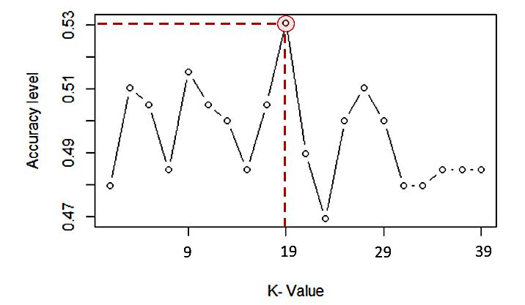
K–nearest neighboUr
The probability of belonging to class ‘Up’ is computed according to the proportion of neighbours that belongs to that class:
The performance of the model is tested with 20 different values for K: all the odd numbers between 1 and 40.
Using this approach, the optimum is K=19, with an accuracy of 53.1%. However, no clear relation between accuracy and K value is observed in the plot.

Slide 13
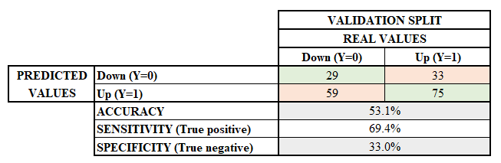
K–nearest neighbour
Accuracy over the validation set is 53.1 %. As for the previous models, this is a poor performance that is only slightly better than assigning the classes randomly.
Sensitivity (true positives) is 69.4% and Specificity (true negatives) is 33.0%. The distribution of the predicted classes in this case is 68% of ‘Up’ and 32% of ‘Down’, which is still a little biased towards ‘Up’.
The Average Mean Square Error when using a leave-one-out cross-validation approach is 0.160. This is the lowest MSE of the three techniques.

Slide 14
COMBINED PREDICTORS
This section proposes to fit the models by adding transformations of the original significant features ‘Lag1’, ‘Lag2’, and ‘Volume’ to achieve better performance. Three combined variables were tested:
FEATURES TEST 1: Lag1, Lag2, Volume and Lag1/Lag2
FEATURES TEST 2: Lag1, Lag2, Volume and Lag1*Lag2
FEATURES: TEST 3 Lag1, Lag2, Volume and Volume(Lag1)/Volume(Lag2)
The included features were not significant and the performance scores do not show improvements.

Slide 15
None of the models used in this project shows a good performance. Accuracy of the predictions is similar in the three techniques (between 53 and 54%).
The Average Mean Square Error of the leave-one-out validation is the lowest for KNN but it is still very high 0.16.
LR and LDA show very high sensitivity and very low specificity. These models predict over 80% of class ‘Up’ .
KNN have a slightly worse sensitivity than the other two techniques, but the specificity is higher.
Defining the best classifier out of the three depends on the costs of making type I and type II errors. If the cost of error type I (false positive) is high, it is be preferable to choose the model with the higher specificity.
Including combined features does not seem to improve the performances of the models.
Next steps: to test additional classification techniques, such as SVM and NN, and to model the continuous variable ‘This Week’ using linear regression and time series.
CONCLUSION

