Slide 1
Linear Algebra
(Credit: Steven Skiena Stony Brook University)
Dantong Yu
Associate Professor

Slide 2
Get the Matrix!
The most critical part of your data science project is reducing all the information you can find one or more data matrices, ideally as large as possible.
Rows are examples.
Columns are distinct features/attributes. You need to be building your matrix now!

Slide 3
Linear Algebra
Linear algebra is the mathematics of matrices. This makes it the language of data science.
Many machine learning algorithms are best understood through linear algebra.
You presumably had an undergraduate course in basic calculus, probability, but here I will review what you need to know to understand what we will discuss in this summer program.

Slide 4

Scalars
A scalar is a single number
Integers, real numbers, rational numbers, etc.
We denote it with italic font:
$$a,n,x$$

Slide 5
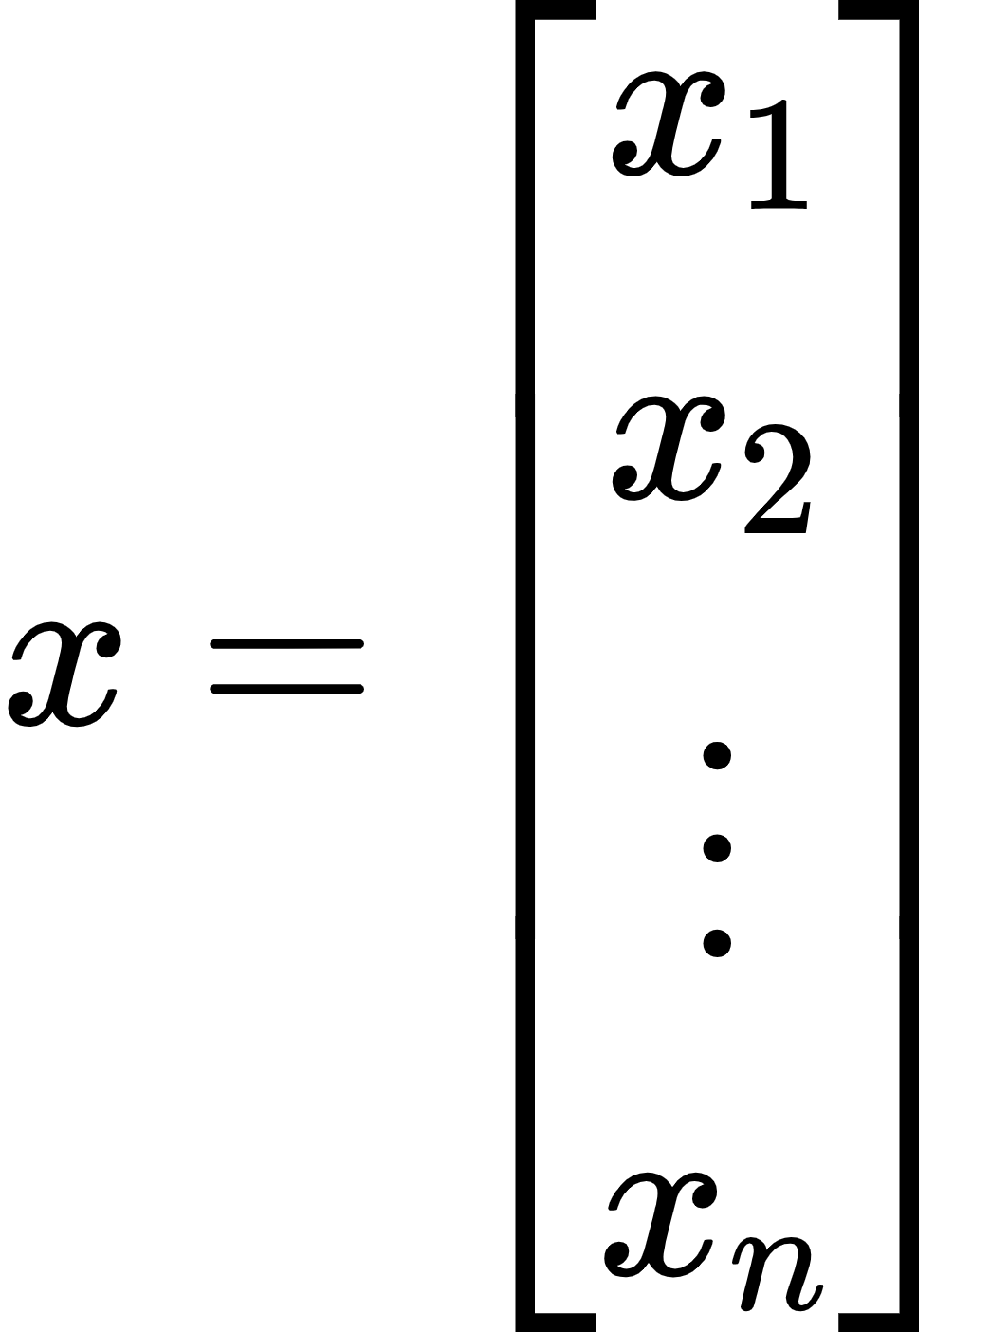

Vectors
A vector is a 1-D array of numbers:
(2.1)
Can be real, binary, integer, etc.
Example notation for type and size:
Notes:
x= \begin{bmatrix}
x_1\\
x_2\\
\vdots\\
x_n
\end{bmatrix}
\mathbb{R}^n

Slide 6
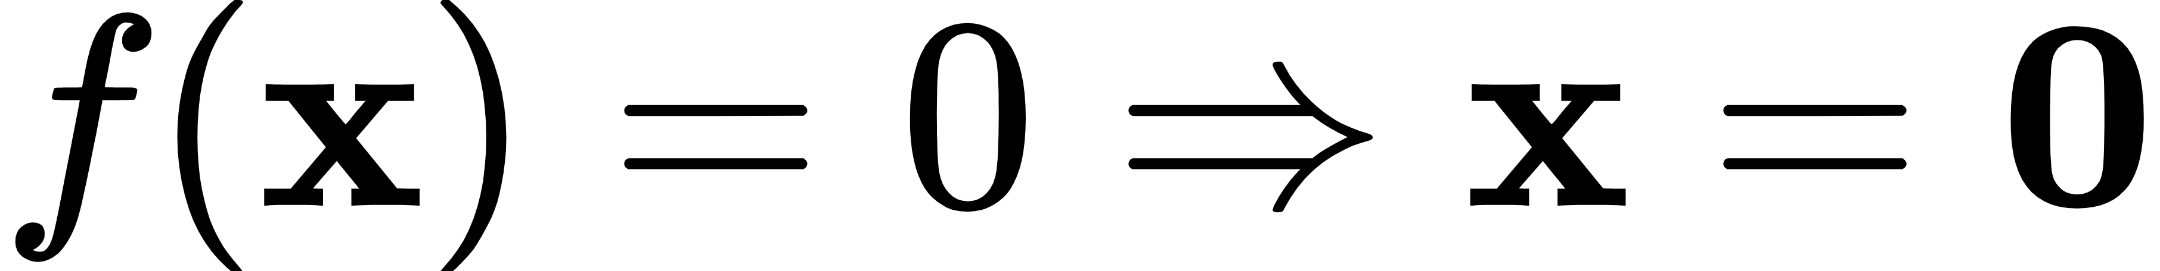

What are Norms of Vector $x$
Functions that measure how “large” or how long a vector is
Similar to a distance between zero and the point represented by the vector
(the triangle inequality)
Notes:
f(\mathbf{x}) =0 \Rightarrow \mathbf{x} =\mathbf{0} \\
f(\mathbf{x} + \mathbf{y}) \le f(\mathbf{x} ) + f(\mathbf{y}) \\
\forall \alpha \in \mathbb{R}, f(\alpha \mathbf{x} ) = \left| \alpha \right| f(\mathbf{x} )\\

Slide 7

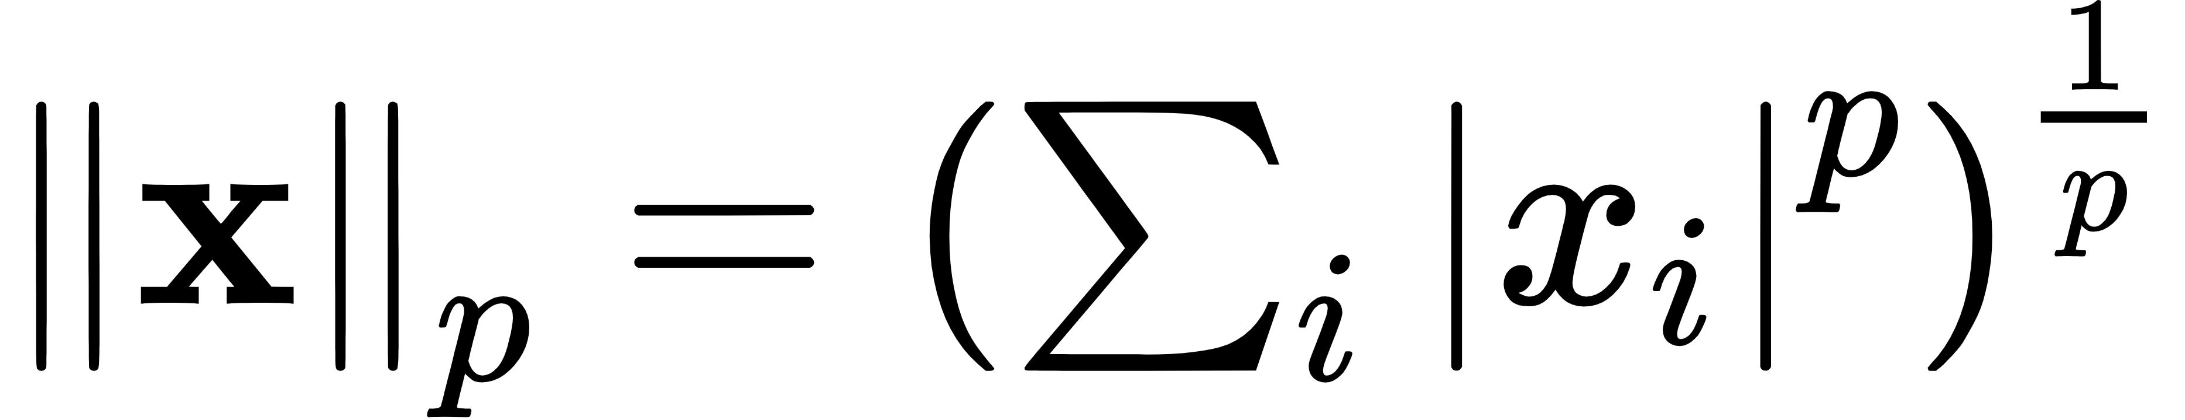
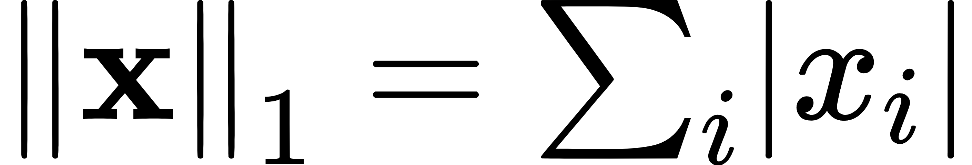
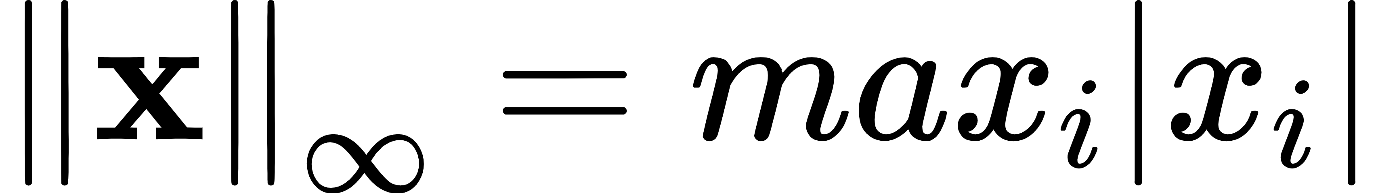
Norms
norm
Most popular norm: L2 norm, p=2
L1 norm, p=1:
(2.31)
•
Max norm, infinite p:
(2.32)
Notes:
L^{p}\\
\left\| \mathbf{x} \right\|_{p} =\left( \sum_{i} \left| x_{i} \right|^{p} \right)^{\frac{1}{p}}\\
\left\| \mathbf{x} \right\|_{1} =\sum_{i}\left| x_{i} \right|\\
\left\| \mathbf{x} \right\|_{\infty} = max_{i}\left| x_{i} \right|\\

Slide 8
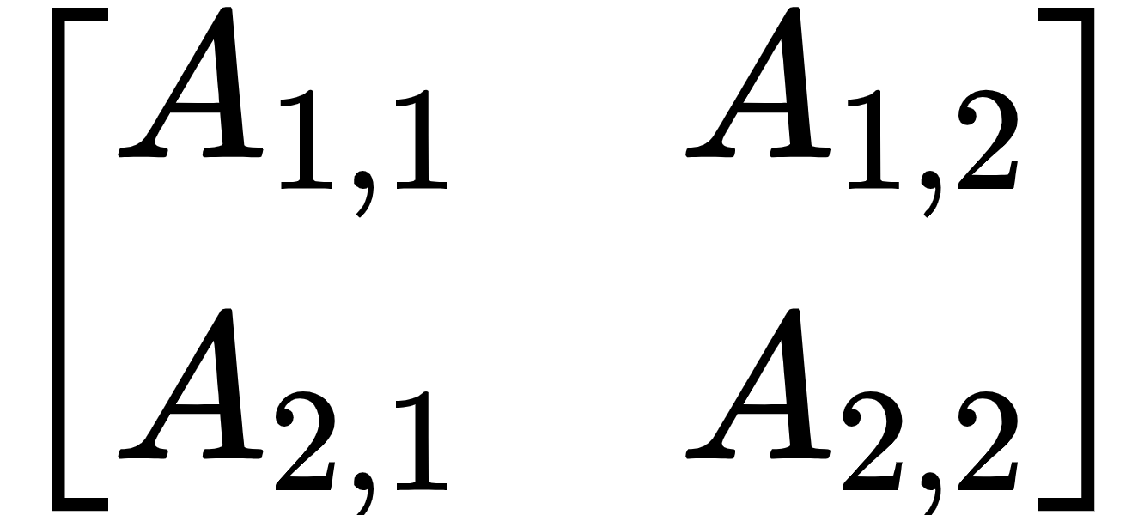
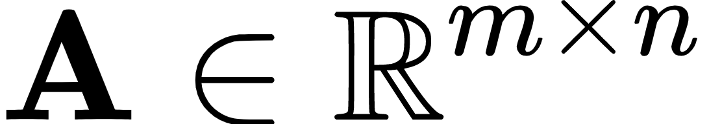
Matrices
A matrix is a 2-D array of numbers:
Row
(2.2)
Column
Example notation for type and shape:
Notes:
\begin{bmatrix}
A_{1,1} & A_{1,2}\\
A_{2,1} & A_{2,2}
\end{bmatrix}
\mathbf{A} \in \mathbb{R}^{m \times n}

Slide 9
Tensors
A tensor is an array of numbers, that may have
zero dimensions, and be a scalar
>>> import numpy as np
>>> a = np.array(1)
>>> a
array(1)
>>> a.shape
()
>>> a.ndim
0
one dimension, and be a vector
two dimensions, and be a matrix
or more dimensions.

Slide 10
What Can n*m Matrices Represent?
Data: rows are objects, columns features.
Geometric point sets: rows are points, columns are dimensions
Systems of Equations: rows are equations, columns are coefficients for each variable.
Graphs/Networks: M[i,j] denotes the number of edges from vertex i to vertex j.
Vectors: any row, column or d*1 matrix

Slide 11

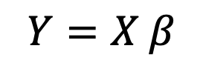
Linear Algebra Formulae
Concise formulas written as products of matrices provides great power.
It yields elegant, concise, mechanical ways to express and manipulate such formulae.
But such strings of operations can, I find, be difficult to interpret and understand.
$$Y=X β$$
$$β={\left(X^{⊤}X\right)}^{−1}X^{⊤}Y$$

Slide 12
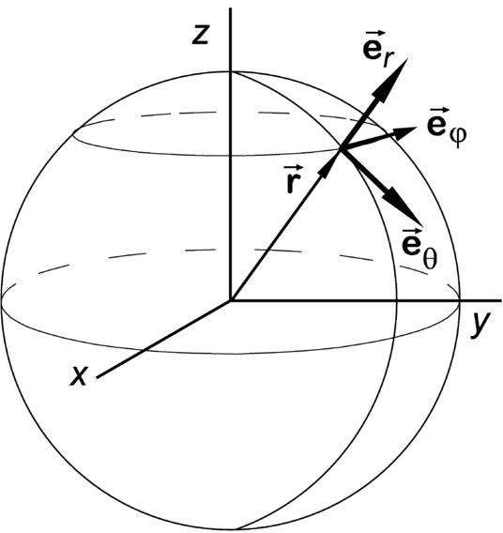
Points vs. Vectors
Points in d dimensions can be represented as unit vectors (points on the sphere), plus their magnitudes.
Distances between points become angles between vectors, for purposes of comparison.
Ignoring magnitudes is a form of scaling, making all points directly comparable.

Slide 13
Vectors

Slide 14
Vectors

Slide 15

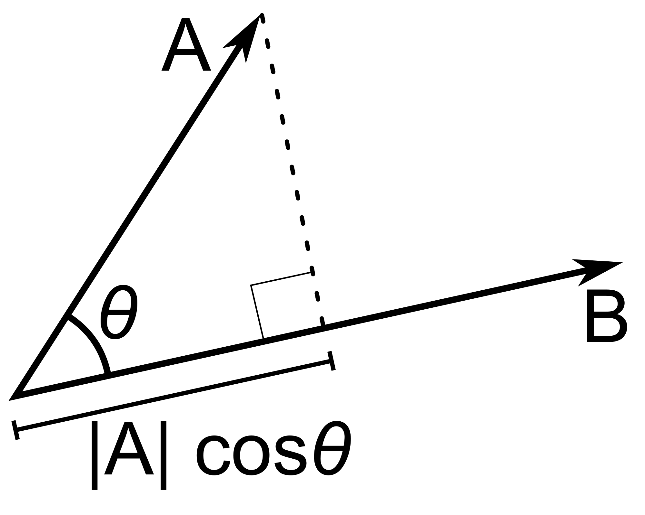
Angles between Vectors
To compute angle AB:
Cos(0)=1, Cos(Pi/2)=0, Cos(Pi)=-1
Scores like correlation coefficients:
Cos = correlation of mean zero variables!
For unit vectors, ||A||=||B||=1, so the angle between A and B is defined by the dot product.

Slide 16


Visualizing Matrix Operations
We use images to represent matrices

Slide 17



A Matrix and its Transpose
The transpose of a matrix M interchanges rows and columns, turning an a$×$b matrix to a b $×$a matrix.
Note that colors get rescaled when magnitudes change.

Slide 18
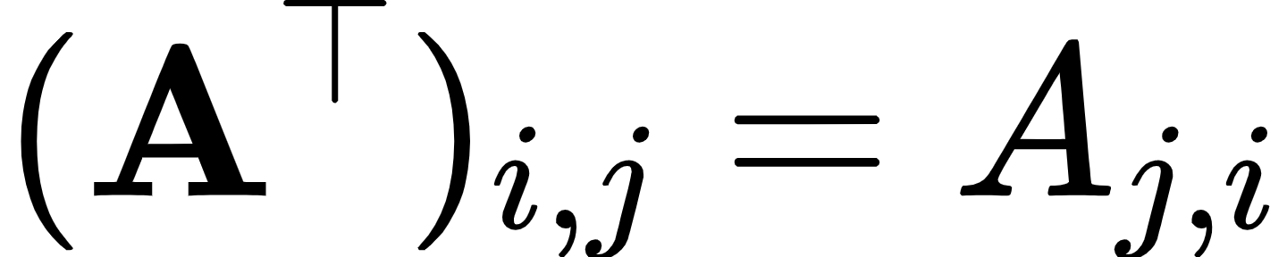
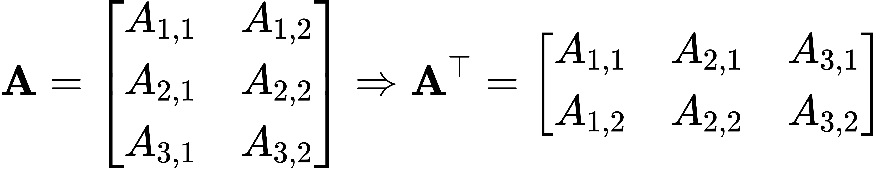

Matrix Transpose
(2.3)
Figure 2.1: The transpose of the matrix can be thought of as a mirror image across the main diagonal.
(2.9)
Notes:
(\mathbf{A}^{\top})_{i,j} = A_{j,i}
\mathbf{A} = \begin{bmatrix}
A_{1,1} & A_{1,2}\\
A_{2,1} & A_{2,2}\\
A_{3,1} & A_{3,2}
\end{bmatrix} \Rightarrow \mathbf{A}^{\top} = \begin{bmatrix}
A_{1,1} & A_{2,1} & A_{3,1}\\
A_{1,2} & A_{2,2} & A_{3,2}
\end{bmatrix}
(\mathbf{AB})^{\top} = \mathbf{B}^{\top} \mathbf{A}^{\top}

Slide 19


Addition and Transposition
A mix of scalar multiplication and addition.

Slide 20


Linear Combination: B=(A+C)/2
Mix of scalar multiplication/ addition.

Slide 21




Matrix Vector Multiplication
Notes:
\mathbf{C} = \mathbf{A}\mathbf{B} \\
C_{i,j} = \sum_{k}A_{i,k}B_{k,j}\\

Slide 22
Matrix Vector Multiplication
Notes:
\mathbf{C} = \mathbf{A}\mathbf{B} \\
C_{i,j} = \sum_{k}A_{i,k}B_{k,j}\\

Slide 23

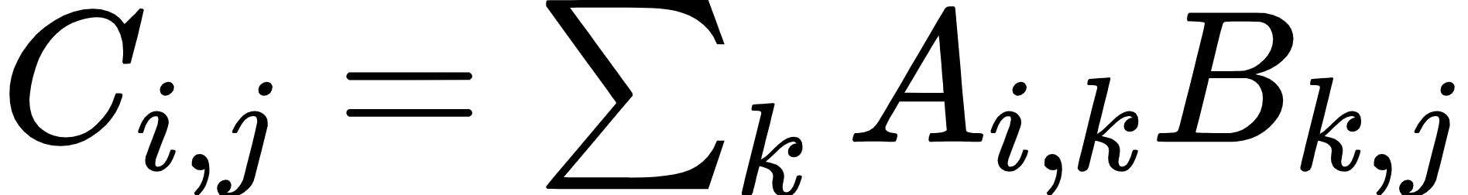



Matrix (Dot) Product
(2.4)
(2.5)
m
= m
n
p
p
n
Must match
Notes:
\mathbf{C} = \mathbf{A}\mathbf{B} \\
C_{i,j} = \sum_{k}A_{i,k}B_{k,j}\\

Slide 24

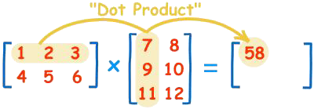
Matrix Multiplication / Dot Products
The product A*B is defined by:
A*B must share inner dimensions to multiply. Each element of the product matrix is a dot product of row/column vectors.
Dot products measure how “in sync” the two vectors are, as in computing covariance or correlation.

Slide 25
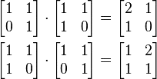
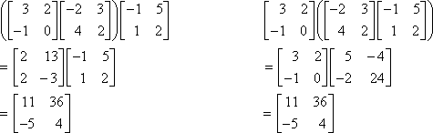
Properties of Matrix Multiplication
It is associative but not commutative:
Multiplication by the identity commutes: Although the algorithm is simple to
program, faster, more numerically stable algorithms exist in highly optimized libraries.

Slide 26


Multiplying Feature Matrices
Suppose A is an n*d data matrix. What is A times its transpose?:
is an n*n matrix of dot products, measuring “in sync-ness” among points.
is a d*d matrix of dot products, measuring “in sync-ness” among features.
These are called covariance matricies.

Slide 27

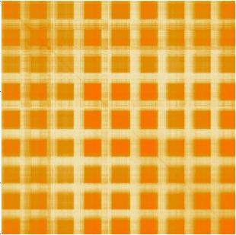
Row or Column Convariance Matrix?

Slide 28
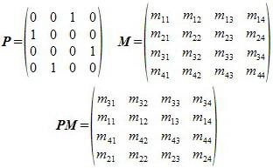
Interpreting Matrix Multiplication
Multiplying 0/1 adjacency matrices yield paths of length two: a[i,k]=a[i,j]*a[j,k]
Multiplication by permutation matrices rearrange rows/columns:

Slide 29
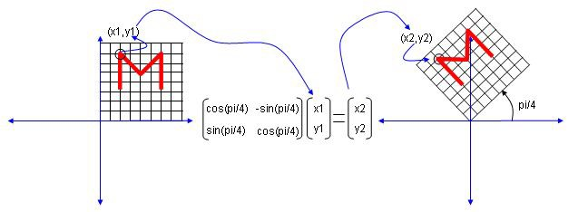
Interpreting Matrix Multiplication
Rotating points in space:
Multiplying something by the right, matrix can have magic properties, in arbitrary dimensions.

Slide 30
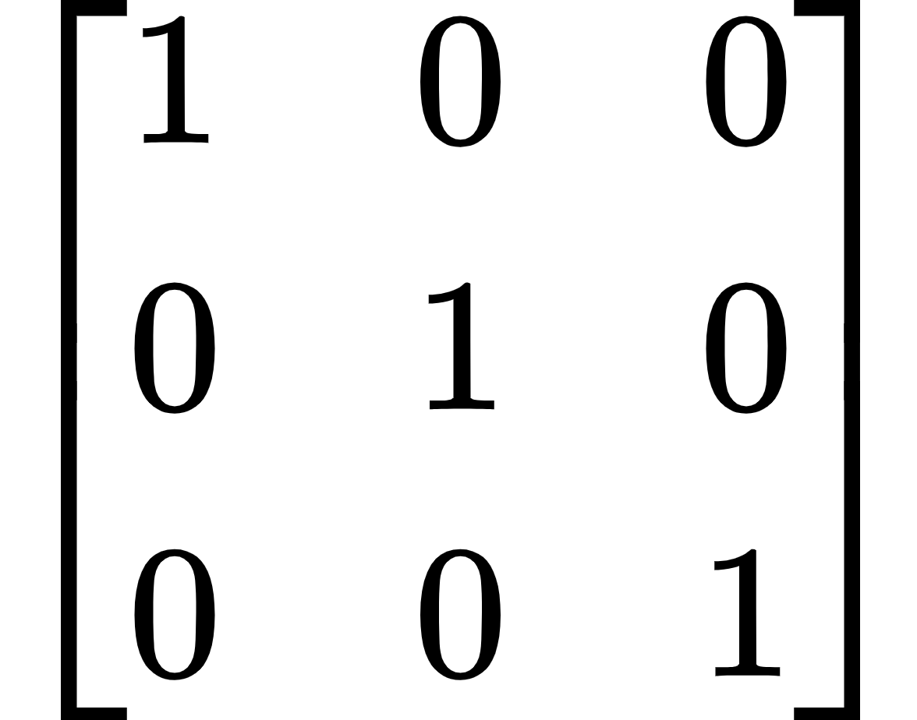

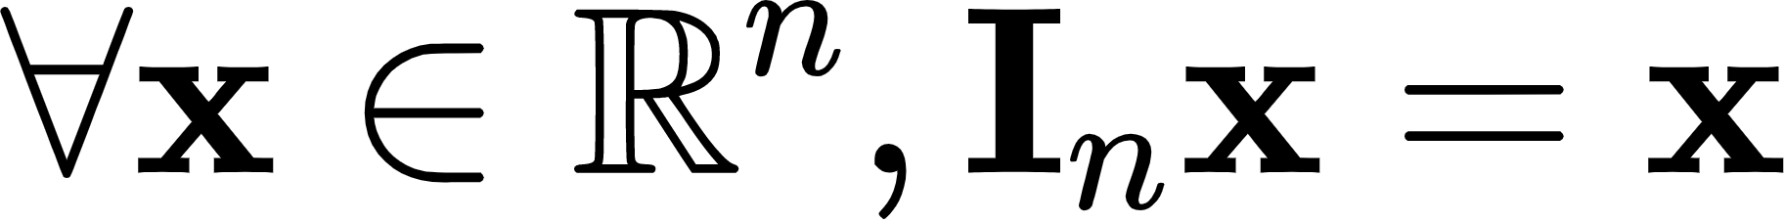
Identity Matrix
Figure 2.2: Example identity matrix: This is .
(2.20)
Notes:
\begin{bmatrix}
1 & 0 & 0\\
0 & 1 & 0\\
0 & 0 & 1
\end{bmatrix}\\
\mathbf{I}_{3}\\
\forall \mathbf{x} \in \mathbb{R}^{n} , \mathbf{I}_{n} \mathbf{x} = \mathbf{x}\\

Slide 31
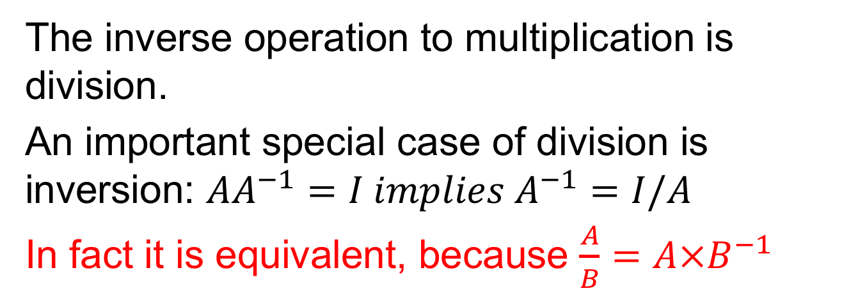
Dividing Matrices
The inverse operation to multiplication is division.
An important special case of division is inversion: $AA^{−1}=I implies A^{−1}=I/A$
In fact it is equivalent, because $\frac{A}{B}=A×B^{−1}$

Slide 32

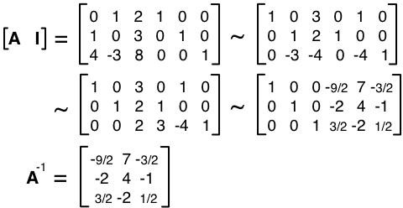
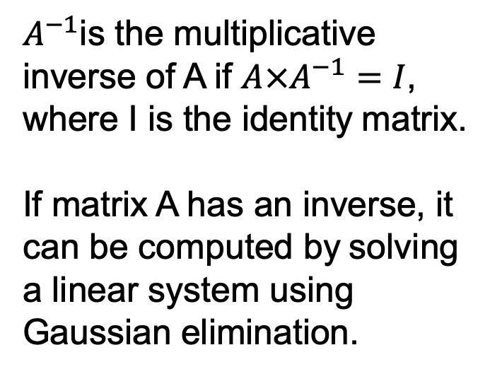
Matrix Inversion
$A^{−1}$is the multiplicative inverse of A if ${A×A}^{−1}=I$, where I is the identity matrix.
If matrix A has an inverse, it can be computed by solving a linear system using Gaussian elimination.

Slide 33




Inverse of Lincoln

Slide 34
Invertibility
Matrix can’t be inverted if…
More rows than columns
More columns than rows
Redundant rows/columns (“linearly dependent”, “low rank”)

Slide 35
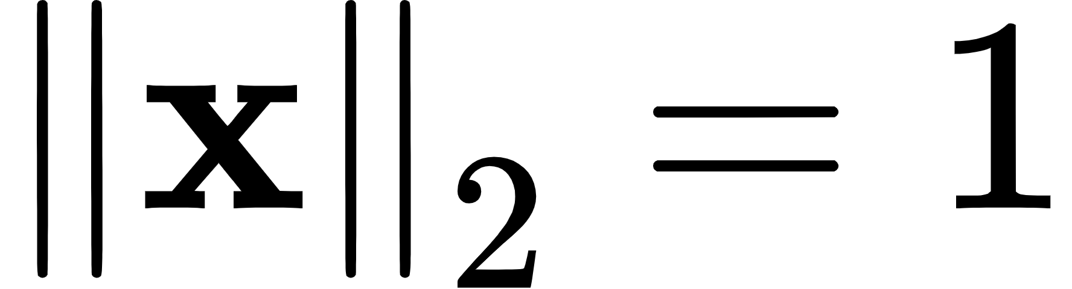

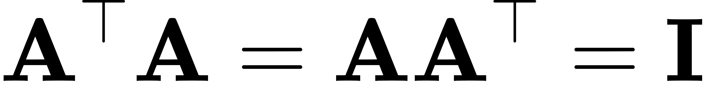

Special Matrices and Vectors
Unit vector:
(2.36)
Symmetric Matrix:
(2.35)
Orthogonal matrix:
Notes:
\left\| \mathbf{x} \right\|_{2} = 1\\
\mathbf{A} = \mathbf{A}^{\top}\\
\mathbf{A}^{\top} \mathbf{A} = \mathbf{A} \mathbf{A}^{\top} = \mathbf{I}\\
\mathbf{A}^{-1} = \mathbf{A}^{\top}\\

Slide 36
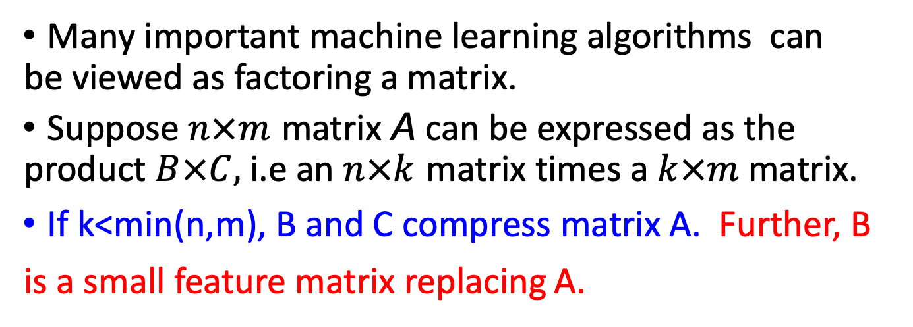
Factoring Matrices
Many important machine learning algorithms can be viewed as factoring a matrix.
Suppose $n×m$ matrix A can be expressed as the product $B×C,$ i.e an $n×k$ matrix times a $k×m$matrix.
If k<min(n,m), B and C compress matrix A. Further, B is a small feature matrix replacing A.

Slide 37

Factoring Word-Document Matricies
If A is a document/word co-ocurrence matrix, and A=BC, where B is d*k and C is k*w:
B is a compressed feature vector for docs
C is a compressed feature vector for words

Slide 38
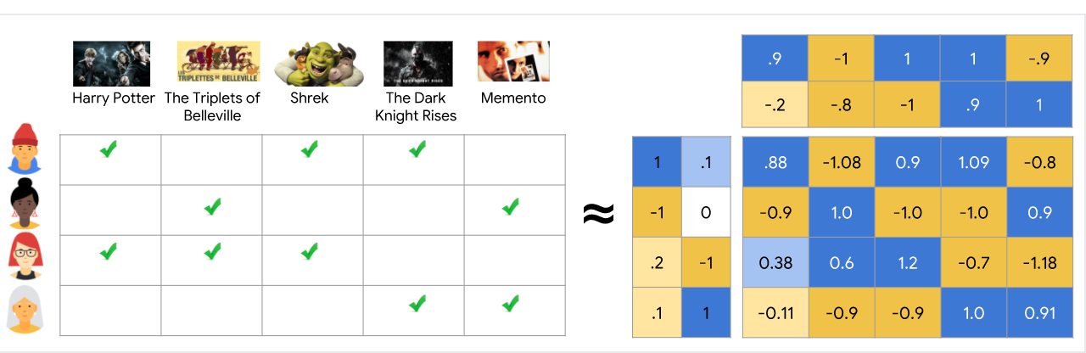
Our Approach (Factorization and Completion)
Movie prediction is essentially a matrix

Slide 39



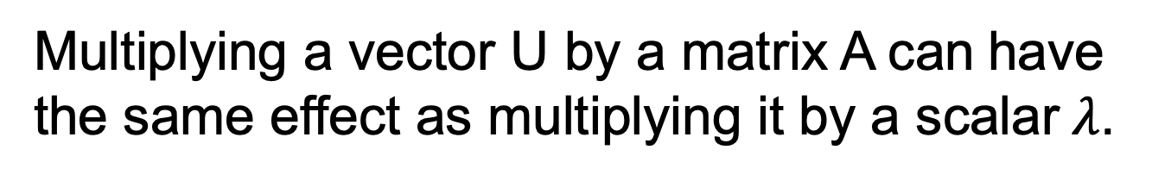
Eigenvalues and Eigenvectors
Multiplying a vector U by a matrix A can have the same effect as multiplying it by a scalar$λ$.
Thus the eigenvalue-eigenvector pair (U, $λ$.) must encode a lot of information about matrix A!

Slide 40
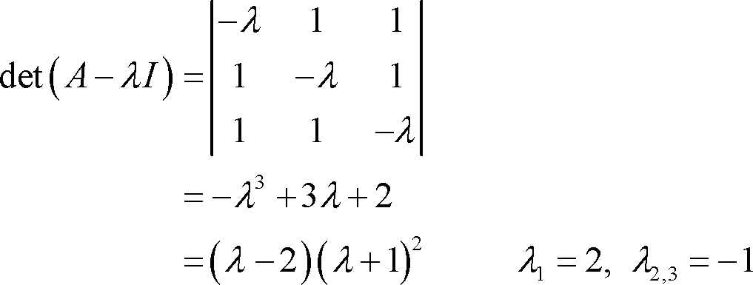
Computing Eigenvalues
The n distinct eigenvalues of a rank n matrix can be found by factoring its characteristic equation:
Faster algorithms exist to find the largest eigenvalues, which are the most important.

Slide 41
Properties of Eigenvalues
A full-rank matrix has n vector-value pairs.
Each pair of Eigen vectors from a symmetric matrix are mutually orthogonal, like x-y axes. E.g. the dot product is of (2,-1) and (1,2) is zero.
Thus eigenvectors can play the role of dimensions or basis in n-dimensional space.
Vectors/values are found by solving linear systems.

Slide 42



Eigenvalue Decomposition
Any n*n symmetric matrix M can be decomposed into its n eigenvector products:
$$M=UΛU^{⊤}$$
Let $U_{i}$ be the column vector of U, then M is decomposed into
the outer product of the column vectors of U
Larger eigenvalues correspond to more important vector products.

Slide 43
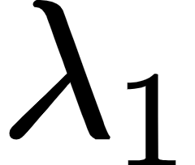

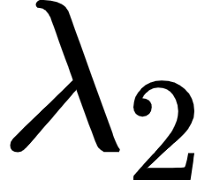
Eﬀect of Eigenvalues
Before multiplication
After multiplication
3
3
_{v}(1)
2
2
1
_{v}(1)
1
_{v}(1)
x₁
0
_{x1}′
0
_{v}(2)
_{v}(2)
_{v}(2)
−1
−1
−2
−2
−3
−3
−3 −2 −1 0
1
2
3
−3 −2 −1 0
1
2
3
x₀
_{x0}′
Notes:
\lambda_{1}
x_{0}
x'_{0}

Slide 44

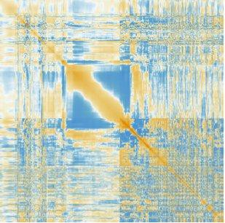
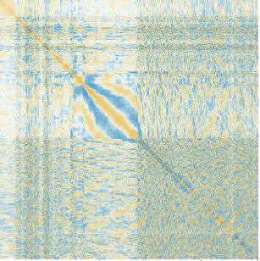
Reconstructing a Covariance Matrix
Summing only the largest vector produces performs dimension reduction, identifying the most important features of the matrix.
Covariance matrix error for the Lincoln memorial reduces when summing the 1, 5, and 50 largest eigenvectors for n=512

Slide 45
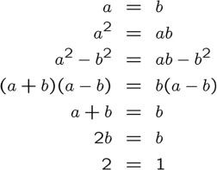
Algebraic Proof: 2=1

Slide 46
Lessons from the Proof
There are special cases / singularities to watch for, like division by 0.
In linear algebra, such cases include singular / non-invertible matrices.

