Slide 1
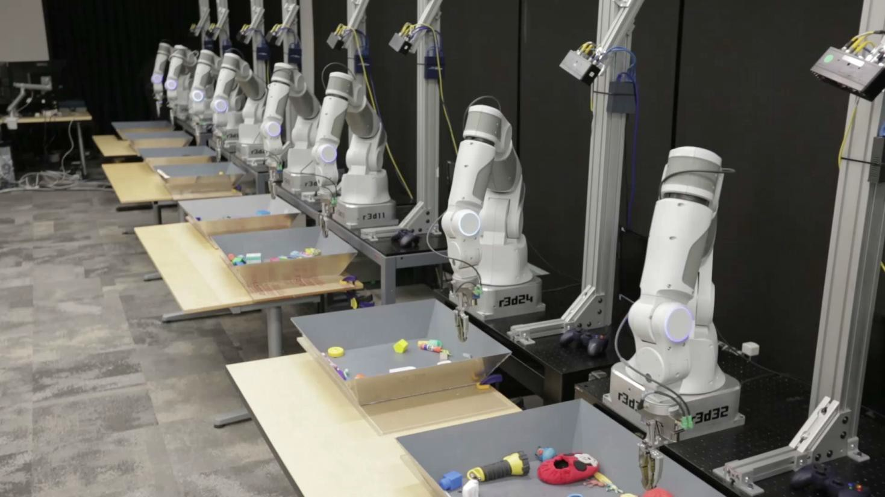

Slide 2
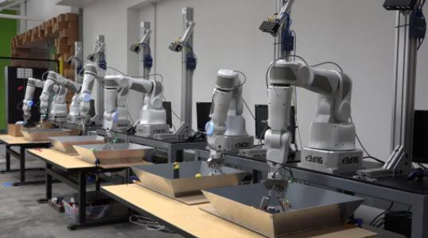



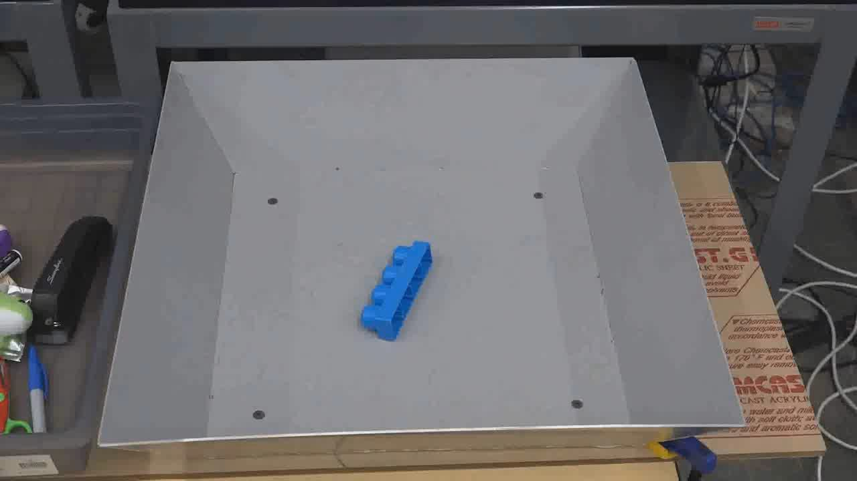
data
reinforcement
learning

Slide 3
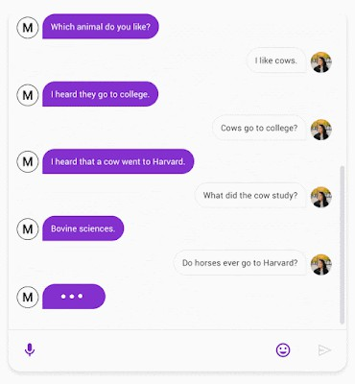
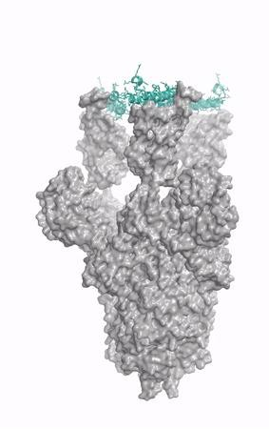
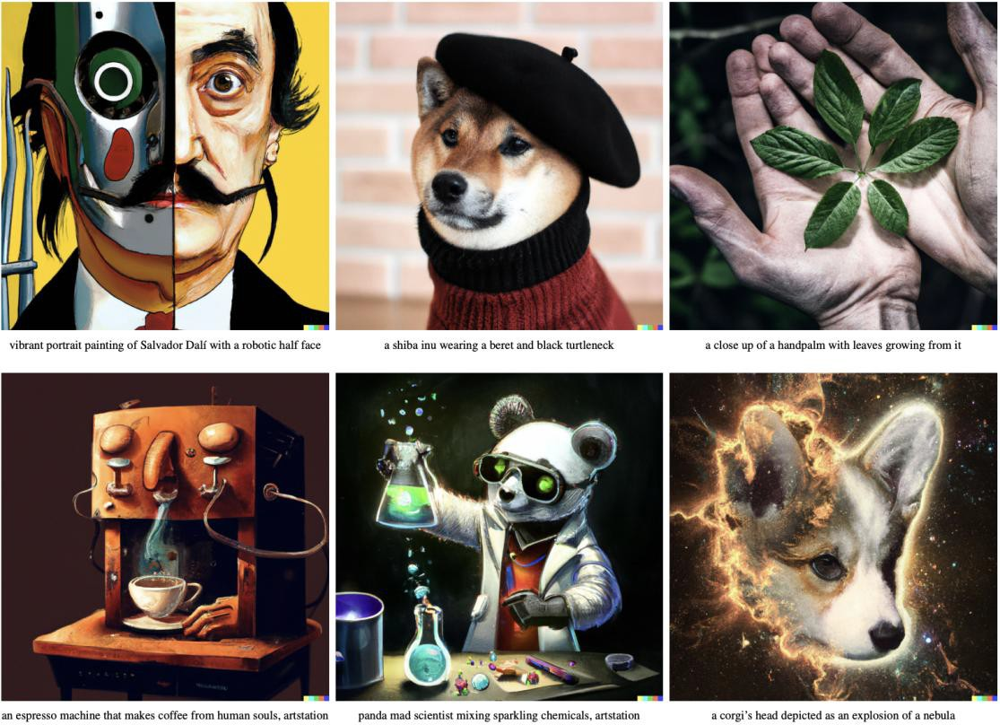
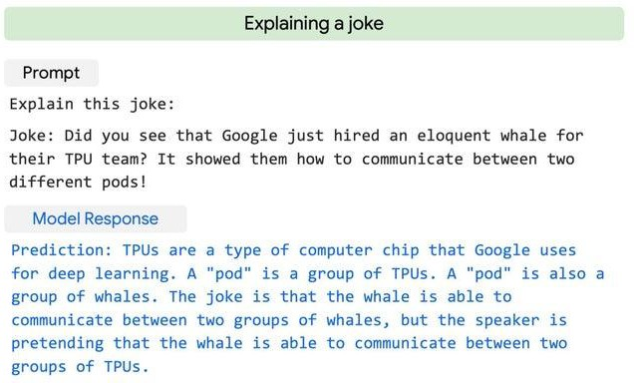
What are some recent advances
we’ve seen in AI?
image credit: UW IPD
5

Slide 4
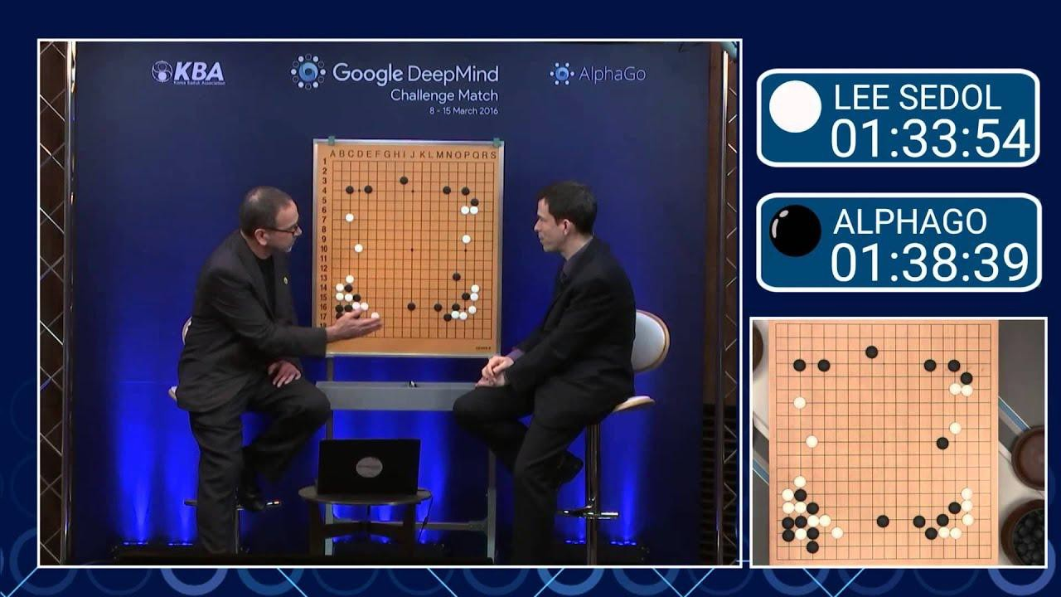
Reinforcement learning can discover new solutions
Impressive because no person had thought of it!
Impressive because it looks like something a person might draw!
“Move 37” in Lee Sedol AlphaGo match: reinforcement learning “discovers” a move that surprises everyone
8

Slide 5
What is reinforcement learning?
Mathematical formalism for learning-based decision making
Approach for learning decision making and control from experience

Slide 6


How is this different from other machine learning topics?
Standard (supervised)
Reinforcement learning:
machine learning:
Data is not i.i.d.: previous outputs influence future inputs!
Ground truth answer is not known, only know if we succeeded or failed
more generally, we know the reward
Usually assumes:
data
i.i.d. data
known ground truth outputs in training
data
supervised learning
reinforcement learning

Slide 7
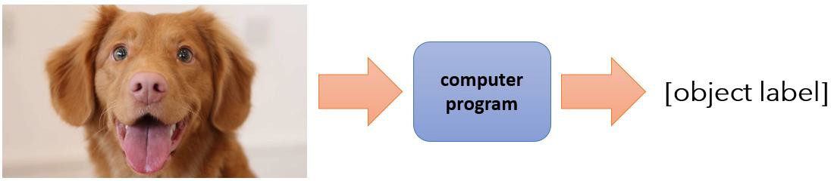
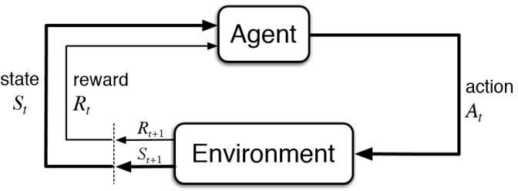





What is reinforcement learning?
supervised learning
reinforcement learning
pick your own actions
someone gives
this to you

Slide 8


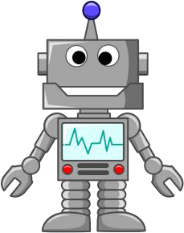

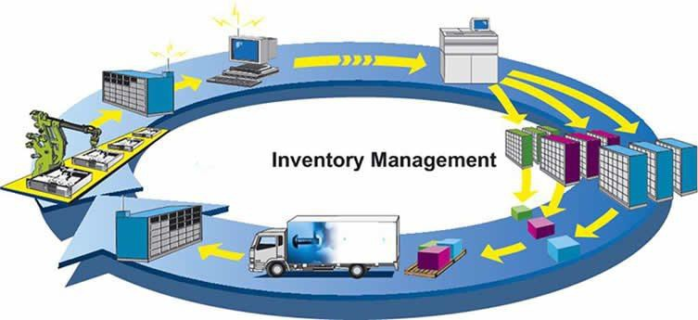
decisions (actions)
Actions: muscle contractions Observations: sight, smell Rewards: food
Actions: motor current or torque Observations: camera images Rewards: task success measure (e.g., running speed)
consequences observations rewards
(states)
Actions: what to purchase Observations: inventory levels Rewards: profit

Slide 9
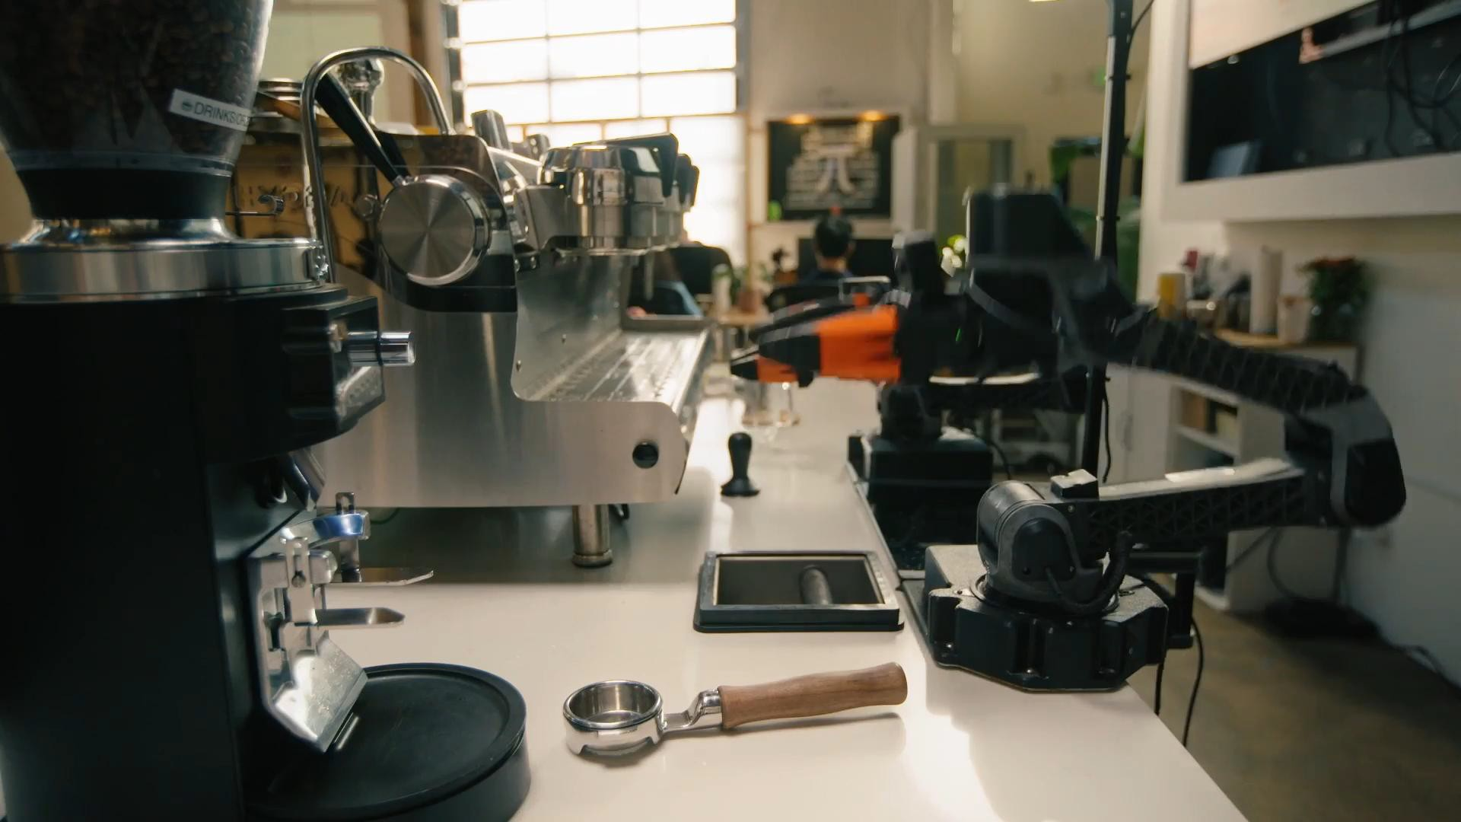
Really really complex physical tasks!
pi.website

Slide 10
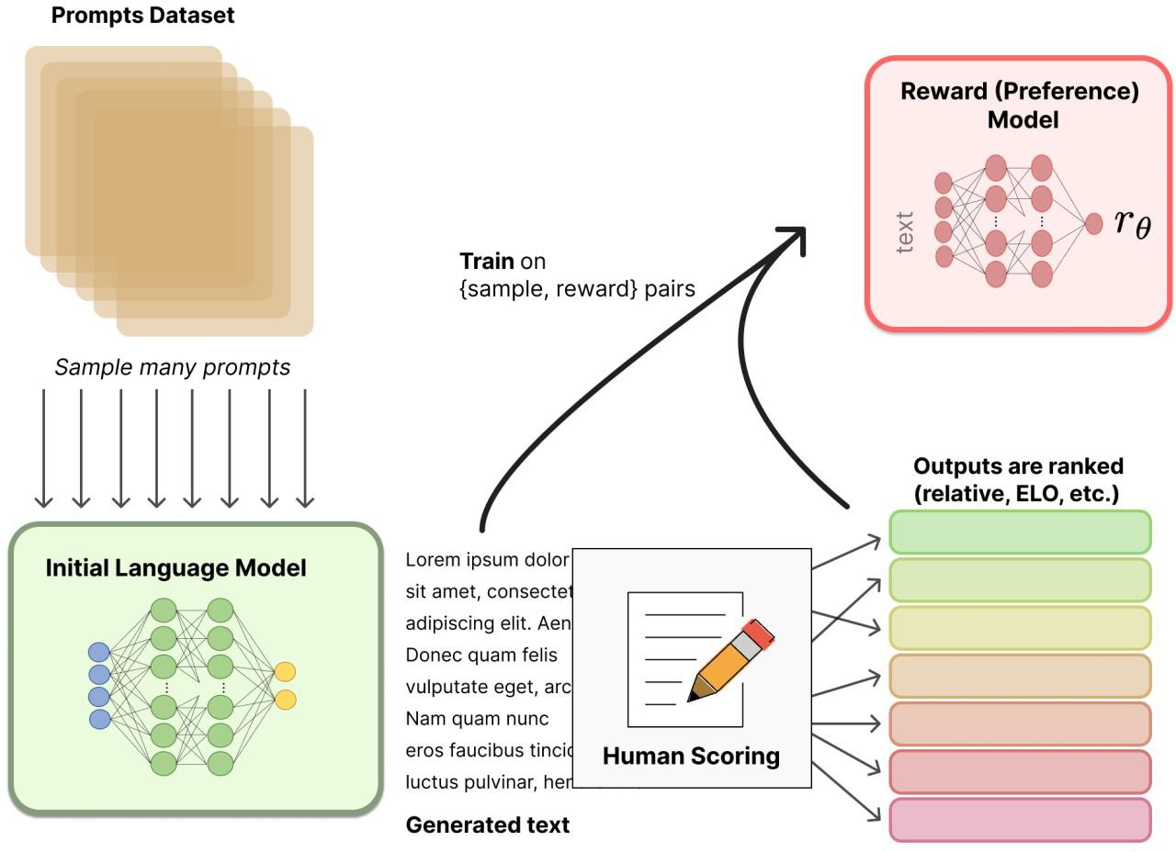
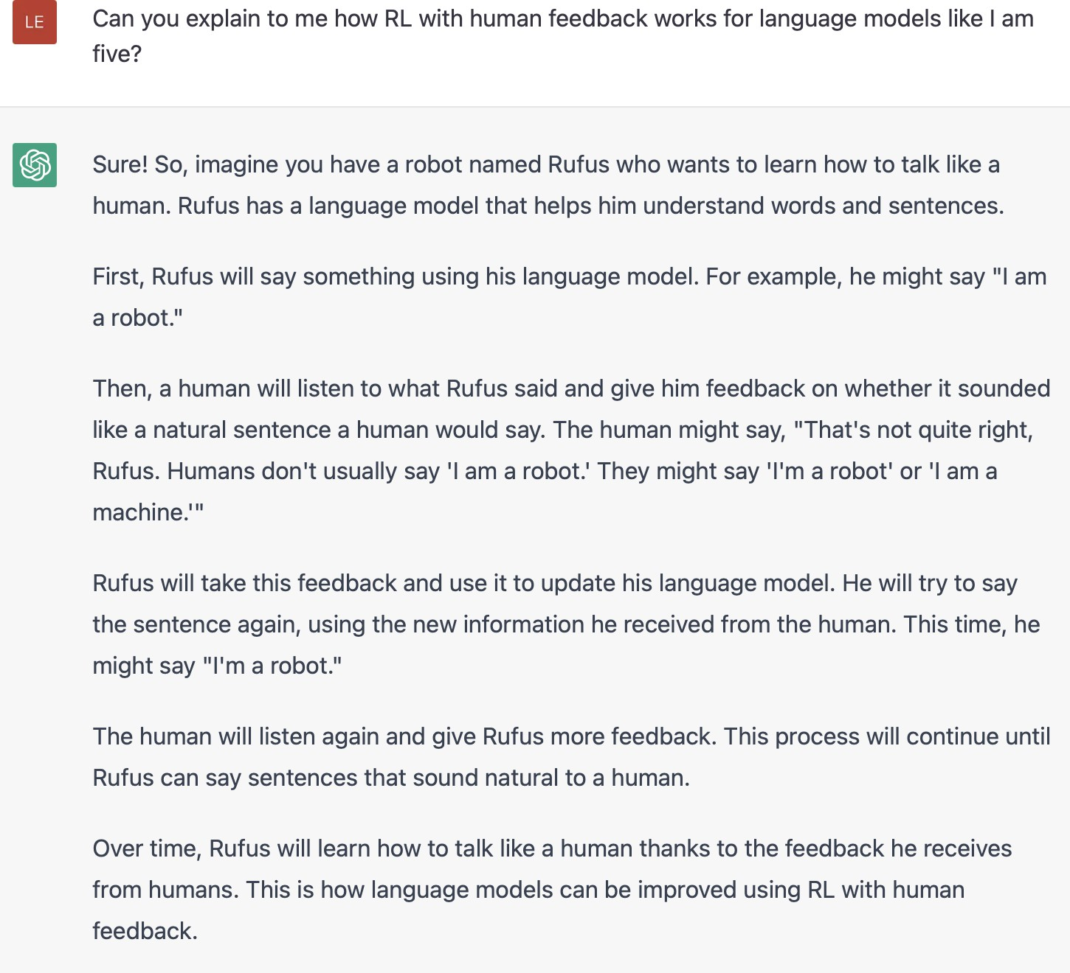
Reinforcement learning with language models
Source: https://huggingface.co/blog/rlhf

Slide 11
Part 3:
Why learn about reinforcement learning?

Slide 12
Reinforcement learning can discover new solutions
Impressive because no person had thought of it!
Impressive because it looks like something a person might draw!
“Move 37” in Lee Sedol AlphaGo match: reinforcement learning “discovers” a move that surprises everyone
27

Slide 13


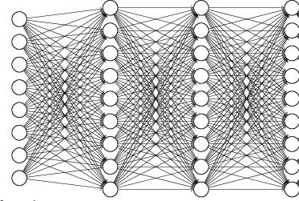

So where does that leave us?
Data-Driven AI Reinforcement Learning
All about using data
All about optimization
+ learns about the real world from data
- doesn’t try to do better than the data
+ optimizes a goal with emergent behavior
- but need to figure out how to use at scale!
Data without optimization
doesn’t allow us to solve new
problems in new ways
29

Slide 14

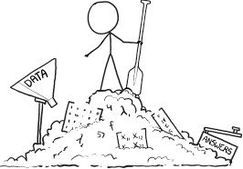


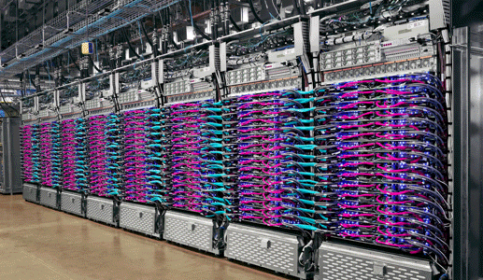



A bitter but misunderstood lesson
The two methods that seem to scale
arbitrarily … are learning and search.
xkcd
Data without optimization doesn’t allow us to solve new^{on} problems in new ways |  | Optimization without data is hard to apply to the real world outside of simulators
 | 2
- “The Bitter Lesson”, Sutton
You mean we should
shovel more data into the GPU, right?
Richard Sutto
Learning
use data to extract patterns
Search
use computation to extract inferences
some optimization process that uses (typically iterative) computation to make rational decisions
optimization
allows us to understand the world
leverages that understanding for emergence
30

Slide 15
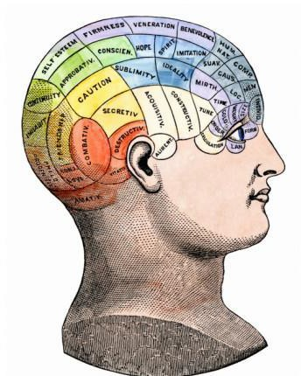
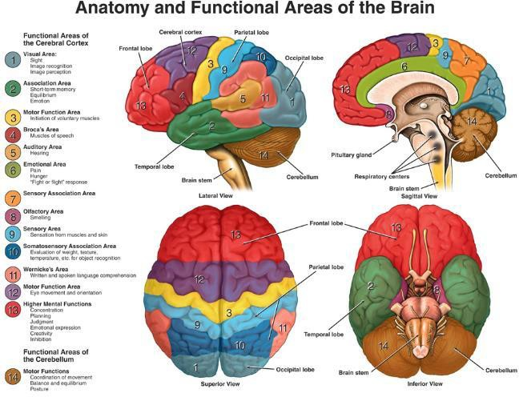
How do we build intelligent machines?
Imagine you have to build an intelligent machine, where do you start?

Slide 16
Learning as the basis of intelligence
Some things we can all do (e.g. walking)
Some things we can only learn (e.g. driving a car)
We can learn a huge variety of things, including very difficult things
Therefore our learning mechanism(s) are likely powerful enough to do everything we associate with intelligence
But it may still be very convenient to “hard-code” a few really important bits

Slide 17
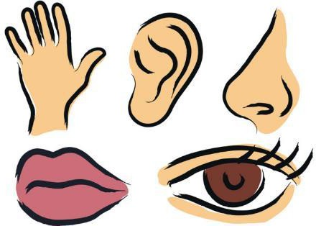
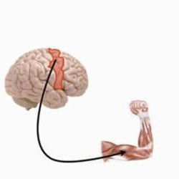
What must that single algorithm do?
Interpret rich sensory inputs
Choose complex actions

Slide 18



Why deep reinforcement learning?
Deep = scalable learning from large, complex datasets
Reinforcement learning = optimization
Learning
use data to extract patterns
Search
use computation to extract inferences
optimization
allows us to understand the world
leverages that understanding for emergence

Slide 19
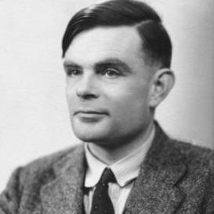
Instead program
of trying to produce a to simulate the adult
mind, why not rather try to
produce one which simulates the child's? If this were then subjected
general learning
algorithm
to an appropriate course of
education one would obtain the adult brain.
- Alan Turing
observations
actions
environment

Slide 20
Part 1:
The Markov decision process

Slide 21
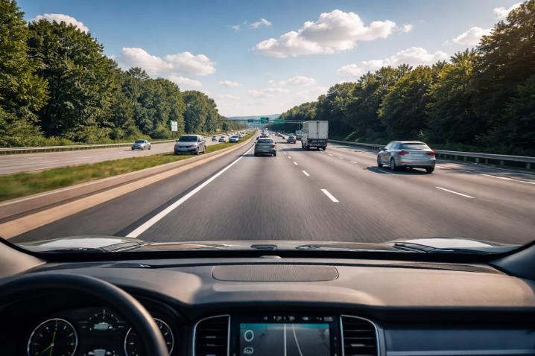
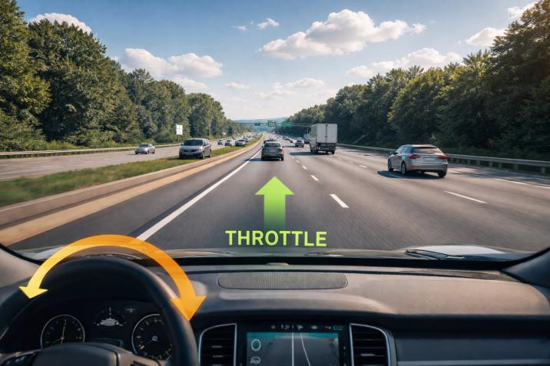



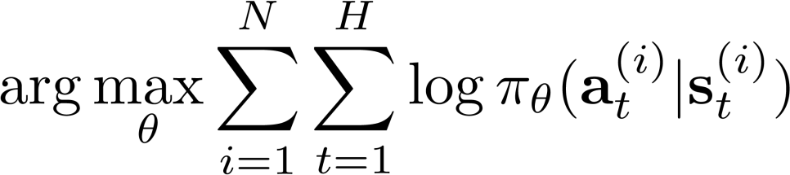
(we’ll come back to partially observed settings later)
Imitation learning:
what if we don’t have good demonstration data?

Slide 22
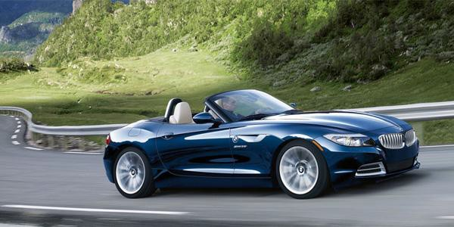
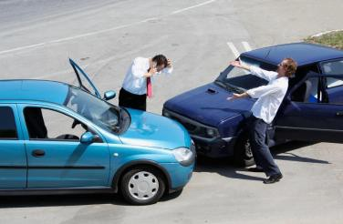



Slide 23
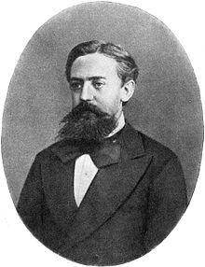









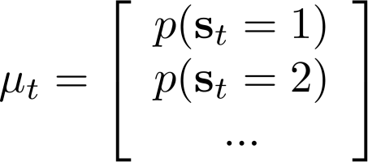

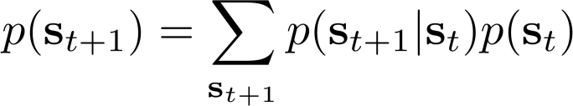

Basic definition: Markov chain
The most basic probabilistic model of a dynamical system No actions yet, only states
Andrey Markov
current state marginal
This bit of linear algebra will be important later!

Slide 24

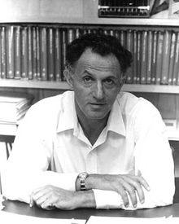






Basic definition: Markov decision process
Can we turn a Markov decision process into a Markov chain?
Richard Bellman

Slide 25
Part 2:
Defining the objective

Slide 26
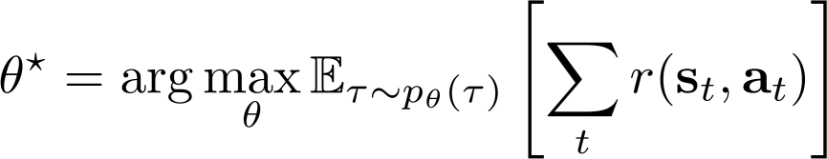
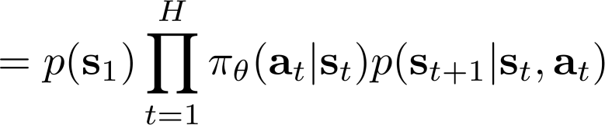


The objective of RL
by the time you’re about to hit someone, it’s too late!
need to optimize for long-term reward

Slide 27
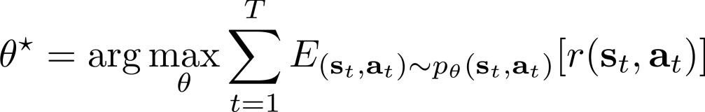

Expectations and stochastic systems
infinite horizon case
finite horizon case
In RL, we almost always care about expectations
+1
-1

Slide 28
Part 3:
Anatomy of an RL algorithm

Slide 29
The anatomy of a reinforcement learning algorithm
fit a model/ estimate the return
generate samples (i.e. run the policy)
improve the policy

Slide 30

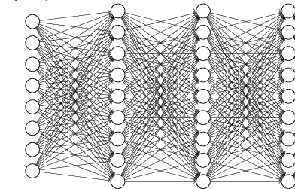


Value function based algorithms
fit a model/ estimate the return
value
generate samples (i.e. run the policy)
improve the policy

Slide 31
Actor-critic: value functions + policy gradients
fit a model/ estimate the return
generate samples (i.e. run the policy)
improve the policy

Slide 32
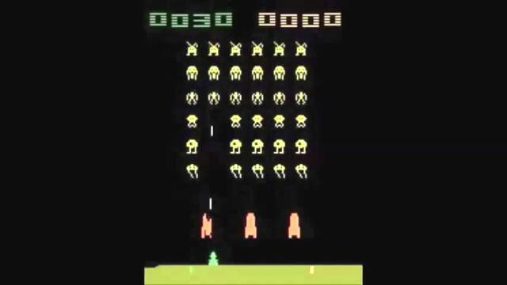
Example 1: Atari games with Q-functions
Playing Atari with deep reinforcement learning, Mnih et al. ‘13
Q-learning with convolutional neural networks

