Slide 1

Introduction to Attention, Transformer, and Large Language Models
Slides Courtesy of Alex Smola and Mu Li

Slide 2
Attention

Slide 3
Outline
Attention
Attention Layer
Transformer
Language Model
Language Model Prompt
Language Model Training
Language Model Fine-Tune

Slide 4
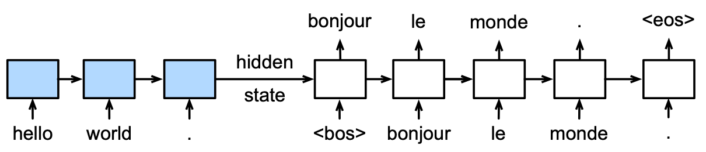
Motivation
Each generated token might be related to different source tokens

Slide 5
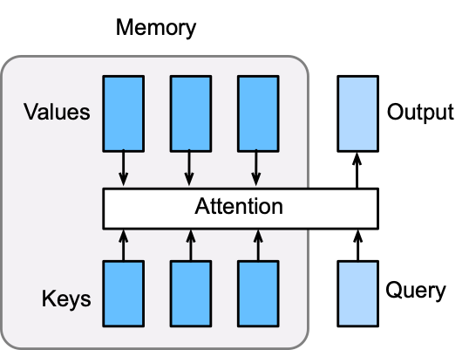
Attention Layer
An attention layer explicitly select related information
Its memory consists of key-value pairs
The output will be close to the values whose keys are similar to the query
Direct DB operation is not differentiable vv

Slide 6







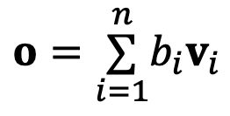
Attention Layer
Assume query and the memory with
Compute n scores with
Use softmax to obtain the attention weights
The output is a weighted sum of values
$$q∈ℝ^{d_{q}}$$
$$(k_{1},v_{1}),…,(k_{n},v_{n})$$
Vary α to get
different
attention
layers,
multi-head
$$k_{i}∈ℝ^{d_{k}}$$
$$v_{i}∈ℝ^{d_{v}}$$
$$a_{1},…,a_{n}$$
$$a_{i}=α(q,k_{i})$$
$$b_{1},…,b_{n}=softmax(a_{1},…,a_{n})$$
$$o=\overset{n}{\underset{i=1}{∑}}b_{i}v_{i}$$

Slide 7





Dot Product Attention
Assume the query has the same length as values
Vectorized version
m queries and n keys
$$q,k∈ℝ^{d}$$
$$α(q,k)=⟨q,k⟩/\sqrt{d}$$
$$Q∈ℝ^{m×d}$$
$$K∈ℝ^{n×d}$$
$$α(Q,K)=QK^{T}/\sqrt{d}$$

Slide 8
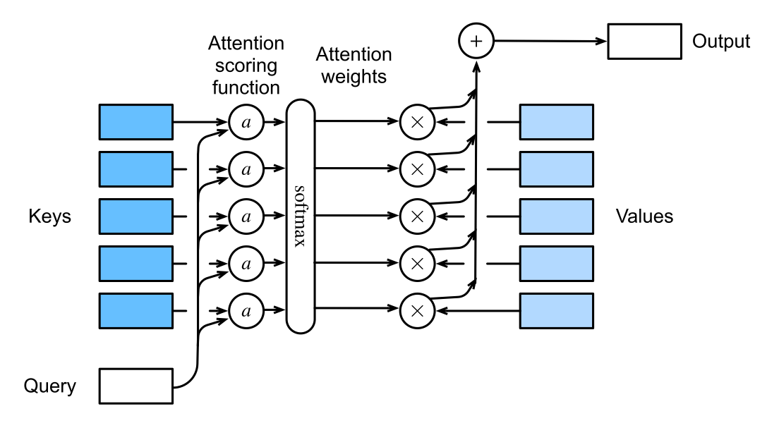

Slide 9
Seq2seq with Attention

Slide 10
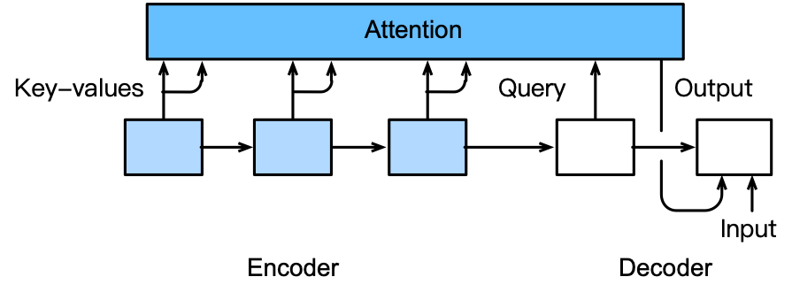
Model Architecture
Each decode step might pay attention to particular encoder steps.
Add an additional attention layer to use encoder’s outputs as memory
The attention output is used as the decoder’s input

Slide 11
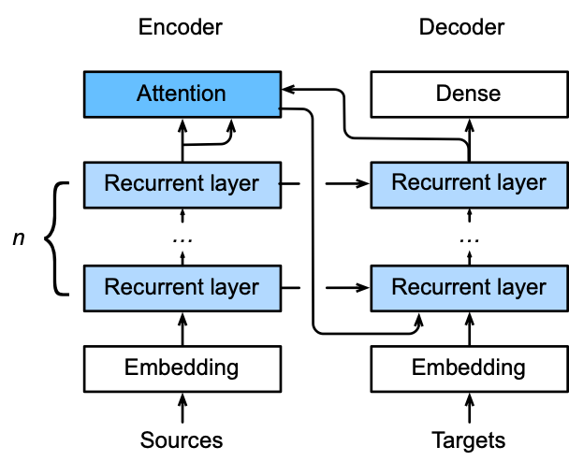
Encoder/Decoder Details
We run through encoder, and save all states into Attention heads,
Decoder h_{t-1} fetches attention
The output of the last recurrent layer in the encoder is used
The attention output is then concatenated with the embedding of decoder input and fed into the first recurrent layer in the decoder

Slide 12

Transformer

Slide 13
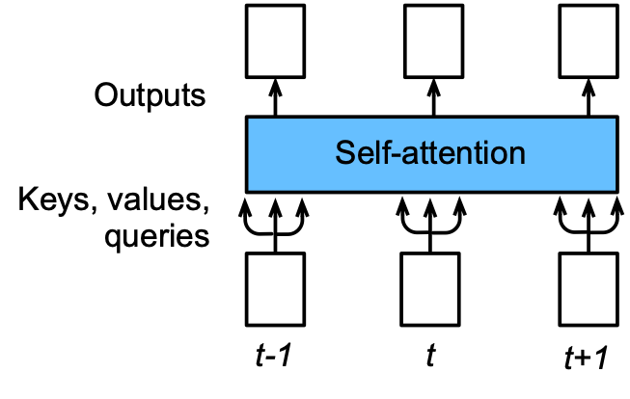
Self-attention
To generate n outputs with n inputs, we can copy each input into a key, a value and a query
No sequential information is preserved
All outputs run in parallel (advantage)
If you permute the input sequence, the output will be permuted, but values do not change.
Must recover the sequential information.

Slide 14
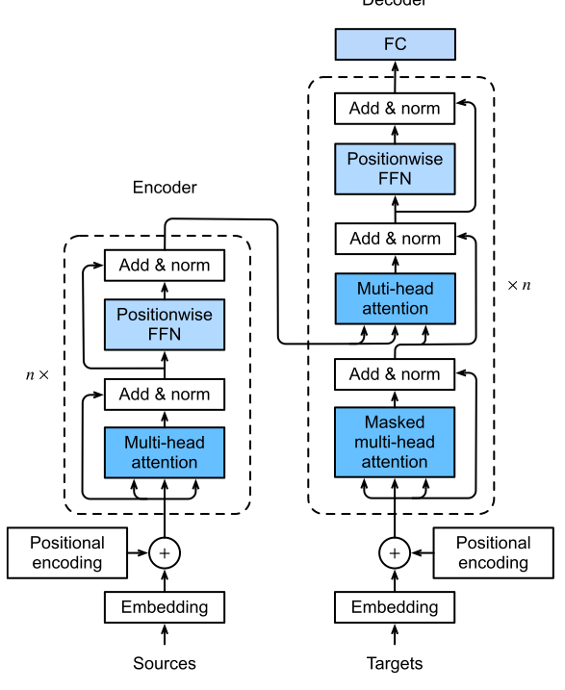
Transformer Architecture
Pass to every one in n blocks
Transformer block
Sequential
information
It’s an encoder-decoder arch
Differ from seq2seq with attention in three places

Slide 15
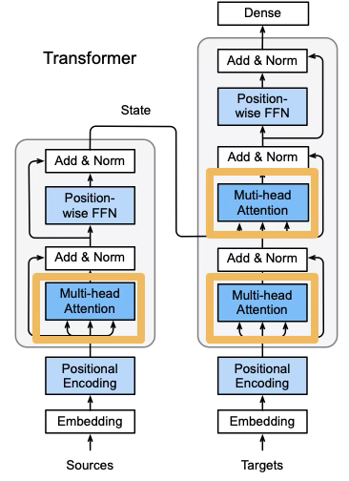
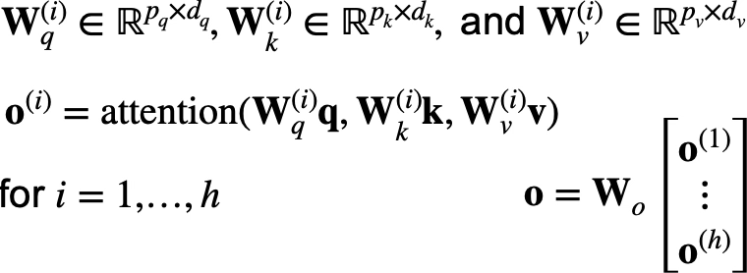
Multi-Head Attention

Slide 16
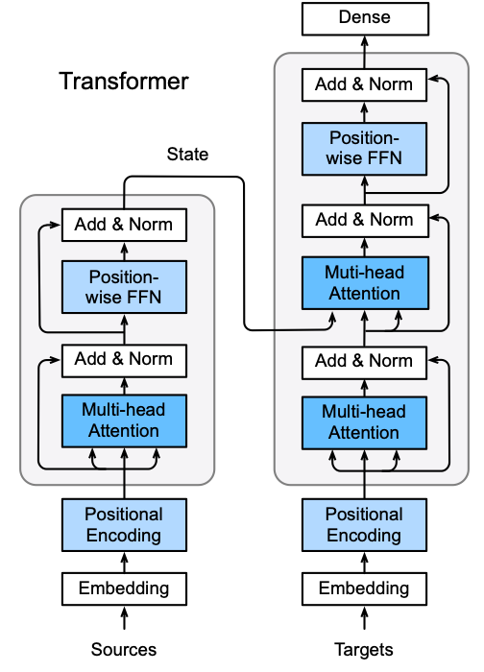

Position-wise Feed-Forward Networks
Reshape input (batch, seq len, fea size) into (batch * seq len, fea size)
Apply a two layer MLP
Reshape back into 3-D
Equals to apply two (1,1) conv layers

Slide 17
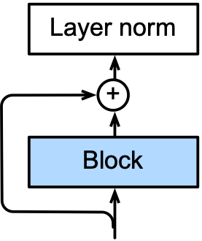
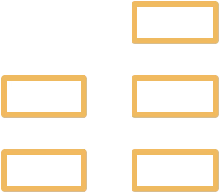
Add and Norm
Layer norm is similar to batch norm
But the mean and variances are calculated along the last dimension
X.mean(axis=-1)instead of the first batch dimension in batch norm X.mean(axis=0)

Slide 18
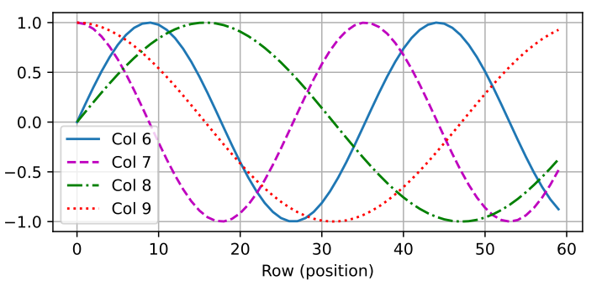


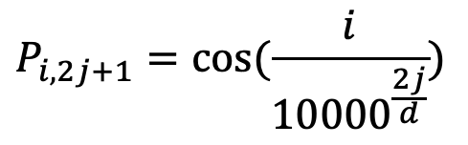
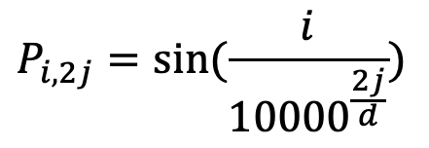

Positional Encoding
Assume embedding output with shape (seq len, embed dim)
Create with
Output X + P
$$X∈ℝ^{l×d}$$
$$P∈ℝ^{l×d}$$
$$P_{i,2j}=sin(\frac{i}{{10000}^{\frac{2j}{d}}})$$
$$P_{i,2j+1}=cos(\frac{i}{{10000}^{\frac{2j}{d}}})$$

Slide 19
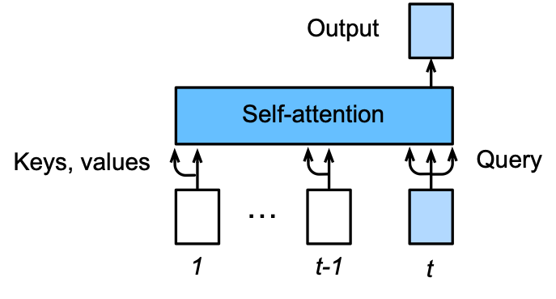
Predicting
Predict at time t:
Inputs of previous times as keys and values
Input at time t as query, as well as key and value, to predict output

Slide 20
What is a large language model?
A neural network with:
Input: a context or prefix,
Output: a distribution over possible next words

Slide 21
LLMs can generate!
A model that gives a probability distribution over next words can generate by repeatedly sampling from the distribution

Slide 22
Three architectures for large language models
Decoders. Encoders Encoder-decoders
GPT, Claude, BERT family, Flan-T5, Whisper
Llama HuBERT

Slide 23
Prompt
Prompt: a text string that a user issues to a language model to get the model to do something useful by conditional generation
Prompt engineering: the process of finding effective prompts for a task.

Slide 24
Prompts
A question:
What is a transformer network?
Perhaps structured:
Q: What is a transformer network? A:
Or an instruction:
Translate the following sentence into Hindi: ‘Chop the garlic finely’.

Slide 25
Three stages of training in LLMs

Slide 26
Finetuning

Slide 27
"Finetuning" means
We'll discuss 1 here, and 3 in later lectures
In all four cases, finetuning means:
taking a pretrained model and further adapting some or all of its parameters to some new data
Notes:
But they differ on exactly which parameters get updated.

Slide 28
1. Finetuning as "continued pretraining" on new data
Further train all the parameters of model on new data
using the same method (word prediction) and loss function (cross-entropy loss) as for pretraining.
as if the new data were at the tail end of the pretraining data
Hence sometimes called continued pretraining

Slide 29
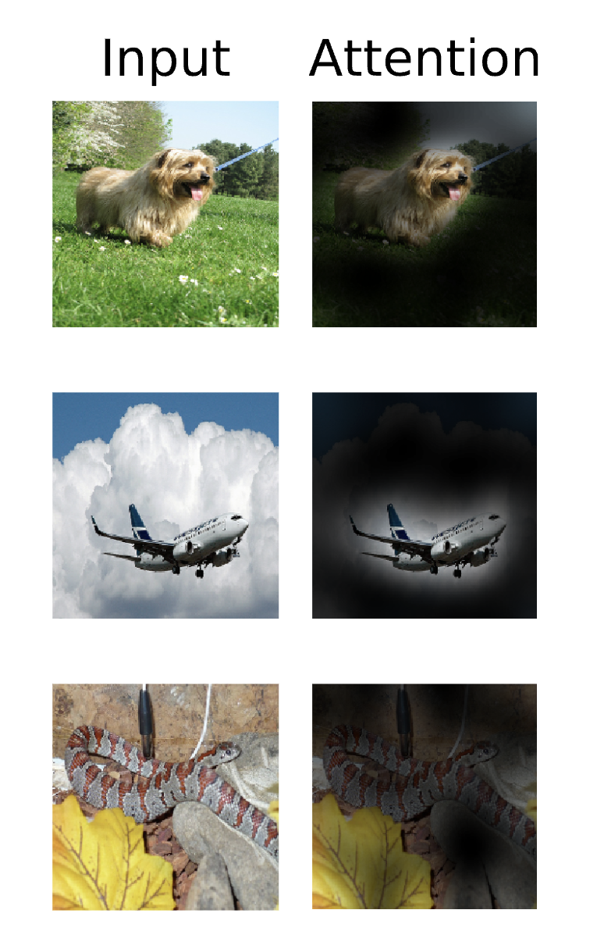
Vision Transformer

Slide 30
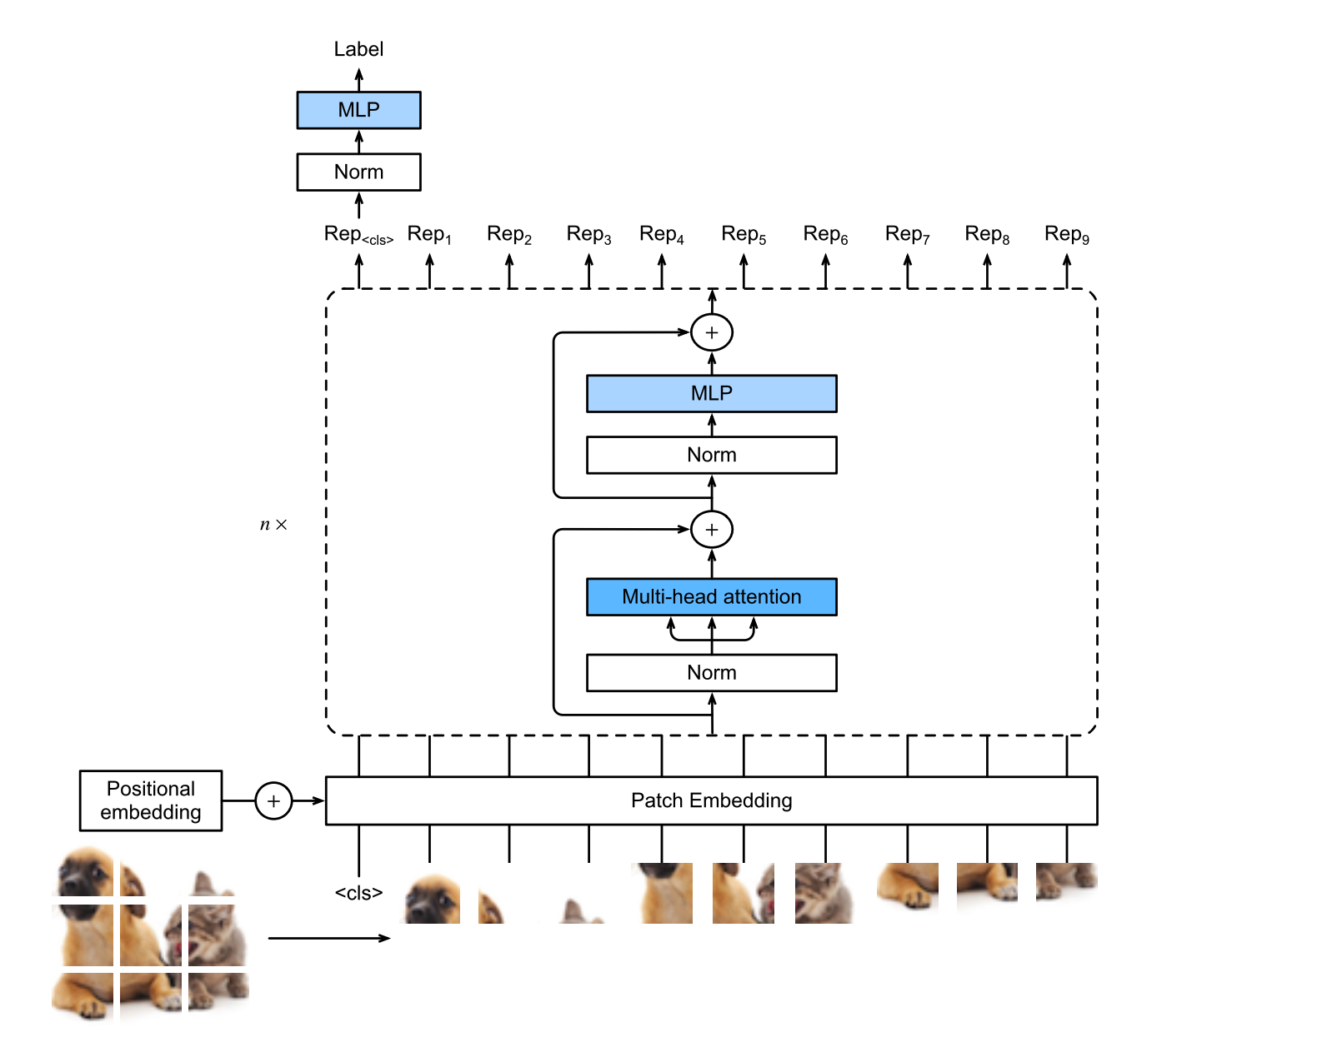
Model Architecture

